Slide 1





Left to Your Own Devices
The Latest on Multiplatform Video Consumption
June 2024

Slide 2



What You’ll Learn
People today have more options for entertainment than ever before. As a result, it's important to stay current on viewership trends and consumption behaviors.
This analysis equips you with the latest updates on:
1
2
3
Device Ownership & Usage
Video Viewing Behaviors
Video Ad Engagement
Click through a box above to be brought directly to the appropriate section
This information is exclusively provided to VAB members and qualified marketers.
PAGE 2

Slide 3

1
Device Ownership & Usage

Slide 4







Homes are very connected with most owning at least four types of devices, which highlights the importance of multiscreen video campaign strategies
Which of the following devices do you and other household members currently own?
93%
93%
74%
61%
TV
Smartphone
Laptop
Tablet
40%
42%
35%
Game Console
Desktop Computer
Smart Speaker
Source: VAB analysis of ARF DASH study, full year 2023 vs. full year 2022. Based on survey of 10,000 A18+. Q3: Which of the following devices do you and other household members currently own? Based on household weighting.
This information is exclusively provided to VAB members and qualified marketers.
PAGE 4

Slide 5
The average household has more TVs than any other device which creates significant opportunities for brands to engage consumers on a big screen
Households: Average Number of Devices Owned
2.4
2.2
2.0
1.8
TV
Smartphone
Smart Speaker
Laptop
1.7
1.7
1.3
Tablet
Game Console
Desktop Computer
Source: VAB analysis of ARF DASH study, full year 2023. Based on survey of 10,000 A18+. Q4: How many of the following devices do you and the members of your household own and have used in the past 6 months? Based on household weighting.
This information is exclusively provided to VAB members and qualified marketers.
PAGE 5

Slide 6

Consumers primarily use mobile devices and computers for non-video activities, reinforcing TV as a key device for engaging audiences through video content

Slide 7

Smartphones are more often used for communication, socializing, searching and shopping than for streaming
For what purposes do you regularly use your smartphone?
Only 3 out of 10 A18+ regularly watch video on their smartphone
Source: VAB analysis of ARF DASH study, full year 2023. Based on survey of 10,000 A18+. Q29: For what purposes do you regularly use Smartphone 1? ‘Smartphone 1’ refers to a respondents’ primary smartphone. A18+ based on respondent weighting.
This information is exclusively provided to VAB members and qualified marketers.
PAGE 7

Slide 8
Although younger adults are more likely to use their smartphones to stream video, they spend more of their time socializing and searching
For what purposes do you regularly use your smartphone?
Only half of A18-34 regularly watch video on their smartphone
Source: VAB analysis of ARF DASH study, full year 2023. Based on survey of 10,000 A18+. Q29: For what purposes do you regularly use Smartphone 1? ‘Smartphone 1’ refers to a respondents’ primary smartphone. A18-34 based on respondent weighting.
This information is exclusively provided to VAB members and qualified marketers.
PAGE 8

Slide 9

Like smartphones, tablets are frequently used for communication and web browsing, however streaming is close behind due to the larger screen
For what purposes do you regularly use your tablet?
Source: VAB analysis of ARF DASH study, full year 2023. Based on survey of 10,000 A18+. Q28: For what purposes do you regularly use tablet 1? ‘Tablet 1’ refers to respondents’ primary tablet. A18+ data based on respondent weighting.
This information is exclusively provided to VAB members and qualified marketers.
PAGE 9

Slide 10
Younger adults are more likely to stream video on the ‘second’ largest device screen in their home than any other activity
For what purposes do you regularly use your tablet?
Source: VAB analysis of ARF DASH study, full year 2023. Based on survey of 10,000 A18+. Q28: For what purposes do you regularly use tablet 1? ‘Tablet 1’ refers to respondents’ primary tablet. A18-34 data based on respondent weighting.
This information is exclusively provided to VAB members and qualified marketers.
PAGE 10

Slide 11

Adults more often use their desktop or laptop for productivity-focused tasks at work and their personal lives rather than for streaming video
For what purposes do you regularly use your desktop / laptop?
A18+
Only 2 out of 10 A18+ regularly watch video on their laptop or desktop
Source: VAB analysis of ARF DASH study, full year 2023. Based on survey of 10,000 A18+. Q25_5: For what purposes do you regularly use desktop computer 1? ‘Desktop 1’ refers to respondents’ primary desktop. A18+ based on respondent weighting.
This information is exclusively provided to VAB members and qualified marketers.
PAGE 11

Slide 12
While younger adults usually use their computer for work-related tasks, gaming and streaming are more popular to them than the average adult
For what purposes do you regularly use your desktop / laptop?
A18-34
Only 3 out of 10 A18-34 regularly watch video on their laptop or desktop
Source: VAB analysis of ARF DASH study, full year 2023. Based on survey of 10,000 A18+. Q25_5: For what purposes do you regularly use desktop computer 1? ‘Desktop 1’ refers to respondents’ primary desktop. A18-34 based on respondent weighting.
This information is exclusively provided to VAB members and qualified marketers.
PAGE 12

Slide 13
2
Video Viewing Behaviors

Slide 14


Homes are watching linear TV live throughout the day and across dozens of networks, enabling many touchpoints for brands to reach their consumers
Breakdown of linear TV viewership
91%
72%
67%
28
of viewing is live
of viewing occurs outside of primetime
of viewing is on cable
average networks viewed per household
Source: Effectv, The TV Viewership Report: 2H 2023. Comcast Aggregated Viewership Data (2H ‘23). Based on average time spent per day with Live, DVR and VOD viewing (6 hours, 11 minutes).
This information is exclusively provided to VAB members and qualified marketers.
PAGE 14

Slide 15
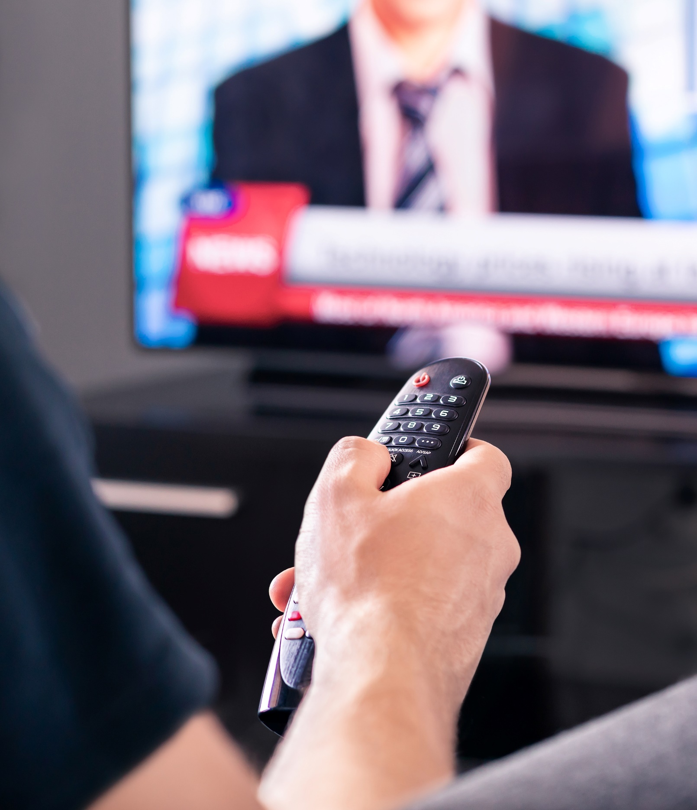

People turn to live TV most often for their news, highlighting its continued importance for reaching viewers, especially during an election year
On which of the following channels do you most often consume news?
Source: Stirista, Political Voter Profile Report, 2024.
This information is exclusively provided to VAB members and qualified marketers.
PAGE 15

Slide 16
Most adults are dedicating at least 2 hours daily to watching TV, while four out of ten adults 18-34 are also spending at least two hours with TV daily
Time spent per day watching TV at home
% share of viewing
A18+
A18-34
Source: VAB analysis of ARF DASH study, full year 2023. Based on survey of 10,000 A18+. QG2: On average, how much time each day do you watch TV (linear TV and streaming) at home from the time you wake up to the time you go to sleep? A18+ & 18-34 data based on respondent weighting.
This information is exclusively provided to VAB members and qualified marketers.
PAGE 16

Slide 17






There is also significant location-based video viewing beyond the home which creates additional engagement opportunities for marketers
Digital Out-of-Home Video Viewing
A18+ Monthly Reach
73.1MM
16.6MM
9.7MM
Bars & Restaurants
Fast Food / QSRs
Auto Centers
7.1MM
6.8MM
Gyms
Retail Stores
Source: Atmosphere TV, The People Platform; Reach based on one view with Atmosphere TV content/ads; Period: April 2024.
This information is exclusively provided to VAB members and qualified marketers.
PAGE 17

Slide 18
3
Video Ad Engagement

Slide 19

Between CTV and set-top box VOD, over 80% of digital ad views occur on the television set
Ad view composition by device
2H 2023
TV Set
Source: Freewheel, Video Marketplace Report , 2H 2023. Reflects U.S. data only.
This information is exclusively provided to VAB members and qualified marketers.
PAGE 19

Slide 20
Ad views are fragmented across distribution points which highlights
the need for cross-platform strategies in optimizing target audience reach
% share of ad views by distribution platform
2H 2023
52% OTT
48% Operator Authentication
Source: Freewheel, Video Marketplace Report, 2H 2023. DTC = direct-to-consumer apps from publishers. ‘OTT’ refers to content distributed to viewers over the Internet. ‘Operator Authentication’ refers to content accessed via a cable/satellite subscription by logging into an operator’s website or app.
This information is exclusively provided to VAB members and qualified marketers.
PAGE 20

Slide 21
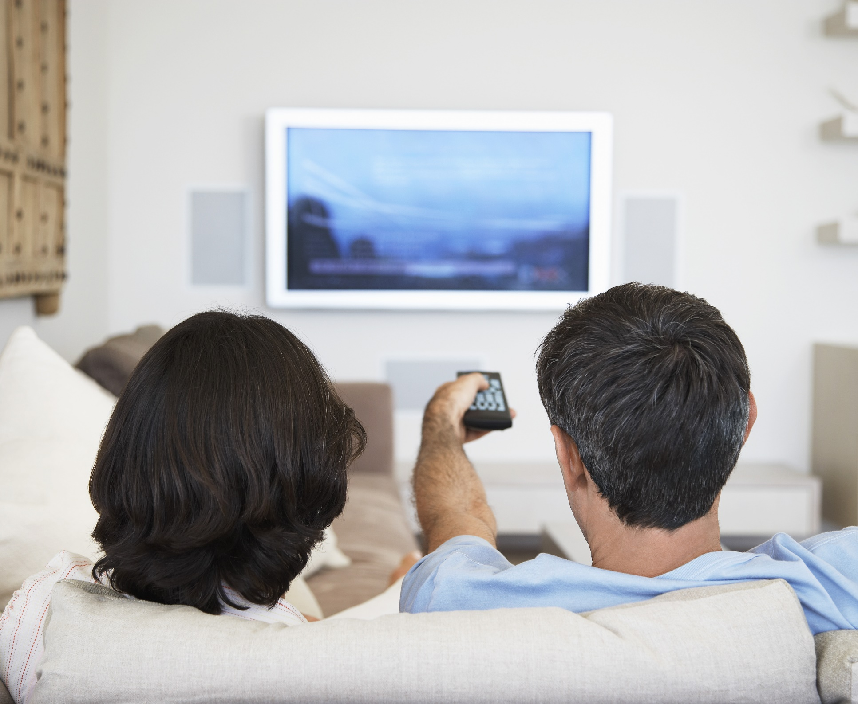




TV drives the highest ad recall of all devices, outperforming computers and smartphones, and a soundbar further enhances this effect
The TV screen drives the highest ad recall of all devices
20%
+34%
+60%
Having a soundbar in the TV set increases ad recall by*
vs. computer
vs. smartphone / tablet
Source: Thinkbox UK, Context Effects, Map The Territory & Tapestry Research, 2024. Source: A18. Do you remember seeing any advertising when you watched [occasion]? A7a. On which device did you watch [OCCASION]? Base: 4,005 viewing occasions with ads answered by 2,017 online respondents aged 18-75 who watched any type of video content via any source the previous day. Sample matched to Barb. *A18. Do you remember seeing any advertising when you watched [OCCASION]? A7b. Did the TV on which you were watching have a ‘sound bar’ to enhance the sound quality? Base: 2,927 viewing occasions with ads watched via TV the previous day. Sample matched to Barb.
This information is exclusively provided to VAB members and qualified marketers.
PAGE 21

Slide 22


When spending memorable moments watching TV with others in the living room, the ads also become more memorable
+23%
Increase in ad recall when watching with others in the living room vs. watching alone
Source: Thinkbox UK, Context Effects, Map The Territory & Tapestry Research, 2024. Source: A18. Do you remember seeing any advertising when you watched [occasion]? A10. Who, if anyone, were you watching [occasions] with? Base: 4,005 viewing occasions with ads answered by 2,017 online respondents aged 18-75 who watched any type of video content via any source the previous day. Sample matched to Barb.
This information is exclusively provided to VAB members and qualified marketers.
PAGE 22

Slide 23



Viewers are often second-screening while watching TV, a behavior that can be leveraged by marketers to connect with consumers directly
3 in 4
1 in 3
U.S. adults look at a mobile device while watching TV
U.S. adults shop online while streaming TV
Source: Samba TV, The State of Viewership: H2 2023, U.S.
This information is exclusively provided to VAB members and qualified marketers.
PAGE 23

Slide 24

Consumers have become more accustomed to interacting with ads on their TV, a behavior that is illustrated by Roundel's research with Target Store shoppers

Slide 25



Target Store shoppers often act after seeing ads on TV, including looking up products they saw advertised on their other devices
% of Target Store Shoppers Who Engage in the Following Behaviors
49%
are likely to search for an item after seeing it on TV*
60%
look up a product on their phone / computer when they see a video ad they are interested in
Source: Roundel, Target Guest Survey on CTV. Based on survey of 2,876 Target guests launched 2/20/24. Note: Target Store Shoppers refers to consumers who have reported actively shopping at Target (in-store or online). *Based on respondents who answered, ‘somewhat likely’ or ‘extremely likely’.
This information is exclusively provided to VAB members and qualified marketers.
PAGE 25

Slide 26
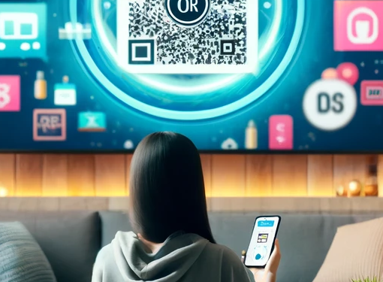


They’re more likely to scan a QR code on a TV, indicating a preference for quick and familiar methods to engage with content and make purchases
50%
more likely for Target guests to say that
they are likely to use a QR code on a TV screen
vs. a remote to ‘click to learn / purchase’
1/3
of guests say they would be likely to
scan a QR code on their TV if they knew
it would take them to a familiar site
(+3% vs. 2023)
15%
are likely to
scan a QR code
10%
are likely to use a remote
Source: Roundel, Target Guest Survey on CTV. Based on survey of 2,876 Target guests launched 2/20/24. Note: Target Store Shoppers refers to consumers who have reported actively shopping at Target (in-store or online). Based on respondents who answered, ‘somewhat likely’ or ‘extremely likely’.
This information is exclusively provided to VAB members and qualified marketers.
PAGE 26

Slide 27
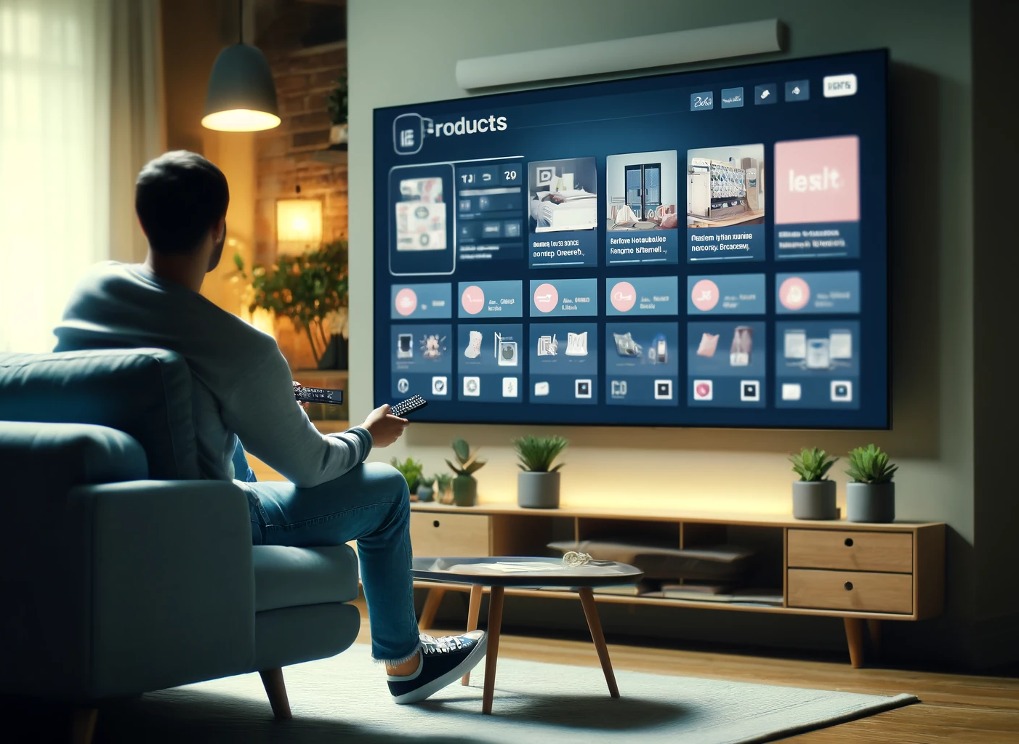
Target Store shoppers are comfortable spending around $30 when making a purchase on their TV, indicating a positive view of in-screen shopping
Target Store shoppers feel comfortable spending
~$30
when making a purchase from their TV
Source: Roundel, Target Guest Survey on CTV. Based on survey of 2,876 Target guests launched 2/20/24. Note: Target Store Shoppers refers to consumers who have reported actively shopping at Target (in-store or online).
This information is exclusively provided to VAB members and qualified marketers.
PAGE 27

Slide 28

Consumers rely on their smartphones and computers for communication and productivity, but TV is crucial for video content as viewers prefer watching on the biggest screen in the home
Live TV is an important platform for brand engagement, offering extensive daily viewership, and providing additional opportunities through location-based video advertising
TV's strong performance in ad views and recall highlights its influential role, with second-screening and interactive ads further enhancing consumer engagement and encouraging purchasing behavior
Key Marketer Takeaways
This information is exclusively provided to VAB members and qualified marketers.
PAGE 28

Slide 29
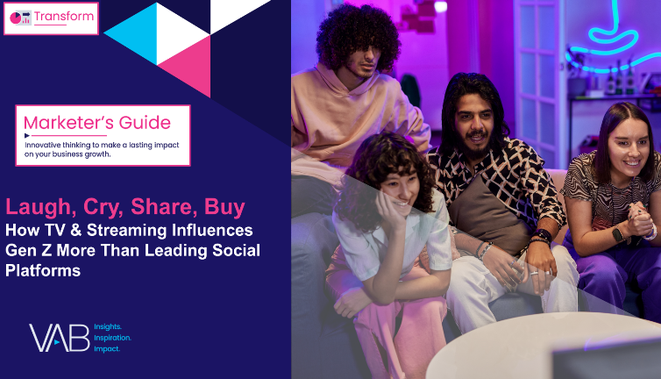


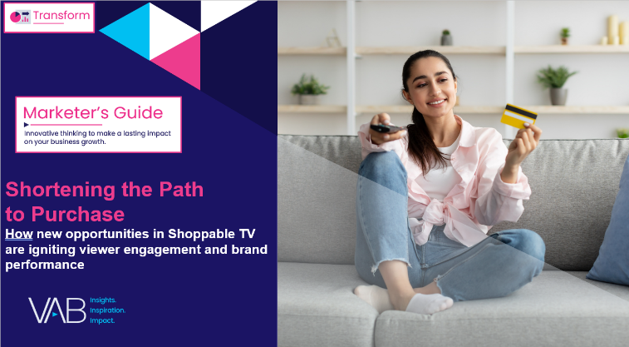

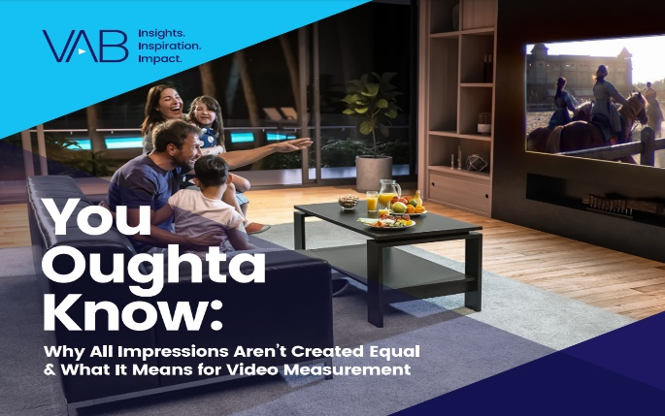

Creators
Jason Wiese
Leah Montner-Dixon
SVP, Director of Strategic Insights
jasonw@thevab.com
Director, Audience & Behavioral Insights
leahm@thevab.com
Kaileen Cain
Laugh, Cry, Share, Buy
How TV & Streaming Influences Gen Z More Than Leading Social Platforms
Prioritize Quality
The Importance of Value When
Selecting Video Platforms
Senior Insights Analyst
kaileenc@thevab.com
Discover more
Looking for more data, insights and takeaways? Check out this related VAB content
The Consumer Connection
Understanding the Effect of Quality
Across Media Platforms
Shortening the Path to Purchase
How New Opportunities in Shoppable TV are Igniting Viewer Engagement & Brand Performance
Through Upfront season, marketers are making important decisions about their video investment strategy.
We’re here to help.
Visit our Upfront Planning Resource Center
for a curated a list of resources filled with the data, analysis and insights needed to make informed investment decisions.
25 Ways TV Grows Brands
Powering Performance Through
Full-Funnel Business Outcomes
You Oughta Know
Why All Impressions Aren’t Created Equal
& What It Means for Video Measurement
VAB Members, brand marketers and agencies get free and immediate access to VAB’s content library. Get access at theVAB.com
This information is exclusively provided to VAB members and qualified marketers.
PAGE 29

Slide 30


About VAB
VAB plays a dual role in the video advertising industry. We are leading the change to bring about a more innovative and transparent marketplace. We also provide the insights and thought leadership that enables marketers to develop business-driving marketing strategies.
Drawing on our marketing expertise, we simplify the complexities in our industry and discover new insights that transform the way marketers look at their media strategy.
We are committed to your business growth and proud to offer VAB members, brand marketers and agencies complimentary access to our continuously-growing Insights library. Get immediate access at theVAB.com.
This information is exclusively provided to VAB members and qualified marketers.
PAGE 30

