Slide 1

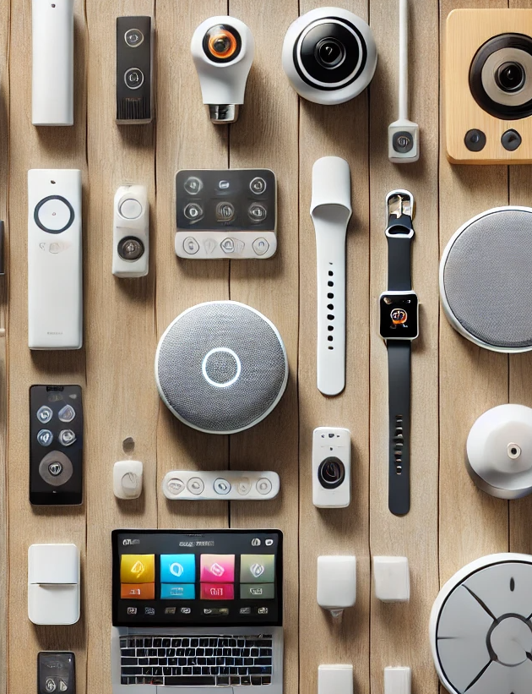



Left To Your Own (Connected) Devices
Examining How Consumers Are Embracing Smart Technology In Their Everyday Lives
January 2026

Slide 2


Understanding consumer penetration and usage trends across 14 connected devices
The connected device ecosystem continues its powerful expansion and deep integration, fundamentally transforming how consumers interact with media. This ongoing growth, which sees more devices becoming essential to people’s daily routine, presents a critical challenge for brands seeking to engage audiences in the right places at the right times.
This proliferation creates a complex, multi-touchpoint environment that demands an evolution in marketing strategy. Marketers must adapt to shifting device trends with nuance, distinguishing between the stable maturity of foundational platforms and the specialized, niche adoption of emerging technologies.
In this update to our inaugural 2025 ‘Left To Your Own (Connected) Devices’ report, we analyze current penetration
and usage trends across 14 connected devices. This resource equips marketers with the strategic knowledge needed to effectively prioritize high-value channels and unlock new realms for meaningful, contextual engagement.
This information is exclusively provided to VAB members and qualified marketers.
PAGE 2

Slide 3






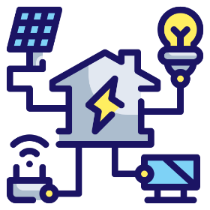
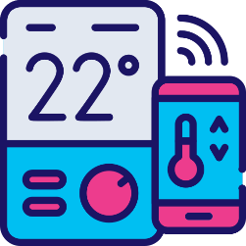
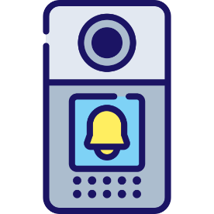


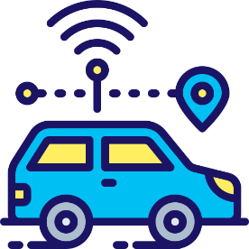


Connected devices continue to expand as they increasingly integrate into all aspects of our lives
14 Connected Devices Examined
Connected TVs
Smartphones
Computers
Tablets
Gaming Consoles
Smart Speakers
Smart Home Hubs
Place-Based
Video Screens
Thermostats
Doorbells
Wearables
AR / VR Headsets
Smart Glasses
Connected Cars
Click through a box above to be brought directly to the appropriate slide
This information is exclusively provided to VAB members and qualified marketers.
PAGE 3

Slide 4
The number of connected devices in households has more than doubled in ten years, unlocking new channels for brand engagement
Average Number of Connected Devices Per U.S. Household
17.6
8.4
Source: Parks Associates, Parks Associates: Amazon Smart Speakers now Account for 60% of all Smart Speaker Purchases, October 1, 2025. Devices include connected health devices, connected smart home devices, computing, mobile, smart speaker and entertainment devices connected to the internet.
This information is exclusively provided to VAB members and qualified marketers.
PAGE 4

Slide 5
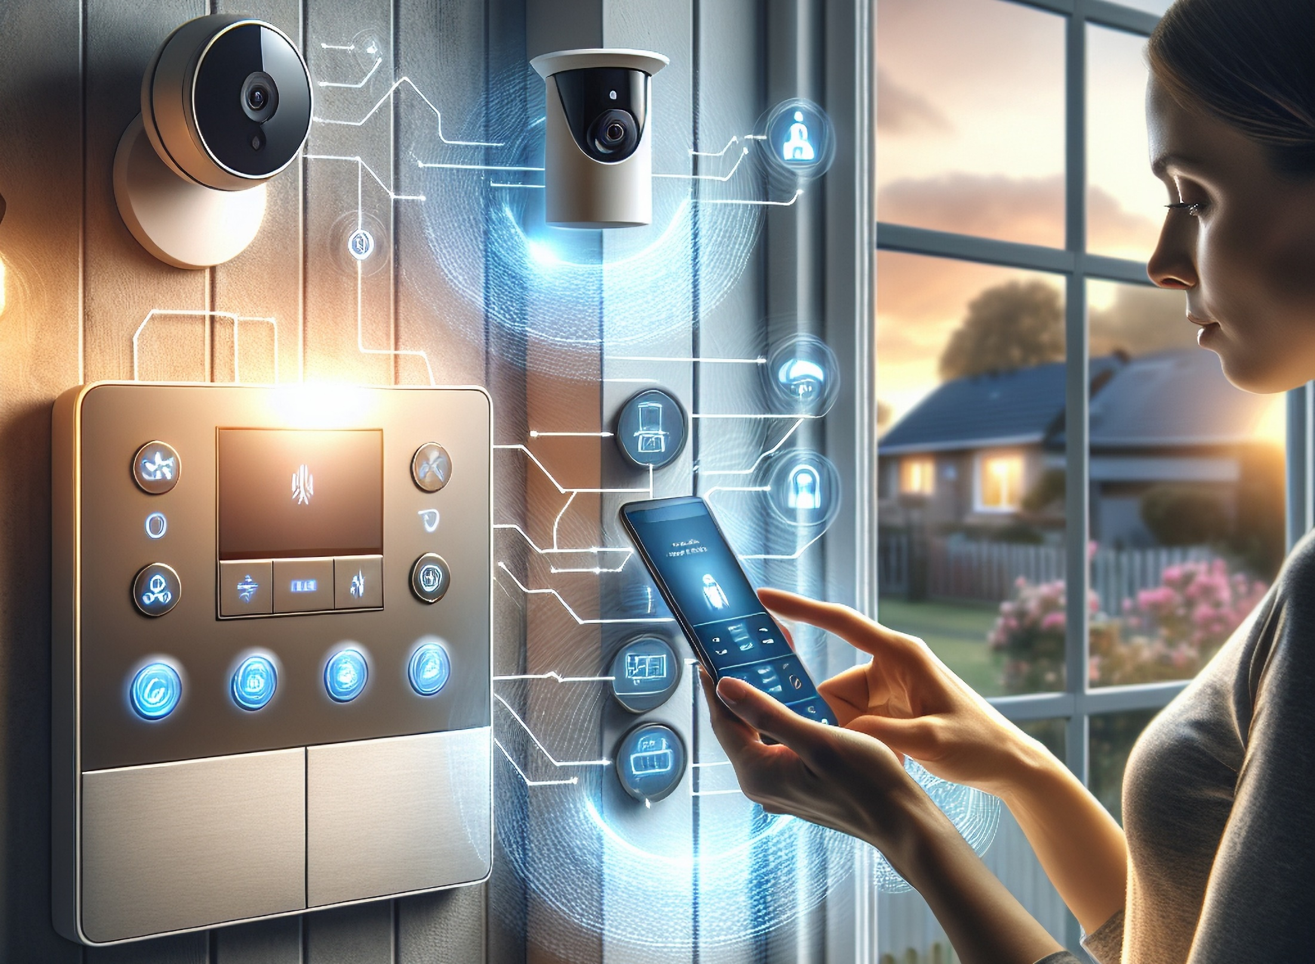
Smart devices are woven into daily life, with nearly half of adults saying they provide meaningful improvements to their lives
‘The benefits of ‘smart’ home devices / appliances could significantly improve my quality of life’
% of A18+ who agree
‘Smart’ home devices / appliances have
become an important part of my life’*
% of A18+ who agree
Source: VAB analysis of MRI-Simmons Spring Doublebase 2021 – 2025 USA Study, A18+. *VAB analysis of MRI-Simmons Spring 2022 – 2025 USA Study, A18+. Based on ‘any agree’.
This information is exclusively provided to VAB members and qualified marketers.
PAGE 5

Slide 6

Our ‘connected’ world represents a mix
of well-established devices and an exciting group of emerging technologies which are all seamlessly integrating into consumers’ lives

Slide 7
Connected TVs: Smart TVs are now the standard in homes, with continued growth and increasing prevalence of households with multiple smart TVs
Smart TV Set Installed Base
In millions
Average # of Smart TVs per HH
% of Total TV Households
Smart TV % of Total TV Set Installed Base
45%
55%
63%
74%
76%
79%
82%
83%
25%
36%
45%
56%
64%
72%
78%
85%
Source: Industry data; S&P Global Market Intelligence Kagan estimates.. Data compiled October 2025. ‘Installed Base’ refers to the total number of units of a product currently in use by customers. Compound Annual Growth Rate (CAGR): 9.0%.
This information is exclusively provided to VAB members and qualified marketers.
PAGE 7

Slide 8

Smartphones: While almost everyone has a smartphone, TV viewing on these devices is still relatively low, skewing younger
% of A18+ population who own a smartphone
How often do A18+ watch TV on their smartphone
Source: VAB analysis of MRI-Simmons Spring Doublebase 2015 – 2025 USA study, A18+.
This information is exclusively provided to VAB members and qualified marketers.
PAGE 8

Slide 9
Computers: Ownership is holding steady as desktops and laptops remain central devices for work, communication, search and shopping
% of households that own a desktop / laptop
For what purposes do you regularly use your desktop / laptop?*
% of A18+
Source: VAB analysis of MRI-Simmons Spring Doublebase 2015 – 2025 USA study, A18+. *VAB analysis of ARF DASH study, FY 2024. Based on survey of 10,000 A18+. Q25_5: For what purposes do you regularly use desktop computer 1? ‘Desktop 1’ refers to respondents’ primary desktop. Q28: For what purposes do you use laptop 1? ‘Laptop 1’ refers to respondents’ primary laptop. Based on respondent weighting.
This information is exclusively provided to VAB members and qualified marketers.
PAGE 9

Slide 10

Tablets: After years of growth, penetration has stabilized as people turn to these devices for browsing, communication and entertainment
% of adults who have a working tablet or e-reader
For what purposes do you regularly use your tablet?*
% of A18+
Source: : VAB analysis of MRI-Simmons Spring Doublebase 2015 – 2025 USA study, A18+. *VAB analysis of ARF DASH study, FY 2024. Based on survey of 10,000 A18+. Q28: For what purposes do you regularly use tablet 1? ‘Tablet 1’ refers to respondents’ primary tablet. Based on respondent weighting.
This information is exclusively provided to VAB members and qualified marketers.
PAGE 10

Slide 11

Gaming Consoles: Years of consistent usage show console gaming has reached a stable plateau, engaging close to one third of Americans
US Digital Console Gamers
% of population
Source: EMARKETER, Digital Console Gamers, October 2025. Note: Internet users of any age who play games through the internet or play games that update via the internet on any device at least once per month; includes desktop/mobile app and browser gaming, online console gaming, and gaming on social networks.
This information is exclusively provided to VAB members and qualified marketers.
PAGE 11

Slide 12










Smart Speakers: Ownership has leveled off at around one-third of the population with usage centered on core everyday activities
% of U.S. 12+ population who own a smart speaker
Top Activities Done Using Smart Speaker*
% of A18+ who own a smart speaker
58%
53%
36%
Listened to music via streaming service
Obtained weather updates
Controlled smart home devices
25%
23%
18%
Obtained other information
Obtained news updates
Listened to live radio
17%
16%
15%
Made a phone call
Listened to a podcast
Obtained sports updates
Source: Edison Research, The Infinite Dial 2025. *VAB analysis of 2025 MRI-Simmons Spring Doublebase USA study, A18+. Based on households who own a smart speaker. Other activities: ‘Played a game’ (10%); ‘Purchased / ordered a product or service’ (9%); ‘Listened to an audiobook’ (9%).
This information is exclusively provided to VAB members and qualified marketers.
PAGE 12

Slide 13
Smart Home Hubs: Nearly one-third of households now use connected home devices, with ownership skewing towards adults 35–54
% of households that have smart home hubs
connected to appliances in their home
A18+
% of households that have smart home hubs
connected to appliances in their home
A35-54
Source: VAB analysis of MRI-Simmons Spring 2019 - 2025 study, A18+. Devices include: Audio system, Coffee maker, Dishwasher, Garage Door, Lighting, Oven, Refrigerator/Freezer, Security System, Thermostat, TV, Video Doorbell, Washer/Dryer, Other.
This information is exclusively provided to VAB members and qualified marketers.
PAGE 13

Slide 14
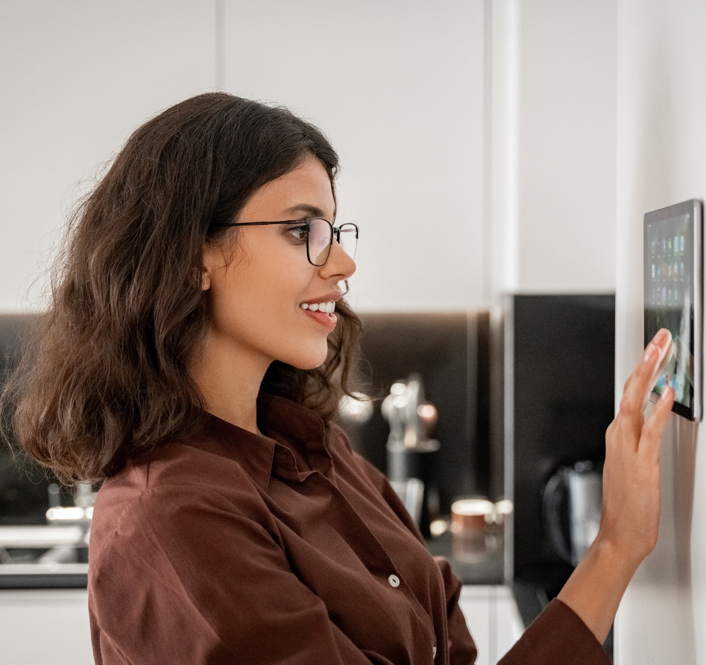
Smart Thermostats: Growing interest in energy-saving technology is driving incremental increases in smart thermostat adoption
% of U.S. 18+ population who own a smart thermostat
Source: VAB analysis of MRI-Simmons Spring Doublebase 2021-2025 USA study, A18+. Spring 2018 – 2020 USA Study, A18+.
This information is exclusively provided to VAB members and qualified marketers.
PAGE 14

Slide 15
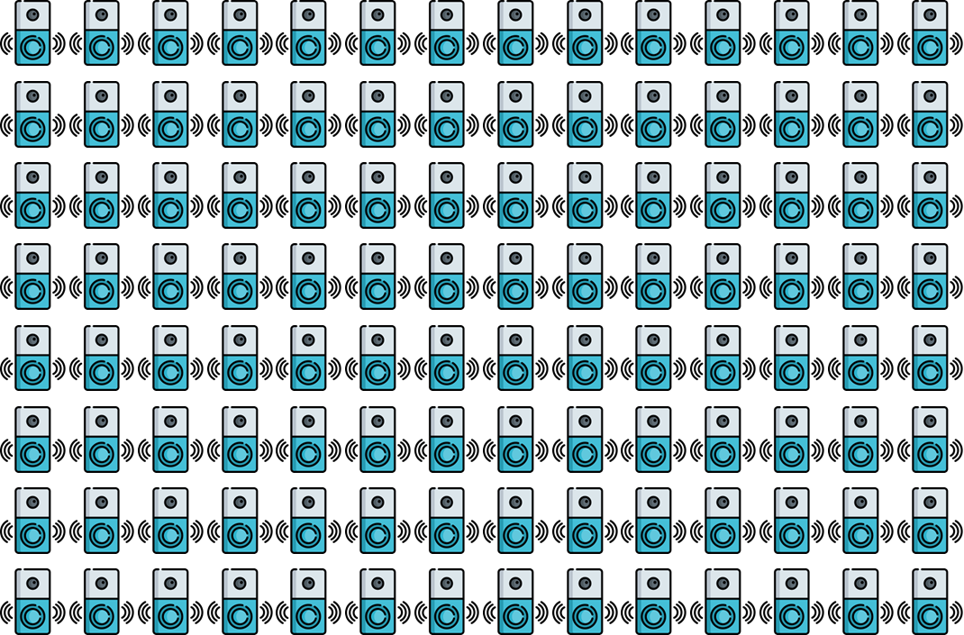

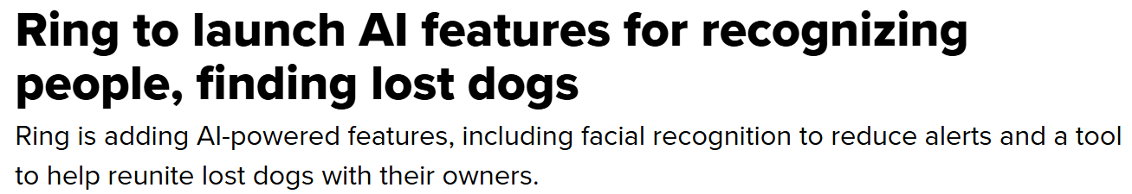
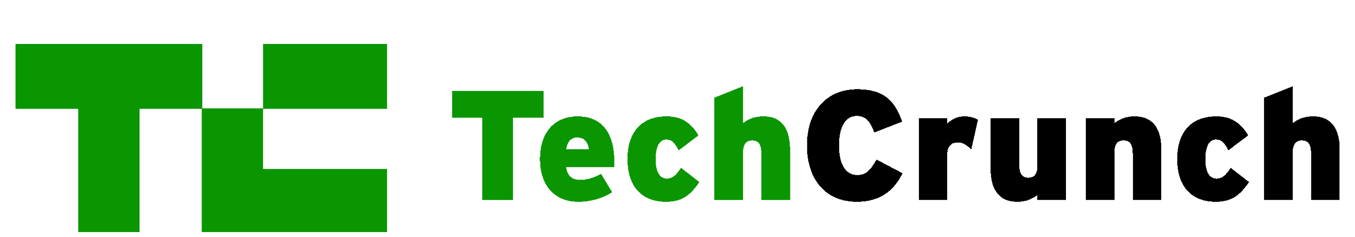
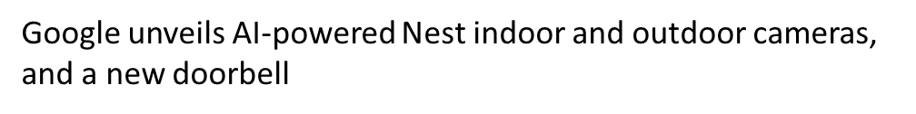



Smart Doorbells: Now in nearly half of U.S. homes, new AI features are being integrated into the devices to streamline security
Smart Home Doorbell Households
In millions
Sampling of recent news about AI features
10/8/2025
10/1/2025
8/27/2025
% of total U.S. Households
7/30/2025
20%
24%
26%
29%
31%
Source: EMARKETER Forecast, July 2025. Note: Households that actively use smart home doorbells at least once per month. Additional Note: A smart home doorbell is an interactive device that connects via internet and/or Bluetooth (or any other connectivity protocol) that can be controlled or automated by using apps, smart home hubs or voice assistants. It notifies the homeowner when a visitor is at the door and frequently has sensors and/or cameras. Examples include Arlo, Eufy, Google Nest, and Ring doorbells.
This information is exclusively provided to VAB members and qualified marketers.
PAGE 15

Slide 16

Wearables: Health and activity-tracking devices is supported by an ongoing interest in managing wellbeing, but adoption has leveled off recently
U.S. Smart Wearable Users
% of A18+ who personally own wearable tech
Source: VAB analysis of MRI-Simmons Spring Doublebase 2021-2025 USA study, A18+. Spring 2019 – 2020 USA Study, A18+. Wearable Tech includes Fitness Trackers (i.e., Fitbit, Garmin, WHOOP, etc.), Smartwatches (i.e., Apple Watch, Fitbit Smartwatch, Google Wear OS, etc.), Virtual Reality Headsets (i.e., Meta Quest, Samsung Gear VR, Sony PlayStation VR, etc.).
This information is exclusively provided to VAB members and qualified marketers.
PAGE 16

Slide 17
AR/VR Headsets: Usage has dropped, as gaming drives the most sampling while broader entertainment and everyday applications remain limited
Augmented and Virtual Reality Headset Installed Base
In millions
VR Activities That Users Have Personally Tried**
% of respondents
Estimated % of North America population*
2.9%
3.4%
3.7%
3.5%
2.6%
2.2%
2.3%
Source: S&P Global Market Intelligence Kagan estimates; industry data. Data compiled July 2025. Based on figures for North America. ‘Installed Base’ refers to the total number of units of a product currently in use by customers. *S&P Global, North America Population (U.S. & Canada,). Compound Annual Growth Rate (CAGR): -1.2%. **Security.org, Virtual Reality Awareness and Adoption Report, October 27, 2025. Note: 40% of respondents have never used a VR headset.
This information is exclusively provided to VAB members and qualified marketers.
PAGE 17

Slide 18

Smart Glasses: Higher adoption signals increased consumer interest in immersive, next-generation digital experiences albeit within a limited base
Total Augmented / Virtual Reality Smart Glasses Installed Base
In millions
Estimated % of North America population*
0.01%
0.04%
0.09%
0.17%
0.33%
0.60%
1.06%
Source: S&P Global Market Intelligence Kagan estimates; industry data. Data compiled July 2025. Based on figures for North America. ‘Installed Base’ refers to the total number of units of a product currently in use by customers. Compound Annual Growth Rate (CAGR): 46.1%. *S&P Global, North America Population (U.S. & Canada).
This information is exclusively provided to VAB members and qualified marketers.
This information is exclusively provided to VAB members and qualified marketers.
PAGE 18
PAGE 18

Slide 19
Connected Cars: The steady rise in connected cars shows drivers embracing smarter experiences, with many using a subscription service
U.S. Connected Car Drivers
In millions
Active Connected Car Services*
% of respondents
% of licensed drivers who drive connected cars
60%
65%
70%
74%
78%
Source: EMARKETER Forecast, October 2025. Note: ages 14+; licensed drivers who have driven a connected car and accessed its internet-enabled features at least once during the calendar year. * S&P Global Mobility; U.S. respondents (n = 1,000); as of March 2025.
This information is exclusively provided to VAB members and qualified marketers.
PAGE 19

Slide 20






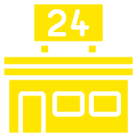
Place-Based Video Screens: In a post-Covid world, nearly half of adults now see digital ads at everyday stops like gas stations and grocery stores
% of A18+ who have seen a place-based digital video ad in the last 30 days
Top 6 Locations Where Respondents Viewed Digital Place-Based Video Ads*
% of A18+
26%
16%
14%
Gas Stations
Grocery Stores
Medical Offices
14%
12%
11%
Fast Food /
Family Restaurants
Shopping Malls
Convenience Stores
Source: VAB analysis of MRI-Simmons Spring Doublebase 2015 – 2025 USA study, A18+. *VAB analysis of MRI-Simmons Spring Doublebase 2025 USA study, A18+.
This information is exclusively provided to VAB members and qualified marketers.
PAGE 20

Slide 21

Adults over 50 account for 36% of the total population and nearly half of all adults
The average U.S. household is now a densely connected ecosystem, driven by deep consumer reliance on smart technology that enhances their quality of life, which establishes these devices as essential and deeply accepted components of daily living
The pervasive integration of connected devices creates
a continuous stream of contextual micro-moments, dramatically increasing the opportunity for brands to move beyond simple frequency and deliver truly meaningful, personalized engagement
As the connected landscape matures, marketers must shift focus from device ownership to device intent, strategically prioritizing investment in high-utility platforms like Connected TV and Smartphones while differentiating their approach for niche technologies like AR/VR where the velocity of adoption is slowing or leveling off
Key Marketer Takeaways
This information is exclusively provided to VAB members and qualified marketers.
PAGE 21

Slide 22
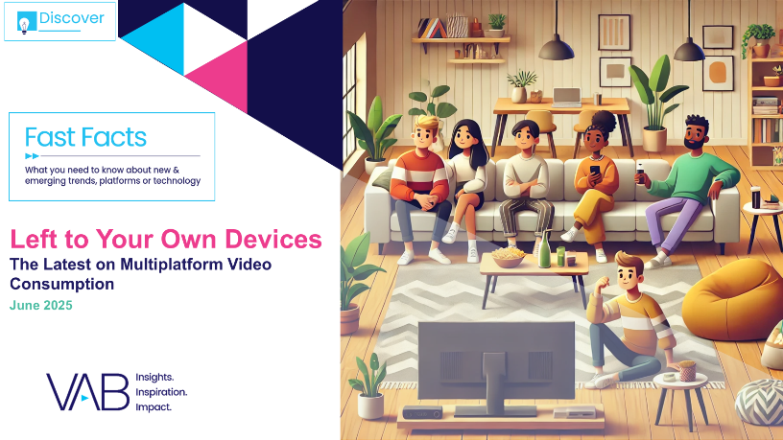
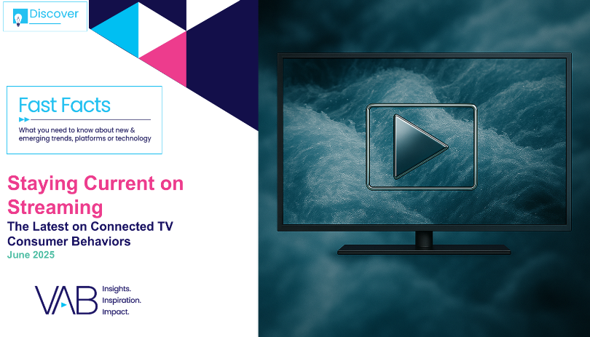
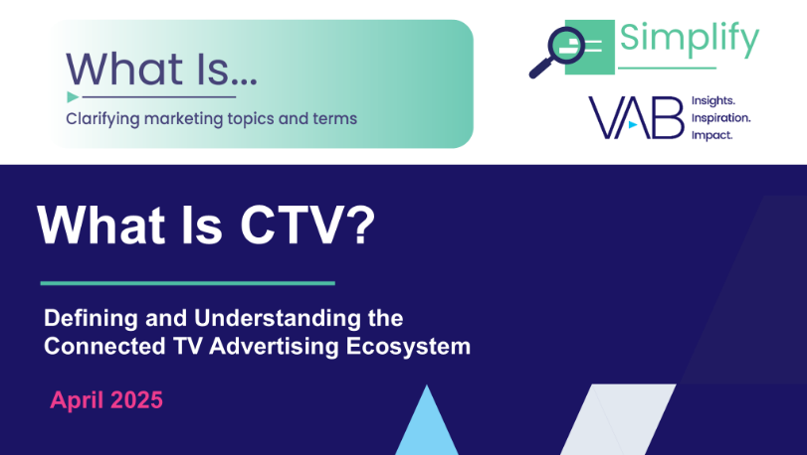

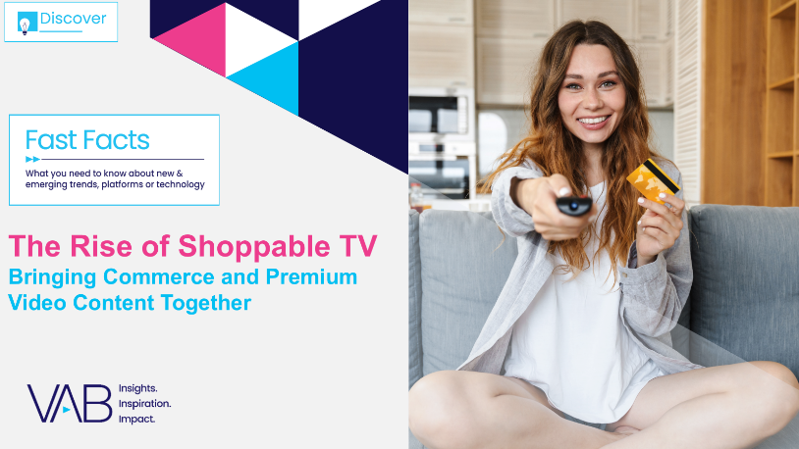
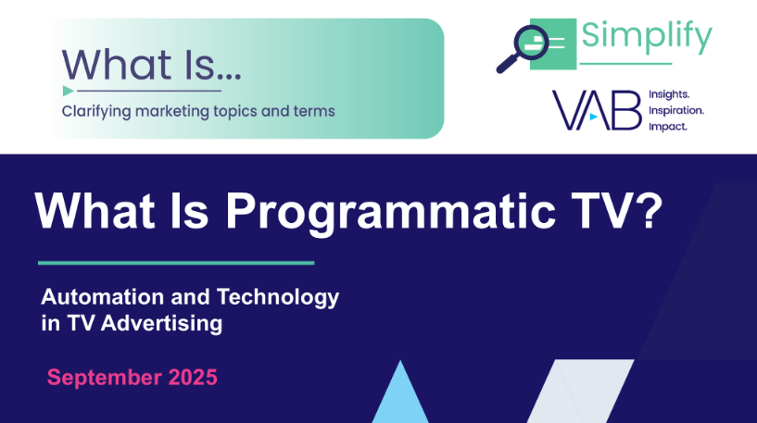
Creators
Jason Wiese
Leah Montner-Dixon
EVP, Strategic Insights & Measurement
jasonw@thevab.com
VP, Audience & Behavioral Insights
leahm@thevab.com
Left To Your Own Devices
The Latest on Multiplatform Video Consumption
Staying Current on Streaming
The Latest on Connected TV
Consumer Behaviors
Karolina Guillen
Associate Director, Insights, Strategy & Analytics karolinag@thevab.com
What Is CTV?
Defining and Understanding the Connected TV Advertising Ecosystem
Free For All
Understanding the Growth of FAST Through Three Key Questions
Discover more
Looking for more data, insights and takeaways? Check out this related VAB content
The Rise of Shoppable TV
Bringing Commerce and Premium Video Content Together
What is Programmatic TV?
The Latest on Multiplatform Video Consumption
VAB Members, brand marketers and agencies get free and immediate access to VAB’s content library. Get access at theVAB.com
This information is exclusively provided to VAB members and qualified marketers.
PAGE 22

Slide 23


About VAB
VAB plays a dual role in the video advertising industry. We are leading the change to bring about a more innovative and transparent marketplace. We also provide the insights and thought leadership that enables marketers to develop business-driving marketing strategies.
Drawing on our marketing expertise, we simplify the complexities in our industry and discover new insights that transform the way marketers look at their media strategy.
We are committed to your business growth and proud to offer VAB members, brand marketers and agencies complimentary access to our continuously-growing Insights library. Get immediate access at theVAB.com.
This information is exclusively provided to VAB members and qualified marketers.
PAGE 23

