Slide 1




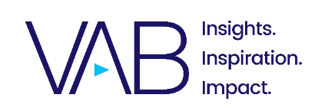
In a League of Their Own
Exploring the Rising Popularity of Women’s Sports

Slide 2
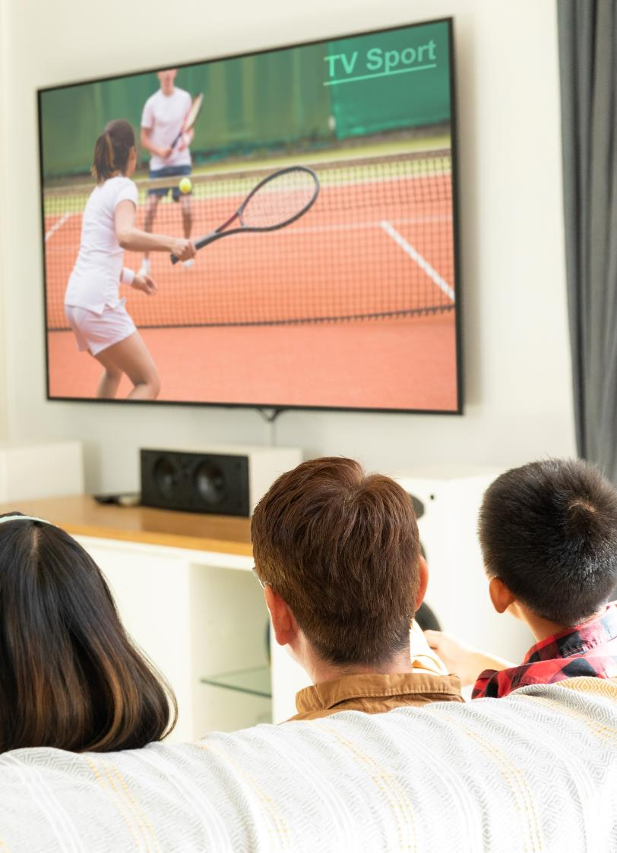

Women’s sports present significant opportunities for brands to engage valuable audiences
Viewership of women’s sports has skyrocketed in recent years, spurred by greater interest, more media coverage, increased competition and ‘marketable’ star athletes.
Through this growth, women’s sports have attracted highly desirable audiences for marketers – delivering both women and men, along with younger segments.
Exposure and coverage continues to expand which provides brands with more opportunities to reach an emotionally engaged audience in a brand safe, live environment that is typically more cost effective and
less saturated than men’s sports.
This information is exclusively provided to VAB members and qualified marketers.
PAGE 2

Slide 3

The momentum and fandom around women’s sports is increasing at a record pace

Slide 4





Women’s sports have experienced unprecedented momentum over the last few years in media coverage, competition and social buzz
Why do you watch more women's sports than you used to?
% that agree with each statement
41%
38%
37%
32%
25%
There are more women’s sports being broadcast
Women’s sports are becoming more entertaining or competitive
I have learned more about a specific female athlete(s)
There is more press and attention around women’s sports than there used to be
Women’s sports are being talked about more on social media
Source: NRG, Future of Women’s Sports: Leveling the Playing Field, October 2022.
This information is exclusively provided to VAB members and qualified marketers.
PAGE 4

Slide 5

This surge in interest has driven demand for more exposure and content across audiences and all levels of fandom
84% of sports fans are interested in watching women’s sports, 51% of which are males
% of respondents who agree with the following statements
General Population
Women
Men
Sports Fan
Avid Fan
Casual Fan
‘I would like to see more media exposure for women’s sport’
50%
51%
48%
60%
66%
57%
‘The sports marketplace has a growing appetite for content, ensuring growth and greater success for women’s sports’
46%
43%
48%
55%
66%
51%
‘Networks, advertisers and other media platforms* have a responsibility to promote the growth of women’s sports’
51%
54%
48%
58%
69%
53%
Source: Seton Hall University, Poll on Women’s Sports in America: ‘Show Us More and We’ll Watch More’, February 17, 2023. *e.g., streaming, social media, etc.
This information is exclusively provided to VAB members and qualified marketers.
PAGE 5

Slide 6




By aligning with women's sports, brands can specifically tap into the significant attention, value and influence of female consumers
The Purchasing Power of Women
85%
75%
66%
~50%
of consumer spending is controlled or influenced
by women*
of discretionary spending will be owned by women by 2028
of consumer wealth will belong to women in the next decade
of the U.S. working population is made up
of women*
(when adjusted for self-employment, women make up the majority)
Source: Bankrate, The rising purchasing power of women: Facts and statistics, January 4, 2023. *TechCrunch, Unlocking the trillion-dollar female economy, May 21, 2023.
This information is exclusively provided to VAB members and qualified marketers.
PAGE 6

Slide 7



Despite the demand for more content, female athletes have continued to grapple with challenges in representation, coverage and compensation
Obstacles faced by female athletes
Lack of representation
Lack of coverage
Lack of compensation
Only 16% of all professional athletes are women
Nearly one-fifth (18%) of U.S. fans said live airings of women’s sports aren’t easily accessible to them*
In professional sports such as basketball, golf, baseball and tennis, the difference in pay between male and females range from 15% to nearly 100%**
Source: Zippia, Professional Athlete Demographics and Statistics in the U.S., June 29, 2023. *Nielsen, Women’s Sports Viewership on the Rise, July 2023. **Forbes, Gender Pay Gap Statistics in 2023, February 27th, 2023.
This information is exclusively provided to VAB members and qualified marketers.
PAGE 7

Slide 8





However, it’s an exciting time for women’s sports as leagues, publishers and legislatures are working to boost visibility and pay for female athletes
Efforts to elevate women’s sports
Increasing representation
Increasing coverage
Closing the gender wage gap
The WNBA and NWSL both have plans to expand their number of teams leading to more opportunities for female athletes
Major publishers like ESPN and Warner Bros. Discovery Sports have invested in more women’s sports coverage leading to an increase in their viewership*
The House of Representatives passed a bill in 2022 that ensures equal compensation for U.S. women competing in international events**
Source: Sports Business Journal, NWSL and WNBA have eyes on expansion and the value of cachet, October 3, 2022. *Digiday, Publishers like ESPN and agencies are seeing more investment in women’s sports coverage, February 27, 2023. **ESPN, House of Representatives passes equal pay bill for U.S. women athletes, December 22,2022. ‘WNBA’ – Women’s National Basketball Association,. ‘NWSL’ – National Women’s Soccer League.
This information is exclusively provided to VAB members and qualified marketers.
PAGE 8

Slide 9
Women’s sports are a significant growth engine for multiscreen TV

Slide 10

“For the past few years, women's sports have been on this incredible growth trajectory. While still in the growth phase, the buy-in is no longer low.
The market is starting to catch up and yesterday’s price is not todays.
We're seeing that with the Women’s World Cup and the snowball impact.
Brands seeing the value and investing. Media seeing brands investing and wanting part of that. More visibility means more fans. More fans means more tickets out the door. It's a cycle. It will only continue to grow and right now we're seeing the phase of growth that takes women's sports to the next level.”
Kelsey Trainor
Founder of ‘Invest in Women’
Forbes, 2023 World Cup Puts Growth of Women’s Sport on Full Display, 6/30/2023
This information is exclusively provided to VAB members and qualified marketers.
PAGE 10

Slide 11

There are more women’s sporting event TV telecasts airing now than ever before as coverage and exposure broadens due to greater demand
# of women’s live sporting events
based on National TV telecasts
+29%
2022 vs. 2018
Source: VAB Analysis of Nielsen NPower Ratings Analysis Program report, 2018 & 2022, Total Day, P2+, based on Telecast Count. Ad-supported national cable TV & broadcast TV, includes Spanish language networks; excludes regional sports networks, local broadcast airings and digital airings of sports through MVPD / network TV apps. Reflects live sporting events only.
This information is exclusively provided to VAB members and qualified marketers.
PAGE 11

Slide 12
Overall TV viewership of women’s sports has grown significantly across audiences, with females outpacing male demographics
In 2022, the audience composition was 62% male and 38% female (vs. 64% and 36% respectively in 2018)
Total time spent viewing women’s live sporting events
in millions of minutes
+32%
2022 vs. 2018
Female % Change: +39%
Male % Change: +28%
16,741
12,696
Source: VAB analysis of Nielsen NPower R&F Program Report, 2018 & 2022, Total Day, Live+SD, males 2+, females 2+, persons 2+. Ad-supported national cable TV & broadcast TV, includes Spanish language networks; excludes regional sports networks, local broadcast airings and digital airings of sports through MVPD / network TV apps. Reflects live sporting events only.
This information is exclusively provided to VAB members and qualified marketers.
PAGE 12

Slide 13
Women’s sports have proven to be highly effective at reaching valuable consumer segments, especially women
% change in total time spent viewing women’s live sporting events
2022 vs. 2018
Persons
Women
Men
P18-49
+20%
W18-49
+21%
M18-49
+19%
P25-54
+15%
W25-54
+28%
M25-54
+10%
Source: VAB analysis of Nielsen NPower R&F Program Report, 2018 & 2022, Total Day, Live+SD. Ad-supported national cable TV & broadcast TV, includes Spanish language networks; excludes regional sports networks, local broadcast airings and digital airings of sports through MVPD / network TV apps. Reflects live sporting events only.
This information is exclusively provided to VAB members and qualified marketers.
PAGE 13

Slide 14





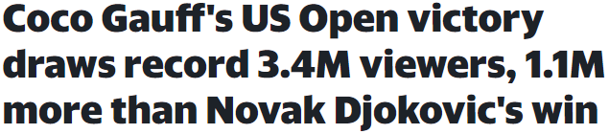








The momentum behind women’s sports has driven significant TV audience increases and fueled new viewership records for leagues and event series
November 28th, 2022
October 20th, 2023
June 2nd, 2022
September 13th, 2023
“The Women’s World Cup would be the largest standalone women’s sporting event in the world, reaching an estimated 2 billion people and 1.5 million spectators”
AdAge, FIFA Women’s World Cup Marketing – Everything Brands Need to Know
7/5/2023
April 11th, 2023
August 6th, 2023
April 3rd, 2023
Women’s World Cup attendance record exceeded in last 16
March 31st, 2023
NCAA women’s March Madness breaks records
November 18th, 2022
September 14th, 2023
September 6th, 2022
August 11th, 2021
This information is exclusively provided to VAB members and qualified marketers.
PAGE 14

Slide 15



In fact, TV viewership for women’s sports signature events is far outpacing the increases seen by comparable men’s sporting events
Women’s sports YoY TV viewership growth in high-profile events
+453%
+171%
+81%
YoY
(vs. +15% YOY for the MLS Cup final)
YoY
(vs. +25% YOY for the men’s NBA finals)
YoY
(vs. +18% YOY for the men’s tournament)
Source: SambaTV, Women’s Sports Are On the Rise, Creating Game-Changing Opportunities for Advertisers, 2022.
This information is exclusively provided to VAB members and qualified marketers.
PAGE 15

Slide 16



Growth in TV viewing creates a greater buzz factor among passionate fans which elevates exposure across social media platforms as well
During the 2022 WNBA season…
WNBA Twitter / X Followers*
Per month (000)
+23% vs. 2020
Across all WNBA social media handles,
186 million video views were recorded –
a YoY increase of 36%
Website traffic to WNBA.com nearly doubled in terms of unique visitors,
total visits and page views
On digital media, 10.3 million video views of the 2023 WNBA Draft were recorded, with the event attracting the largest online audience in the event’s history - a +141% YoY increase
Source: Sportradar, Women’s Basketball is booming – but is your platform equipped for the WNBA’s big return?, 2023. *Statista, WNBA Twitter Followers, 2023.
This information is exclusively provided to VAB members and qualified marketers.
PAGE 16

Slide 17
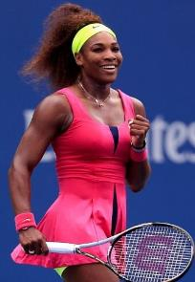
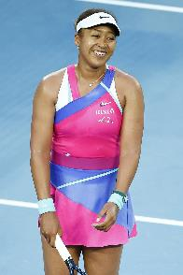
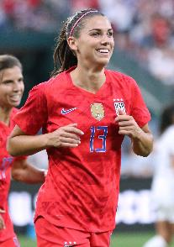
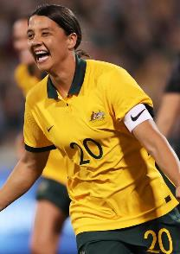
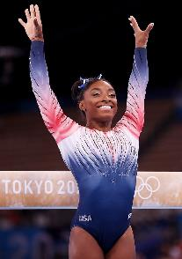


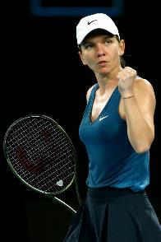

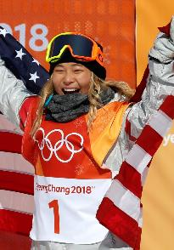
Increased exposure has turned female athletes into mainstream stars, many of whom also rank high in overall marketability across all sports
Although only 16% of professional athletes are female, 53% of the top 15 marketable athletes are female (8 out of 15)*
Top 10 marketable female athletes
#1
#2
#3
#4
#5
Serena Williams
#2 Overall
Naomi Osaka
#6 Overall
Alex Morgan
#8 Overall
Sam Kerr
#9 Overall
Simone Biles
#11 Overall
#6
#7
#8
#9
#10
Emma Raducanu
#12 Overall
Alexia Putellas
#13 Overall
Simona Halep
#15 Overall
Katie Ledecky
#21 Overall
Chloe Kim
#22 Overall
Source: SportsProMedia, The Most Marketable Athletes of 2022, 2023. Marketability is scaled on their brand strength, audience and reach, and economics. *Top marketable athletes ranking is based on SportsPro and Northstar’s ‘Marketability Score’, which is made up of 3 components that are added together to generate an overall score: brand strength, audience & reach, economics. Athletes considered were active during the evaluation period (12/1/21-7/31/22) in one of the 24 sports analyzed.
This information is exclusively provided to VAB members and qualified marketers.
PAGE 17

Slide 18
The growth in women’s sports has created more opportunities for marketers to align with engaged audiences

Slide 19

More ad impressions in women’s sports means more opportunities for brands to connect with passionate audiences in engaging live content
In 2022, the advertising impressions skew was 64% male and 36% female (vs. 67% and 33% respectively in 2018)
Women’s Live Sporting Events: Total TV IMPs (equivalized)
in millions
+36%
2022 vs. 2018
Female % Change: +49%
Male % Change: +29%
9,920
6,832
Source: VAB analysis of Nielsen Ad Intel report, 2018 & 2022, Total Day, Live+SD, males 12+, females 12+, persons 12+; excludes promos and PSAs. Reflects national cable TV, Spanish language cable TV, broadcast TV, Spanish language broadcast TV, spot TV, syndicated TV (excludes regional sports networks); based on calendar years. Reflects live sporting events only.
This information is exclusively provided to VAB members and qualified marketers.
PAGE 19

Slide 20

Advertiser buy-in has surged across women’s sports with TV ad dollars more than doubling over the last several years
Advertisers in categories like restaurants, professional services, insurance and auto were seen leading the charge in 2022 investments
Total TV advertiser spend for women’s live sporting events
in millions
+139%
2022 vs. 2018
# of categories:
220
243
Source: VAB analysis of Nielsen Ad Intel report, 2018 & 2022, Total Day, Live+SD. Based on Nielsen-defined “subcategory” product. Reflects national cable TV, Spanish language cable TV, broadcast TV, Spanish language broadcast TV, spot TV, syndicated TV; based on calendar years. Reflects live sporting events only.
This information is exclusively provided to VAB members and qualified marketers.
PAGE 20

Slide 21


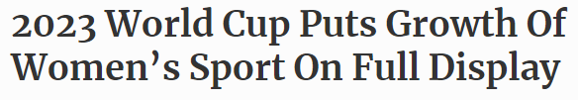


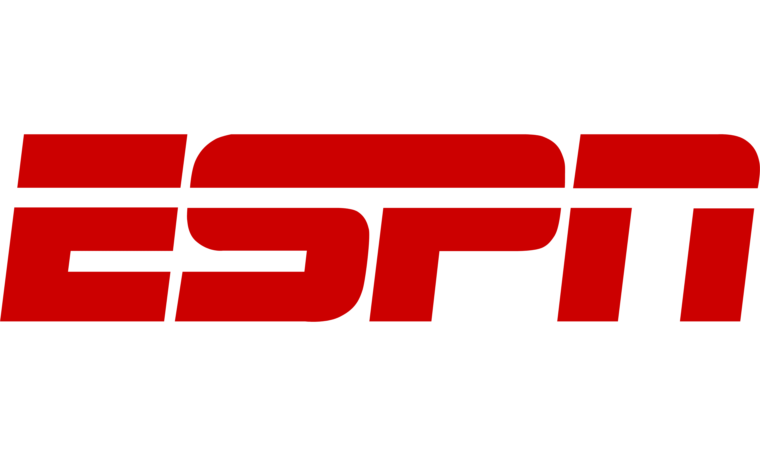
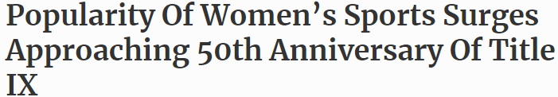





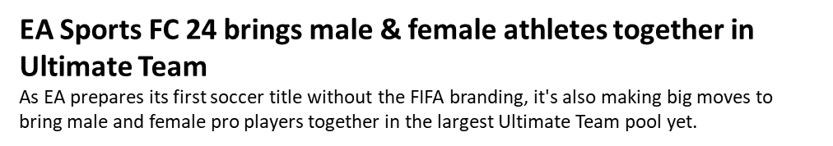

Fueled by demand, the entire ecosystem of media publishers, distributors, leagues and advertisers are partnering to broaden coverage further
Sampling of recent efforts to increase visibility of women’s sports
February 8th, 2023
June 30th, 2023
November 7th, 2022
April 7th, 2022
April 5th, 2023
May 13th, 2023
This year, 15 sponsors and nearly 100 advertisers activated during the championship, up from 14 and 22, respectively, a year ago.
April 24th, 2023
February 21st, 2023
May 17th, 2023
The Audience for Women’s Sports Is Surging. Richer Media Deals Could Follow.
The NCAA women’s basketball tournament, Women’s World Cup and others seek to turn rising ratings into much bigger broadcast fees.
July 13th, 2023
June 19th, 2021
February 1st, 2023
Women’s college sports get boost in TV ratings, visibility
This information is exclusively provided to VAB members and qualified marketers.
PAGE 21

Slide 22
Viewers have a range of interests and are tuning into a variety of women’s sporting events across both linear TV and streaming platforms
% of those who watch the following women’s sports events on TV or streaming
% of sports viewers (P18-54)
Summer Olympics
(gymnastics, track & field, softball, etc.)
Winter Olympics
(alpine skiing, figure skating, curling, etc.)
FIFA Women’s World Cup
Women's NCAA March Madness
Women's Tennis Grand Slam
(Wimbledon, French Open)
WNBA Playoffs
Women’s NCAA Women’s College World Series
Women's MMA
Other NCAA Women's Sports Championships
(volleyball, field hockey, soccer etc.)
Women's LPGA Majors
(U.S. Women's Open, Women's PGA Championship)
Source: VAB custom research fielded by Hub Entertainment Research as part of the 2023 Monetizing Video report. Data sourced from Hub’s survey of 1,602 consumers, self-identified active sports viewers (TV or streaming) ages 18-54 who meet the following criteria: watch at least one hour of TV / week, have broadband access. Data collected June 2023. VAB1: Do you watch the following women’s sport events on TV or streaming? Male and Female cuts.
This information is exclusively provided to VAB members and qualified marketers.
PAGE 22

Slide 23
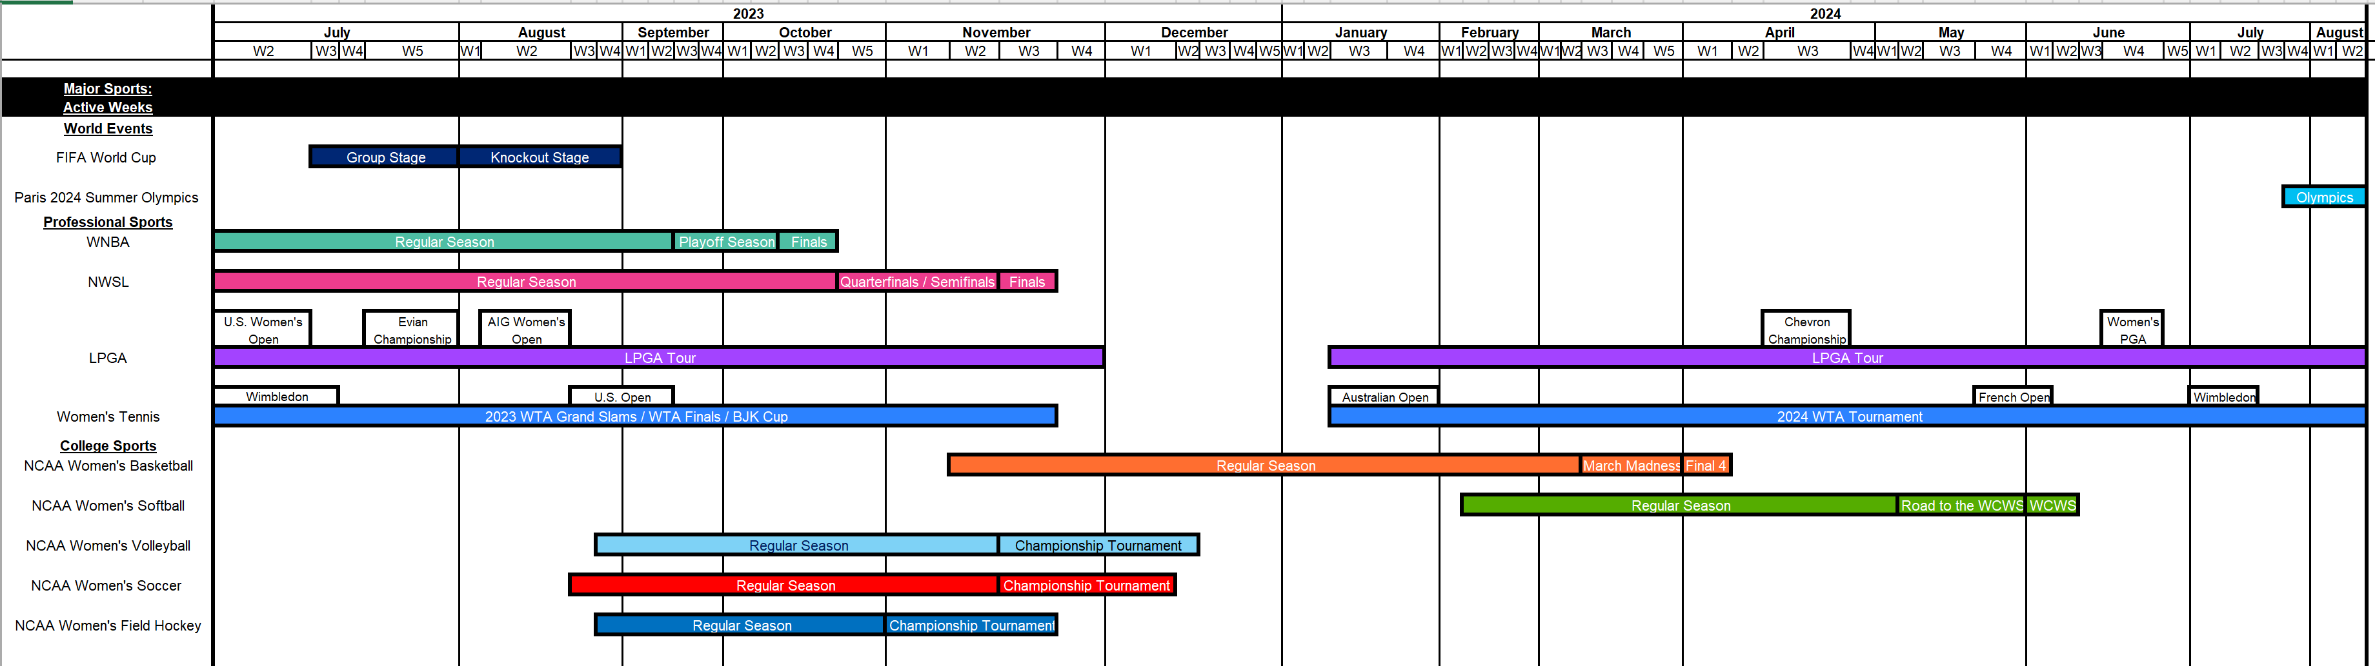
Marketers can reach engaged audiences by aligning with various women’s sports leagues and signature events throughout the year
A 14-month calendar of select sports leagues, post-season tournaments and major events
This information is exclusively provided to VAB members and qualified marketers.
PAGE 23

Slide 24
By forming strategic partnerships and aligning relevant messaging, brands can boost engagement and drive purchase intent

Slide 25

“Brands that seize the momentum of the Women’s World Cup and its growing popularity are poised to reap the greatest rewards. If they can get the partnerships right, there is an opportunity to reach new audiences that are engaging with the sport for the first time whilst aligning themselves with sports influencers to develop a highly symbiotic relationship.”
Becky Owen
Chief Marketing & Innovation Officer, Billion Dollar Boy
WARC, Women’s World Cup players boost Instagram following, 8/23//2023
This information is exclusively provided to VAB members and qualified marketers.
PAGE 25

Slide 26

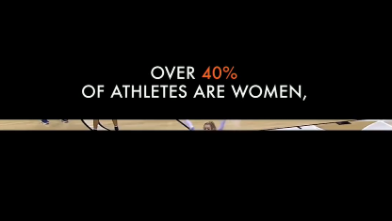
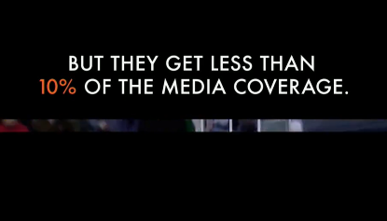

By aligning relevant messaging with a high-profile women’s sports event, Buick effectively increased consideration among invested sports fans
In March 2022, Buick launched their ‘See Her Greatness’ campaign to align with the NCAA Women’s March Madness. This campaign features creative that highlights the disparity female athletes face, having only 10% of media coverage despite making up almost half of all athletes and showcases Buick’s commitment to raising that percentage.
Results: The campaign highly over indexed the average ad attention for the brand and has garnered the third highest attention score of all Buick ads that ran within the same timeline.
‘See Her Greatness’ spot - $2.9 MM
Airings Throughout 24 days: 3/12/2022-4/4/2022
52 Airings / 157 MM HH IMPs
Business Outcomes
Attention Index: 120
Viewers completed watching this ad 20% more than an average ad aired in this same media placement context.
Brand Attention Ranking: #3
Ad ranked #3 in viewer attention among 21 Buick ads that aired between 3/12/2022-4/4/2022.
click banner above images to watch spot
Source: VAB analysis of iSpot.tv TV occurrence data and attention analytics, time period: 3/12/2022-4/4/2022, estimated media spend. Impressions represent US TV HHs and include activity within measured national broadcast and cable TV linear, national time-shifted, local, VOD and OTT. Attention scoring is based on national aired impressions viewed live/same day and played from the beginning. Interruptions = changing the channel, skipping the ad (via DVR), turning off the TV device or pulling up the programming guide.
This information is exclusively provided to VAB members and qualified marketers.
PAGE 26

Slide 27
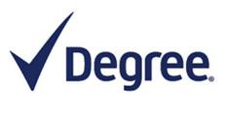

As seen by recent successes of FIFA Women’s World Cup ads, women’s sports campaigns drive lower funnel outcomes like purchase intent
Consideration Impact of Unilever’s Degree FIFA Women’s World Cup Ad: Made You Look*
Top 2 box purchase / visit intent
According to System1’s Test Your Ad platform, the FIFA Women’s World Cup’s top ranked ads have outperformed the top ads in the previous men’s World Cup in their ability to drive market share growth by measuring viewers’ emotional responses to creative.
How to read: Across the gen pop audience (adults 16+), the 30-second spot drew a +14-point advantage in purchase / visit intent over the one-year personal care video ad average.
Source: MediaPost, Women's FIFA Ads Outpull Men's Tournament's On Impact Ratings, 8/14/23. *iSpot, Video Ads That Won the Women’s World Cup 2023, August 16, 2023.
This information is exclusively provided to VAB members and qualified marketers.
PAGE 27

Slide 28

Women’s sports is a great opportunity to reach an emotionally engaged audience in a brand safe, live environment that provides similar advertiser benefits as men’s sports but at a lower cost and greater ability to stand out due
to less ad saturation
Campaigns that associate with female athletes, teams or leagues enable brands to effectively distinguish themselves among passionate fans while demonstrating their ability to drive outcomes like increased purchase intent
Key Marketer Takeaways
This information is exclusively provided to VAB members and qualified marketers.
PAGE 28

Slide 29


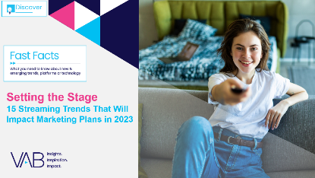



Creators
Jason Wiese
Leah Montner-Dixon
SVP, Director of Strategic Insights
jasonw@thevab.com
Director, Audience & Behavioral Insights
leahm@thevab.com
Karolina Guillen
Kaileen Cain
Insights Manager
karolinag@thevab.com
Insights Analyst
kaileenc@thevab.com
Discover more
Looking for more data, insights and takeaways? Check out this related VAB content
The Best Seats In The House
Recreating The Gameday Sports Experience At Home
The Best Seats In the House
A Custom Study Exploring Sports Fans’ Viewing Preferences
We are committed to providing marketers with the data and insights they need to develop thoughtful, inclusive campaigns & strategies. To find out more on the unique media consumption behaviors and cultural trends of diverse audiences, visit the VAB’s DEIB Marketing Resources.
Setting the Stage
15 Streaming Trends That Will Impact Marketing Plans in 2023
How can my brand leverage the strength of the rising Latina consumer through video?
VAB Members, brand marketers and agencies get free and immediate access to VAB’s content library. Get access at theVAB.com
This information is exclusively provided to VAB members and qualified marketers.
PAGE 29

Slide 30


About VAB
VAB plays a dual role in the video advertising industry. We are leading the change to bring about a more innovative and transparent marketplace. We also provide the insights and thought leadership that enables marketers to develop business-driving marketing strategies.
Drawing on our marketing expertise, we simplify the complexities in our industry and discover new insights that transform the way marketers look at their media strategy.
We are committed to your business growth and proud to offer VAB members, brand marketers and agencies complimentary access to our continuously-growing Insights library. Get immediate access at theVAB.com.
This information is exclusively provided to VAB members and qualified marketers.
PAGE 30

