Slide 1

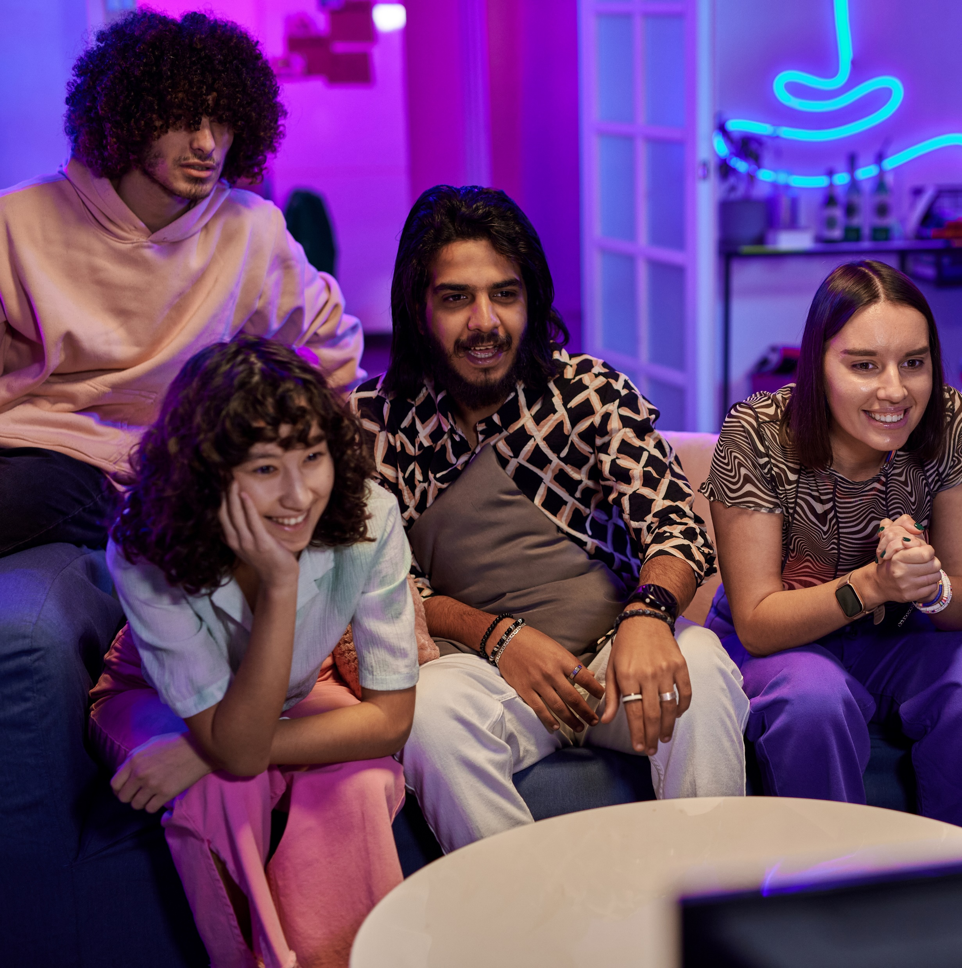



Laugh, Cry, Share, Buy
How TV & Streaming Influences Gen Z More Than Leading Social Platforms

Slide 2
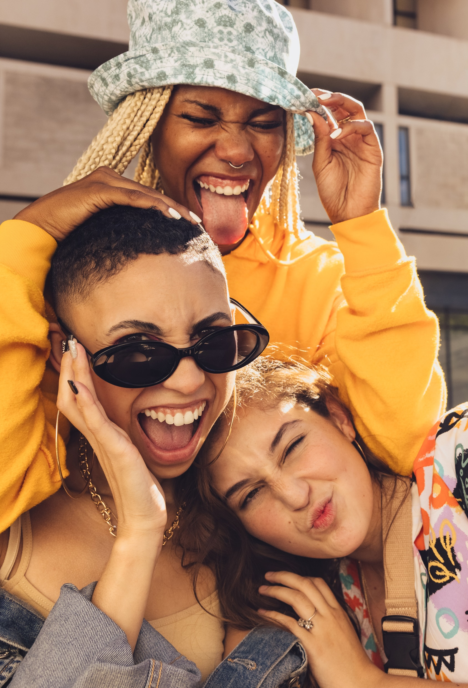

For Gen Z audiences, ‘premium’ is all about the feels
To really grab Gen Z's attention in the middle of all the distractions, it's key
to remember that their world isn’t just about social media. Recent custom research from VAB shows that younger audiences vibe more with premium video content from TV and streaming than with content on top social platforms.
Why does this matter?
If you want to connect with Gen Z on a deeper level, it’s all about hitting them with that quality video content they actually feel.
What you’ll learn:
Why young viewers get more feels from their fav TV and streaming shows than from social platforms
How TV and streaming is legit at making young viewers want to keep the energy going by extending engagement across platforms, way more than just scrolling social media
How marketers can tap into TV and streaming vibes to hype Gen Z
on everything from fashion and food to travel and more
*See appendix for a glossary guide of Gen Z terms and details on our custom research methodology.
For the purposes of this report, ‘Gen Z’ refers to individuals aged 13 - 24.
This information is exclusively provided to VAB members and qualified marketers.
PAGE 2

Slide 3






Premium video like TV & streaming creates good vibes with Gen Z because of its high-quality environment and ability to create emotional connections
Aligning ads with emotional content can quadruple their effectiveness in creating impact and building brand equity*
What differentiates premium video content found on TV in all its forms from user-generated content (UGC) on digital platforms?
‘Emotion’ is the new ‘Premium’
‘Premium content’ – industry shorthand for advertising impact – has primarily been related to the cost of production, with more expensive programming being deemed more premium.
However, research suggests that ‘premium’ has more to do with the emotional connection viewers have with their favorite content, which can be significantly impactful at driving ad receptivity.
High Production Quality
Complex Character Development
Emotional Storytelling
Brand Safe Environment
Content Duration
Download VAB’s ‘What Is TV’ to learn more. *Source: Kantar, Harness the power of emotion in digital advertising, 3/13/2023.
This information is exclusively provided to VAB members and qualified marketers.
PAGE 3

Slide 4
Engagement with high-quality, long-form premium video content grabs much higher attention than other digital and social channels
Avg. Seconds Viewed of :15 Ad by Platform
(Comparing second x second viewing via eye-tracking methodology*)
Cinema, TV & Streaming
Digital & Social
Cinema
Linear TV
CTV
In-Stream*
In-Article
Social**
11.3
Secs
7.4
Secs
7.3
Secs
3.0
Secs
2.4
Secs
1.6
Secs
According to research, ad memory starts to kick in at 2.5 secs (active attention)***
Source: *NCM & Lumen, ‘Cinema in the Media Mix,’ March 2023; Cinema attention is based on an in-theater second-by-second eye tracking study with Lumen Research conducted in November 2022; Linear TV & CTV reflects platform norms from TVision data. In-Stream & Social reflects digital norms from Attention Economy figures based on US Lumen mobile passive panel data. *In-Stream reflects the average of two platforms (2.6 secs & 3.3 Secs). **Social reflects the average of two platforms (2.0 Secs & 1.1 Secs). ***WARC, Understanding the ‘Triple Jeopardy’ Threat of Advertising Attention, Canes Lions, June 2022.
This information is exclusively provided to VAB members and qualified marketers.
PAGE 4

Slide 5
Gen Z audiences are notably engaged with TV content, vibing with various genres and formats
Weekly Media Activities Among 13-24 Year Olds
86%
Use a TV
(for any content)
72%
Watch TV
Content
61%
Have a TV in
their bedroom
This is especially true for 18–24-year-olds, Asian and Black Gen Zers
Source: Horowitz Research, The ‘Tea’ on Gen Z, January 25, 2024.
This information is exclusively provided to VAB members and qualified marketers.
PAGE 5

Slide 6
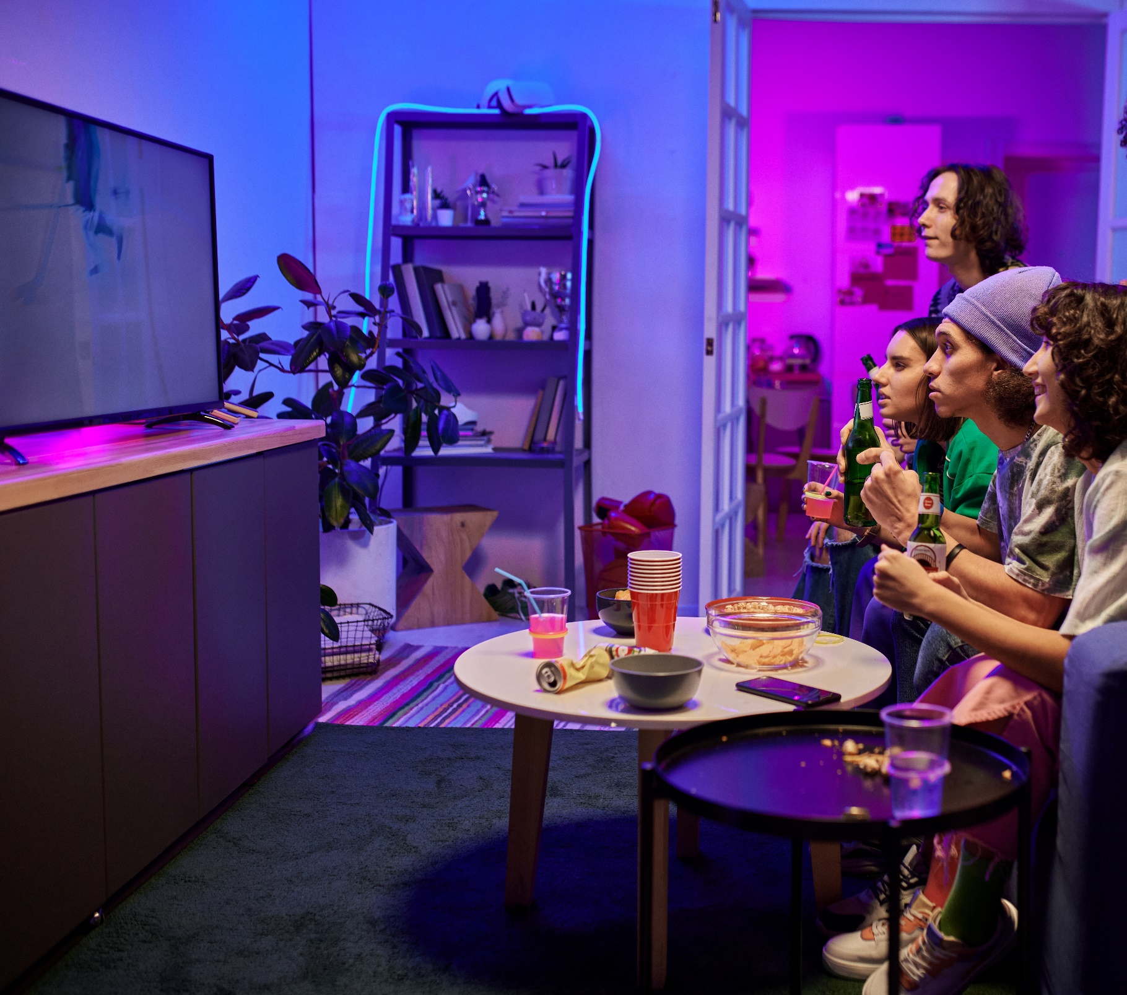
Gen Z’s taste for rich storytelling and character development leads them to high-key spend more time with quality content over non-premium video
Hours per week spent watching Non-Premium Videos vs. TV & Movies
Among P13-24 weekly non-premium video content viewers
Source: Hub Entertainment Research, Video Redefined, January 2024. Based on survey of 1,900 consumers, ages 13-74. P13-24 respondents = 620 (unweighted). Data collected December 2023. ‘Non-premium video’ includes short-form or user-generated video on YouTube, influencer video content, etc.
This information is exclusively provided to VAB members and qualified marketers.
PAGE 6

Slide 7

Going beyond viewership, VAB conducted custom research to understand how emotionally-driven storytelling and complex character development influences Gen Z

Slide 8



















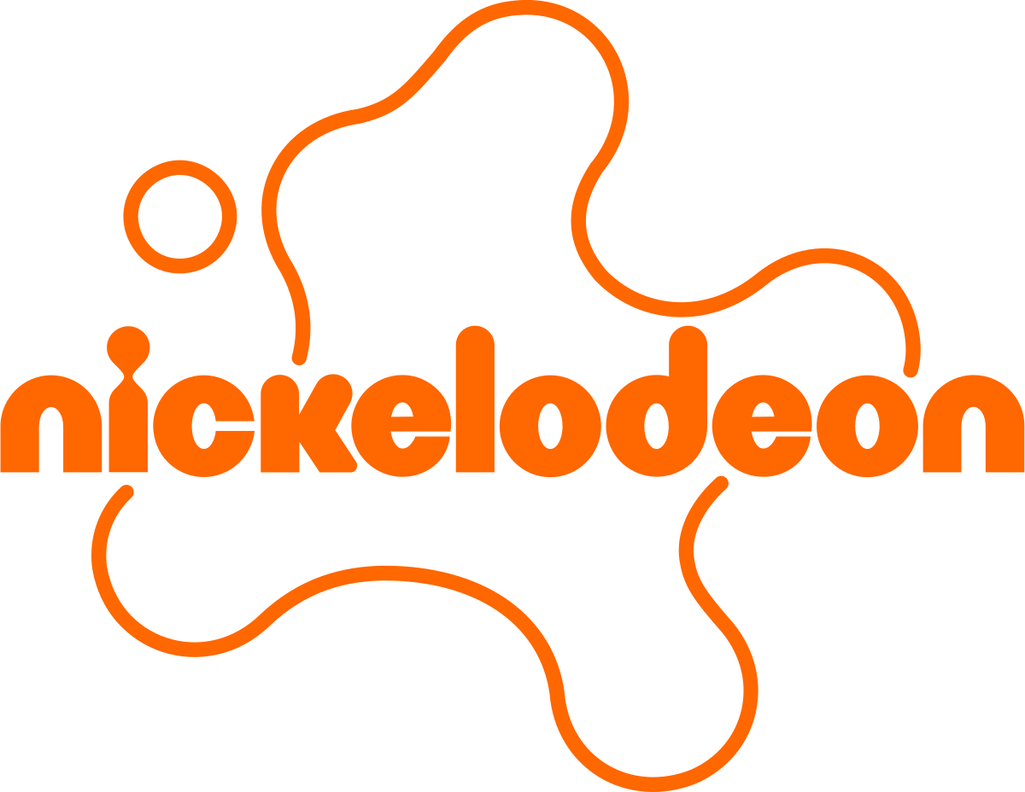



















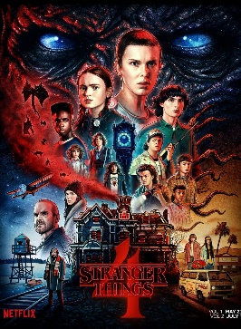






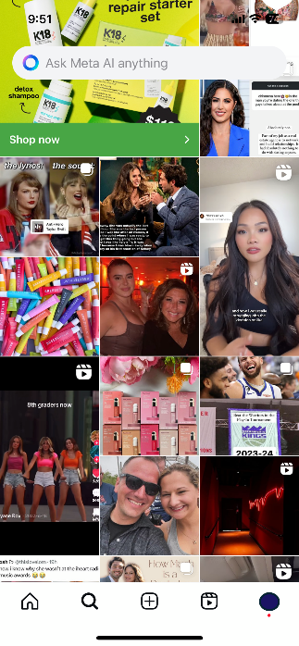
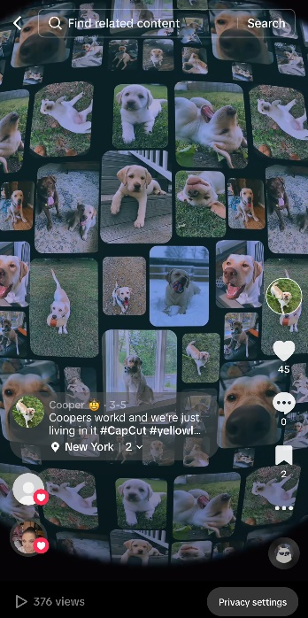
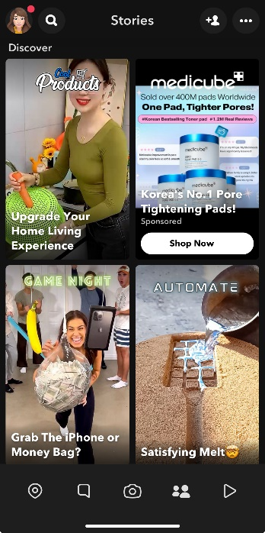
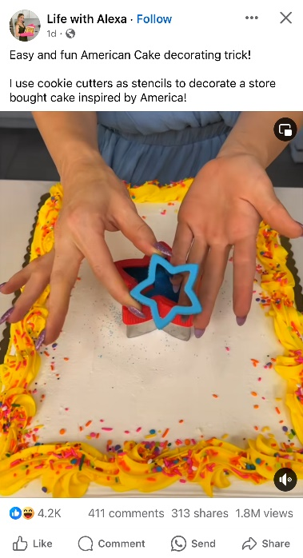
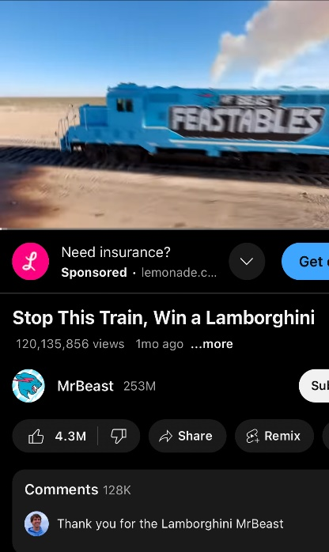


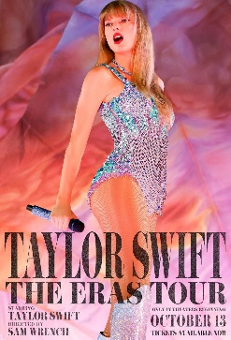

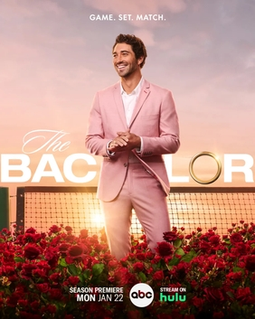

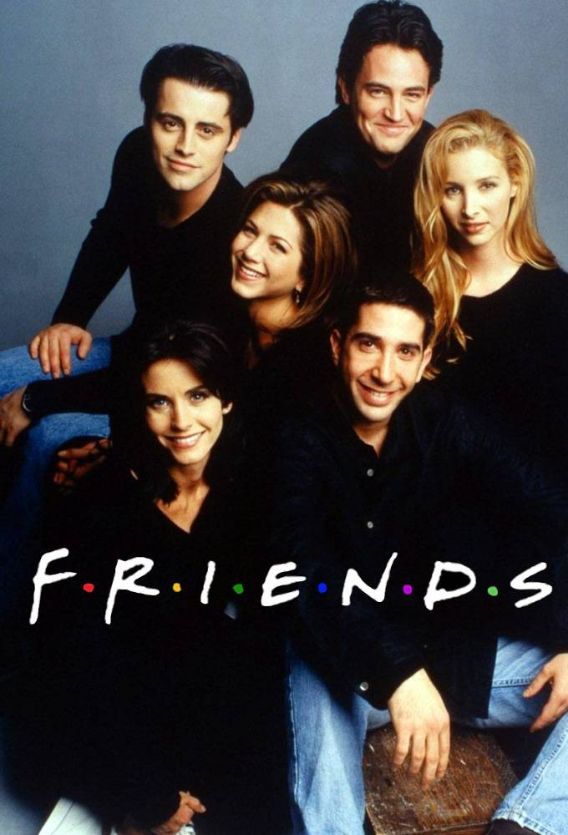
In our custom research, we sought to understand the impact that TV and streaming content has on Gen Z vs. the leading social media platforms
Examples of TV & Streaming Content
High-quality, professionally-produced content on trusted and
brand-safe linear TV networks or streaming services
Leading Social Media Platforms
Typically, short-form videos on social networks which are produced by digital-native creators, online and offline media brands or ‘everyday’ social media users
This information is exclusively provided to VAB members and qualified marketers.
PAGE 8

Slide 9




The Tea: TV & streaming fosters deeper emotional connections, engagement and actions compared to leading social platforms
Emotional Reactions
Enriched Engagement
Inspired Actions
Gen Z forms deeper emotional connections with their favorite
TV & streaming content
The deeper connections forged through TV & streaming content enhance both ‘real life’ and online experiences among Gen Z
Gen Z eagerly draws inspiration from TV & streaming content and applies this across key aspects
of their lives
Richer Emotional Responses
Appointment Viewing
Influences Personal Style
Deeper Connections
‘Me Time’ Focused
Stimulates Consumers’ Appetites
Influencers
Shared Quality Experiences
Inspires Culinary Delights
Desire For More
Determines Vacation Destinations
Online Communities
Popular Culture Connector
This information is exclusively provided to VAB members and qualified marketers.
PAGE 9

Slide 10
TV & streaming content fosters greater emotional reactions among Gen Z by creating richer responses and deeper connections
Emotional Reactions
Enriched Engagement
Inspired Actions
Gen Z forms deeper emotional connections with their favorite
TV & streaming content
The deeper connections forged through TV & streaming content enhance both ‘real life’ and online experiences among Gen Z
Gen Z eagerly draws inspiration from TV & streaming content and applies this across key aspects
of their lives
Richer Emotional Responses
Appointment Viewing
Influences Personal Style
Deeper Connections
‘Me Time’ Focused
Stimulates Consumers’ Appetites
Influencers
Shared Quality Experiences
Inspires Culinary Delights
Desire For More
Determines Vacation Destinations
Online Communities
Popular Culture Connector
This information is exclusively provided to VAB members and qualified marketers.
PAGE 10

Slide 11






Richer Emotional Responses
Rich narratives and complex characters in TV & streaming content hits differently for Gen Z, evoking strong emotions through authenticity
28%
% of P13-24 who have cried because
of something they watched
on the following platforms
TV / Streaming vs. Social Media*
% more likely
20%
+42%
of Gen Z say something they watched on TV or streaming has
‘brought me to tears’
10%
+176%
VS.
11%
+162%
12%
+134%
20%
+41%
*How to read: P13-24 are 42% more likely to have cried because of something they watched in TV or streaming content vs. TikTok content
Source: VAB custom research fielded by Hub Entertainment Research as part of the 2023 Video Redefined report. Data sourced from Hub’s survey of 1,900 consumers, ages 13-74. P13-24 respondents = 620 (unweighted). Data collected December 2023. Q1: Which of the following statements apply to you when you watch videos, shows or movies on the following platforms?
This information is exclusively provided to VAB members and qualified marketers.
PAGE 11

Slide 12
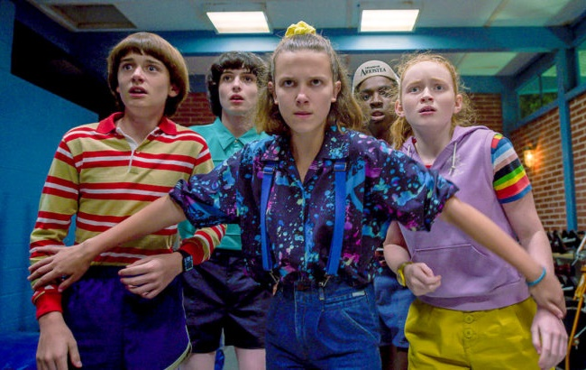

Richer Emotional Responses
Their deep commitment to characters is likely to get Gen Z buzzing as they eagerly anticipate discussing the next developments with friends
23%
% of P13-24 who have experienced anticipation / worry because of something they watched on the following platforms
TV / Streaming vs. Social Media*
% more likely
20%
+15%
of Gen Z say something they
watched on TV or streaming has
‘made me anxious or worried’
14%
+68%
VS.
18%
+31%
12%
+89%
20%
+15%
*How to read: P13-24 are 68% more likely to experience anticipation / worry because of something they watched in TV or streaming content vs. Snapchat content
Source: VAB custom research fielded by Hub Entertainment Research as part of the 2023 Video Redefined report. Data sourced from Hub’s survey of 1,900 consumers, ages 13-74. P13-24 respondents = 620 (unweighted). Data collected December 2023. Q1: Which of the following statements apply to you when you watch videos, shows or movies on the following platforms?
This information is exclusively provided to VAB members and qualified marketers.
PAGE 12

Slide 13
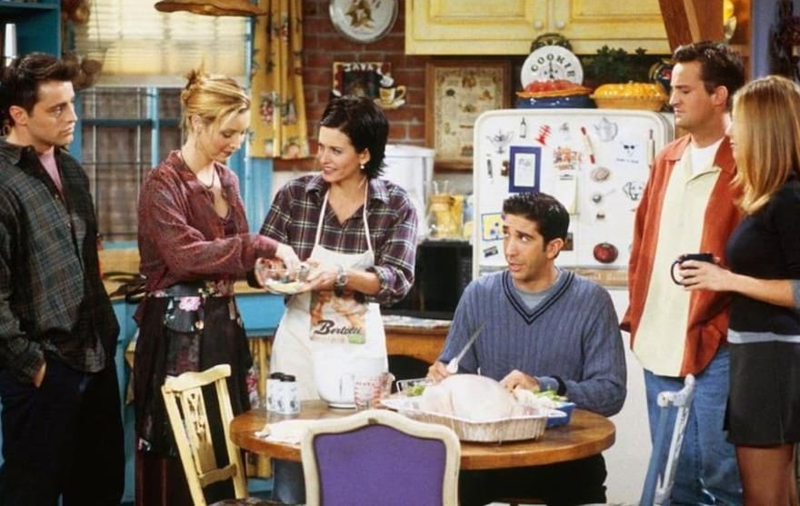

Richer Emotional Responses
Gen Z viewers get mad hyped by seeing their favorite TV and streaming characters live their truths and overcome challenges
25%
% of P13-24 who have felt overjoyed because of something they watched on the following platforms
TV / Streaming vs. Social Media*
% more likely
25%
+3%
of Gen Z say something they watched on TV or streaming has
‘made me feel overjoyed’
15%
+70%
VS.
20%
+27%
15%
+66%
28%
-9%
*How to read: P13-24 are 70% more likely to feel overjoyed because of something they watched in TV or streaming content vs. Snapchat content
Source: VAB custom research fielded by Hub Entertainment Research as part of the 2023 Video Redefined report. Data sourced from Hub’s survey of 1,900 consumers, ages 13-74. P13-24 respondents = 620 (unweighted). Data collected December 2023. Q1: Which of the following statements apply to you when you watch videos, shows or movies on the following platforms?
This information is exclusively provided to VAB members and qualified marketers.
PAGE 13

Slide 14
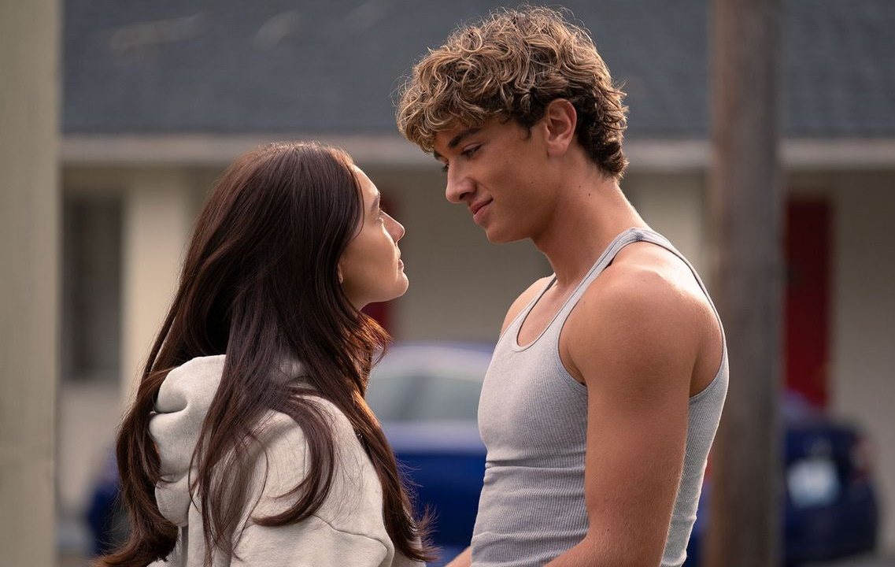

Richer Emotional Responses
Gen Z is more likely to be all up in their feelings with the struggles of favorite characters from TV and streaming which enriches their empathy
23%
% of P13-24 who have felt angry / upset because of something they watched on the following platforms
TV / Streaming vs. Social Media*
% more likely
23%
-4%
of Gen Z say something they
watched on TV or streaming has
‘made me feel angry or upset’
16%
+38%
VS.
17%
+30%
18%
+29%
21%
+6%
*How to read: P13-24 are 29% more likely to have gotten angry or upset because of something they watched in TV or streaming content vs. Facebook content
Source: VAB custom research fielded by Hub Entertainment Research as part of the 2023 Video Redefined report. Data sourced from Hub’s survey of 1,900 consumers, ages 13-74. P13-24 respondents = 620 (unweighted). Data collected December 2023. Q1: Which of the following statements apply to you when you watch videos, shows or movies on the following platforms?
This information is exclusively provided to VAB members and qualified marketers.
PAGE 14

Slide 15


Richer Emotional Responses
TV and streaming’s extra AF storytelling delivers more authentic surprises and impactful moments, leaving Gen Z shook
24%
% of P13-24 who have been shocked
by something they watched on the following platforms
TV / Streaming vs. Social Media*
% more likely
27%
-13%
of Gen Z say something they
watched on TV or streaming has
‘shocked me’
15%
+60%
VS.
18%
+34%
15%
+62%
24%
Flat
*How to read: P13-24 are 60% more likely to feel shocked because of something they watched in TV or streaming content vs. Snapchat content
Source: VAB custom research fielded by Hub Entertainment Research as part of the 2023 Video Redefined report. Data sourced from Hub’s survey of 1,900 consumers, ages 13-74. P13-24 respondents = 620 (unweighted). Data collected December 2023. Q1: Which of the following statements apply to you when you watch videos, shows or movies on the following platforms?
This information is exclusively provided to VAB members and qualified marketers.
PAGE 15

Slide 16
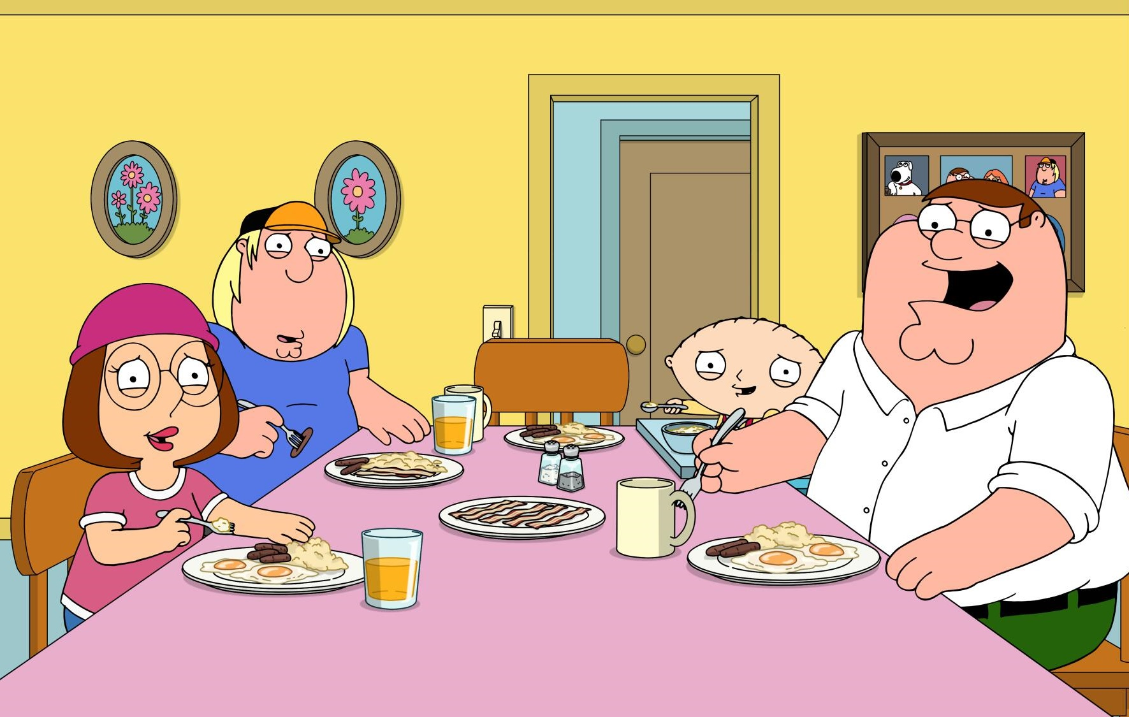

Richer Emotional Responses
Gen Z audiences tend to LOL more at crafted comedy in TV and streaming content than the quick humor found on most social platforms (period)
49%
% of P13-24 who have laughed out loud because of something they watched on the following platforms
TV / Streaming vs. Social Media*
% more likely
52%
-5%
of Gen Z say something they
watched on TV or streaming has
‘made me laugh out loud’
30%
+65%
VS.
35%
+42%
22%
+126%
57%
-13%
*How to read: P13-24 are 65% more likely to laugh out loud because of something they watched in TV or streaming content vs. Snapchat content
Source: VAB custom research fielded by Hub Entertainment Research as part of the 2023 Video Redefined report. Data sourced from Hub’s survey of 1,900 consumers, ages 13-74. P13-24 respondents = 620 (unweighted). Data collected December 2023. Q1: Which of the following statements apply to you when you watch videos, shows or movies on the following platforms?
This information is exclusively provided to VAB members and qualified marketers.
PAGE 16

Slide 17

Deeper Connections
Because they get all the feels, Gen Z builds more meaningful connections with characters and people from TV and streaming content
% of P13-24 who feel personally connected to a character / personality from content on the following platforms
TV / Streaming vs. Social Media*
% more likely
34%
25%
+35%
15%
+125%
of Gen Z say they
‘feel personally connected to a character / personality’
from TV or streaming content
VS.
21%
+61%
16%
+117%
27%
+26%
*How to read: P13-24 are 35% more likely to feel personally connected to a character / personality from TV or streaming content vs. TikTok content
Source: VAB custom research fielded by Hub Entertainment Research as part of the 2023 Video Redefined report. Data sourced from Hub’s survey of 1,900 consumers, ages 13-74. P13-24 respondents = 620 (unweighted). Data collected December 2023. Q1: Which of the following statements apply to you when you watch videos, shows or movies on the following platforms?
This information is exclusively provided to VAB members and qualified marketers.
PAGE 17

Slide 18

Influencers
Gen Z wants to share their meaningful connections and experiences around their favorite TV and streaming content with friends
% of P13-24 who tried to convince a friend to watch a TV show, movie or video the following platforms
TV / Streaming vs. Social Media*
% more likely
34%
27%
+24%
14%
+133%
of Gen Z say they have
‘tried to convince a friend to watch a TV show, movie or video’
on TV or streaming
VS.
18%
+84%
15%
+119%
29%
+16%
*How to read: P13-24 are 119% more likely to have tried to convince a friend to watch a TV or streaming show, movie or video vs. Facebook content
Source: VAB custom research fielded by Hub Entertainment Research as part of the 2023 Video Redefined report. Data sourced from Hub’s survey of 1,900 consumers, ages 13-74. P13-24 respondents = 620 (unweighted). Data collected December 2023. Q1: Which of the following statements apply to you when you watch videos, shows or movies on the following platforms?
This information is exclusively provided to VAB members and qualified marketers.
PAGE 18

Slide 19
TV & streaming fosters greater engagement among Gen Z through ‘must see’ content that drives deep ‘real life’ and online immersion
Emotional Reactions
Enriched Engagement
Inspired Actions
Gen Z forms deeper emotional connections with their favorite
TV & streaming content
The deeper connections forged through TV & streaming content enhance both ‘real life’ and online experiences among Gen Z
Gen Z eagerly draws inspiration from TV & streaming content and applies this across key aspects
of their lives
Richer Emotional Responses
Appointment Viewing
Influences Personal Style
Deeper Connections
‘Me Time’ Focused
Stimulates Consumers’ Appetites
Influencers
Shared Quality Experiences
Inspires Culinary Delights
Desire For More
Determines Vacation Destinations
Online Communities
Popular Culture Connector
This information is exclusively provided to VAB members and qualified marketers.
PAGE 19

Slide 20

Appointment Viewing
Intentionally carving out chill (or bed rot) time, Gen Z enjoys bingeing their go-to TV and streaming content
 | % of P13-24 who regularly set aside time to watch content on the following platforms | TV / Streaming vs. Social Media* % more likely
37%
25%
+47%
20%
+84%
of Gen Z say
‘I regularly set aside
time in my schedule
to watch my favorite
TV or streaming content’
+109%
18%
15%
+147%
26%
+40%
*How to read: P13-24 are 40% more likely to set aside time to enjoy their favorite premium video content vs. YouTube content
Source: VAB custom research fielded by Hub Entertainment Research as part of the 2023 Video Redefined report. Data sourced from Hub’s survey of 1,900 consumers, ages 13-74. P13-24 respondents = 620 (unweighted). Data collected December 2023. Q2: Which of the following statements apply to you when you watch something on the following platforms?
This information is exclusively provided to VAB members and qualified marketers.
PAGE 20

Slide 21

‘Me Time’ Focused
Treating it as their vibe check to decompress from the day, Gen Z is all in while watching TV & streaming content
% of P13-24 who regard watching content on the following platforms
as ‘me-time’
TV / Streaming vs. Social Media*
% more likely
38%
+19%
32%
24%
+57%
of Gen Z
regard watching
TV or streaming content
as ‘me-time’
VS.
22%
+70%
23%
+68%
31%
+21%
*How to read: P13-24 are 19% more likely to regard watching content on premium video platforms as ‘me-time’ vs. TikTok content
Source: VAB custom research fielded by Hub Entertainment Research as part of the 2023 Video Redefined report. Data sourced from Hub’s survey of 1,900 consumers, ages 13-74. P13-24 respondents = 620 (unweighted). Data collected December 2023. Q2: Which of the following statements apply to you when you watch something on the following platforms?
This information is exclusively provided to VAB members and qualified marketers.
PAGE 21

Slide 22

Shared Quality Experiences
Gen Z values the memes and memz created by watching TV and streaming content together with their BFFs and fam
 | % of P13-24 who enjoy the quality time they share with friends / family while watching content on the following platforms | TV / Streaming vs. Social Media* % more likely
43%
22%
+92%
23%
+86%
of Gen Z say when watching
TV or streaming
‘they enjoy the quality time they share with friends / family’
21%
+100%
21%
+104%
29%
+50%
*How to read: P13-24 are 92% more likely to enjoy the quality time they share with friends / family watching premium video content vs. TikTok content
Source: VAB custom research fielded by Hub Entertainment Research as part of the 2023 Video Redefined report. Data sourced from Hub’s survey of 1,900 consumers, ages 13-74. P13-24 respondents = 620 (unweighted). Data collected December 2023. Q1: Which of the following statements apply to you when you watch videos, shows or movies on the following platforms?
This information is exclusively provided to VAB members and qualified marketers.
PAGE 22

Slide 23

Desire For More
Following along to build deeper connections, Gen Z stans (and sometimes simps over) their favorite TV and streaming actors and personalities
32%
% of P13-24 who have ‘followed’ or ‘liked’ an actor / personality on the following platforms
TV / Streaming vs. Social Media*
% more likely
31%
+5%
of Gen Z have
‘‘followed’ or ‘liked’ an
actor / character / personality’
from TV or streaming content
20%
+58%
VS.
31%
+3%
24%
+36%
29%
+13%
*How to read: P13-24 are 58% more likely to ‘follow’ or ‘like’ an actor / character / personality from premium video content vs. Snapchat content
Source: VAB custom research fielded by Hub Entertainment Research as part of the 2023 Video Redefined report. Data sourced from Hub’s survey of 1,900 consumers, ages 13-74. P13-24 respondents = 620 (unweighted). Data collected December 2023. Q2: Which of the following statements apply to you when you watch something on the following platforms?
This information is exclusively provided to VAB members and qualified marketers.
PAGE 23

Slide 24

Desire For More
Curiosity about characters or personalities from their fav shows gets
Gen Z hype to ‘FBI search’ them on the internet
 | % of P13-24 who go on Wikipedia to learn more about a topic or actor / personality from the following platforms | TV / Streaming vs. Social Media* % more likely
27%
17%
+57%
14%
+85%
of Gen Z say they
‘go on Wikipedia to learn more about a topic or actor / character / personality’
from TV or streaming content
15%
+82%
16%
+72%
20%
+32%
*How to read: P13-24 are 57% more likely to go on Wikipedia to learn more about a topic or actor / character / personality from premium video content vs. TikTok content
Source: VAB custom research fielded by Hub Entertainment Research as part of the 2023 Video Redefined report. Data sourced from Hub’s survey of 1,900 consumers, ages 13-74. P13-24 respondents = 620 (unweighted). Data collected December 2023. Q2: Which of the following statements apply to you when you watch something on the following platforms?
This information is exclusively provided to VAB members and qualified marketers.
PAGE 24

Slide 25

Desire For More
TV and streaming content lives rent-free in Gen Z’s head as they often look for extra clips and highlights online to enhance their viewing
% of P13-24 who have watched additional clips or highlights of content online from the following platforms
TV / Streaming vs. Social Media*
% more likely
34%
27%
+27%
20%
+70%
VS.
Gen Z is more likely to have
‘watched additional clips or highlights of content online’
from TV or streaming content
+30%
26%
21%
+61%
34%
Flat
*How to read: P13-24 are 27% more likely to watched additional clips or highlights of content online from premium video content vs. TikTok content
Source: VAB custom research fielded by Hub Entertainment Research as part of the 2023 Video Redefined report. Data sourced from Hub’s survey of 1,900 consumers, ages 13-74. P13-24 respondents = 620 (unweighted). Data collected December 2023. Q2: Which of the following statements apply to you when you watch something on the following platforms?
This information is exclusively provided to VAB members and qualified marketers.
PAGE 25

Slide 26

Online Communities
Gen Z is big on hitting up fan sites for their fav TV and streaming shows, vibing with others in online communities
23%
% of P13-24 who visit websites / fan forums / blogs to learn more information about content on the following platforms
TV / Streaming vs. Social Media*
% more likely
19%
+21%
of Gen Z say they
‘visit websites / fan forums / blogs to learn more information’
about TV or streaming content
14%
+62%
VS.
18%
+32%
17%
+36%
19%
+20%
*How to read: P13-24 are 32% more likely to visit websites / fan forums / blogs to learn more information about premium video content vs. Instagram content
Source: VAB custom research fielded by Hub Entertainment Research as part of the 2023 Video Redefined report. Data sourced from Hub’s survey of 1,900 consumers, ages 13-74. P13-24 respondents = 620 (unweighted). Data collected December 2023. Q2: Which of the following statements apply to you when you watch something on the following platforms?
This information is exclusively provided to VAB members and qualified marketers.
PAGE 26

Slide 27
TV & streaming content fosters greater inspiration and consumer action across a variety of relevant categories for Gen Z
Emotional Reactions
Enriched Engagement
Inspired Actions
Gen Z forms deeper emotional connections with their favorite
TV & streaming content
The deeper connections forged through TV & streaming content enhance both ‘real life’ and online experiences among Gen Z
Gen Z eagerly draws inspiration from TV & streaming content and applies this across key aspects
of their lives
Richer Emotional Responses
Appointment Viewing
Influences Personal Style
Deeper Connections
‘Me Time’ Focused
Stimulates Consumers’ Appetites
Influencers
Shared Quality Experiences
Inspires Culinary Delights
Desire For More
Determines Vacation Destinations
Online Communities
Popular Culture Connector
This information is exclusively provided to VAB members and qualified marketers.
PAGE 27

Slide 28




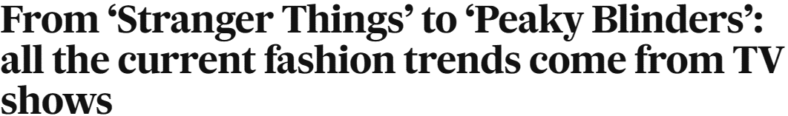




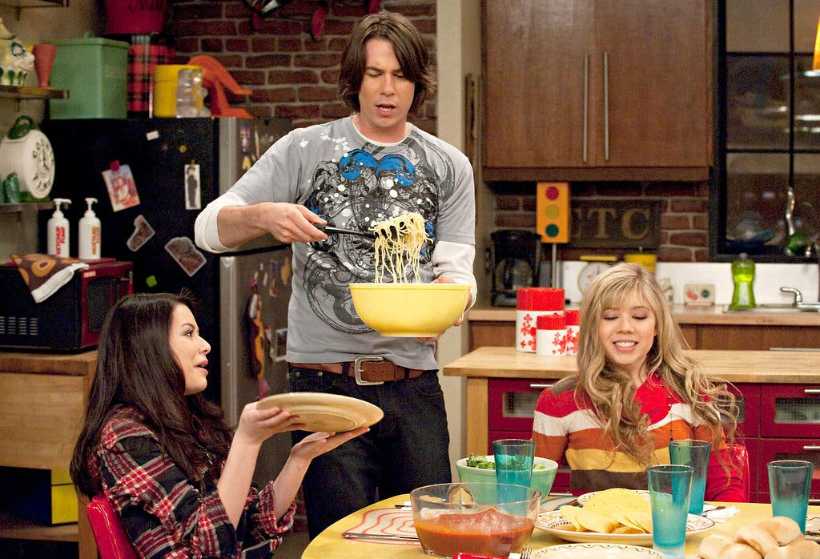
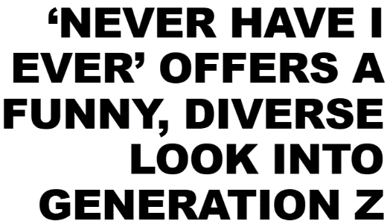

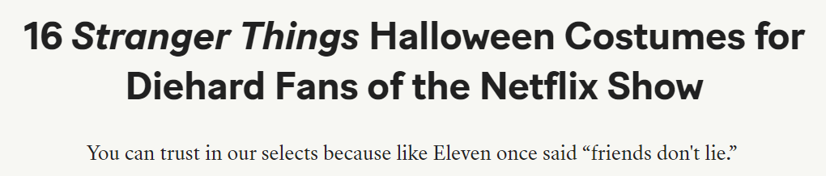




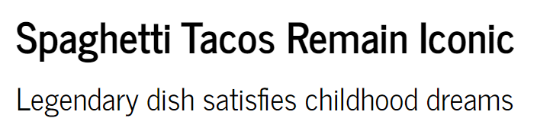
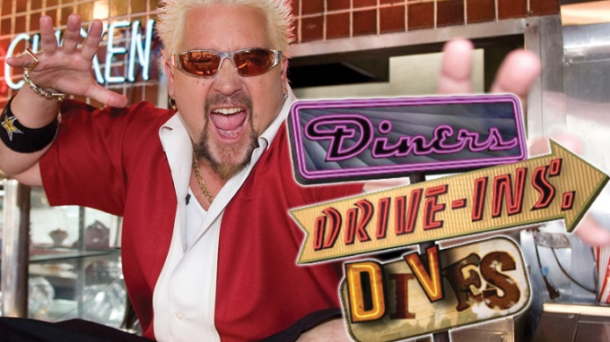


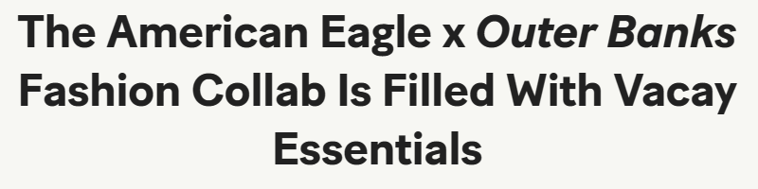
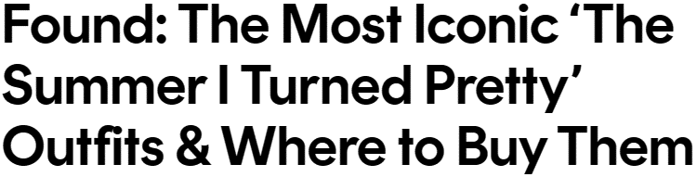
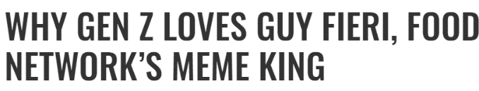
No Cap: Gen Z eagerly draws inspiration from TV & streaming content and applies this across key aspects of their lives
Sampling of TV & Streaming Shows Gen Z Pulls Inspiration From
9/7/2022
10/15/2022
2/20/2024
2/25/2021
5/7/2020
5/24/2023
2/22/2023
4/8/2021
7/24/2023
This information is exclusively provided to VAB members and qualified marketers.
PAGE 28

Slide 29
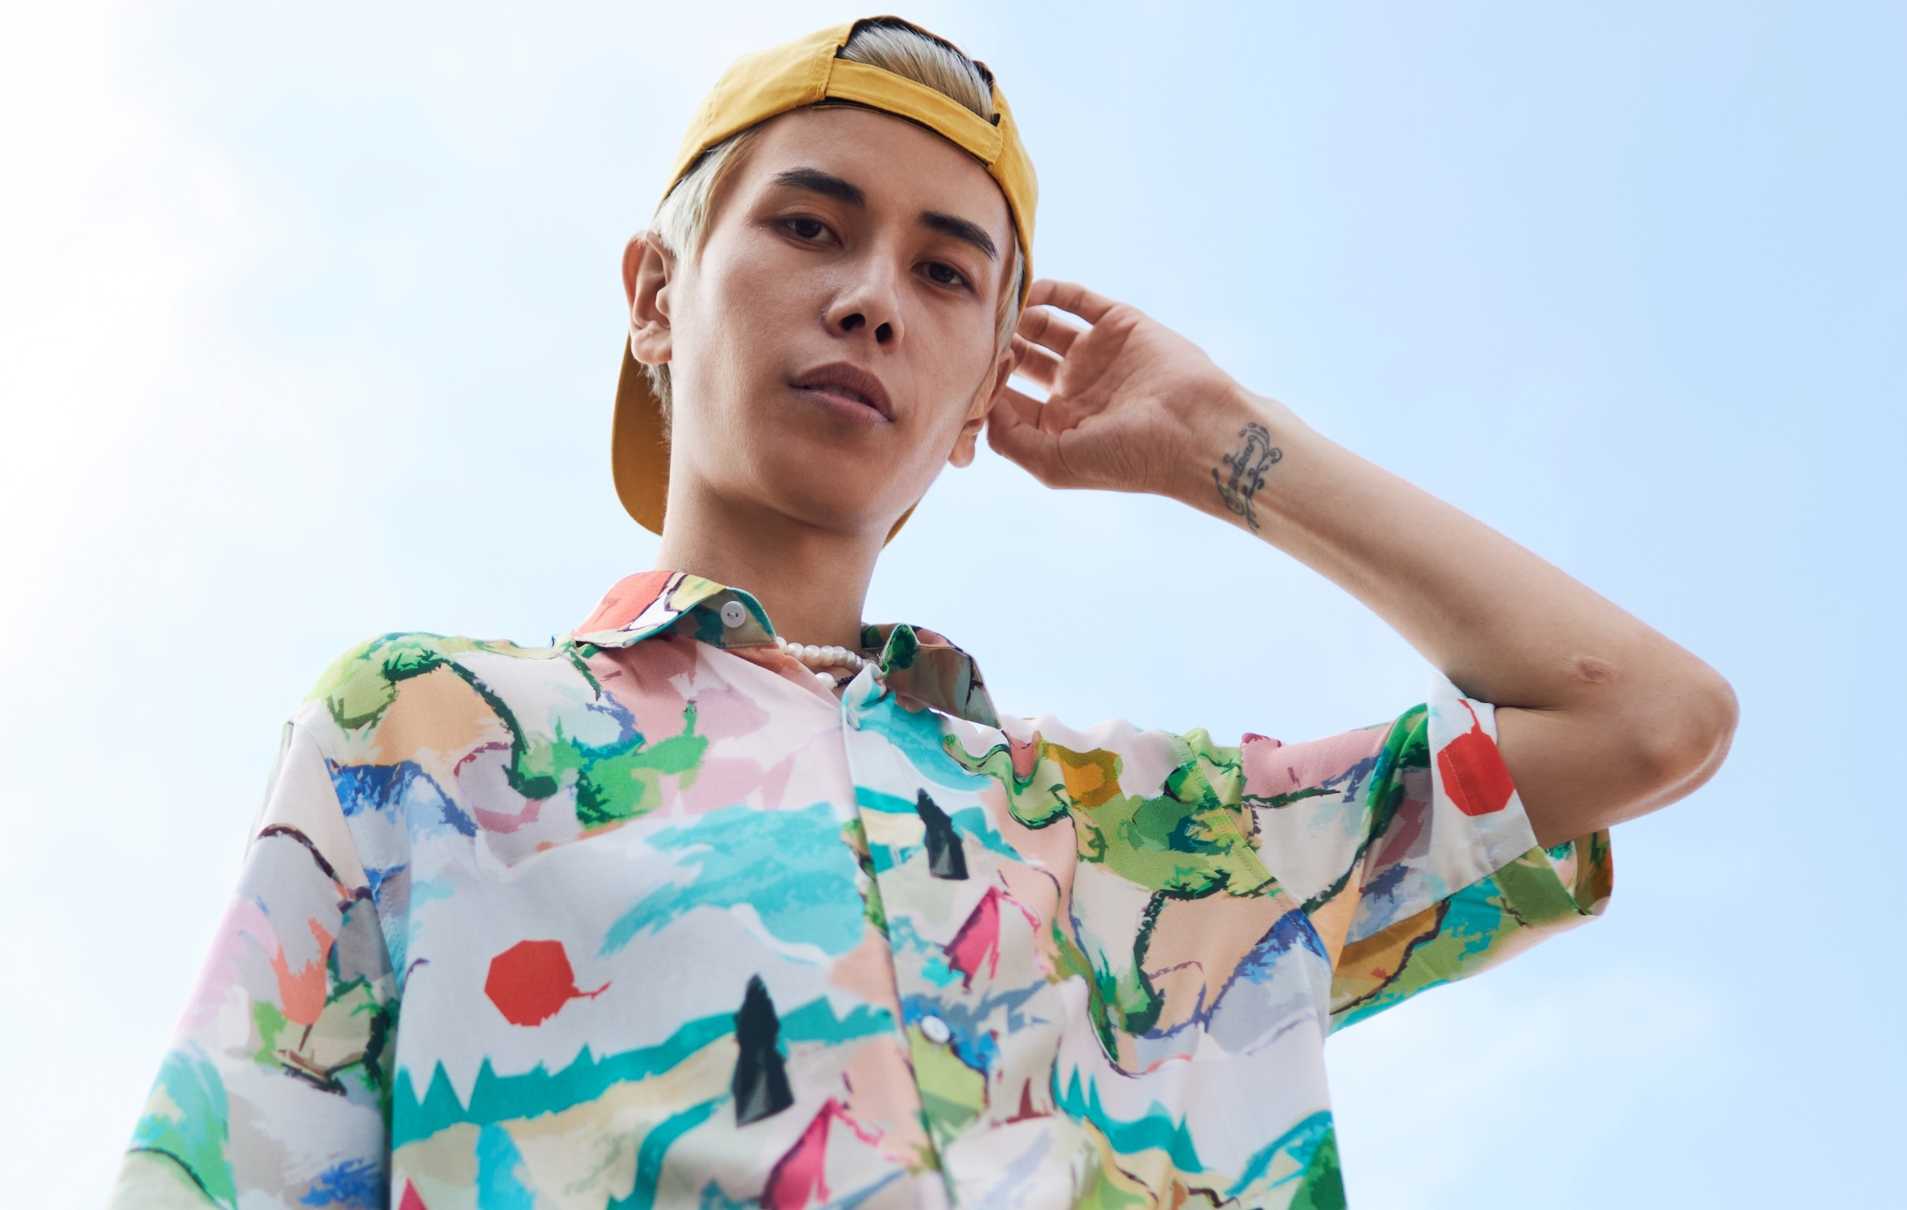
Influences Personal Style
Retail: Shows like The Summer I Turned Pretty inspire Gen Z’s style, making TV and streaming key for retailers targeting this audience
% of P13-24 who have modeled their personal style after an actor / character / personality from the following platforms
TV / Streaming vs. Social Media*
% more likely
20%
16%
+24%
18%
+10%
VS.
of Gen Z say they have
‘modeled my personal style after an actor / character / personality’
from TV or streaming content
19%
+9%
13%
+53%
16%
+29%
*How to read: P13-24 viewers are 24% more likely to model their personal style after a character / actor / personality from premium video content vs. TikTok content
Source: VAB custom research fielded by Hub Entertainment Research as part of the 2023 Video Redefined report. Data sourced from Hub’s survey of 1,900 consumers, ages 13-74. P13-24 respondents = 620 (unweighted). Data collected December 2023. Q3: Which of the following actions have you taken as a result of watching something on the following platforms?
This information is exclusively provided to VAB members and qualified marketers.
PAGE 29

Slide 30

Influences Personal Style
Apparel: Gen Z shoppers are more influenced to buy clothing from TV and streaming shows like Outer Banks than by social media influencers
% of P13-24 who have purchased clothing similar to what an actor / character / personality wore
from the following platforms
TV / Streaming vs. Social Media*
% more likely
24%
18%
+33%
14%
+76%
of Gen Z say they have
‘purchased clothing similar to what an actor / character / personality wore’
in TV or streaming content
VS.
21%
+15%
13%
+83%
16%
+51%
*How to read: P13-24 viewers are 33% more likely to purchase clothing similar to what a character / actor / personality from premium video content wore vs. TikTok content
Source: VAB custom research fielded by Hub Entertainment Research as part of the 2023 Video Redefined report. Data sourced from Hub’s survey of 1,900 consumers, ages 13-74. P13-24 respondents = 620 (unweighted). Data collected December 2023. Q3: Which of the following actions have you taken as a result of watching something on the following platforms?
This information is exclusively provided to VAB members and qualified marketers.
PAGE 30

Slide 31

Stimulates Consumers’ Appetite
Restaurants: TV and streaming content featuring culinary spots are more likely to inspire Gen Z to try out new experiences and visit ‘Flavor town’
% of P13-24 who have eaten at a restaurant because a chef / owner / author was featured in content
from the following platforms
TV / Streaming vs. Social Media*
% more likely
21%
16%
+27%
15%
+35%
VS.
of Gen Z say they have
‘eaten at a restaurant because a
chef / owner / author was featured’
in TV or streaming content
17%
+20%
17%
+22%
17%
+20%
*How to read: P13-24 viewers are 20% more likely to have eaten in a restaurant featured in premium video content vs. Instagram content
Source: VAB custom research fielded by Hub Entertainment Research as part of the 2023 Video Redefined report. Data sourced from Hub’s survey of 1,900 consumers, ages 13-74. P13-24 respondents = 620 (unweighted). Data collected December 2023. Q3: Which of the following actions have you taken as a result of watching something on the following platforms?
This information is exclusively provided to VAB members and qualified marketers.
PAGE 31

Slide 32
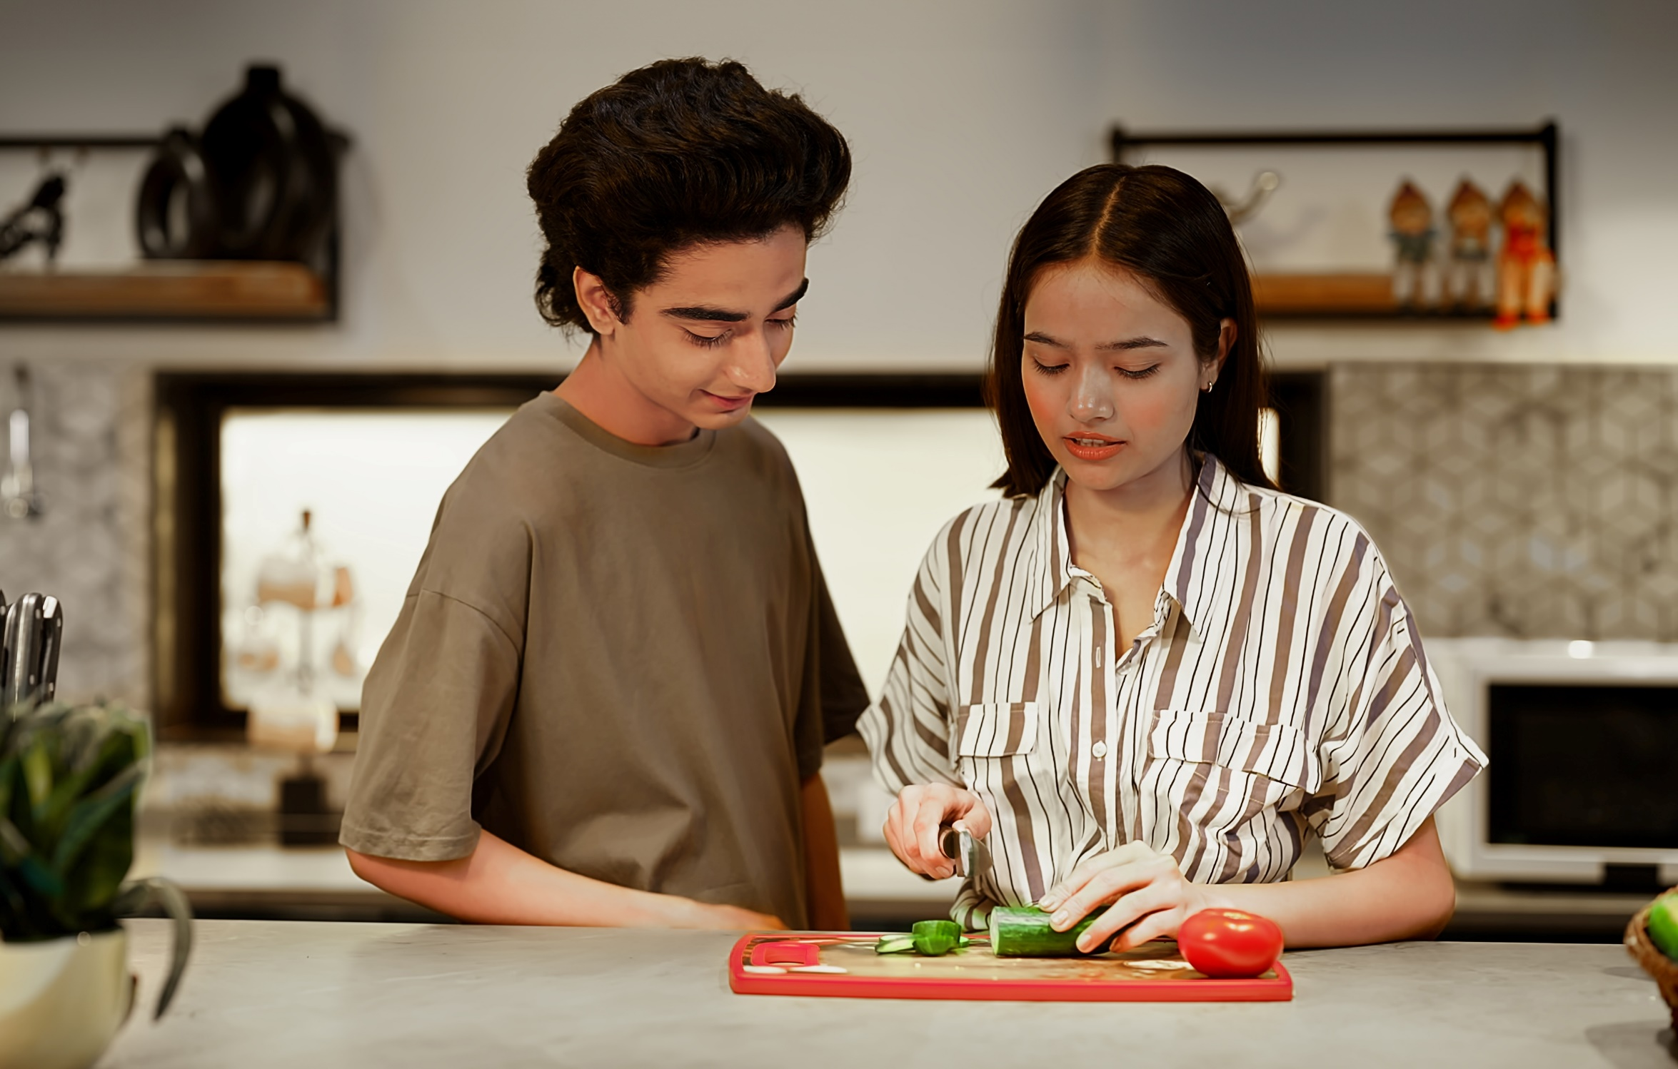
Inspires Culinary Delights
Food & CPG: TV and streaming has sparked culinary curiosity among
Gen Z viewers, leading them to experiment with ‘fun and fresh’ new recipes
% of P13-24 who have been inspired to make a food recipe from content
on the following platforms
TV / Streaming vs. Social Media*
% more likely
29%
29%
-1%
21%
+38%
of Gen Z say they have been
‘inspired to make a food recipe’
because of TV or streaming content
VS.
25%
+15%
25%
+15%
26%
+11%
*How to read: P13-24 viewers are 38% more likely to make a food recipe they saw featured in premium video content vs. TikTok content
Source: VAB custom research fielded by Hub Entertainment Research as part of the 2023 Video Redefined report. Data sourced from Hub’s survey of 1,900 consumers, ages 13-74. P13-24 respondents = 620 (unweighted). Data collected December 2023. Q3: Which of the following actions have you taken as a result of watching something on the following platforms?
This information is exclusively provided to VAB members and qualified marketers.
PAGE 32

Slide 33

Determines Travel Destinations
Travel: TV and streaming inspires Gen Z to explore like Mr. Worldwide, making them effective platforms for ‘experience’ brands to connect
% of P13-24 who have visited a location / vacationed at a place that was featured in content on the following platforms
TV / Streaming vs. Social Media*
% more likely
17%
14%
+21%
18%
-5%
VS.
of Gen Z have
‘visited a location / vacationed at a place because it was featured’
in TV or streaming content
17%
+1%
17%
-3%
14%
+23%
*How to read: P13-24 viewers are 21% more likely to visit a location featured in premium video content vs. TikTok content
Source: VAB custom research fielded by Hub Entertainment Research as part of the 2023 Video Redefined report. Data sourced from Hub’s survey of 1,900 consumers, ages 13-74. P13-24 respondents = 620 (unweighted). Data collected December 2023. Q3: Which of the following actions have you taken as a result of watching something on the following platforms?
This information is exclusively provided to VAB members and qualified marketers.
PAGE 33

Slide 34

Popular Culture Connector
Brands Searching for Relevancy: Evident from their music interests, TV and streaming content slaps which strengthens cultural ties among Gen Z
% of P13-24 who have listened to or purchased songs created by an actor / character / personality from content on the following platforms
26%
TV / Streaming vs. Social Media*
% more likely
24%
+8%
of Gen Z say they have
‘listened to or purchased songs created by an actor / character / personality’
from TV or streaming
21%
+22%
VS.
21%
+20%
19%
+35%
30%
-14%
*How to read: P13-24 viewers are 22% more likely to listen to or purchase a song created by a character / actor / personality from premium video content vs. TikTok content
Source: VAB custom research fielded by Hub Entertainment Research as part of the 2023 Video Redefined report. Data sourced from Hub’s survey of 1,900 consumers, ages 13-74. P13-24 respondents = 620 (unweighted). Data collected December 2023. Q3: Which of the following actions have you taken as a result of watching something on the following platforms?
This information is exclusively provided to VAB members and qualified marketers.
PAGE 34

Slide 35

Popular Culture Connector
Brands Searching for Relevancy: TV and streaming content is the main character and more likely to inspire Gen Z to emulate pop culture icons
24%
% of P13-24 who have dressed up like an actor / character / personality from content on the following platforms
TV / Streaming vs. Social Media*
% more likely
15%
+60%
of Gen Z say they have
‘dressed up like an actor / character / personality from TV or streaming content for Halloween or a theme party’
12%
+98%
VS.
13%
+80%
12%
+108%
15%
+57%
*How to read: P13-24 viewers are 60% more likely to dress up like a character / actor / personality from premium video content for a theme party vs. TikTok content
Source: VAB custom research fielded by Hub Entertainment Research as part of the 2023 Video Redefined report. Data sourced from Hub’s survey of 1,900 consumers, ages 13-74. P13-24 respondents = 620 (unweighted). Data collected December 2023. Q3: Which of the following actions have you taken as a result of watching something on the following platforms?
This information is exclusively provided to VAB members and qualified marketers.
PAGE 35

Slide 36
Adults over 50 account for 36% of the total population and nearly half of all adults
Gen Z vibes more with TV & streaming content than with social media
Premium, brand-safe video platforms like TV and streaming excel in engaging Gen Z audiences with their high-quality environment and compelling storytelling, surpassing social channels in emotional impact
Gen Z often regards TV & streaming content as ‘appointment viewing’ that also enables shared quality experiences among friends and family
The strong bonds that Gen Z viewers develop with storylines, characters and personalities from TV and streaming shows often drive them to further engage across platforms which strengthens their connection to the content
The emotion and engagement of TV & streaming content inspires culture and personal emulation of societal trends
while influencing consumer behavior across relevant Gen Z categories like retail, apparel & fashion, restaurants, food / CPG, travel and more
Key Marketer Takeaways
This information is exclusively provided to VAB members and qualified marketers.
PAGE 36

Slide 37






Want More Data?
Through our custom research, we can cut statements on several demographics for VAB members, just ask!
VAB Member Exclusive
Additional Custom Study Segments Available
Demos
Gender
Kids in Household
P16-24 / P25-34 / P16-34 / P18-34 / P35-54 / P35-74 /
P55-74 / P55-64 / P65-74
Female 16-24 / 25-34 / 16-34 / 35-74
Male 16-24 / 25-34 /
16-34 / 35-74
Kids in HH / No Kids in HH
Kids 0-5 in HH / Kids 6-12 in HH / Kids 13-17 in HH
Ethnicity
Household Income
Non-Hispanic White
Non-Hispanic Black
Hispanic
<$75K+ / $75K+
<$50K / $50K-$74K / $75K - $99K / $100K+
And More Cuts Involving Viewing Behaviors
For additional demo data, please contact info@thevab.com with the desired segments & requested slides
This information is exclusively provided to VAB members and qualified marketers.
PAGE 37

Slide 38
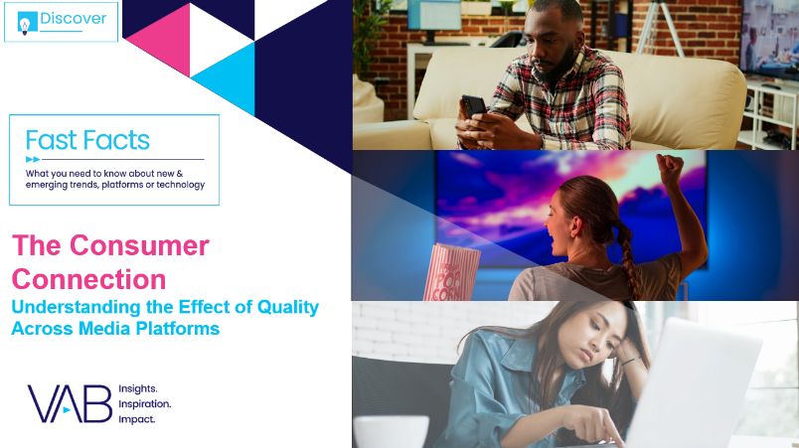
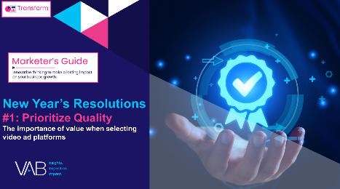

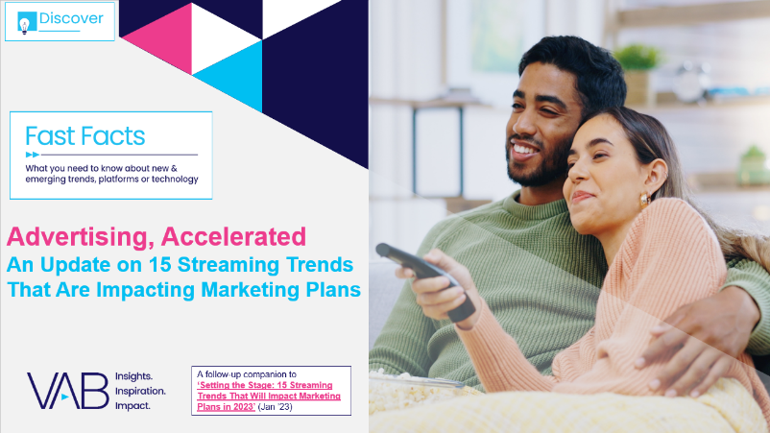
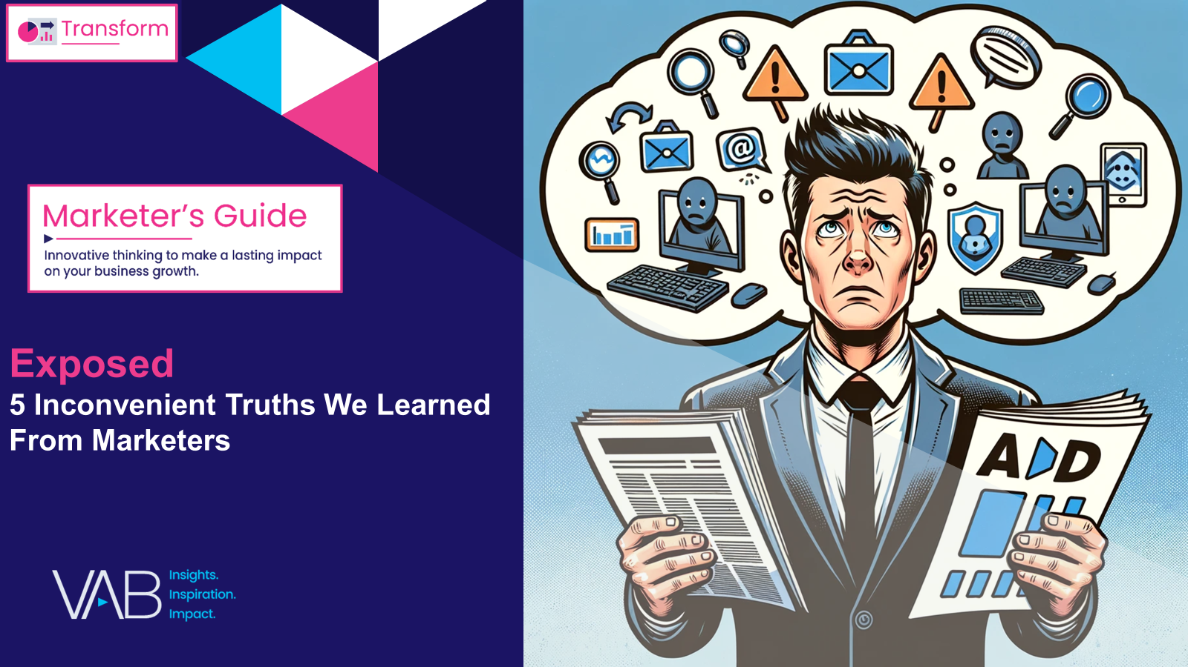


Creators
Jason Wiese
Leah Montner-Dixon
SVP, Director of Strategic Insights
jasonw@thevab.com
Director, Audience & Behavioral Insights
leahm@thevab.com
Kaileen Cain
Britney Caprio
The Consumer Connection
Understanding the Effect of Quality Across Media Platforms
VAB’s New Year’s Resolutions for Marketers – #1: Prioritize Quality
Senior Insights Analyst
kaileenc@thevab.com
Gen Z-in-Residence
Marketing Associate
britneyc@thevab.com
Gen Z-in-Residence
Discover more
Looking for more data, insights and takeaways? Check out this related VAB content
Recipe for Success
Six Key Ingredients for
Stirring Growth in Streaming
Advertising, Accelerated
An Update on 15 Streaming Trends That Are Impacting Marketing Plans
Through Upfront season, marketers are making important decisions about their video investment strategy.
We’re here to help.
Visit our Upfront Planning Resource Center
for a curated a list of resources filled with the data, analysis and insights needed to make informed investment decisions.
Exposed
5 Inconvenient Truths We Learned From Marketers
Hidden Costs
Three Critical Business Ramifications
of Digital Ad Fraud
This information is exclusively provided to VAB members and qualified marketers.
PAGE 38

Slide 39


About VAB
VAB plays a dual role in the video advertising industry. We are leading the change to bring about a more innovative and transparent marketplace. We also provide the insights and thought leadership that enables marketers to develop business-driving marketing strategies.
Drawing on our marketing expertise, we simplify the complexities in our industry and discover new insights that transform the way marketers look at their media strategy.
We are committed to your business growth and proud to offer VAB members, brand marketers and agencies complimentary access to our continuously-growing Insights library. Get immediate access at theVAB.com.
This information is exclusively provided to VAB members and qualified marketers.
PAGE 39

Slide 40









Our Glossary Guide to 25 Gen Z Terms
‘Memes and memz’ - memes and memories, doing something for a good joke or a fun memory
‘Mr. Worldwide’ – Gen Z icon, singer-songwriter Pitbull
‘No Cap’ – not a lie, the truth
(period) – said at the end of a statement to signify the end of the discussion, mic drop moment
‘Rent-Free’ – obsessively thinking about someone or something when its usually irrelevant or not important
‘Simp’ – someone who shows excessive sympathy or attention to a person where the feelings aren’t reciprocated
‘Shook’ – shocked / surprised
‘Slaps’ – excellent or amazing
‘Stan’ – fans who are highly engaged and supportive of someone
‘Tea’ – the hot gossip, someone that someone might not know
‘Vibe check’ – the general atmosphere of a group of people
or a room. Can be good or bad vibes
‘Vibing’ / ‘Vibes’ – to have positive feelings about something
‘BFFS’ – Best friends forever
‘Bed Rotting’ – a form of self care where one stays in bed for an extended period doing passive activities
‘Extra AF’ – something / someone that is over the top or is simply doing too much
‘Fav’ – favorite
‘FBI Search’ – taking the time to search up someone online, usually on social media
‘The Feels’ / ‘In my feelings’ – something that is emotionally moving
‘flavortown’ – Guy Fierri slang term, it is a state of mind where food and fun meet in harmony
‘High-Key’- used in replace of ‘very’ ‘really’ ‘a lot’ and ‘much’
‘Hits Different’- something that has a profound impact on you
‘Hit up’ – to ask for something
‘LOL’ – Laugh out Loud
‘Mad Hyped’ – really excited / pumped about something
‘Main character’ – a type of energy someone gives off, thinking they are the main character in their own story
This information is exclusively provided to VAB members and qualified marketers.
PAGE 40

Slide 41
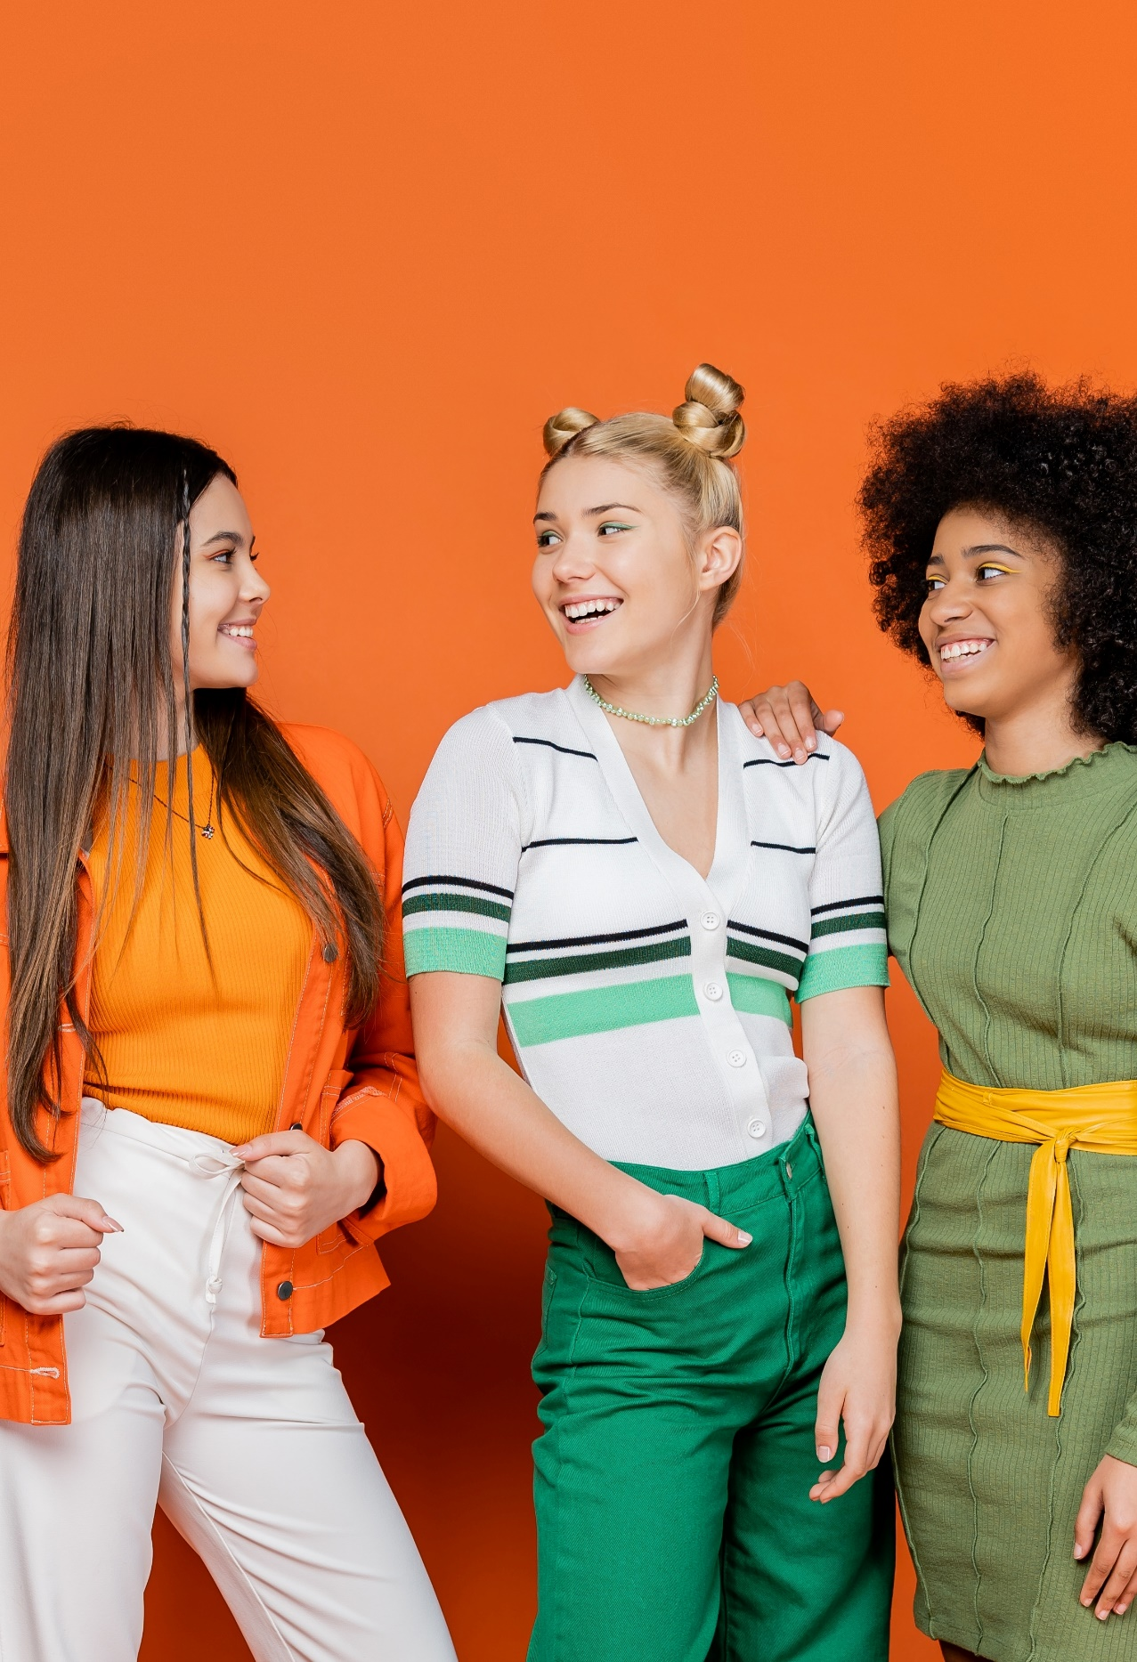
VAB conducted independent research to gauge how TV & streaming content resonates with Gen Z relative to leading social media platforms
VAB is often asked how engagement with TV & streaming compares to leading social platforms, especially among younger audiences.
Building upon our past ‘Committed’ report conducted in 2018, we leveraged our custom research partnership with Hub Entertainment Research to reassess and understand how Gen Z audiences are engaging with TV & streaming content compared to social media.
The custom study results are based on responses from online surveys
of 1,900 consumers, ages 13-74 in December 2023
This information is exclusively provided to VAB members and qualified marketers.
PAGE 41

