Slide 1

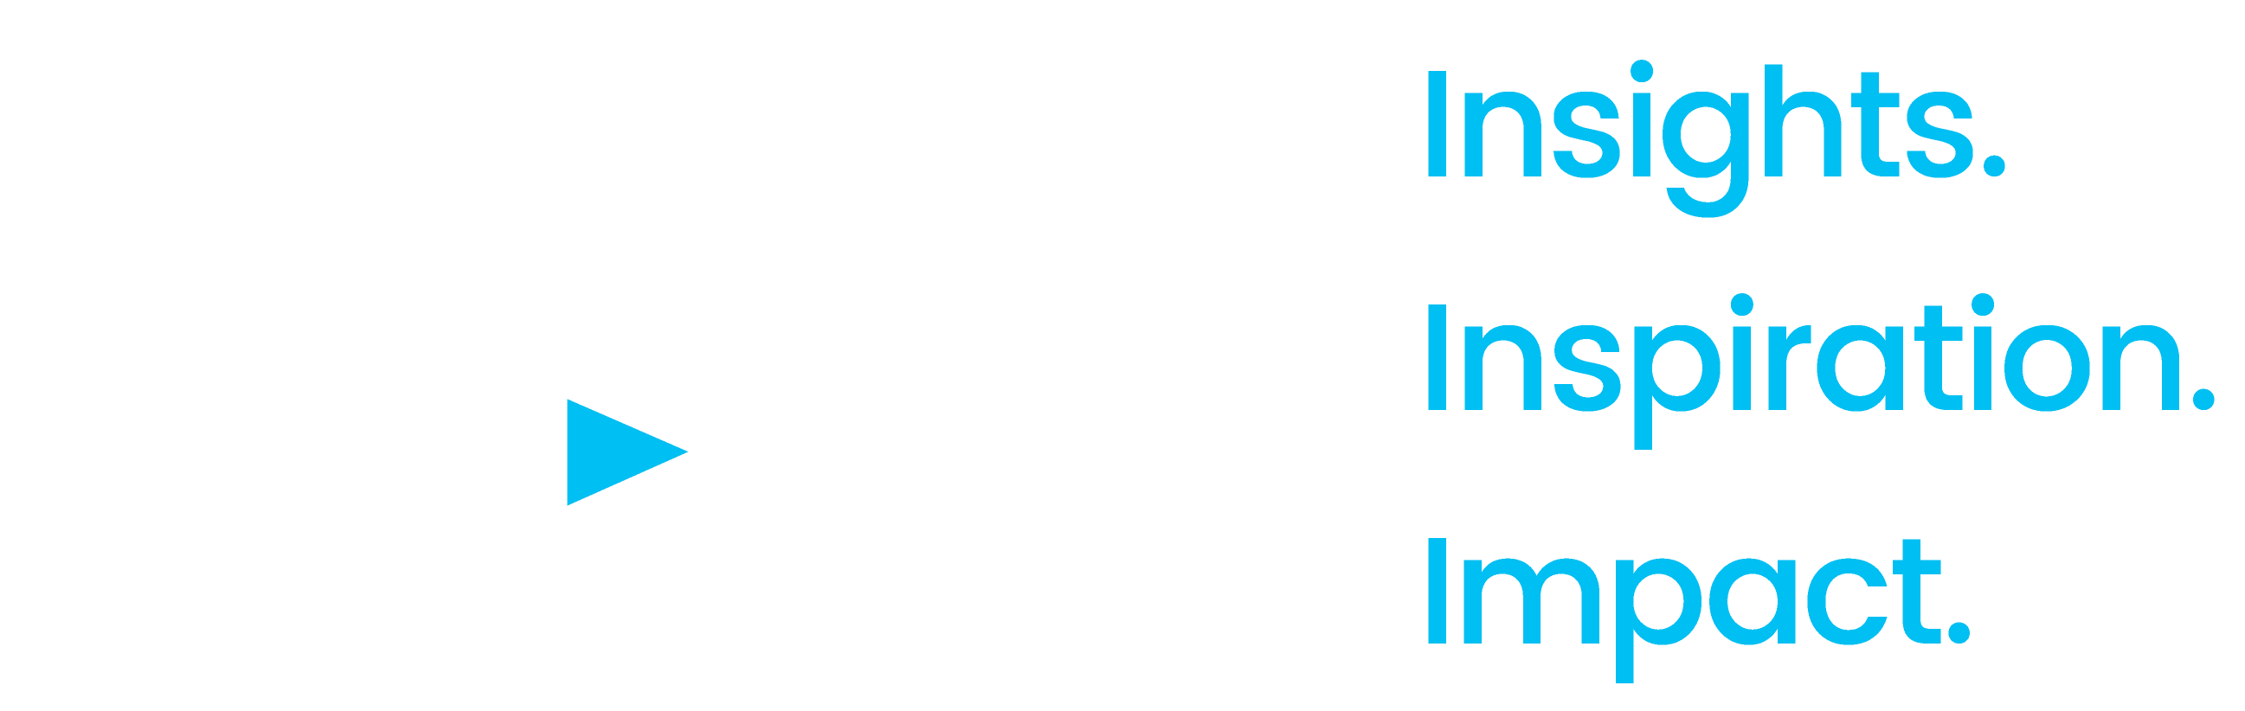
2020
Keep Calm and Advertise On
How to Successfully Navigate
Your Brand Through an
Economic Downturn

Slide 2

About VAB
VAB is an insights-driven organization that inspires marketers to reimagine their media strategies resulting in fully informed decisions.
Drawing on our marketing expertise, we simplify the complexities in our industry and discover new insights that transform the way marketers look at their media strategy.
Simplify
We save you time by bringing you the latest data & actionable takeaways you can use to inform your marketing plans.
Discover
We keep you one step ahead with the latest thinking so you can create innovative, forward-looking strategies.
Transform
We help you build your brand by focusing on core marketing principles that will help drive tangible business outcomes.
This information is exclusively provided to VAB members and qualified marketers. Further distribution is prohibited.
PAGE 2

Slide 3
Contents
1
5
Advertiser Reaction to COVID-19
Creative Messaging That Is Right for the Time
2
6
Advertising Through Crises
Five Key Reminders for Marketers
3
7
Economic Trends & Projections
Additional Resources
4
A One-Hundred Year Perspective
This information is exclusively provided to VAB members and qualified marketers. Further distribution is prohibited.
PAGE 3

Slide 4
What You’ll Learn…
Marketers reacted swiftly to the current crisis, resulting in paused campaigns for Q2, however many are undecided on the impact to 2H 2020 campaigns.
An economic downturn driven by a pandemic impacts society and our economy differently than a typical financial crisis, however, it does not effect the fundamental principles of marketing.
There is overwhelming evidence that advertising during a downturn has significant business benefits both in the short and long term. This is proven by historical data, marketing principles, marketer and agency case studies and financial analysis.
There is cause for optimism. Most experts agree this economic downturn will rebound quickly.
Many brands have leveraged recessionary periods to their advantage, spending to catapult themselves to rapid success in the recovery period after.
Messaging, as well as spending, should be thoughtfully considered.
This information is exclusively provided to VAB members and qualified marketers. Further distribution is prohibited.
PAGE 4

Slide 5
‘Should I or should I not spend?’ is a major question marketers ask themselves in an economic downturn
“…most firms tend to cut back on advertising during a recession. This behavior reduces noise and increases the effectiveness of advertising of any single firm that advertises. Thus, the firm that increases advertising in this environment can enjoy higher sales and market share. When the economy expands, all firms tend to increase advertising. At that point, no single firm gains much by that increase. The gains of the firms that maintained or increased advertising during a recession, however, persist”
Gerard & Kethan Tellis
Journal of Advertising Research
Research on Advertising in a Recession: A Critical Review and Synthesis (September 2009)
This information is exclusively provided to VAB members and qualified marketers. Further distribution is prohibited.
PAGE 5

Slide 6

Advertiser Reaction to COVID-19

Slide 7
Nearly nine out of 10 advertisers (89%) took action with their ad budgets because of COVID-19, with more brands recently canceling their campaigns completely
How has Coronavirus impacted your advertising efforts?
Source: Advertiser Perceptions, “Coronavirus Effect on Advertising’ Report. Q12: In which of the following ways has the Coronavirus (COVID-19) outbreak impact your recent or ongoing advertising efforts? Base: Total Respondents. Wave 1 = survey fielded March 17-20, 2020, 203 interviews conducted. Wave 2 = survey fielded April 1-4, 2020, 152 interviews conducted.
This information is exclusively provided to VAB members and qualified marketers. Further distribution is prohibited.
PAGE 7

Slide 8
While advertisers expect the largest impact to be concentrated in 2Q, over half are anticipating further budget disruptions through at least the end of the year
Impact of Decreased Ad Spend Over The Next Four Quarters
Source: ‘Advertiser Perceptions, Coronavirus Effect on Advertising’ Report. Q19: Thinking about your 2020 decrease in ad spending as a result of the Coronavirus (COVID-19) outbreak, which quarters do you anticipate will be impacted most? Base: decreasing ad spending in light of Coronavirus. Survey fielded April 1-4, 2020, 152 interviews conducted.
This information is exclusively provided to VAB members and qualified marketers. Further distribution is prohibited.
PAGE 8

Slide 9
82% of buyers adjusted or paused their planned ad spend between
April - June…looking ahead into 2nd half 2020, two-thirds of buyers
are undecided about their ad budgets
April – June 2020
% Buyers Making Ad Spend Changes in 2Q
Second Half 2020
% Buyers Making Ad Spend Changes in 2nd Half
Still to be determined
No
Yes
Yes, we’ve adjusted advertising spend
No
Still to be determined
Yes, all advertising is/has been paused
Source: IAB. Left-hand chart – ‘Coronavirus Ad Spend Impact: Brands, Agencies, Other Buyers – April 2020,’ 4/29/20. Survey fielded April 15-21, 2020. N = 294 completes from those responsible for US advertising spend in 2020 (media planners, media buyers, brands).
Q: Are you making any Q2 (April-June) changes to advertising spend as a result of Coronavirus vs. planned investment you had originally planned? Right-hand chart - ‘Coronavirus Ad Spend Impact: Buy-Side,’ 3/27/20. Survey fielded March 18-24, 2020. N = 390 completes
from those responsible for US advertising spend in 2020 (media planners, media buyers, brands). Q: Are you making any advertising spend changes in the second half of 2020 as a result of Coronavirus?
This information is exclusively provided to VAB members and qualified marketers. Further distribution is prohibited.
PAGE 9

Slide 10
Approximately 80% of brands are planning to reduce their media budget for the rest of the year; more than half expect to cut spend by > 20%
How do you expect your media budgets will change for the rest of the year?
Decrease
Increase
<10%
10-20%
30-40%
No Change
>50%
40-50%
30-40%
20-30%
10-20%
<10%
85%
75%
65%
55%
45%
35%
25%
15%
5%
5%
15%
Source: Ebiquity, ‘COVID-19 & Media: Ebiquity Client Survey Results.’ Survey conducted between March 19-31, 2020. n=43.
This information is exclusively provided to VAB members and qualified marketers. Further distribution is prohibited.
PAGE 10

Slide 11

Summary: Advertiser Reaction to COVID-19
Most advertisers have reacted strongly to the current climate, with the common response being to pause or halt their campaign and spending
While many advertisers have already changed plans for Q2, most are taking a “wait and see” approach to plans and budgets for the 2nd half 2020
This information is exclusively provided to VAB members and qualified marketers. Further distribution is prohibited.
PAGE 11

Slide 12
Advertising Through Crises

Slide 13
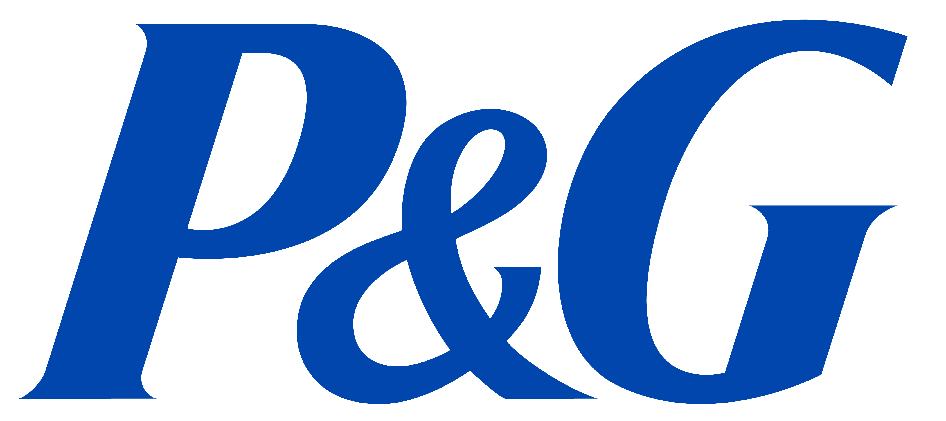

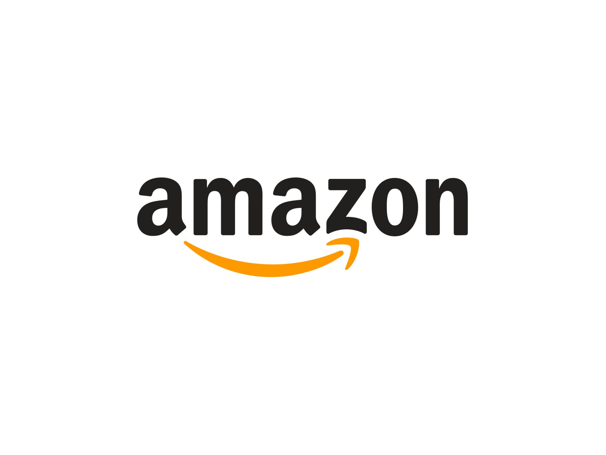



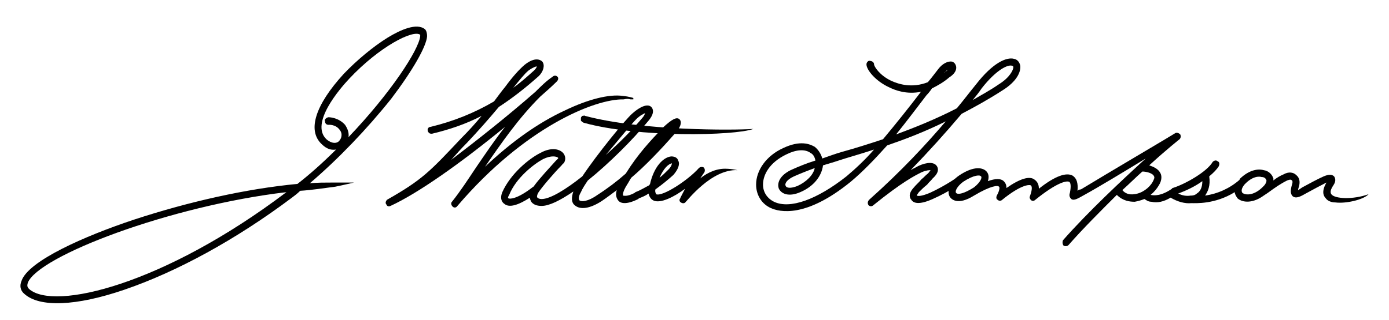

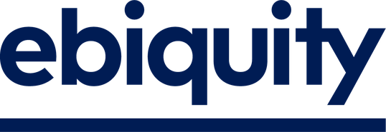
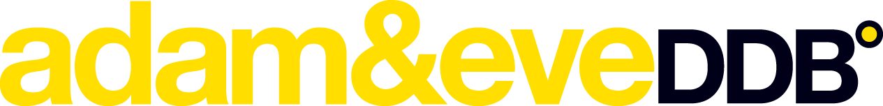

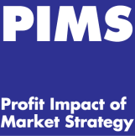
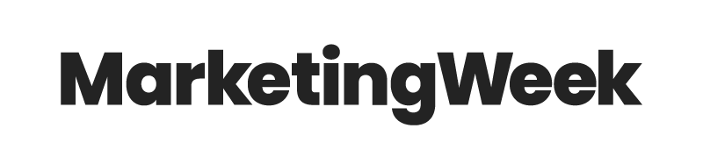
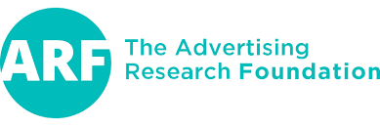

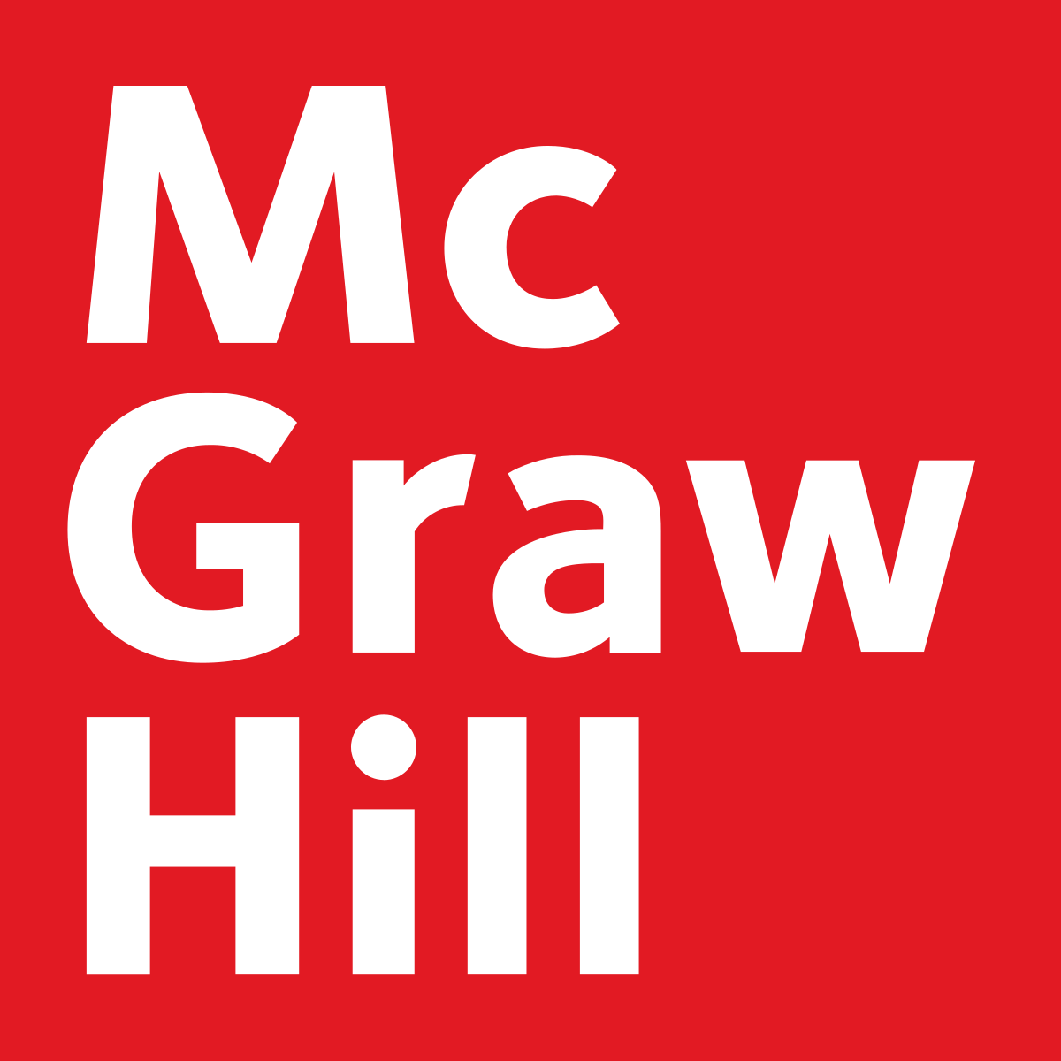








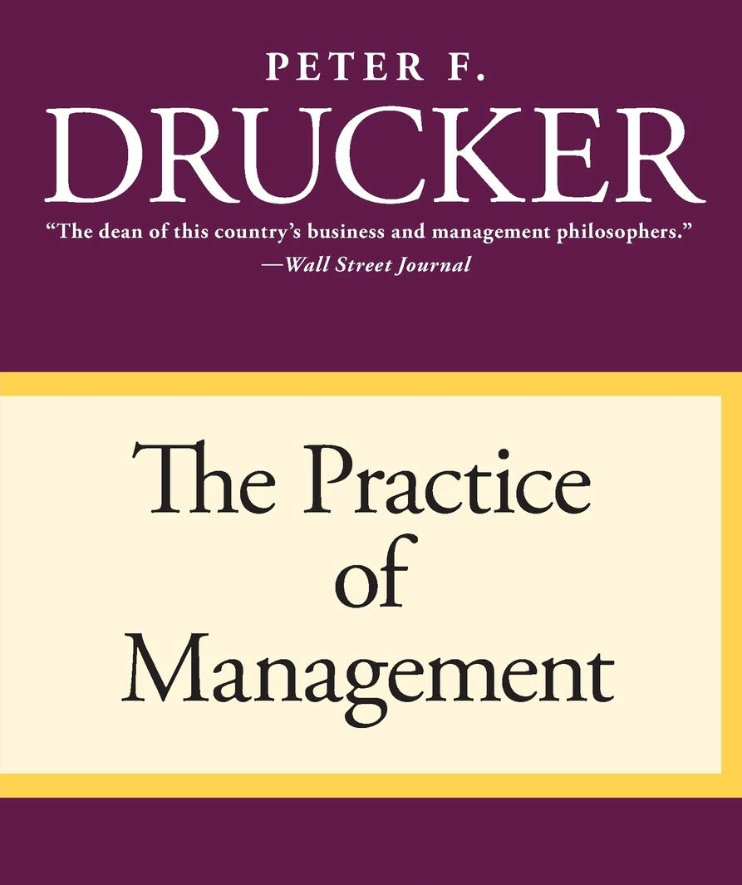
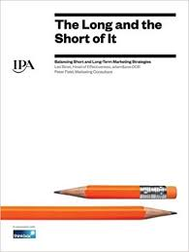
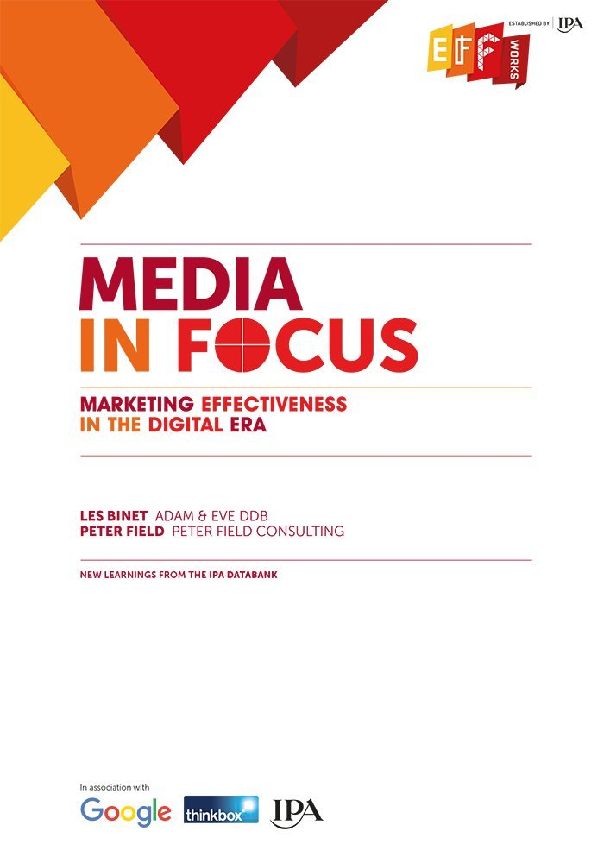
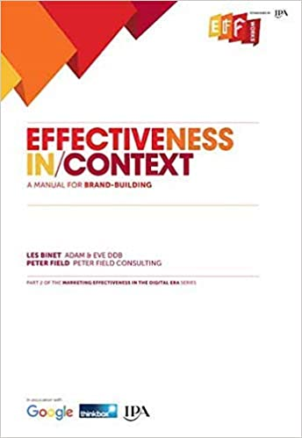
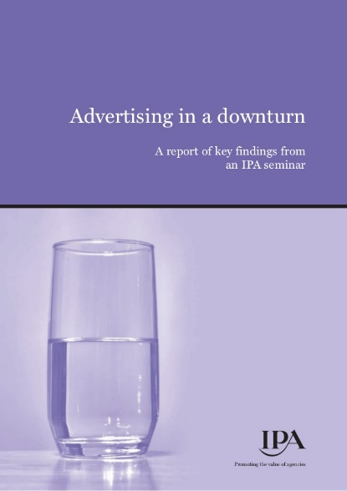


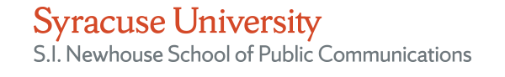
Academic scholars, Fortune 100 companies, financial analysts, research firms and ad agencies all conducted independent analyses and agree advertising through a downturn is better for your long-term brand health
This information is exclusively provided to VAB members and qualified marketers. Further distribution is prohibited.
PAGE 13

Slide 14
“Maintain marketing spending. This is not the time to cut advertising. It is well documented that brands that increase advertising during a recession, when competitors are cutting back, can improve market share and return on investment at lower cost than during good economic times.”
John Quelch
Harvard Business School
Marketing Your Way Through A Recession
This information is exclusively provided to VAB members and qualified marketers. Further distribution is prohibited.
PAGE 14

Slide 15
The ability of advertising to drive business outcomes for brands during and after an economic downturn is not merely an opinion, it is a fact
Advertising has evolved into a data-driven, in fact data-obsessed, industry and we have data covering the last one-hundred years of economic downturns that empirically prove advertising’s ability to drive sales and increase share of market during the time of recessions and beyond.
In this guide we feature a compilation of eight case studies throughout the years that include
over 2,000 brands within the totality of the analyses. These studies were conducted by highly-esteemed academic and marketing scholars applying rigorous standards and methodologies
to all their work and findings.
Taken together, the link between well-researched, well-tested marketing principles, such as
share of voice driving share of market, and business outcomes is undeniable. These principles
have stood the test of time and are just as applicable today as they were in past recessions.
This information is exclusively provided to VAB members and qualified marketers. Further distribution is prohibited.
PAGE 15

Slide 16
But isn’t what we are experiencing now different than past financial crises? Yes, a pandemic has unique factors
COVID-19 has rapidly upended all parts of society across the world and particularly in the United States. This global crisis has led to skyrocketed unemployment rates, massive lockdowns and closures affecting all sectors and levels of commerce.
An economic downturn brought on by a pandemic or natural disaster is different than a typical financial crisis for two main reasons:
1. Varied Effects on Business Sectors
Rather than an overall decline across all economic sectors, during COVID-19, some categories have experienced rapid growth / ‘panic’ buying (virtual communications like Zoom, essential goods like toilet paper and other paper products) while others are closed completely or severely impacted (restaurants / bars, travel).
2. Recovery Rate
When the impetus for the economic downturn is based on external factors (a virus resulting in government restrictions) rather than
deep-rooted issues with the economy, the rebound is much quicker as the financial system is more equipped to deal with the set back.
This information is exclusively provided to VAB members and qualified marketers. Further distribution is prohibited.
PAGE 16

Slide 17
Can we still look to the past to guide us during COVID-19?
Yes, these economic factors do not change basic marketing principles
Although a pandemic affects businesses and the economy in different ways than a traditional financial crisis, it does not change the fundamental principles of marketing and consumer behavior.
Regardless of the economic conditions, sales, revenue and profitability are directly correlated to the relationship between share of voice and share of market.
Share of Voice (SOV): a company / brand’s share of the total advertising dollars spent,
or impressions delivered, within an industry / category.
Share of Market (SOM): the percentage of the total sales or revenues within an industry / category generated by a particular company / brand at a given time.
This information is exclusively provided to VAB members and qualified marketers. Further distribution is prohibited.
PAGE 17

Slide 18
During an economic downturn, marketers need to maintain
their share of voice to avoid a prolonged and expensive recovery
During this time, some sectors will have no choice but to cut back or go dark, with closures or supply chain issues making doing business impossible. However, for the other categories whose sales are impacted but can function, this is a crucial time.
In both an uncertain or strong economy, advertisers who decrease their share of voice will experience lower profits and will be forced to spend more money to regain their position. Although this principle always holds true, we will illustrate how this correlation is amplified during an economic downturn, meaning it will take advertisers who cut back or go dark longer to recover when the economy rebounds.
Keep in mind, maintaining share of voice does not necessarily mean maintaining your current budget.
As we previously illustrated, many advertisers cut their budgets during a recession, therefore there is the opportunity to preserve your position for a lower overall investment. The key is to actively monitor your competitors' expenditures.
This guide will demonstrate through 100 years of advertising data how cutting back spend or going dark may provide short-term relief, but will cause long-term harm to your brand.
This information is exclusively provided to VAB members and qualified marketers. Further distribution is prohibited.
PAGE 18

Slide 19
Summary: Advertising Through Crises
Experts all agree that advertising during a recession results in higher sales and increased market share
While a pandemic is different than a typical financial crisis, experts also agree the fundamental correlation between share of voice and share of market still apply
Advertisers who reduce their share of voice during an economic downturn suffer greater consequences; they experience lower profits and are forced to regain share later at a higher price in a more competitive marketplace
However, in today’s market environment there are certainly exceptions for advertising in some sectors and businesses that are currently unable to service their customers or have on-going supply chain issues
This information is exclusively provided to VAB members and qualified marketers. Further distribution is prohibited.
PAGE 19

Slide 20
Economic Trends & Projections

Slide 21
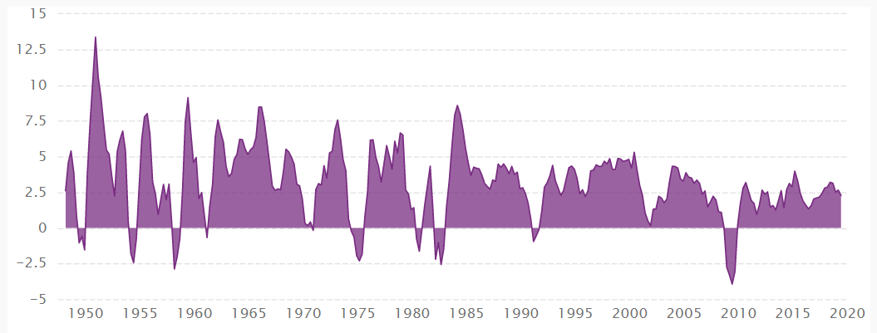
Since the end of World War II, there have been 11 recessions in the U.S. and these recessions have had an average duration of 11 months with
long periods of prosperity typically in-between
The shortest recession was in 1980 due to the increased interest rates by the Federal Reserve, the longest was 18 months in Dec ‘07- Jun ‘09 due to the subprime mortgage crisis. The 2001 recession was eight months with the economy rebounding rather quickly after September 11th.
United States Real Gross Domestic Product (GDP): 1948 – 2019 (YoY)
Source: Census and Economic Information Center, CEICdata.com, March 1948 – December 2019.; Wikipedia.com
This information is exclusively provided to VAB members and qualified marketers. Further distribution is prohibited.
PAGE 21

Slide 22
According to a recent report from Goldman Sachs, bear markets recover quicker after an adverse event than cyclical ones or those caused by underlying structural issues in the economy
Average length and recovery time of U.S. bear markets since 1800, by type of trigger
(in months)
*Average recovery time = time it takes to get back to previous level
Source: Goldman Sachs, Bear Essentials: A Guide to Navigating a Bear Market, 3/9/20. Bear markets include seven structural, 14 cyclical and 5 event-driven ones. Structural bear market = trigger by structural imbalances and financial bubbles. Very often there is a ‘price’ shock such as deflation that follows. Cyclical bear market = typically a function of rising interest rates, impending recessions and falls in profit. They are a function of the economic cycle. Event-driven bear market = triggered by a one-off ‘shock’ that does not lead to a domestic recession (such as a war, oil price shock, EM crisis or technical market dislocation)
This information is exclusively provided to VAB members and qualified marketers. Further distribution is prohibited.
PAGE 22

Slide 23
Globally, the International Monetary Fund (IMF) currently expects
a rather swift recovery after COVID-19 contraction
Global GDP growth forecasts before and during the COVID-19 pandemic
Source: International Monetary Fund, World Economic Outlook, January 2020 & April 2020.
This information is exclusively provided to VAB members and qualified marketers. Further distribution is prohibited.
PAGE 23

Slide 24
In the United States, most economists are projecting a ‘V’-shaped recovery in 2021 after a sharp economic decline in 2020
GDP growth forecast for the United States
as of April 2020
*IMF projections based on the assumption that the pandemic fades in the second half of 2020 and containment efforts can be gradually unwound and that effective policy measures are taken to limit the economic harm done by lockdown measures.
Source: International Monetary Fund, World Economic Outlook, January 2020 & April 2020.
This information is exclusively provided to VAB members and qualified marketers. Further distribution is prohibited.
PAGE 24

Slide 25
Depending on the economic outlook once the public health crisis is under control though, recovery could morph more into the shape of
a reverse ‘square root’ from a classic ‘V’-shape
COVID-19: What A ‘Square Root’ Recovery Could Look Like
0%
Growth path depends on pent-up demand, amount of permanent damage and policy
Slow growth until health under control
Percent Change from Peak
Initial bounce back after restrictions lifted
Severe recession drop
Time to Recovery
Source: Oregon Office of Economic Analysis, ‘'COVID-19: The Square Root Recovery?’, April 7th, 2020.
This information is exclusively provided to VAB members and qualified marketers. Further distribution is prohibited.
PAGE 25

Slide 26
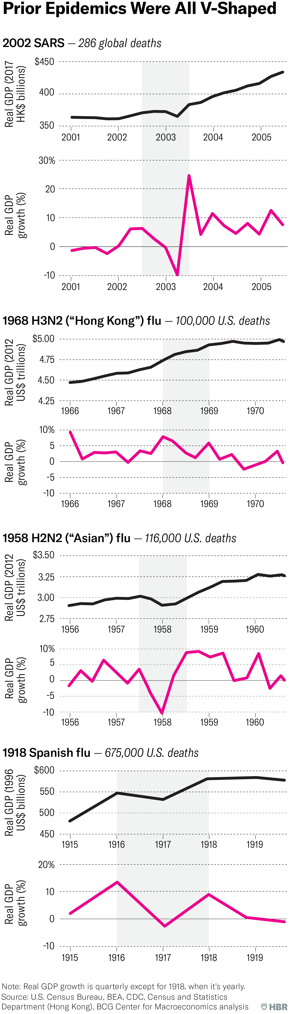
COVID-19 recovery projections are in line with historical trends as economies in prior pandemics all experienced variations of a ‘V’-shaped recovery
1918 Spanish Flu
675,000 U.S. deaths
1958 H2N2 (‘Asian’) Flu
116,000 U.S. deaths
1968 H3N2 (‘Hong Kong’) Flu
100,000 U.S. deaths
2002 SARS
286 global deaths
Source: Harvard Business Review, ‘What Coronavirus Could Mean For The Global Economy,’ 3/2/20. Note: Real GDP growth is quarterly except for 1918, when it’s yearly. Sources are based on U.S. Census Bureau, Bureau of Economic Analysis (BEA), CDC, Census and Statistics Department (Hong Kong), BCG Center for Macroeconomics analysis.
This information is exclusively provided to VAB members and qualified marketers. Further distribution is prohibited.
PAGE 26

Slide 27
Summary: Economic Trends & Projections
Many predict a quick recovery into 2021, however forecasts vary on the rate of full recovery vs. a plateauing based on the state of economic factors once the public health crisis is under control
There are typically long periods of prosperity in between recessions
Historically, the economy has rebounded quickly after pandemics
This information is exclusively provided to VAB members and qualified marketers. Further distribution is prohibited.
PAGE 27

Slide 28
A One-Hundred Year Perspective

Slide 29
“Because the purpose of business is to create a customer, the business enterprise has two — and only two — basic functions: marketing and innovation. Marketing and innovation produce results; all the rest are costs. Marketing is the distinguishing, unique function of the business.”
Peter Drucker
Management Consultant, Educator, Author
The Practice of Management (1954)
This information is exclusively provided to VAB members and qualified marketers. Further distribution is prohibited.
PAGE 29

Slide 30
First, it’s important to understand that the full impact of advertising’s effect is not seen immediately which helps explain how brands that spend during a recession continue to see significant share gains in the years after it
Share of Sales Impact by Timeframe
Hours / Days
Weeks / Months
Months / Years
100%
42%
18%
(via digital attribution)
(via marketing mix modeling)
(via brand equity modeling)
How to read: 18% of sales derived from advertising occurs within hours/days of exposure
Source: Ebiquity, ‘Advertising Through a Recession,’ April 2020.
This information is exclusively provided to VAB members and qualified marketers. Further distribution is prohibited.
PAGE 30

Slide 31
For 100 years, scholars have been demonstrating how brands that increase their ad budgets during an economic downturn grow sales much faster than their competitors – both during the time period and beyond it
In the 1920’s, companies that decreased their advertising spend saw sales decline both during the recession and then for the following three years.
In relative terms, these companies actually underperformed even those that elected to do no advertising at all.
This was the first in a series of proof points over the last century to prove the ability of increased advertising during a recession to drive outcomes.
Sales Index Trends by Advertising Segment
Sales Index
(1920 = 100)
1920-1921 Depression
Source: Roland S. Vaile, ‘The Use of Advertising During Depression,’ Harvard Business Review 5, April 1927. Analysis includes 250 companies. Specific sales index data points based on Mark Ritson’s, ‘Marketing in the Time of Coronavirus’ webinar, April 2020 (Marketing Week, Mini MBA in Marketing program).
This information is exclusively provided to VAB members and qualified marketers. Further distribution is prohibited.
PAGE 31
PAGE 1

Slide 32
1974-1975 Recession: Similar patterns were seen in the 1970’s as companies that did not cut their advertising budget not only remained strong during the recession but emerged even stronger after it
Sales Index Trends by Advertising Segment
Average Index within each grouping
50% higher sales index than advertisers who cut in both years of the recession
Sales Index
(1972 = 100)
1974-1975 Recession
Source: Meldrum and Fewsmith, Inc, Associated Business Publications, 1979, based on an analysis of 143 companies. Specific sales index data points based on Mark Ritson’s, ‘Marketing in the Time of Coronavirus’ webinar, April 2020 (Marketing Week, Mini MBA in Marketing program).
This information is exclusively provided to VAB members and qualified marketers. Further distribution is prohibited.
PAGE 32

Slide 33
“The gangster move in a recession is not just to maintain the budget but actually increase ad spend. That sounds like a lunatic move until you understand ESOV and the dynamics of long-term brand building.”
Mark Ritson
Marketing & Branding Consultant
Former Professor of Marketing at Melbourne Business School
Founder, Marketing Week Mini MBA
Marketing Week, 4/6/20
ESOV = Excess Share of Voice (see slide 42 for more detail on the concept of ESOV).
This information is exclusively provided to VAB members and qualified marketers. Further distribution is prohibited.
PAGE 33

Slide 34
1980 Recession: An analysis conducted by WPP across almost 400 companies proved that increasing advertising during a recession has
a positive impact on return on investment (ROI)
Changes in ROI related to changes in advertising spending during a recession
42% increase over the average
Change in ROI
1980 Recession
Source: Biel and Stephen King, 1990, WPP Center for Research and Development . Analysis includes 390 companies utilizing data from the Profit Impact of Market Strategy (PIMS) database.
This information is exclusively provided to VAB members and qualified marketers. Further distribution is prohibited.
PAGE 34

Slide 35
1980 Recession: This same WPP analysis also showed that brands who invested in advertising during the recession saw a considerable increase in market share over those that decreased their spend
The brands cutting ad spend didn’t lose market share during the recession due to the extinction of some competitors, however they didn’t see any increase in profitability.
Brands that increased their spend enjoyed
a significant increase in market share.
Most of their market share gains were achieved during the recessionary period and then maintained during the growth that followed.
Percentage Point Change in Market Share
4.5x more than advertisers who decreased spend
Percentage Point Change
in Share of Market (SOM)
1980 Recession
Source: Biel and Stephen King, 1990, WPP Center for Research and Development . Analysis includes 390 companies utilizing data from the Profit Impact of Market Strategy (PIMS) database.
This information is exclusively provided to VAB members and qualified marketers. Further distribution is prohibited.
PAGE 35
PAGE 1

Slide 36
1981-1982 Recession: A McGraw-Hill research analysis of 600 companies showed that those who maintained or increased their ad spend averaged significantly higher sales growth for three years after the recession
Sales Index Trends by Advertising Segment
Companies that maintained their advertising experienced significant sales growth throughout the four-year period
Recession Started Here
‘Cut in both 1982 & 1983’ benchmark
Sales were relatively even before the recession
1981-1982 Recession
Source: McGraw-Hill Research, analysis of 600 companies covering 16 different industries from 1980 – 1985. Forbes, ‘When A Recession Comes, Don’t Stop Advertising,’ Brad Adgate, 9/5/19.
This information is exclusively provided to VAB members and qualified marketers. Further distribution is prohibited.
PAGE 36

Slide 37
1990-1991 Recession: the same principles continued to hold true through another scholar-driven analysis that showed the negative effect of cutting ad spend resulted in significant share loss to competitors
Sales Index Trends for Brands Who Maintained / Increased Ad Spending vs. Cut Ad Spending
Sales Index
(1990 = 100)
1990-1991 Recession
Source: Thomas Kamber, Journal of Brand Management; 2002.
This information is exclusively provided to VAB members and qualified marketers. Further distribution is prohibited.
PAGE 37

Slide 38
“I thought about it and decided not to take part”
Sam Walton
Walmart Founder
quoted after being asked about the 1990 recession
This information is exclusively provided to VAB members and qualified marketers. Further distribution is prohibited.
PAGE 38

Slide 39
In the early 1990’s, professor John Philip Jones analyzed the relationship between Share of Voice (SOV) and Share of Market (SOM) and found there’s a rather clear equilibrium that exists between the two
SOV vs. SOM
This information is exclusively provided to VAB members and qualified marketers. Further distribution is prohibited.
PAGE 39

Slide 40
This is also substantiated by Millward Brown tracking data which finds
a brand is most likely to gain market share when it’s SOV increases
and when it is higher than it’s share of market
Probability of share growth
Share of communications awareness (SOV) greater than share of market?
No
No
Yes
Yes
Share of communications awareness (SOV) higher than previous year?
No
Yes
No
Yes
Chances of share increase?
Source: Kantar Millward Brown, ‘What happens when brands go dark?’ Millward Brown Knowledge Points, July 2018.
This information is exclusively provided to VAB members and qualified marketers. Further distribution is prohibited.
PAGE 40

Slide 41
1980s – early 2000s Recession Periods: According to a wide-ranging study by PIMS, companies that sustain investment during a recession do better relative to competitors during a recession and grow more quickly after it
Using brands that maintain their spend as a benchmark, brands that cut ad spend see their market share shrink after a recession by 0.7% on average, while those that increase spend realize
a market share increase of 1.6%.
Why?
Because their relative share of voice increases in comparison to their competitors who scale back investment, which in turn grows their share of market.
Changes in Market Share (percentage points) for Brands Cutting, Holding and Increasing Marketing Spend During Recessions
Market share gains in first two years of recovery (1980s – early 2000s)
benchmark
1980s – early 2000s Recession Periods
Source: Ebiquity, ‘Advertising Through a Recession,’ utilizing data analysis from PIMS – the Profit Impact Marketing Strategy database.
This information is exclusively provided to VAB members and qualified marketers. Further distribution is prohibited.
PAGE 41
PAGE 1

Slide 42
1980s – early 2000s Recession Periods: The same PIMS study demonstrated that companies increasing their advertising investment
also improved their ‘Return on Capital Employed (ROCE)’
Companies increasing their investment, improved their ‘Return on Capital Employed (ROCE)’
% point improvement
‘Return on Capital Employed’ = a financial ratio that measures a company’s profitability and the efficiency with which its capital is used (i.e., a measurement of how well a company is generating profits from its capital).
Source: Ebiquity, ‘Advertising Through a Recession,’ utilizing data from PIMS – the Profit Impact Marketing Strategy database. The PIMS database at that time of this analysis covered 749 consumer business containing both marketing data and financial information for those business.
This information is exclusively provided to VAB members and qualified marketers. Further distribution is prohibited.
PAGE 42

Slide 43

Furthermore, the concept of ‘Excess Share Of Voice’ (ESOV) is central to understanding why advertising in a recession makes sense
Market share is a function of many things. But one of the biggest drivers of sales is a brand’s share of voice.
The more a brand spends on advertising vs. its competitors, the more it will grow. This proven relationship is called ‘Excess Share of Voice (ESOV).’
If a brand has a 20% share of market but a 30% share of voice, it has an ESOV of +10.
In almost every recorded instance, a brand with a positive ESOV will gradually grow its share of the market to a level that will eventually match its share of voice.
-Mark Ritson, The Australian Business Review, 4/6/20
This information is exclusively provided to VAB members and qualified marketers. Further distribution is prohibited.
PAGE 43

Slide 44
2008-2009 Recession: According to marketing effectiveness expert,
Peter Field, investing in SOV drove strong growth through the recession
Companies whose ‘excess share of voice’ (ESOV) was over 8% generated 5x more effects than companies who maintained or decreased their share of voice
Average # of Very Large Business Effects*
Annualized Market Share Growth
5x more than 0% or less
4.5x more than 0% or less
Excess Share of Voice (ESOV)
Excess Share of Voice (ESOV)
2008-2009 Recession (began Dec ’07)
*‘Very Large Business Effects’ = metrics like profit, sales, market share, penetration, loyalty, and price sensitivity
Source: Peter Field’s ‘Advertising in Recession – Long, Short, Dark? Guide to Advertising Best Practice in Recession,’ 4/6/20, LinkedIn 2020 B2B Institute. Base: IPA Databank 50 cases covering 2008 recession (the Institute of Practitioners in Advertising).
This information is exclusively provided to VAB members and qualified marketers. Further distribution is prohibited.
PAGE 44

Slide 45
2008-2009 Recession: Based on the same analysis, investing in share
of voice during the recession drove large, long-term profit growth afterwards as well
% cases reporting very large profit growth
Excess Share of Voice (ESOV)
2008-2009 Recession (began Dec ‘07)
Source: Peter Field’s ‘Advertising in Recession – Long, Short, Dark? Guide to Advertising Best Practice in Recession,’ 4/6/20, LinkedIn 2020 B2B institute. Base: IPA Databank 50 cases covering 2008 recession (the Institute of Practitioners in Advertising). .
This information is exclusively provided to VAB members and qualified marketers. Further distribution is prohibited.
PAGE 45

Slide 46
“The only sensible course for any advertiser who wants to maintain a presence through this recession – and if your business is teetering on the edge of bankruptcy you aren’t going to be able to do this – is to be putting money into long-term brand building because the role of that investment is for the recovery, not for now.”
Peter Field
Author & Independent Marketing and Advertising Consultant
Marketing Week, 3/26/20
This information is exclusively provided to VAB members and qualified marketers. Further distribution is prohibited.
PAGE 46

Slide 47
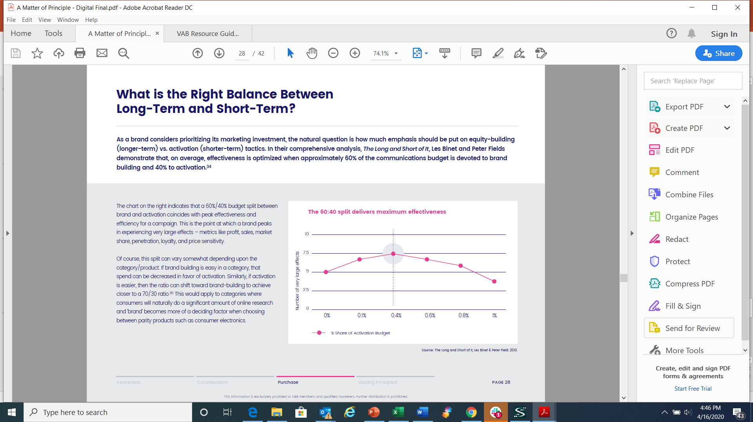
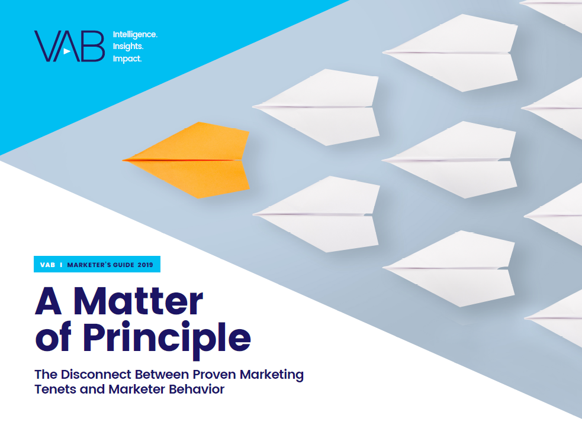
Even during crises, marketers need to find a balance between
long-term branding and short-term performance to maximize results
The chart on the right indicates that a 60%/40% budget split between brand and activation coincides with peak effectiveness and efficiency for a campaign. This is the point at which a brand peaks in experiencing very large effects – metrics like profit, sales, market share, penetration, loyalty, and price sensitivity.
Of course, this split can vary somewhat depending upon the category/product. If brand building is easy in a category, that spend can be decreased in favor of activation. Similarly, if activation is easier, then the ratio can shift toward brand-building to achieve closer to a 70/30 ratio. This would apply to categories where consumers will naturally do a significant amount of online research and ‘brand’ becomes more of a deciding factor when choosing between parity products such as consumer electronics.
Click here for the full VAB report to learn more about the 10 marketing principles that are equally applicable for brands during both bull and bear markets.
Source: Peter Field’s ‘Advertising in Recession – Long, Short, Dark? Guide to Advertising Best Practice in Recession,’ 4/6/20, LinkedIn 2020 B2B institute. Base: IPA Databank 50 cases covering 2008 recession (the Institute of Practitioners in Advertising). .
This information is exclusively provided to VAB members and qualified marketers. Further distribution is prohibited.
PAGE 47

Slide 48
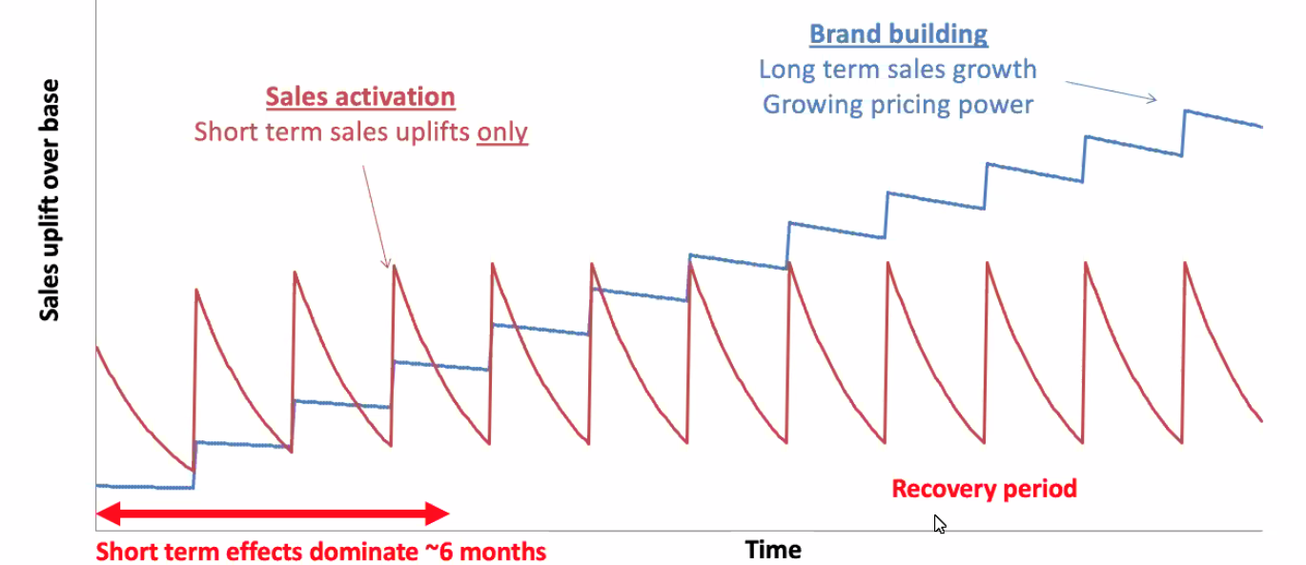
Brand building strategies particularly matter during a recession
as they provide long-term sales growth and increased pricing power
Source: Binet & Field, 2013. ‘The Long and the Short of It: Balancing Short and Long-Term Marketing Strategies.
This information is exclusively provided to VAB members and qualified marketers. Further distribution is prohibited.
PAGE 48

Slide 49






2008-2009 Recession: Savvy marketers, including retail titans like Amazon and Walmart, focused on long-term branding efforts by increasing their TV investment which delivered positive business outcomes as a result
Ecommerce
Retail
Telecommunications
CPG (Household)
Amazon launched its first TV campaign in the middle of the recession in 2008 and saw a compound annual growth rate of 34% between 2008-2012
Walmart significantly increased their TV investment in both 2008 & 2009 and saw high single digit sales increases
in each year with continued growth after the recession
T-Mobile had a moderate increase in their TV investment in both 2008 & 2009 and saw a compound annual growth rate of 21% between 2008-2011
Church & Dwight increased their TV investment in both 2008 & 2009 and increased their sales by 10% in each year
Source: U.S. TV spend based on VAB analysis of Nielsen Ad Intel data, national TV spend (national cable TV, national broadcast TV, Spanish language broadcast TV, Spanish language cable TV), CY 2007-2012. U.S. revenues are based on company filings (10-K) for U.S. revenue via SEC.gov (EDGAR). Church & Dwight’s primary TV support was for Arm Hammer.
This information is exclusively provided to VAB members and qualified marketers. Further distribution is prohibited.
PAGE 49

Slide 50




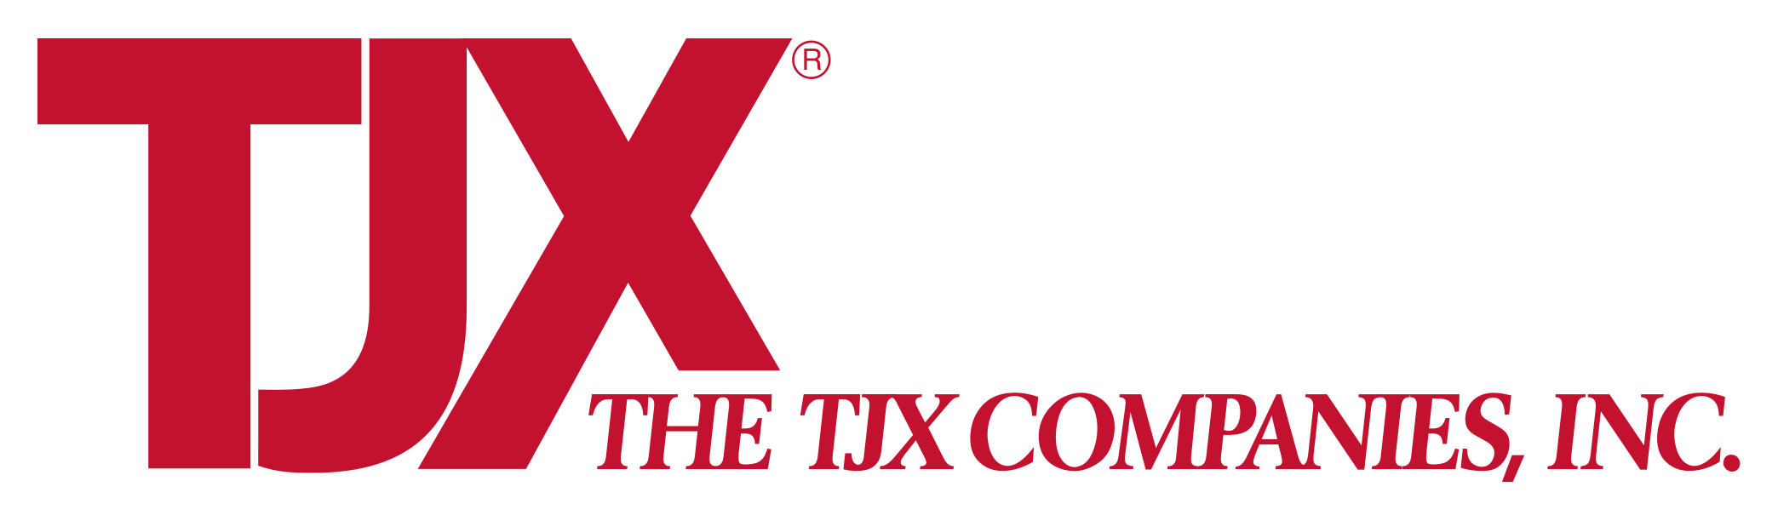
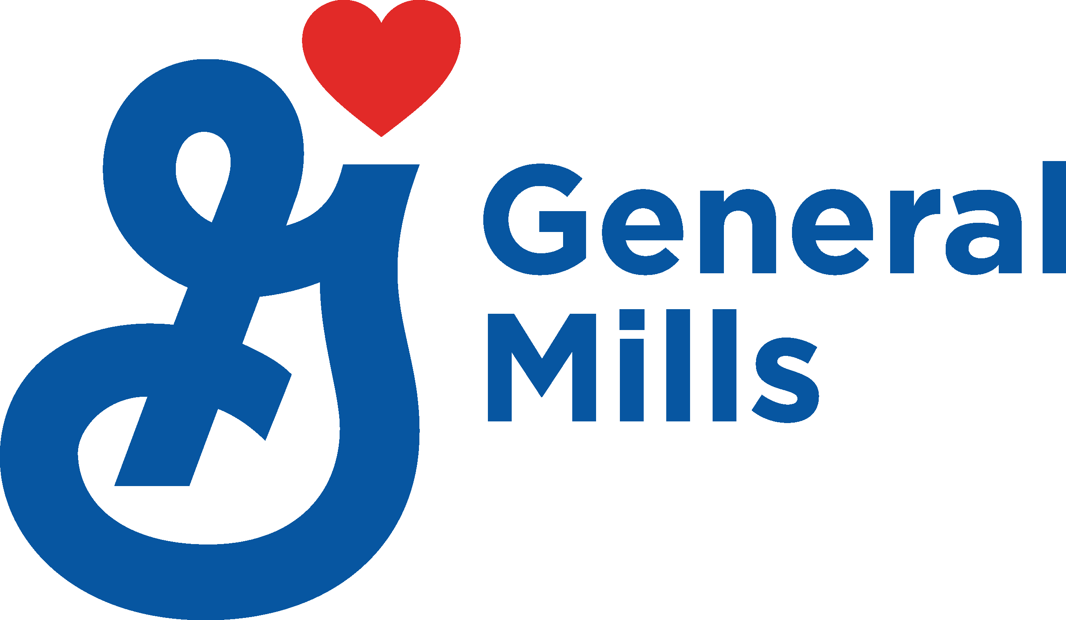
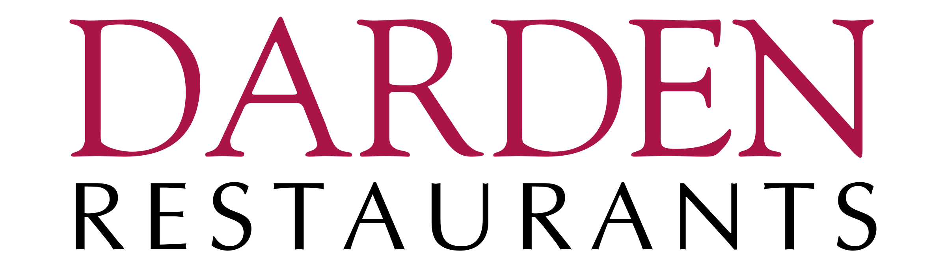

2008-2009 Recession: Regardless of category or investment level, brands who increased their TV spend experienced positive business outcomes
Department Stores
Food
Restaurants
Confectionary
TJX increased their TV investment in both 2008 & 2009 and saw a compound annual growth rate of 6% between 2008-2012
General Mills increased their TV investment in both 2008 & 2009 and increased their sales an average of 9% over both years
Darden increased their TV investment in both 2008 & 2009 and increased their sales by an average of 14%
over those two years
Hershey increased their TV investment in both 2008 & 2009 and saw a compound annual growth rate of 6% between 2008-2012
Source: TV spend based on VAB analysis of Nielsen Ad Intel data, national TV spend (national cable TV, national broadcast TV, Spanish language broadcast TV, Spanish language cable TV), CY 2007-2012. U.S. revenues are based on company filings (10-K) for U.S. revenue via SEC.gov (EDGAR). TJX’s primary TV support was for TJ Maxx & Marshall’s, Darden’s was for Olive Garden.
This information is exclusively provided to VAB members and qualified marketers. Further distribution is prohibited.
PAGE 50

Slide 51

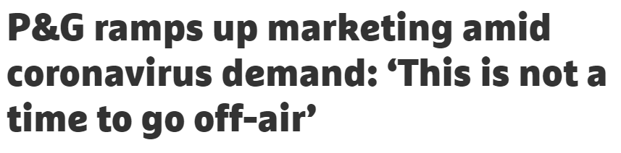
“There's a big upside here in terms of reminding consumers of the benefits that they've experienced with our brands and how they've [met] their family's needs, which is why this is not a time to go off air. This is not a time to retrench and really that's all in service to our consumers and service to our retail partners, and – we believe – in service to our society.”
Jon Moeller
Chief Financial Officer, Procter & Gamble
Fiscal Q3 ‘20 Procter & Gamble Quarterly Earnings Call, 4/27/20 (via The Drum)
This information is exclusively provided to VAB members and qualified marketers. Further distribution is prohibited.
PAGE 51

Slide 52
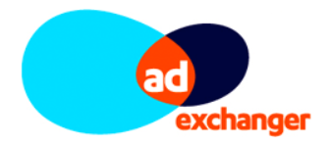
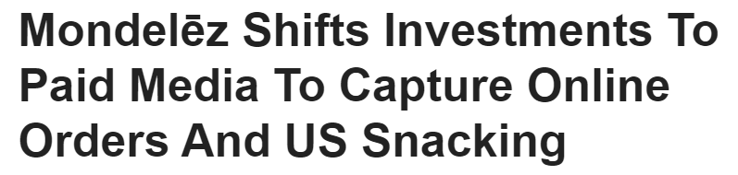
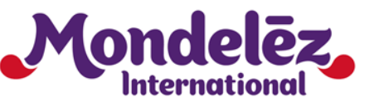
“This is a moment to really, what I would call, attack the market in the second half.”
Dirk Van de Put
CEO, Mondelez International
Q1 ‘20 Mondelez Quarterly Earnings Call,
4/29/20 (via AdExchanger)
This information is exclusively provided to VAB members and qualified marketers. Further distribution is prohibited.
PAGE 52

Slide 53
Summary: A One-Hundred Year Perspective
The full impact of advertising is seen over time
For that reason, brands that maintain or increase their spend during a recession are rewarded well into recovery
Brands that increase their spend, especially relative to their competitors, will grow sales and share of market faster
Savvy brands leverage recessionary periods to grow their brands exponentially
This information is exclusively provided to VAB members and qualified marketers. Further distribution is prohibited.
PAGE 53

Slide 54
Creative Messaging
That Is Right for the Time

Slide 55
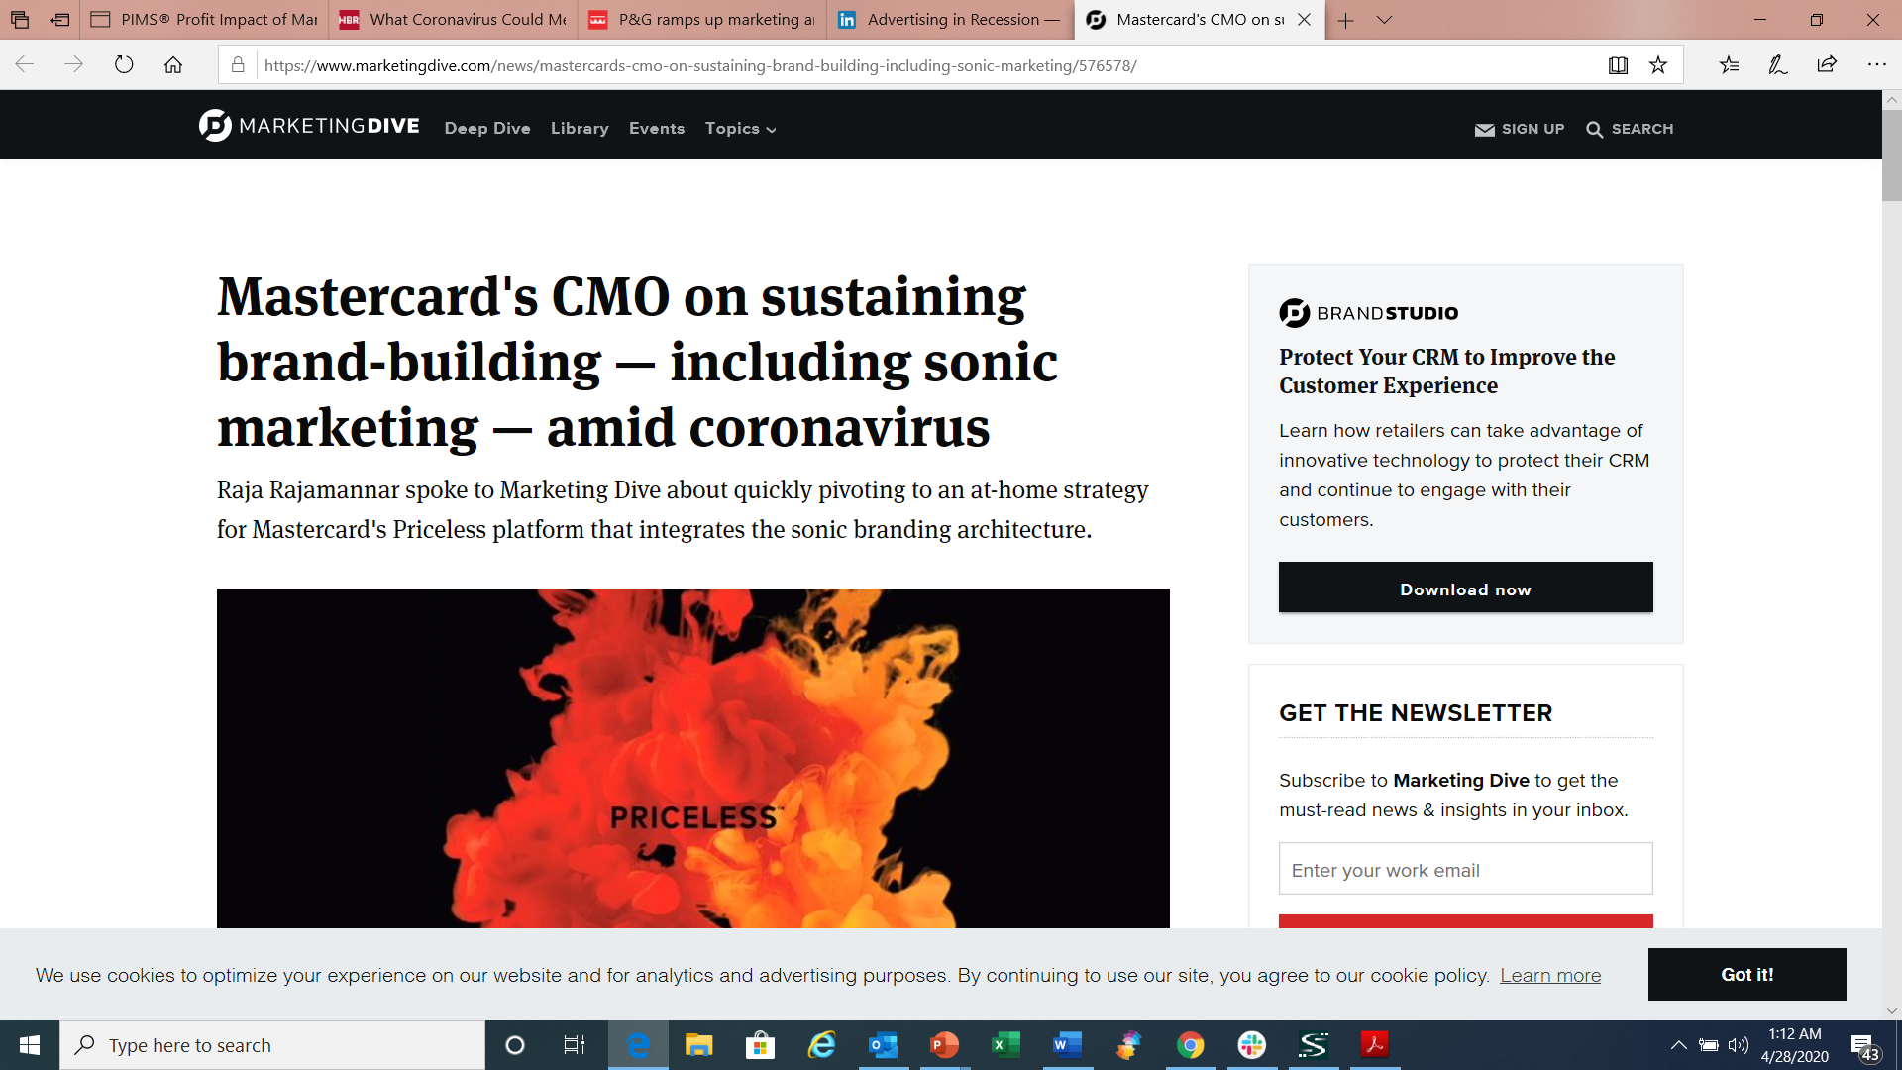

“Our strategy remains the same, our objectives remain the same,
but our approach has been modified. The brand has to be visible. We cannot go dark. But the time is not to sell, this is a time to serve. This is a time to enable and not be opportunistic.”
Raja Rajamannar
Chief Marketing Officer, Mastercard
Marketing Dive, 4/23/20
This information is exclusively provided to VAB members and qualified marketers. Further distribution is prohibited.
PAGE 55

Slide 56


A shift towards ‘right-brain’ messaging involving empathy, connection and understanding can drive greater effectiveness for advertisers during a recession
Ads about humanity and community are more effective and garner greater attention than those about self, self-image and performance
Features of ads described as ‘left-’ or ‘right-brained’
Left Brain
Right Brain
Flatness
Abstracted product, feature, ingredient
Abstracted body part (e.g., hands, mouth)
Words obtrude during the ad
Voiceover
Monologue (e.g., testimonial)
Adjectives used as nouns
Freeze-frame effect
Audio repetition (metered prose, sound effects)
Highly rhythmic soundtrack
A clear sense of place
One scene unfolding with progression
Characters with agency (voice, movement, expression)
Implicit, unspoken communication (knowing glances)
Dialogue
Distinctive accents
Play on words or subversion of language
Set in the past (costumes & sets)
Reference to other cultural works (pastiche / parody)
Music with melody
Source: System1, ‘COVID-19: A right-brain reset for advertisers’, 3/23/2020 System1’s Orlando Wood via LinkedIn, ‘What Should Ads Look Like in the Time of Recession?’, 4/21/2020; Peter Field, ‘Advertising in a Downturn Revisited’, April 2020.
This information is exclusively provided to VAB members and qualified marketers. Further distribution is prohibited.
PAGE 56

Slide 57
Brands began evolving their messaging in March as the realities
of COVID-19 began to set in and are poised to make further changes
to align with consumers needs and the mindset of society as a whole
In a recent ANA members survey, 46% of advertisers who said they had adjusted their creative in response to COVID-19 agreed that the changes made had been ‘substantial’
89% of advertisers expect to adjust creative messaging going forward as well, in reflection of the current climate
Guiding Principles Among Advertisers Who Made ‘Substantial’ Creative Modifications
How Brands Are Adjusting Their
Creative Messaging Going Forward
Display empathy for what stakeholders are facing – and demonstrate the brand is there to help
Pull most price- and item-focused messaging
Craft new ads from existing footage to ensure cultural relevance
Scrap creative executions that are not representative of the current climate
Acknowledge school closures and social distancing
Provide essential/useful information
Avoid certain lifestyle imagery (e.g. based on travel, spring break, and social gatherings)
Showing empathy for the contemporary situation while retaining brand relevance
Removing content that may be inappropriate, insensitive or tone deaf
Being more comforting and less promotional
Adapting to emerging consumer needs on an on-going basis
Focusing on products that are most pertinent and useful in an increasingly “virtual world”
Source: WARC, ‘How marketing creative is evolving in the COVID-19 era’, 4/17/2020. Association of National Advertisers (ANA), survey of 196 companies within ANA’s membership, survey fielded March 30 – 31, 2020. 92% of companies within the survey adjusted their marketing creative in response to COVID-19.
This information is exclusively provided to VAB members and qualified marketers. Further distribution is prohibited.
PAGE 57

Slide 58

In fact, 420 brands across 15 major industries had launched COVID-19 related messaging on national TV through the sixth week of the pandemic
COVID-19 Related National TV Imps By Industry
80 Billion Total Nat’l TV Imps
Top Brands by Industry
Industry | Brand | Nat’l TV IMPs
Restaurants | Burger King | 2.2 B
Vehicles | Lexus | 1.3 B
Retail | Lowes | 1.3 B
Electronics | Sprint | 1.4 B
Government | CDC | 2.4 B
Insurance | State Farm | 1.7 B
Home | Cottonelle | 822 MM
Business | H&R Block | 509 MM
Food & Beverage | Kellogg’s | 329 MM
Life & Entertainment | CNN | 707 MM
Health & Beauty | Dove | 681 MM
Travel | Hotels.com | 219 MM
Source: VAB analysis of iSpot.tv data released 5/5/20; reported national TV impressions for COVID-19-related creative, 2/26/2020 – 4/26/2020, P18+. World Health Organization formerly announced COVID-19 as a pandemic on 3/11/20.
This information is exclusively provided to VAB members and qualified marketers. Further distribution is prohibited.
PAGE 58

Slide 59
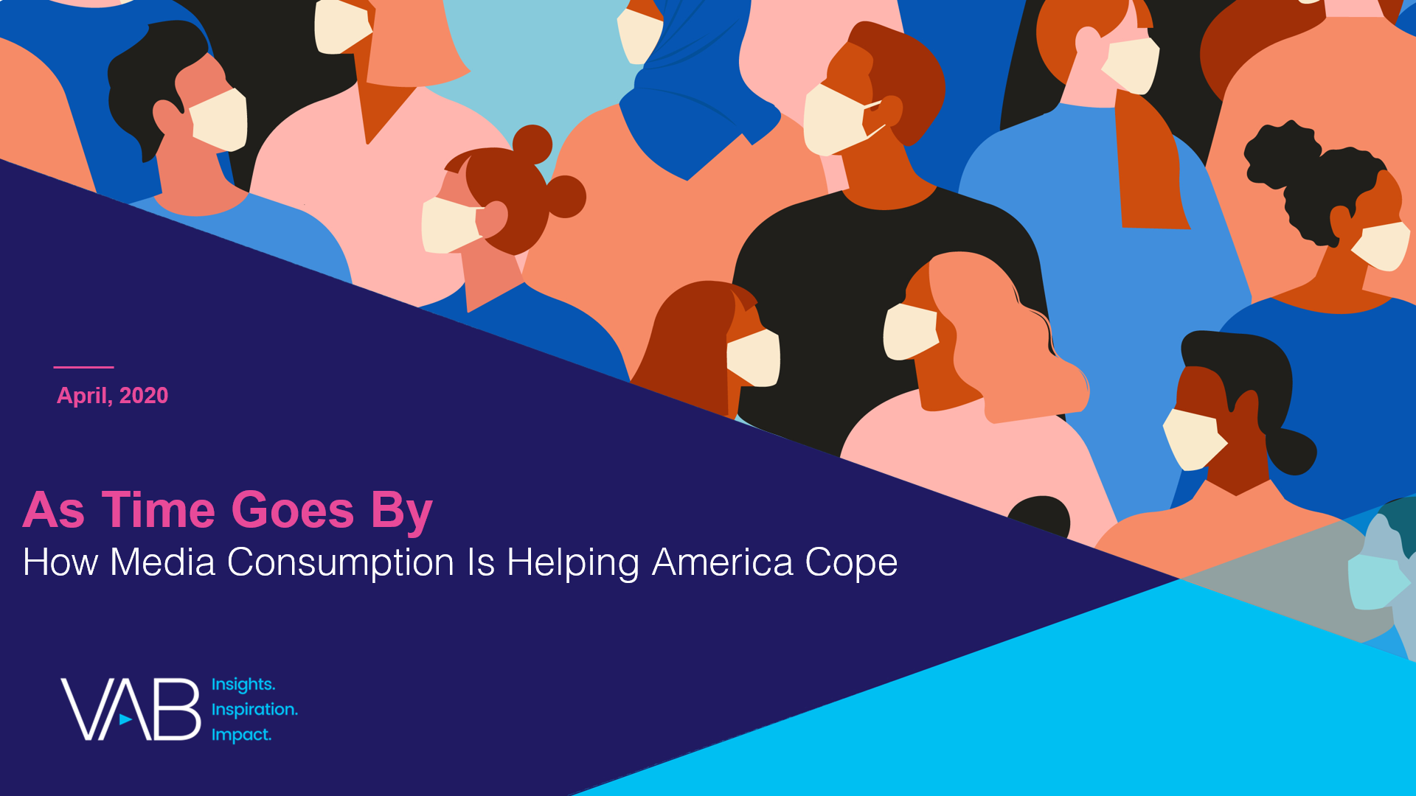
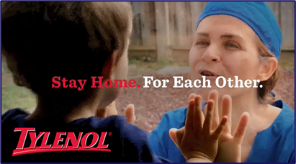
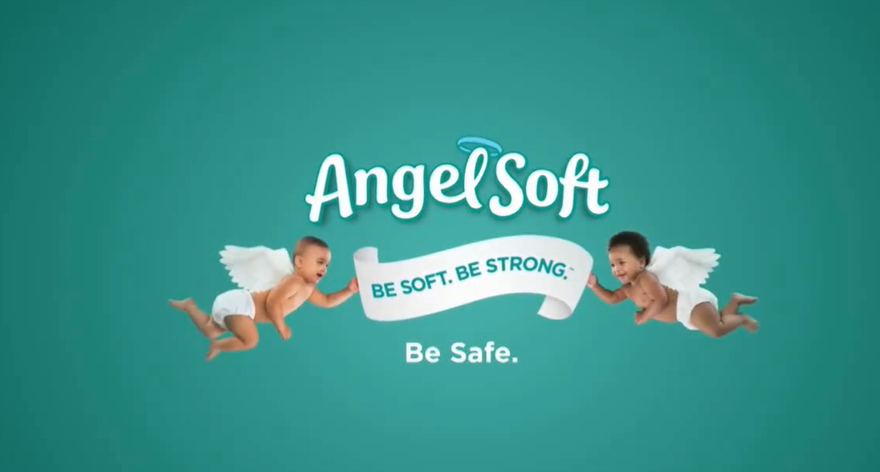
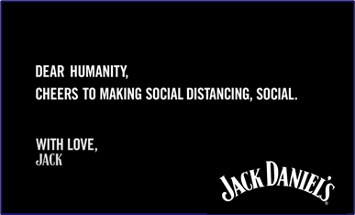

A VAB custom study found companies choosing to share
COVID-19 specific messaging can gain positive brand perceptions
Click here for the full
VAB custom study
“Companies with specific COVID-19 related advertising messages positively impacts my perception of the brand”
% that agree with the statement
52%
of all respondents
Source: VAB’s 'As Time Goes By: How Media Consumption Is Helping America Cope’. VAB / Lucid ‘Media Usage In The Time of COVID-19 Survey,’ April 2020. Survey base: P18+ & household subscribes to cable, telco, internet TV or satellite TV (n=1,004). Q14: Some companies have created specific COVID-19 related advertising messages (e.g. Guinness, Ford, Burger King, Verizon). How do these types of advertisements typically impact your perception of a brand?
This information is exclusively provided to VAB members and qualified marketers. Further distribution is prohibited.
PAGE 59
PAGE 1

Slide 60



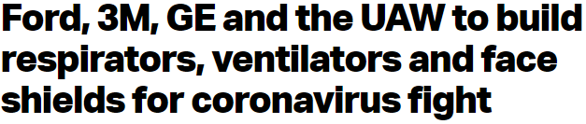
…And companies who demonstrate an authentic commitment to helping communities during this crisis will likely increase purchase intent
“I am more likely to purchase a product or service from companies that are lending resources or helping local communities during the crisis”
% that agree with the statement
55%
of all respondents
Source: VAB’s 'As Time Goes By: How Media Consumption Is Helping America Cope’. VAB / Lucid ‘Media Usage In The Time of COVID-19 Survey,’ April 2020. Survey base: P18+ & household subscribes to cable, telco, internet TV or satellite TV (n=1,004). Q15: Some companies are lending resources (e.g. Comcast donating free internet, Ford, 3M and GE Healthcare making healthcare equipment), or helping local communities during the crisis (Miller Lite starts ‘virtual tip jar’ to support out-of-work bartenders). How does this affect your likelihood to purchase a product or service from this company?
This information is exclusively provided to VAB members and qualified marketers. Further distribution is prohibited.
PAGE 60
PAGE 1

Slide 61
Summary: Creative Messaging That is Right for the Time
During this time of heightened emotions, many brands are re-evaluating their messages
Empathy often equals effectiveness when talking to consumers in times of crisis
Research indicates consumers look favorably on brands who are responding to the crisis in a helpful yet authentic manner
This information is exclusively provided to VAB members and qualified marketers. Further distribution is prohibited.
PAGE 61

Slide 62





Five key reminders for marketers
Maintaining your SOV now will cost you less in the long-term
‘Going dark’ or significantly cutting your advertising spend will not only result
in more pronounced short-term losses but it’ll also be
a more expensive recovery for your brand post-recession.
Advertising during a recession is for the recovery
Brands that maintain or increase their SOV experience significant gains over the long-term and the principle of ‘excess share of voice’ shows that the more
a brand spends on advertising vs. its competitors, the
more they will grow.
Be a fierce protector of your market share
Stay vigilant and keep
a watchful eye on your competitors in order to determine the investment needed to maintain, or grow, market share. Be prepared to pivot your own strategies quickly
as a result.
Recessions can be
an opportunity for expansion & growth
If your competitors pull back spending and the market becomes less saturated with competing messages, advertisers can seize the opportunity to distinguish their brands in the minds of consumers.
Messaging should evolve to be ‘right
for the time’
Creative should align with evolving customer needs and current consumer sentiments through more compassionate brand-building efforts. Companies that show an authentic commitment to community will likely increase purchase intent.
This information is exclusively provided to VAB members and qualified marketers. Further distribution is prohibited.
PAGE 62

Slide 63

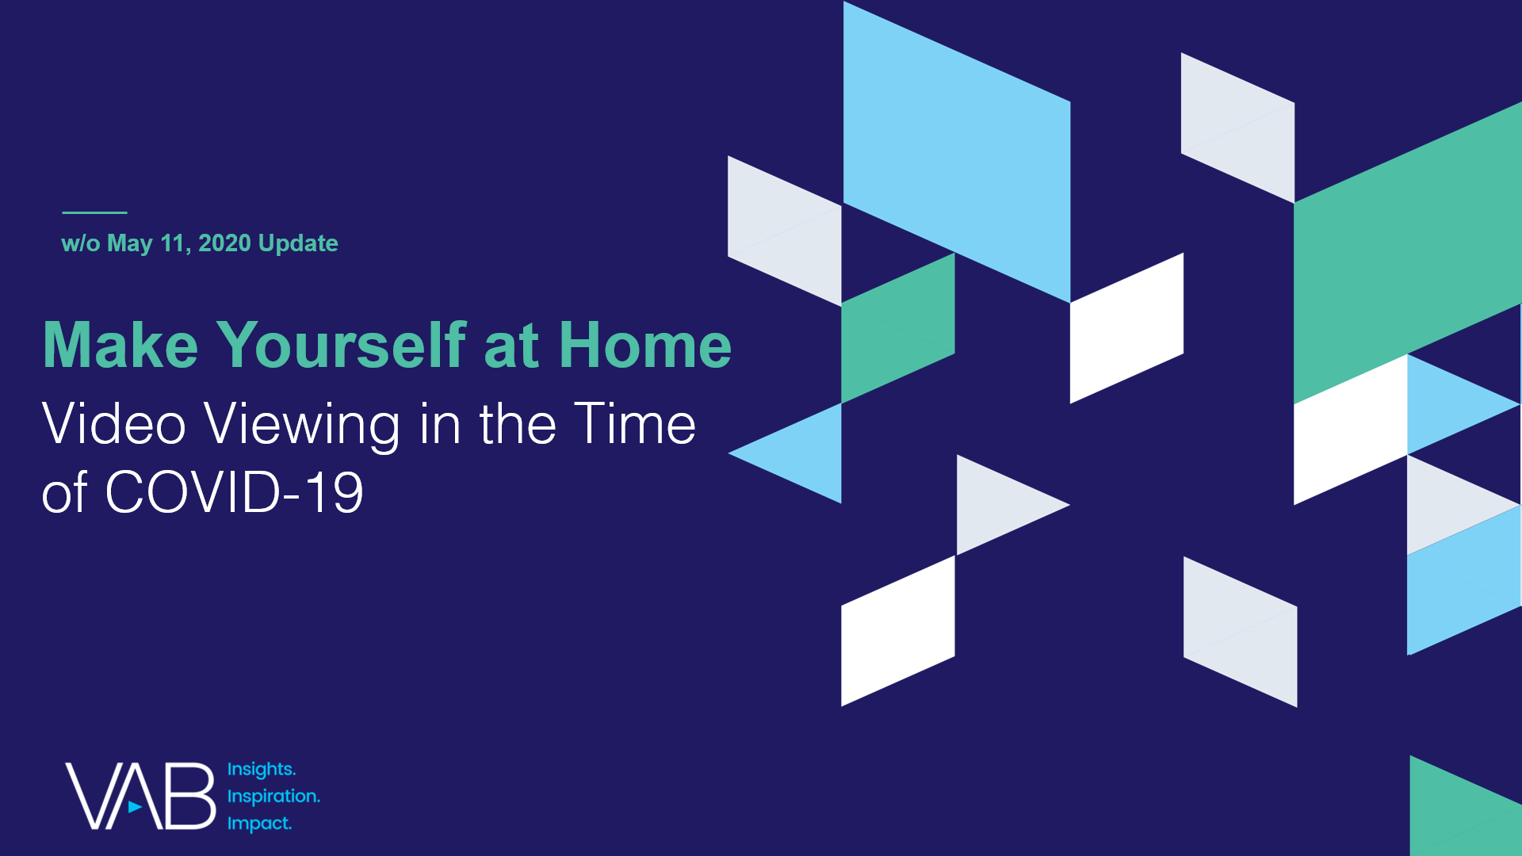
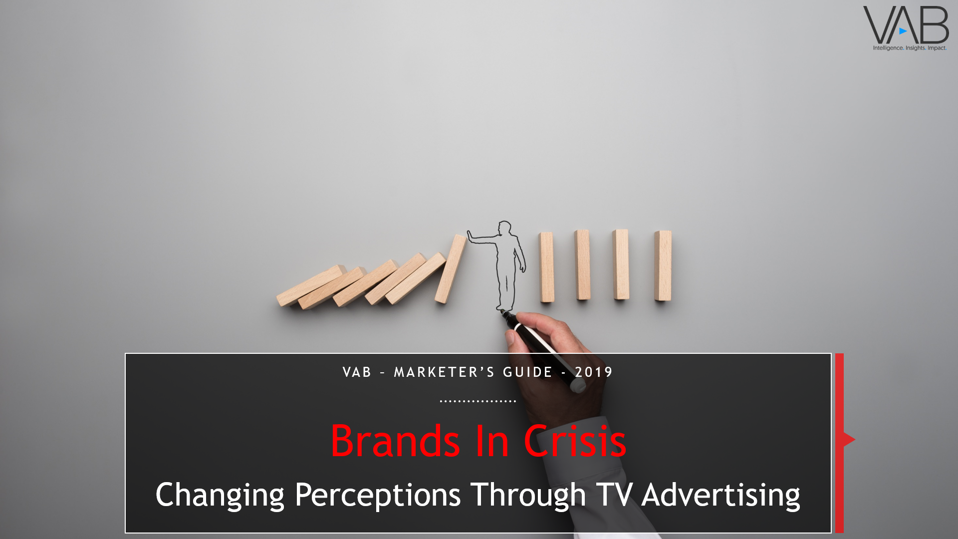
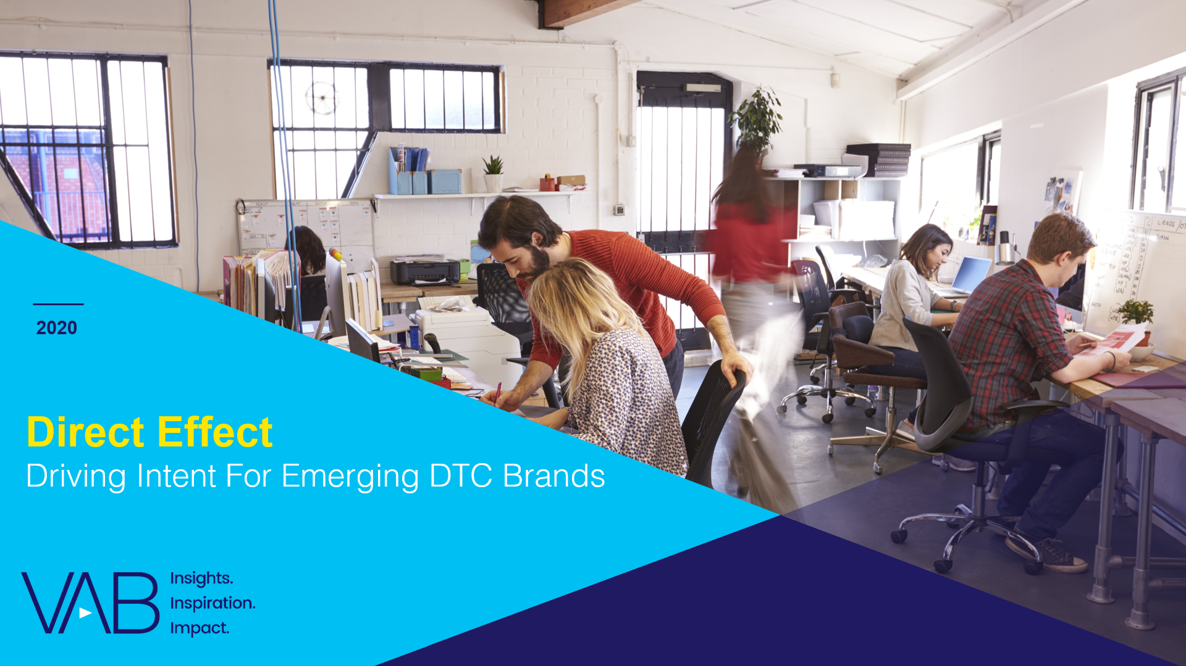
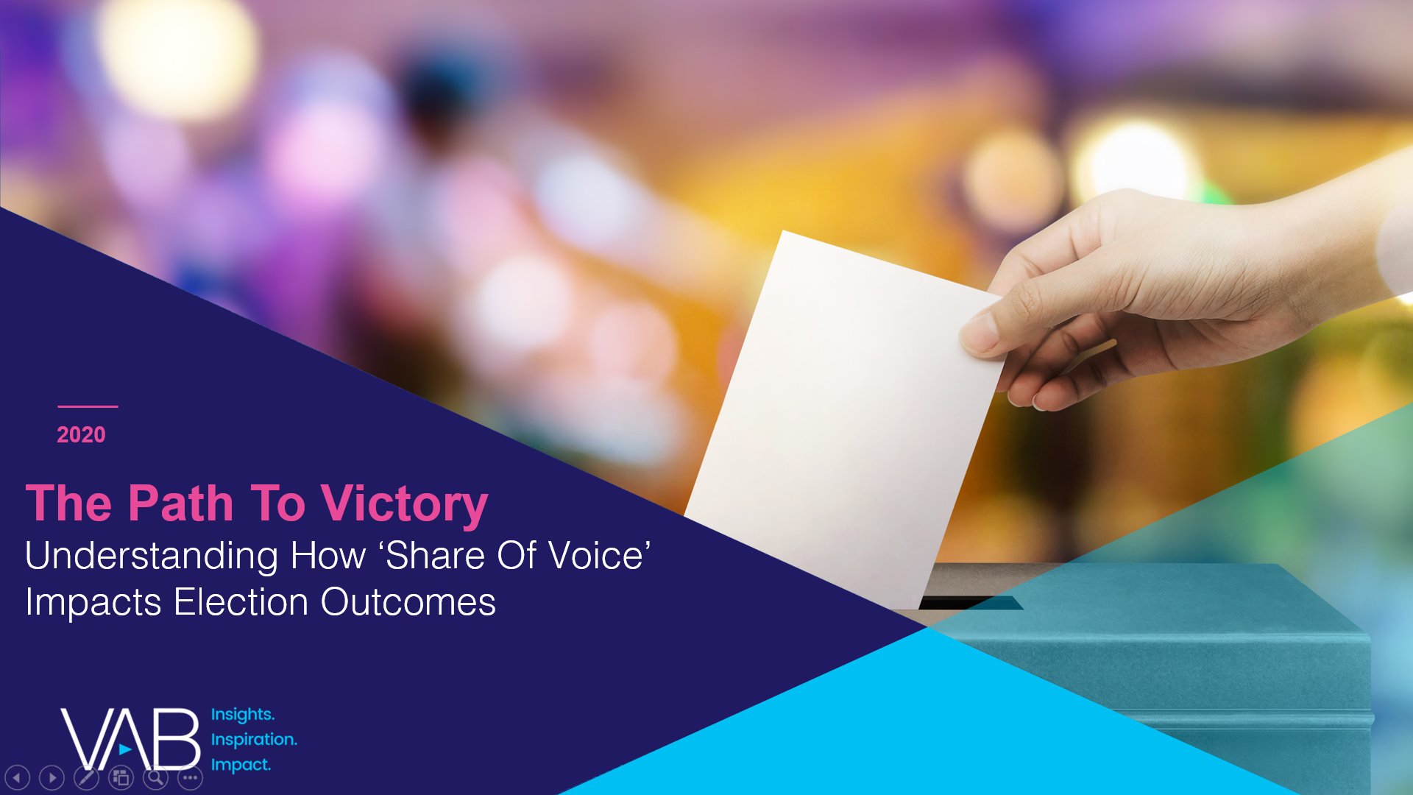
To learn more, check out these related marketer’s guide and reports from VAB…
Learn about the 10 marketing principles that are equally applicable for brands during both bull and bear markets and also the most common pitfalls that thwart business growth.
Through this custom study, learn about the changes in consumers’ media behaviors as well as their views on brands and advertising during the COVID-19 pandemic.
Learn how marketers launched campaigns balancing long-term brand health by focusing
on a relevant, purpose-driven message that also has a clear call-to-action during COVID-19.
Learn how brands have responded to adversity in uncertain times by reviewing cases studies focused on their approach to crisis management at the company level.
Learn how TV advertising drives business outcomes across the purchase funnel including ‘intent’ through increasing website traffic for a set of ‘direct-to-consumer’ brands.
Learn about a real-world category analysis utilizing data from the 2018 midterm elections proving out a central marketing tenet that ‘share of voice’ drives ‘share of market.’
Click on the cover imagery above to download each report
This information is exclusively provided to VAB members and qualified marketers. Further distribution is prohibited.
PAGE 63

Slide 64
…and click on the below ‘advertising in a recession’ marketing articles and research pieces to read what others in the industry are saying
  AdAge - History Shows Marketers Who Keep Spending During Downturns Fare Much Better
  Forbes - How to Adapt Your Marketing to a Possible Slowdown in an Economy Shaped by the Coronavirus
  Forbes - When A Recession Comes, Don't Stop Advertising
  Harvard Business Review - Advertising as an Anti-Recession Tool
  Harvard Business Review - What Coronavirus Could Mean for the Global Economy
  Journal of Advertising Research - A Critical Review and Synthesis of Research on Advertising in a Recession
  Mark Ritson - If You're In Marketing, Now Is The Time To Spend, Not Bend
  Mark Ritson - Marketing in the Time of Coronavirus
  Marketing Week - It's the Recession on Steroids - Why Brands Need to Think Long-Term Amid the Coronavirus Pandemic
  Marketing Week - Marketing in the Time of COVID-19
  Marketing Week - The Best Marketers Will Be Upping, Not Cutting, Their Budgets
  Peter Field - Advertising in Recession - Long, Short or Dark? A Guide to Advertising Best Practice in Recession
  System1 - COVID-19: A Right-Brain Reset for Advertisers
  The Drum - P&G Ramps Up Marketing Amid Coronavirus Demand
  WARC - Lessons for Adapting to Recession from Peter Field
  WARC - The Opportunity To Grow Market Share Is Clear, But Marketers Aren't Taking It
This information is exclusively provided to VAB members and qualified marketers. Further distribution is prohibited.
PAGE 64

Slide 65
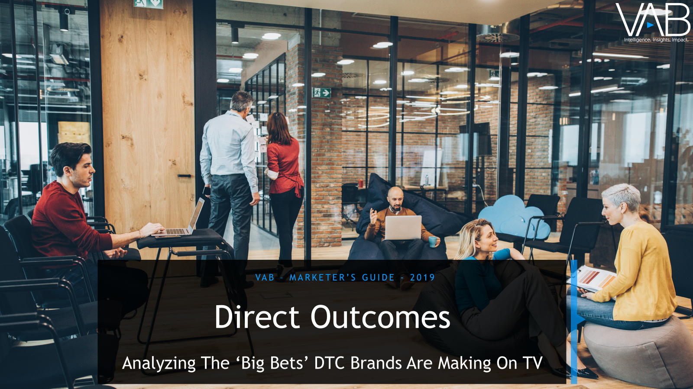

Thank You
Creators
Danielle DeLauro
Jason Wiese
Leah Montner-Dixon
Executive Vice President
danielled@thevab.com
SVP, Director of Strategic Insights
jasonw@thevab.com
Insights Manager
leahm@thevab.com
Interested in learning more? Check out this related content:
A Matter Of Principle:
The Disconnect Between Proven Marketing Tenets And Marketer Behavior
Brands In Crisis:
Changing Perceptions
Through TV Advertising
Direct Outcomes:
Analyzing The ‘Big Bets’ DTC Brands Are Making On TV
This information is exclusively provided to VAB members and qualified marketers. Further distribution is prohibited.
PAGE 65

Slide 66

Get immediate access to the VAB Insights library
We’ve answered hundreds of marketers’ questions.
Our guides, reports, webinars and videos provide actionable insights to help marketers navigate today’s video landscape and think differently about their strategy.
We are committed to your business growth and proud to offer brand marketers and agencies complimentary access to our continuously-growing Insights library.
Get Access at theVAB.com or visit us here
This information is exclusively provided to VAB members and qualified marketers. Further distribution is prohibited.
PAGE 66

