Slide 1
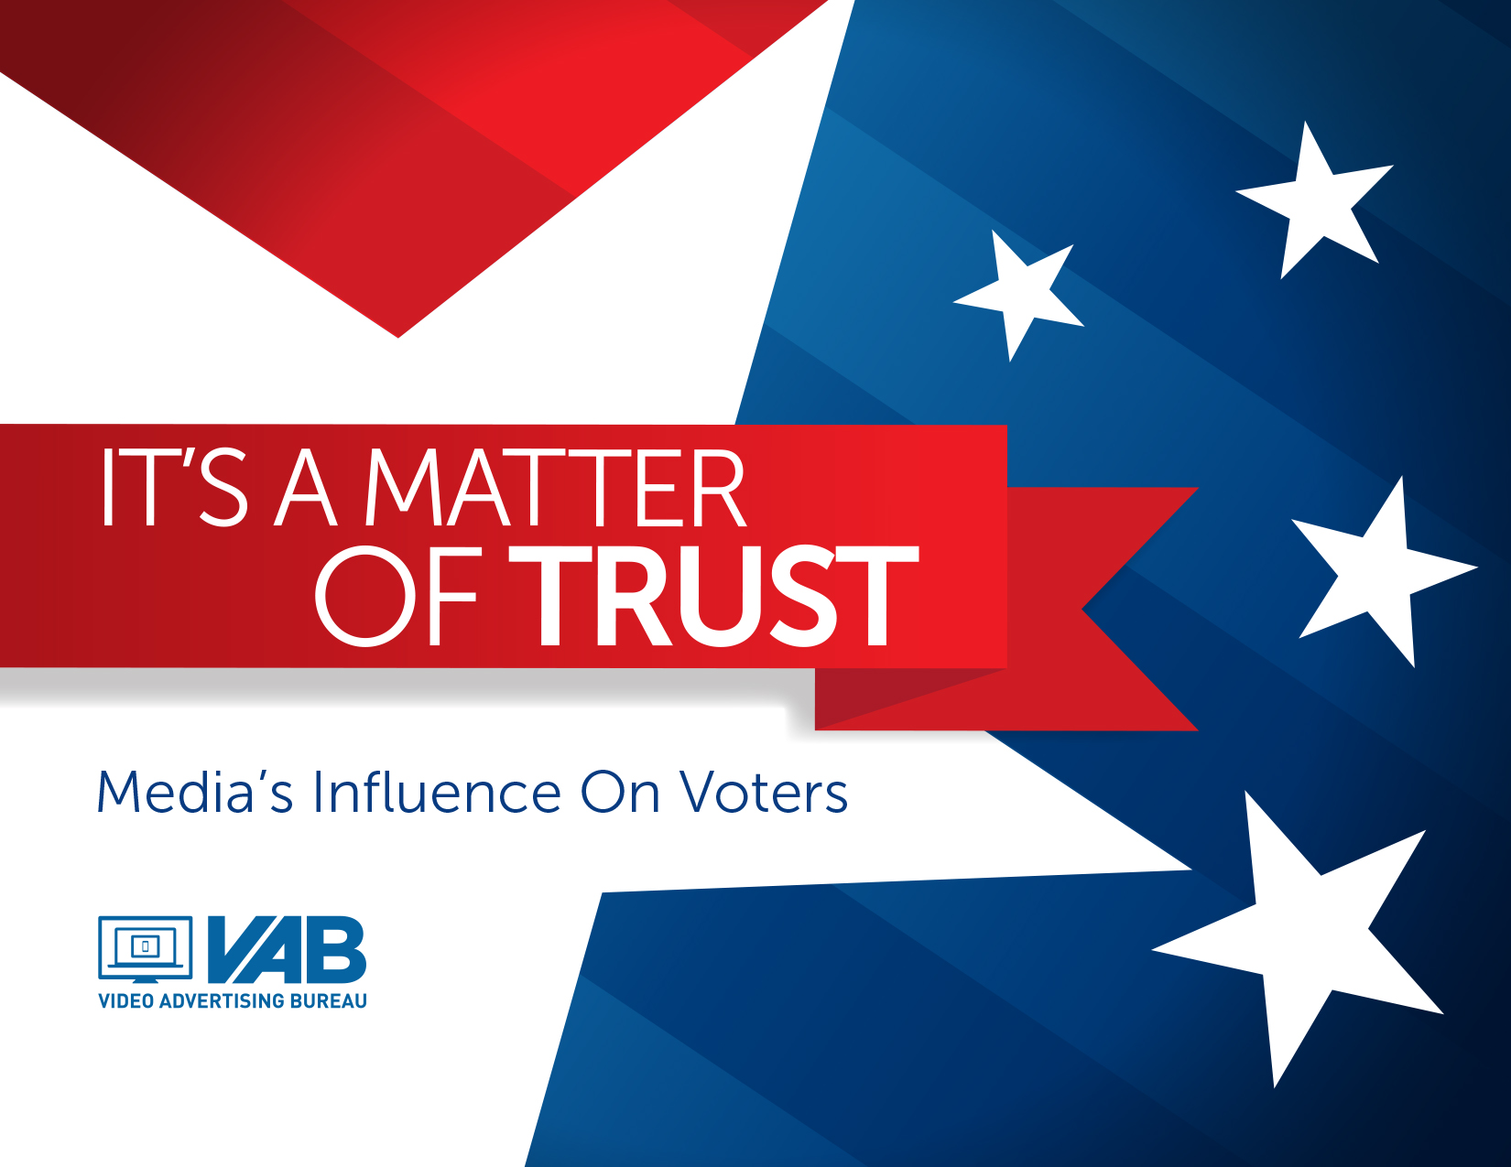
It’s A Matter Of Trust
Media’s Influence On Voters

Slide 2
The Ballot
1. Our Platform 3
2. Methodology 4
3.Who Are The Survey Respondents? 5-9
4. Today’s Hot Button Issue: “Fake News” And Who Can You Trust? 10-18
5. Trust In The Process: The Driving Force Behind Voter Decision Making 19-31
6. The Influence Advantage: Multi-Screen TV vs. Total Online Platforms 32-36
7. Local Cable News: A Leader In The Community 37-39
8. Final Thoughts 40
9. Members’ Exclusive: Cable Networks vs. Broadcast TV 41-47; 49-50
VAB: it’s a matter of trust

Slide 3
Our Platform
One of the biggest cultural catchphrases to emerge during the last election cycle was “Fake News.” This oft-used phrase has continued to permeate every corner of American society over the last two years. The concept has been even further amplified by recent scandals on some media platforms involving foreign meddling through unverified content sharing and targeted advertising as well as the unintentional sharing of user data with more than dubious partners.
While politics is usually thought of as the “great divide,” voters of all ages, genders, ethnicities, occupations and political affiliation agree that what matters most is having a form of media that they can trust, media that disseminates accurate information, so that they can make informed decisions on political candidates and key issues facing the country.
In fact, trusted media has the ability to create a bond with voters which, in turn, helps guide them in their decision making process throughout the election cycle. As we get closer to election day, there’s no doubt that “fake news” will continue to be disseminated in one form or another. So, who do voters trust?
With its around-the-clock 100% professionally produced content and controlled practices for news reporting, it’s no surprise that multi-screen TV brands are the most trusted source for almost all segments. The trust voters have with TV brands to deliver the most accurate political information heightens their attentiveness level and makes it the most influential platform throughout the election process – from initial discovery of candidates and information gathering to the casting of their final vote.
VAB: it’s a matter of trust

Slide 4
Methodology
The VAB commissioned Research Now to conduct the 2018 Mid-Term Election Survey fielded between May-June 2018. The information is based on 1,000 respondents from a randomly selected national internet panel whose demographics are representative to the U.S. Census.
Our mission was to better understand the effect of “fake news” and trust among voters as well as the power that media and advertising have in a voters’ decision-making process throughout the election cycle.
This poll of registered adult 18+ voters or people that plan on voting in the 2018 mid-term local elections takes an in-depth look at how 12 different media platforms influence key voting constituents such as age, gender, ethnicity, occupation and political party affiliation.
VAB: it’s a matter of trust

Slide 5

Who Are The Survey Respondents?

Slide 6
Survey Respondents Represent A Mix Of Geographies, Employment Status, Incomes & Ideologies
General demographics like age, gender, and ethnicity closely align with the U.S. Census
Geography
Employment Status
Annual Household Income
Ideology
VAB: it’s a matter of trust
Source: VAB / Research Now Poll of Registered or Likely Voters A18+; June 2018. Total Respondents=1,003.

Slide 7
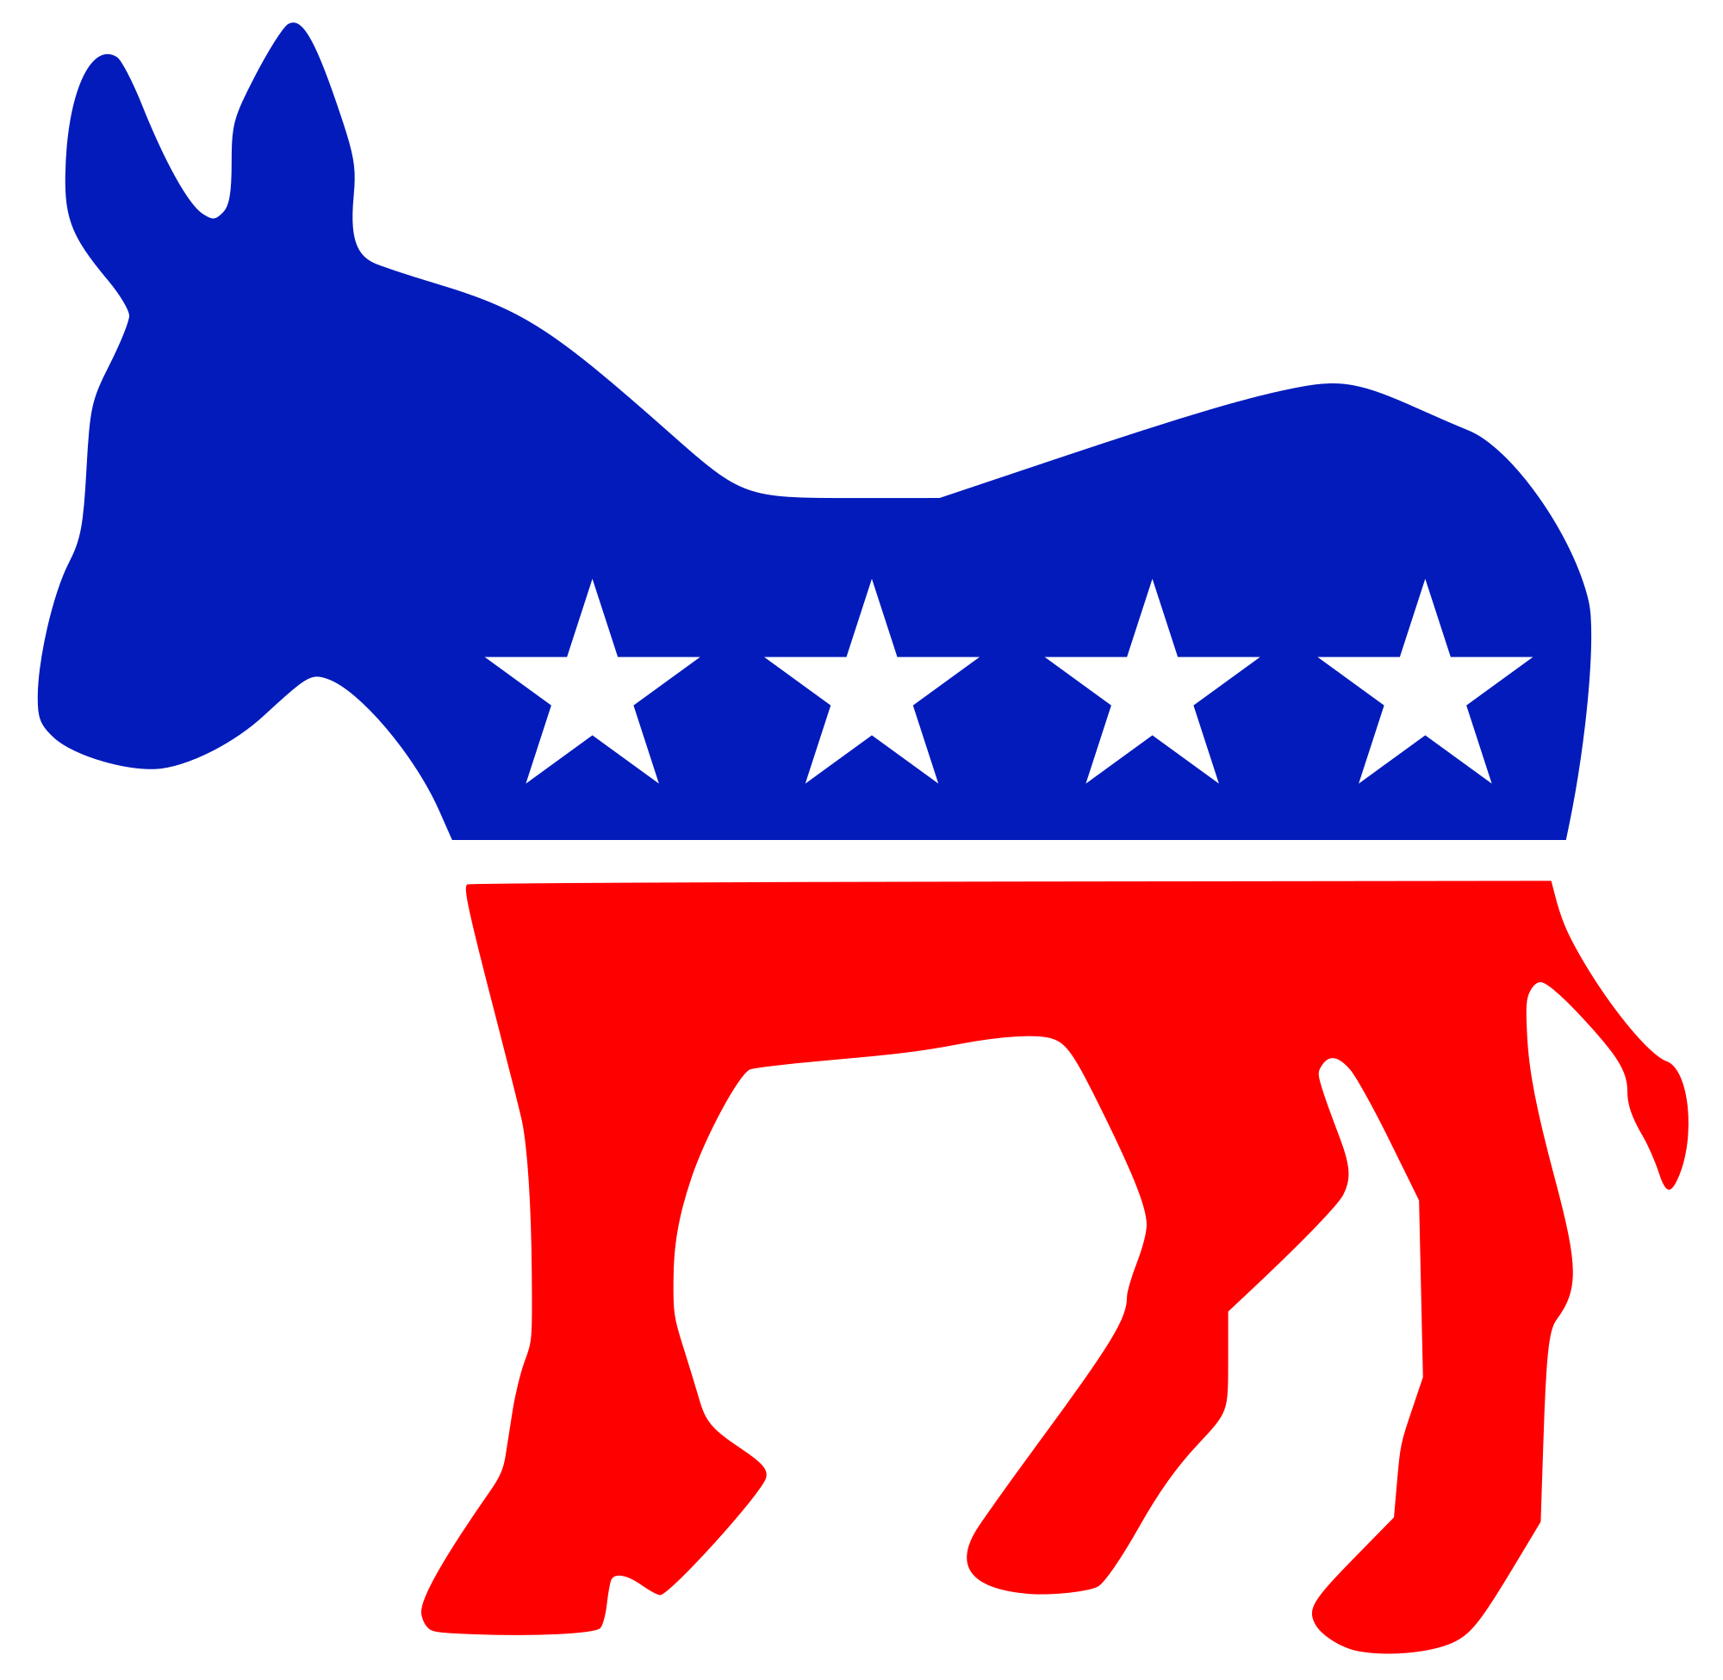

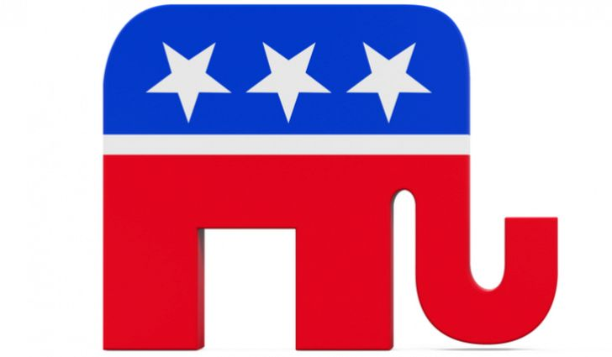
Respondents Represent A Proportionate Blend Of Political Affiliations
Republican
Democrat
Independent/Other
A18+
33%
44%
23%
A18-34
31%
46%
23%
A25-54
32%
46%
23%
A55+
36%
39%
25%
Black
9%
69%
22%
Hispanic
23%
56%
21%
Female
31%
48%
21%
Male
35%
39%
26%
White Collar
33%
43%
24%
Blue Collar
30%
50%
20%
VAB: it’s a matter of trust
Source: VAB / Research Now Poll of Registered or Likely Voters A18+; June 2018. Q10: What political affiliation would you say you are most closely affiliated with? Total Respondents=1,003.

Slide 8
Most Are Experienced Voters Since A Majority Also Voted In
The 2016 Presidential Election
“I voted in the 2016 Presidential election”
“I plan on voting for the first time”
VAB: it’s a matter of trust
Source: VAB / Research Now Poll of Registered or Likely Voters A18+; June 2018. Q13: Which of the following statements are true for you? Total Respondents=1,003.

Slide 9
Even Though They’re Experienced Voters Most Still Make Their Final Voting Decision Less Than A Week Before An Election
76% of adults 18-34 don’t make their final decision until the week leading up to the election
When Do You Typically Make Your Final Decision Regarding Who You Are Going To Vote For In November's Mid-term/Local Elections?
59%
63%
VAB: it’s a matter of trust
Source: Source: VAB / Research Now Poll of Registered or Likely Voters A18+; June 2018. Q26: When do you typically make your final decision regarding who you are going to vote for in November's mid-term/local elections? Total Respondents=1,003.

Slide 10

Today’s Hot Button Issue:
“Fake News” And Who Can
You Trust?

Slide 11
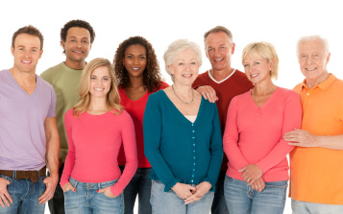
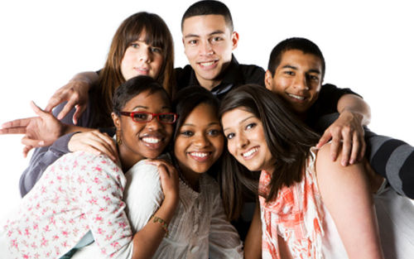

Voters Of All Demographics Are Deeply Concerned Over
The Influence That “Fake News” May Have On Elections
“I Am Concerned About The Influence Fake News May Have On Voters and/or Elections”
% Who Agree
VAB: it’s a matter of trust
Source: VAB / Research Now Poll of Registered or Likely Voters A18+; June 2018. Q19.1: How much do you agree or disagree with the following statements? I am concerned about the influence fake news may have on voters/election. Respondents who answered Agree or Strongly Agree. Total Respondents=1,003.

Slide 12
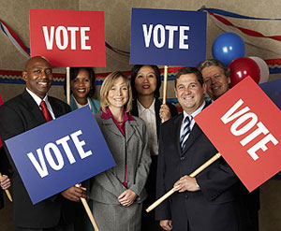

The Issue Of “Fake News” Transcends Party Lines As The Concern Is Pervasive Among Both Republicans & Democrats
“I Am Concerned About The Influence Fake News May Have On Voters and/or Elections”
% Who Agree
VAB: it’s a matter of trust
Source: VAB / Research Now Poll of Registered or Likely Voters A18+; June 2018. Q19.1: How much do you agree or disagree with the following statements? I am concerned about the influence fake news may have on voters/election. Respondents who answered Agree or Strongly Agree. Total Respondents=1,003.

Slide 13
Social Media, Which Is Often Unregulated And Unhinged, Remains Especially Problematic When It Comes To “Fake News”
“I Am Concerned By The Amount Of Fake News On Social Media”
% Who Agree
VAB: it’s a matter of trust
Source: VAB / Research Now Poll of Registered or Likely Voters A18+; June 2018. Q23: How much do you agree or disagree with the following statements? I am concerned by the amount of fake news on social media. Respondents who answered Agree or Strongly Agree. Total Respondents=1,003.

Slide 14
All Sides Are Very Concerned With The Role That Social Media Plays in The Dissemination Of “Fake News”
“I Am Concerned By The Amount Of Fake News On Social Media”
% Who Agree
VAB: it’s a matter of trust
Source: VAB / Research Now Poll of Registered or Likely Voters A18+; June 2018. Q23: How much do you agree or disagree with the following statements? I am concerned by the amount of fake news on social media. Respondents who answered Agree or Strongly Agree. Total Respondents=1,003.

Slide 15
TV Is The Most Trusted Source For Providing Accurate Political Information & Far More Trusting Than Social Media Or Radio
More people rely on Television networks and their online properties over non-TV related news sites and social media because voters know and trust the professional content these brands deliver
Age
Gender / Ethnicity
VAB: it’s a matter of trust
Source: VAB / Research Now Poll of Registered or Likely Voters A18+; June 2018. Numbers do not equal 100% as multiple selections were allowed. Q22: There has been a lot of discussion recently about ‘fake news’. Which source do you trust to provide the most accurate political information? Respondents who answered Agree or Strongly Agree. Total Respondents=1,003.

Slide 16
TV Is Also The Most Trusted Source For Information Across
Party Affiliation As Well As Both Blue And White Collars
More people rely on Television networks and their online properties over non-TV related news sites and social media because voters know and trust the professional content these brands deliver
Party Affiliation
Occupation
VAB: it’s a matter of trust
Source: VAB / Research Now Poll of Registered or Likely Voters A18+; June 2018. Numbers do not equal 100% as multiple selections were allowed. Q22: There has been a lot of discussion recently about ‘fake news’. Which source do you trust to provide the most accurate political information? Respondents who answered Agree or Strongly Agree. Total Respondents=1,003.

Slide 17
This Trust Has Established TV As The Main Medium That Most People Rely On To Help Them Form Their Opinion On Key Issues
Television’s ability to disseminate accurate information has enabled TV brands to build trust with people across screens. This information helps people to form their opinions on key issues, much more than any other media.
Age
Gender / Ethnicity
VAB: it’s a matter of trust
Source: VAB / Research Now Poll of Registered or Likely Voters A18+; June 2018. Numbers do not equal 100% as multiple selections were allowed. Q21: Which of the following media helps you best to form an opinion on key issues facing the country, such as gun control, health care, economy, global warming, immigration, etc...? Total Respondents=1,003.

Slide 18
A Majority Of Democrats & Republicans, Blue & White Collars, All Turn To TV For Help In Forming Their Opinion On Key Issues
Multiscreen TV’s (TV + online) percentages are virtually the same across party affiliations and occupations and no other media comes anywhere close to their level of influence
Party Affiliation
Occupation
VAB: it’s a matter of trust
Source: VAB / Research Now Poll of Registered or Likely Voters A18+; June 2018. Numbers do not equal 100% as multiple selections were allowed. Q21: Which of the following media helps you best to form an opinion on key issues facing the country, such as gun control, health care, economy, global warming, immigration, etc...? Total Respondents=1,003.

Slide 19

Trust In The Process:
The Driving Force Behind Voter Decision Making

Slide 20
Trusted Media Can Influence Each Step In A Voter’s Decision Making Process Leading Up To Election Day
Voters have an on-going relationship with many different media platforms and these platforms, coupled with the never-ending news cycle, can help shape opinions long before a candidate even announces they are running for office
Voter’s Decision Making Process
Discover Candidates / Issues
Gather Information
Generate Interest
Cast the Final Vote
“Where are you most
likely to first learn about
Political candidates/issues?
“Which of the following have prompted you to
take an action (seek info about political candidates/ issues, discuss with others)?
“Which of the following
keeps you informed about
Political candidates/issues?
“Which of the following influences your final decision when voting?
VAB: it’s a matter of trust

Slide 21
Regardless Of Demographic, Affiliation Or Occupation, Voters Are Most Influenced By TV Brands Throughout The Election Cycle
With each step of the decision making process, voters prefer the trusted media of Television, and TV Brands on the whole, as their top political news source
Voter’s Decision Making Process
Discover Candidates / Issues
Gather Information
Generate Interest
Cast the Final Vote
Television is most likely where voters first learn about political candidates/ issues
Television is most likely to have prompted a voter to take an action (seek info about political candidates/ issues, discuss with others)
Television is relied on most to keep voters informed through the election cycle
Television is the media that most influences a person’s final vote
VAB: it’s a matter of trust

Slide 22
The Trust That Exists With TV Brands Extends To Advertising
As It’s The Ad Platform Most Likely To Get Voters’ Attention
Survey Fun Fact: 61% of Adults 18+ and 65% of adults 18-34 try to actively avoid online political ads on Facebook and YouTube
Age
Gender / Ethnicity
VAB: it’s a matter of trust
Source: Source: VAB / Research Now Poll of Registered or Likely Voters A18+; June 2018. Numbers do not equal 100% as multiple selections were allowed. Q14: Which of the following types of political advertising is most likely to get your attention? Q23: How much do you agree or disagree with the following statements? I tend to skip, minimize the page/screen or turn off the sound when an online political ad plays on YouTube/Facebook. Respondents who answered Agree or Strongly Agree. Total Respondents=1,003.

Slide 23
75% of Democrats & Republicans Say That Political Advertising On TV Is The Media Most Likely To Get Their Attention
Survey Fun Fact: 64% of Independents and 67% of white collars try to actively avoid online political ads on Facebook and YouTube
Party Affiliation
Occupation
VAB: it’s a matter of trust
Source: Source: VAB / Research Now Poll of Registered or Likely Voters A18+; June 2018. Numbers do not equal 100% as multiple selections were allowed. Q14: Which of the following types of political advertising is most likely to get your attention? Q23: How much do you agree or disagree with the following statements? I tend to skip, minimize the page/screen or turn off the sound when an online political ad plays on YouTube/Facebook. Respondents who answered Agree or Strongly Agree. Total Respondents=1,003.

Slide 24
Because Of This Attentiveness, It’s No Surprise That TV Is How Most Voters Are Likely To First Learn About Candidates And Issues
Survey Fun Fact: Emails from political candidates aren’t even opened by 56% of adults 18+ and 61% of adults 18-34
Age
Gender / Ethnicity
VAB: it’s a matter of trust
Source: VAB / Research Now Poll of Registered or Likely Voters A18+; June 2018. Numbers do not equal 100% as multiple selections were allowed. Q15: Where are you most likely to first learn about Political candidates and issues...? Q24: How much do you agree or disagree with the following statements? I delete emails from political candidates without opening them. Respondents who answered Agree or Strongly Agree. Total Respondents=1,003.

Slide 25
Over 70% of Democrats & Republicans Are Most Likely To
First Learn About Candidates And Issues From TV
Survey Fun Fact: Emails from political candidates aren’t even opened by 60% of Independents and 59% of white collars
Party Affiliation
Occupation
VAB: it’s a matter of trust
Source: VAB / Research Now Poll of Registered or Likely Voters A18+; June 2018. Numbers do not equal 100% as multiple selections were allowed. Q15: Where are you most likely to first learn about Political candidates and issues...? Q24: How much do you agree or disagree with the following statements? I delete emails from political candidates without opening them. Respondents who answered Agree or Strongly Agree. Total Respondents=1,003.

Slide 26
Political TV Ads Are Also Much More Likely Than Any Other Media To Spur Voters To Take An Action After Seeing An Ad
Against adults 18+, TV ads are 3x more likely than social media, and 4x more likely than radio ads, to prompt a voter to take an action
Age
Gender / Ethnicity
VAB: it’s a matter of trust
Source: VAB / Research Now Poll of Registered or Likely Voters A18+; June 2018. Numbers do not equal 100% as multiple selections were allowed. Q18: Which of the following types of political advertisements have prompted you to take an action (i.e. seek information about a political candidate/ issue, discuss with family/friends/co-workers)? Total Respondents=1,003.

Slide 27
Almost Two-Thirds of Democrats & Republicans Are Likely To
Take An Action After Seeing A Political Ad On TV
Against Independents, TV ads are over 3x more likely than social media, and almost 5x more likely than radio ads, to prompt a voter to take an action
Party Affiliation
Occupation
VAB: it’s a matter of trust
Source: VAB / Research Now Poll of Registered or Likely Voters A18+; June 2018. Numbers do not equal 100% as multiple selections were allowed. Q18: Which of the following types of political advertisements have prompted you to take an action (i.e. seek information about a political candidate/ issue, discuss with family/friends/co-workers)? Total Respondents=1,003.

Slide 28
Due To On-Going Trust, Voters Are More Likely To Rely On TV To Keep Them Informed Throughout The Election Cycle
Survey Fun Fact: 58% of adults 18+ and 67% of adults 18-34 believe that Cable TV news websites and apps are a good source for political information
Age
Gender / Ethnicity
VAB: it’s a matter of trust
Source: VAB / Research Now Poll of Registered or Likely Voters A18+; June 2018. Numbers do not equal 100% as multiple selections were allowed. Q16: Which of the following keeps you informed about Political candidates and issues...? Q20: How much do you agree or disagree with the following statements? Cable TV news websites/apps (CNN.com, MSNBC.com, etc.) are a good source for political information. Respondents who answered Agree or Strongly Agree. Total Respondents=1,003.

Slide 29
Over 70% Of Each Party & Occupation Are Likely To Rely On TV To Keep Them Informed Throughout The Election Cycle
Survey Fun Fact: 66% of Democrats and 66% of blue collars believe that Cable TV news websites and apps are a good source for political information
Party Affiliation
Occupation
VAB: it’s a matter of trust
Source: VAB / Research Now Poll of Registered or Likely Voters A18+; June 2018. Numbers do not equal 100% as multiple selections were allowed. Q16: Which of the following keeps you informed about Political candidates and issues...? Q20: How much do you agree or disagree with the following statements? Cable TV news websites/apps (CNN.com, MSNBC.com, etc.) are a good source for political information. Respondents who answered Agree or Strongly Agree. Total Respondents=1,003.

Slide 30
Trust Translates Into Influence As Multi-Screen TV Is Much More Likely To Influence Voters’ Final Decision Than Any Other Media
Survey Fun Fact: 55% of adults 18+ and 65% of adults 18-34 feel that political ads on the radio all seem the same to them
Age
Gender / Ethnicity
VAB: it’s a matter of trust
Source: VAB / Research Now Poll of Registered or Likely Voters A18+; June 2018. Numbers do not equal 100% as multiple selections were allowed. Q17: Which of the following influences your final decision when voting for political candidates and issues...? Q24: How much do you agree or disagree with the following statements? Political ads on the radio all seem the same to me. Respondents who answered Agree or Strongly Agree. Total Respondents=1,003.

Slide 31
A Majority Of Republicans, Democrats And Independents Say That TV Influences Their Final Voting Decisions
Survey Fun Fact: 58% of Republicans and 60% of white collars feel that political ads on the radio all seem the same to them
Party Affiliation
Occupation
VAB: it’s a matter of trust
Source: VAB / Research Now Poll of Registered or Likely Voters A18+; June 2018. Numbers do not equal 100% as multiple selections were allowed. Q17: Which of the following influences your final decision when voting for political candidates and issues...? Q24: How much do you agree or disagree with the following statements? Political ads on the radio all seem the same to me. Respondents who answered Agree or Strongly Agree. Total Respondents=1,003.

Slide 32

The Influence Advantage:
Multi-Screen TV vs.
Total Online Platforms

Slide 33
The Collective Influence Of Multi-Screen TV Is Much Greater Than The Aggregate Of All Online Platforms Across Demos
Television reels in voters right from the start as they begin to gather information on upcoming elections
Initial Stages of Decision Making Process
Where Do You Get Most Of Your Information About National Politics From?
Which Of The Following Types Of Political Advertising Is Most Likely To Get Your Attention?
Where Are You Most Likely To First Learn About Political Candidates And Issues?
A18+
85% / 48%
84% / 44%
82% / 41%
A18-34
81% / 67%
81% / 66%
79% / 61%
Age
A25-54
83% / 53%
85% / 51%
83% / 48%
A55+
89% / 35%
83% / 27%
84% / 24%
Black
85% / 47%
83% / 38%
88% / 36%
Hispanic
84% / 56%
85% / 57%
79% / 48%
Gender / Ethnicity
Female
85% / 48%
81% / 46%
81% / 42%
Male
85% / 48%
86% / 42%
83% / 39%
Multi-Screen TV
Total Internet (excluding TV news sites)
VAB: it’s a matter of trust
Source: VAB / Research Now Poll of Registered or Likely Voters A18+; June 2018. Numbers do not equal 100% as multiple selections were allowed. Multi-Screen TV Figure (TV and TV News Websites/Apps); Total internet excluding TV-news websites (online radio/online newspapers/non-TV-related news websites/online search/social media). Total Respondents=1,003

Slide 34
The Collective Influence Of Multi-Screen TV Is Much Greater Than The Aggregate Of All Online Platforms Across Affiliation
Television reels in voters right from the start as they begin to gather information on upcoming elections
Initial Stages of Decision Making Process
Where Do You Get Most Of Your Information About National Politics From?
Which Of The Following Types Of Political Advertising Is Most Likely To Get Your Attention?
Where Are You Most Likely To First Learn About Political Candidates And Issues?
Republican
84% / 45%
84% / 38%
83% / 37%
Democrat
87% / 51%
85% / 51%
84% / 43%
Party Affiliation
Independent
82% / 48%
81% / 40%
80% / 42%
White Collar
85% / 55%
85% / 49%
81% / 47%
Occupation
Blue Collar
81% / 41%
84% / 52%
84% / 40%
Multi-Screen TV
Total Internet (excluding TV news sites)
VAB: it’s a matter of trust
Source: VAB / Research Now Poll of Registered or Likely Voters A18+; June 2018. Numbers do not equal 100% as multiple selections were allowed. Multi-Screen TV Figure (TV and TV News Websites/Apps); Total internet excluding TV-news websites (online radio/online newspapers/non-TV-related news websites/online search/social media). Total Respondents=1,003

Slide 35
Multi-Screen TV’s Influence Over Online Platforms Continues Through The Decision Making Process Up To Election Day
Voters start to rely on multi-screen TV early on and continue to turn to it much more so than online platforms
Advanced Stages of Decision Making Process
Which Of The Following Types Of Political Advertisements Have Prompted You To Take An Action?
Which Of The Following Keeps You Informed About Political Candidates And Issues?
Which Of The Following Influences Your Final Decision When Voting For Political Candidates and Issues?
A18+
76% / 44%
85% / 48%
76% / 44%
A18-34
75% / 59%
82% / 64%
75% / 59%
Age
76% / 50%
85% / 53%
76% / 50%
A25-54
A55+
76% / 32%
86% / 35%
76% / 32%
Black
78% / 41%
86% / 48%
75% / 48%
Hispanic
80% / 47%
84% / 56%
76% / 46%
Gender / Ethnicity
77% / 42%
85% / 50%
74% / 47%
Female
Male
77% / 34%
85% / 45%
78% / 42%
Multi-Screen TV
Total Internet (excluding TV news sites)
VAB: it’s a matter of trust
Source: VAB / Research Now Poll of Registered or Likely Voters A18+; June 2018. Numbers do not equal 100% as multiple selections were allowed. Multi-Screen TV Figure (TV and TV News Websites/Apps); Total internet excluding TV-news websites (online radio/online newspapers/non-TV-related news websites/online search/social media). Total Respondents=1,003

Slide 36
Multi-Screen TV’s Influence Over Online Platforms Continues Through The Decision Making Process Up To Election Day
Voters start to rely on multi-screen TV early on and continue to turn to it much more so than online platforms
Advanced Stages of Decision Making Process
Which Of The Following Types Of Political Advertisements Have Prompted You To Take An Action?
Which Of The Following Keeps You Informed About Political Candidates And Issues?
Which Of The Following Influences Your Final Decision When Voting For Political Candidates and Issues?
Republican
79% / 38%
86% / 41%
76% / 41%
Democrat
76% / 41%
87% / 52%
77% / 49%
Party Affiliation
Independent
75% / 34%
82% / 49%
73% / 41%
White Collar
76% / 44%
86% / 55%
77% / 49%
Occupation
Blue Collar
77% / 38%
82% / 46%
75% / 48%
Multi-Screen TV
Total Internet (excluding TV news sites)
VAB: it’s a matter of trust
Source: VAB / Research Now Poll of Registered or Likely Voters A18+; June 2018. Numbers do not equal 100% as multiple selections were allowed. Multi-Screen TV Figure (TV and TV News Websites/Apps); Total internet excluding TV-news websites (online radio/online newspapers/non-TV-related news websites/online search/social media). Total Respondents=1,003

Slide 37
Local Cable News:
A Leader In The Community

Slide 38
Community, Quality, Character & Concise Coverage Are The Hallmarks Of Local Cable News
Survey Fun Fact: 65% of adult 25-54 voters say that local cable TV news channels are a good source of political information
% Who Agree
A18+
A18-34
A25-54
A55+
Black
Hispanic
Female
Male
Local Cable provides extensive news coverage and political information
60%
67%
67%
48%
64%
65%
61%
60%
58%
67%
65%
47%
67%
59%
60%
57%
Local Cable has quality news programs
Local Cable provides an informative local perspective on national issues
60%
71%
67%
47%
71%
61%
60%
60%
I rely upon local cable news to cover local issues that affect my community
61%
70%
65%
51%
65%
65%
61%
61%
I watch more Local Cable news now than in the past
47%
64%
55%
32%
49%
57%
50%
45%
VAB: it’s a matter of trust
Source: VAB / Research Now Poll of Registered or Likely Voters A18+; June 2018. Q27: Thinking about Local Cable News, please rate the following statements (Respondents who answered Agree or Strongly Agree). Q23: How much do you agree or disagree with the following statements? Local cable TV news channels are a good source for political information. Respondents who answered Agree or Strongly Agree. Total Respondents=1,003.

Slide 39
This Authentic, Community-Driven Approach Works Well Across Party Affiliation As Well As Both Blue & White Collars
% Who Agree
Republican
Democrat
Independent
White Collar
Blue Collar
Local Cable provides extensive news coverage and political information
59%
64%
55%
65%
66%
Local Cable has quality news programs
58%
63%
51%
62%
66%
Local Cable provides an informative local perspective on national issues
59%
62%
57%
64%
73%
I rely upon local cable news to cover local issues that affect my community
59%
65%
56%
64%
67%
I watch more Local Cable news now than in the past
47%
51%
42%
52%
59%
VAB: it’s a matter of trust
Source: VAB / Research Now Poll of Registered or Likely Voters A18+; June 2018. Q27: Thinking about Local Cable News, please rate the following statements (Respondents who answered Agree or Strongly Agree). Total Respondents=1,003.

Slide 40
Final Thoughts
While politics has the ability to divide the country, the desire for trustworthy and accurate news sources is what unites voters.
As some platforms unintentionally allow the dissemination of unverified news stories and political ads, Television is trusted because it provides an environment that features 100% professionally produced news.
This is why Television is the most influential media throughout the election cycle.
Voter’s Decision Making Process
Discover Candidates / Issues
Gather Information
Generate Interest
Cast the Final Vote
Television is most likely where voters first learn about candidates/issues
Television is most likely to have prompted a voter to take an action
Television is relied on most to keep voters informed through the election cycle
Television is the media that most influences a person’s final vote
The combined power of multi-screen TV further strengthens the influence that TV brands have among voters of all ages, genders, demographics, occupations and political party affiliations; while local cable news delivers extensive and authentic news and political coverage from a local community perspective.
VAB: it’s a matter of trust

Slide 41

Members’ Exclusive:
Cable Networks vs. Broadcast TV

Slide 42



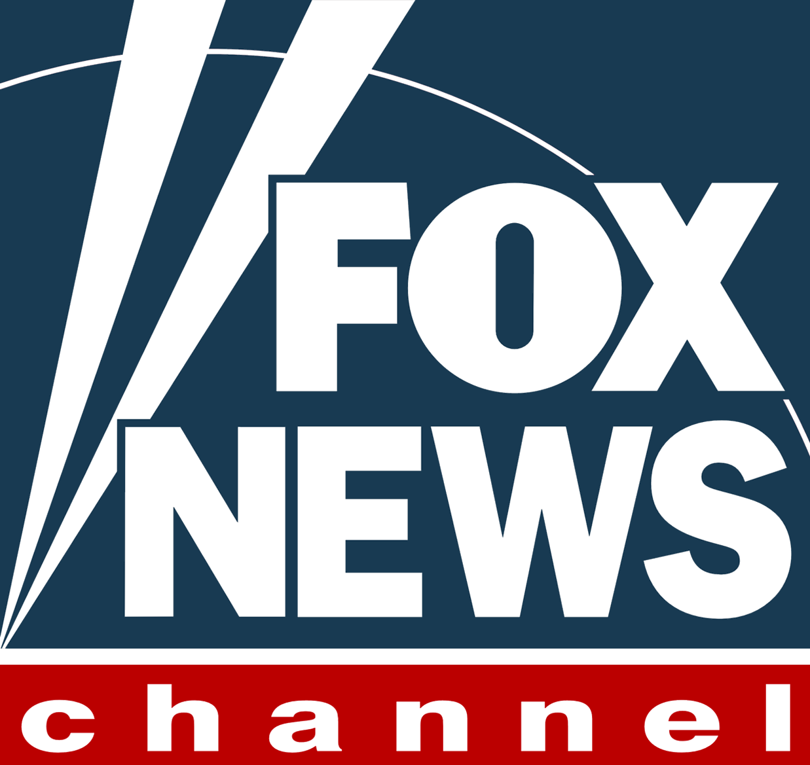




Most Voters Are More Likely To Trust Cable News Networks Over Broadcast Networks To Provide Accurate Political Information
Which Of The Following Media Do You Trust More To Provide The Most Accurate Political Information?
Cable Networks
Broadcast Networks (Local or National)
VAB: it’s a matter of trust
Source: VAB / Research Now Poll of Registered or Likely Voters A18+; June 2018. Q22a: Looking at Television further, please specify which ONE do you trust more to provide the most accurate political information? Total Respondents=1,003.

Slide 43
Those Who Turn To TV When Forming Opinions Are More Likely To Rely On Cable News Networks Over Broadcast
Which Of The Following Media Helps You Best To Form An Opinion On Key Issues Facing The Country?
Cable Networks
Broadcast Networks (Local or National)
VAB: it’s a matter of trust
Source: VAB / Research Now Poll of Registered or Likely Voters A18+; June 2018. Q21a: In the previous question you selected Television, please specify which ONE helps you best form an opinion on key issues facing the country? Base = Those who form an opinion on key issues facing the country with help of Television. Respondents=685.

Slide 44
Those Who Get Most Of Their Information On National Politics From TV Mostly Prefer Cable News To Broadcast
Where Do You Get Most Of Your Information About National Politics From?
Cable Networks
Broadcast Networks (Local or National)
VAB: it’s a matter of trust
Source: VAB / Research Now Poll of Registered or Likely Voters A18+; June 2018. Q25a: In the previous question you selected Television, please specify which ONE do you get most of your information about national politics from? Base = Those who get most of national politics information from Television. Respondents=698.

Slide 45
Most Voters That First Learn About Candidates & Issues From TV Also Prefer Cable News Networks Over Broadcast
Where Are You Most Likely To First Learn About Political Candidates And Issues?
Cable Networks
Broadcast Networks (Local or National)
VAB: it’s a matter of trust
Source: VAB / Research Now Poll of Registered or Likely Voters A18+; June 2018. Q15a: In the previous question you selected Television, please specify which ONE you prefer when first learning about Political candidates? Base = Those who likely to first learn about Political candidates and issues through TELEVISION. Respondents=712.

Slide 46
Those That Watch TV To Stay Informed About Candidates And Issues Are More Likely To Rely On Cable News Than Broadcast
Which Of The Following Keeps You Informed About Political Candidates And Issues?
Cable Networks
Broadcast Networks (Local or National)
VAB: it’s a matter of trust
Source: VAB / Research Now Poll of Registered or Likely Voters A18+; June 2018. Q16a: In the previous question you selected Television, please specify which ONE you prefer to keep you informed about Political candidates and issues? Base = Those who keep informed about Political candidates and issues through TELEVISION. Respondents=727.

Slide 47
Those Whose Voting Decisions Are Influenced By TV Are Likely To Be More Influenced By Cable News Than Broadcast
It’s no surprise that voters are more influenced by cable networks since 58% of Adults 18+ and 64% of Adults 25-54 feel that political ads on Local Broadcast TV news all seem the same to them
Which Of The Following Influences Your Final Decision When Voting For Political Candidates and Issues?
Cable Networks
Broadcast Networks (Local or National)
VAB: it’s a matter of trust
Source: VAB / Research Now Poll of Registered or Likely Voters A18+; June 2018. Q17a: In the previous question you selected Television, please specify which ONE influences your final decision the most when voting for Political candidates and issues? Base = Those who’s final decision when voting for Political candidates and issues is influenced most by TELEVISION. Q19: How much do you agree or disagree with the following statements? Political ads on Local Broadcast TV news all seem the same to me. Respondents who answered Agree or Strongly Agree. Respondents=613.

Slide 48
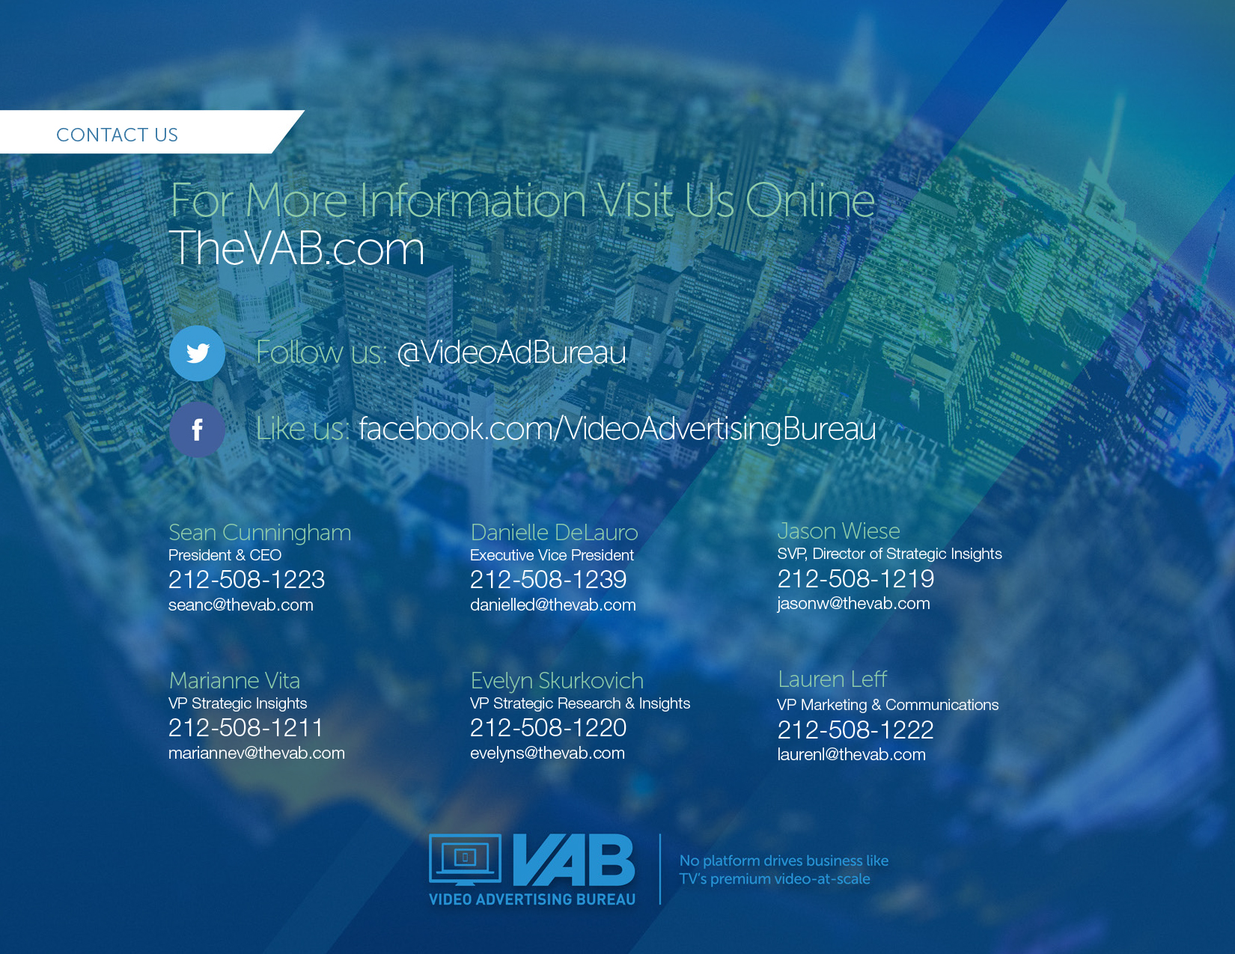

Slide 49
TV Brands Are Overwhelmingly The Primary Source For Voters To Get Information About National Politics
Why is this important for mid-term elections? Because 55% of adults 18+ and 63% of adults 18-34 say that national politics influence who they vote for in local elections
Age
Gender / Ethnicity
VAB: it’s a matter of trust
Source: VAB / Research Now Poll of Registered or Likely Voters A18+; June 2018. Numbers do not equal 100% as multiple selections were allowed. Q25: Where do you get most of your information about national politics from? Q19: How much do you agree or disagree with the following statements? National politics influences who I vote for in local elections. Respondents who answered Agree or Strongly Agree. Total Respondents=1,003.

Slide 50
TV Brands Are Also The Preferred National Political News Source For Voters Of All Political Affiliations And Occupations
Why is this important for mid-term elections? Because, for instance, 60% of Democrats and 60% of white collars say that national politics influence who they vote for in local elections
Party Affiliation
Occupation
VAB: it’s a matter of trust
Source: VAB / Research Now Poll of Registered or Likely Voters A18+; June 2018. Numbers do not equal 100% as multiple selections were allowed. Q25: Where do you get most of your information about national politics from? Q19: How much do you agree or disagree with the following statements? National politics influences who I vote for in local elections. Respondents who answered Agree or Strongly Agree. Total Respondents=1,003.

