Slide 1
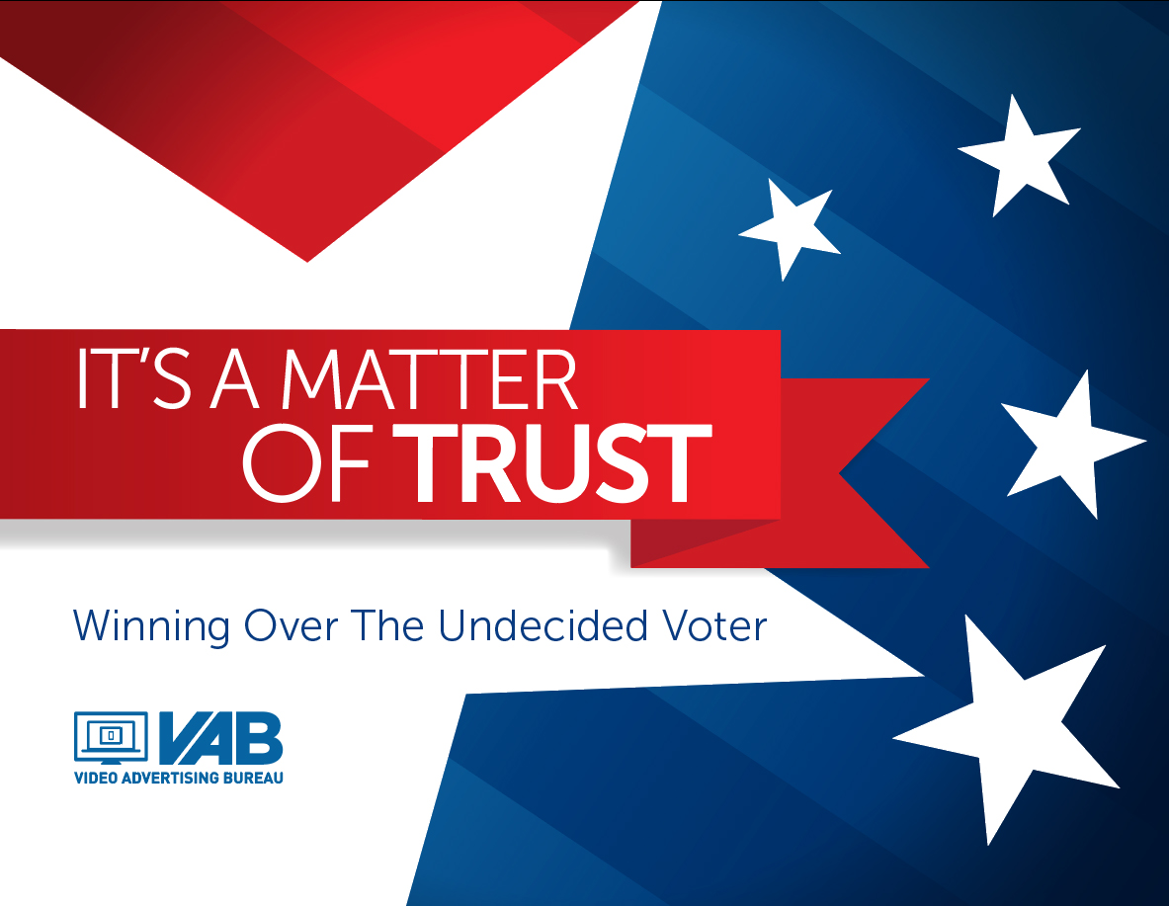
It’s A Matter Of Trust
Winning Over The Undecided Voter

Slide 2
The Ballot
1. Our Platform 3
2. Methodology 4
3.Who Are The Undecided Voters? 5-8
4. Today’s Hot Button Issue: “Fake News” And Who Can You Trust? 9-12
5. Trust In The Process: The Driving Force Behind Voting Decision Making 13-22
6. Closing Remarks 23
7. Contact Information 24
VAB: Winning OVER the undecided voter

Slide 3
Our Platform
In our first report stemming from our 2018 Midterm Election Survey entitled It's A Matter Of Trust: Media's Influence On Voters, we talked about the prevalence of “fake news” on some platforms, especially social media, and the potential impact it has on key voting constituents across age, gender, ethnicity, occupation and political party affiliation.
Because of the dissemination of “fake news” we also discussed the importance of media that voters can trust; media that widely reports accurate information so that people can make informed decisions on political candidates and key issues facing the country. It’s trusted media, and its advertising by extension, that has the ability to create a bond with voters which helps guide them in their decision making process through the election cycle.
As a companion piece to that first report, we have taken an in-depth look at another subset of survey respondents: The “Undecided Voter.”
Not surprisingly, the same concerns and desires exist for the “undecided voter” as they do for other key voting constituents. “Fake news” is a major concern for them during the election therefore they too desire trusted, accurate media sources to get their information.
Much like other voting constituents, it’s also no surprise that multi-screen TV brands are the most trusted source for undecided voters. This trust to deliver the most accurate, professional political information heightens their attentiveness level and makes it the most influential platform, from both a content and advertising perspective, to win over the undecided voter right up to election day.
VAB: Winning OVER the undecided voter

Slide 4
Methodology
The VAB commissioned Research Now to conduct the 2018 Mid-Term Election Survey fielded between May-June 2018. The study is based on 1,000 respondents from a randomly selected national internet panel whose demographics are representative to the U.S. Census. All respondents are registered adult 18+ voters or people that plan on voting in the 2018 mid-term local elections.
As a supplement to our first report on the mid-term elections released over the summer – It's A Matter Of Trust: Media's Influence On Voters – our mission here was to better understand how 12 different media platforms impact the decision making process for the nearly 25% of survey respondents identified as “undecided voters who expect to make their decision one week or less before election day.”
VAB: Winning OVER the undecided voter

Slide 5

Who Are The Undecided Voters?

Slide 6
Almost One-Quarter Of Total Respondents Are Undecided Voters Who Expect To Make Their Decision Very Close To Election Day
What Is Your Current Status Regarding Who You’re Going To Vote For In The 2018 Elections?
When Do You Typically Make Your
Final Decision?
The following analysis will specifically focus on the undecided voters who expect to make their voting decision one week or less before election day
VAB: Winning OVER the undecided voter
Source: Source: VAB / Research Now Poll of Registered or Likely Voters A18+; June 2018. Q13: I am currently undecided regarding who I am going to vote for in the 2018 midterm election. Q26: When do you typically make your final decision regarding who you are going to vote for in November's mid-term/local elections? Total Survey Respondents: 1,003. Voters that are currently undecided on who they are going to vote for and who expect to make their decision one week or less before the election = 243.
Notes:
6

Slide 7
Undecided Voters Are More Than Twice As Likely To Be
First-Time Voters Than Total Survey Respondents
“I plan on voting for the first time in the 2018 midterm elections”
VAB: Winning OVER the undecided voter
Source: VAB / Research Now Poll of Registered or Likely Voters A18+; June 2018. Q13: Which of the following statements are true for you: I plan on voting for the first time. Undecided voters = voters that are currently undecided on who they are going to vote for and who expect to make their decision one week or less before the election. Undecided Voter Respondents = 243. Total Survey Respondents: 1,003.

Slide 8
Undecided Voters Are More Likely To Be Affluent Adults 18-49, With A Slight Skew Towards Females 18-34
Age
Gender
Annual Household Income
Ethnicity
(Index) = Survey Respondents / U.S. Population
VAB: Winning OVER the undecided voter
Source: VAB / Research Now Poll of Registered or Likely Voters A18+; June 2018. Undecided voters = voters that are currently undecided on who they are going to vote for and who expect to make their decision one week or less before the election. Undecided Voter Respondents = 243. Total Survey Respondents: 1,003. Within ethnicity, 17% of undecided voters are Hispanic, a 98 index against the US population.

Slide 9

Today’s Hot Button Issue:
“Fake News” And Who Can You Trust?

Slide 10
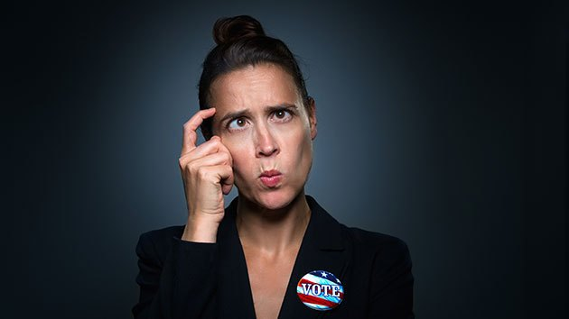
3 Out of 4 Undecided Voters Are Concerned About Fake News On Social Media And The Influence It May Have On Elections
% Undecided Voters Who Agree
“I am concerned by the amount of fake news on social media”
“I am concerned about the influence fake news may have on voters and/or election”
75%
75%
VAB: Winning OVER the undecided voter
Source: VAB / Research Now Poll of Registered or Likely Voters A18+; June 2018. Q19.1: How much do you agree or disagree with the following statements? I am concerned about the influence fake news may have on voters/election. Q23: How much do you agree or disagree with the following statements? I am concerned by the amount of fake news on social media. Respondents who answered Agree or Strongly Agree. Undecided voters = voters that are currently undecided on who they are going to vote for and who expect to make their decision one week or less before the election. Undecided Voter Respondents = 243. Total Survey Respondents: 1,003.

Slide 11
Conversely, TV Is The Most Trusted Media Source For Providing Undecided Voters With Accurate Political Information
More undecided voters rely on Television networks and their online properties over non-TV related news sites and social media because they know and trust the professional content these brands deliver
VAB: Winning OVER the undecided voter
Source: VAB / Research Now Poll of Registered or Likely Voters A18+; June 2018. Numbers do not equal 100% as multiple selections were allowed. Q22: There has been a lot of discussion recently about ‘fake news’. Which source do you trust to provide the most accurate political information? Respondents who answered Agree or Strongly Agree. Undecided voters = voters that are currently undecided on who they are going to vote for and who expect to make their decision one week or less before the election. Undecided Voter Respondents = 243. Total Survey Respondents: 1,003.

Slide 12
This Trust Has Established TV As The Primary Medium To Help Undecided Voters Form Their Opinion On Key Issues
TV’s ability to disseminate accurate information at scale, and provide live personality-driven coverage through the continuous news cycle, has enabled TV brands to build trust with people across screens.
This trusted reporting helps people form their opinions, much more than any other media.
VAB: Winning OVER the undecided voter
Source: VAB / Research Now Poll of Registered or Likely Voters A18+; June 2018. Numbers do not equal 100% as multiple selections were allowed. Q21: Which of the following media helps you best to form an opinion on key issues facing the country, such as gun control, health care, economy, global warming, immigration, etc...? Undecided voters = voters that are currently undecided on who they are going to vote for and who expect to make their decision one week or less before the election. Undecided Voter Respondents = 243. Total Survey Respondents: 1,003.

Slide 13

Trust In The Process:
The Driving Force Behind Voting Decision Making

Slide 14
Trusted Media Can Influence Each Step In The Undecided Voter’s Decision Making Process Leading Up To Election Day
Voters, even undecided voters, have an on-going relationship with many different media platforms and these platforms, coupled with the never-ending news cycle, can help shape opinions long before a candidate even announces they are running for office
Voter’s Decision Making Process
Discover Candidates / Issues
Gather Information
Generate Interest
Cast the Final Vote
“Where are you most
likely to first learn about
Political candidates/issues?
“Which of the following have prompted you to
take an action (seek info about political candidates/ issues, discuss with others)?
“Which of the following
keeps you informed about
Political candidates/issues?
“Which of the following influences your final decision when voting?
VAB: Winning OVER the undecided voter

Slide 15
Much Like The Total Respondents, Undecided Voters Are Also Most Influenced By TV Brands Throughout The Election Cycle
With each step of the decision making process, undecided voters prefer the trusted media of Television, and TV Brands on the whole, as their top political news source
Voter’s Decision Making Process
Discover Candidates / Issues
Gather Information
Generate Interest
Cast the Final Vote
Television is most likely where voters first learn about political candidates/ issues
Television is most likely to have prompted a voter to take an action (seek info about political candidates/ issues, discuss with others)
Television is relied on most to keep voters informed through the election cycle
Television is the media that most influences a person’s final vote
VAB: Winning OVER the undecided voter

Slide 16
The Trust That Exists With TV Brands Extends To Advertising
As It’s The Ad Platform Most Likely To Get Voters’ Attention
Survey Fun Fact: 66% of undecided voters try to actively avoid online political ads on Facebook and YouTube
VAB: Winning OVER the undecided voter
Source: Source: VAB / Research Now Poll of Registered or Likely Voters A18+; June 2018. Numbers do not equal 100% as multiple selections were allowed. Q14: Which of the following types of political advertising is most likely to get your attention? Q23: How much do you agree or disagree with the following statements? I tend to skip, minimize the page/screen or turn off the sound when an online political ad plays on YouTube/Facebook. Respondents who answered Agree or Strongly Agree. Undecided voters = voters that are currently undecided on who they are going to vote for and who expect to make their decision one week or less before the election. Undecided Voter Respondents = 243. Total Survey Respondents: 1,003.

Slide 17
Because Of This Attentiveness, It’s No Surprise That TV Is How Most Undecided Voters First Learn About Candidates And Issues
Survey Fun Fact: Emails from political candidates aren’t even opened by 59% of undecided voters
VAB: Winning OVER the undecided voter
Source: VAB / Research Now Poll of Registered or Likely Voters A18+; June 2018. Numbers do not equal 100% as multiple selections were allowed. Q15: Where are you most likely to first learn about Political candidates and issues...? Q24: How much do you agree or disagree with the following statements? I delete emails from political candidates without opening them. Respondents who answered Agree or Strongly Agree. Undecided voters = voters that are currently undecided on who they are going to vote for and who expect to make their decision one week or less before the election. Undecided Voter Respondents = 243. Total Survey Respondents: 1,003.

Slide 18
Political TV Ads Are Also Much More Likely Than Any Other Media To Spur Undecided Voters To Take An Action After Seeing An Ad
Against undecided voters, TV ads are almost 3x more likely than social media, and over 3.5x more likely than radio ads, to prompt a voter to take an action
VAB: Winning OVER the undecided voter
Source: VAB / Research Now Poll of Registered or Likely Voters A18+; June 2018. Numbers do not equal 100% as multiple selections were allowed. Q18: Which of the following types of political advertisements have prompted you to take an action (i.e. seek information about a political candidate/ issue, discuss with family/friends/co-workers)? Undecided voters = voters that are currently undecided on who they are going to vote for and who expect to make their decision one week or less before the election. Undecided Voter Respondents = 243. Total Survey Respondents: 1,003.

Slide 19
Due To On-Going Trust, Undecided Voters Are Likely To Rely On TV To Keep Them Informed Throughout The Election Cycle
Survey Fun Fact: 63% of undecided voters believe that Cable TV news websites and apps are a good source for political information
VAB: Winning OVER the undecided voter
Source: VAB / Research Now Poll of Registered or Likely Voters A18+; June 2018. Numbers do not equal 100% as multiple selections were allowed. Q16: Which of the following keeps you informed about Political candidates and issues...? Q20: How much do you agree or disagree with the following statements? Cable TV news websites/apps (CNN.com, MSNBC.com, etc.) are a good source for political information. Respondents who answered Agree or Strongly Agree. Undecided voters = voters that are currently undecided on who they are going to vote for and who expect to make their decision one week or less before the election. Undecided Voter Respondents = 243. Total Survey Respondents: 1,003.

Slide 20
Trust Translates Into Influence As Multi-Screen TV Is Much More Likely To Influence Voters’ Final Decision Than Other Media
Survey Fun Fact: 59% of undecided voters feel that political ads on the radio all seem the same to them
VAB: Winning OVER the undecided voter
Source: VAB / Research Now Poll of Registered or Likely Voters A18+; June 2018. Numbers do not equal 100% as multiple selections were allowed. Q17: Which of the following influences your final decision when voting for political candidates and issues...? Q24: How much do you agree or disagree with the following statements? Political ads on the radio all seem the same to me. Respondents who answered Agree or Strongly Agree. Undecided voters = voters that are currently undecided on who they are going to vote for and who expect to make their decision one week or less before the election. Undecided Voter Respondents = 243. Total Survey Respondents: 1,003.

Slide 21
In Fact, Multi-Screen TV Has A Clear Scale Advantage Over
All Online Platforms Throughout The Decision Making Process
Undecided voters rely on multi-screen TV early on and continue to turn to it more so than online platforms
Undecided Voters
Initial Stages of Decision Making Process
Where Do You Get Most Of Your Information About National Politics From?
Which Of The Following Types Of Political Advertising Is Most Likely To Get Your Attention?
Where Are You Most Likely To
First Learn About Political Candidates And Issues?
86% / 55%
82% / 53%
85% / 47%
Advanced Stages of Decision Making Process
Which Of The Following Types Of Political Advertisements Have Prompted You To Take An Action?
Which Of The Following
Keeps You Informed About Political Candidates And Issues?
Which Of The Following Influences Your Final Decision When Voting For Political Candidates and Issues?
73% / 44%
85% / 50%
75% / 48%
Multi-Screen TV
Total Internet (excluding TV news sites)
VAB: Winning OVER the undecided voter
Source: VAB / Research Now Poll of Registered or Likely Voters A18+; June 2018. Numbers do not equal 100% as multiple selections were allowed. Multi-Screen TV Figure (TV and TV News Websites/Apps); Total internet excluding TV-news websites (online radio/online newspapers/non-TV-related news websites/online search/social media). Undecided voters = voters that are currently undecided on who they are going to vote for and who expect to make their decision one week or less before the election. Undecided Voter Respondents = 243. Total Survey Respondents: 1,003.

Slide 22
And From A Community Perspective, Local Cable TV News Channels Are A Go-To Political Source For Undecided Voters
Survey Fun Fact: 61% of undecided voters say that local cable TV news channels are a good source of political information
Community, Quality, Character & Concise Coverage are the hallmarks of local cable news
Undecided Voters
% who agree
Local Cable provides an informative local perspective on national issues
63%
Local Cable provides extensive news coverage and political information
61%
I rely upon local cable news to cover local issues that affect my community
60%
Local Cable has quality news programs
56%
I watch more Local Cable news now than in the past
49%
VAB: Winning OVER the undecided voter
Source: VAB / Research Now Poll of Registered or Likely Voters A18+; June 2018. Q27: Thinking about Local Cable News, please rate the following statements (Respondents who answered Agree or Strongly Agree). Q23: How much do you agree or disagree with the following statements? Local cable TV news channels are a good source for political information. Respondents who answered Agree or Strongly Agree. Undecided voters = voters that are currently undecided on who they are going to vote for and who expect to make their decision one week or less before the election. Undecided Voter Respondents = 243. Total Survey Respondents: 1,003.

Slide 23
Closing Remarks
Much as we saw with total respondents in our first report - It's A Matter Of Trust: Media's Influence On Voters; even though politics has the ability to divide the country, the desire for trustworthy and accurate news sources is what unites voters, even the undecided voters.
As some platforms unintentionally allow the dissemination of unverified news stories and political ads, Television is trusted because it provides an environment that features 100% professionally produced news.
This is why Television is the most influential media throughout the election cycle and candidates that effectively use the platform can win over the undecided voter.
Voter’s Decision Making Process
Discover Candidates / Issues
Gather Information
Generate Interest
Cast the Final Vote
Television is most likely where voters first learn about candidates/issues
Television is most likely to have prompted a voter to take an action
Television is relied on most to keep voters informed through the election cycle
Television is the media that most influences a person’s final vote
The combined power of multi-screen TV further strengthens the influence that TV brands have among undecided voters; while local cable news delivers extensive and authentic news and political coverage from a local community perspective.
VAB: Winning OVER the undecided voter

Slide 24
