Slide 1
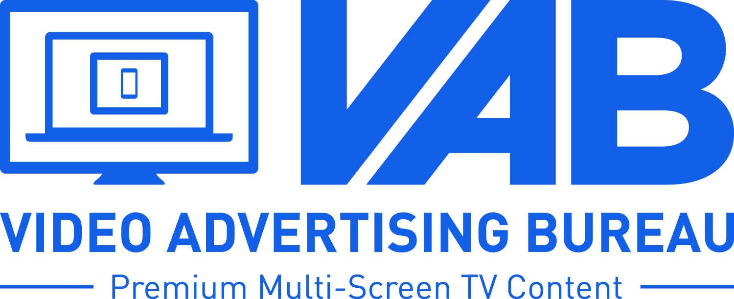
“IGNITION POINT”:
The TV-Traffic Correlation for Call-To-Action Brands
Notes:
1
1

Slide 2
Tab #1: Summary
Summary
As the Internet becomes the modern storefront, generating website traffic takes on a higher priority in marketing. This is particularly true for brands that depend on advertising to generate high sales volume on short notice.
The most essential question for these marketers becomes, what gets it all started?
While clutter clouds the media measurement arena, one straight-line correlation stands out for call-to-action brands: Their website traffic rises and falls in step with TV advertising.
This is the second report in the VAB’s commitment to illustrate critical effects of TV advertising that are hidden by the silo nature of syndicated data. Last year, we looked at the correlation between TV advertising and website traffic for 75 pure-play Internet companies, and found 85% showed a direct correlation between TV spending and website traffic.
This time, we chose to look at 125 brands in six categories – restaurants, retail, travel, telco / location-based mobile apps, financial and insurance – that collectively accounted for more than $30 billion in TV advertising in 2014. Importantly, we studied a cross-section of brands – large, midsized, smaller, national, regional and local – with more than 100,000 unique visitors per month as measured by comScore. All results are from the February 2014 to March 2015 period.
Fully 82% of these brands showed a correlation between TV advertising and website traffic. Of the 85 brands with visitor increases, 87% had upped TV spending. On average, they increased spending by 22% and saw 24% increases in unique visitors. Of the 40 brands with visitor decreases, 70% had lowered TV spending – an average of 10% less TV spending with a concurrent 9% decrease in visitors.

Slide 3
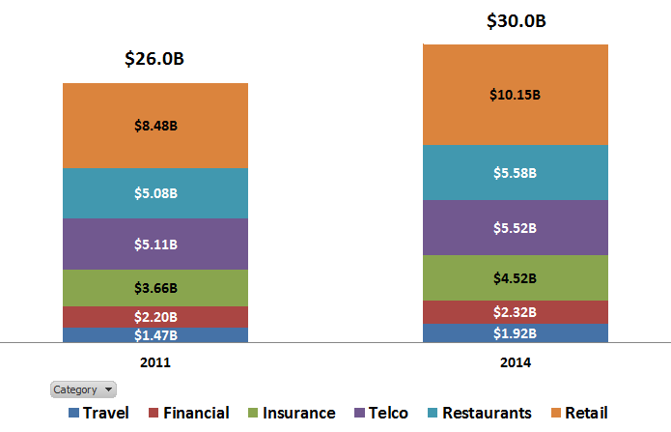
Tab #2: TV Investment
Our Hypothesis: TV Boosts Action, Not Just Awareness
In an increasingly action-oriented marketing environment, major call-to-action advertisers increased spending by 15% on TV from 2011 to 2014. Why would they do this if TV is just the great awareness medium? Our hypothesis was that TV advertising of all types – brand, promotion, DRTV – increases consumer action as well as brand engagement
To examine this, we looked at a widely-available, agnostic measure – website traffic expressed in unique visitors
“CTA” Categories:
2011 vs. 2014 Total TV Spend Trend
(Billions)
vs. ‘11
+15%
+20%
+10%
+8%
+23%
+6%
+30%
Source: Nielsen AdViews; TV spend (cable TV, broadcast TV, SLC TV, SLN TV, syndication, spot TV) calendar year 2011 vs. 2014

Slide 4





















































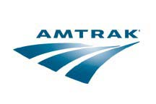

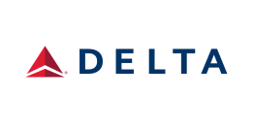
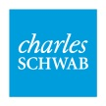


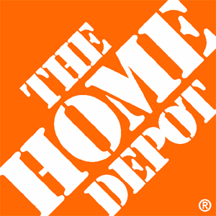


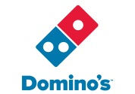



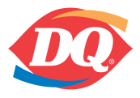









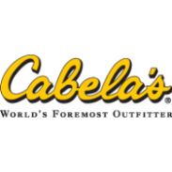




















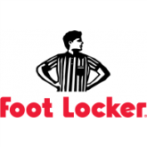



























Tab #3: CTA Brands
Our Universe: 125 Major National & Local Brands In 6 CTA Categories
Based on a 14-month time period (Feb’14 – Aug’14 vs. Sep.’14 – Mar’15), we compared the monthly unique visitor average to TV spend average for the first seven months vs. the last seven months to understand what, if any, correlations exist
Restaurants, Retail, Travel, Telco/Apps, Financial & Insurance
The list reflects a sample of different-sized brands with a mix of national & regional/local footprints. To be considered, brands had to have a 100K+ monthly unique visitor average per comScore.

Slide 5








































































































Tab #4: Comparison
Our Findings: A Positive Correlation Between TV Spend & Website Traffic
102 of the 125 “Call-To-Action” Brands (82%) Analyzed Exhibited a Direct Correlation Between TV Spend & Website Traffic
Unique Visitors
40 Brands in Unique Visitors
28 out of 40 Brands (70%) also had lower TV spend
Unique Visitors
85 Brands in Unique Visitors
74 out of 85 Brands (87%) also had higher TV spend

Slide 6
Tab #5: TV & Web Traffic
Our Findings: How Consistent Is This Correlation?
125 CTA Brand Advertisers: Unique Visitors vs. TV Spend
Feb. ‘14 – Mar. ’15 (14 Month “Half vs. Half” Comparison)
Brands Whose
Traffic Went Down
Brands Whose
Traffic Went Up
40 Advertisers
On average:
-10% less TV Spend
-9% less Unique Visitors
85 Advertisers
On average:
+22% more TV Spend
+24% more Unique Visitors
Source: Nielsen AdViews, TV spend (cable TV, broadcast TV, SLC TV, SLN TV, syndication, spot TV) Feb 2014-Mar 2015; comScore, mediametrix multiplatform, unique visitors Total Audience (P2+). Spend & unique visitors based on Feb-Aug ‘14 vs. Sep’14-Mar ‘15 monthly avg

Slide 7
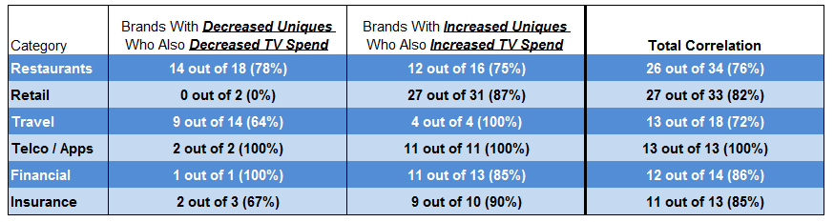
Tab #6: Categories
Call-To-Action Brands’ Correlation Scorecard
Source: Nielsen AdViews, TV spend (cable TV, broadcast TV, SLC TV, SLN TV, syndication, spot TV) Feb 2014-Mar 2015; comScore, mediametrix multiplatform, unique visitors Total Audience (P2+). Spend & unique visitors based on Feb-Aug ‘14 vs. Sep’14-Mar ‘15 monthly avg

Slide 8

Tab #7: Traffic Down
Deep Dives: Select Examples of Brands’ Demonstrated TV Spend / Site Traffic Correlation
Bloom: Combine the charts on this page & the next one
TV Spend Down, Traffic Down
TV Spend (000):
Feb. ‘14 - Aug. ’14:
$4,739
$1,823
$9,879
$798
$1,702
Sep. ‘14 – Mar. ‘15:
$3,834
$1,334
$6,452
$430
$645
% Difference:
-19%
-27%
-35%
-46%
-62%
Unique Visitors (000):
Feb. ‘14 - Aug. ’14:
1,604
966
1,487
1,318
242
Sep. ‘14 – Mar. ‘15:
1,389
766
1,089
1,048
90
% Difference:
-13%
-21%
-27%
-21%
-63%
Source: Nielsen AdViews, TV spend (cable TV, broadcast TV, SLC TV, SLN TV, syndication, spot TV) Feb 2014-Mar 2015; comScore, mediametrix multiplatform, unique visitors Total Audience (P2+). Spend & unique visitors based on Feb-Aug ‘14 vs. Sep’14-Mar ‘15 monthly avg

Slide 9
Tab #7: Traffic Down
Deep Dives: Select Examples of Brands’ Demonstrated TV Spend / Site Traffic Correlation
TV Spend Down, Traffic Down
TV Spend (000):
Feb. ‘14 - Aug. ’14:
$1,987
$997
$1,436
$3,633
$42,657
Sep. ‘14 – Mar. ‘15:
$440
$503
$1,230
$719
$40,607
% Difference:
-78%
-50%
-14%
-80%
-5%
Unique Visitors (000):
Feb. ‘14 - Aug. ’14:
564
631
1,231
2,508
10,684
Sep. ‘14 – Mar. ‘15:
384
274
1,104
1,190
8,564
% Difference:
-32%
-57%
-10%
-53%
-19%
Source: Nielsen AdViews, TV spend (cable TV, broadcast TV, SLC TV, SLN TV, syndication, spot TV) Feb 2014-Mar 2015; comScore, mediametrix multiplatform, unique visitors Total Audience (P2+). Spend & unique visitors based on Feb-Aug ‘14 vs. Sep’14-Mar ‘15 monthly avg

Slide 10

Tab #8: Traffic Up
Deep Dives: Select Examples of Brands’ Demonstrated TV Spend / Site Traffic Correlation
Bloom: Combine the charts on this page & the next one
TV Spend Up, Traffic Up
TV Spend (000):
Feb. ‘14 - Aug. ’14:
$6,314
$8,256
$2,407
$4,194
$3,617
Sep. ‘14 – Mar. ‘15:
$7,808
$11,410
$3,566
$5,067
$5,046
% Difference:
+24%
+38%
+48%
+21%
+39%
Unique Visitors (000):
Feb. ‘14 - Aug. ’14:
1,317
822
2,448
6,078
1,328
Sep. ‘14 – Mar. ‘15:
1,956
1,176
4,204
7,720
1,687
% Difference:
+49%
+43%
+72%
+27%
+27%
Source: Nielsen AdViews, TV spend (cable TV, broadcast TV, SLC TV, SLN TV, syndication, spot TV) Feb 2014-Mar 2015; comScore, mediametrix multiplatform, unique visitors Total Audience (P2+). Spend & unique visitors based on Feb-Aug ‘14 vs. Sep’14-Mar ‘15 monthly avg

Slide 11


Tab #8: Traffic Up
Deep Dives: Select Examples of Brands’ Demonstrated TV Spend / Site Traffic Correlation
TV Spend Up, Traffic Up
TV Spend (000):
Feb. ‘14 - Aug. ’14:
$11,034
$688
$4,578
$16,389
$4,967
Sep. ‘14 – Mar. ‘15:
$12,377
$1,497
$9,057
$20,212
$5,878
% Difference:
+12%
+118%
+98%
+23%
+18%
Unique Visitors (000):
Feb. ‘14 - Aug. ’14:
2,011
3,330
763
1,519
7,528
Sep. ‘14 – Mar. ‘15:
2,480
5,735
1,633
2,719
9,222
% Difference:
+23%
+72%
+114%
+79%
+23%
Source: Nielsen AdViews, TV spend (cable TV, broadcast TV, SLC TV, SLN TV, syndication, spot TV) Feb 2014-Mar 2015; comScore, mediametrix multiplatform, unique visitors Total Audience (P2+). Spend & unique visitors based on Feb-Aug ‘14 vs. Sep’14-Mar ‘15 monthly avg

Slide 12



Tab #8: Traffic Up
Deep Dives: Select Examples of Brands’ Demonstrated TV Spend / Site Traffic Correlation
Bloom: Combine the charts on this page & the next one
TV Spend Up, Traffic Up
TV Spend (000):
Feb. ‘14 - Aug. ’14:
$11,387
$44,612
$2,474
$9,379
$15,304
Sep. ‘14 – Mar. ‘15:
$14,569
$54,603
$3,274
$11,764
$16,862
% Difference:
+28%
+22%
+32%
+25%
+10%
Unique Visitors (000):
Feb. ‘14 - Aug. ’14:
451
52,203
137
24,303
9,540
Sep. ‘14 – Mar. ‘15:
748
71,492
226
34,102
11,726
% Difference:
+66%
+37%
+65%
+40%
+23%
Source: Nielsen AdViews, TV spend (cable TV, broadcast TV, SLC TV, SLN TV, syndication, spot TV) Feb 2014-Mar 2015; comScore, mediametrix multiplatform, unique visitors Total Audience (P2+). Spend & unique visitors based on Feb-Aug ‘14 vs. Sep’14-Mar ‘15 monthly avg

Slide 13



Tab #8: Traffic Up
Deep Dives: Select Examples of Brands’ Demonstrated TV Spend / Site Traffic Correlation
TV Spend Up, Traffic Up
TV Spend (000):
Feb. ‘14 - Aug. ’14:
$4,134
$872
$1,407
$24,076
$2,771
Sep. ‘14 – Mar. ‘15:
$6,765
$1,280
$1,972
$33,011
$3,201
% Difference:
+64%
+47%
+40%
+37%
+15%
Unique Visitors (000):
Feb. ‘14 - Aug. ’14:
1,482
3,602
255
36,981
4,718
Sep. ‘14 – Mar. ‘15:
2,244
4,526
449
48,327
5,227
% Difference:
+51%
+26%
+76%
+31%
+11%
Source: Nielsen AdViews, TV spend (cable TV, broadcast TV, SLC TV, SLN TV, syndication, spot TV) Feb 2014-Mar 2015; comScore, mediametrix multiplatform, unique visitors Total Audience (P2+). Spend & unique visitors based on Feb-Aug ‘14 vs. Sep’14-Mar ‘15 monthly avg

Slide 14
Tab #9: Conclusion
Conclusion
The temptation has been to think it’s necessary to find an Internet starting point, and completely reorient marketing, to succeed in the digital world. The data leads to a more reassuring conclusion for marketers. The ignition point is something they’re intimately familiar with – TV advertising.
This report adds to a mounting body of sophisticated evidence pointing to one conclusion: TV advertising is the primary driver of sales traffic.

