Slide 1

Members Center

Slide 2
News Ticker
Summary 3-5
Television: The Anchor Of The News Ecosystem 6-14
An Investigative Look At The Scale of National TV News 15-23
“News” Continues To Make News in 2017 24-27
Complementary Content Through Supplementary Screens 28-37
Online “Seekers” & “Social”-izers 38-41
News Wrap-Up 42-45
Contact Information 46
Igniting today’s headlines

Slide 3
The Newswire
News consumption is on fire. This fire is ignited by the continuous stream of current events, analyses and opinions which fuels the “around the clock” news cycle.
Based on last year’s elections, it should come as no surprise that news consumption was up by double-digits YOY in 2016; however, interest in news has not subsided even as we get deeper into 2017. This year, news audiences have been steady or, in some cases, are exceeding the highs seen during the pre- and post-election coverage in 4Q 2016.
The news category has been a clear winner for the large majority of the population who have an insatiable thirst for knowledge and desire to keep up with all the breaking news in this ultra fast-paced environment.
Sitting firmly in the lead anchor chair within this news ecosystem are TV brands. More Americans spend more time getting their news from TV than any other medium and TV brands are also the dominant force when it comes to online consumption.
There’s an inherent trust factor with credible, well-established TV brands that just doesn’t exist for many other publishers which is why a majority of online “news seekers” prefer to get their information from reliable news websites over social media.
In this post-election world people are relying even more on TV to get up-to-the-minute news, insights and analyses from brands they trust and they’re augmenting this coverage with online TV extensions to keep pace with breaking news happening all day, everyday.
Igniting today’s headlines

Slide 4
There’s Such An Abundance Of News Stories, If The Last Few Years Were A Song It’d Probably Go Something Like This…
The below is a contemporary version of Billy Joel’s iconic song, “We Didn’t Start The Fire,” whose original lyrics chronicled 40 years of headline events (1949-1989)
Donald Trump, Freddie Gray, Red China, equal pay
Book of Mormon, Capitol Hill, Pokemon Go
Megan Kelly, Peggy Whitson, automation, Television
North Korea, South Korea, San Bernardino
Zuckerberg, Saddam, Bastille Day, MOAB-bomb
Maddow, PewDiePie, and the robots with A.I.
Harry Potter, vaccine, England's got the same queen
Guantanamo, Ryan Lochte, marijuana, wi-fi
We didn't start the fire
It was always burning
Since the world's been turning
We didn't start the fire
No we didn't light it
But we tried to fight it
Sarah Palin, Andrey Karlov, Uber and Tsarnaev
Manchester, Judge Scalia, Citizen Barack
Jong-Un, Boko Haram, al-Baghdadi, Islam
NC state bathroom stalls, Vin Diesel and the Rock
Bernstein, Paula Dean, Cleveland's got a winning team
Russians Did It! on demand, Bill O’Reilly, “small hands”
Fargo, iOS, Lady Gaga, mischief
Duchess Kate, ethnic hate, trouble with Islamic State
(Chorus)
Email hack, drone attacks, Bernie, Merkel, alternate facts
Brexit, FBI, travel ban with “no fly”
Marathon, build a wall? Kyoto Protocol
Mayweather, Last Jedi, children of the genocides
Katy Perry, "Ben Hur," Bill Cosby, Crimea
Paltrow’s Goop, Castro, what really is Pluto?
U2, James Comey, Ebola and Hannity
Brooklyn Decker, Aleppo, shooting in Orlando
(Chorus)
Michael Bay, Allman, “Moonlight” and “La La Land”
Snowden, Yemen, foreign immigration
Crown Prince of Arabia, U.S. Biebermania
Mizzou, John Glenn, Stewart dumps Pattinson
Pope Francis, Space-X, everyday protests
CIA, Jon Benet, Trump’s inauguration day
(Chorus)
Border control, Kardashian, The Clintons almost back again
Harambe shot, Trump mocked, Deflategate, Nice rocked
Putin, collusion, Palestine, terror on the airlines
Nuke program in Iran? U.S.’s in Afghanistan
Memes on 4chan, Prince dies, Chris Cornell, suicides
Foreign debts, homeless vets, raids, meth, Somali pirates
Disappearance of bookstores, politicians break the law
The Syrians are at war, it continues more and more
Igniting today’s headlines

Slide 5
News Is On Fire And One Of The Hottest Genres In The
Video Ecosystem With A 21% Increase In Total Time Spent
Over 1 Billion Hours are collectively spent consuming news content on video-enabled devices each week
+21%
Includes news content viewed on TV (“National Broadcast TV News,” “Local Broadcast TV News,” “National Cable TV News”), PC (“PC News”) & Smartphones (“Smartphone News”) and reflects all activity done, not just video viewing.
Igniting today’s headlines
Source: Nielsen Total Audience Report Q4 2016 – Adults 18+. National TV News (Nielsen National Television Panel, News summary type code, Broadcast – ABC, CBS, FOX, NBC, TEL, UNI; Cable – CNBC, CNN, FOXNC, MSNBC); Local TV News (Nielsen 25 LPM Markets, Local news genre, Broadcast – ABC, CBS, FOX, NBC, TEL, UNI); PC News (Netview, Current Events & Global News subcategory): Smartphone News (EMM, Current Events & Global News subcategory). Local Cable TV News data is not available within the report.

Slide 6

Television:
The Anchor Of The News Ecosystem

Slide 7
Keeping Up With News & Current Events Is Important To
A Large Majority Of The Population
Igniting today’s headlines
Source: Pew Research Center “The Modern News Consumer,” released 7/7/16 with survey conducted Jan 12 – Feb 8, 2016 among 4,654 US adults 18+.

Slide 8
TV Continues To Be The Most Widely Used Platform For Adults To Get Their News
Igniting today’s headlines
Source: Pew Research Center “The Modern News Consumer,” released 7/7/16 with survey conducted Jan 12 – Feb 8, 2016 among 4,654 US adults 18+. “TV” includes cable, local, nightly network while “Online” includes social media, websites/apps.

Slide 9
People Who Like To “Watch” The News Overwhelmingly Prefer Television Over Online
Igniting today’s headlines
Source: Pew Research Center “The Modern News Consumer,” released 7/7/16 with survey conducted Jan 12 – Feb 8, 2016 among 4,654 US adults 18+. “Other” media includes radio & print. “Watching” as opposed to “reading” or “listening.”

Slide 10
TV Dominates As The Preferred News Platform Among Very Loyal News Consumers
46% of Americans define themselves as “very loyal” news consumers (they are loyal to their news sources and go to those same sources for news all the time)
  67% of very loyal news consumers follow the news all or most of the time; a much higher rate than others
Igniting today’s headlines
Source: Pew Research Center “The Modern News Consumer,” released 7/7/16 with survey conducted Jan 12 – Feb 8, 2016 among 4,654 US adults 18+. “Other” media includes radio & print. “Watching” as opposed to “reading” or “listening.”

Slide 11
All Of This Helps Explain Why TV Accounts for 91% of the Total Time Spent Consuming News On Video-Enabled Devices
TV includes National Broadcast TV News, Local Broadcast TV News & National Cable TV News
Igniting today’s headlines
Source: Nielsen Total Audience Report Q4 2016 – Adults 18+. National TV News (Nielsen National Television Panel, News summary type code, Broadcast – ABC, CBS, FOX, NBC, TEL, UNI; Cable – CNBC, CNN, FOXNC, MSNBC); Local TV News (Nielsen 25 LPM Markets, Local news genre, Broadcast – ABC, CBS, FOX, NBC, TEL, UNI); PC News (Netview, Current Events & Global News subcategory): Smartphone News (EMM, Current Events & Global News subcategory). Local Cable TV News data is not available within the report.

Slide 12
Average Time Spent With National Cable TV News Among News Consumers Increased By 28% In The Past Year
Average Weekly Time Spent With News Content Among News Consumers (Adults 18+)
(Hr:Min)
6:28
+28%
5:03
4:30
4:27
-1%
2:06
2:07
+1%
1:14
+54%
0:48
+22%
0:18
0:22
Reflects “all in” consumption, not just video viewing
Igniting today’s headlines
Source: Nielsen Total Audience Report Q4 2016 – Adults 18+. National TV News (Nielsen National Television Panel, News summary type code, Broadcast – ABC, CBS, FOX, NBC, TEL, UNI; Cable – CNBC, CNN, FOXNC, MSNBC); Local TV News (Nielsen 25 LPM Markets, Local news genre, Broadcast – ABC, CBS, FOX, NBC, TEL, UNI); PC News (Netview, Current Events & Global News subcategory): Smartphone News (EMM, Current Events & Global News subcategory). “Time Spent” reflective of news consumers only. Average week across the year. Local Cable TV News data is not available within the report.

Slide 13
Average Time Spent With National Cable TV News Among “Millennial” News Consumers Increased By 53% In The Past Year
Average Weekly Time Spent With News Content Among News Consumers (Adults 18-34)
(Hr:Min)
+53%
-2%
+3%
+42%
+7%
Reflects “all in” consumption, not just video viewing
Igniting today’s headlines
Source: Nielsen Total Audience Report Q4 2016 – Adults 18-34. National TV News (Nielsen National Television Panel, News summary type code, Broadcast – ABC, CBS, FOX, NBC, TEL, UNI; Cable – CNBC, CNN, FOXNC, MSNBC); Local TV News (Nielsen 25 LPM Markets, Local news genre, Broadcast – ABC, CBS, FOX, NBC, TEL, UNI); PC News (Netview, Current Events & Global News subcategory): Smartphone News (EMM, Current Events & Global News subcategory). “Time Spent” reflective of news consumers only. Average week across the year. Local Cable TV News data is not available within the report.

Slide 14
All Major Ethnicities Greatly Increased Their Time Spent With National Cable TV News During The Election Year
Average Weekly Time Spent With News Content Among News Consumers
(Hr:Min)
+24%
+1%
+64%
-1%
+1%
+52%
+27%
+55%
-5%
+52%
+29%
-3%
-3%
+10%
+51%
-5%
+46%
+12%
+13%
Reflects “all in” consumption, not just video viewing
Igniting today’s headlines
Source: Nielsen Total Audience Report Q4 2016. National TV News (Nielsen National Television Panel, News summary type code, Broadcast – ABC, CBS, FOX, NBC, TEL, UNI; Cable – CNBC, CNN, FOXNC, MSNBC); Local TV News (Nielsen 25 LPM Markets, Local news genre, Broadcast – ABC, CBS, FOX, NBC, TEL, UNI); PC News (Netview, Current Events & Global News subcategory): Smartphone News (EMM, Current Events & Global News subcategory). “Time Spent” reflective of news consumers only. Average week across the year. Local Cable TV News data is not available within the report.

Slide 15

An Investigative Look At The Scale Of National TV News

Slide 16
News Is Being Watched Around The Clock As Gross Rating Points Are Spread Fairly Evenly Across The Day
Weekday only
Igniting today’s headlines
Source: Nielsen Ad Intel, reflects cable TV & broadcast TV for the broadcast month of March 2017; equivalized GRPs (GRPE). For the purposes of this analysis, dayparts reflect Weekday Mornings (6a-9a), Weekday Daytime (9a-4:30p), Weekday Early Fringe / Early News (includes Prime Access as well; 4:30p-8p), Weekday Prime / Late Night (includes Late News as well; 8p – 1a); Weekday Overnight (1a-6a); Weekend (all day Saturday & Sunday).

Slide 17



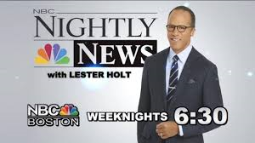











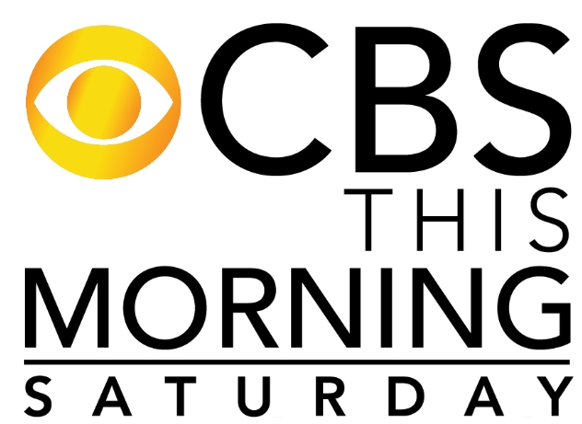












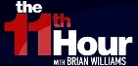

















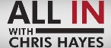




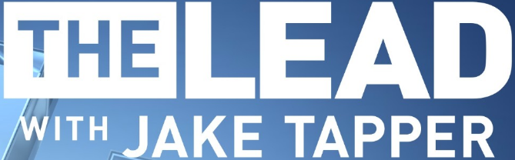























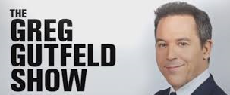







Each Daypart Is Anchored By Several Daily, or Weekly, Signature News Series That Air On National TV
Sampling of Signature News Series
Monday-Friday
Weekend
Morning
Daytime
Early Fringe / Early News
Prime /
Late Night
Saturday
Sunday
Igniting today’s headlines
As of May 2017

Slide 18
News Is Nearly Ubiquitous Among The TV Viewer Given It’s Never-Ending Daily Cycle Of Current Event Reporting & Analysis
Annual Cume National TV News Reach
CY 2016
Igniting today’s headlines
Source: Nielsen NPower R&F Program Report, Total Day, Live+7; P2+, P25-54 & P18-34; ad-supported cable TV + broadcast TV, January 1st – December 31st 2016; based on news category.

Slide 19
National TV News Monthly Reach Is Fairly Consistent But Naturally Saw A Spike Leading Up To The Election In November
On average, over 75% of P2+ & A25-54 watch national TV news programming each month
Monthly Cume National TV News Programming Reach
CY 2016
Igniting today’s headlines
Source: Nielsen NPower R&F Program Report, Total Day, Live+7; P2+, P25-54 & P18-34; ad-supported cable TV + broadcast TV, January 1st – December 31st 2016; based on news category.

Slide 20
There Has Been A 26% Increase In The National TV News Audience During Any Given Minute Over The Past Year
National TV News Programming: Average Minute Audience (000)
CY 2015 vs. CY 2016
+26%
+26%
+35%
Note: “Average Audience” based on the average audience per minute for news programming during the full calendar year (total day).
Igniting today’s headlines
Source: Nielsen NPower R&F Program Report, Total Day, Live+7; P2+, P25-54 & P18-34; ad-supported cable TV + broadcast TV, based on calendar year and reflects news category genre.

Slide 21
Almost 38 Billion Hours Of News Programming Were Collectively Viewed On Ad-Supported National TV In 2016
93% of total viewing of news programming was live
National TV News Programming: Total Cume P2+ Hours Viewed
CY 2016
Hours
Hours
Hours
Igniting today’s headlines
Source: Nielsen NPower R&F Program Report, Total Day, Live+7; P2+; ad-supported cable TV + broadcast TV, based on calendar year and reflects news category genre.

Slide 22
National TV News Viewing Has Collectively Increased Across
Each Major Stream YOY
National TV News Programming: Total Cume P2+ Hours Viewed Comparison
CY 2015 vs. CY 2016
+26%
+26%
+25%
Billion
Hours
Billion
Hours
Billion
Hours
Igniting today’s headlines
Source: Nielsen NPower R&F Program Report, Total Day, Live+7; P2+; ad-supported cable TV + broadcast TV, based on calendar year and reflects news category genre.

Slide 23
With Everchanging Updates To Current Events, News Remains Almost Exclusively A “Live” Or “Near Live” Viewing Experience
National TV News Programming: Viewership By Stream
% of Total Viewing Hours in CY 2016
Igniting today’s headlines
Source: Nielsen NPower R&F Program Report, Total Day, Live+7; P2+, P25-54 & P18-34; ad-supported cable TV + broadcast TV, based on calendar months YOY and reflects news category genre.

Slide 24
“News” Continues To Make News In 2017

Slide 25
Average Time Spent With Televised News Programming Continues To See Increases In 2017 Relative To Prior Year
National TV News Programming: Average Quarterly Minutes Viewed Comparison
1Q 2016 vs. 1Q 2017
+14%
+12%
+7%
Igniting today’s headlines
Source: Nielsen NPower R&F Program Report, Total Day, Live+7; P2+, P25-54 & P18-34; ad-supported cable TV + broadcast TV, based on YOY calendar months within the quarter and reflects viewers within the news category genre.

Slide 26
Post-Election, National TV News Has Essentially Maintained Their Average Audiences In 2017 From The Election Highs Of 4Q
National TV News Programming: Average Minute Audience (000)
CY 2016 vs. 4Q 2016 vs. 1Q 2017
Note: “Average Audience” based on the average audience per minute for news programming during the full calendar year (total day).
Igniting today’s headlines
Source: Nielsen NPower R&F Program Report, Total Day, Live+7; P2+, P25-54 & P18-34; ad-supported cable TV + broadcast TV, based on YOY calendar months and reflects news category genre.

Slide 27
Overall Time Spent With National TV News Programming Has Been Skewing More Towards Cable TV Recently
National TV News Programming: Total Time Spent % By Medium
CY 2015 – 1Q ‘17
Igniting today’s headlines
Source: Nielsen NPower R&F Program Report, Total Day, Live+7; P2+, P25-54 & P18-34; ad-supported cable TV + broadcast TV, based on calendar years for 2015 & 2016 and months for 1Q ’17 and reflects news category genre. % breakout based on total minutes viewed / average audience.

Slide 28
Complementary Content Through Supplementary Screens

Slide 29
Although TV Is King, People Who Use Mobile Devices To Get News Have Grown Significantly Over The Last Few Years
60%
41%
Igniting today’s headlines
Source: Pew Research Center “The Modern News Consumer,” released 7/7/16 with survey conducted Jan 12 – Feb 8, 2016 among 4,654 US adults 18+.

Slide 30





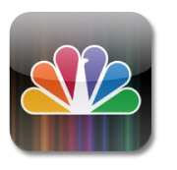

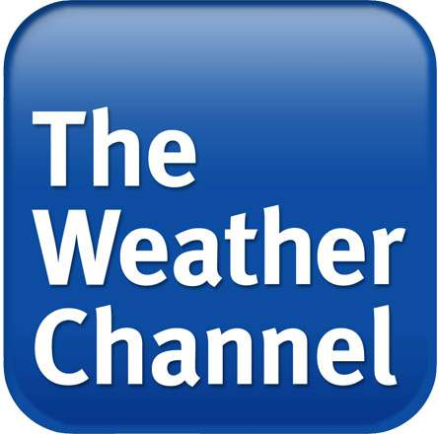




With Extensive Reporting & Live Streaming, TV Brands Are Well-Positioned To Be The Primary Source Of News To Online Users
Live streaming along with additional online analyses and reporting from news programmers & providers gives flexibility to cable subscribers, allowing them to view content across devices
Sampling of Live Streaming Mobile Apps
Igniting today’s headlines

Slide 31
National TV-Branded News Platform Reach Is Nearly Universal Among The Digital Population
TV-Branded News Platform Cume Unique Visitors Coverage
March ‘17
Igniting today’s headlines
Source: comScore MediaMetrix, multiplatform (web+mobile), unique visitors for total digital population, March 2017, Total Audience (Desktop P2+; Mobile P18+). comScore Audience Duplication, multiplatform (web+mobile), March 2017, Total Audience (Desktop P2+; Mobile P18+), Unduplicated unique visitors based on a custom created News TV Branded Website subcategory which includes digital platforms such as ABC News, CNN, NBC News, CBS News, Fox News, BBC & Weather Channel. Local broadcast affiliate websites are excluded from this custom set.

Slide 32
Monthly Cume Reach Across TV News Digital Platforms Is
Stable Throughout The Year
TV-Branded News Platform Cume Total Monthly Visitors
(000)
Igniting today’s headlines
Red line reflects the average monthly unique visitors across the time period
Source: comScore Audience Duplication, multiplatform (web+mobile), April 2016-March 2017, Total Audience (Desktop P2+; Mobile P18+). Unduplicated unique visitors based on a custom created News TV Branded Website subcategory which includes digital platforms such as ABC News, CNN, NBC News, CBS News, Fox News, BBC & Weather Channel. Local broadcast affiliate websites are excluded from this custom set; local cable news websites are not measured.

Slide 33
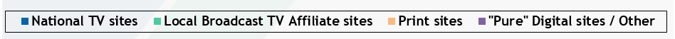
National TV-Branded Digital Platforms Account For Half Of The Total Minutes Spent Within The News Category
National TV news websites’ share of time spent among Millennials is equal to other major demos
Share of Total Minutes Spent Online Within the News/Info Category by Media Group
March ‘17
Igniting today’s headlines
Source: VAB analysis of comScore MediaMetrix, multiplatform (web+mobile) data, total minutes viewed, March 2017, Total Audience (Desktop P2+; Mobile P18+). Groups were custom made within the news/information category – “national TV sites” includes digital platforms such as ABC News, CNN, NBC News, CBS News, Fox News, BBC & Weather Channel; “print sites” include newspaper & magazine-related sites; “ pure digital sites / other” also includes radio-related sites. Local cable news websites are not measured.

Slide 34
National TV-Branded Websites’ Share Of Total Time Spent Within The News Category Has Grown Since The Election
National TV news websites saw its largest share gain against Millennials as time spent with “pure” digital-based sites decreased
Share of Total Minutes Spent Online Within the News/Info Category by Media Group
November ‘16 vs. March ‘17
Igniting today’s headlines
Source: VAB analysis of comScore MediaMetrix, multiplatform (web+mobile) data, total minutes viewed, November ‘16 vs. March ‘17, Total Audience (Desktop P2+; Mobile P18+). Groups were custom made within the news/information category – “national TV sites” includes digital platforms such as ABC News, CNN, NBC News, CBS News, Fox News, BBC & Weather Channel; “print sites” include newspaper & magazine-related sites; “ pure digital sites / other” also includes radio-related sites. Local cable news websites are not measured.

Slide 35
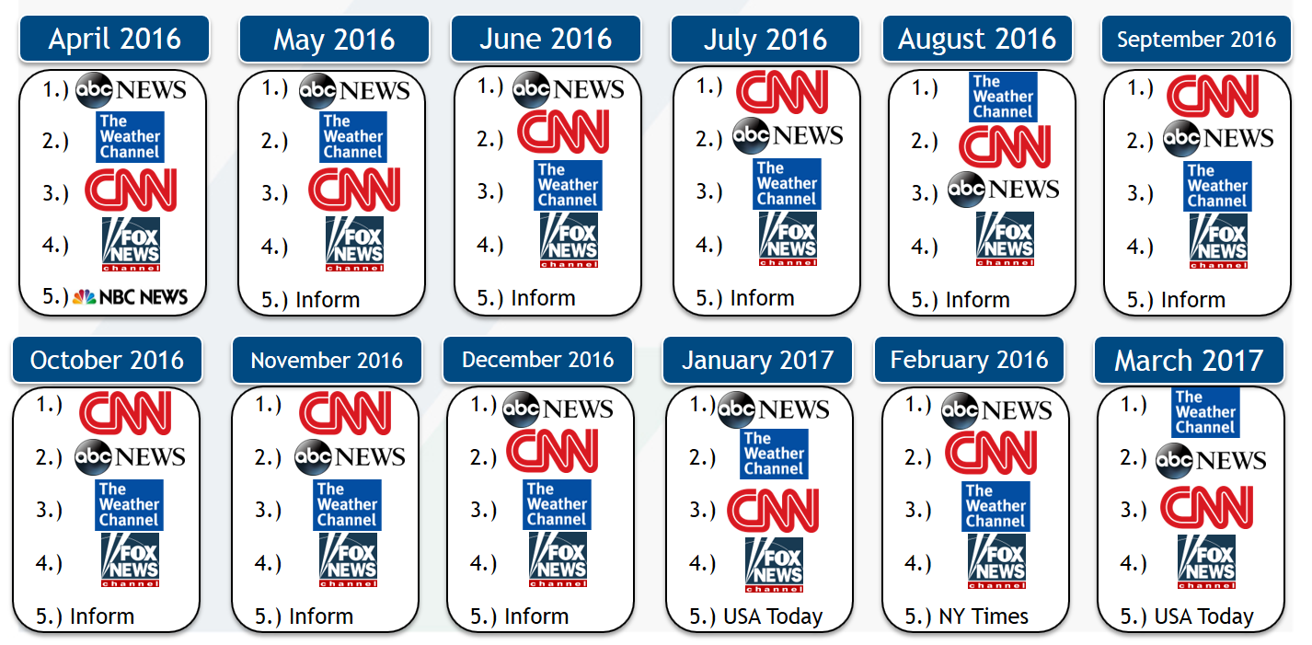
TV-Related Brands Make Up The Top 4 Most Trafficked Digital Platforms In The News Category Every Month
Top 5 News Digital Platform Rank By Total Minutes Viewed (Total Audience)
Igniting today’s headlines
Source: comScore MediaMetrix, multiplatform (web+mobile) media trend data, April 2016-March 2017; News/Information category, Total Audience (Desktop P2+; Mobile P18+). “Inform” (formerly NDN) is a video aggregator that encompasses a wide-range of newspaper, local TV & radio station websites.

Slide 36
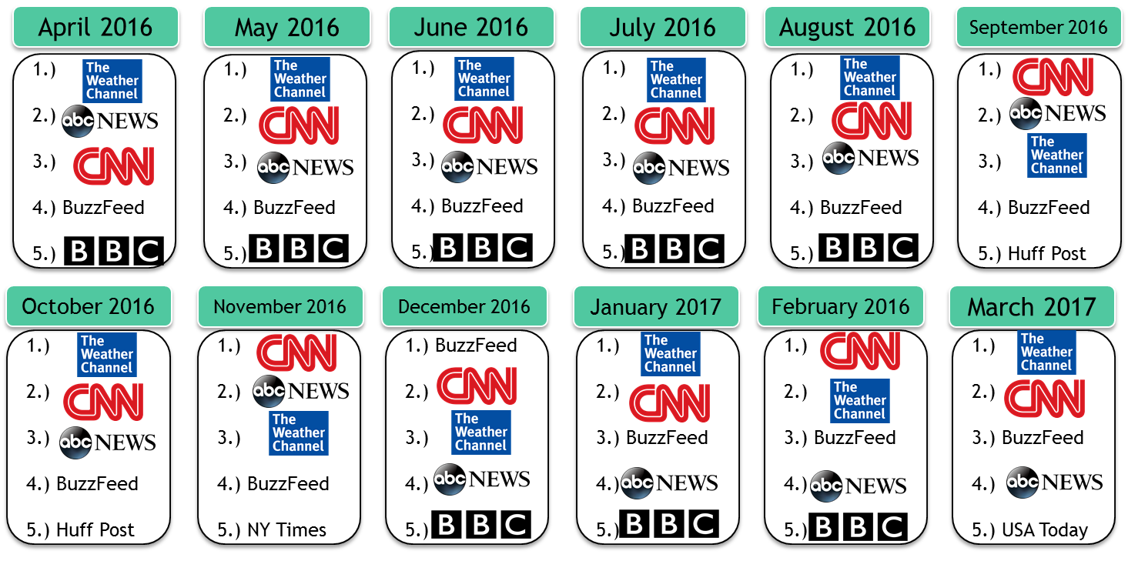
TV-Related Brands Also Make Up Most Of The Top 5 Monthly Digital News Platforms Among Millennials
Top 5 News Digital Platform Rank By Total Minutes Viewed (P18-34)
Igniting today’s headlines
Source: comScore MediaMetrix, multiplatform (web+mobile) media trend data, April 2016-March 2017; News/Information category, P18-34.

Slide 37


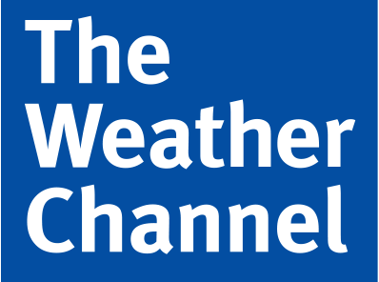



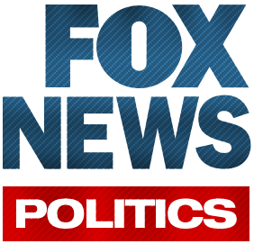



A TV Brand Is #1 Across The News/Information Subcategories Whether It’s General News, Politics Or Weather
Top 5 News Subcategory Digital Platform Rank By Total Minutes Viewed (March 2017)
General News
Politics
Weather
1.)
2.)
3.)
4.)
5.)
1.)
2.)
3.) Politico
4.)
5.) Huff Post Politics
1.)
2.) AccuWeather
3.) WeatherBug
4.) Pelmorex
5.) Yahoo Weather
Total Audience:
(Desktop P2+; Mobile P18+)
General News
Politics
Weather
1.)
2.) Buzzfeed
3.)
4.)
5.)
1.)
2.)
3.) Politico
4.)
5.) TheHill.com
1.)
2.) AccuWeather
3.) Pelmorex
4.) WeatherBug
5.) Yahoo Weather
P18-34:
Igniting today’s headlines
Source: comScore MediaMetrix, multiplatform (web+mobile) data, March 2017; News/Information category – General News, Politics, Weather subcategories

Slide 38

Online “Seekers” & “Social”-izers

Slide 39
People Who Go Online Looking For News Are Much More Likely To Get It From Websites Than Social Media
63% of “seekers,” or people that actively go online looking for news, follow the news all or most of the time; a much higher rate than others
Igniting today’s headlines
Source: Pew Research Center “The Modern News Consumer,” released 7/7/16 with survey conducted Jan 12 – Feb 8, 2016 among 4,654 US adults 18+.

Slide 40

But When Televised News Make Headlines, People Go On Social Media To Talk About It… A Lot
Example: TV-Related Topics That Trended In The Twitter Top 10 During Primetime In The Month Leading Up To The Election
Date
Topic / Rank
Description
Date
Topic / Rank
Description
#VPDebate
#1 trending hashtag related to VP debate; several other debate-related topics trended as well throughout night
#DrainTheSwamp
In a televised speech covered by the major news networks, Donald Trump unveils ethics and lobbying reform plan where he intends to “drain the swamp”
4-Oct
18-Oct
#debate
#Hillary
#sniffles
Hashtags related to the 2nd Presidential Debate; while several other debate-related topics trended as well
#debatenight
3rd and final Presidential debate. Several other topics related to what was being said during the debate began trending throughout the night as well
9-Oct
19-Oct
#KenBoneFacts
Hashtag related to an audience member, now internet celebrity, of the previous night’s Presidential debate
Annual fundraiser dinner for support of Catholic charities that invites the Presidential candidates each election year to speak and is covered by the major TV news networks
10-Oct
#AlSmithDinner
20-Oct
#ncgov
North Carolina governor televised debate and coverage by major TV news networks
11-Oct
#FLSenDebate
Hotly-contested Florida Senate debate featuring Marco Rubio and covered by the major TV news networks.
The final Puerto Rico gubernatorial debate which was covered by Univision
#WeWillRise
CNN documentary: “We Will Rise: Michelle Obama’s Mission to Educate Girls Around the World”
26-Oct
#ConvenceMe
12-Oct
#BillyBushMadeMeDoIt
Hashtags related to Melania Trump’s CNN interview with Anderson Cooper.
A user-generated hashtag begins trending after Melania blames Billy Bush for Trump’s comments about women
#MelaniaTrump
Rare speech given by Melania Trump, which was covered by the major TV news networks, who spoke about stopping cyber-bullying among other issues
3-Nov
17-Oct
#MelaniaTrump
IGNITING TODAY’S HEADLINES
Source: VAB custom analysis of Top 10 trending Twitter Topics each night (8:15p, 9:15p, 10:15p, 11:15p) between October 4th, 2016 – November 6th, 2016.

Slide 41
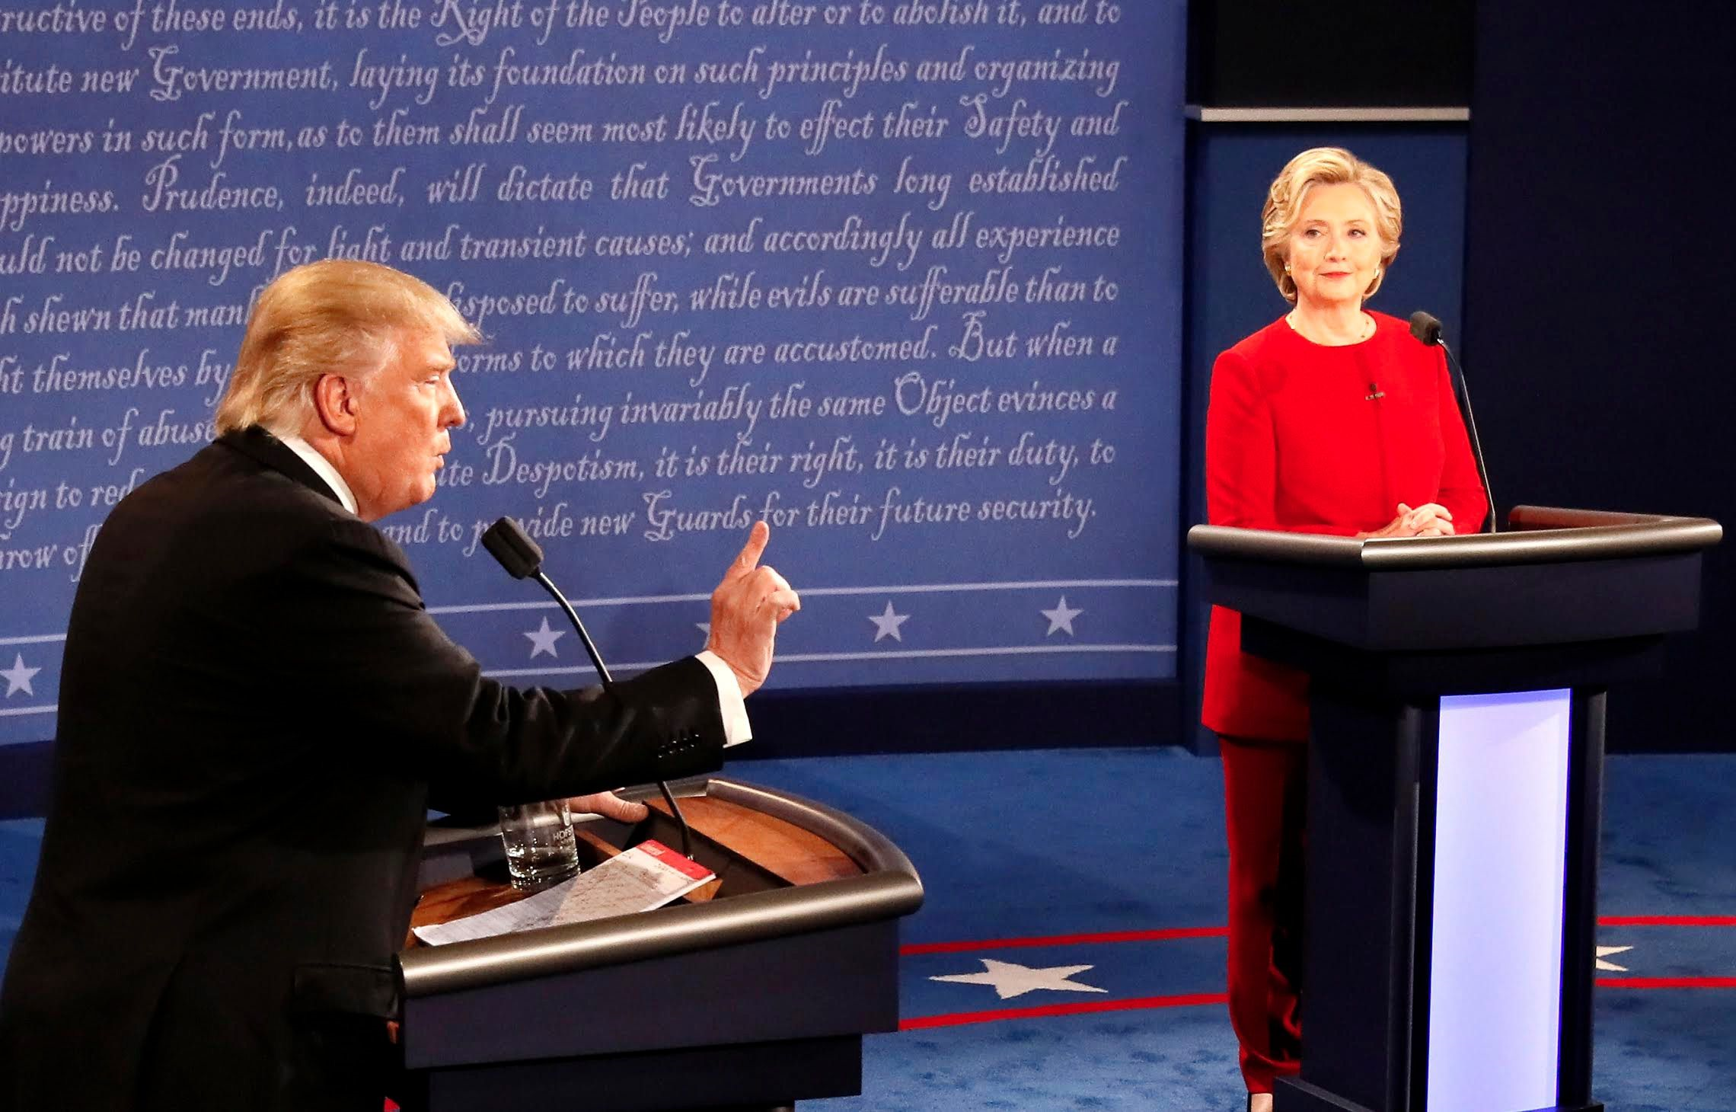
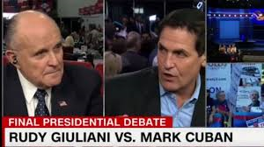
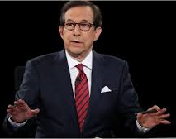
Big News Events, Like The Presidential Debate Nights, Offer Particular Social Fodder For Twitter Users
Beyond the top trending #DebateNight hashtag, nine different topics related to the televised Presidential debate on October 19th trended in the top 10 throughout the night
TV-Related Topics in Top 10:
-#ChrisWallace
-#Putin
-#SCOTUS
-Bad Hombres
-BIGLY
-Emmys
-Hillary
-#MarkCuban
-Nasty Woman
#DebateNight: Top Trending Topic
“…And that’s what’s happened bigly”
“He started tweeting the Emmy’s were rigged against him”
“The Supreme Court needs to stand on the side of the American people”
“Such a
nasty woman”
“We have some bad hombres here and we’re going to get ‘em out”
“Putin would rather have a puppet as President”
#Hillary
The Debate “Undercard”
The Moderator
#MarkCuban
41
#ChrisWallace
Source: VAB custom analysis of Top 10 trending Twitter Topics on October 19th, 2016 (8:15p, 9:15p, 10:15p, 11:15p)

Slide 42

News Wrap-Up

Slide 43
Not Surprisingly, There Was A Double-Digit Surge In National TV News Spending During The 2016 Election Year
Advertisers spent 18% more on national news programming in 2016 vs. the prior year; and 17% more than the last Presidential election cycle in 2012.
Igniting today’s headlines
Source: Nielsen Ad Intel, reflects national cable TV, Spanish language cable TV, broadcast TV, Spanish language broadcast TV; based on calendar years. Includes the following genres: News, News-general, documentary news & children’s news & info.

Slide 44
This Double-Digit Surge Continues Into 2017, An Impressive Increase Since 1Q ‘16 Was The Kickoff To The Primary Elections
Advertisers spent 10% more on national news programming in 1Q ‘17 vs. the prior year; and 32% more than the first quarter after the last Presidential election cycle in 2013.
Igniting today’s headlines
Source: Nielsen Ad Intel, reflects national cable TV, Spanish language cable TV, broadcast TV, Spanish language broadcast TV; based on calendar months within the quarters. Includes the following genres: News, News-general, documentary news & children’s news & info.

Slide 45
The Number Of Advertisers Has Also Increased Within The
News Genre Over the Last Several Years
There was a 7% increase in the number of national TV news advertisers in 1Q ‘17 vs. the prior year; and 6% more than the first quarter after the last Presidential election cycle in 2013.
Igniting today’s headlines
Source: Nielsen Ad Intel, reflects national cable TV, Spanish language cable TV, broadcast TV, Spanish language broadcast TV; based on calendar months within the quarters. Based on parent company advertisers and reflects the following genres: News, News-general, documentary news & children’s news & info.

Slide 46


For More Information Visit Us Online
TheVAB.com
Follow us:
@VideoAdBureau
Like us:
facebook.com/VideoAdvertisingBureau

Slide 47
National Cable TV News Saw a 37% Increase in Time Spent Between The Last Two Presidential Election Years
6:28
+37%
4:43
4:08
4:27
+2%
1:57
2:07
+9%
Igniting today’s headlines
Source: Nielsen Total Audience Report Q4 2016, Local Broadcast TV News represents LPM Markets

