Slide 1
A Look at Online Ad Viewability
If You Can’t See It, It Can’t Impact You

Slide 2
Viewability is a key currency in digital advertising that tracks ad impressions which are actually seen by real humans. These impressions are called ‘viewed impressions’.
To simplify, if you have an advertisement that shows at bottom of website and visitor does not scroll far enough to see it, a viewed impression will not be recorded.
Why Is It Important? Viewability is key for both publishers and buyers as many impressions that are sold are never viewed and this causes advertisers to waste millions of dollars each year.
Viewability is highly correlated to ad-effectiveness. For digital ads to make an impact, they must be viewed.
Ad Viewability Matters
Source: Doubleclickbygoogle.com/articles/the-state-of-video-ad-viewability/; mobileleads.com/blog/viewability-important-advertising-campaigns/; go.integralads.com/os-ad-fraud*

Slide 3
Advertisers May Be Losing Up to 60% of Their Digital Ad
Campaign Impressions Due to Lack of Viewability,
Fraud and Ad Blocking
Illustrative Example: Share of Digital Spend
$328K lost to off-target age & gender
$472K Value Received
$2M Digital
Spend
$1.2M lost from ads out of view, fraud and ad blocking
Source: Nielsen Viewability in Digital Advertising: What’s Next 2/18 (Ad Blocking:eMarketer, June 2016; Viewability/Fraud: Integral ad Science 1Q16 Media Quality report On-Target loss based on Nielsen DAR overall campaign On-Target % of 59%, 2Q17)

Slide 4

In Fact,Viewability Rates In the U.S.
Lag Other Countries
% In-View of Video Ads (Web & Apps)
Turkey | 77% |  | Brazil | 68%
Netherlands | 76% |  | India | 68%
Italy | 72% |  | Canada | 67%
Denmark | 71% |  | Korea | 66%
Israel | 71% |  | United States | 65%
Italy | 71% |  | Germany | 64%
Colombia | 70% |  | Japan | 64%
Spain | 70% |  | Great Britain | 61%
Spain | 70% |  | Russia | 60%
Australia | 69% |  | France | 59%
Mexico | 69%
Source: doubleclickbygoogle.com/articles/the-state-of-video-ad-viewability/

Slide 5
It’s a good start but its not enough…
Advertisers are insisting on third party measurement and transparency. And many are negotiating buys based on their own definitions of viewability.
Even MRC is reviewing their own standards to possibly increase to 100% of pixels in-view.
Current Measurement & Lack of Standardization
MRC’s Viewability Standards
Display – 50% of pixels in-view for 1 second
Larger units with 242,500 pixels must have 30% of pixels in view for 1 sec
Video Ads – 50% of pixels in-view for 2 second
Lack of Universal Viewability Standards
Facebook & Instagram count views at 3 seconds
Snapchat counts views upon opening
YouTube – depends on format
Source: Ipsos ‘Viewability Matters: What Advertisers need to know about advertising viewability,4/18 & Current MRC Standards

Slide 6
The Current Reality of Online Advertising Viewability:
- Only 20% of YouTube Trueview ads are viewed to completion
- Only 22% of Facebook video ads are viewed for 3 seconds
- Only 65% of viewers who watch the first three seconds of a video will continue on to at least the ten second mark, and 45% will watch thirty seconds.
- 10-30% of programmatic ads don’t reach human eyes at all
- 600 million devices carry ad blockers
Given The Rise In Digital Spend - Ad
Viewability Is More Important Than Ever
Source: Ipsos ‘Viewability Matters: What Advertisers need to know about advertising viewability,4/18

Slide 7
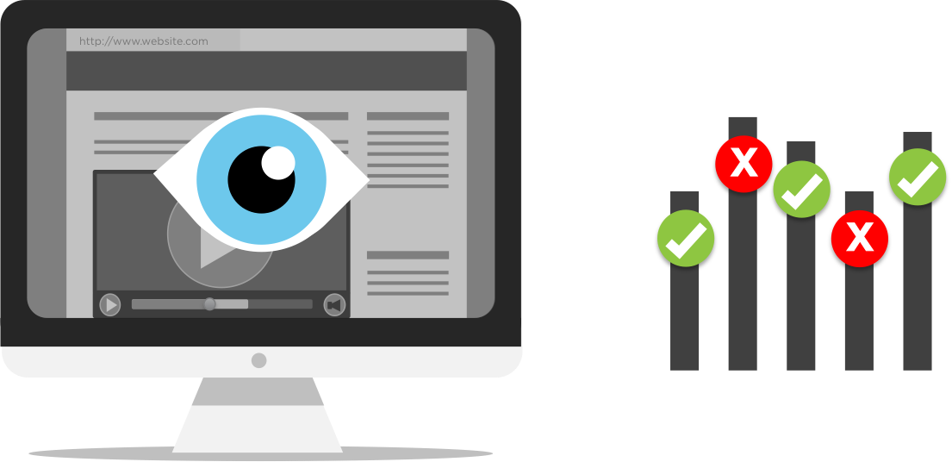
- Ads might be hidden behind another browser or tab
- Ad is not ‘above the fold’ of a web page (refers to top portion of page which is visible without user having to scroll around)
- Due to certain screen sizes, certain ads might load below the fold
- User has ad blocker which hides ads or completely disables them from loading
- Problem is some ad blocking programs only scan a page after it’s loaded and looks for patterns or HTML that contains ‘ad’. It neither hides or removes them. To an ad network, the ad is served, and an impression is recorded but its not visible on screen.
- Bot traffic to sites – created by an automation of bots, they can falsify traffic and click through rates
Some Factors Which Can Affect Online Viewability
Source: mobileleads.com/blog/viewability-important-advertising-campaigns/

Slide 8
A Glance At Desktop Viewability…

Slide 9
Desktop Viewability Rates Have Continued To Improve,
Especially On Desktop Video
Source: IAS Media Quality Report, 2Q17 v. 1Q17, U.S. , in view per MRC standard

Slide 10
Publisher Direct Viewability
Outpaces Programmatic Substantially
% in View Per MRC Standard: Desktop Display
% in View Per MRC Standard: Desktop Video
v. 60.7% 1Q17
v. 74.0% 1Q17
v. 51.7% 1Q17
v. 48.5% 1Q17
Source: IAS Media Quality Report, 2Q17, U.S. , in view per MRC standard v. 1Q17

Slide 11
As Time-In-View Increases, Viewability Decreases; Publisher Direct Has Higher Viewability Throughout
And Don’t Forget to Factor in Audibility…Along With Not Viewing Your
Ads, Are They Being Heard?
% in View Per MRC Standard by Time In View: Desktop Display
Source: IAS Media Quality Report, 2Q17, U.S.

Slide 12
Consequently, Completion Rates Drop Gradually As The Video Plays But Publisher Direct Outpaces Programmatic
Completion Rate In View: Desktop Video
Source: IAS Media Quality Report, 2Q17, U.S.; Distribution rate by quartile

Slide 13
In General, Younger Consumers Tend To Have Lower Viewability Rates, Making It Harder To Reach Them
The higher the viewability rate, the more likely the demo group is to view ads
Viewability rate= How many total delivered impressions were viewable by
a specific demographic?
(Viewable Impressions in demo group / Total measured impressions) X 100
Source: Nielsen Digital Ad Ratings from 3Q15-2Q17, Computer only
Notes:
Source: Online Survey conducted (Sept 12- Oct 6, 2014) among: current/prospective comScore clients in US (by emQ17ail invite); and visitors to comScore.com from US (via web intercept survey).
Respondents indicated they are either:
i) Digital marketing/advertising professional
ii) Other professional in digital advertising space

Slide 14
A Glance At Mobile Viewability…

Slide 15
Mobile Has Grown Substantially Over The Last Several Years, Comprising Practically Three-Quarters of Time Spent With Digital
Share of Digital Time: A18+ (Feb’18)
Tablet
Desktop
Smartphone
Source: comScore Media Metrix Multi-Platform and Mobile Metrix, U.S., February 2018, A18+

Slide 16
Since Mobile Usage Is Most Prevalent Among Millennials,
Viewability Rate Is Key When Targeting Them
Share of Platform Time Spent by Age
Source: comScore Media Metrix Multi-Platform & Mobile Metrix, U.S., Age 18+, February 2018

Slide 17
Given The Complexities of Mobile, Viewability
Rate For Video Has Slightly Declined
Ad viewability levels are falling due to a need for “more page scrolling”
and “loading delays”.*
Source: IAS Media Quality Report, 2Q17, U.S. , in view per MRC standard; ‘Viewability Matters: What Advertisers need to know about advertising viewability,4/18*

Slide 18
In Mobile, There Is A Much Higher Chance Of Your Ad Being Seen In Publisher Direct
% in View Per MRC Standard: Mobile Display
% in View Per MRC Standard: Mobile Video
Source: IAS Media Quality Report, 2Q17, U.S. , in view per MRC standard

Slide 19
..and Similar To Desktop, Viewability Drops Considerably as Time-In-View Progresses
Publisher Direct Performs At A Higher Rate
% in View Per MRC Standard by Time In View: Mobile Display
Source: IAS Media Quality Report, 2Q17, U.S.

Slide 20
Viewability Completion Rate Dwindles With Video Progression But Publisher Direct Is Consistently Higher
Completion Rate In View: Mobile Video
Source: IAS Media Quality Report, 2Q17, U.S.; % distribution by quartile

Slide 21

Facebook research suggests that 41% of videos on platform are ‘basically meaningless without sound’.
Sound Is Another Major Factor Which Affects
An Ad’s Effectiveness
Source: Wochit ‘Complete Guide To Social Video’

Slide 22
All in All, Studies Have Shown, People Remember…
Only 10% of what they hear…
Only 20% of what they read…
But 80% of what they see
Viewability is Key!
Source: Wochit ‘Complete Guide To Social Video’

Slide 23
How Can You Increase Your Ad’s Viewability
Content: Content that holds a user’s attention has the highest viewability.
- Publisher Direct tend to have highest viewability rates.
Position: Most viewable position is right above the fold for display.
Ad Size: Most viewable ad sizes are vertical units – since they stay on screen longer as users move around a page.
Avoid certain ad units: OpenX & Pixalate joint study found that 300X250 is one of the most prolific video ad units – ranking among the worst offenders of providing bad ad environments.*
  80% less viewable compared to all other video ad sizes
  320X480 mobile ad units also prone to video ad fraud
Source: Wochit ‘Complete Guide To Social Video’;*OpenX.com/openx-cracks-down-on-ad-unit-abuse-by-banning-300X250-video/

Slide 24


For More Information Visit Us Online
TheVAB.com
Follow us:
@VideoAdBureau
Like us:
facebook.com/VideoAdvertisingBureau

