Slide 1


January 10, 2025
Question of the Week:
“
If TikTok is banned, where else can I connect and engage with their audience?
”

Slide 2

Due to national security concerns, ByteDance may be forced to divest from TikTok by January 19th or face a ban in the U.S.
…TikTok will be removed from Apple’s App Store
and Google Play, which could result in…
January 10, 2025
The US Supreme Court is set to hear arguments to determine if the ban on TikTok violates First Amendment rights.
Existing users being able to retain the app, but updates and support will cease - potentially leading to bugs and poor user experience
Oracle-hosted servers supporting TikTok’s US operations may be shut down, potentially disabling the app entirely
If the Supreme Court agrees
to the ban on January 19th…
This information is exclusively provided to VAB members and qualified marketers.
PAGE 2

Slide 3
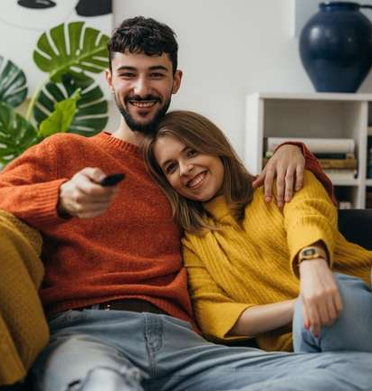
Brands can prepare for change by implementing plans that shift ad spend & engagement strategies to reach TikTok’s audience through multiscreen TV
What this means for marketers?
As audiences continually seek out relevant and enriching content, it’s important to understand what resonates best
and how emotion can turn into engagement and action.
Recent custom research from VAB shows that young, diverse audiences are more engaged with high-quality content on TV and streaming than with content from top social media platforms.
Why does this matter?
For marketers looking for an alternative, the high-quality content of multiscreen TV delivers superior scale, engagement, emotional connection and customer
action compared to TikTok.
This information is exclusively provided to VAB members and qualified marketers.
PAGE 3

Slide 4
Scale: On average, people across all ages and demographics spend much more time with multiscreen TV than with social video & UGC platforms
Hours Per Week Spent Watching TV Shows & Movies vs. Non-Premium Videos
Among weekly non-premium video content viewers
Source: Hub Entertainment Research, Video Redefined, January 2024. Based on survey of 1,900 consumers, ages 13-74. Gen Z (P13-24) respondents = 620 (unweighted). Hispanic respondents = 325 (unweighted). Black respondents = 228 (unweighted). Data collected December 2023. ‘Non-premium video’ includes short-form or user-generated video on YouTube, influencer video content, etc. Download VAB’s ‘The Big Picture: 12 Key Charts on the Impact of TV & Streaming vs. Social Media Platforms’ to learn more.
This information is exclusively provided to VAB members and qualified marketers.
PAGE 4

Slide 5

Engagement: Audiences are more likely to regularly set aside time to watch their favorite content on multiscreen TV than on TikTok
% who ‘regularly set aside time in my schedule to watch my favorite content’ that was featured on the following platforms
 | Gen Z | Hispanic | Black
TV / Streaming | 37% | 39% | 45%
TikTok | 25% | 22% | 22%
TV / Streaming vs. TikTok % more likely | +47% | +76% | +110%
*How to read: P13-24 are 47% more likely to set aside time in their schedule to watch their favorite TV or streaming content vs. TikTok content
Source: VAB custom research fielded by Hub Entertainment Research as part of the 2023 Video Redefined report. Data sourced from Hub’s survey of 1,900 consumers, ages 13-74. Gen Z (P13-24) respondents = 620 (unweighted). Hispanic respondents = 325 (unweighted). Black respondents = 228 (unweighted). Data collected December 2023. Q2: Which of the following statements apply to you when you watch something on the following platforms?
This information is exclusively provided to VAB members and qualified marketers.
PAGE 5

Slide 6
Emotion: Audiences form more meaningful bonds with characters and personalities from multiscreen TV content compared to TikTok
% of platform users who ‘feel personally connected to a character / personality’ on the following platforms
 | Gen Z | Hispanic | Black
TV / Streaming | 34% | 34% | 31%
TikTok | 25% | 21% | 15%
TV / Streaming vs. TikTok % more likely | +35% | +62% | +117%
*How to read: P13-24 are 21% more likely to feel personally connected to a character / personality from TV or streaming content vs. TikTok content
Source: VAB custom research fielded by Hub Entertainment Research as part of the 2023 Video Redefined report. Data sourced from Hub’s survey of 1,900 consumers, ages 13-74. Gen Z (P13-24) respondents = 620 (unweighted). Hispanic respondents = 325 (unweighted). Black respondents = 228 (unweighted). Data collected December 2023. Q1: Which of the following statements apply to you when you watch videos, shows or movies on the following platforms? Based on users of the platform.
This information is exclusively provided to VAB members and qualified marketers.
PAGE 6

Slide 7
Action: The deep emotional connection that multiscreen TV fosters is more likely to inspire the purchasing of goods and services than TikTok
% who ‘have eaten at a restaurant or purchased a cookbook’ that was featured in content on the following platforms
 | Gen Z | Hispanic | Black
TV / Streaming | 21% | 21% | 20%
TikTok | 16% | 20% | 16%
TV / Streaming vs. TikTok % more likely | +27% | +4% | +25%
*How to read: P13-24 are 27% more likely to have eaten at a restaurant or purchased a cookbook featured in TV or streaming content vs. TikTok content
Source: VAB custom research fielded by Hub Entertainment Research as part of the 2023 Video Redefined report. Data sourced from Hub’s survey of 1,900 consumers, ages 13-74. Gen Z (P13-24) respondents = 620 (unweighted). Hispanic respondents = 325 (unweighted). Black respondents = 228 (unweighted). Data collected December 2023. Q3: Which of the following actions have you taken as a result of watching something on the following platforms?
This information is exclusively provided to VAB members and qualified marketers.
PAGE 7

Slide 8
Additionally, marketers should be aware that many young adults feel social media has a negative effect on their emotional health
% of A18-27 who believe social media had
a negative impact on their emotional health
29%
of adults ages 18-27 say that social media has
hurt them personally
37%
A18-27
47%
LGBTQ A18-27
44%
Women A18-27
Source: Harris Poll via The New York Times, Gen Z Has Regrets, 09/17/2024. Based on online survey of 1,006 Gen Z adults, aged 18-27 about their beliefs regarding the impact that social media and smartphones have had on them and whether they’d support select reform efforts to address addiction; fielded 8/8/24 – 8/15/24.
This information is exclusively provided to VAB members and qualified marketers.
PAGE 8

Slide 9



As a result, Gen Z is already disconnecting from social media, seeking relief from its negative impact and upsetting content
% of Gen Z respondents who agree with the following
83%
54%
51%
Have taken steps to distance themselves from social media
(e.g., turning off in-app notifications, deleting accounts, or muting and unfollowing certain users)
Have closed or stopped using an account in the last year because they’ve been upset by posts they’ve seen*
Are actively engaging less with social media for the sake of their mental health*
Source: Harris Poll via EMARKETER, Gen Z’s love-hate relationship with social media deepens, 9/25/24. *Marigold, 2024 U.S. Consumer Trends Index.
This information is exclusively provided to VAB members and qualified marketers.
PAGE 9

Slide 10

Conversely, multiscreen TV cultivates positive experiences which makes people more inclined to purchase products they see advertised
Impact of Positive Mindset on Response to Advertising
+18%
+35%
Increase in brand favorability
Increase in purchase intent
Source: Hearst, Power of Positivity, 2023.
This information is exclusively provided to VAB members and qualified marketers.
PAGE 10

Slide 11
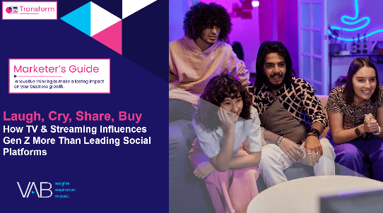
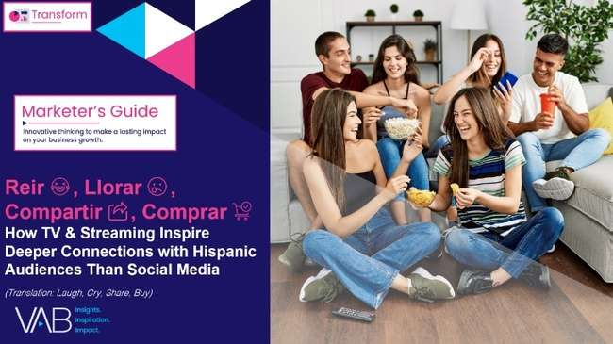
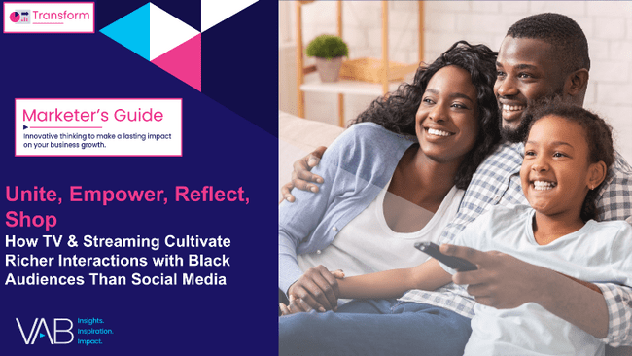
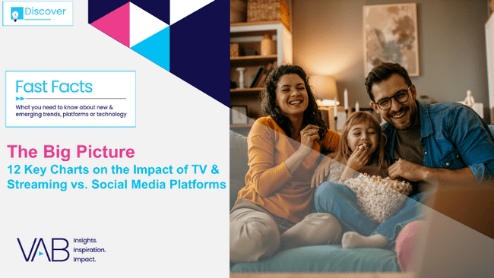
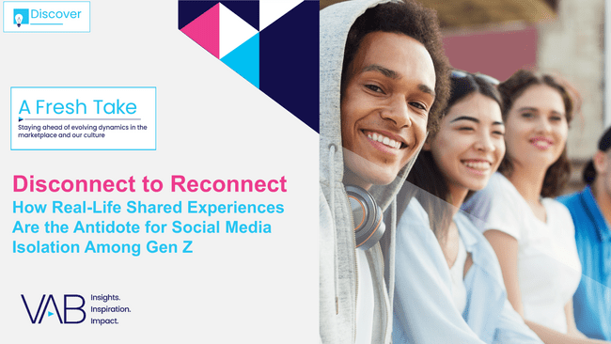

Want to learn more on engagement between multiscreen TV vs. five social media platforms? Check out our full custom studies below
41
pages
32
pages
35
pages
Laugh, Cry, Share, Buy
How TV & Streaming Influences Gen Z
More Than Leading Social Platforms
Reir, Llorar, Compartir, Comprar
How TV & Streaming Inspire Deeper Connections with Hispanic Audiences Than Social Media
Unite, Empower, Reflect, Shop
How TV & Streaming Cultivate Richer Interactions with Black Audiences Than Social Platforms
22
pages
33
pages
Click on the report covers to download each guide
The Big Picture
12 Key Charts on the Impact of TV & Streaming vs. Social Media Platforms
Disconnect to Reconnect
How Real-Life Shared Experiences Are the Antidote
for Social Media Isolation Among Gen Z
Click on the report covers to download each guide
Note: The five social media platforms within our custom studies (‘Laugh, Cry, Share, Buy;’ ‘Reir, Llorar, Compartir, Comprar;’ ‘Unite, Empower, Reflect, Shop’ and ‘The Big Picture’) include Facebook, Instagram, Snapchat, TikTok and YouTube.
This information is exclusively provided to VAB members and qualified marketers.
PAGE 11

Slide 12


About VAB
VAB plays a dual role in the video advertising industry. We are leading the change to bring about a more innovative and transparent marketplace. We also provide the insights and thought leadership that enables marketers to develop business-driving marketing strategies.
Drawing on our marketing expertise, we simplify the complexities in our industry and discover new insights that transform the way marketers look at their media strategy.
We are committed to your business growth and proud to offer VAB members, brand marketers and agencies complimentary access to our continuously-growing Insights library. Get immediate access at theVAB.com.
This information is exclusively provided to VAB members and qualified marketers.
PAGE 12

