Slide 1
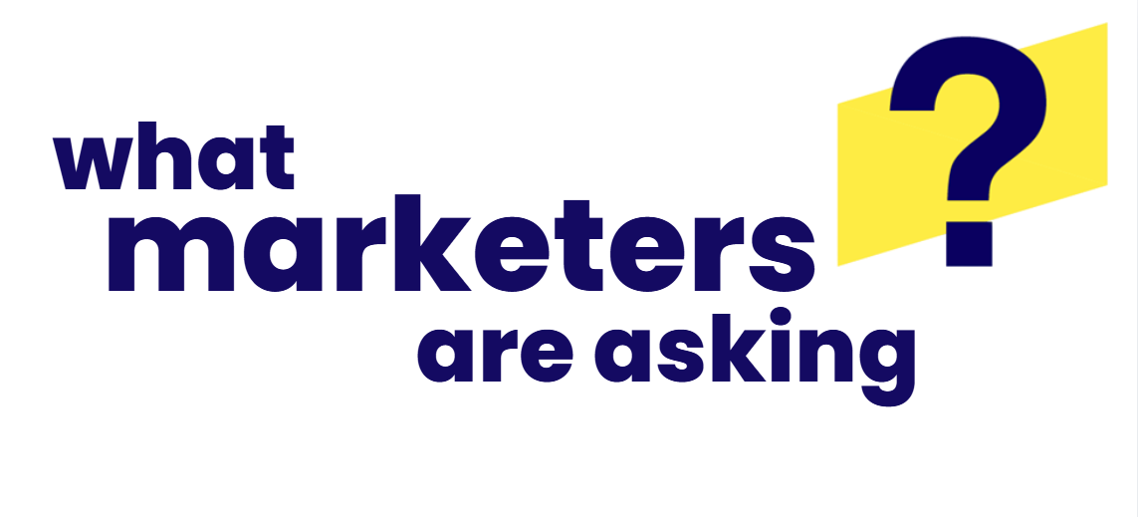

June 2026
“How will the World Cup deliver for brands this summer?”

Slide 2









The 2026 World Cup provides marketers with a Truly Premium Video event for over five weeks this summer
Hosted across 16 cities in the U.S., Canada & Mexico between June 11th to July 19th, the World Cup represents truly premium video in its highest form and delivers on many of its key attributes, which creates strong marketing opportunities for brands throughout the tournament.
8 Ways that Showcase the World Cup as a Truly Premium Video Event
3
4
1
Attention
Relevancy
Scale
Emotional Engagement
2
5
6
7
8
Communal
Connection
Cross-Platform Accessibility
Second-Screening
Conversion
This information is exclusively provided to VAB members and qualified marketers.
PAGE 2

Slide 3

















































Relevancy
The World Cup is bringing together 48 nations in a five weeklong tournament across 16 host cities in the U.S., Canada & Mexico
Host locations – U.S.: Atlanta, Boston, Dallas, Houston, Kansas City, LA, Miami, New York/New Jersey, Philadelphia, San Francisco & Seattle;
Canada: Toronto, Vancouver; Mexico: Guadalajara, Mexico City, Monterrey
2026 World Cup Nations by Group
2026 World Cup Timeline
A
Mexico
Czechia
B
Canada
Bosnia & Herzegovina
C
Brazil
Morocco
6/11: Opening Ceremony / Match
6/11 – 6/27: Group Stages
6/28 – 7/3: Round of 32
7/4 – 7/7: Round of 16
7/9 – 7/11: Quarter-finals
7/14 – 7/15: Semi-finals
7/19: Final
South Africa
Korea Republic
Qatar
Switzerland
Haiti
Scotland
D
USA
Paraguay
E
Germany
Curaçao
F
Netherlands
Japan
Australia
Türkiye
Côte d'Ivoire
Ecuador
Sweden
Tunisia
G
Belgium
Egypt
H
Spain
Cabo Verde
I
France
Senegal
Iran
New Zealand
Saudi Arabia
Uruguay
Iraq
Norway
J
K
L
Argentina
Algeria
Portugal
Congo DR
England
Croatia
Austria
Jordan
Uzbekistan
Colombia
Ghana
Panama
This information is exclusively provided to VAB members and qualified marketers.
PAGE 3

Slide 4

Scale
Nearly 65 million U.S. adults are planning to watch the World Cup, with significant viewership projected across all age breaks between A18-54
The 2026 World Cup U.S. adult viewership is projected to be composed of 58% Males & 42% Females, which offers marketers opportunities across genders
% of U.S. Adults Planning to Watch the 2026 World Cup
By Age Group
24%
of adults 18+ plan to watch 2026 FIFA World Cup
(63.9MM A18+)
124 index
133 index
139 index
103 index
Source: VAB analysis of MRI-Simmons, Q2 2026 Trending Topics Study.
How to read index: A18-24 are 24% more likely than A18+ to watch the 2026 World Cup.
This information is exclusively provided to VAB members and qualified marketers.
PAGE 4

Slide 5




Attention
The tournament combines national pride with global support and
curiosity as fans rally behind multiple teams and cultures
% of U.S. World Cup viewers who agree that…*
66%
84%
82%
‘I like watching the World Cup because I feel connected
and proud of my country’
‘Watching the World Cup
is a way for me to learn about different countries & cultures’
of U.S. soccer fans support more than one national team
Source: For Soccer, ‘Insights Into American World Cup Fans’, as of 5/12/26. Note: Includes responses for ‘Root for multiple countries equally’ – 23% & ‘One favorite team, care about others’ – 43%. *VAB analysis of MRI-Simmons, Q2 2026 Trending Topics Study, Base: Planning to watch 2026 World Cup.
This information is exclusively provided to VAB members and qualified marketers.
PAGE 5

Slide 6




Emotional Engagement
The World Cup delivers passionate, highly engaged fans who are excited to watch, and party together, with friends and family
% of U.S. World Cup viewers who…*
73%
89%
36%
of U.S. soccer fans are excited about the 2026 World Cup
Agree that watching the World Cup is a great way to connect
with friends and family
Plan to host a World Cup party or event
Source: ThinkNow Research, ‘International Soccer United States Expectations for 2026’, February 2026. *VAB analysis of MRI-Simmons, Q2 2026 Trending Topics Study, Base: Planning to watch 2026 World Cup.
This information is exclusively provided to VAB members and qualified marketers.
PAGE 6

Slide 7
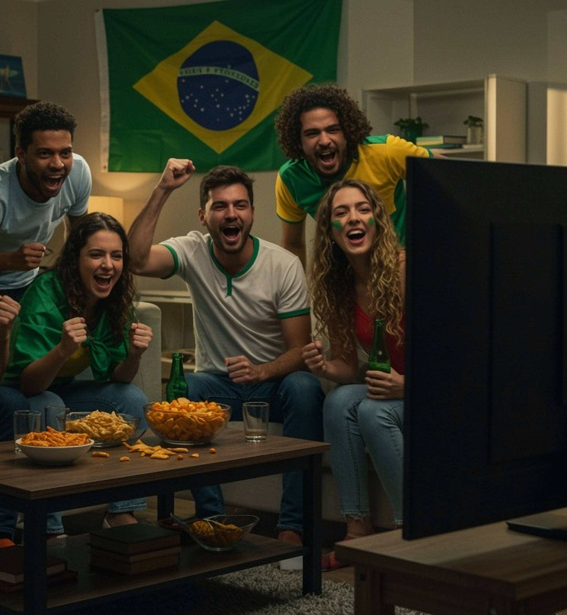




Communal Connection
Fans won’t just be watching at home; they will be also be immersed in communal experiences throughout the tournament
Where are U.S. viewers planning on watching the 2026 World Cup?
75%
At home
40%
Friend or family member’s house
40%
Restaurant or Bar*
17%
Fan zone or public viewing area
Source: VAB analysis of MRI-Simmons, Q2 2026 Trending Topics Study, Base: Planning to watch 2026 World Cup. *Restaurant: 29%, Bar: 28%
This information is exclusively provided to VAB members and qualified marketers.
PAGE 7

Slide 8

Cross-Platform Accessibility
Fans are planning to watch World Cup content across platforms, giving brands even more opportunities to connect with these engaged audiences
Methods of Watching the World Cup
% of U.S. respondents planning to watch the World Cup*
82%
Plan to watch live on broadcast TV network or a streaming service
Source: VAB analysis of MRI-Simmons, Q2 2026 Trending Topics Study, Base: Planning to watch 2026 World Cup. *Respondents select all that apply.
This information is exclusively provided to VAB members and qualified marketers.
PAGE 8

Slide 9






Second-Screening
The World Cup experience extends beyond the TV screen as viewers engage across devices, creating social and shoppable moments
Actions Taken While Second-Screening When Watching TV*
based on overall TV viewing behaviors (and not exclusive to World Cup)
59%
83%
78%
74%
Text / message someone
Scroll social media
Search for something related
of U.S. soccer fans are likely to use a second screen
while watching 2026
World Cup matches
69%
68%
59%
Gen Z (A18-26): 70%
Millennials (A27-42): 78%
Gen X (A43-58): 61%
Baby Boomers (A59+): 34%
Browse online shopping
Look up a product they saw in an ad while watching TV
Gaming
Source: ThinkNow Research, ‘International Soccer United States Expectations for 2026’, February 2026.*tvScientific, 2026 Consumer Trends Report: How TV Shapes Modern Behavior, April 2026.
This information is exclusively provided to VAB members and qualified marketers.
PAGE 9

Slide 10
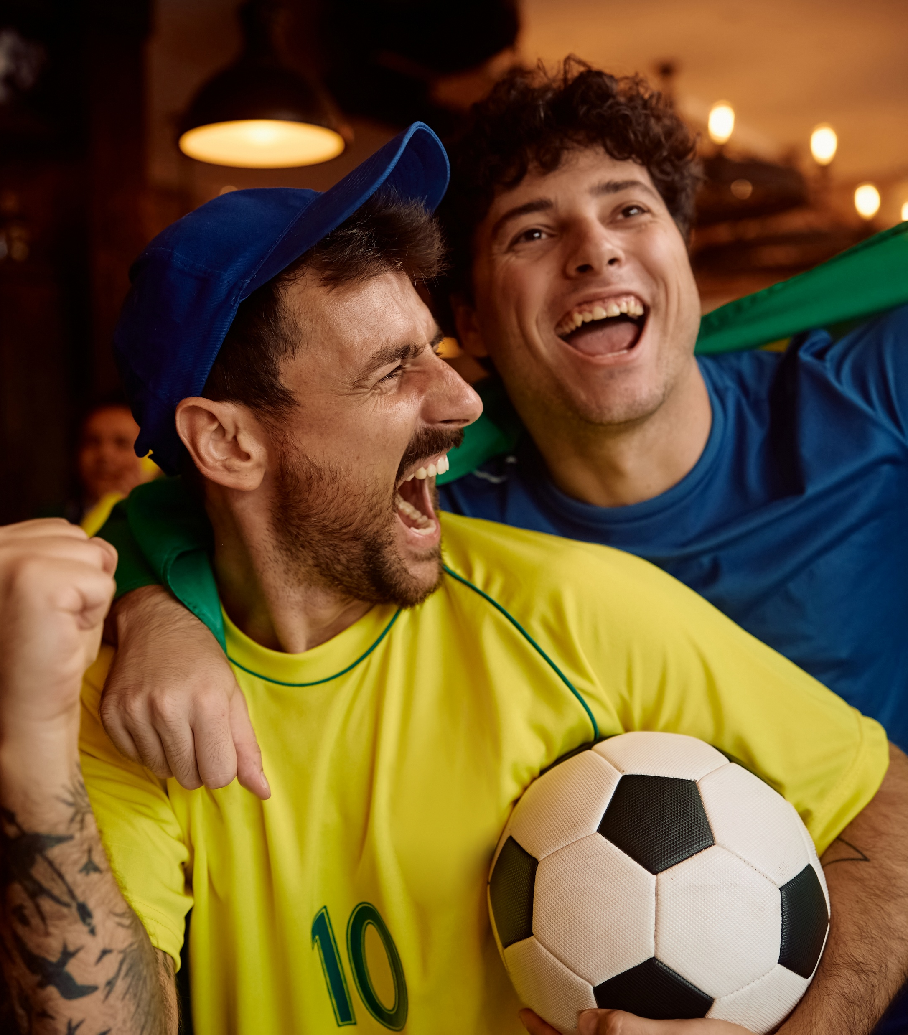
Conversion
Fandom transforms into commerce not just around the World Cup itself, but for brand sponsors who advertise during the tournament as well
% of U.S. World Cup Viewers Who Plan to Purchase…
63%
of World Cup viewers are more likely to buy from brands that sponsor
the World Cup
Source: VAB analysis of MRI-Simmons, Q2 2026 Trending Topics Study, Base: Planning to watch 2026 World Cup.
This information is exclusively provided to VAB members and qualified marketers.
PAGE 10

Slide 11
Adults over 50 account for 36% of the total population and nearly half of all adults
The 2026 World Cup: Truly Premium Video in Action
The 2026 World Cup represents truly Premium Video, combining relevance, scale, attention, emotional engagement, communal connection and measurable business impact for marketers
The World Cup is a global cultural spectacle that unites audiences through national pride, shared viewing and cultural discovery, creating opportunities for brands to build emotional connections through fandom and authentic storytelling
Viewers will watch live soccer matches across TV and streaming, while also actively engaging with ‘second screening’ across mobile, social, search and shopping platforms; creating many different opportunities for brands across platforms
The World Cup creates a powerful commerce opportunity as fan passion translates into real-world spending and stronger purchase intent for brands that advertise during the tournament
Key Marketer Takeaways
This information is exclusively provided to VAB members and qualified marketers.
PAGE 11

Slide 12


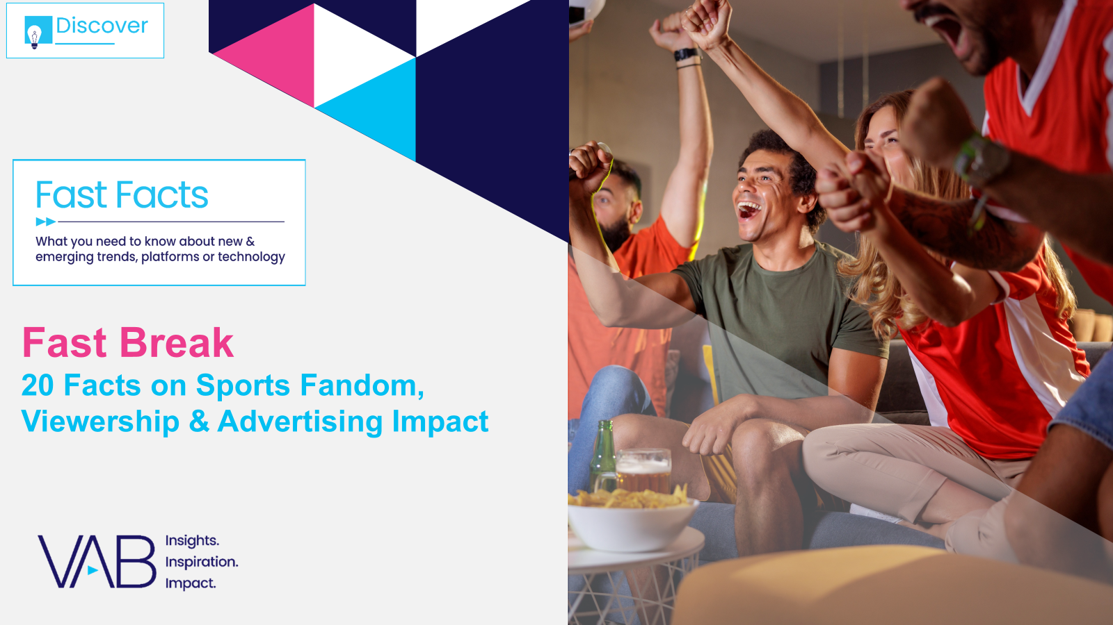

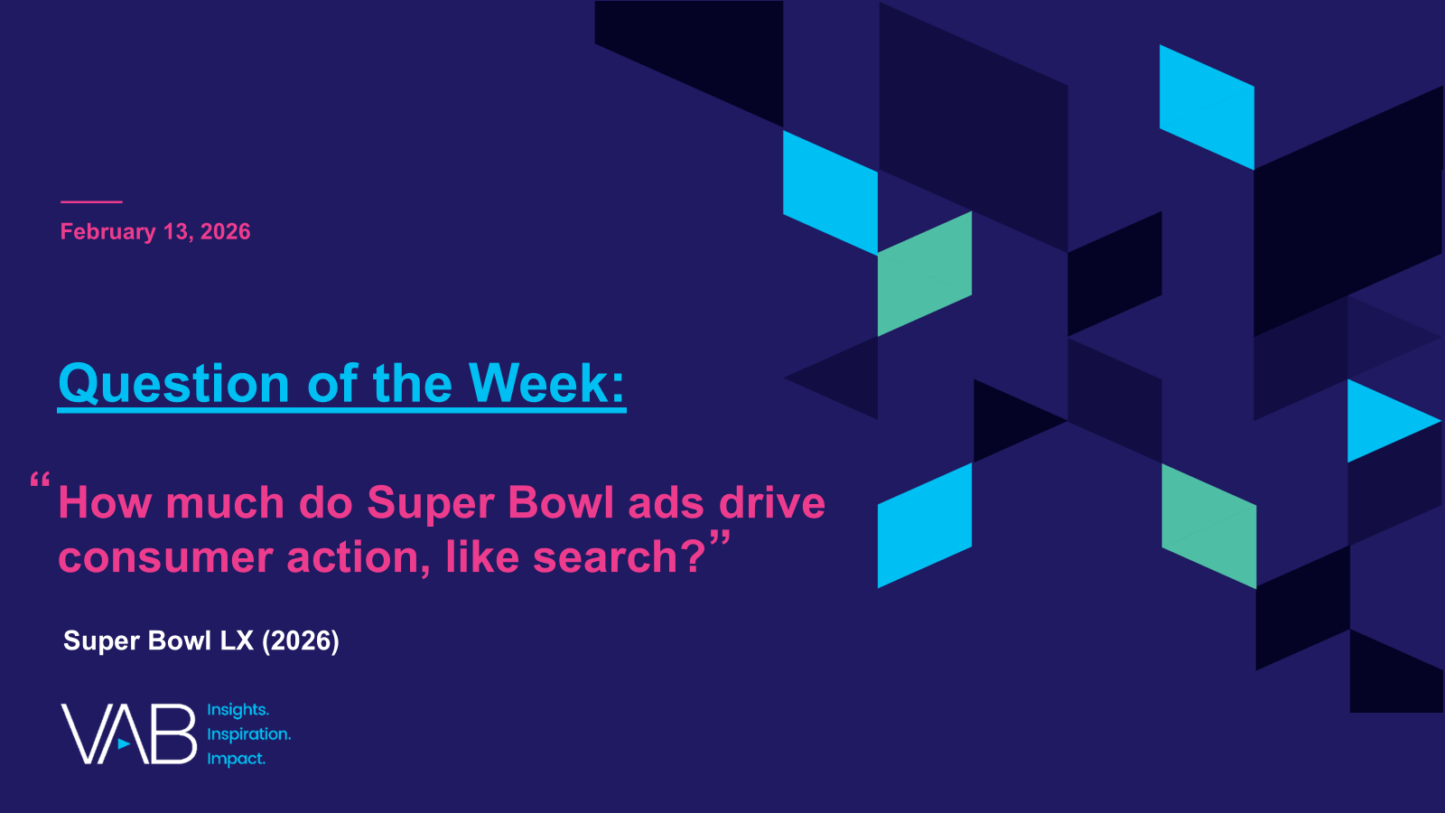
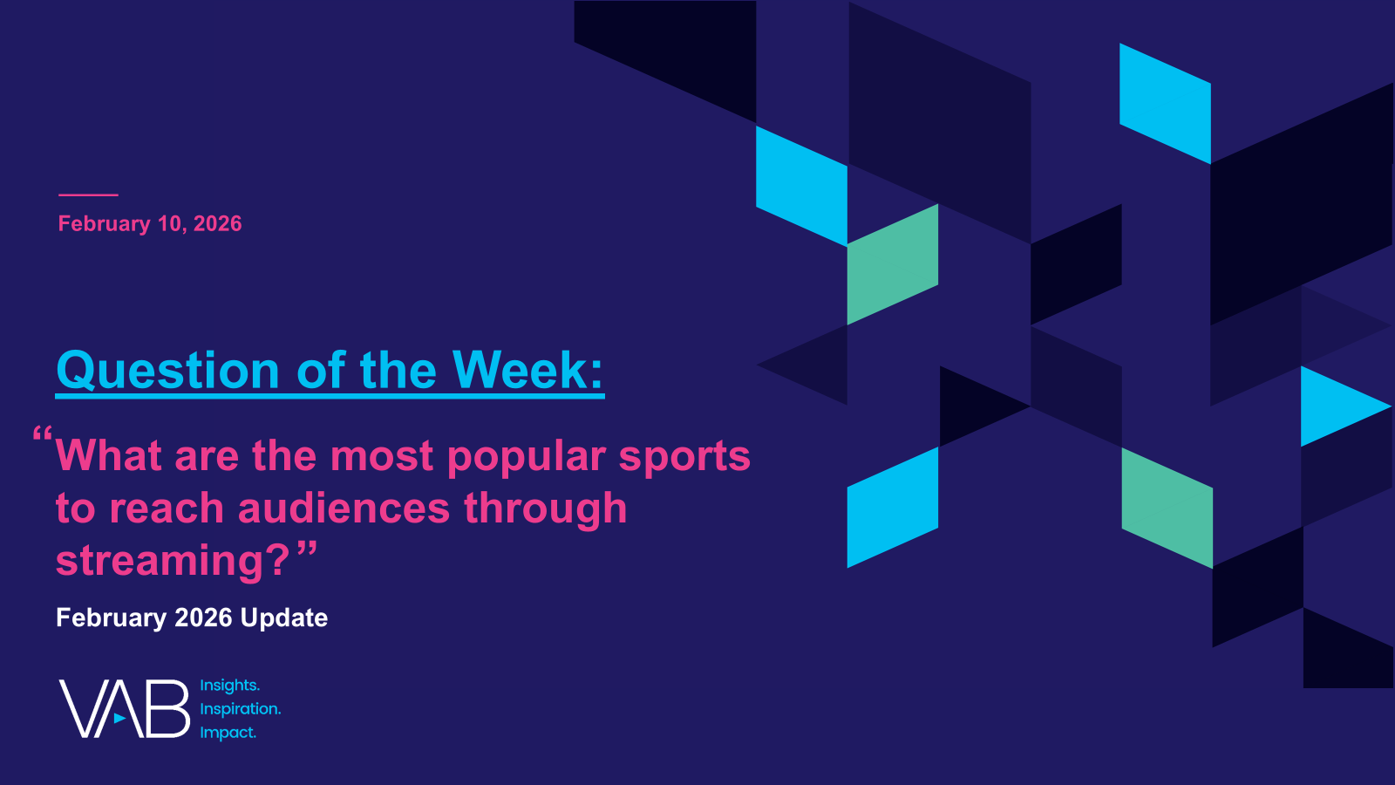
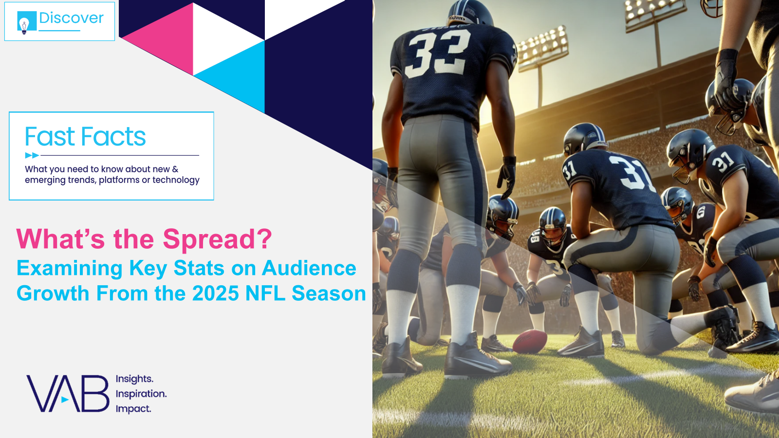
Creators
Jason Wiese
Reed Kiely
EVP, Strategic Insights & Measurement
jasonw@thevab.com
VP, Data Insights & Trends
reedk@thevab.com
Karolina Guillen
Amanda Cashman
The Power of Premium Video
What It Means for Multiscreen TV and Why It Matters to Marketers
Fast Break
20 Facts on Sports Fandom, Viewership & Advertising Impact
Associate Director, Insights, Strategy & Analytics karolinag@thevab.com
Insights Analyst
amandac@thevab.com
Discover more
Looking for more data, insights and takeaways? Check out this related VAB content
Visit our ‘What Marketers Are Asking’ Hub
for data-backed, concise answers and sharp insights on the most commonly asked questions about marketing strategy.
Best in Show
Five Advantages of Multiscreen TV, From Brand to Performance
“How much do Super Bowl ads drive consumer action, like search?”
“What are the most popular sports to reach audiences through streaming?”
What’s the Spread?
Examining Key Stats on Audience Growth From the 2025 NFL Season
VAB Members, brand marketers and agencies get free and immediate access to VAB’s content library. Get access at theVAB.com
This information is exclusively provided to VAB members and qualified marketers.
PAGE 12

Slide 13


About VAB
VAB plays a dual role in the video advertising industry. We are leading the change to bring about a more innovative and transparent marketplace. We also provide the insights and thought leadership that enables marketers to develop business-driving marketing strategies.
Drawing on our marketing expertise, we simplify the complexities in our industry and discover new insights that transform the way marketers look at their media strategy.
We are committed to your business growth and proud to offer VAB members, brand marketers and agencies complimentary access to our continuously-growing Insights library. Get immediate access at theVAB.com.
This information is exclusively provided to VAB members and qualified marketers.
PAGE 13

