Slide 1


April 25, 2025
Question of the Week:
“
How should I think about my advertising in the wake of economic uncertainty caused by tariffs?
”

Slide 2

Continuing to advertise during economic uncertainty is the key to business growth
The recent announcements and actions on U.S. tariffs from the Trump administration have caused upheaval in global financial markets, created a wave of economic uncertainty among consumers and has formed a cloud of caution over corner offices.
This has led some businesses to question their advertising investments as they
look to hold down costs throughout their companies.
Although there is over 100 years of analysis that demonstrates how businesses that advertise during times of economic uncertainty and continue to invest in both brand
and performance channels, like multiscreen TV, achieve long-term growth; we’ve specifically analyzed the last period of economic uncertainty to prove the value
of advertising.
It was only a few years ago that the U.S. was in a prolonged period of economic uncertainty – stoked by a global pandemic, the highest inflation in over 40 years, international conflicts and a lingering threat of recession. During this same period,
931 advertisers launched their first TV campaigns.
Continue reading to learn more about the outsized business outcomes these bold, new TV advertisers achieved in the most challenging of economic environments –
all because they launched advertising campaigns.
This information is exclusively provided to VAB members and qualified marketers.
PAGE 2

Slide 3










Tariff announcements and policies are creating economic uncertainties and dominating conversations across the advertising industry
4/3/2025
4/11/2025
4/12/2025
Trump announces sweeping new tariffs to promote US manufacturing, risking inflation and trade wars
19 ad leaders on how Trump tariffs and the economy are impacting brand and media strategy
That seat will cost how much? US businesses already seeing impact of Trump tariffs
4/11/2025
4/16/2025
As Luxury Brands Brace For Tariffs, Affluent Consumers Hit Pause
Fed Chair Powell gives starkest warning yet on potential economic consequences from tariffs
3/4/2025
4/4/2025
3/12/2025
Trump puts tariffs on thousands of goods from Canada and Mexico, risking higher prices
A running list of companies that have talked about raising prices due to Trump's tariffs
‘Volatility and conflict’: Business leaders sound warnings over Trump’s tariffs
4/2/2025
3/20/2025
How Trump’s tariffs are already impacting U.S. small businesses
Small businesses are already being hit hard, but here’s what these tariffs could mean for the global economy in the long run.
Trump unveils sweeping 10% tariff and 'reciprocal' tariffs on dozens of nations
This information is exclusively provided to VAB members and qualified marketers.
PAGE 3

Slide 4
Ad industry leaders are encouraging brands to continue brand-building activities while seeking growth opportunities in these uncertain times
“A lot of the conversation that we revive during periods like this is that we don’t want to sacrifice brand building. And so, for example, if we had a large client that might be affected by tariffs or any other kind of economic downturn, the conversation that we would have is to remind them of all the proof points about why it’s important to continue to invest in your brand.”
“Panic-spending on activation may feel necessary in the moment, but forsaking brand equity and consumer connection in the process creates a steeper climb post-recovery. We’ve seen this pattern before. Economic uncertainty drives short-term thinking, but history favors the brands that continue to invest in their identity and resonance.”
“It’s arguable that in recessionary times the need for brand-level advertising investment is even greater because you need to give people emotional reasons to buy that supersede the rational objections they may have to price. Basically, how can you make consumers love you so much that your brand or product is worth the cost?”
Deanna Cullen, head of media investment, Wpromote
Hasan Ramusevic, CEO, Hasan + Shumaker
Kerry McKibbin, partner and president, Mischief USA
“Going dark might save a few bucks now, but it hands the mic to your competitors. And the data backs it up—brands that keep advertising in tough times come out stronger…The brands that nail both performance and brand-building are the ones who’ll pull ahead while
everyone else hits pause.”
“The consumer is seeing all kinds of yellow-flashing lights not knowing if they will turn green or red. We will see a shift toward more performance vs. brand marketing with value and benefit at the center. Demand creation for all categories will be paramount with media dollars needing to be stretched.”
“Our clients are cautious and they are right to be cautious, but they are also very competitive because they are looking for every growth opportunity.”
Michael Shaughnessy, chief operating officer, Kargo
Arthur Sadoun, CEO, Publicis Group
Bill Koenigsberg, CEO, Horizon Media
Source: Ad Age, 19 ad leaders on how Trump tariffs and the economy are impacting brand and media strategy, 4/11/25. Ad Age, Publicis CEO Arthur Sadoun blames the industry’s weakening perception on rivals more than tariffs, 4/15/25.
This information is exclusively provided to VAB members and qualified marketers.
PAGE 4

Slide 5

Continuing to advertise during times of economic uncertainty has been a central principle of business growth for over the last 100+ years

Slide 6
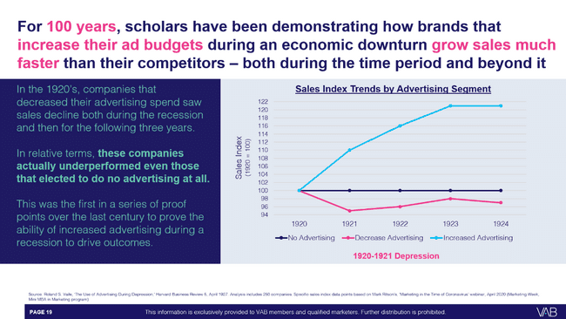
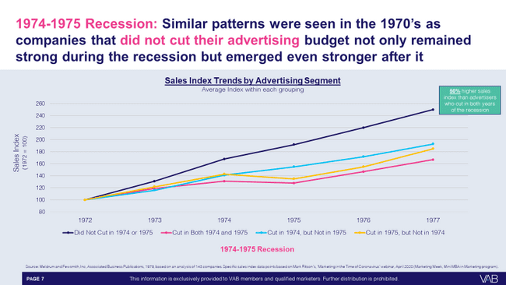
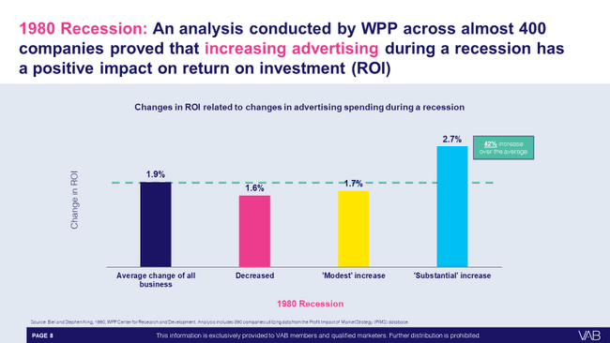
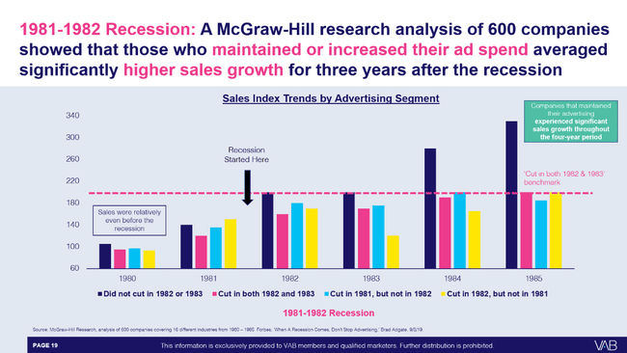
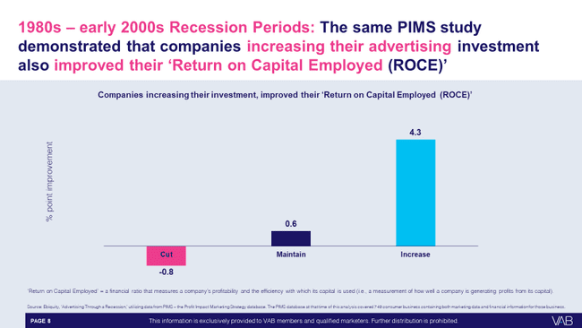
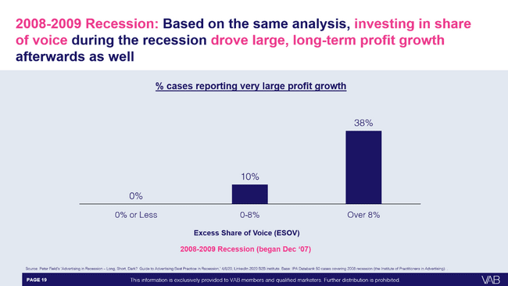
100 years of analyses demonstrate how businesses that invest in brand equity during economic uncertainty grow sales faster than competitors
To learn more, download our 66-page report: Keep Calm and Advertise On: How to Successfully Navigate Your Brand Through an Economic Downturn
This information is exclusively provided to VAB members and qualified marketers.
PAGE 6

Slide 7

In times of continued economic uncertainty, brands must maintain their messaging to reap long-term benefits
“Marketers must resist cutting budgets. Every empirical study and almost every anecdotal report from past recessions strongly suggests that brands may deliver on their short-term financial goals but often lose those gains in the long term.
The power of brands erodes as advertising and marketing spend declines.
The cost of recapturing lost short-term sales due to spending declines more than offsets the temporary financial gain… When marketers pull back investments, market capitalization is undercut and sub-optimizes long-term performance.
Brands that increased investment during the last recession saw 63% stronger ROI and 60% ROI grew year-over-year.”
Bob Liodice, CEO of the Association of National Advertisers (ANA)
ANA, Q&A: How to Develop Recession-Proof Marketing, January 26, 2023
This information is exclusively provided to VAB members and qualified marketers.
PAGE 7

Slide 8
The U.S. was recently in an extended period
of economic uncertainty during the pandemic years and its immediate aftermath which featured hyper-inflation and global conflict

Slide 9
In 2022, the inflation rate was at the highest in more than 40 years, driven by a range of factors including the pandemic and global conflicts
How much of an impact, if any at all, do you think the following
have had on price increases in the past year?
% of respondents who answered ‘major’ or ‘significant’ impact
In June 2022, on average, the price
of goods and services increased
9.2%
Increase in Consumer Price Index* for all items
in June 2022, reflecting the largest 12-month increase
since November 1981
Source: Bureau of Labor Statistics Consumer Price Index News Release, 7/13/22. *The Consumer Price Index (CPI) is a measure of the average change over time in the prices paid by urban consumers for a market basket of consumer goods and services. Ipsos & FiveThirtyEight, 2022 Election Tracking Survey. Data based on poll conducted April 27 – May 5, 2022 on behalf of FiveThirtyEight using the probability-based KnowledgePanel®. This poll is based on a nationally representative probability sample of 2,006 adults age 18 or older interviewed online in English and Spanish.
This information is exclusively provided to VAB members and qualified marketers.
PAGE 9

Slide 10
Over the course of 2022 & 2023, most Americans saw inflation as the most pressing issue and a ‘very big problem’ in the country
% who say each of the following is ‘a very big problem’ in the country today
2022
2023
Source: Pew Research Center, By a wide margin, Americans view inflation as the top problem facing the country today, 5/12/22. Based on survey of U.S. adults conducted April 25 – May 1, 2022; Inflation, Health Costs, Partisan Cooperation Among the Nation’s Top Problems, 6/21/2023.
This information is exclusively provided to VAB members and qualified marketers.
PAGE 10

Slide 11







Because of this, the U.S. was under the shadow of a potential recession for several years which caused many marketers to spend cautiously
April 10, 2022
March 8, 2023
October 17, 2023
The U.S. economy in 2023: Most people have jobs, but many are unhappy about their money
Recession Or Soft Landing: What’s Next for the U.S. Economy?
September 13, 2022
May 12, 2023
INFLATION DRIVES COMPANIES TO SPEND LESS ON MARKETING, OFFER MORE VALUE
CMO Survey shows supply-chain issues, job market fears and threats of recession sink marketer optimism
Why current US recession warnings are unlike all the others
Mar ‘22
Apr ‘22
May ‘22
Sep ‘22
Feb ‘23
Mar ‘23
Apr ‘23
May ‘23
Aug ‘23
Oct ‘23
March 29, 2022
February 27, 2023
The Fed Has Made a U.S. Recession Inevitable
U.S. recession expected to start later than previously predicted
August 29, 2023
US Consumer Confidence Pulled Back in August
May 20, 2022
April 28, 2023
‘Cost conscious consumers, restrictive economy’: Advertising’s tough ride in 2022
US consumers send mixed signals in an uncertain economy
This information is exclusively provided to VAB members and qualified marketers.
PAGE 11

Slide 12
In fact, at least half of all U.S. adults thought we were either in a recession or at the beginning of one consistently during this period
Sentiment About Whether The U.S. Economy Is In A Recession
73%
62%
64%
61%
60%
60%
56%
54%
53%
50%
51%
51%
50%
50%
50%
50%
52%
Source: VAB analysis of Dentsu, Consumer Navigator: American Mindset – May 2022, November 2022, June 2023, January 2024, April 2024, September 2024, January 2025 & March 2025, A18+. Note: No data available for December 2022, June 2023 and December 2023.
This information is exclusively provided to VAB members and qualified marketers.
PAGE 12

Slide 13

However, consumers continued spending throughout all this uncertainty as retail sales increased by over $1 trillion annually between 2020 - 2023
+7.0%
+3.6%
+14.4%
+3.5%
+7.6%
+3.5%
+4.3%
+4.1%
+3.3%
+2.9%
+2.9%
Source: National Retail Federation (NRF), NRF Forecasts 2023 Retail Sales to Grow Between 4% and 6%, 3/29/2023. 2023 retail sales sourced from National Retail Federation (NRF), NRF 2024 Annual Retail Sales Forecast FAQ, 3/27/2024.
This information is exclusively provided to VAB members and qualified marketers.
PAGE 13

Slide 14

During Covid, consumers built strong bonds with their favorite brands, illustrating the outsized equity and love formed during uncertain times
‘I feel an emotional connection to the brand I buy from the most’
% of consumers who agree with the following
+17%
vs. 2020
Pre-Covid
Today
Source: Salesforce, State of the Connected Consumer, 2022. Base = 13,020 consumers among 29 countries.
This information is exclusively provided to VAB members and qualified marketers.
PAGE 14

Slide 15



Customers with strong brand love were more likely to overlook reasonable price increases during inflation, even citing “empathy” for the business
% of people that agree with the following statements
81%
73%
71%
“I have empathy for small businesses that need to increase prices due
to inflation or shortages.”
“I am willing to continue to buy from companies that increase their prices if I feel valued as a customer.”
"I have empathy for companies where I've been a long-time customer when they need to increase their prices due
to inflation or shortages."
Source: Ipsos, Here’s how inflation is affecting our shopping, June 2022. Ipsos Coronavirus Consumer Tracker, fielded May 24 – 25, 2022 among 1,120 U.S. adults. Q: How much do you agree or disagree with the following statements – agree summary.
This information is exclusively provided to VAB members and qualified marketers.
PAGE 15

Slide 16


Many still splurged on their favorite brands, even amidst the highest prices in 40 years, illustrating the importance of reinforcing unique brand value
% of adults 18+ who agree with the following statements
‘Even though prices are rising due to inflation, I am not going to stop buying what I want’
‘I don't mind spending more money to get the products I want’
54%
65%
Source: Ipsos, Here’s how inflation is affecting our shopping, June 2022. Ipsos Coronavirus Consumer Tracker, fielded May 24 – 25, 2022 among 1,120 U.S. adults. MRI-Simmons 2022 Q2 Trending Topics Study, A18+. “Any agree” = somewhat / strongly agree.
This information is exclusively provided to VAB members and qualified marketers.
PAGE 16

Slide 17
During that period of economic uncertainty,
over $4 billion was invested in TV by bold, new advertisers who launched their first campaigns between 2021 – 2023

Slide 18




931 new advertisers launched their first national TV campaign during the prolonged three-year period of economic uncertainty
New National TV Advertisers
2021 – 2023
Over $4B
was invested by
931 first-time
national TV advertisers
Between 2021 - 2023
Year | # of New Advertisers | # of Categories | New TV $$$
2021 | 315 | 74 | $1.32B
2022 | 303 | 71 | $1.33B
2023 | 313 | 56 | $1.36B
Source: VAB analysis of Nielsen Ad Intel data as of 2/7/24, 1/1/23-12/31/23. Prior years based on VAB analysis of Nielsen Ad Intel Data from the following periods: 1/1/2021-12/31/2021, 1/1/2022-12/31/2022. TV spend includes national cable TV, broadcast TV, Spanish language cable TV, Spanish language broadcast TV. Brands reflect those with national TV spend over $100K.
This information is exclusively provided to VAB members and qualified marketers.
PAGE 18

Slide 19
These 931 new TV advertisers that launched their first campaign between 2021 – 2023 represented a diverse mix of brands across 115 categories
2021-2023 New National TV Advertisers: Top 25 Categories Ranked by Total Advertisers
Rank | Category | # of Brands
 |  | 2021 | 2022 | 2023 | Total
1 | Financial Services | 21 | 19 | 21 | 61
2 | Pharmaceutical | 11 | 24 | 23 | 58
3 | Apparel & Accessories | 19 | 17 | 21 | 57
4 | Professional Services | 15 | 9 | 19 | 43
5 | Legal Services | 11 | 17 | 6 | 34
6 | Health & Wellness | 9 | 12 | 13 | 34
7 | Insurance | 15 | 9 | 8 | 32
8 | Organizations | 5 | 14 | 10 | 29
9 | Vitamins & Supplements | 7 | 8 | 14 | 29
10 | Personal Care | 10 | 12 | 6 | 28
11 | Wellness & Beauty | 14 | 2 | 12 | 28
12 | Home | 11 | 10 | 6 | 27
13 | Mobile Apps | 8 | 11 | 7 | 26
14 | Home Improvement | 4 | 11 | 11 | 26
15 | Alcoholic Beverages | 10 | 9 | 6 | 25
16 | Home Furnishing | 6 | 8 | 11 | 25
17 | Food | 7 | 6 | 7 | 20
18 | Travel | 3 | 5 | 10 | 18
19 | Beverages | 5 | 1 | 11 | 17
20 | Pet | 5 | 5 | 6 | 16
21 | Gaming | 6 | 2 | 4 | 12
22 | Food Delivery | 4 | 2 | 6 | 12
23 | Cleaning & Sanitation | 5 | 4 | 3 | 12
24 | Fitness | 6 | 5 | 0 | 11
25 | Education | 0 | 2 | 9 | 11
26 | Other Categories (90) | 98 | 79 | 63 | 240
 | Grand Total | 315 | 303 | 313 | 931
Source: VAB analysis of Nielsen Ad Intel Data from the following periods: 1/1/2021-12/31/2021, 1/1/2022-12/31/2022, 1/1/2023-12/31/2023. TV spend includes national cable TV, broadcast TV, Spanish language cable TV, Spanish language broadcast TV. Brands reflect those with TV spend over $100K.
This information is exclusively provided to VAB members and qualified marketers.
PAGE 19

Slide 20

These new advertisers invested in multiscreen TV’s ability to build brand equity and deliver business performance, a balance that was even more critical for the consumer environment at the time

Slide 21








The first-time advertisers launched their TV campaigns to reach new and broader audiences, build brand equity and grow their customer base
“Our goal has always been making quality essentials accessible to more people, and TV advertising can help us bring that purpose to larger audiences while supporting business growth.”
“It’s important for us to find different channels to build brand awareness in a mass way…TV allows for us to get on the radar of those who may have not been familiar with our digital presence, especially as it gives us access to several different audiences and demographics.”
“It’s about scale and the halo effect television offers…. As we try to expose our brand to a larger audience and
get that reach, you can really see the sound and sight of TV being able to
do that.”
“We’ve always focused on helping our customers design cozy, comfortable spaces that inspire enduring memories and connections. TV allows us to share Plow & Hearth’s story while highlighting the variety and quality of our offering.”
Tori Moreland, Head of Branding, Quince
(Business Wire, 4/10/23)
Nick Guillen, Co-Founder and Co-CEO, Truff
(Ad Age, 9/30/22)
Alvaro De La Rocha, CMO, Bespoke Post
(Digiday, 9/30/21)
Leslie Newton, CEO, Plow & Hearth
(Plow & Hearth Press Release, 4/25/22)
“This is our opportunity to share
this amazing American brand
with millions…and we’re excited
for new customers to discover us.”
“Now that the brand is more established, our goal is to reach a broader audience to showcase the benefits of Arlo’s smarter security solutions.”
“We as a brand were very excited to share with more consumers via our TV campaigns what supplements can do for their pets and pet ownership.”
“Launching a commercial is the natural next step to drive more awareness and excitement around the brand and products.”
Bobby Ferrario, GM & CMO, Orchard Brands
(Business Wire, 9/13/22)
Lily Knowles, Senior Vice President of Sales and Marketing, Arlo
(MediaPost, 8/1/22)
Yvethe Tyszka, VP of Marketing, Zesty Paws
(Brand Innovators, 1/12/21)
Sarah Galletti, Founder & Chief Creative Officer, Tattooed Chef
(Tattooed Chef Press Release, 4/5/21)
This information is exclusively provided to VAB members and qualified marketers.
PAGE 21

Slide 22
The ‘halo effect’ of TV creates a much more positive impact on consumer perception of its advertisers vs. all other platforms, especially social
Media signaling:
The perceived cost and scale
of an advertising channel that
can enhance brand attributes
in the eyes of the consumer.
Signaling determines a platform’s ability to strengthen brand perception in terms of its financial footing, popularity and degree to which it could be trusted.
‘Signaling strength’ by channel
How to read: 46% of respondents believe TV advertising enhances a brand’s attributes
Source: WARC, Why media quality will take centre stage in 2024, 1/22/24.
This information is exclusively provided to VAB members and qualified marketers.
PAGE 22

Slide 23
The 931 new TV advertisers saw outsized results for mid-funnel outcomes, like website traffic, during the height of economic uncertainty and hyper-inflation

Slide 24
As seen across the 931 advertisers, the initial success of a TV campaign prompted an increase in investment as they battle for greater market share
New TV Advertisers Average National TV Spend
TV Launch Month vs. Post-TV Launch
($$$)
2021
(315 advertisers)
2022
(303 advertisers)
2023
(313 advertisers)
+70%
+54%
+37%
(Average Advertiser)
(Monthly Average)
(Average Advertiser)
(Monthly Average)
(Average Advertiser)
(Monthly Average)
To gauge how advertisers perceived the impact of their TV campaigns, we compared the average investment across brands during the first month of their campaigns with the average investment for the months that followed.
Source: VAB analysis of Nielsen Ad Intel data as of 2/7/24, 1/1/21-12/31/23. TV spend includes nat’l cable TV, nat’l broadcast TV, Spanish language cable TV, Spanish language broadcast TV. Brands reflect those with national TV spend over $100K.
This information is exclusively provided to VAB members and qualified marketers.
PAGE 24

Slide 25
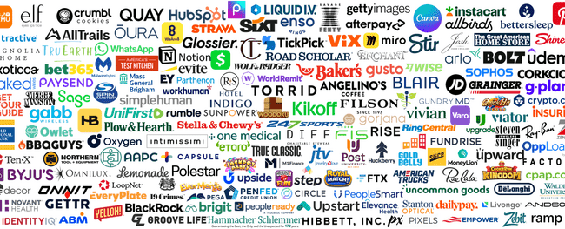



To quantify brand success, we analyzed first-time TV advertisers between 2021-2023 who had measured website traffic in Comscore
931
Total first-time
national TV advertisers
2021 - 2023
201
Brands with measured website traffic available in Comscore
To learn more, download our 48-page report: Breaking Through: How New Advertisers Are Using TV To Ignite Interest & Turn Consumers Into Customers
Source: VAB analysis of Nielsen Ad Intel, January 2021 – December 2023 (calendar months) & VAB analysis of Comscore mediametrix multiplatform media trend data, P18+. April 2020 – April 2024 (calendar months).
This information is exclusively provided to VAB members and qualified marketers.
This information is exclusively provided to VAB members and qualified marketers.
PAGE 25

Slide 26
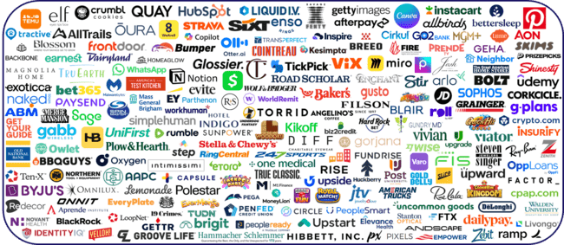
The 201 brands examined within our analysis included brands of all sizes, especially many small and medium-sized businesses
Source: VAB analysis of Nielsen Ad Intel, January 2021 – December 2023 (calendar months) & VAB analysis of Comscore mediametrix multiplatform media trend data, P18+. April 2020 – April 2024 (calendar months).
This information is exclusively provided to VAB members and qualified marketers.
This information is exclusively provided to VAB members and qualified marketers.
PAGE 26

Slide 27
Once their TV campaign launched, brands saw an immediate double-digit influx of website visitors on average which grew as activity continued
Measured Website Traffic’ Brands Analysis: Average Monthly Website Unique Visitors
Monthly Website Unique Visitors (000) Comparison
based over a four-year time period: Apr ‘20 – Apr ‘24
+20%
+12%
+523K monthly uniques
+326K monthly uniques
vs. six months average prior to TV launch
vs. six months average prior to TV launch
(monthly average)
(TV launch – April 2024)
Source: VAB analysis of Comscore mediametrix multiplatform media trend data, P18+. April 2020 – April 2024 (calendar months), figures are based on monthly averages for the 173 brands analyzed. VAB analysis of Nielsen Ad Intel, TV activity based on reported spending across national cable TV, national broadcast TV, Spanish language broadcast TV, Spanish language cable TV, spot TV, syndication TV. ‘When On TV’ represents the monthly average for brands in months where they spent in TV as measured through Nielsen Ad Intel between January 2021 – April 2024 (calendar months), across the 173 brands examined for this analysis. During this four-year analysis, the average advertiser was on TV for 13 months.
This information is exclusively provided to VAB members and qualified marketers.
PAGE 27

Slide 28

Performance-driven DTC brands achieved even greater website traffic lifts across their TV campaigns than the average brand within the overall group
83 ‘Direct-to-Consumer’ Brands Analysis: Average Monthly Website Unique Visitors
Monthly Website Unique Visitors (000) Comparison
based over a four-year time period: Apr ‘20 – Apr ‘24
+50%
+28%
+1.1MM
monthly uniques
+619K
monthly uniques
vs. six months average prior to TV launch
vs. six months average prior to TV launch
(monthly average)
(TV launch – April 2024)
Source: VAB analysis of Comscore mediametrix multiplatform media trend data, P18+. April 2020 – April 2024 (calendar months), figures are based on monthly averages for the 83 brands analyzed. VAB analysis of Nielsen Ad Intel, TV activity based on reported spending across national cable TV, national broadcast TV, Spanish language broadcast TV, Spanish language cable TV, spot TV, syndication TV. ‘When On TV’ represents the monthly average for brands in months where they spent in TV as measured through Nielsen Ad Intel between January 2021 – April 2024 (calendar months), across the 83 brands analyzed. Note: Direct-to-Consumer is defined by the company’s ability to sell their product directly to end customers without third-party retailers, wholesalers or other middlemen.
This information is exclusively provided to VAB members and qualified marketers.
This information is exclusively provided to VAB members and qualified marketers.
PAGE 28

Slide 29
Brands across TV investment levels saw double-digit average increases in their website traffic, with higher investment levels garnering higher lifts
Average Monthly Website Unique Visitors
Monthly Website Unique Visitors (000) Comparison
based over a four-year time period: Apr ‘20 – Apr ‘24
Under $500K Spend
35 Brand Analysis
$2MM - $5MM Spend
35 Brand Analysis
$10MM+ Spend
44 Brand Analysis
+42%
(+1.4MM)
+36%
(+1.2MM)
+25%
(+681K)
+8%
(+64K)
+20%
(+166K)
+9%
(+262K)
(monthly average)
(TV launch – April 2024)
(monthly average)
(TV launch – April 2024)
(monthly average)
(TV launch – April 2024)
Source: VAB analysis of Comscore mediametrix multiplatform media trend data, P18+. April 2020 – April 2024 (calendar months), figures are based on monthly averages for the brands analyzed. VAB analysis of Nielsen Ad Intel, TV activity based on reported spending across national cable TV, national broadcast TV, Spanish language broadcast TV, Spanish language cable TV, spot TV, syndication TV. ‘When On TV’ represents the monthly average for brands in months where they spent in TV as measured through Nielsen Ad Intel between January 2021 – April 2024 (calendar months).. The brands within this group invested their spend in TV between January 2021 – April 2024.
This information is exclusively provided to VAB members and qualified marketers.
This information is exclusively provided to VAB members and qualified marketers.
PAGE 29

Slide 30
First-time advertisers who had much more continuity in their multiscreen TV campaigns saw even greater lifts of curious customers entering their digital storefronts

Slide 31
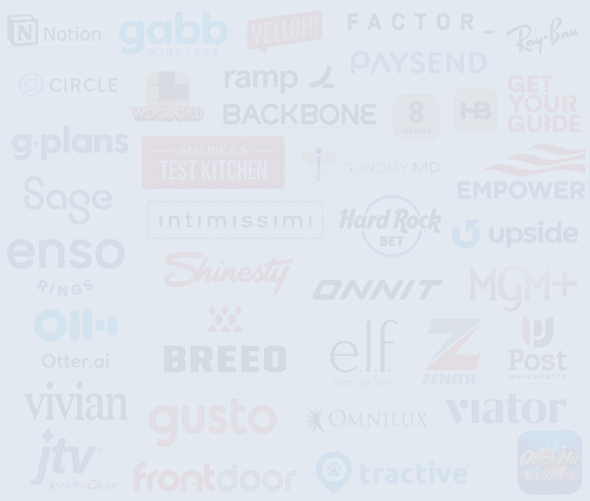

In our second analysis, we examined website & app traffic across 38 brands that launched their first national TV campaign in 2023
Selection Criteria
Brands with measured website traffic in Comscore
  Note: most new advertisers are ‘emerging’ brands and thus not measured
Brands that launched their first multiscreen TV campaign (including local TV) after 1Q 2021
  This allowed us to have at least a few months of ‘pre-TV launch’ monthly website/app traffic data for each brand
Focused on brands with similar ‘pre-TV launch’ monthly website/app traffic and excluded clear outliers from the selection set
  A statistical outlier within this selection set could significantly skew results from a traffic comparison perspective
38
Brands included in analysis
Analysis Methodology
To learn more, download our 22-page report:
A Commanding Presence: How Ad Continuity in Multiscreen TV Drives Incremental Growth for Brands
We analyzed Comscore website & mobile app traffic data between January 2021 - December 2024 to compare monthly unique visitors for each brands’ measured website or app between their pre-TV launch period and post-TV campaign launch period
  Some brands may have launched a local TV campaign prior to 2023, that activity has been included within this analysis
Source: VAB analysis of Comscore mediametrix multiplatform media trend data, P18+. January 2021 – December 2024 (calendar months), figures are based on monthly averages for the brands analyzed in each segment. VAB analysis of Nielsen Ad Intel, TV activity based on reported spending across national cable TV, national broadcast TV, Spanish language broadcast TV, Spanish language cable TV, spot TV, syndication TV, January 2021 – December 2024 (calendar months).
This information is exclusively provided to VAB members and qualified marketers.
This information is exclusively provided to VAB members and qualified marketers.
PAGE 31

Slide 32

































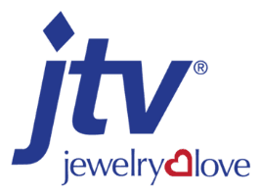




The 38 brands were grouped into four segments based on length of TV activity to best understand the business impact of a sustained presence
Under 6 Months on TV
(11 Brands)
6-12 Months on TV
(6 Brands)
13-18 Months on TV
(12 Brands)
19+ Months on TV
(9 Brands)
Average # of ‘When on TV’ months by segment once TV is launched*
3
9
15
25
*Analysis Time Period: Jan ’21 – Dec ‘24
Source: VAB analysis of Nielsen Ad Intel, January 2021 – December 2024 (calendar months) & VAB analysis of Comscore mediametrix multiplatform media trend data, P18+. January 2021 – December 2024 (calendar months). *Based on a 48-month analysis period
This information is exclusively provided to VAB members and qualified marketers.
PAGE 32

Slide 33
Although all TV advertisers saw spikes to their website traffic, the brands with the most commanding presence saw the biggest lifts
Brand Average: Average Monthly Website Unique Visitors
Monthly Website Unique Visitors (000) Comparison
based over a four-year time period: Jan ‘21 – Dec ‘24
Pre-TV Launch
‘When On TV’
+70%
+548K
monthly uniques
+16%
+32%
vs. monthly average prior to TV launch
+12%
+232K
monthly uniques
+130K
monthly uniques
+93K
monthly uniques
vs. monthly average prior to TV launch
vs. monthly average prior to TV launch
vs. monthly average prior to TV launch
Under 6 Months
6-12 Months
13-18 Months
19+ Months
(avg. 3 months on TV)
(avg. 9 months on TV)
(avg. 15 months on TV)
(avg. 25 months on TV)
Source: VAB analysis of Comscore mediametrix multiplatform media trend data, P18+. January 2021 – December 2024 (calendar months), figures are based on monthly averages for the brands analyzed in each segment. VAB analysis of Nielsen Ad Intel, TV activity based on reported spending across national cable TV, national broadcast TV, Spanish language broadcast TV, Spanish language cable TV, spot TV, syndication TV. ‘When On TV’ represents the monthly average for brands in months where they spent in TV as measured through Nielsen Ad Intel between January 2021 – December 2024 (calendar months), across the brands analyzed in each segment. During this four-year analysis, the average advertiser was on TV for 13 months and spent $10.8MM.
This information is exclusively provided to VAB members and qualified marketers.
PAGE 33

Slide 34
Audience-based TV buying is an effective solution for brands to precisely target their best customer prospects, a critical priority for many businesses especially in times of economic uncertainty

Slide 35

Due to budgetary pressures from uncertain economic conditions, most marketers are open to new ways to plan, buy and measure TV campaigns
Impact of Uncertain Economic Conditions
on Video Investment Approach
79%
of ‘total marketer’ respondents are more open to new ways to plan, buy and measure the efficiency and effectiveness of TV campaigns
Source: VAB / Spectrum Reach / Advertiser Perceptions ‘Audience-Based Buying Survey,’ February 2023, fielded January 11 – 27, 2023 (n=210). Survey base: Advertising decision-makers who are involved in buying or planning digital video, cable / broadcast TV, or advanced TV. Q25. How much do you agree or disagree with the following statements regarding your [company’s/main client’s] video investment approach considering today’s uncertain economic conditions? (strongly/somewhat agree). Base = Total Respondents.
This information is exclusively provided to VAB members and qualified marketers.
PAGE 35

Slide 36



Economic uncertainty has placed a greater focus on strategies that deliver effectiveness and efficiencies against best customer prospects
Impact of Uncertain Economic Conditions on Video Investment Approach
% of total marketers
88%
86%
85%
say that there is increased scrutiny
on ROI / media budgets and greater pressure to prove the effectiveness
of video campaigns
say that there is a greater importance placed on the need for their video campaigns to deliver efficiencies
on a CPM basis
say that precisely targeting best customer prospects has become more of a priority for video campaigns
Source: VAB / Spectrum Reach / Advertiser Perceptions ‘Audience-Based Buying Survey,’ February 2023, fielded January 11 – 27, 2023 (n=210). Survey base: Advertising decision-makers who are involved in buying or planning digital video, cable / broadcast TV, or advanced TV. Q25. How much do you agree or disagree with the following statements regarding your [company’s/main client’s] video investment approach considering today’s uncertain economic conditions? (strongly/somewhat agree). Base = Total Respondents.
This information is exclusively provided to VAB members and qualified marketers.
PAGE 36

Slide 37
















Brands looking to precisely target customer prospects can utilize an audience-based TV buying approach across multiscreen TV platforms
Sample Target ‘A’
Sample Target ‘B’
Personal Characteristics
Under $50K HHI
Expectant Mothers
College Students
Avid
Gamers
$150K+ HHI
Business Executives
Binge Streamers
Health-Conscious Adults
Buying Habits
Affordable Fashionistas
Trending Recipe Chefs
Ready-Made Meal Buyers
American-Made Auto Enthusiasts
Seasoned Travelers
Tech Junkies
Luxury Vehicle Buyers
Organic Eaters
Source: MRI-Simmons Winter 2022 USA Study, A18+. Sample Target ‘A’ (21% of A18+ population) = (Household Income Under $50K) + (Agree with 2 out of 5 statements: “The economy has a direct effect on my spending habits [any agree]”, “I prefer road trips over trips that require a flight [any agree]”, “I only save for a specific purpose [any agree]”, “I like to experiment with new clothing styles [any agree]” , “Meeting new friends on social media is important [somewhat important / very important]”). Sample Target ‘B’ (16% of A18+ population) = (Household Income $150K+) + (Agree with 2 out of 5 statements: “I consider my work to be a career, not just a job [any agree]”, “My friends and acquaintances look to me to organize our activities [any agree]”, “My budget allows for me to buy expensive designer clothes [any agree]” , “I am willing to pay more for a flight in order to travel on my favorite airline [any agree]”, “I would be comfortable buying a "big ticket" item, like a car or appliance, completely online [any agree]”. “Any agree” = somewhat / strongly agree.
This information is exclusively provided to VAB members and qualified marketers.
PAGE 37

Slide 38




ABB enables marketers to seamlessly engage with multiple target audiences across premium, brand-safe multiscreen TV platforms
Tactics currently being used within audience-based TV buying strategies
% of total marketers using ABB
49%
44%
41%
31%
are running their campaign across different platforms / screens beyond linear TV
are targeting multiple audiences in order to focus
on best customer prospects
are targeting different audiences across different screens
are using an audience-based TV buying self-serve platform developed by a media partner
Source: VAB / Spectrum Reach / Advertiser Perceptions ‘Audience-Based Buying Survey,’ February 2023, fielded January 11 – 27, 2023 (n=210). Survey base: Advertising decision-makers who are involved in buying or planning digital video, cable / broadcast TV, or advanced TV. Q140. What tactics is your [company/main client] currently using within [their/your] audience-based TV buying strategies? Base = ‘Audience-Based Buying is a key part/small part/testing for TV’ (n=190). *Q154. Thinking about the impact of brand safety on [your/your main client’s] implementation of audience-based TV campaigns, how much do you agree or disagree with the following statements? (strongly/somewhat agree). Base = Total Respondents.
This information is exclusively provided to VAB members and qualified marketers.
PAGE 38

Slide 39
Marketers implement ABB within their TV strategy because it drives brand outcomes through the purchase journey
% of total marketers who believe audience-based TV buying can impact each of the following KPIs
Awareness
Consideration
Intent
Sales
Full-Funnel
Source: VAB / Spectrum Reach / Advertiser Perceptions ‘Audience-Based Buying Survey,’ February 2023. Wave 2 fielded January 11 – 27, 2023 (n=210); Survey base: Advertising decision-makers who are involved in buying or planning digital video, cable / broadcast TV, or advanced TV. Q150. To what extent do you believe audience-based buying of TV advertising can impact each of the following KPIs? (extremely impactful / very impactful). Base = Total Respondents.
This information is exclusively provided to VAB members and qualified marketers.
PAGE 39

Slide 40



Personalized messaging through audience-based TV buying turns buyers into repeat purchasers and advocates
% of consumers who are more likely to…
Purchase
Repurchase
Recommend
76%
78%
78%
Consider purchasing from brands that engage with them in a personalized and tailored way
Repurchase from brands that offer personalized communications and products / services
Recommend brands to their friends and family that offer personalized communications and products / services
Source: McKinsey & Company, Next in Personalization 2021 Report. Based on consumer survey fielded 9/7/2021-9/8/2021 (n=1,013), sampled and weighted to match the US general population 18+. Question: “Please indicate how much you agree or disagree with the statements below when it comes to personalized communications and products/services from brands/businesses.”; Purchase: “I am more likely to consider buying from brands/businesses that engage with me in a personalized and tailored way.”; Repurchase: “I am more likely to repurchase from brands/businesses that offer personalized communications and products/services.”; Recommend: “I am more likely to recommend brands/businesses to my friends and family that offer personalized communications and products/services.” Numbers shown indicate respondents that selected “somewhat agree”, “agree” and “strongly agree”.
For more information, download: How Might Customized, Targeted Video Ads Help Create Stronger Engagement?
This information is exclusively provided to VAB members and qualified marketers.
PAGE 40

Slide 41
Advertising continuity is the key to growth during times of economic uncertainty
Over one hundred years of historical analysis has consistently demonstrated how businesses that invest in brand equity during economic uncertainty grow sales faster than their competitors
It was only a few years ago that the U.S. was in an extended
period of economic uncertainty marked by a global pandemic, hyper-inflation, international conflicts and a lingering threat of recession; however, consumers continued to spend – adding over $1 trillion annually in retail sales throughout those years
931 advertisers launched their first TV campaign during that period, and they were rewarded with outsized outcomes like double-digit growth in their website traffic, with performance-driven DTC brands seeing the greatest lifts
Furthermore, brands that continued advertising and had a much more sustaining presence in their multiscreen TV campaigns saw the biggest lifts to their website traffic
Audience-based TV buying is an effective performance solution, especially in times of economic uncertainty, for brands
to precisely target their best customer prospects across premium, multiscreen TV platforms
Key Marketer Takeaways
PAGE 41
This information is exclusively provided to VAB members and qualified marketers.

Slide 42

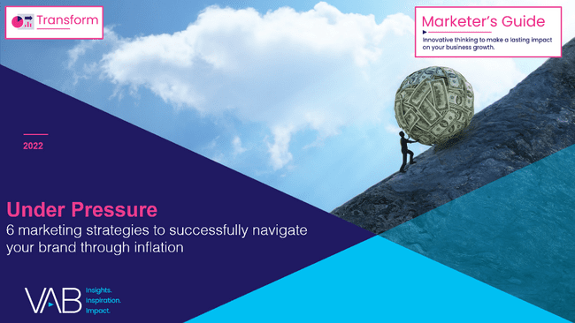







Discover more: This ‘Question of the Week’ was developed in
part based on the below content. Click report covers to download.
Keep Calm and Advertise On
How to Successfully Navigate Your Brand Through an Economic Downturn
Under Pressure
6 Marketing Strategies to Successfully Navigate Your Brand Through Inflation
Best in Show
Five Advantages of Multiscreen TV,
From Brand to Performance
Welcome to TV – Full Year 2022
Meet the New Advertisers Investing in Outcomes Amidst Economic Uncertainty
Breaking Through
How New Advertisers Are Using TV To Ignite Interest & Turn Consumers Into Customers
A Commanding Presence
How Ad Continuity in Multiscreen TV Drives Incremental Growth for Brands
Unlocking Brand Growth with Audience-Based Buying
A Fresh Look at How Marketers
Are Adopting Innovative TV Strategies
The Power of Premium Video
What It Means for Multiscreen TV
and Why It Matters to Marketers
This information is exclusively provided to VAB members and qualified marketers.
PAGE 42

Slide 43


About VAB
VAB plays a dual role in the video advertising industry. We are leading the change to bring about a more innovative and transparent marketplace. We also provide the insights and thought leadership that enables marketers to develop business-driving marketing strategies.
Drawing on our marketing expertise, we simplify the complexities in our industry and discover new insights that transform the way marketers look at their media strategy.
We are committed to your business growth and proud to offer VAB members, brand marketers and agencies complimentary access to our continuously-growing Insights library. Get immediate access at theVAB.com.
This information is exclusively provided to VAB members and qualified marketers.
PAGE 43

