Slide 1

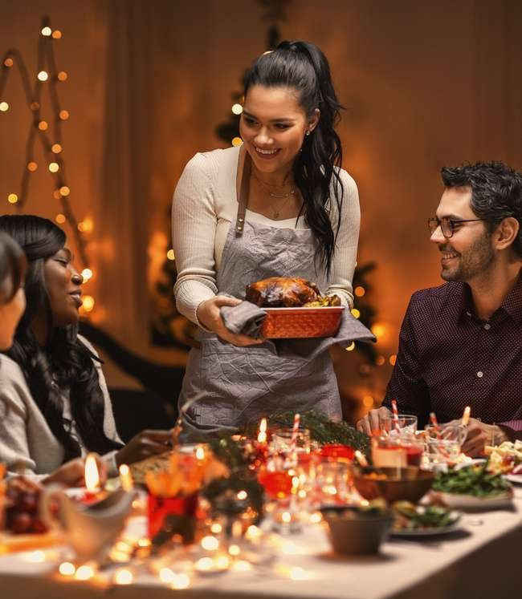
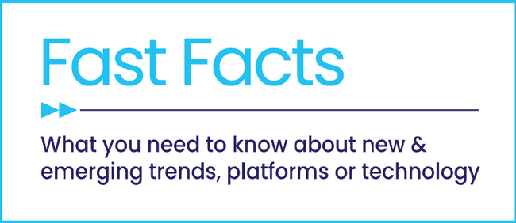


Holidays with Heart
How Marketers Can Authentically Connect With Hispanic Shoppers

Slide 2
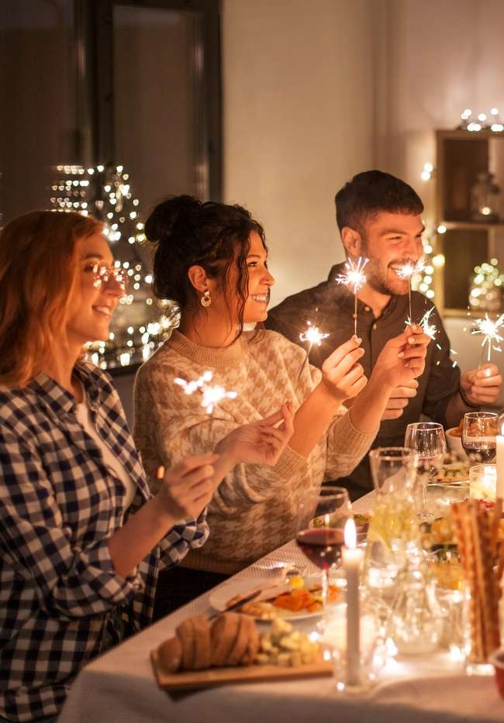

Values-driven marketing resonates strongly with Hispanic consumers
Hispanic consumers stand out as one of the fastest-growing, most influential audiences in the U.S. With rising spending power and a focus on family and home, especially during the holidays, this segment represents a powerful opportunity for marketers seeking to build meaningful connections.
What makes this audience unique is their expectation for authenticity and alignment with cultural values. Hispanic consumers are more likely to support brands that demonstrate transparency, respect traditions and communicate in ways that feel genuine.
By approaching holiday campaigns with cultural relevance and values-driven messaging, marketers can not only earn trust and loyalty but also create lasting brand relationships that extend well beyond the season.
This information is exclusively provided to VAB members and qualified marketers
PAGE 2

Slide 3

1
The growth of the Hispanic audience and their value to marketers during this holiday season

Slide 4
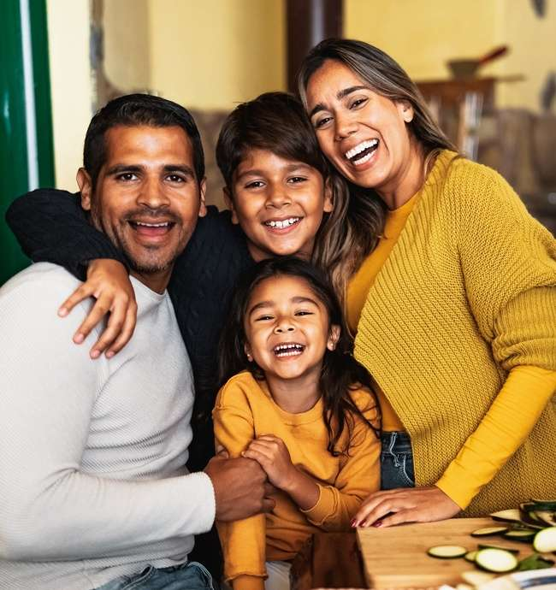
Projected to grow to over 85 million by 2045, the Hispanic population
is a valuable segment for marketers looking to expand their reach
Projected U.S. Hispanic Population
In millions
Source: U.S. Census Bureau, Population Division. Projected Population by Sex, Race, and Hispanic Origin for the United States, Main Series: 2022-2060. November 2023. *U.S. Census Bureau, Current Population Survey, Annual Social and Economic Supplement, 2015.
This information is exclusively provided to VAB members and qualified marketers
PAGE 4

Slide 5
Hispanic consumers represent one of the fastest-growing and most influential segments in the U.S.
Hispanic Average Annual Household Expenditures
In thousands
+4%
YOY
+17%
YOY
+11%
YOY
+14%
YOY
+3%
YOY
Source: VAB analysis of Bureau of Labor Statistics data, Table 2200. Hispanic or Latino origin of reference person: Annual expenditure means, shares, standard errors, and coefficients of variation, Consumer Expenditure Surveys, 2013, 2015, 2017, 2019, 2021 & 2023.
This information is exclusively provided to VAB members and qualified marketers
PAGE 5

Slide 6




Combined with their rising spending power, Hispanics are a young, family-oriented audience for brands to engage with
Facts on Hispanic Consumers in the U.S.
m
37.7
Median Age
vs. 50.3 NH 18+
3.8
People per HH
vs. 2.9 in average NH household
30%
Have College or
Post-Grad Degrees*
vs. 20% 10 years ago
68%
Are Multilingual**
and 32% who only speak English
Source: VAB analysis of MRI-Simmons 2025 Spring Doublebase USA Study. Based on adults 18+ with Spanish or Hispanic origin. *Have college degrees: bachelor’s degree or post-graduate degree or associate degree. Comparison to 10 years ago based on VAB analysis of 2015 Doublebase MRI Study. **Nielsen, Fanáticos, 2024. Multilingual includes those who speak ‘some Spanish.’ NH = Non-Hispanic.
This information is exclusively provided to VAB members and qualified marketers
PAGE 6

Slide 7









As young, active, family-focused consumers, Hispanic households lead in spending on lifestyle, kids and home-related categories
As their spending power expands, this growing segment proves to be an increasingly valuable audience for brands
Hispanic Annual Aggregate Expenditures by Category
In billions (% change 2023 vs. 2021)
$74.6B
(+34% vs ‘21)
vs. +30% NH
$49.9B
(+14% vs ‘21)
vs. +2% NH
$45.6B
(+12% vs. ‘21)
vs. -9% NH
$31.0B
(+5% vs. ‘21)
vs. -1% NH
Food away from home
Entertainment
Household furnishings & equipment
Telephone services
15%
of consumer spending in 2025 comes from Hispanic HHs
vs. 13.6% in 2020*
$31.7B
(+20% vs. ‘21)
vs. -18% NH
$21.5B
(+1% vs. ‘21)
vs. -4% NH
$7.9B
(+1% vs. ‘21)
vs. -10% NH
$1.5B
(+8% vs. ‘21)
vs. 0% NH
Beef, pork, poultry & other meats
Fruits & vegetables
Children ages 15 & under
Postage & stationery
Source: VAB analysis of Bureau of Labor Statistics data, Table 2200. Hispanic or Latino origin of reference person: Shares of annual aggregate expenditures and sources of income, Consumer Expenditure Surveys, 2021 & 2023. * Numerator, The State of Hispanic Spending, August 2025.
This information is exclusively provided to VAB members and qualified marketers
PAGE 7

Slide 8
Hispanic spending is amplified during the holiday season, creating opportunities for brands who apply culturally resonant marketing
% of those who plan to do the following this holiday season*
$2,218
estimated average amount Hispanic consumers
spent on holiday expenses in 2024
Source: BMO Survey, U.S. Latinos plan to spend more on the holidays this year, November 2024. *CivicScience, 5 Key Holiday Insights Among Hispanic Americans, December 2024.
This information is exclusively provided to VAB members and qualified marketers
PAGE 8

Slide 9








Hispanics are highly engaged in holiday traditions like buying gifts and socializing, making them a key audience for brands and retailers
% of Hispanics who plan to do the following for the holidays
47%
Buy gifts
42%
33%
29%
Attend a holiday party at a family/friend’s house
Buy decorations
+11% more than NH
Listen to holiday radio stations
22%
20%
21%
18%
Attend/watch a holiday themed event
Make a charitable donation
+3% more than NH
Host a holiday party
+3% more than NH
Eat at a restaurant
Source: VAB analysis of MRI-Simmons, 2024 Q4 Trending Topics Study. Based on A18+ respondents of Spanish or Hispanic origin. This includes the holidays in the month of December.. NH refers to Non-Hispanics.
This information is exclusively provided to VAB members and qualified marketers
PAGE 9

Slide 10
2
How marketers can connect with Hispanic consumers throughout their holiday shopping journey

Slide 11

Hispanic consumers are more likely to embrace brands offering value as they navigate rising prices during this holiday season
Top Issues Concerning Hispanics Today
% of Hispanic / Latino Respondents
Source: Numerator, Hispanic Consumer Spending Report, July 2025. Total respondents: Rising prices (44%), immigration policy & issues (20%), financial security / personal debt (27%), public safety & crime (20%), health (26%).
This information is exclusively provided to VAB members and qualified marketers
PAGE 11

Slide 12

Values-driven messaging that aligns with Hispanic values and beliefs can authentically connect with this audience during the holidays
Cultural authenticity, transparency and responsible corporate practices are essential to earning and sustaining their loyalty
% of Hispanics / Latinos that agree with the following statements
57%
‘It is important that companies I buy from align with my personal values’
vs. 44% total U.S. respondents
44%
‘I often research the corporate policies, values, or initiatives of brands/retailers that I shop’
vs. 31% total U.S. respondents
Source: Numerator, Hispanic Consumer Spending Report, July 2025.
This information is exclusively provided to VAB members and qualified marketers
PAGE 12

Slide 13

By integrating Spanish-language messaging into campaigns, marketers are more likely to grab attention and increase recall with Hispanic audiences
% of Hispanics who agree with the following statement
52%
‘When a product or service is advertised in Spanish, I am more likely to pay attention to the advertisement and remember it later’
Source: VAB analysis of MRI-Simmons Q3 2025 Trending Topics Study. Based on A18+ respondents of Spanish or Hispanic origin.
This information is exclusively provided to VAB members and qualified marketers
PAGE 13

Slide 14

Advertising in Spanish signals cultural respect that strengthens consumer perception among Hispanic audiences
% of Hispanics who agree with the following statement
64%
‘I believe that companies who advertise in Spanish respect my culture and want my business’
Source: VAB analysis of MRI-Simmons Q3 2025 Trending Topics Study. Based on A18+ respondents of Spanish or Hispanic origin.
This information is exclusively provided to VAB members and qualified marketers
PAGE 14

Slide 15

Spanish-language multiscreen TV ads reinforce trust and consideration and can guide Hispanic consumers as they get closer to purchase
% of Hispanics who agree with the following statement
41%
‘Advertisements in Spanish are the best source of information when I’m purchasing products or services’
Source: VAB analysis of MRI-Simmons Q3 2025 Trending Topics Study. Based on A18+ respondents of Spanish or Hispanic origin.
This information is exclusively provided to VAB members and qualified marketers
PAGE 15

Slide 16

Campaigns that honor heritage can turn inclusivity into a competitive advantage for brands looking to boost loyalty with Hispanic consumers
% of Hispanics who agree with the following statement
54%
‘I am more likely to be loyal to a company that makes an effort to advertise in Spanish’
Source: VAB analysis of MRI-Simmons Q3 2025 Trending Topics Study. Based on A18+ respondents of Spanish or Hispanic origin.
This information is exclusively provided to VAB members and qualified marketers
PAGE 16

Slide 17

Learn how Multiscreen TV engages holiday shoppers at every stage
of the customer journey, from attention and engagement to driving sales
Click report cover above to download
This information is exclusively provided to VAB members and qualified marketers
PAGE 17

Slide 18

Hispanic shoppers are growing by population and influence and, despite economic pressures, they’re driving holiday spending this season, highlighting opportunities for brands to win by aligning messaging with their family-oriented values and traditions
Values-driven marketing resonates strongly with Hispanic consumers when campaigns demonstrate authenticity by aligning with personal beliefs and Spanish-language messaging which drives increases in ad recall, brand perception, consideration, sales and loyalty
Key Marketer Takeaways
This information is exclusively provided to VAB members and qualified marketers
PAGE 18

Slide 19

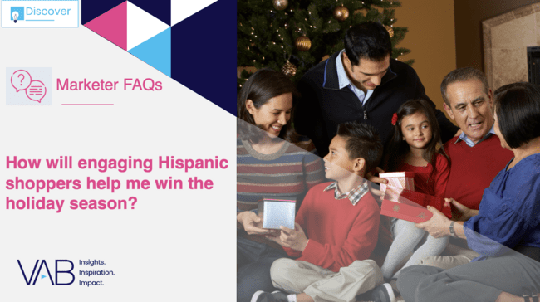
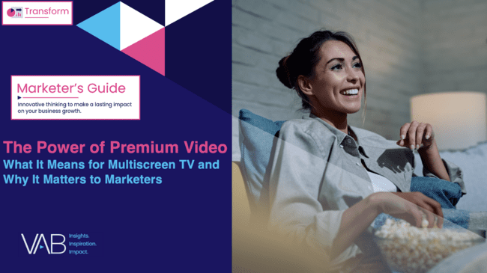



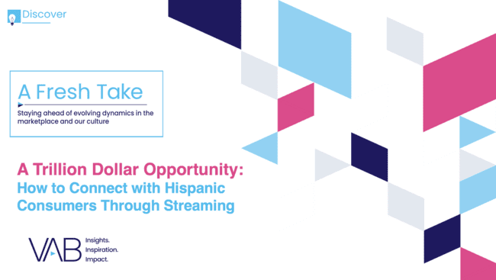
Creators
Jason Wiese
Leah Montner-Dixon
EVP, Strategic Insights & Measurement
jasonw@thevab.com
Director, Audience & Behavioral Insights
leahm@thevab.com
Karolina Guillen
Reir, Llorar, Compartir, Comprar
How TV & Streaming Inspire Deeper Connections with Hispanic Audiences Than Social Media
How will engaging Hispanic shoppers help me win the holiday season?
Associate Director, Insights, Strategy & Analytics
karolinag@thevab.com
Discover more
Looking for more data, insights and takeaways? Check out this related VAB content
The Power of Premium Video
What It Means for Multiscreen TV
and Why It Matters to Marketers
Best in Show
Five Advantages of Multiscreen TV, From Brand to Performance
We are committed to providing marketers with the data and insights they need to develop thoughtful, inclusive campaigns & strategies. To find out more on the unique media consumption behaviors and cultural trends of diverse audiences, visit the VAB’s DEIB Marketing Resources.
“How should I think about my advertising
in the wake of economic uncertainty
caused by tariffs?”
A Trillion Dollar Opportunity
How to Connect with Hispanic Consumers Through Streaming
This information is exclusively provided to VAB members and qualified marketers
PAGE 19

Slide 20


About VAB
VAB plays a dual role in the video advertising industry. We are leading the change to bring about a more innovative and transparent marketplace. We also provide the insights and thought leadership that enables marketers to develop business-driving marketing strategies.
Drawing on our marketing expertise, we simplify the complexities in our industry and discover new insights that transform the way marketers look at their media strategy.
We are committed to your business growth and proud to offer VAB members, brand marketers and agencies complimentary access to our continuously-growing Insights library. Get immediate access at theVAB.com.
This information is exclusively provided to VAB members and qualified marketers
PAGE 20

