Slide 1


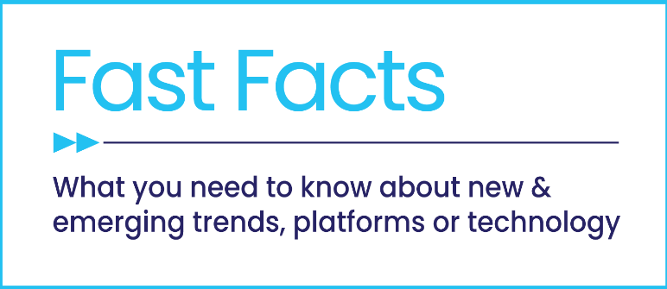
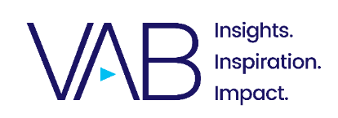
Friend or Frenemy?
Examining the Reasons Why Facebook Bans Billions of Accounts Each Year

Slide 2
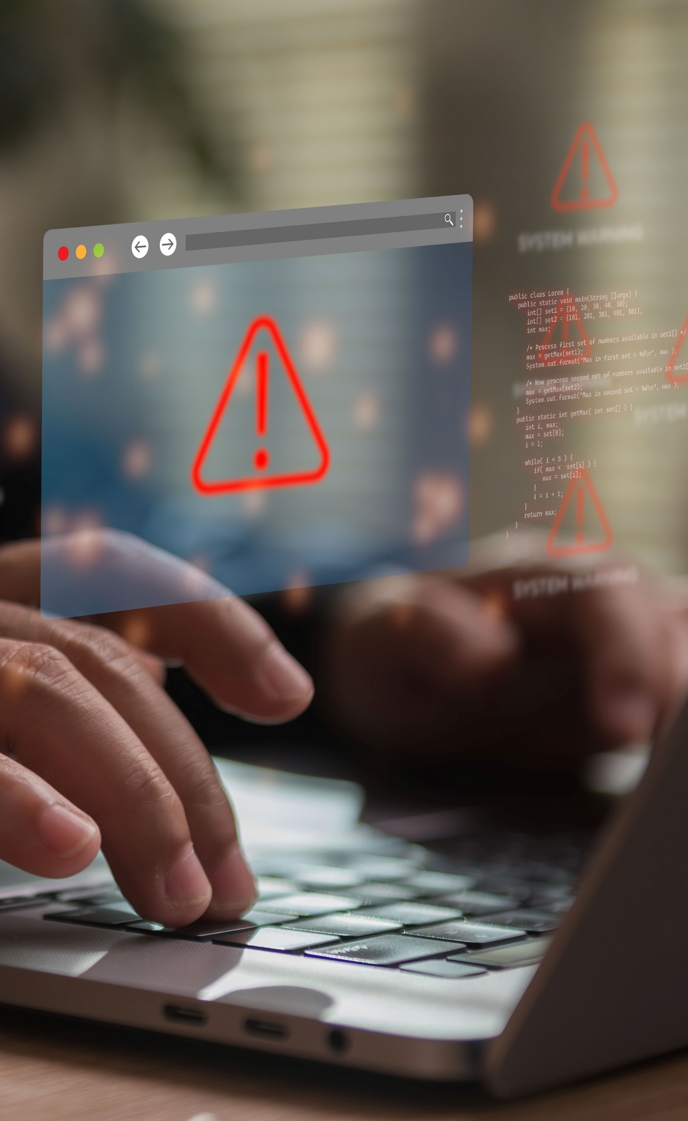
The pervasiveness of fake accounts and scams negatively impacts both consumers and brands
Fake accounts on social media platforms undermine consumer trust and create brand safety risks for advertisers. These fake accounts infiltrate social platforms by the billions with perpetrators using false identities for malicious intent to harm consumers and drive deceitful actions by bots.
To understand how widespread this issue is, we examined the number of fake accounts that Facebook has banned on an annual basis.
While Meta hasn’t published the number of false and duplicate accounts within their SEC-regulated filings since 2023, they do provide data on fake accounts
in their transparency center online which we referenced for our analysis.
The number of banned accounts on Facebook is indicative of the scale of consumer and brand safety issues involving fraud, scams and the selling
of illicit goods across Meta Platforms.
Due to the pervasiveness and persistence of these issues, brands and consumers should both be asking themselves – is Facebook & Meta a friend or frenemy?
This information is exclusively provided to VAB members and qualified marketers.
PAGE 2

Slide 3

How many fake accounts does Facebook ban each year?

Slide 4
Facebook banned three and a half billion fake accounts on their platform in 2025 and more than 38 billion accounts over the last eight years
Fake Accounts Banned by Facebook
In Billions
Source: VAB analysis of Meta Transparency Center, Fake Accounts – Facebook, Accounts Actioned, as of 4/28/26. ‘Accounts Actioned’ refers to fake accounts banned.
This information is exclusively provided to VAB members and qualified marketers.
PAGE 4

Slide 5
The number of fake Facebook accounts are the equivalent of nearly half the world’s population, underscoring the magnitude of this issue
Banned Fake Facebook Accounts’ Share of Global Population
2018
2019
2020
2021
2022
2023
2024
2025
Fake Accounts Banned by Facebook
3.34B
6.50B
5.80B
6.50B
5.80B
2.62B
4.33B
3.50B
7.73B
7.81B
7.89B
7.95B
8.02B
8.09B
8.16B
8.23B
Global Population*
Fake Accounts Banned % Share of Global Population
43%
83%
74%
82%
72%
32%
53%
43%
Source: VAB analysis of Meta Transparency Center, Fake Accounts – Facebook, Accounts Actioned, as of 4/28/26. *VAB analysis of United Nations, Department of Economic and Social Affairs, Population Division (2024), World Population Prospects: The 2024 Revision, custom data acquired via UN Data Portal – Population Division website as of 4/28/26. ‘Accounts Actioned’ refers to fake accounts banned.
This information is exclusively provided to VAB members and qualified marketers.
PAGE 5

Slide 6
Further sizing this issue, the number of fake Facebook accounts banned is typically much larger than the count of actual monthly active users
Ratio of Fake Facebook Accounts to Monthly Active Users
2018
2019
2020
2021
2022
2023
2024
2025
Fake Accounts Banned by Facebook
3.34B
6.50B
5.80B
6.50B
5.80B
2.62B
4.33B
3.50B
Facebook’s Monthly Active Users (MAU)*
2.26B
2.43B
2.71B
2.89B
2.95B
3.03B
‘Monthly Active Facebook Users’ No Longer Reported by Meta
‘Monthly Active Facebook Users’ No Longer Reported by Meta
Ratio of Fake Accounts Banned to Monthly Active Users (MAU)*
1.5
2.7
2.1
2.2
2.0
0.9
N/A
N/A
Source: VAB analysis of Meta Transparency Center, Fake Accounts – Facebook, Accounts Actioned, as of 4/28/26. ‘Accounts Actioned’ refers to fake accounts banned. *VAB analysis of Meta Platforms, Inc. annual company filings. Based on average of quarterly monthly active users worldwide.
This information is exclusively provided to VAB members and qualified marketers.
PAGE 6

Slide 7
The number of banned accounts on Facebook is indicative of the scale of consumer & brand safety issues involving fraud, scams and illicit goods across Meta Platforms

Slide 8
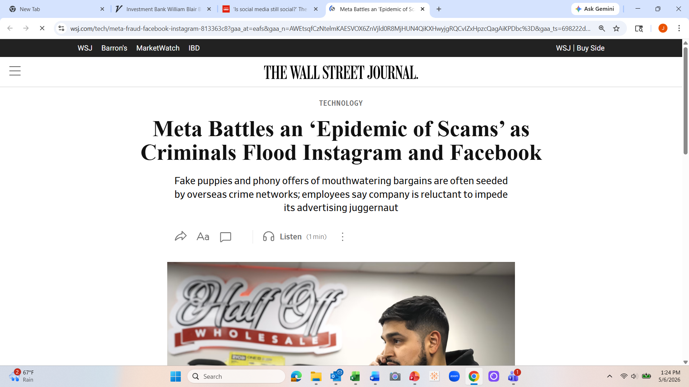
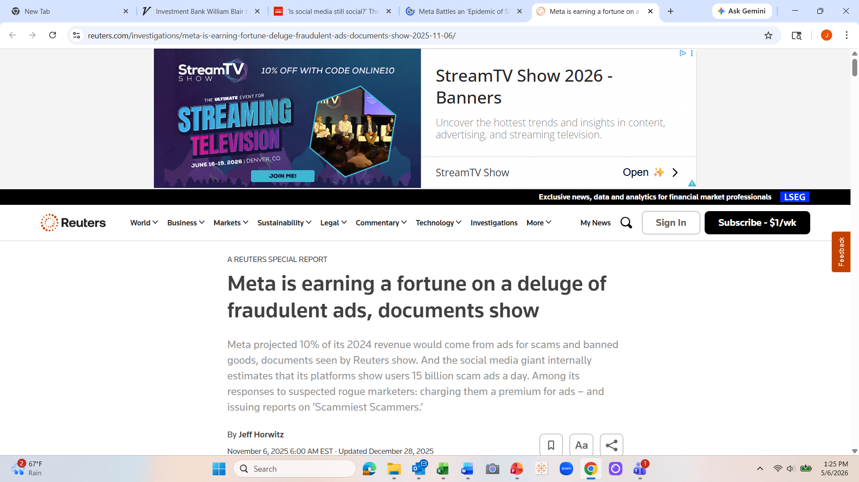



Based on their own internal documents and estimates, Meta knows that its’ platforms are flooded with scams and fraudulent ads
May 15, 2025
November 6, 2025
December 3, 2025
Meta's detection systems identified and disrupted nearly 12 million accounts across Facebook, Instagram, and WhatsApp in the first half of 2025 associated with criminal scam centers.
December 15, 2025
December 15, 2025
Meta’s $3 Billion Fraud Problem: How Chinese Advertisers Exploited Facebook and Instagram
Meta tolerates rampant ad fraud from China to safeguard billions in revenue
This information is exclusively provided to VAB members and qualified marketers
PAGE 8

Slide 9

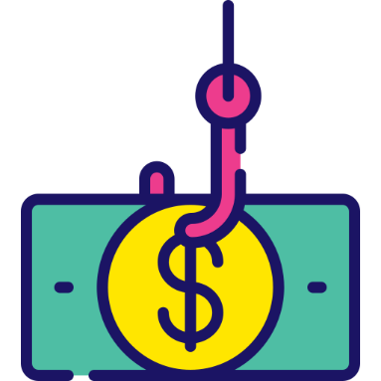
Most new advertisers on Facebook and Instagram are promoting fake ‘products’ that no legitimate brand would want to be associated with
70%
of newly active advertisers on Instagram and Facebook were promoting scams, poor quality products or illicit goods
Source: New York Times, Meta Battles an ‘Epidemic of Scams’ as Criminals Flood Instagram and Facebook, 5/15/25.
This information is exclusively provided to VAB members and qualified marketers
PAGE 9

Slide 10
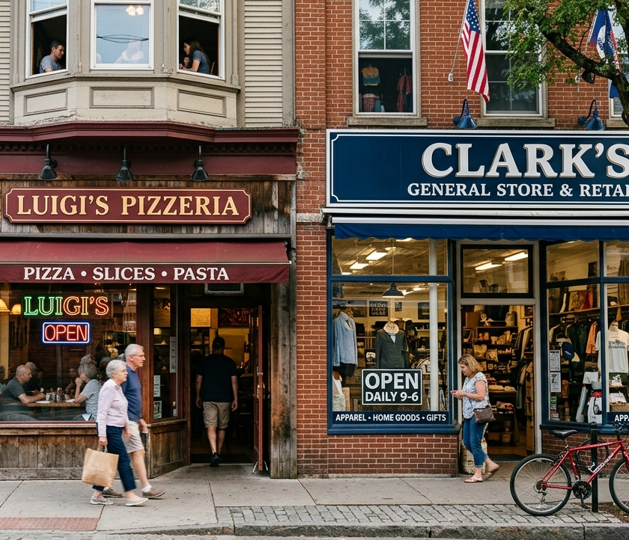
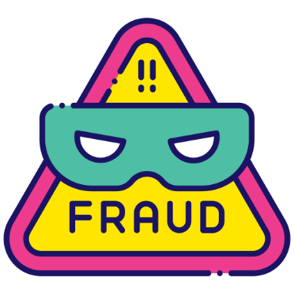
Criminals are also using Facebook and Instagram to impersonate real businesses for their own nefarious benefit
4,400 ads
were found impersonating a real business’ name and phone number on Instagram and Facebook, while the original, legitimate business purchased only 15 ads across those two platforms
Source: New York Times, Meta Battles an ‘Epidemic of Scams’ as Criminals Flood Instagram and Facebook, 5/15/25.
This information is exclusively provided to VAB members and qualified marketers
PAGE 10

Slide 11
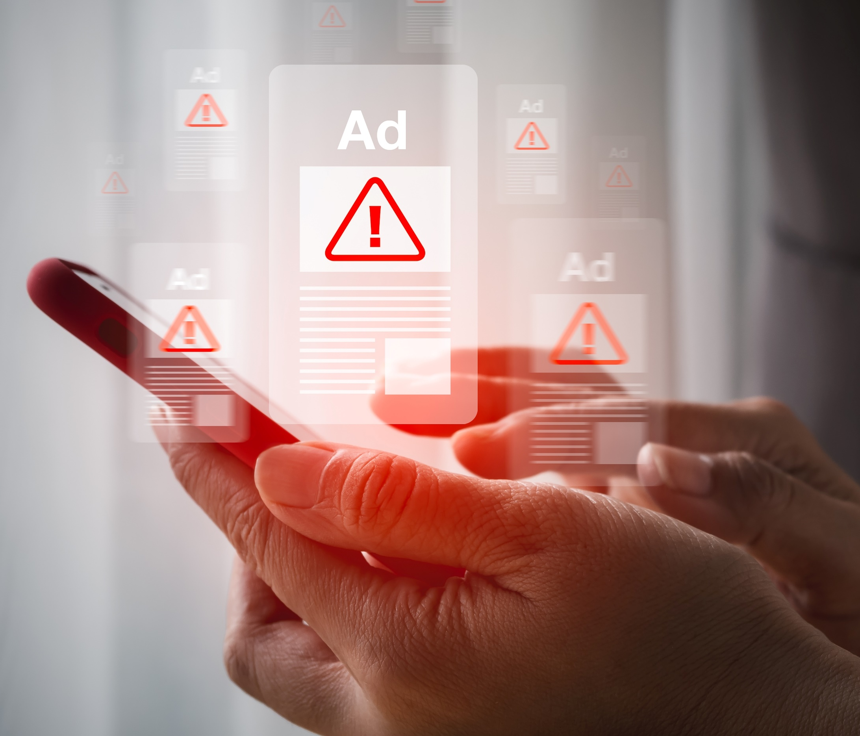

Meta platforms delivered over 15 billion higher risk scam ads each day
in 2024, creating a negative experience for both consumers and brands
15 Billion
‘higher risk’ scam advertisements daily on Meta platforms in 2024
Source: Reuters, Meta is earning a fortune on a deluge of fraudulent ads, documents show, 11/6/25. Estimates from Meta internal projections.
This information is exclusively provided to VAB members and qualified marketers
PAGE 11

Slide 12
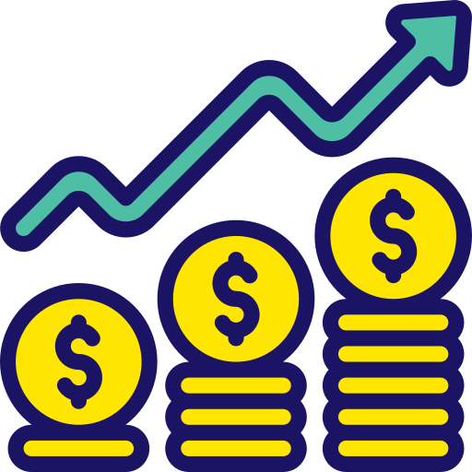
Scam ads are deeply pervasive across Meta platforms, accounting for
10% of their total revenue ($16 billion) in 2024
“It is easier to advertise scams on Meta platforms than Google.”
Meta Internal Review
via Reuters (11/6/25)
$16 Billion
of Meta’s revenue came from ads promoting scams and banned goods
in 2024, estimated at 10% of total revenue
"Scams don't just harm individual victims, they undermine trust in our entire advertising ecosystem, which is the
very foundation of our business model."
Meta Newsroom
(12/3/2025)
Source: Reuters, Meta is earning a fortune on a deluge of fraudulent ads, documents show, 11/6/25. Estimates from Meta internal projections.
This information is exclusively provided to VAB members and qualified marketers
PAGE 12

Slide 13
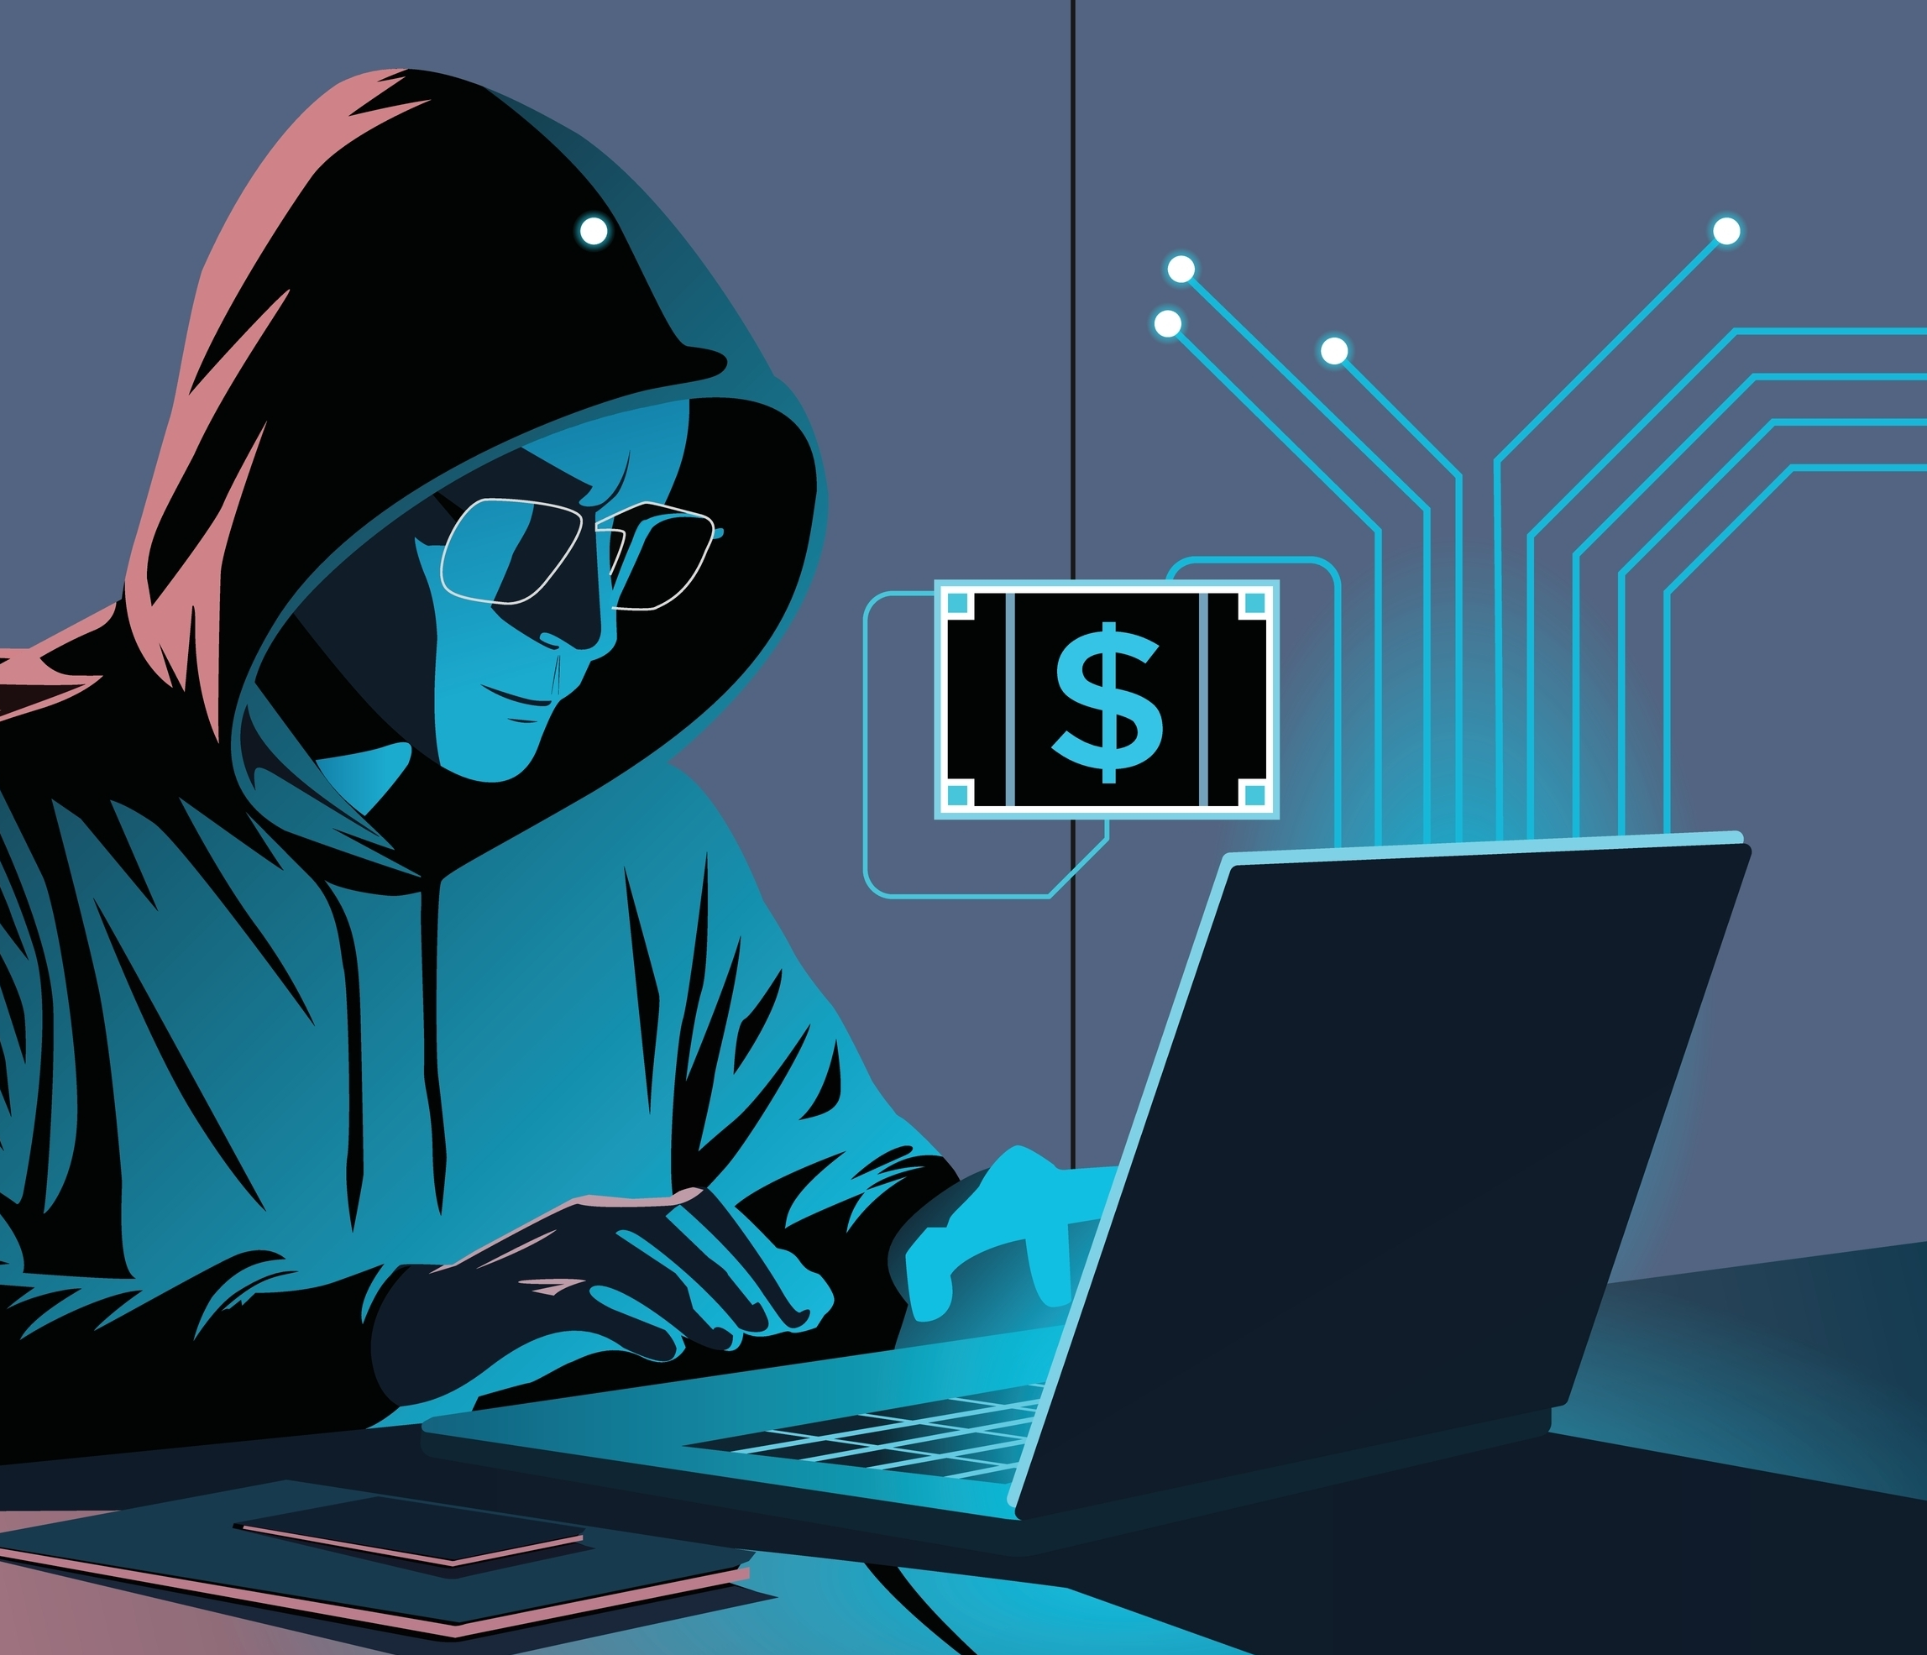
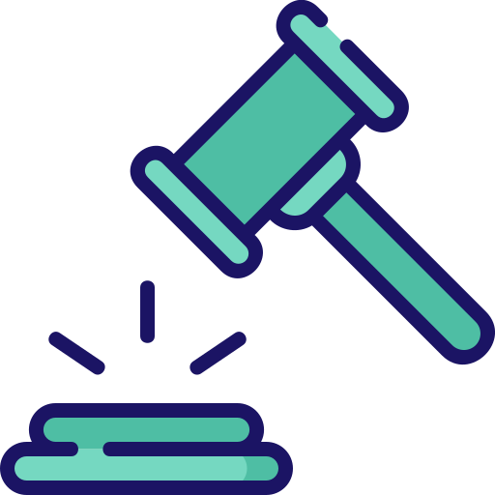
Since Meta allows many violations before acting, it’s reasonable to believe that Facebook should have banned much more than 3.5 billion accounts
8 to 32
financial fraud strikes* are allowed for Meta advertisers
before their account is banned
Source: New York Times, Meta Battles an ‘Epidemic of Scams’ as Criminals Flood Instagram and Facebook, 5/15/25. *Strikes on Meta for advertisers are a punitive, step-by-step enforcement system applied when ads or connected pages violate Community Standards or Advertising Policies.
This information is exclusively provided to VAB members and qualified marketers
PAGE 13

Slide 14
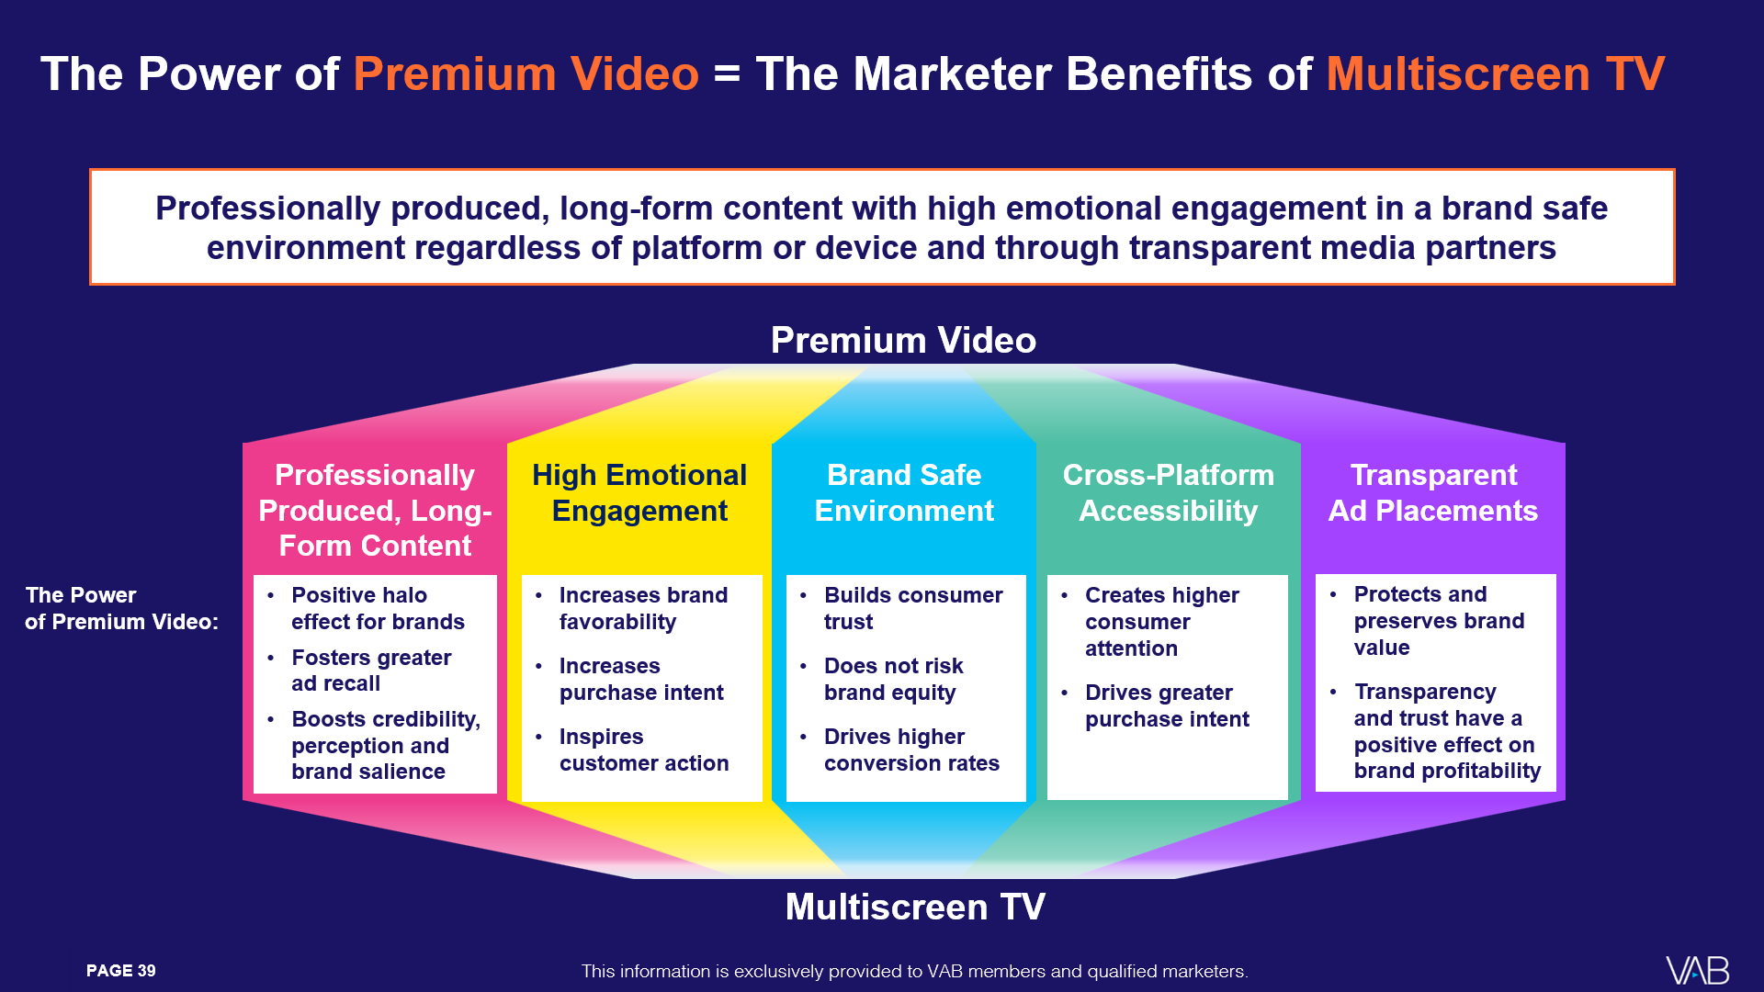

Summary: While brand safety issues are rife across Meta platforms, marketers can turn to Premium Video to achieve real performance
Scam & Fraud Issues Across Meta Platforms
3.5 billion
fake Facebook accounts banned in 2025 alone
8 to 32
financial fraud strikes are allowed for Meta advertisers
before their account is banned
70%
of new advertisers on Instagram and Facebook were promoting scams, poor quality products or illicit goods
$16 billion
in Meta revenue from
ads promoting scams
and banned goods in 2024
To learn more, download
‘The Power of Premium Video’
This information is exclusively provided to VAB members and qualified marketers
PAGE 14

Slide 15

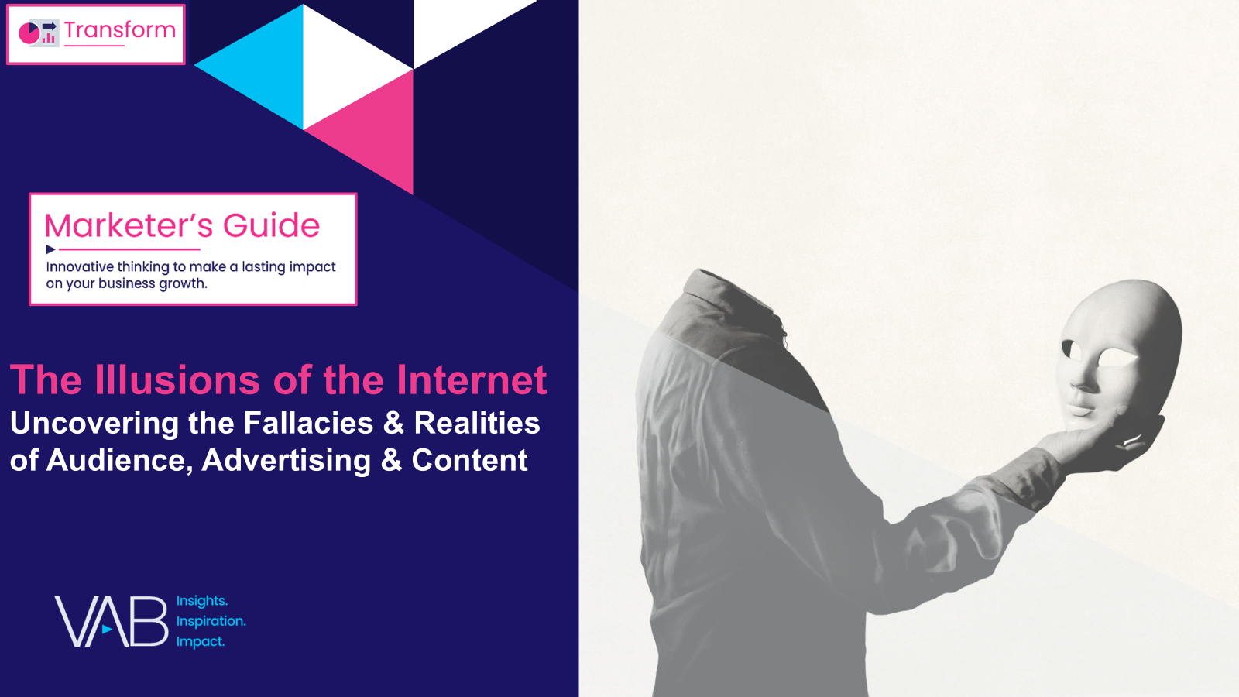
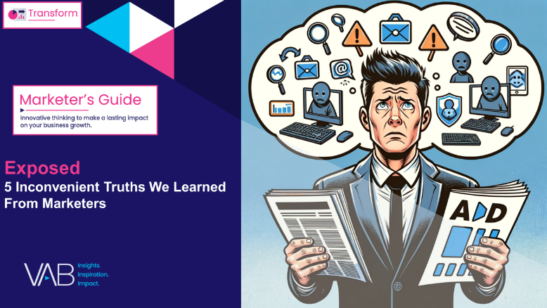
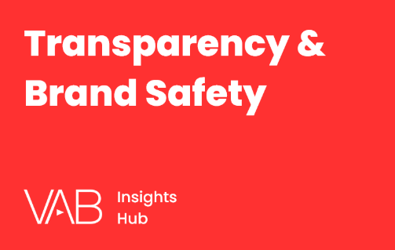
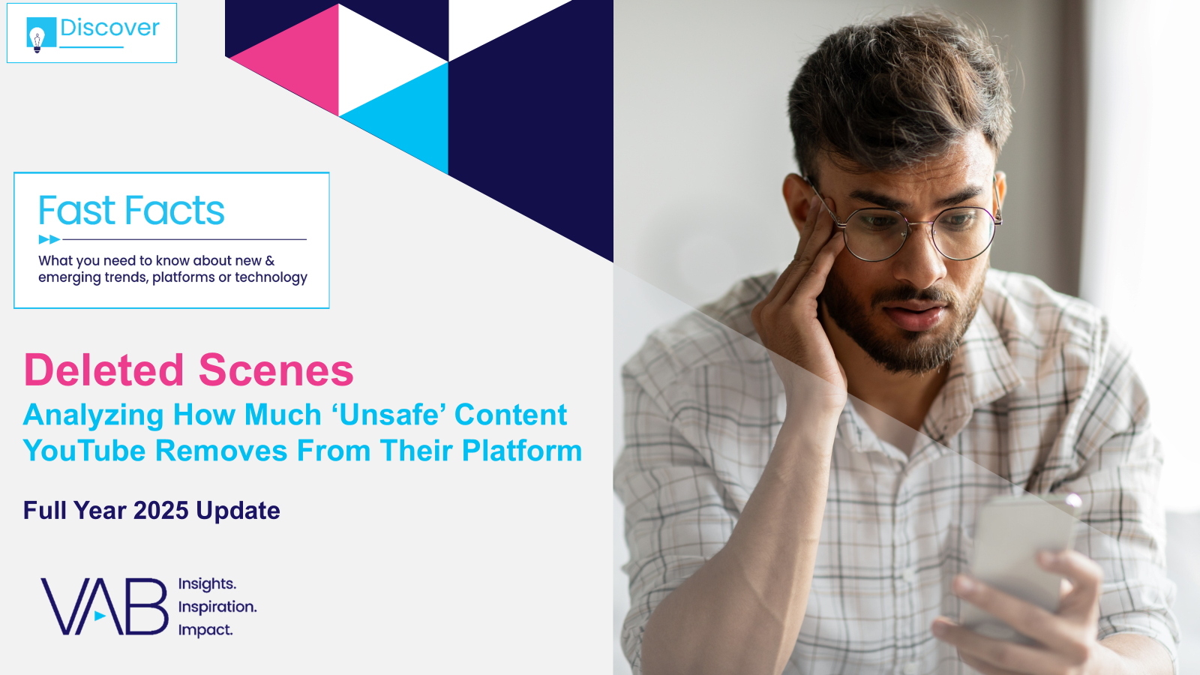
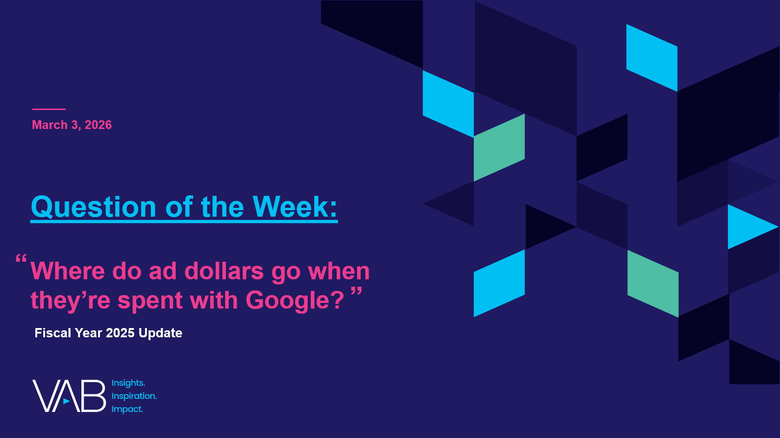

Download these other VAB resources to understand more about the importance of transparency, brand safety and quality within ad campaigns
Visit our Transparency & Brand Safety Hub
to learn more about the importance of a transparent, accurate and competitive
video advertising marketplace.
The Illusions of the Internet
Uncovering the Fallacies & Realities of Audience, Advertising & Content
Exposed
5 Inconvenient Truths We
Learned From Marketers
Deleted Scenes
Analyzing How Much ‘Unsafe’ Content YouTube Removes From Their Platform
Where do ad dollars go when they’re spent with Google?
This information is exclusively provided to VAB members and qualified marketers
PAGE 15

Slide 16

About VAB
VAB plays a dual role in the video advertising industry. We are leading the change to bring about a more innovative and transparent marketplace. We also provide the insights and thought leadership that enables marketers to develop business-driving marketing strategies.
Drawing on our marketing expertise, we simplify the complexities in our industry and discover new insights that transform the way marketers look at their media strategy.
We are committed to your business growth and proud to offer VAB members, brand marketers and agencies complimentary access to our continuously-growing Insights library. Get immediate access at theVAB.com.
This information is exclusively provided to VAB members and qualified marketers
PAGE 16

