Slide 1


May 2026
“How has the FDA’s crackdown on deceptive drug advertising affected multiscreen TV?”

Slide 2

In the six months after the FDA crackdown, pharma Rx brands increased TV spend by 53%
In September 2025, the FDA launched a crackdown on deceptive drug advertising with an initial issuance of over 100 letters to pharma companies.
As several marketers have asked us about the implications
of the FDA’s actions, specifically as it relates to pharma Rx advertising on multiscreen TV platforms, we took a deep dive
into the category to understand:
Recent multiscreen TV investment trends for the pharma Rx category, both before and after the FDA’s initial crackdown in September 2025
TV ad duration (or commercial unit length) trends for the pharma Rx category, both before and after the FDA’s crackdown, including the following cuts:
  Total TV & streaming
  Prime time daypart
  Sports events, news & entertainment genres
  Pharma Rx product categories
This information is exclusively provided to VAB members and qualified marketers.
PAGE 2

Slide 3





Current federal mandates require that pharma Rx advertisements adhere to several rules and regulations
Present a fair balance between a product’s
risks & benefits
Avoid exaggerated benefits
Don’t create a misleading overall impression
Properly disclose financial relationships
Include info regarding major side effects & considerations
This information is exclusively provided to VAB members and qualified marketers.
PAGE 3

Slide 4


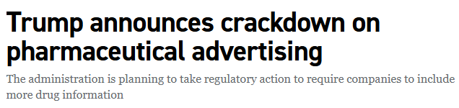
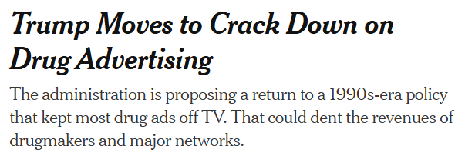
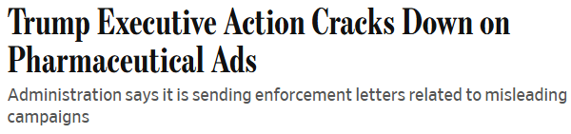



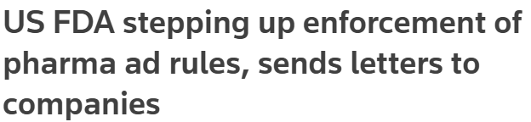

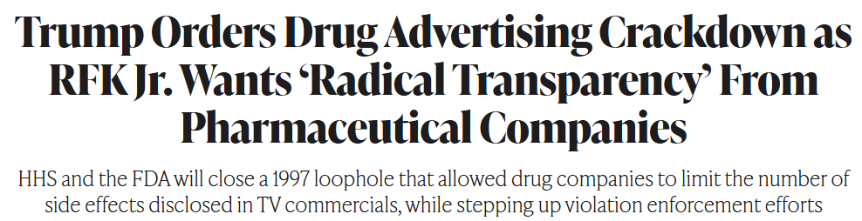


In early September 2025, the FDA launched a crackdown on deceptive drug advertising
9/9/2025
9/9/2025
9/9/2025
9/9/2025
9/9/2025
9/10/2025
9/10/2025
This information is exclusively provided to VAB members and qualified marketers.
PAGE 4

Slide 5

The FDA crackdown involved over 65 ‘warning’ letters sent to pharma companies, 96% of which were targeted towards digital & social platforms
In total, over 100 letters were sent to pharma companies by the FDA on September 9th, 2025; 65% of which were targeted towards digital & social platforms
FDA ‘Warning’ or ‘General Notice’ Letters by Media
based on letters sent on 9/9/25
Source: VAB analysis of data from www.fda.gov as of 9/12/25. *Untitled letters are used for violations that do not meet the threshold of regulatory significance for a warning letter. Unlike a warning letter, an untitled letter does not include a statement that warns the individual or firm that failure to promptly correct the violation may result in enforcement action.
This information is exclusively provided to VAB members and qualified marketers.
PAGE 5

Slide 6

The clarity provided by the FDA’s actions in September 2025 spurred increased investment across multiscreen TV platforms

Slide 7
4Q 2025 pharma ad spend in multiscreen TV was up over $400MM (+13%) vs. 4Q 2024 and the number of Rx advertisers increased to 140
Pharma Rx TV Spend: By 4Q
$ in billions
+13%
YoY
-1%
YoY
# of Brands:
124
122
140
YOY:
-2%
+15%
Source: VAB analysis of Nielsen AdIntel, January 2023 – March 2026; TV Media: Cable TV, Network TV, Spanish Language Cable TV, Spanish Language Network TV, Spot TV, Syndication TV, Streaming. Sub-group category: Pharmaceutical Houses, GP (includes Rx product categories). $$$ exclude promos and PSAs. # of Brands = active TV advertisers during the time period.
This information is exclusively provided to VAB members and qualified marketers.
PAGE 7

Slide 8







In fact, seven pharma Rx brands launched their first multiscreen TV ad campaign in 4Q ’25, with a collective TV ad spend of over $200 MM
First-Time Pharma Rx Multiscreen TV Advertisers (between Sept ’25 – Dec ’25)
Spending based on September ‘25 – March ’26, $$$ (000)
Brand Name
Drug Category
Received FDA Approval
TV Launch Month
Total Multiscreen TV Spend
Cobenfy Rx
Schizophrenia
September 2024
September 2025
$106,781.1
Auvelity Rx
Depression
August 2022
September 2025
$40,292.5
Brukinsa Rx
B-cell malignancies
(i.e., lymphoma, leukemia)
November 2019
November 2025
$19,205.9
Ocrevus Rx
Multiple Sclerosis
March 2017
November 2025
$18,064.1
LEQEMBI Rx
Early Alzheimer's
January 2023
September 2025
$16,677.6
Elahere Rx
Ovarian Cancer
November 2022
November 2025
$6,013.7
ENHERTU Rx
Various cancers
(i.e., breast, lung, stomach)
December 2019
September 2025
$613.5
Source: VAB analysis of Nielsen Ad Intel data as of 4/9/26, 8/1/25 – 3/31/26. TV Spend includes national cable TV, broadcast TV, Spanish language cable TV, Spanish language broadcast TV, spot TV, syndicated TV and streaming TV.
Total Spend: $207,648.3
This information is exclusively provided to VAB members and qualified marketers.
PAGE 8

Slide 9
Pharma Rx multiscreen TV spend also accelerated in 1Q 2026 as total investment almost doubled during the period vs. previous years
Pharma Rx TV Spend: By 1Q
$ in billions
+94%
YoY
+34%
YoY
-7%
YoY
# of Brands:
114
112
120
132
YOY:
-2%
+7%
+10%
Source: VAB analysis of Nielsen AdIntel, January 2023 – March 2026; TV Media: Cable TV, Network TV, Spanish Language Cable TV, Spanish Language Network TV, Spot TV, Syndication TV, Streaming. Sub-group category: Pharmaceutical Houses, GP (includes Rx product categories). $$$ exclude promos and PSAs. # of Brands = active TV advertisers during the time period.
This information is exclusively provided to VAB members and qualified marketers.
PAGE 9

Slide 10
Overall, multiscreen TV investment by pharma Rx brands was up 53% in the two quarters after the FDA crackdown on deceptive drug advertising
Pharma Rx TV Spend: Comparative Six-Month Period
$ in billions
+53%
YoY
-4%
YoY
# of Brands:
143
138
153
YOY:
-3%
+11%
Source: VAB analysis of Nielsen AdIntel, January 2023 – March 2026; TV Media: Cable TV, Network TV, Spanish Language Cable TV, Spanish Language Network TV, Spot TV, Syndication TV, Streaming. Sub-group category: Pharmaceutical Houses, GP (includes Rx product categories). $$$ exclude promos and PSAs. # of Brands = active TV advertisers during the time period.
This information is exclusively provided to VAB members and qualified marketers.
PAGE 10

Slide 11
Rx brands are being more mindful of proactively adhering to pharma advertising rules and regulations across multiscreen TV platforms…
…one quantitative way of verifying these proactive adjustments is to analyze changes in TV ad unit durations

Slide 12
Pharma Rx Category:
National TV Commercial Unit & Time Distribution % Share by Ad Duration
Total Measured National TV & Streaming

Slide 13
In the two quarters after the FDA crackdown, there has been a noticeable shift towards longer pharma Rx ad unit durations compared to prior year
Pharma Category: National TV Commercial Unit % Share by Ad Duration
Source: Nielsen Ad intel, National TV Commercial Unit & Time Distribution by Ad Duration; sub-group category: Pharmaceutical Houses, GP (Rx product categories only), which reflects prescription remedies; national broadcast TV, national cable TV, Spanish Language broadcast TV, Spanish Language Cable TV, Streaming; Based on six-month average for Oct ’24 – Mar ’25 & Oct ’25 – Mar ’26. Percentages are rounded off.
This information is exclusively provided to VAB members and qualified marketers.
PAGE 13

Slide 14
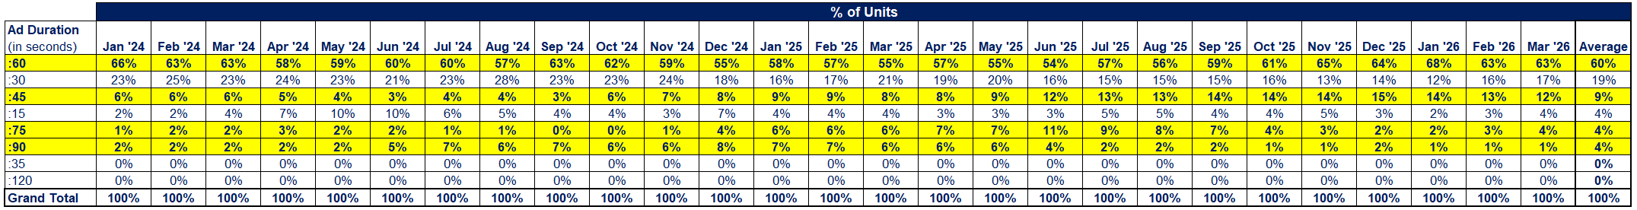
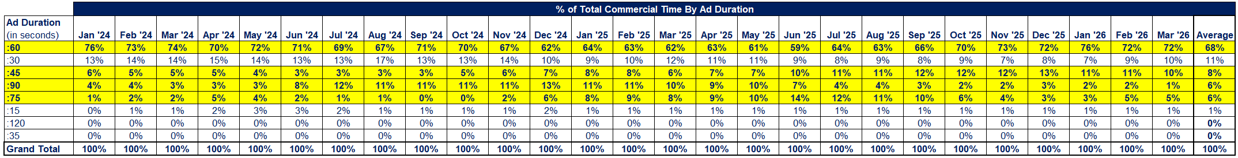
27-Month Time Period: January ‘24 – March ’26
Between 1Q 2024 and Q1 2026, the share of pharma Rx ad units longer than 30 seconds in the first quarter increased from 74% to 82%
Pharma Category: National TV Commercial Unit & Time Distribution % Share by Ad Duration
Source: Nielsen Ad intel, National TV Commercial Unit & Time Distribution by Ad Duration; sub-group category: Pharmaceutical Houses, GP (Rx product categories only), which reflects prescription remedies; national broadcast TV, national cable TV, Spanish Language broadcast TV, Spanish Language Cable TV, Streaming; January 2024 – March 2026. Percentages are rounded off. Percentages in the headline based on three-month average for 1Q 2024 & 1Q 2026. Charts are sorted by average percentages by ad duration.
This information is exclusively provided to VAB members and qualified marketers.
PAGE 14

Slide 15
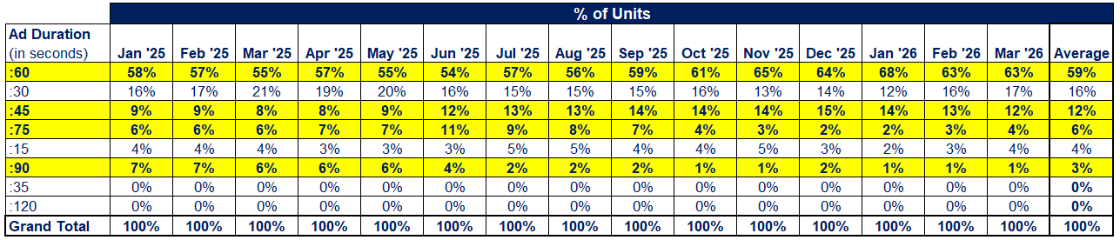
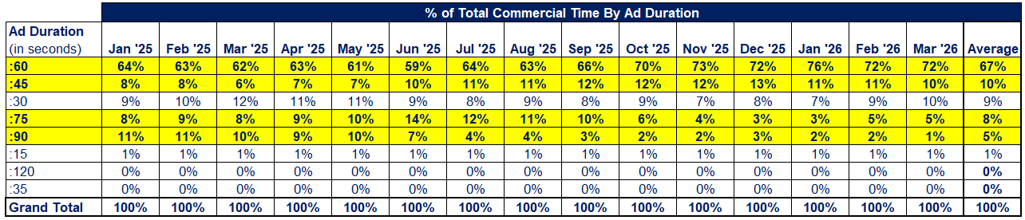
15-Month Time Period: January ‘25 – March ’26
The share of 60-second TV ad units in the pharma Rx category increased by seven percentage points (56% → 63%) between August ‘25 & March ’26
Pharma Category: National TV Commercial Unit & Time Distribution % Share by Ad Duration
Source: Nielsen Ad intel, National TV Commercial Unit & Time Distribution by Ad Duration; sub-group category: Pharmaceutical Houses, GP (Rx product categories only), which reflects prescription remedies; national broadcast TV, national cable TV, Spanish Language broadcast TV, Spanish Language Cable TV, Streaming; January 2025 – March 2026. Percentages are rounded off. Charts are sorted by average percentages by ad duration.
This information is exclusively provided to VAB members and qualified marketers.
PAGE 15

Slide 16
Pharma Rx Category:
National TV Commercial Unit & Time Distribution % Share by Ad Duration
TV Prime Time Daypart
(15-month period: January ’25 – March ’26)

Slide 17
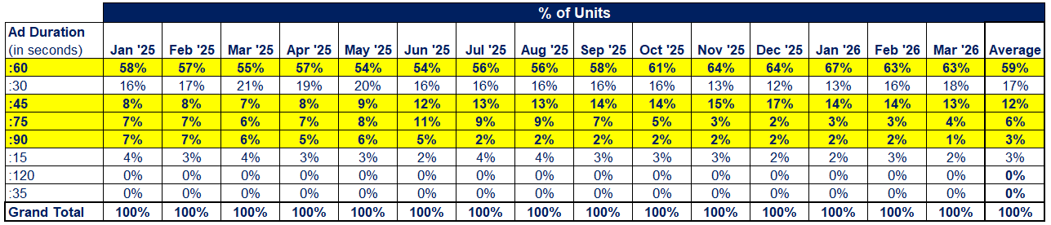
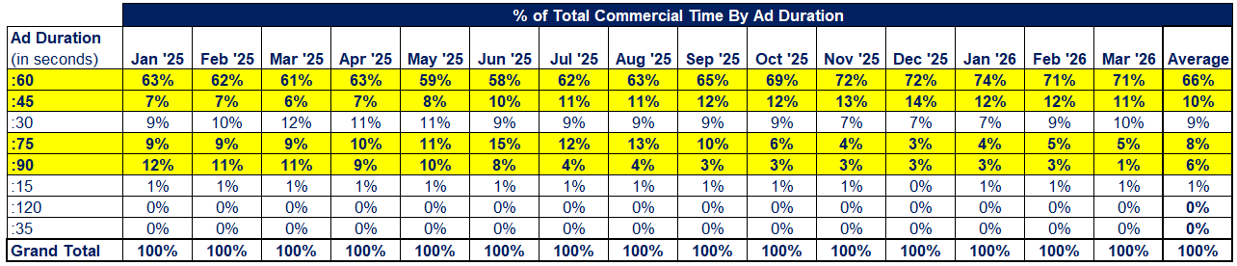
15-Month Time Period: January ‘25 – March ’26
The share split of pharma Rx TV ad unit lengths during prime time aligns very closely with the overall share splits across all dayparts
The share of 60-second TV ad units in the Pharma Rx category increased by seven percentage points (56% → 63%) between August ‘25 & March ’26
Pharma Category: National TV (Prime Time Daypart) Commercial Unit & Time Distribution % Share by Ad Duration
Source: Nielsen Ad intel, National TV Commercial Unit & Time Distribution by Ad Duration; sub-group category: Pharmaceutical Houses, GP (Rx product categories only), which reflects prescription remedies; national broadcast TV, national cable TV, Spanish Language broadcast TV, Spanish Language Cable TV, Streaming; January 2025 – March 2026. Daypart: TV Prime Time. Percentages are rounded off. Charts are sorted by average percentages by ad duration.
This information is exclusively provided to VAB members and qualified marketers.
PAGE 17

Slide 18
Pharma Rx Category:
National TV Commercial Unit & Time Distribution % Share by Ad Duration
Sports Event, News & Entertainment TV Program Genres
(15-month period: January ’25 – March ’26)

Slide 19
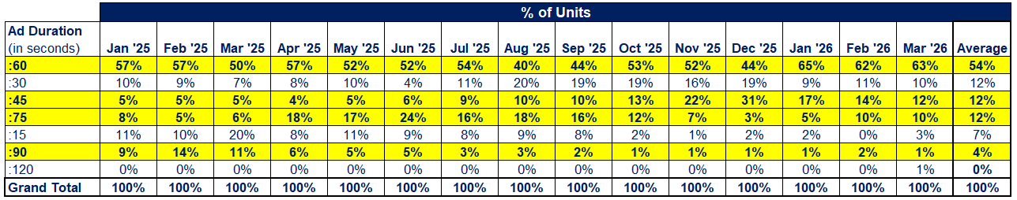
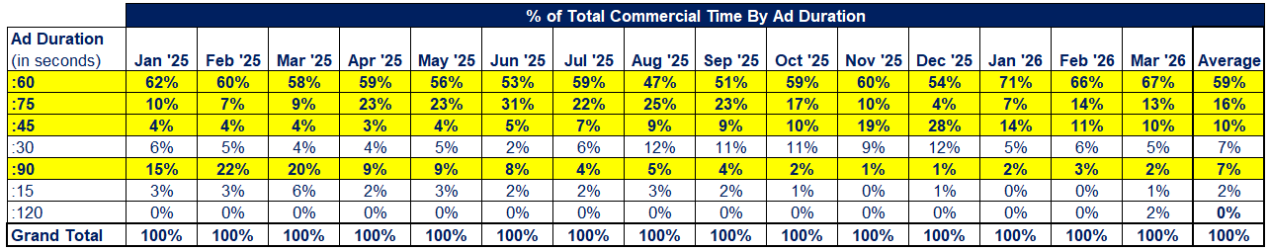
15-Month Time Period: January ‘25 – March ’26
In the first quarter, the year-over-year share of pharma Rx ad units longer than 30 seconds in live sports increased from 77% to 86%
Pharma Category: National TV (Live Sports Events) Commercial Unit & Time Distribution % Share by Ad Duration
Source: Nielsen Ad intel, National TV Commercial Unit & Time Distribution by Ad Duration; sub-group category: Pharmaceutical Houses, GP (Rx product categories only), which reflects prescription remedies; national broadcast TV, national cable TV, Spanish Language broadcast TV, Spanish Language Cable TV, Streaming; January 2025 – March 2026. Program Genre: Sports Event (All). Percentages are rounded off. Charts are sorted by average percentages by ad duration.
This information is exclusively provided to VAB members and qualified marketers.
PAGE 19

Slide 20
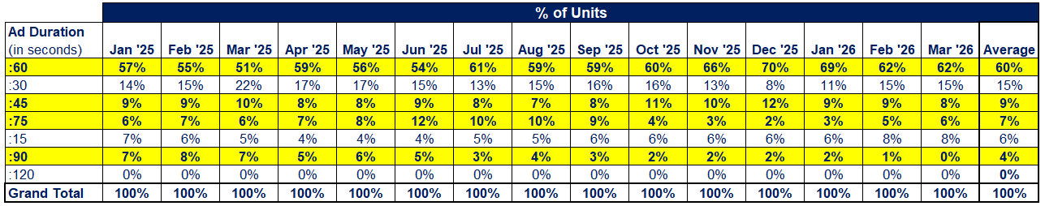
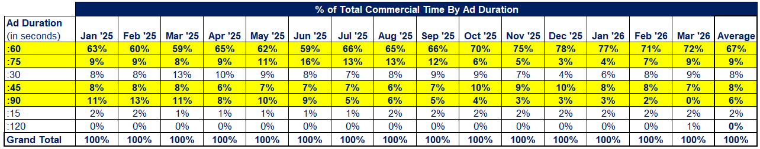
15-Month Time Period: January ‘25 – March ’26
In the first quarter, the year-over-year share of pharma Rx ad units longer than 30 seconds in news programs increased slightly from 77% to 79%
Pharma Category: National TV (News) Commercial Unit & Time Distribution % Share by Ad Duration
Source: Nielsen Ad intel, National TV Commercial Unit & Time Distribution by Ad Duration; sub-group category: Pharmaceutical Houses, GP, which reflects prescription remedies; national broadcast TV, national cable TV, Spanish Language broadcast TV, Spanish Language Cable TV, Streaming; January 2025 – March 2026. Program Genre: News. Percentages are rounded off. Charts are sorted by average percentages by ad duration.
This information is exclusively provided to VAB members and qualified marketers.
PAGE 20

Slide 21
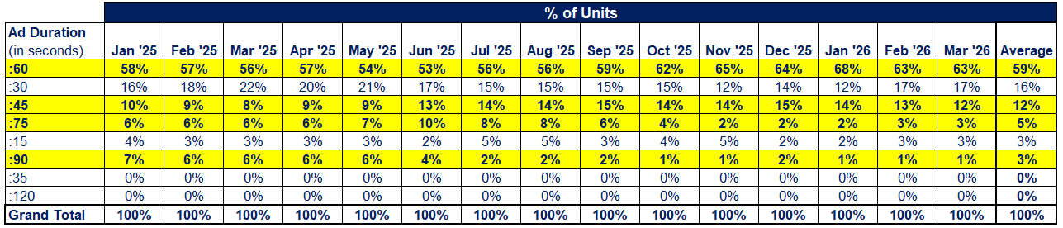
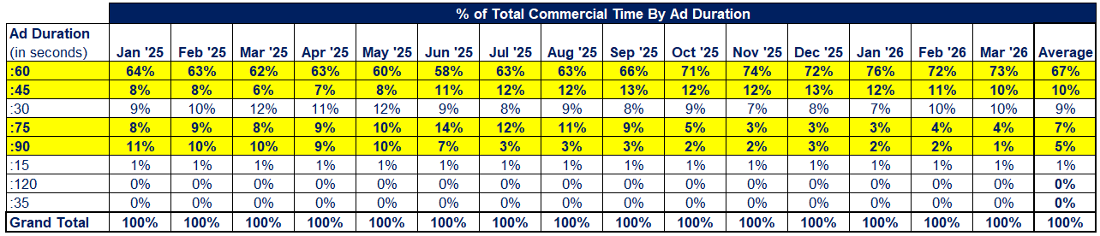
15-Month Time Period: January ‘25 – March ’26
In the first quarter, the year-over-year share of pharma Rx ad units longer than 30 seconds in entertainment programming increased from 78% to 82%
Pharma Category: National TV (Entertainment) Commercial Unit & Time Distribution % Share by Ad Duration
Source: Nielsen Ad intel, National TV Commercial Unit & Time Distribution by Ad Duration; sub-group category: Pharmaceutical Houses, GP, which reflects prescription remedies; national broadcast TV, national cable TV, Spanish Language broadcast TV, Spanish Language Cable TV, Streaming; January 2025 – March 2026. Program Genre: Various entertainment genres including dramas, comedies, documentaries, feature films, excludes live sports, sports-related programming, children’s programs and news. Charts are sorted by average percentages by ad duration.
This information is exclusively provided to VAB members and qualified marketers.
PAGE 21

Slide 22
Pharma Rx Category:
National TV Commercial Unit & Time Distribution % Share by Ad Duration
Pharma Rx Product Categories
(3-month period: January ’26 – March ’26)

Slide 23
The product categories with the highest share of longer-length TV ads in 1Q ’26 include depression, HIV, tardive dyskinesia, bipolar, cancer, diabetes
Pharma Rx Product Categories: National TV Commercial Unit % Share by Ad Duration
(Top 15 product categories: based on share of :60-second or longer ad units & sorted by total # of national TV units)
1Q ‘26
Source: Nielsen Ad intel, National TV Commercial Unit & Time Distribution by Ad Duration; sub-group category: Pharmaceutical Houses, GP (Rx product categories only), which reflects prescription remedies; national broadcast TV, national cable TV, Spanish Language broadcast TV, Spanish Language Cable TV, Streaming; January 2026 – March 2026. Percentages are rounded off. AMD = Age-related macular degeneration.
This information is exclusively provided to VAB members and qualified marketers.
PAGE 23

Slide 24
The product categories with the highest share of shorter-length TV ads in 1Q ’26 include asthma, migraines, animal, dry eyes, ED and alcoholism
Pharma Rx Product Categories: National TV Commercial Unit % Share by Ad Duration
(Top 10 product categories: based on share of :30-second or shorter ad units & sorted by total # of national TV units)
1Q ‘26
99%
95%
96%
100%
Source: Nielsen Ad intel, National TV Commercial Unit & Time Distribution by Ad Duration; sub-group category: Pharmaceutical Houses, GP (Rx product categories only), which reflects prescription remedies; national broadcast TV, national cable TV, Spanish Language broadcast TV, Spanish Language Cable TV, Streaming; January 2026 – March 2026. Percentages are rounded off. COPD = Chronic Obstructive Pulmonary Disease.
This information is exclusively provided to VAB members and qualified marketers.
PAGE 24

Slide 25
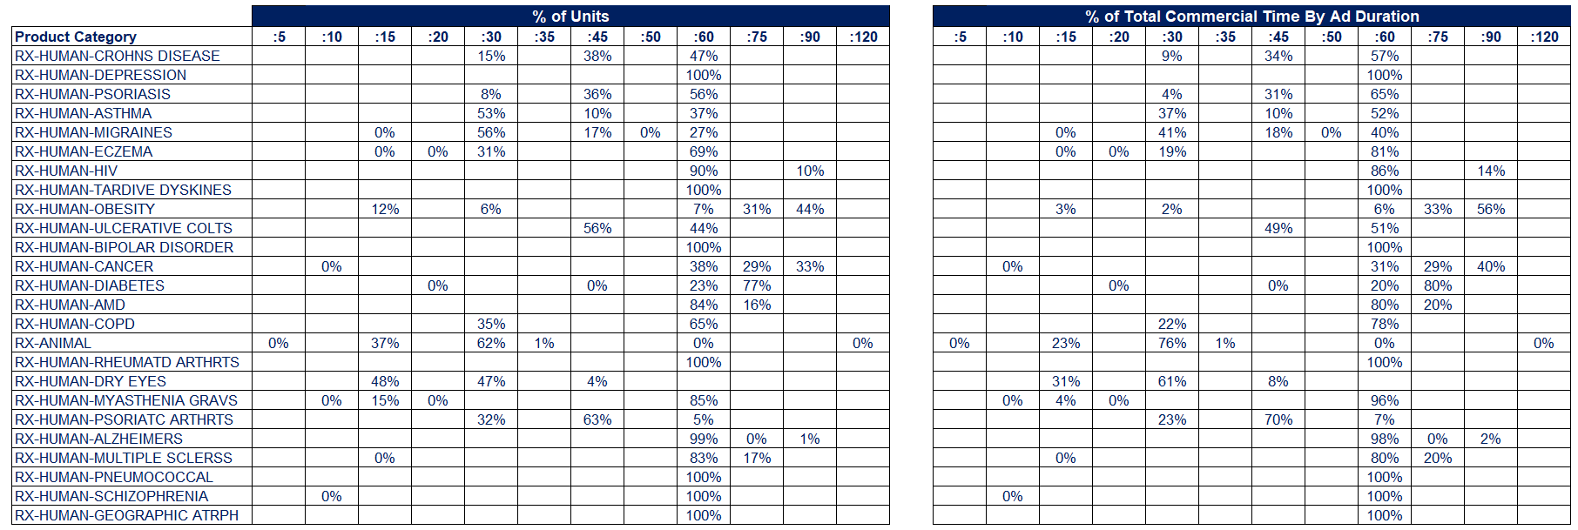
3-Month Time Period: January ‘25 – March ’26
Full List: Share of TV ad units by length across the top 50 pharma Rx product categories, sorted based on the # of national TV units in 1Q ’26…
Pharma Rx Product Categories: National TV Commercial Unit & Time Distribution by Ad Duration
(product categories sorted by total # of national TV units)
Source: Nielsen Ad intel, National TV Commercial Unit & Time Distribution by Ad Duration; sub-group category: Pharmaceutical Houses, GP (Rx product categories only), which reflects prescription remedies; national broadcast TV, national cable TV, Spanish Language broadcast TV, Spanish Language Cable TV, Streaming; January 2026 – March 2026. Percentages are rounded off.
This information is exclusively provided to VAB members and qualified marketers.
PAGE 25

Slide 26
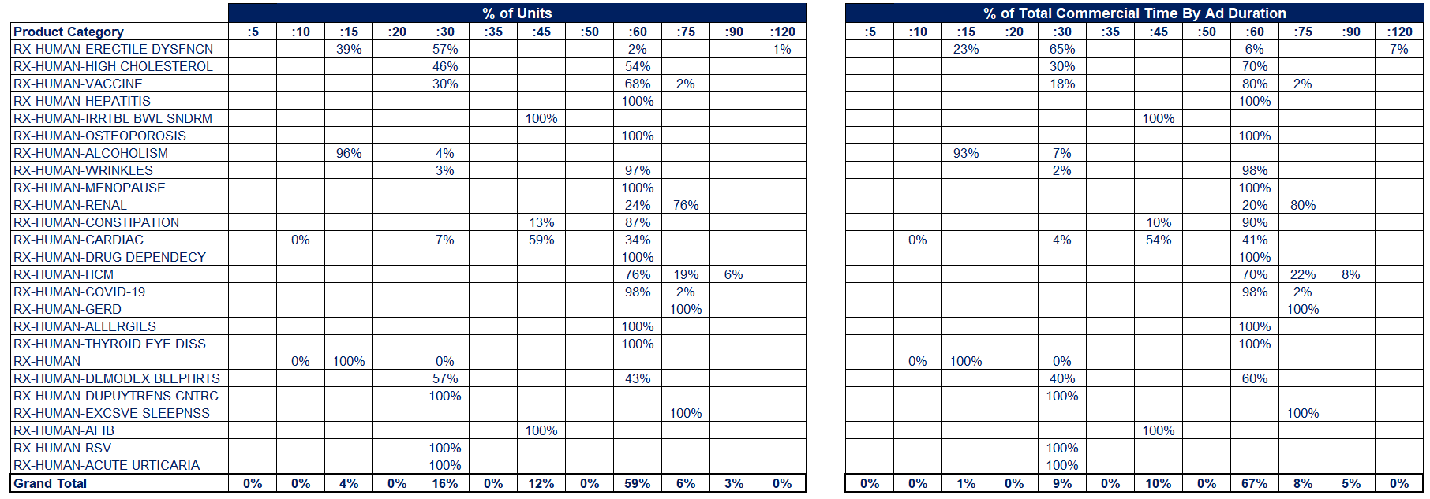
3-Month Time Period: January ‘25 – March ’26
Full List Cont’d: Share of TV ad units by length across the top 50 pharma
Rx product categories, sorted based on the # of national TV units in 1Q ’26
Pharma Rx Product Categories: National TV Commercial Unit & Time Distribution by Ad Duration
(product categories sorted by total # of national TV units)
Source: Nielsen Ad intel, National TV Commercial Unit & Time Distribution by Ad Duration; sub-group category: Pharmaceutical Houses, GP (Rx product categories only), which reflects prescription remedies; national broadcast TV, national cable TV, Spanish Language broadcast TV, Spanish Language Cable TV, Streaming; January 2026 – March 2026. Percentages are rounded off.
This information is exclusively provided to VAB members and qualified marketers.
PAGE 26

Slide 27
In the six months after the FDA crackdown, pharma Rx brands increased TV spend by 53%
In September 2025, the FDA launched a crackdown on deceptive drug advertising where 96% of the ‘warning’ letters sent to pharma companies were targeted towards digital platforms, assets and practices
The marketplace clarity provided by the FDA’s actions spurred significantly increased investment across multiscreen TV platforms in the six months immediately following the crackdown, with an 11% increase in Pharma Rx advertisers and 53% increase in total TV spend YoY
Rx brands are being more mindful of proactively adhering to pharma advertising rules and regulations across multiscreen TV platforms as they present a fair balance between their product’s risks and benefits and include information regarding major side effects and considerations
Key Marketer Takeaways
PAGE 27
This information is exclusively provided to VAB members and qualified marketers.

Slide 28



Download the reports below to learn more about pharma DTC advertising and how multiscreen TV guides patients on their path to treatment
Dedicated to Your Good Health
How TV Drives Discovery & Encourages Education in the Pharma DTC Category
Why Banning Pharma TV Ads Would Disproportionately Affect Minority Groups
TV Means Business
How Premium Video Drives Sales in the Pharmaceutical Category
This information is exclusively provided to VAB members and qualified marketers.
PAGE 28

Slide 29


About VAB
VAB plays a dual role in the video advertising industry. We are leading the change to bring about a more innovative and transparent marketplace. We also provide the insights and thought leadership that enables marketers to develop business-driving marketing strategies.
Drawing on our marketing expertise, we simplify the complexities in our industry and discover new insights that transform the way marketers look at their media strategy.
We are committed to your business growth and proud to offer VAB members, brand marketers and agencies complimentary access to our continuously-growing Insights library. Get immediate access at theVAB.com.
This information is exclusively provided to VAB members and qualified marketers.
PAGE 29

