Slide 1





How do I use streaming video to boost sales?
2021
Marketer FAQs

Slide 2

We scoured the industry for real-world examples of how today's most innovative marketers are using streaming within their video campaigns to deliver on their business objectives.
In these Marketer FAQs, you will find real-world guidance on common questions marketers have when developing streaming video campaigns.
This information is exclusively provided to VAB members and qualified marketers. Further distribution is prohibited.
PAGE 2

Slide 3

In this Marketer FAQ series, you’ll find answers to these often-asked questions on the impact of streaming video
1
2
3
4
How do I use streaming to extend the reach of my video campaign beyond linear TV?
How do I use streaming video
to boost sales?
How can I make an impact on a local level with streaming?
How can I drive in-store traffic with streaming?
Click here to download the other pieces in this series
This information is exclusively provided to VAB members and qualified marketers. Further distribution is prohibited.
PAGE 3

Slide 4


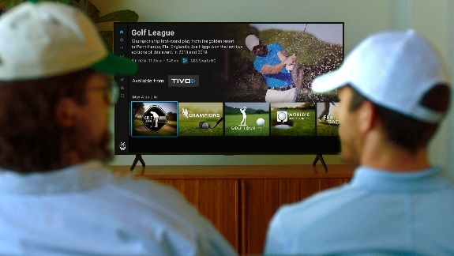



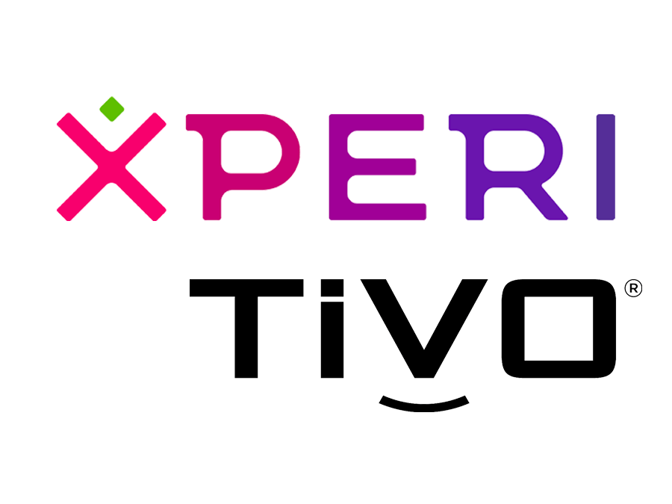
Category:
Consumer Technology
TiVo extended campaign reach through data-driven CTV advertising targeting sport enthusiasts, which drove a double-digit lift in device sales
Streaming only
Challenge
TiVo wanted to drive awareness for their new Stream 4K dongle and boost device sales
Solution
Launched campaign targeting households of sports enthusiasts during a premier golf tournament to promote their new Stream 4k product and inspire online conversion
  Content Affinity: Reach active sports fans by leveraging first-party, deterministic STB viewership data on CTV ad spots during the broadcast
  Sequential Targeting: Identify households exposed to the ad & extend campaign reach by digitally targeting them with secondary messages
  Conversion Attribution: By matching IP addresses to online sales during the campaign window, attributed sales lift from households exposed to the ad
Target Segment
Sports Enthusiasts
Results
CTV advertising generated a +25% lift in Stream 4K sales vs. households not exposed to the ad
Company / Platform / Media Type
TiVo, Xperi / Streaming Only / Connected TV (CTV)
+25%
Lift in Stream 4K Sales
Compared to households not exposed to ad
Source: TiVo & Xperi, Case study: TiVo Extends Campaign Reach and Lifts Device Sales with Data-Driven CTV Advertising. Campaign time period: flight date – 6/21/21-6/29/21; measurement period - 6/21/21 - 7/5/21, which was extended beyond the campaign window to capture Stream 4K purchases post-flight.
This information is exclusively provided to VAB members and qualified marketers. Further distribution is prohibited.
PAGE 4

Slide 5


Category:
Consumer Packaged Goods
A CPG brand implemented contextually relevant binge ads, leading to incremental sales growth
Streaming + Multiscreen TV
Challenge
A CPG brand sought to increase sales by creating real connections with engaged viewers across connected TV, desktop and mobile
Solution
Hulu’s in-house creative team, Greenhouse, worked with the brand to create sequential Binge Ads. The contextually and situationally-relevant messages appeared during viewers’ binge-watching session
Campaign delivered & measured in collaboration with Hulu, a CPG sales partner and a data connectivity platform
Target Segment
W25-49
Results
Those only exposed to the Binge Ad were highly responsive to the campaign but those exposed to both the Binge and Standard Ad drove the highest response rate, likely due to increased frequency
Company / Platform / Media Type
Hulu / Streaming + Multiscreen / Connected TV (CTV), Desktop, Mobile
Response Index
90 | 180 | 335
●/● Response Index (Campaign Response / Households)
Source: Hulu, Binge Ad Case Study, Q1 2020. Campaign length: 3 months; Binge Ad ran 1 month.
This information is exclusively provided to VAB members and qualified marketers. Further distribution is prohibited.
PAGE 5

Slide 6



Category:
B2B (Entertainment / TV)
Streaming only
A TV network leveraged a sell-side platform to ensure
brands across their portfolio would reach the right audiences, leading to programmatic growth and increased revenue
Challenge
AMC Networks sought to simplify their ad buying process and unlock inventory for more advertisers following an increase in programming development and implementation of a more aggressive distribution strategy
Solution
Magnite’s demand facilitation specialists worked with AMC Networks to grow revenue & generate new business by leveraging platform tools and educating advertisers about AMC’s premium inventory and improving overall campaign performance
Results
The Magnite CTV platform delivered triple digit YoY programmatic growth, as well as triple digit YoY revenue growth (+415%)
Company / Platform / Media Type
Magnite / Streaming Only / Magnite Connected TV (CTV) Platform
Programmatic Growth
Revenue growth
July 2020 - 2021
Q2 2020 – Q2 2021
2020 - 2021
+120%
+311%
+415%
Source: Magnite, Case study: Magnite Helps AMC Networks Monetize Premium Video Inventory. Campaign time period: Programmatic growth - July 2020 – July 2021, Q2 2020 – Q2 2021; Revenue growth – 2020-2021.
This information is exclusively provided to VAB members and qualified marketers. Further distribution is prohibited.
PAGE 6

Slide 7
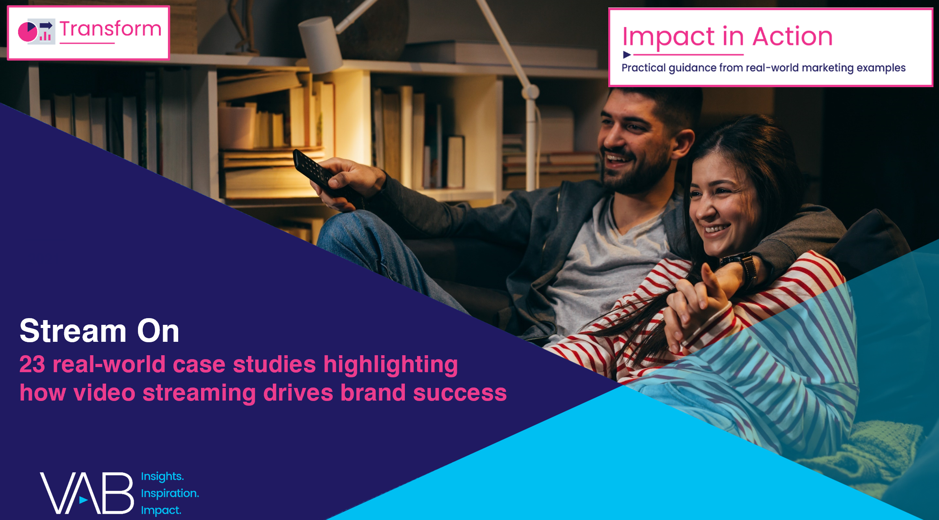
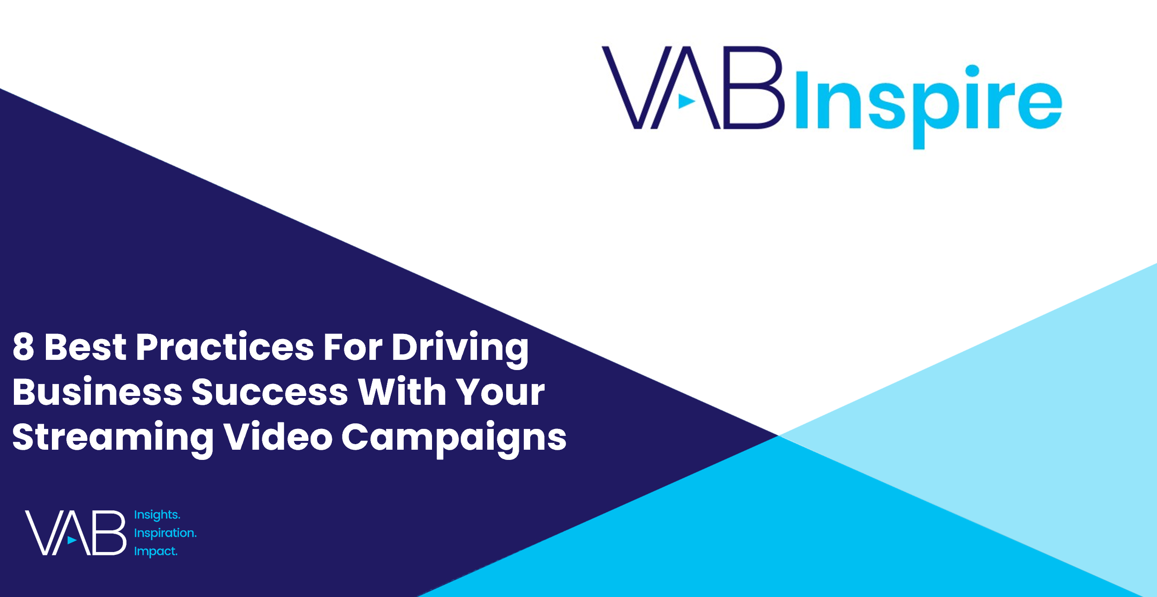
Interested in more?
Download Stream On for the full 23 case studies across 15 product categories
View this webinar to learn the 8 best practices marketers employ when creating successful streaming campaigns
This information is exclusively provided to VAB members and qualified marketers. Further distribution is prohibited.
PAGE 7

Slide 8


About VAB
VAB is an insights-driven organization that inspires marketers to reimagine their media strategies resulting in fully informed decisions.
Drawing on our marketing expertise, we simplify the complexities in our industry and discover new insights that transform the way marketers look at their media strategy.
We are committed to your business growth and proud to offer VAB members, brand marketers and agencies complimentary access to our continuously-growing Insights library. Get immediate access at theVAB.com.
Curious to learn more about VAB? Check out this quick video to see what we do and how we can help you develop business-driving marketing strategies.
This information is exclusively provided to VAB members and qualified marketers. Further distribution is prohibited.
PAGE 8

