Slide 1





How do I use streaming
to extend the reach of my video campaign beyond linear TV?
2021
Marketer FAQs

Slide 2

We scoured the industry for real-world examples of how today's most innovative marketers are using streaming within their video campaigns to deliver on their business objectives.
In these Marketer FAQs, you will find real-world guidance on common questions marketers have when developing streaming video campaigns.
This information is exclusively provided to VAB members and qualified marketers. Further distribution is prohibited.
PAGE 2

Slide 3

In this Marketer FAQ series, you’ll find answers to these often-asked questions on the impact of streaming video
1
2
3
4
How do I use streaming to extend the reach of my video campaign beyond linear TV?
How do I use streaming video
to boost sales?
How can I make an impact on a local level with streaming?
How can I drive in-store traffic with streaming?
Click here to download the other pieces in this series
This information is exclusively provided to VAB members and qualified marketers. Further distribution is prohibited.
PAGE 3

Slide 4



Category:
Automotive (Luxury)
Streaming + Linear TV
A luxury auto advertiser’s streaming campaign on Tubi delivered on cross-channel incremental reach
Challenge
A luxury auto advertiser wanted to extend the reach of their video campaign beyond linear TV
Solution
Tubi partnered with TVSquared who combined ACR and digital measurement to understand the incremental reach that Tubi offered beyond the advertiser's linear investments
Target Segment
Household Income $75K+
Results
89% of Tubi’s audience was incremental to the linear buy, and only 3% of media volume overlapped between Tubi and linear campaigns
Company / Platform / Media Type
Tubi / Streaming + Linear TV / OTT + Linear TV
LINEAR
OTT
89%
of Tubi’s Audience was incremental to linear investments
 | Share of Impressions | Reach of Proportion | Avg. Frequency
OTT | 14% | 12% | 3.4
LINEAR | 83% | 86% | 2.8
OVERLAP | 3% | 1% | 6.3
Source: Tubi, Case study: Tubi drives incremental reach. Campaign time period: 6/16/21-6/30/21. ACR and digital measurement via TVSquared.
This information is exclusively provided to VAB members and qualified marketers. Further distribution is prohibited.
PAGE 4

Slide 5




Category:
Financial
A financial services brand reached incremental audiences and drove efficiencies via a cross-channel campaign
Streaming + Linear TV
Challenge
A leading financial services brand wanted to grow awareness and adoption of its free digital product, particularly by untapped audiences that hadn’t previously been reached with its linear-only campaigns
Solution
Simulmedia used its Cross-Channel Insights platform to identify the client’s target on both CTV and linear while gauging overlap of audiences between the two
Simulmedia accessed premium CTV inventory across dozens of publishers to pinpoint most
cost-effective impressions
Target Segment
Audiences unexposed to brand’s linear-only campaigns
Results
86% of audience reached by CTV campaign was only reached on CTV
Less than 2% of exposed HHs were reached by both linear and CTV campaigns
With 3% of overall spend, CTV campaign drove nearly 10% in incremental reach
Company / Platform / Media Type
Simulmedia / Streaming + Linear TV / Connected TV (CTV), Optimized Linear TV
Cross-Channel Measurement
Finding Unique Audiences on CTV
LINEAR
CTV
903K
86%
10%
Unique devices reached
Were reached only on CTV, through the financial service’s CTV campaign
CTV campaign drove almost 10% in incremental reach
Source: Simulmedia, Case Study: How Simulmedia Drove Incremental CTV Reach. Campaign time period: 6/14/2021-7/2/2021.
Source: Simulmedia, Case Study: How Simulmedia Drove Incremental CTV Reach. Campaign time period: 6/14/2021-7/2/2021.
This information is exclusively provided to VAB members and qualified marketers. Further distribution is prohibited.
PAGE 5

Slide 6






Category:
Insurance
Streaming + Linear TV
A leading mutual insurance company optimized
their OTT campaign, enabling expanded reach, greater brand awareness and increased website visits
Challenge
Mutual insurance company Amica wanted to justify and optimize their investment in streaming and measure incremental conversions* across OTT publishers compared to their linear TV campaigns
Solution
Utilized iSpot Unified Measurement to analyze the incremental reach and compare the performance of ads running across linear TV and major streaming providers, with the ability to compare at an individual OTT publisher level
Target Segment
Custom audience target
Results
Streaming served as a valuable complement to traditional TV buys, driving 6x higher conversion rates than linear TV ads alone
With visibility into deduplicated reach & conversion rates of linear vs. streaming ads, Amica determined :15s streaming ads were most effective in driving conversions, allowing them to adjust their media plan
Company / Platform / Media Type
iSpot.tv / Streaming + Linear TV / Linear TV, OTT (Connected TV)
With the help of Unified Measurement, Amica was able to:
6X
Prove that streaming ads converted at a 6x higher rate than linear ads alone
Identify OTT publishers with higher conversion rates
to continue to invest in
Determine that :15s streaming ads were more effective in driving conversions and adjust media plan accordingly
Source: iSpot.tv, Case study: Justifying and Optimizing Linear and Streaming TV Advertising. Campaign time period: Q2 2020. *Primary conversion KPI: web visits.
This information is exclusively provided to VAB members and qualified marketers. Further distribution is prohibited.
PAGE 6

Slide 7



Category:
Automotive (Luxury)
A luxury auto brand achieved incremental reach among previously-unexposed audiences by targeting qualified segments across OTT
Streaming + Multiscreen (non-TV)
Challenge
A luxury automotive brand wanted to drive incremental reach of those who hadn’t seen their linear ad, while controlling and optimizing frequency of ad-exposed viewers by tercile
Solution
Created a custom suppression segment comprised of viewers already exposed to brand’s ad on linear, layered with granular digital qualifiers
Targeted new, qualified audiences across OTT, as well as retargeted light & medium ad-exposed viewers across digital
Delivered cross-screen reach & frequency reporting to identify overlap of ad exposed audiences across linear & digital to ensure the brand’s ad reached the right viewers, at the right time
Target Segment
Auto intenders who had not previously engaged with the brand
Third-party audience who have been exposed via linear TV
Results
VideoAmp measured 3.2MM in incremental reach across OTT, an increase of 74% vs. linear TV, for an overall cost savings of $701K
Company / Platform / Media Type
VideoAmp / Streaming + Multiscreen (non-linear) / OTT
3.2MM
74%
$701K
Incremental Reach Across OTT
Increase Reach Compared to Linear
In Overall Cost Savings
Source: VideoAmp, Case study: Luxury Automotive Brand Leaves No Household Behind with 3.2M Incremental Reach Across OTT. Campaign time period: February 2019.
This information is exclusively provided to VAB members and qualified marketers. Further distribution is prohibited.
PAGE 7

Slide 8

Category:
Fitness
A fitness advertiser was able to monitor & optimize
a cross-platform campaign aimed at driving incremental reach and online registrations
Streaming + Linear TV
Challenge
A fitness advertiser launched a 2-part cross-platform TV campaign & needed a single source for converged TV measurement and attribution to track reach, frequency and incremental reach of linear and Connected TV (CTV)
Solution
Brand leveraged TVSquared’s ADvantage XP platform for 1:1 deterministic measurement & attribution for a unified view of performance & delivery metrics for all inventory sources including national broadcast & local cable for linear and streaming platforms like Roku, Hulu, Tubi, etc.
Target Segment
Custom Audience Target*
Results
Adjustments to inventory led to a greater share of impressions on streaming in 2nd campaign (+87%)
Increasing CTV impressions and diversifying across additional publishers increased unique CTV household reach by a further 22% (vs. earlier campaign)
Company / Platform / Media Type
TVSquared’s ADvantage XP platform / Streaming + Linear TV / Connected TV (CTV), Linear TV
OVERLAP – 4%
Impression split | CTV | Linear
Campaign 1 | 14% | 86%
Campaign 2 | 58% | 42%
CTV
LINEAR
*represents overlap of second campaign
Transforming Insights into Actionable Results
78%
of CTV Households Were Incremental to Linear
By increasing CTV impression share
4x
Response Rate for CTV
vs. Linear in Campaign 1
Influenced greater impression share for CTV in Campaign 2
-37%
Cost per Registration for CTV
Following adjustments across inventory sources
+116%
Increase in TV driven registrations for CTV
Optimizations drove increase
+93%
Uplift in HHs engaged
due to Linear TV
Optimizations drove lift
-39%
Cost per Registration for Linear TV
Following adjustments across inventory sources
Source: TVSquared, Case study: ADvantage XP: Delivering a Single Source of Truth for Converged TV . Campaign time period: Campaign 1 - January–March 2021 vs. Campaign 2 - May–July 2021. *Custom target built based on the number and variety of channels and genres they used.
This information is exclusively provided to VAB members and qualified marketers. Further distribution is prohibited.
PAGE 8

Slide 9
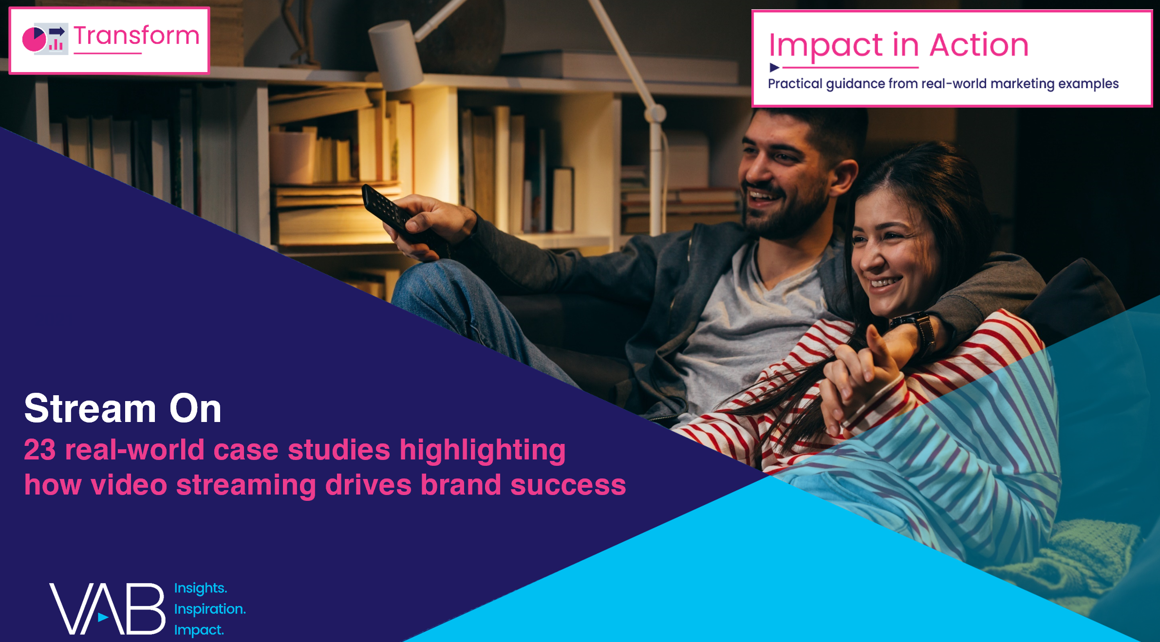
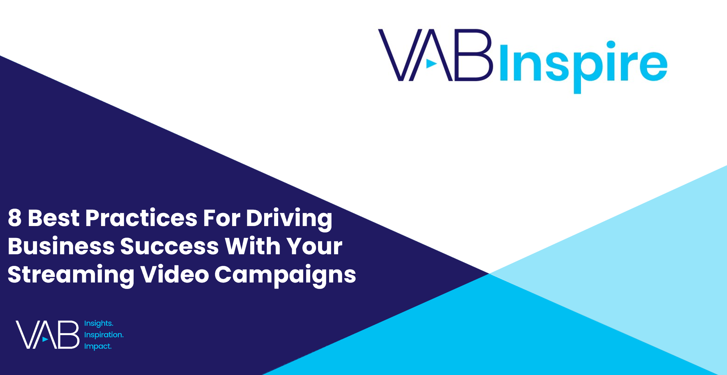
Interested in more?
Download Stream On for the full 23 case studies across 15 product categories
View this webinar to learn the 8 best practices marketers employ when creating successful streaming campaigns
This information is exclusively provided to VAB members and qualified marketers. Further distribution is prohibited.
PAGE 9

Slide 10


About VAB
VAB is an insights-driven organization that inspires marketers to reimagine their media strategies resulting in fully informed decisions.
Drawing on our marketing expertise, we simplify the complexities in our industry and discover new insights that transform the way marketers look at their media strategy.
We are committed to your business growth and proud to offer VAB members, brand marketers and agencies complimentary access to our continuously-growing Insights library. Get immediate access at theVAB.com.
Curious to learn more about VAB? Check out this quick video to see what we do and how we can help you develop business-driving marketing strategies.
This information is exclusively provided to VAB members and qualified marketers. Further distribution is prohibited.
PAGE 10

