Slide 1





Inside Out
How Cinema Turns Emotion Into Brand Opportunity

Slide 2

“Watching a film in the theater with an audience is an experience. We can laugh together, cry together, scream and fight together, perhaps sit in devastated silence together. And in a time in which the world can feel very divided, this is more important than ever. It’s a communal experience you simply don’t get at home.”
Sean Baker, Best Director Oscar Speech for Anora
(03/02/2025)

Slide 3
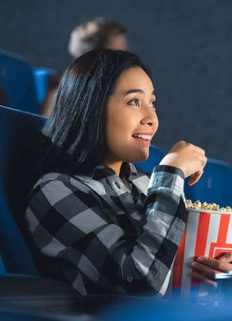


Cinema brings joy, suspense, drama and humor to life, driving brand impact
A trip to the movie theater is more than entertainment, it is joy, excitement and even a tear or two. It sparks passion, fuels fandom and inspires action. From the thrill of a trailer drop to
the nostalgia of beloved IP (intellectual property), movies create 'core memories' that shape who we are and connect us to others.
For marketers, these deeply felt experiences are more than emotional, they’re opportunities. Cinema captures attention in an immersive environment that primes highly engaged audiences to notice, remember and respond to brands.
What you’ll learn in this report
Why emotion is the new ‘premium’ and how cinema’s immersive environment drives engagement, recall and brand impact
How ‘emotional fandom,’ community and anticipation around movies delivers audience experiences similar to another high-engagement platform: sports
How ‘the momentum of movies’ creates continuous, high-value opportunities
for marketers
This information is exclusively provided to VAB members and qualified marketers.
PAGE 3

Slide 4




In this report, we explore how cinema transcends entertainment to emotionally engage audiences and drive outcomes for advertisers
1
2
3
4
‘Emotion’ is the
New ‘Premium’
Big Screen, Big Feels, Big Outcomes
The ‘Surround Sound’
of Cinema as ‘Sport’
The Momentum
of Movies
This information is exclusively provided to VAB members and qualified marketers.
PAGE 4

Slide 5

1
‘Emotion’ is the New ‘Premium’

Slide 6





























Exciting, high-quality premium content captures audience attention and fosters engagement through strong emotional connections
Aligning ads with emotional content can quadruple their effectiveness in creating impact and building brand equity*
Sampling of Recent Theatrical Releases
‘Emotion’ is the new ‘Premium’
‘Premium content’ – industry shorthand for advertising impact – has primarily been related to the cost of production, with more expensive programming being deemed more premium.
However, research suggests that ‘premium’ has more to do with the emotional connection viewers have with their favorite content, which can be significantly impactful at driving ad receptivity.
Source: Kantar, Harness the power of emotion in digital advertising, 3/13/2023.
This information is exclusively provided to VAB members and qualified marketers.
PAGE 6

Slide 7
Audiences are drawn to a variety of positive, emotional storytelling tones including ones that are optimistic, idealistic, upbeat and lighthearted
The Tone of Storytelling Audiences Prefer in a Movie or Show
% of respondents
Tragic
Cynical
Moody
Serious
Tense
Gritty
How to read: 71% of respondents prefer optimistic tones while 29% prefer tragic tones
Source: MarketCast, New America Content Exploration, July 2025.
This information is exclusively provided to VAB members and qualified marketers.
PAGE 7

Slide 8
The cinematic environment drives positive emotion among almost all moviegoers which creates strong opportunities for brand engagement
The moviegoing experience drives a
+22%
“When people are emotionally engaged, they not only remember more, they care more. This presents a huge opportunity for brands to foster deeper consumer connections.”
lift in positive emotions
Pre-Screening
Post-Screening
78%
are in a positive mindset entering the theater
95%
are in a positive mindset
after their theater experience
Devora Rogers, Chief Strategy Officer at Alter Agents
(PR Newswire, 6/10)
Source: Screenvision and Alter Agents, Cinema’s Emotional Resonance, 2024.
This information is exclusively provided to VAB members and qualified marketers.
PAGE 8

Slide 9


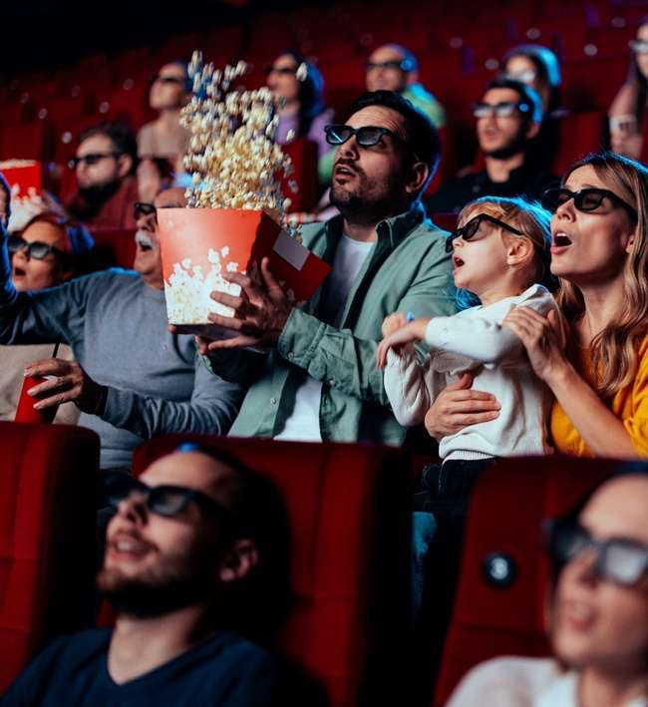
A positive, engaged mindset makes audiences receptive to ads and primes them to be more likely to purchase the products they see
Impact of Positive Mindset on Response to Advertising
+18%
+35%
Increase in brand favorability
Increase in purchase intent
Source: Hearst, Power of Positivity, 2023.
This information is exclusively provided to VAB members and qualified marketers.
PAGE 9

Slide 10
2
Big Screen, Big Feels,
Big Outcomes

Slide 11




Going to the movies is a shared experience that leaves audiences feeling more deeply connected to family, friends and other fans
% of respondents who go to the movies...
89%
of moviegoers say the aspect they enjoy the most is the connection
97%
in a Group
83%
with Family
75%
with Friends
(Gen Z respondents)
Source: Screenvision and Alter Agents, Cinema’s Emotional Resonance, 2024. 'Group’ includes at least one other person.
This information is exclusively provided to VAB members and qualified marketers.
PAGE 11

Slide 12
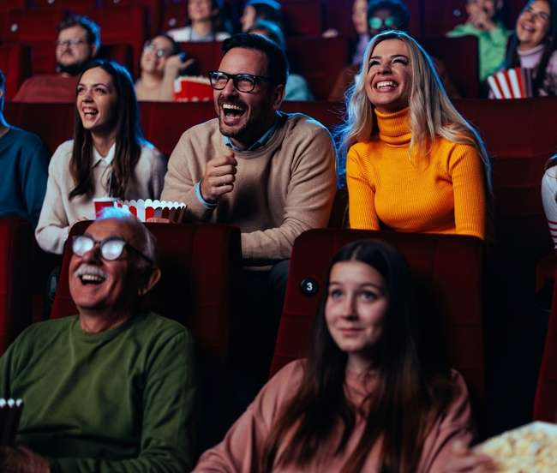
In fact, most people across lifestages mention ‘spending time with friends and family’ as a top reason for going to see a movie at the theater
Top reason for going to the movie theater
% who said ‘to spend time with friends and family’ is a ‘major factor’
Gen Alpha
Gen Z
68%
60%
64% of Gen Alpha agree they’ll go to the theater ‘to make seeing the movie feel like a special event’
Millennials
Gen X
59%
63%
Source: NRG, Gen Alpha Saves the Box Office?, August 2025.
This information is exclusively provided to VAB members and qualified marketers.
PAGE 12

Slide 13








The communal experience makes cinema a uniquely powerful environment where advertisers can connect more deeply through collective reactions
Moviegoers agree with the following statements
96%
The sound and visuals in the theater make the experience feel more immersive
92%
Watching movies in a theater helps them feel immersed
in the story
84%
The shared reactions of the audience enhance their enjoyment of the movie
Source: Screenvision and Alter Agents, Cinema’s Emotional Resonance, 2024.
This information is exclusively provided to VAB members and qualified marketers.
PAGE 13

Slide 14
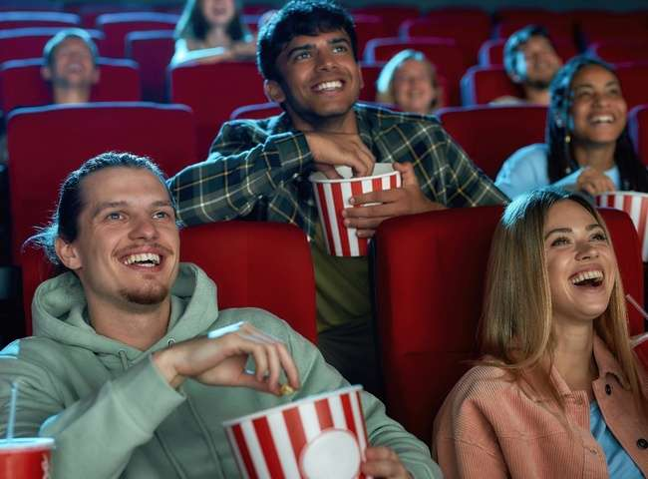








Movie soundtracks turn those communal reactions into shared emotions, deepening the audiences’ connection to the story
December 18, 2024
July 15, 2025
May 7, 2025
July 8, 2025
This information is exclusively provided to VAB members and qualified marketers.
PAGE 14

Slide 15




The communal power of cinema doesn’t just create shared emotions; it also activates the brain to make brands unforgettable
Cinema increases brain activity in four measured neuroscience areas
+21%
Global memory
+16%
Personal relevance
+14%
Detail memory
+2%
Approach / withdrawal
Source: The Media Leader, Neuroscience explains why cinema ads are ‘significantly’ more impactful and memorable, November 29, 2023. “Global memory”, or right brain, influences more “big picture” holistic processing while “detail memory”, or left brain, relates to how people remember brands, key messages, calls to action, and ad creative. “Personal relevance” refers to how personally relevant participants found the content, whereas “approach/withdrawal” links to “the lean in/lean out emotional direction” to the content they were exposed to.
This information is exclusively provided to VAB members and qualified marketers.
PAGE 15

Slide 16

The cinematic environment evokes powerful emotions which enables brands to connect more effectively with highly engaged audiences
84%
of moviegoers agree that watching movies in a theater is an emotionally powerful experience
+20%
Increase in brand favorability after exposure to cinema ad*
Source: Screenvision and Alter Agents, Cinema’s Emotional Resonance, 2024. *Screenvision, Custom Research Study Norms 2024-2025.
This information is exclusively provided to VAB members and qualified marketers.
PAGE 16

Slide 17
3
The ‘Surround Sound’ of Cinema as ‘Sport’

Slide 18




Movies have similar emotional attributes as sports while providing a much more accessible and affordable experience for audiences and brands
Attributes of ‘Emotional Fandom’ in Cinema & Sports
Personal
Investment
Community
&
Belonging
Rituals
&
Traditions
Identity
&
Loyalty
Escapism
&
Shared Joy
This information is exclusively provided to VAB members and qualified marketers.
PAGE 18

Slide 19


Within these attributes, movies can elicit a similar level of audience intensity and connection as sports when it comes to ‘emotional fandom’
Attributes of ‘Emotional Fandom’ in Cinema & Sports
Personal Investment
Community & Belonging
Rituals & Traditions
Identity & Loyalty
Escapism & Shared Joy
Movie fans are emotionally invested in characters, franchises, and storylines
Audiences flock to theaters
for opening weekends, connecting with others who share their love for cinema
Dressing up for premieres, quoting famous lines, or rewatching classics on anniversaries
Fandom around film franchises can form part
of personal identity, often passed through generations
Cinema offers immersion into different worlds, catharsis, and collective joy or awe
Sports fans live and die by the wins and losses of their favorite teams, often tying their emotions to outcomes
Fans gather in stadiums, bars, or at home to watch games together, creating shared experiences and traditions
Ritualistic superstitions, wearing team jerseys, tailgating, and chanting in stadiums
Team allegiance often becomes a core part of identity, which is passed down through families
Sports provide entertainment, distraction, and a sense of hope,
no matter the outcome
This information is exclusively provided to VAB members and qualified marketers.
PAGE 19

Slide 20

Movie fans treat a theatrical release like a ‘big game’ with most people across lifestages preferring to see a movie on its opening weekend
% of respondents who prefer to see a new movie on opening weekend, by generation
Gen Alpha
Gen Z
63%
58%
Millennials
Gen X
59%
53%
Source: NRG, Gen Alpha Saves the Box Office?, August 2025.
This information is exclusively provided to VAB members and qualified marketers.
PAGE 20

Slide 21









Much like sports, the 360-surround sound of cinema keeps audiences connected to a theatrical release well before and after showtime
Download our full report, ‘Reeling in Audiences', to learn more about the 10 acts of attention along the cinematic journey to the movies
Awareness
Excitement
Anticipation
Intent
Preparation
Extend
Before Release
1+ Years Out
6+ Months Out
2-3 Months Out
1+ Weeks Out
1+ Days Out
After Release
Movie Announcements
Fans flock to become part of the social conversation when theatrical releases, and the stars attached to them, are formally announced
Movie Trailers
Millions of views amassed
for online trailers months before their theatrical release as people learn more about movies that interest them
Release Anticipation
Making Plans
Buying Tickets
Socializing
89%
of moviegoers ‘eagerly’ anticipate
a new movie*
88%
of moviegoers
always plan in advance to see
a new movie*
59%
of moviegoers
purchase tickets one or more days before release**
95%
of moviegoers
recommend seeing
a movie in a theater to friends and family*
35MM views
34MM views
Source: Total trailer views as of 8/20/25 from the film studio’s official YouTube channel. *NCM, Moviegoing Audience Insights, Behind-The-Screens (BTS) Online Community, November / December 2023, Base: A18+ Moviegoers. **Screenvision, Screen Engine Data, March 2024. Base: Total Respondents (18+), ‘Thinking about your movie ticket purchasing behavior, when do you typically purchase your tickets for a movie you would like to see?’.
This information is exclusively provided to VAB members and qualified marketers.
PAGE 21

Slide 22





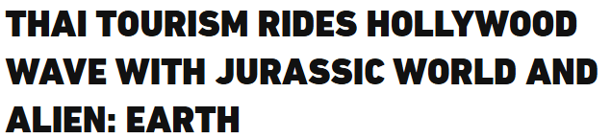










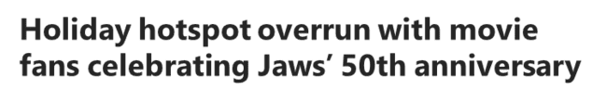
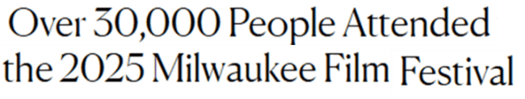









Like sports, theatrical immersion extends beyond the screen, as fans step into the world of movies through merchandise, travel and related events
Movie Fans Collect Merch to Feel Closer to the Stories They Love
Fans Flock to Tourist Destinations Featured On Screen
Movie-Related Events Attract Thousands of Fans
July 24, 2025
August 12, 2025
August 30, 2025
June 3, 2025
June 20, 2025
May 14, 2025
December 6, 2024
November 7, 2024
October 21, 2024
This information is exclusively provided to VAB members and qualified marketers.
PAGE 22

Slide 23


Cinema offers marketers an opportunity to extend impact and reach across highly engaged audiences even for brands that are buying sports
Audience Reach Overlap of Fandoms
Moviegoers
Sports Fans
69%
of moviegoers are also sports fans
Source: VAB analysis of MRI-Simmons, Spring 2025 Study, Moviegoer = Watched a movie in theaters in the last 12 months.
Sports Fan = Watched sporting event on TV in the last 12 months. % overlap represent moviegoers that are also sports fans.
This information is exclusively provided to VAB members and qualified marketers.
PAGE 23

Slide 24
4
The Momentum of Movies

Slide 25
Movies are the most popular ‘away from home’ entertainment activity, surpassing concerts and sports, attracting passionate audiences at scale
Entertainment / Leisure Activities Participated In The Last 12 Months
% of respondents
Source: VAB analysis of MRI-Simmons Spring 2025 Doublebase USA Study. Base: A18+. Reflects leisure activities participated in the last 12 months. ‘Concert / Musical Performance’ includes respondents who have attended any of the following music performances: country, rock, classical music / opera, R&B / hip-hop / rap, other music performances. Live sports events includes any live sporting event attended in the last 12 months. Theme parks include any theme park visited in the last 12 months.
This information is exclusively provided to VAB members and qualified marketers.
PAGE 25

Slide 26
Theatrical movies are very popular ‘at home’ entertainment as well, making up 75% of the top 20 streamed movies (and ~$4B in box office revenues)
Top 20 Streaming Programs – Movies, 1H 2025
Top 20 Streaming Movies – 1H 2025
Rank | Movie | Streamer | Minutes Viewed (in Billions) | Domestic Box Office Revenue
1 | Moana 2 | Disney+ | 7.227 | $460,405,297
2 | Despicable Me 4 | Netflix | 6.274 | $361,004,205
3 | Back in Action | Netflix | 5.264 | N/A
4 | Moana | Disney+ | 3.846 | $248,757,044
5 | The Wild Robot | Netflix / Peacock | 3.817 | $143,901,945
6 | Sonic The Hedgehog 2 | Netflix / Paramount+ | 3.732 | $190,872,904
7 | The Electric State | Netflix | 3.254 | N/A
8 | Wicked | Peacock | 3.233 | $473,231,120
9 | Frozen | Disney+ | 3.056 | $400,953,009
10 | The Accountant 2 | Prime Video | 3.031 | $65,523,366
11 | Kraven The Hunter | Netflix | 2.968 | $25,026,310
12 | Gladiator II | Paramount+ | 2.799 | $172,438,016
13 | Twisters | Peacock | 2.781 | $267,762,265
14 | Nonnas | Netflix | 2.734 | N/A
15 | Mufasa: The Lion King | Disney+ | 2.730 | $254,567,693
16 | The Life List | Netflix | 2.691 | N/A
17 | Super Mario Bros. Movie | Netflix | 2.666 | $574,934,330
18 | Straw | Netflix | 2.656 | N/A
19 | Encanto | Disney+ | 2.620 | $96,093,622
20 | Lilo & Stitch (2002) | Disney+ | 2.619 | $145,794,338
 |  | Theatrical Total | 53.399 | $3,881,265,464
75%
were theatrical releases…
…which accounted for
$3.9B
in domestic theatrical revenue*
and…
54.4B
minutes of streaming viewing
Source: VAB analysis of Nielsen, Top 20 Streaming Programs – Movies, Jan ’25 – Jun ’25. *Domestic theatrical B.O. from Boxofficemojo.com, as of 8/20/25.
Note: Light blue movies denote theatrical releases and dark blue movies denote ‘direct to streaming’ releases.
This information is exclusively provided to VAB members and qualified marketers.
PAGE 26

Slide 27




Theatrical ticket sales are on the rise, with 55 million more admissions in the first half of 2025 compared to 2024, a 24% increase vs. prior year
Movie Tickets Sold
In Millions
+55 Million Tickets Sold
(+24%)
Source: The People Platform, 2025 Mid-Year State of Cinema Report: Admissions Surge, Powering a Banner Year, August 2025.
This information is exclusively provided to VAB members and qualified marketers.
PAGE 27

Slide 28

The cinema has movies for everyone, from family-friendly ‘PG’ to mature
‘R’ movies, offering marketers an ability to reach key audience segments
Share of Tickets Sold by MPA Rating
1H 2025
NR
1%
Source: The People Platform, 2025 Mid-Year State of Cinema Report: Admissions Surge, Powering a Banner Year, August 2025.
This information is exclusively provided to VAB members and qualified marketers.
PAGE 28

Slide 29





Recent releases have even overperformed industry analysts’ top-end revenue projections as audiences seek out cinematic experiences in droves
Domestic Box Office Projections vs. Opening Weekend Box Office
$ in MM
+117%
+15%
+40%
+43%
+27%
Source: Projections based on VAB analysis of Screendollars, Wednesday Report Forecast, 4/2/25, 5/14/25, 6/25/25, 7/2/25 & 9/3/25. Chart projections reflect a median of projection range (The Conjuring: Last Rite’s 9/3 projection was $55MM to $65MM, with a median of $60MM). Opening Weekend Revenue based on finalized opening weekend box office per boxofficemojo.com, as of 9/9/25.
This information is exclusively provided to VAB members and qualified marketers.
PAGE 29

Slide 30








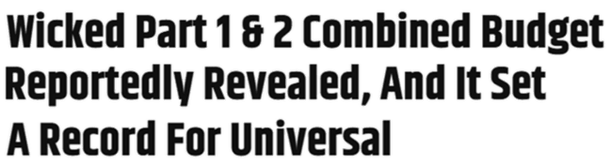



Studios are committed to bringing more films to the big screen, with larger budgets, expanded theatrical slates and re-releases of past favorites
August 13, 2025
August 25, 2025
March 7, 2025
November 22, 2024
June 10, 2025
August 31, 2025
This information is exclusively provided to VAB members and qualified marketers.
PAGE 30

Slide 31





















Emotions coming to a theater near you: High-profile movies and specialty films create opportunities for brands to connect with engaged audiences
10/3/25
10/10/25
10/10/25
10/10/25
10/17/25
10/17/25
10/31/25
11/7/2025
11/14/25
11/21/2025
11/26/2025
12/5/25
12/12/25
12/19/25
12/19/25
12/25/25
Source: IMDb, Upcoming Releases, 2024/2025. Note: Release dates planned as of 8/21/2025 and subject to change.
This information is exclusively provided to VAB members and qualified marketers.
PAGE 31

Slide 32
Cinema creates an immersive environment for brands to engage audiences through emotion
Emotion is the new premium, with cinema’s powerful storytelling that gives brands a unique opportunity to connect more deeply and memorably with audiences
The communal nature of the theater amplifies positive emotions and shared energy, creating a uniquely impactful space where brand relationships feel authentic and lasting
Like sports, cinema taps into ‘emotional fandom,’ passion and community, which offers marketers an opportunity
to extend impact and reach across highly engaged audiences intensely immersed in collective experiences
Shared, immersive theater experiences drive stronger outcomes, with the collective energy of the audience amplifying emotions and strengthening brand connections
Key Marketer Takeaways
This information is exclusively provided to VAB members and qualified marketers.
PAGE 32

Slide 33

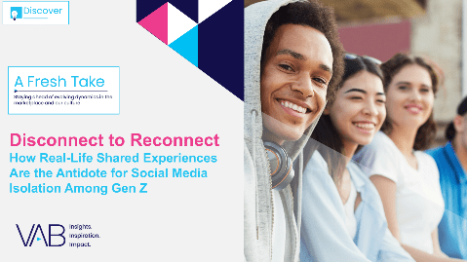
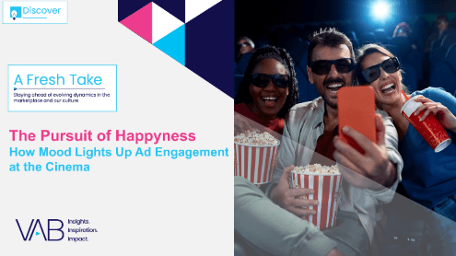
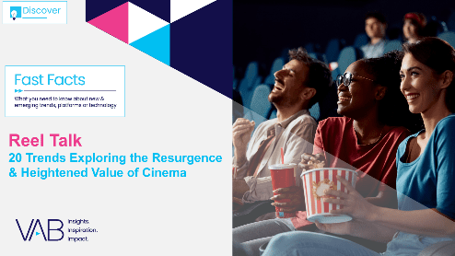

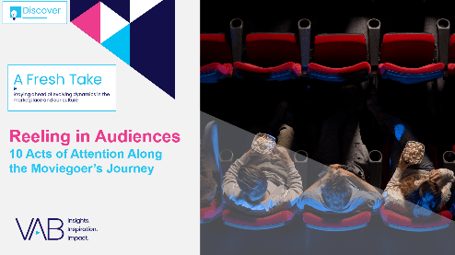
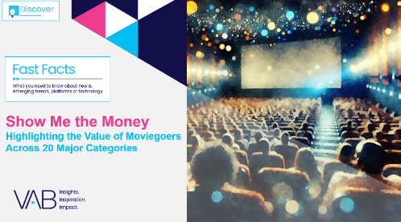

Creators
Jason Wiese
Leah Montner-Dixon
EVP, Strategic Insights & Measurement
jasonw@thevab.com
Director, Audience & Behavioral Insights
leahm@thevab.com
The Power of Premium Video
What It Means for Multiscreen TV
and Why It Matters to Marketers
Disconnect to Reconnect
How Real-Life Shared Experiences Are the Antidote for Social Media Isolation Among Gen Z
Reed Kiely
Karolina Guillen
Director, Data Insights & Trends
reedk@thevab.com
Associate Director, Insights, Strategy & Analytics karolinag@thevab.com
The Pursuit of Happyness
How Mood Lights Up
Ad Engagement at the Cinema
Reel Talk
20 Trends Exploring the Resurgence & Heightened Value of Cinema
Discover more
Looking for more data, insights and takeaways? Check out this related VAB content
Reeling in Audiences
10 Acts of Attention Along
the Moviegoer’s Journey
Show Me the Money
Highlighting the Value of Moviegoers Across 20 Major Categories
VAB Members, brand marketers and agencies get free and immediate access to VAB’s content library. Get access at theVAB.com
This information is exclusively provided to VAB members and qualified marketers.
PAGE 33

Slide 34


About VAB
VAB is an insights-driven organization that inspires marketers to reimagine their media strategies resulting in fully informed decisions.
Drawing on our marketing expertise, we simplify the complexities in our industry and discover new insights that transform the way marketers look at their media strategy.
We are committed to your business growth and proud to offer VAB members, brand marketers and agencies complimentary access to our continuously-growing Insights library. Get immediate access at theVAB.com.
This information is exclusively provided to VAB members and qualified marketers.
PAGE 34

