Slide 1





How can TV build buzz and interest for my brand online?
Marketer FAQs

Slide 2
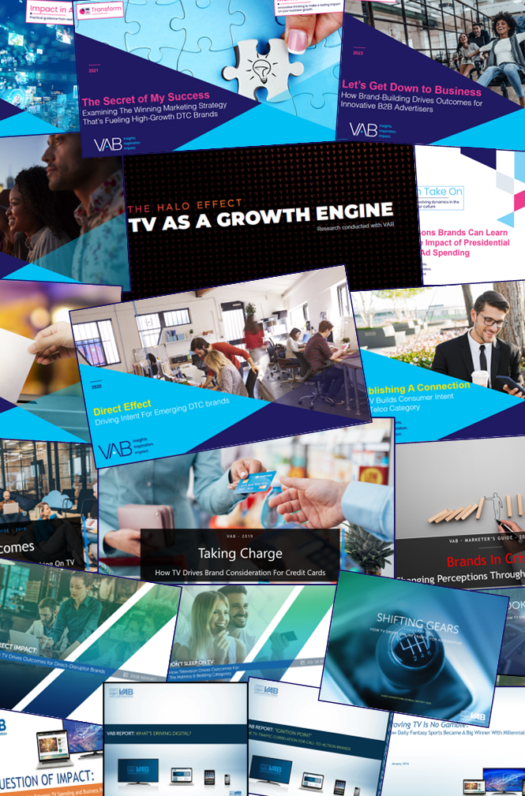



How can TV advertising drive more digital engagement with my brand?
This is a question many marketers ask.
Through VAB’s decade-long studying of what drives business outcomes across the purchase funnel, we explore how brands are using TV campaigns to further build their online presence.
You’ll learn:
  How TV advertising heightens curiosity and increases customer consideration
  The impact TV campaigns have on purchase intent and their ability to bring new customers to brands’ digital platforms
This information is exclusively provided to VAB members and qualified marketers.
PAGE 2

Slide 3





























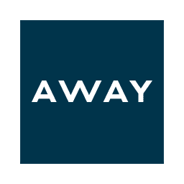


















VAB has studied hundreds of brands across categories to understand the effect TV campaigns have on mid-to-lower funnel digital metrics
Sampling of Brands Analyzed
Purchase Funnel
Awareness
Sales
Intent
Consideration
Value Creation
This information is exclusively provided to VAB members and qualified marketers.
PAGE 3

Slide 4

10 ways that TV campaigns build a larger online presence for brands
Awareness
Consideration
Intent
Sales
Value Creation
Delivers new
customer prospects
Provokes search queries
Sparks social conversations
Drives people to branded
digital storefronts
Creates a halo effect for
digital actions
Lifts website traffic for brands at all life stages
Boosts app downloads
Converts best prospects for
niche brands
Motivates younger audiences to act
Grows customer acquisition
PAGE 4
click through the appropriate box if you would like to be brought directly to the corresponding slide

Slide 5

TV heightens curiosity which makes new customers more likely to add a brand to their consideration set

Slide 6
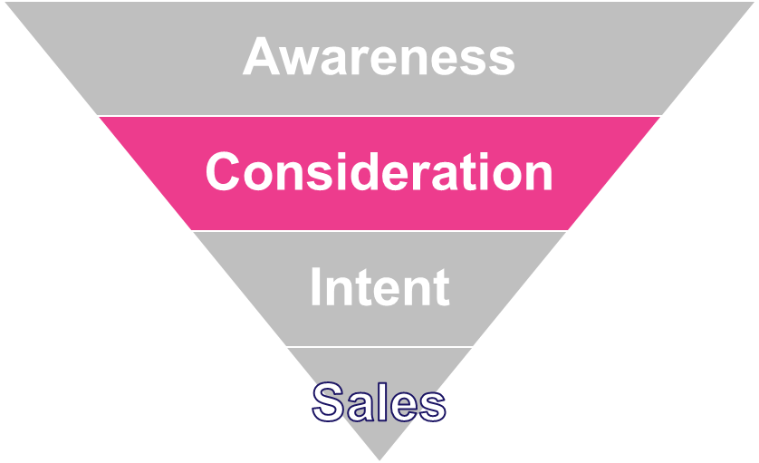






Provokes search queries
Brands that increase their TV investment see comparatively significant lifts in search results
Sampling of Brands: TV Spend vs. Search Queries
Year-Over-Year % Increase
Brand | TV Spend | Search Queries
 | +38% | +99%
 | +149% | +119%
 | +682% | +1,125%
 | +173% | +119%
 | +1,637% | +1,456%
 | +8,426% | +6,929%
 | +105% | +197%
 | +337% | +160%
 | +3,874% | +3,398%
 | +783% | +762%
Source: TV spending based on VAB analysis of Nielsen Ad Intel data, TV spend (national cable TV, national broadcast TV, Spanish language broadcast TV, Spanish language cable TV, spot TV, syndication TV), *CY 2017 & 2018. Search Queries based on VAB analysis of iSpot.tv data and reflects TV commercial-related searches (Google, Bing, Yahoo!). Digital actions are correlated to TV ad airing data.
Want to learn more? Click here to download ‘Direct Outcomes’
PAGE 6

Slide 7



Sparks social conversations
Increased TV investment leads to a significant lift in online social conversations
The impact of TV ads on social conversations is sizeable, driving a +206% growth in social actions from a +93% growth in TV spend across the total 22 measured “emerging” direct brands
Sampling of Brands: TV Spend vs. ‘Social Actions’
Year-Over-Year % Increase*
Brand | TV Spend | Social Actions
 | +121% | +558%
 | +150% | +174%
 | +5,815% | +77,000%
 | +801% | +109%
 | +141% | +232%
 | +155% | +25,120%
 | +2,246% | +475%
 | +216% | +73%
 | +845% | +26,300%
 | +69% | +764%
Source: TV spending based on VAB analysis of Nielsen Ad Intel data, TV spend (national cable TV, national broadcast TV, Spanish language broadcast TV, Spanish language cable TV, spot TV, syndication TV), *CY 2016 & 2017. Social actions based on VAB analysis of iSpot.tv data and reflects TV commercial-related social actions (posts, likes, shares and comments related to TV ads on Facebook, Twitter, YouTube, iSpot.tv)
Want to learn more? Click here to download ‘Direct Impact’
PAGE 7

Slide 8


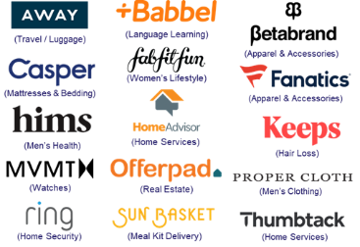
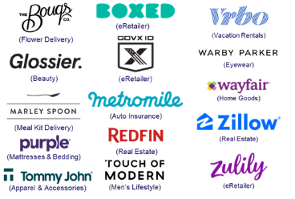
Delivers new customer prospects
TV campaigns expose brands to new audiences which delivers an influx of fresh, high-valued customers with more spending power
Unique Website Visitors Composition Shift
30 Direct-to-Consumer Brand Average
1Q ‘21 vs. 1Q ’17 (Monthly Avg)
30 DTC Brands Analyzed
Median Age
P50+ Comp %
+6.7
years
+14.1
percentage points
49.9 vs 43.2
1Q ’21 vs 1Q ’17* monthly average
51.7% vs 37.6%
1Q ’21 vs 1Q ’17* monthly average
30-Brand Cume TV spend between 2010-2016: $1.5B
30-Brand Cume TV spend between 2010-1Q 2021: $4.8B
Source: VAB analysis of Comscore mediametrix multiplatform media trend data, P18+. 1Q ’17: January – March ‘17, 1Q ‘21: January – March ‘21 (calendar months), monthly average within each quarter, P50+ comp% is based on monthly unique visitors; figures are based on monthly averages for each 3-month time period across the 30 brands analyzed. *1Q ‘17 (Jan-Mar ‘ 17) is reflective of the first 3-month measurement period available and is inclusive of a few brands that were first measured after this time period, based on their first 3-month measurement period. Note: Comscore did not begin measuring ‘median age’ as a reported metric until February ‘17, therefore the first time period reflects Feb-Apr ‘17.
Want to learn more? Click here to download ‘The Secret of My Success’
PAGE 8

Slide 9
Greater consideration is more likely to increase a customer’s likelihood of purchase

Slide 10
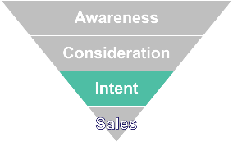
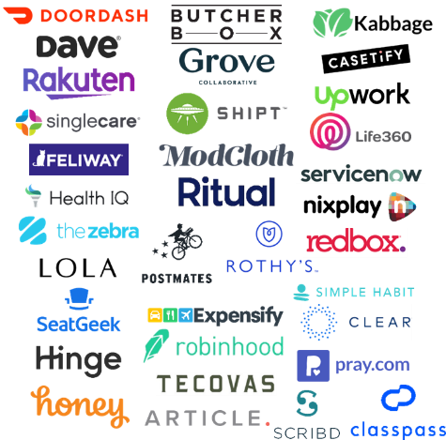
Drives people to branded digital storefronts
After TV launches, digital-native brands see a surge of new customers to their online stores, with a lift through their campaign
36 ‘Emerging’ Direct-to-Consumer (DTC) Brands*
Average Monthly Website Unique Visitors (000)
Based Over a Four-Year Time Period: Jan ‘16 – Jan ‘20
TV Campaign Duration
36 DTC Brands Analyzed
+85%
(+1.6MM monthly uniques)
+56%
(+1.0MM monthly uniques)
vs. monthly average prior to TV launch
vs. monthly average prior to TV launch
(monthly average)
(TV launch – January 2020)
Source: VAB analysis of Nielsen Ad Intel data, TV spend (national cable TV, national broadcast TV, Spanish language broadcast TV, Spanish language cable TV, spot TV, syndication TV), Feb ‘18 – Jan ‘20 (calendar months). VAB analysis of Comscore mediametrix multiplatform media trend data, total audience (Desktop P2+, Mobile 18+), Jan ‘16 – Jan ‘20 (calendar months). ‘Prior to TV Launch’ reflects the average monthly unique visitors based on when each brand’s website began being measured by Comscore, or starting from January 2016 if measurement began before that month. *Reflects the 36 brands that are measured in Comscore and had reported monthly unique visitors in at least one month prior to their campaign launch.
Want to learn more? Click here to download ‘Direct Effect’
PAGE 10

Slide 11















Creates a halo effect for digital actions
TV campaigns create a ‘halo effect’ for brands, driving more people to their website even in months when they are not on TV
25 Business-to-Business (B2B) Brands Analysis
Monthly Website Unique Visitors (000) Comparison
Based Over a Four-Year Time Period: Apr ‘18 – Apr ‘22
25 B2B Brands Analyzed
TV Campaign Duration
+26%
+226K monthly uniques
vs. three months average prior to TV launch
Monthly Average ‘When On TV’
(monthly average)
(TV launch – April 2022)
(TV launch – April 2022)
Source: VAB analysis of Comscore mediametrix multiplatform media trend data, P18+. April 2018 – April 2022 (calendar months), figures are based on monthly averages for the 25 brands analyzed. ‘When On TV’ represents the monthly average for brands in months where they spend on national TV as measured through Nielsen AdIntel across the April 2018 – April 2022 (calendar months) time period across the 25 brands analyzed. ‘When Not On Air’ represents the monthly average for brands in months where they don’t spend on national TV, after their first month of TV spend, as measured through Nielsen AdIntel across the April 2018 – April 2022 (calendar months) time period across the 25 brands analyzed.
Want to learn more? Click here to download ‘Let’s Get Down to Business’
PAGE 11

Slide 12














































Boosts app downloads
When mobile app brands advertise on TV, they see significant increases in visits to their digital platforms
46 Mobile App Advertisers
Average Mobile App Unique Visitors Comparison
“When On” vs. “When Off” TV during a 15-Month Analysis Time Period
App categories include:
Games
Clash of Kings, Candy Crush, Clash of Clans
eCommerce
Walmart, Best Buy
Travel
Expedia, Orbitz, Uber
Sports
MLB, NBA, NFL, Yahoo Sports
Financial / Insurance
Discover, Progressive
‘When On’ TV Average Month
‘When Off’ TV Average Month
+25% more Unique Visitors
(average by advertiser)
-20% less Unique Visitors
(average by advertiser)
Sources: Nielsen AdIntel, (web-based app game product category), TV spend (cable TV, broadcast TV, Spanish language cable TV, Spanish language broadcast TV, syndication TV, spot TV); October 2014 – December 2015. comScore mobile metrix media trend (application access only), unique visitors (P2+), October 2014 – December 2015. Analysis is based on comparison of average monthly unique visitors for “When TV Off” vs. “When TV On” months of activity.
Want to learn more? Click here to download ‘What’s APP’ning!!’
PAGE 12

Slide 13
Lifts website traffic for brands at all life stages
No brand is too ‘young’ for TV as advertisers across life stages see new customers coming to their digital platforms after their TV launch
“When On TV” Monthly Average vs. Three-Month Average Prior To TV
Average Website Unique Visitors
Direct-to-Consumer (DTC) Brands
140 brands across 25+ categories
Non-DTC Brands
50 brands across 15+ categories
Three Years Old or Younger
(40 brands)
Between Four – Seven Years Old
(60 brands)
Eight Years or Older
(40 brands)
Under Twenty Years Old
(25 brands)
Over Twenty Years Old
(25 brands)
+138%
+72%
+23%
+50%
+21%
Unique Visitors % increase:
Unique Visitors increase:
+811K
+1,383K
+803K
+2,302K
+315K
Source: VAB analysis of Nielsen Ad Intel data, TV spend (national cable TV, national broadcast TV, Spanish language broadcast TV, Spanish language cable TV, spot TV, syndicated TV), Jun ‘16 – Jun ’20 (calendar months). VAB analysis of Comscore mediametrix multiplatform (desktop + mobile) media trend data; P18+, Jun ’16 – Jun ‘20 (calendar months).
Want to learn more? Click here to download ‘The Halo Effect’
PAGE 13

Slide 14







Converts best prospects for niche brands
Brands with niche targets are using audience-based TV buying to reach their best customers and drive them to their digital platforms
Sampling of Business-to-Business Brands: Monthly Website Unique Visitors (000) Comparison
Based Over a Four-Year Time Period: Apr ‘18 – Apr ‘22
Brand | B2B Category | Three-Month Average: Prior to TV Launch | Monthly Average: ‘When On TV’ | # Diff (000) | % Diff
 | Software | 71 | 153 | +82 | +115%
 | Graphic Design | 5,281 | 9,480 | +4,199 | +80%
 | Security | 217 | 644 | +427 | +197%
 | Expense Mgmt. | 240 | 477 | +237 | +99%
 | Banking/Finance | 118 | 241 | +123 | +105%
 | Software | 142 | 306 | +164 | +116%
 | Staffing | 118 | 163 | +45 | +38%
 | Software | 1,288 | 1,723 | +434 | +34%
 | Comm. Real Estate | 144 | 419 | +275 | +191%
 | Freelancing | 1,542 | 1,759 | +216 | +14%
 | Software | 387 | 698 | +312 | +81%
 | Human Resources | 15 | 156 | +141 | +929%
Source: VAB analysis of Comscore mediametrix multiplatform media trend data, P18+. April 2018 – April 2022 (calendar months), figures are based on monthly averages for the 25 brands analyzed. ‘When On TV’ represents the monthly average for brands in months where they spend on national TV as measured through Nielsen AdIntel across the April 2018 – April 2022 (calendar months) time period across the 25 brands analyzed.
Want to learn more? Click here to download ‘Let’s Get Down to Business’
PAGE 14

Slide 15







Motivates younger audiences to act
TV campaigns for younger-targeted, disruptor brands inspire engagement and online conversion
Sampling of Younger-Skewing Disruptor Brands
Monthly Website Unique Visitors (000) Comparison
Based Over a Four-Year Time Period: Jan ‘16 – Jan ‘20
Based Over a Four-Year Time Period: Mar ‘16 – Feb ’19
Brand | Monthly Average: Prior to TV Launch | Monthly Average: TV Launch – Jan ‘20 | # Diff | % Diff
 | 5,467 | 22,020 | +16,553 | +303%
 | 2,920 | 3,923 | +1,003 | +34%
 | 765 | 1,662 | +897 | +117%
 | 549 | 1,081 | +532 | +97%
 | 286 | 474 | +188 | +66%
Brand | Monthly Average: Prior to TV Launch | Monthly Average: TV Launch – Feb ‘19 | # Diff | % Diff
 | 2,471 | 10,549 | +8,078 | +327%
 | 5,978 | 13,812 | +7,833 | +131%
 | 1,309 | 1,630 | +321 | +25%
 | 1,584 | 3,008 | +1,424 | +90%
 | 254 | 1,324 | +1,070 | +422%
Source: Direct Effect - VAB analysis of Nielsen Ad Intel data, TV spend (national cable TV, national broadcast TV, Spanish language broadcast TV, Spanish language cable TV, spot TV, syndication TV), Feb ‘18 – Jan ‘20 (calendar months). VAB analysis of Comscore mediametrix multiplatform media trend data, total audience (Desktop P2+, Mobile 18+), Jan ‘16 – Jan ‘20 (calendar months). ‘Prior to TV Launch’ reflects the average monthly unique visitors based on when each brand’s website began being measured by Comscore, or starting from January 2016 if measurement began before that month. Direct Outcomes - Source: VAB analysis of Nielsen Ad Intel data, TV spend (national cable TV, national broadcast TV, Spanish language broadcast TV, Spanish language cable TV, spot TV, syndication TV), March ‘15 – February ‘19 (calendar months). VAB analysis of Comscore mediametrix multiplatform media trend data, total audience (Desktop P2+, Mobile 18+), March ’15 – February ’19 (calendar months). ‘Prior to TV Launch’ reflects the average monthly unique visitors based on when each brand’s website began being measured by Comscore, or starting from March 2015 if measurement began before that month.
Want to learn more? Click here to download ‘Direct Effect’ and ‘Direct Outcomes’
PAGE 15

Slide 16



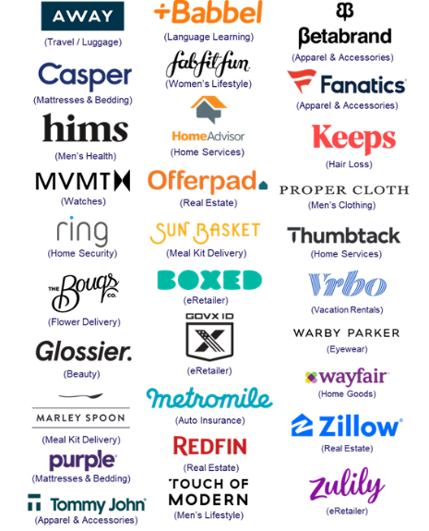
Grows customer acquisition
TV campaigns drive increased digital platform engagement with high-value customers who are more likely to become repeat visitors
Key Website Metrics: 30 Direct-to-Consumer Brand Average
1Q ‘21 vs. 1Q ‘17*: Monthly Avg Comparison
30 DTC Brands Analyzed
Unique Visitors (000)
Total Visits (000)
Total Minutes (MM)
# Difference
+3,156
+22,184
+95
% Difference
+63%
+135%
+89%
Total U.S. Internet Avg
% Difference
+10%
+26%
+34%
Source: VAB analysis of Comscore mediametrix multiplatform media trend data, P18+. 1Q ’17: January – March ’17, 1Q ’21: January – March ‘21 (calendar months), figures are based on monthly averages for each 3-month time period across the 30 brands analyzed. *1Q ’17 (Jan-Mar ’17) is reflective of the first 3-month measurement period available and is inclusive of a few brands that were first measured after this time period, based on their first 3-month measurement period. 30 brands total TV spend (between 1Q ‘17 – 1Q’21): $3.3B.
Want to learn more? Click here to download ‘The Secret of My Success’
PAGE 16

Slide 17
Adults over 50 account for 36% of the total population and nearly half of all adults
TV campaigns have a measurable impact on digital metrics like search queries and online social interactions which grows consumer curiosity and increases customer consideration
The halo effect of TV lifts purchase intent by bringing an influx of new customers to brands’ digital platforms, including their websites and mobile apps
Key Implications for Marketers
This information is exclusively provided to VAB members and qualified marketers.
PAGE 17

Slide 18
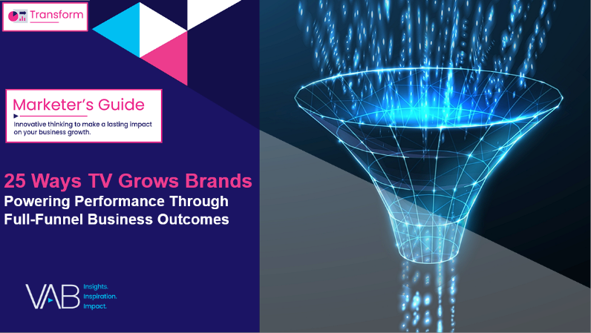
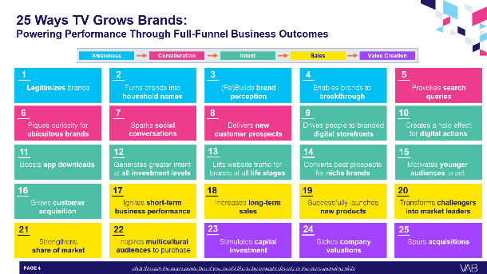
To learn more about the full-funnel impact of TV advertising, download our full report below
‘25 Ways TV Grows Brands’ explores real-world examples of how TV drives full-funnel outcomes, distilled from a decade of VAB’s TV attribution reports across 1,000+ brands, 80+ categories and
30+ metrics analyzed.
This information is exclusively provided to VAB members and qualified marketers.
PAGE 18

Slide 19





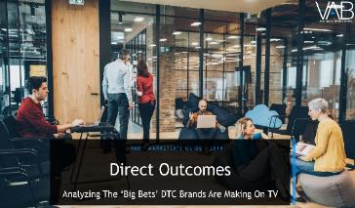

Creators
Jason Wiese
Reed Kiely
SVP, Director of Strategic Insights
jasonw@thevab.com
Director, Data Insights & Trends
reedk@thevab.com
Let’s Get Down to Business
How Brand-Building Drives Outcomes for Innovative B2B Advertisers
The Secret of My Success
Examining The Winning Marketing Strategy That’s Fueling High-Growth DTC Brands
Discover more
Looking for more data, insights and takeaways? Check out this related VAB content
The Halo Effect: TV as a Growth Engine
Why Brands are Accelerating their Path to TV
Analyzing Outcomes From The Tech Giants’ TV Investment
Direct Effect
Driving Intent For Emerging DTC Brands
Direct Outcomes
Analyzing The ‘Big Bets’ DTC Brands
Are Making On TV
VAB Members, brand marketers and agencies get free and immediate access to VAB’s content library. Get access at theVAB.com
This information is exclusively provided to VAB members and qualified marketers.
PAGE 19

Slide 20


About VAB
VAB plays a dual role in the video advertising industry. We are leading
the change to bring about a more innovative and transparent marketplace. We also provide the insights and thought leadership that enables marketers to develop business-driving marketing strategies.
Drawing on our marketing expertise, we simplify the complexities in our industry and discover new insights that transform the way marketers look at their media strategy.
We are committed to your business growth and proud to offer VAB members, brand marketers and agencies complimentary access to our continuously-growing Insights library. Get immediate access at theVAB.com.
This information is exclusively provided to VAB members and qualified marketers.
PAGE 20

