Slide 1
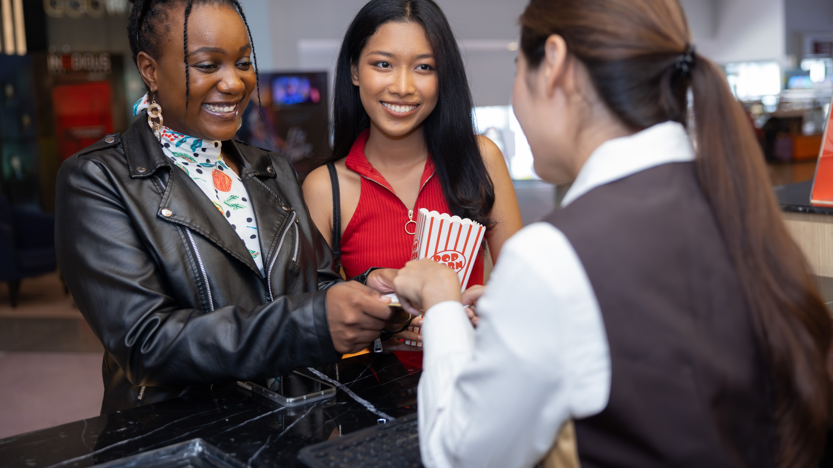




How can cinema deliver desirable audiences for my brand?
Marketer FAQs

Slide 2


Diverse audiences are valuable consumers who are deeply connected to cinema.
Multicultural audiences now collectively represent over four out of ten people in the U.S. and their buying power has increased immensely over the last ten years.
Cinema, a very diverse platform from both an audience and content perspective, provides marketers with very targeted opportunities to reach desirable multicultural audiences in a highly relevant and engaging premium video environment.
These heavy movie-goers are active consumers who drive business results across major categories including restaurants, travel, streaming, financial and retail.
This information is exclusively provided to VAB members and qualified marketers.
PAGE 2

Slide 3

Sizing the marketplace opportunity for diverse audiences

Slide 4
The multicultural population has been steadily growing and now represents over four out of every ten people in the U.S.
Over the last ten years, diverse audiences have collectively increased by 28 million people while Non-Hispanic White has remained flat
U.S. P2+ Population Share and Size by Race & Ethnicity
Diverse: 43% (152MM)
(198MM)
(72MM)
(45MM)
(23MM)
(13MM)
Diverse: 41% (141MM)
(199MM)
(66MM)
(43MM)
(21MM)
(11MM)
Diverse: 39% (128MM)
(198MM)
(59MM)
(41MM)
(19MM)
(10MM)
Diverse: 37% (113MM)
(198MM)
(53MM)
(39MM)
(16MM)
(9MM)
Source: VAB analysis of U.S. Census Bureau data, 2013 & 2018 data based on ‘National Population by Characteristics: 2010-2020’; 2023, 2028 data based on ‘2017 National Population Projections: 2017 - 2060’. Note: NH = Non-Hispanic.
Black represents Non-Hispanic Black, Asian represents Non-Hispanic Asian and Other represents Non-Hispanic Other. ‘Other’ includes: NH Multiracial, NH AIAN (American Indian and Alaska Native) and NH (Native Hawaiian and Pacific Islander).
This information is exclusively provided to VAB members and qualified marketers.
PAGE 4

Slide 5
Multicultural audiences are highly desirable consumers as their buying power has vastly increased over the last ten years
Growth of Key ‘Buying Power’ Metrics by Race/Ethnicity
% increase from 2012 to 2022
Hispanic
Black
Asian
Household Income*
+110%
(2022: $81,810)
+194%
(2022: $97,810)
+104%
(2022: $139,700)
Annual Expenditures*
+52%
(2022: $64,330)
+50%
(2022: $57,996)
+44%
(2022: $87,950)
Household Net Worth**
+59%
(2022: $146K)
+47%
(2022: $132K)
+26%
(2022: $442K)
Source: *VAB analysis of Bureau of Labor Statistics, ‘2022 Consumer Expenditure Survey’ & ‘2012 Consumer Expenditure Survey’, Average Annual Expenditures (Mean). **VAB analysis of MRI-Simmons, 2022 Fall Doublebase & 2012 Doublebase,
P18+, Median Household Income. Note: Black represents Non-Hispanic Black and Asian represents Non-Hispanic Asian.
This information is exclusively provided to VAB members and qualified marketers.
PAGE 5

Slide 6
Cinema is an engaging and highly relevant premium video platform for diverse audiences

Slide 7

Cinema is a very diverse video platform as multicultural audiences account for over half of all movie-goers
Audience Composition by Race/Ethnicity
Diverse Audiences
58%
Source: VAB analysis of Comscore Post-Trak reported box office demographics for the opening weekend of theatrical releases in August 2023. Diverse audiences represent 57.5% of cinema audience composition.
This information is exclusively provided to VAB members and qualified marketers.
PAGE 7

Slide 8















Cinema offers marketers more targeted opportunities to reach diverse audiences than the most popular digital video platforms
Diverse Audience Composition % by Platform
Cinema
(Formerly Twitter)
Source: For cinema - VAB analysis of Comscore Post-Trak reported box office demographics for the opening weekend of theatrical releases in August 2023. For digital video platforms - VAB analysis of MRI-Simmons Cord Evolution Study, August 2023; P18+. Audience % based on Monthly Users / Viewers of each platform – ‘Streaming Services used in the last 30 days’ and ‘Social media, photo or video-sharing services visited or used in the last 30 days.’ Composition % represents diverse respondents (excludes non-Hispanic White).
This information is exclusively provided to VAB members and qualified marketers.
PAGE 8

Slide 9
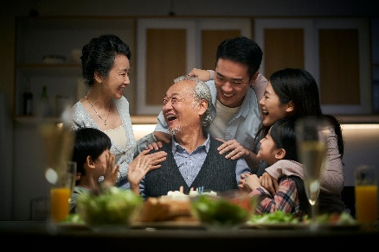
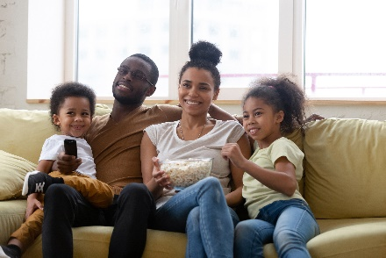

Multicultural movie-goers are deeply connected to content and celebrities that accurately represent their own culture and identity
% who agree with the following statements
Base: heavy movie-goers
“My cultural/ethnic heritage is an
important part of who I am”
“Having shows that highlight issues/stories that are important to racial diverse communities available on a streaming service makes it more valuable to me”*
“I feel really good about seeing celebrities in
the media that share my ethnic background”
Hispanic
Black
Hispanic
Black
Hispanic
Black
79%
83%
62%
66%
50%
72%
Asian
Asian
Asian
75%
50%
56%
Source: VAB analysis of MRI-Simmons Spring Doublebase, 2023, *MRI-Simmons Cord Evolution Study, August 2023; Base= heavy movie-goers: attend a movie at least once a month. Note: Black represents Non-Hispanic Black & Asian represents Non-Hispanic Asian.
This information is exclusively provided to VAB members and qualified marketers.
PAGE 9

Slide 10






Almost half of all top cinema releases feature diverse actors which provides multicultural audiences with consistent, highly relevant, premium content
Diversity in Top Box Office Films
Top 100 Total Grossing Movies - CY 2022 through Q3 2023
Films with Diverse Lead / Co-Leads: Share by Race/Ethnicity
Top 100 Total Grossing Movies - CY 2022 through Q3 2023
44%
Sampling of Movies With Diverse Leads
of movies feature
diverse lead /
co-leads*
Source: VAB analysis of Box Office Mojo, ‘Domestic Box Office for 2022’ & ‘Domestic Box Office for 2023’, Top 100 Grossing are based on in-year gross revenues of movies released during the 1/1/22-9/31/23 and exclude re-releases. Q1-Q3 2023 represents films released in 1/1/23 – 9/31/23. Note: ‘Other’ diverse leads/co-leads include multiracial actors. *‘Lead / Co-Lead’ = Top two actors/actresses by billing.
This information is exclusively provided to VAB members and qualified marketers.
PAGE 10

Slide 11
Theatrical releases can be highly targeted towards diverse audiences especially across superhero, action, video game, kids and horror genres
2023 Releases - Race/Ethnicity Composition by Movie
Based on Opening Weekend Audience
Diverse Audience Comp %
74%
73%
70%
69%
68%
66%
63%
63%
62%
58%
57%
47%
Source: 2023 Comscore Post-Trak reported box office demographics for opening weekend of above movies, with supplemental data from deadline.com. Note: Some movies include a calculation for Asian/Other composition.
This information is exclusively provided to VAB members and qualified marketers.
PAGE 11

Slide 12

Multicultural movie-goers are more likely to buy products from brands and businesses that are relevant to them and who activate locally
% who agree with the following statements
Base: heavy movie-goers
“It is important for companies to create advertising that is culturally diverse in
order to stay relevant”
“I am more likely to buy products from companies that advertise or sponsor events in my community”**
Hispanic
Black
Hispanic
Black
69%
79%
52%
52%
Asian
Asian
78%
39%
Source: VAB analysis of MRI-Simmons Spring Doublebase, 2023, **MRI-Simmons Cord Evolution Study, August 2023; P18+. Base= heavy movie-goers: attend a movie at least once a month. Note: Black represents Non-Hispanic Black & Asian represents Non-Hispanic Asian.
This information is exclusively provided to VAB members and qualified marketers.
PAGE 12

Slide 13
Diverse movie-goers are desirable consumers who drive business across major categories

Slide 14
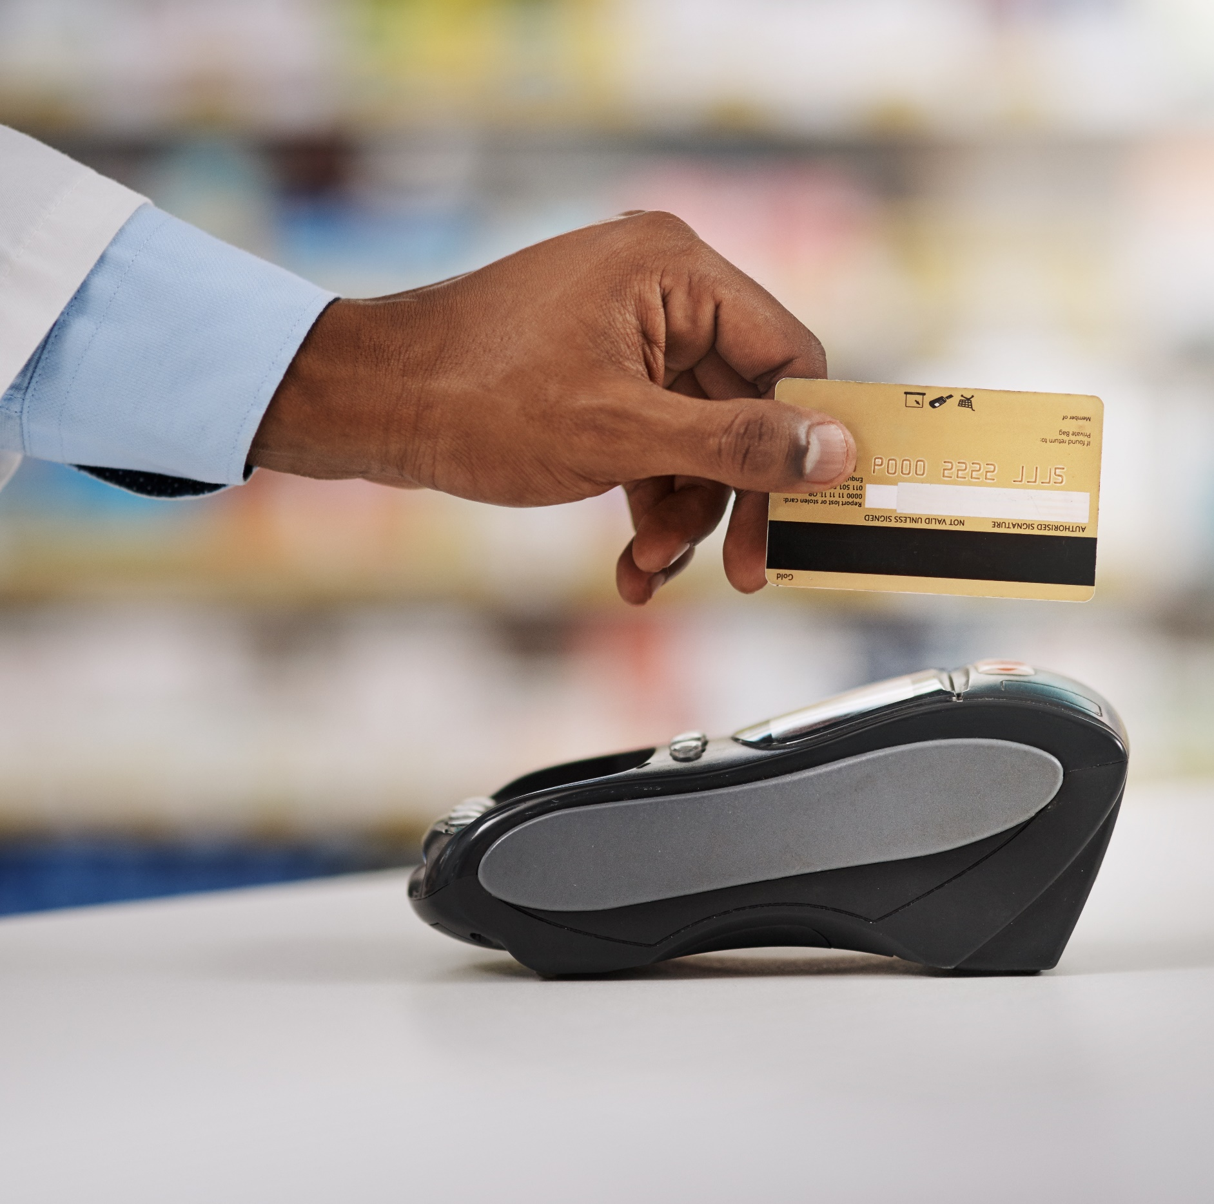





This analysis looks at diverse movie-goer behaviors across five categories that collectively account for over $2 trillion in total spending annually
Retail /
Department Stores
Restaurants
$2.2 Trillion
Total Annual U.S. Consumer Expenditures
(five category total)
Financial
Travel
Streaming
Source: VAB analysis of Bureau of Labor Statistics, 2022 Consumer Expenditure Survey, Average Annual Expenditures (Mean) by category; Restaurants = “Food away from home”; Travel = ‘Vehicle rental, leases, licenses, and other charges’, ‘Public and other transportation’ & ‘Housing – Other Lodging’; Financial = ‘Personal insurance and pensions’; Streaming = ‘Entertainment - Fees and admissions’; Department Stores = ‘Apparel and services’.
This information is exclusively provided to VAB members and qualified marketers.
PAGE 14

Slide 15



Restaurants: Diverse movie-goers are social spenders who love the experience of dining out regularly
% who agree with the following statements
Base: heavy movie-goers
% have visited any restaurant
in the last 30 days
% have visited a family restaurant or steakhouse in the last 30 days
“For me, going out to eat
is all about the experience”
94% / 94% / 93%
74% / 71% / 64%
70% / 68% / 68%
104 index
vs. P18+*
103 index
vs. P18+
102 index
vs. P18+
118 index
vs. P18+
113 index
vs. P18+
102 index
vs. P18+
110 index
vs. P18+
109 index
vs. P18+
109 index
vs. P18+
*How to read: Hispanic heavy movie-goers are 4% more likely to ‘have visited any restaurant in the last 30 days’ than P18+
Source: VAB analysis of MRI-Simmons Spring Doublebase, 2023; P18+. Base= heavy movie-goers: attend a movie at least once a month. Note: Black represents Non-Hispanic Black & Asian represents Non-Hispanic Asian.
This information is exclusively provided to VAB members and qualified marketers.
PAGE 15

Slide 16



Restaurants: Diverse movie-goers are also active consumers who enjoy the convenience of QSRs and online food delivery apps
% who agree with the following statements
Base: heavy movie-goers
% have visited a fast-food restaurant in the last 30 days
“Eating at a fast-food restaurant
is fun”
% have ordered food delivery through apps or websites
92% / 93% / 91%
55% / 58% / 57%
45% / 54% / 61%
105 index
vs. P18+*
106 index
vs. P18+
104 index
vs. P18+
123 index
vs. P18+
141 index
vs. P18+
138 index
vs. P18+
132 index
vs. P18+
151 index
vs. P18+
168 index
vs. P18+
*How to read: Hispanic heavy movie-goers are 5% more likely to ‘have visited a fast-food restaurant in the last 30 days’ than P18+
Source: VAB analysis of MRI-Simmons Spring Doublebase, 2023; P18+. Base= heavy movie-goers: attend a movie at least once a month. Note: Black represents Non-Hispanic Black & Asian represents Non-Hispanic Asian.
This information is exclusively provided to VAB members and qualified marketers.
PAGE 16

Slide 17



Travel: Diverse movie-goers are avid adventurers who love to travel throughout the country and internationally
% who agree with the following statements
Base: heavy movie-goers
% have traveled internationally
in the last three years
% that have stayed in a hotel, motel or other lodging 5+ times
in the past 12 months
% have traveled within the U.S.
in the last 12 months**
59% / 64% / 76%
42% / 39% / 52%
31% / 30% / 41%
120 index
vs. P18+*
109 index
vs. P18+
130 index
vs. P18+
131 index
vs. P18+
129 index
vs. P18+
173 index
vs. P18+
139 index
vs. P18+
107 index
vs. P18+
146 index
vs. P18+
*How to read: Hispanic heavy movie-goers are 20% more likely to ‘have traveled within the U.S. in the last 12 months’ than P18+
Source: VAB analysis of MRI-Simmons Spring Doublebase, 2023; P18+. Base= heavy movie-goers: attend a movie at least once a month. Note: Black represents Non-Hispanic Black & Asian represents Non-Hispanic Asian. **“Have traveled within the U.S.in the last 12 months” excludes Alaska and Hawaii & “have traveled internationally in the last three years” includes Alaska and Hawaii.
This information is exclusively provided to VAB members and qualified marketers.
PAGE 17

Slide 18



Travel: Diverse movie-goers are also willing to pay for high quality experiences and be rewarded for it
% who agree with the following statements
Base: heavy movie-goers
“It’s worth it to me to pay more for
high quality hotel accommodations”
“I’m willing to pay more for a flight in order to travel on my favorite airline”
“I prefer to use an airline or hotel chain where I am a member of their loyalty/rewards program”
60% / 72% / 54%
38% / 41% / 38%
55% / 64% / 64%
104 index
vs. P18+*
126 index
vs. P18+
95 index
vs. P18+
109 index
vs. P18+
133 index
vs. P18+
122 index
vs. P18+
106 index
vs. P18+
121 index
vs. P18+
120 index
vs. P18+
*How to read: Hispanic heavy movie-goers are 4% more likely to agree that ‘it’s worth it to me to pay more for high quality hotel accommodations’ than P18+
Source: VAB analysis of MRI-Simmons Spring Doublebase, 2023; P18+. Base= heavy movie-goers: attend a movie at least once a month. Note: Black represents Non-Hispanic Black & Asian represents Non-Hispanic Asian.
This information is exclusively provided to VAB members and qualified marketers.
PAGE 18

Slide 19



Streaming: Diverse movie-goers enjoy streaming all kinds of premium video content at home when they are not at their local cineplex
% who agree with the following statements
Base: heavy movie-goers
% have used a subscription streaming service in the
past 12 months
% have used an ad-supported
streaming service in
the last 12 months
“I have favorite free TV
network apps that I always
use to stream content”
88% / 87% / 82%
73% / 79% / 69%
66% / 65% / 57%
110 index
vs. P18+*
108 index
vs. P18+
101 index
vs. P18+
111 index
vs. P18+
120 index
vs. P18+
150 index
vs. P18+
120 index
vs. P18+
118 index
vs. P18+
104 index
vs. P18+
*How to read: Hispanic movie-goers are 10% more likely to ‘have used a subscription streaming service in the past 12 months’ than P18+
Source: VAB analysis of MRI-Simmons Spring Doublebase, 2023; P18+. Base= heavy movie-goers: attend a movie at least once a month. Note: Black represents Non-Hispanic Black & Asian represents Non-Hispanic Asian.
This information is exclusively provided to VAB members and qualified marketers.
PAGE 19

Slide 20



Streaming: Cinema provides an engaging environment to reach desirable, diverse movie-goers who are looking to stream new content
% who agree with the following statements
Base: heavy movie-goers
“I get excited when I hear about
new streaming services/apps being launched in the future”
“Despite all streaming services available, I still find it hard to find new shows to watch”
“It’s important to me that a streaming service offers content I can watch with my kids”
65% / 60% / 49%
59% / 55% / 48%
37% / 36% / 29%
130 index
vs. P18+*
121 index
vs. P18+
98 index
vs. P18+
122 index
vs. P18+
114 index
vs. P18+
100 index
vs. P18+
135 index
vs. P18+
131 index
vs. P18+
103 index
vs. P18+
*How to read: Hispanic movie-goers are 30% more likely to agree that ‘I get excited when I hear about new streaming services/apps being launched in the future’ than P18+
Source: VAB analysis of MRI-Simmons Spring Doublebase, 2023; P18+. Base= heavy movie-goers: attend a movie at least once a month. Note: Black represents Non-Hispanic Black & Asian represents Non-Hispanic Asian.
This information is exclusively provided to VAB members and qualified marketers.
PAGE 20

Slide 21



Financial: Diverse movie-goers are influencers amongst their family and friends and are also very receptive to advertising for financial services
% who agree with the following statements
Base: heavy movie-goers
“People often ask me for advice when it comes to financial matters”
“I find advertising for financial
services to be interesting”
“I have a 401(k) plan”
Hispanic
Black
Hispanic
Black
Hispanic
Black
33%
36%
40%
32%
22%
23%
(115 Index vs. P18+)*
(141 Index vs. P18+)
(132 index vs P18+)
(153 index vs. P18+)
(112 index vs. P18+)
(93 index vs. P18+)
Asian
Asian
Asian
32%
32%
32%
(125 Index vs. P18+)
(151 index vs. P18+)
(132 index vs. P18+)
*How to read: Hispanic heavy movie-goers are 15% more likely to agree that ‘people often ask me for advice when it comes to financial matters’ than P18+
Source: VAB analysis of MRI-Simmons Spring Doublebase, 2023; P18+. Base= heavy movie-goers: attend a movie at least once a month. Note: Black represents Non-Hispanic Black & Asian represents Non-Hispanic Asian.
This information is exclusively provided to VAB members and qualified marketers.
PAGE 21

Slide 22



Retail / Department Stores: Diverse movie-goers are active shoppers who enjoy spending on apparel and accessories to accentuate their image
% who agree with the following statements
Base: heavy movie-goers
% of those who visited or shopped in any shopping center 3+ times in the last 6 months
% of those who spent $500+ on clothing / shoes in the last 12 months
“I would pay extra for a product that is consistent with the image I want to convey”
Hispanic
Black
Hispanic
Black
Hispanic
Black
31%
26%
59%
50%
42%
53%
(182 index vs. P18+)*
(206 index vs. P18+)
(124 index vs P18+)
(116 index vs. P18+)
(120 index vs P18+)
(145 index vs. P18+)
Asian
Asian
Asian
33%
51%
48%
(260 index vs. P18+)
(117 index vs. P18+)
(134 index vs. P18+)
*How to read: Hispanic heavy movie-goers are 82% more likely to ‘visit or shop in any shopping center 3+ times in the last 6 months’ than P18+
Source: VAB analysis of MRI-Simmons Spring Doublebase, 2023; P18+. Base= heavy movie-goers: attend a movie at least once a month. Note: Black represents Non-Hispanic Black & Asian represents Non-Hispanic Asian.
This information is exclusively provided to VAB members and qualified marketers.
PAGE 22

Slide 23






Additional Category Insights: Diverse movie-goers are more likely to be planning major purchases as many move towards a different life stage
Diverse heavy movie-goers are more likely than P18+ to….
Electronics
Pay just about anything for an electronic product they really want
Health
Plan to purchase a health membership in the next 6 months*
+71%
+84%
+44%
+46%
+68%
+75%
Technology
Have people ask their opinion when they are buying new technology
Fitness
Plan to go to the gym more in the next
6 months*
+49%
+45%
+32%
+42%
+61%
+40%
Home Improvement
Have purchased a house in the past 12 months*
Automotive
Plan to purchase a car in the next 6 months*
+54%
+43%
+49%
+37%
+53%
+10%
Source: VAB analysis of MRI-Simmons Spring Doublebase, 2023, *MRI-Simmons 2023 Q3 Trending Topics Study; P18+. Base= heavy movie-goers: attend a movie at least once a month. Note: Black represents Non-Hispanic Black & Asian represents Non-Hispanic Asian.
This information is exclusively provided to VAB members and qualified marketers.
PAGE 23

Slide 24
Upcoming theatrical releases will continue to be highly relevant for diverse audiences

Slide 25

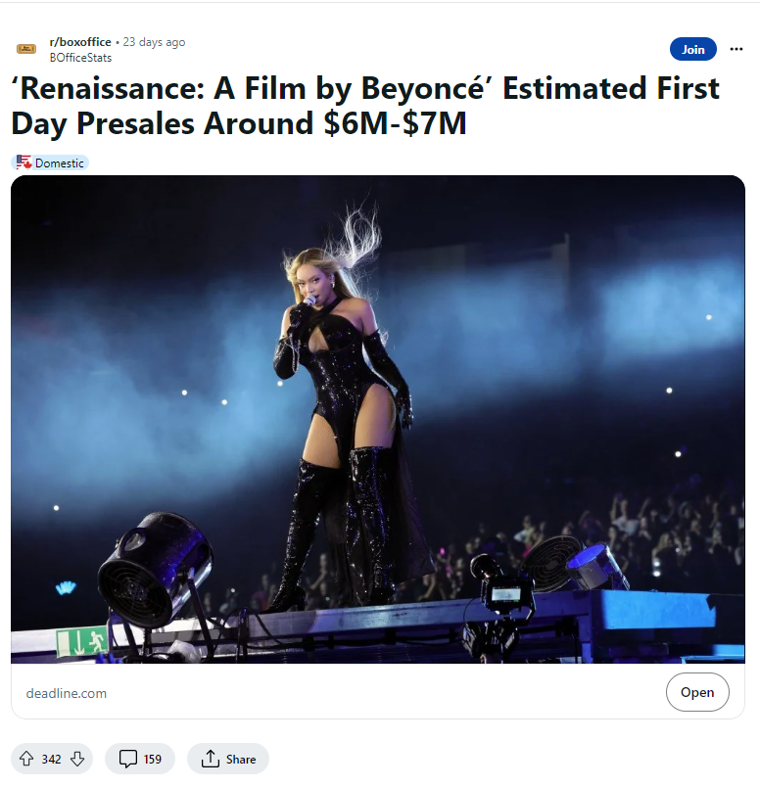
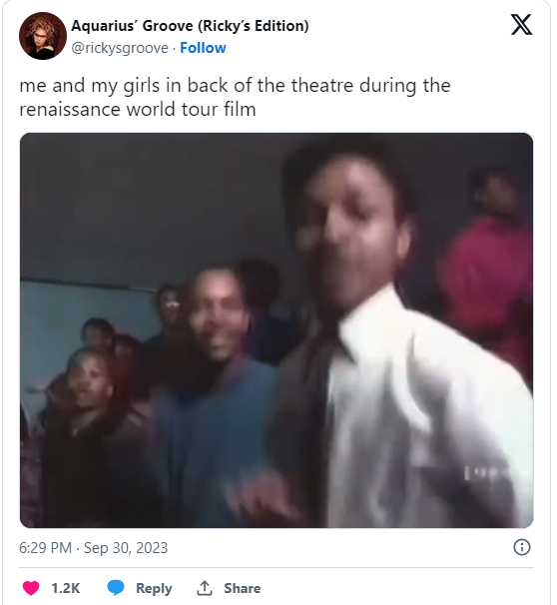
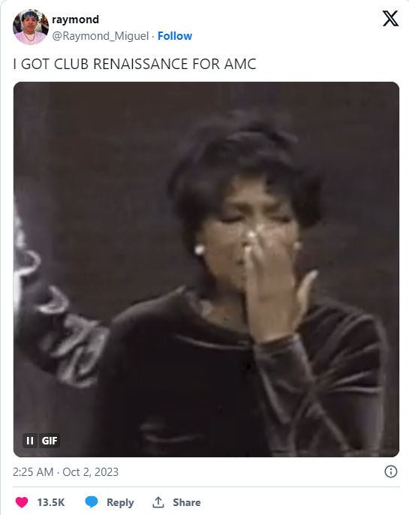
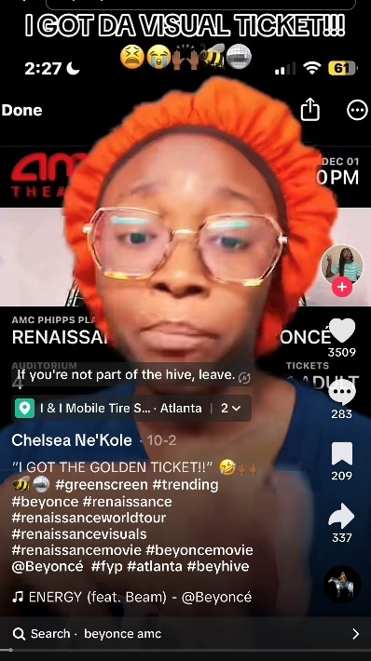


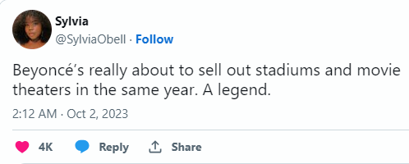
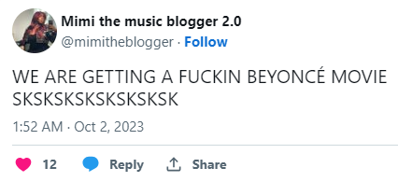
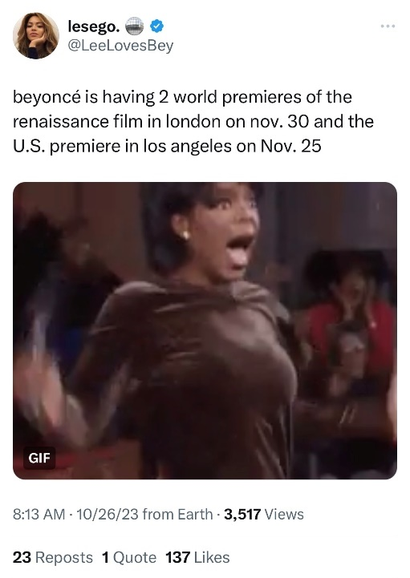
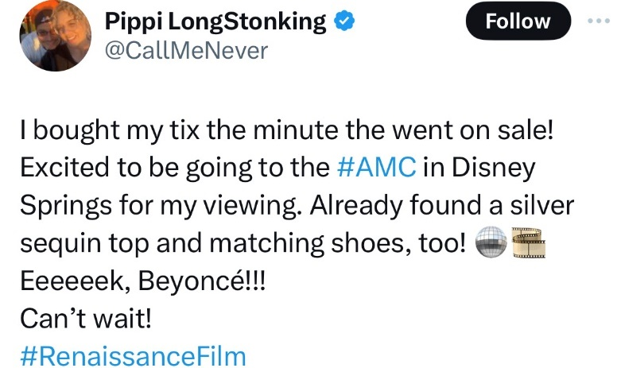

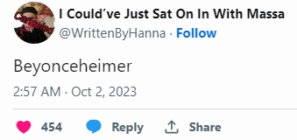
Beyonce’s ‘Renaissance’ concert film created massive social buzz among multicultural audiences that drove ticket pre-sales
Social Media Activity Around ‘Renaissance’
October 3rd, 2023
‘Renaissance: A Film by Beyoncé’ Estimated First-Day Presales Around $6M-$7M – Box Office
October 4th, 2023
Beyoncé’s Concert Film Has Made Millions In Advance Sales After Just One Day
October 26th, 2023
Beyoncé to Premiere ‘Renaissance’ Concert Film in London and L.A., International Tickets Go on Sale Nov. 9 (Exclusive)
The singer will hold the world premiere of 'Renaissance: A Film by Beyoncé' in London on Nov. 30 and the U.S. premiere in Los Angeles on Nov. 25. The film will officially debut in theaters Dec. 1.
-
October 4, 2023
Beyoncé’s Renaissance World Tour Film smashes box office expectations
This information is exclusively provided to VAB members and qualified marketers.
PAGE 25

Slide 26














Upcoming theatrical releases will provide marketers with continuous opportunities to reach desirable, diverse audiences
12/22/23
12/22/23
12/25/23
2/2/24
2/14/24
3/15/24
3/29/24
Imaginary
4/24/24
5/3/24
6/14/24
6/28/24
7/3/24
8/9/24
12/20/24
Source: Box Office Mojo. Note: only represents a sampling of 2023-2024 cinema releases. Release dates as of 11/13/23, subject to change.
This information is exclusively provided to VAB members and qualified marketers.
PAGE 26

Slide 27
The multicultural population now represents four out of every ten people in the U.S. and has achieved double
to triple-digit growth in household income and spending over the last ten years. As such, multicultural audiences are highly lucrative for advertisers.
Cinema is a highly engaging video platform that provides marketers with targeted opportunities to reach a high concentration of diverse audiences through relevant, authentic, premium content
Investing in cinema advertising allows brands to connect and emotionally engage with these desirable audiences that are heavy spenders across a range of major consumer categories
Key Marketer Takeaways
This information is exclusively provided to VAB members and qualified marketers.
PAGE 27

Slide 28

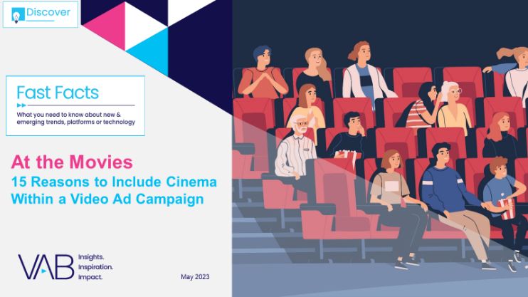




Creators
Jason Wiese
Reed Kiely
SVP, Director of Strategic Insights
jasonw@thevab.com
Director, Data Insights & Trends
reedk@thevab.com
The Passion of the Cinema
Tapping into people’s excitement for quality, premium video content
At the Movies
15 Reasons to Include Cinema Within
a Video Campaign
Karolina Guillen
Insights Manager
karolinag@thevab.com
Discover more
Looking for more data, insights and takeaways? Check out this related VAB content
I Know What You Did This Summer
Harnessing Consumer Momentum
at the Movies (2022)
Capturing the ‘Elusives’
at the Cinema
How Brands Can Reach Young, Diverse and Cordless Consumers
Engaging the ‘Sophisticates’
at the Cinema
How Brands Can Reach Adults 25-44 That Value Premium Experiences
Engaging Frequent Video Streamers Through Cinema
VAB Members, brand marketers and agencies get free and immediate access to VAB’s content library. Get access at theVAB.com
This information is exclusively provided to VAB members and qualified marketers.
PAGE 28

Slide 29


About VAB
VAB plays a dual role in the video advertising industry. We are leading
the change to bring about a more innovative and transparent marketplace. We also provide the insights and thought leadership that enables marketers to develop business-driving marketing strategies.
Drawing on our marketing expertise, we simplify the complexities in our industry and discover new insights that transform the way marketers look at their media strategy.
We are committed to your business growth and proud to offer VAB members, brand marketers and agencies complimentary access to our continuously-growing Insights library. Get immediate access at theVAB.com.
This information is exclusively provided to VAB members and qualified marketers.
PAGE 29

