Slide 1


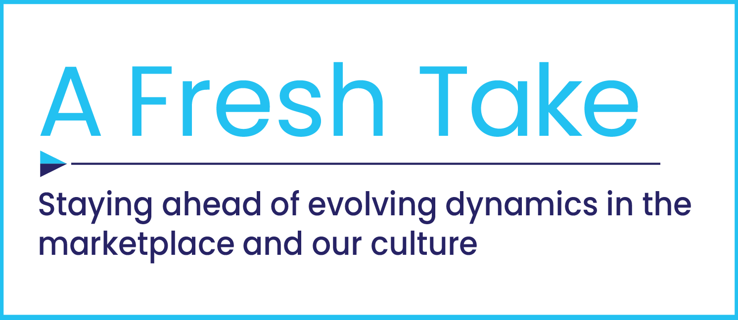
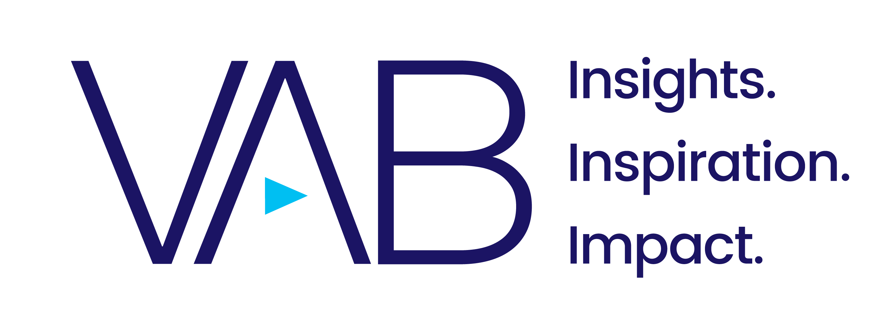
How Audio Podcasts Complement Video Viewing

Slide 2


Audio podcasts have become more popular over the last few years as consumers seek out more entertainment and informational content.
By understanding how and when people are engaging with audio podcasts, marketers can leverage the platform for incremental opportunities to engage consumers during traditionally ‘non-video viewing’ occasions.
This information is exclusively provided to VAB members and qualified marketers. Further distribution is prohibited.
PAGE 2

Slide 3

People increased their usage of video and audio platforms during COVID, especially watching TV shows online
% of respondents who have viewed / listened to more of the following content during the pandemic
48%
24%
TV Shows Online
Podcasts
Source: VAB analysis of Magna & Spotify, Digital Audio Expansiveness: Growing Landscape & Opportunities, 2020. Data based on February 2021 online survey of people who have listened to digital audio or watched digital video in the past 24 hours, n= 2,505 (Gen pop: n=2,206, booster of Spotify users: n=300). Q: How has your time spent listening or watching the following types of media changed, if at all, during this COVID-19 pandemic?
This information is exclusively provided to VAB members and qualified marketers. Further distribution is prohibited.
PAGE 3

Slide 4

Overall video and audio consumption is expected to increase even more going forward
% who expect to increase their consumption of the following content through 2021
38%
35%
35%
Free Streaming / AVOD*
Live TV
Podcasts
Source: VAB analysis of Magna & Spotify, Digital Audio Expansiveness: Growing Landscape & Opportunities, 2020. Data based on February 2021 online survey of people who have listened to digital audio or watched digital video in the past 24 hours, n= 2,505 (Gen pop: n=2,206, booster of Spotify users: n=300). Q: In what ways has the role of audio in your life changed due to the COVID-19 pandemic? Respondents who answered, ‘I’m looking forward to it more’. Tremor Video & Unruly, The NEW New Normal: How Consumer Behaviors Are Likely to Change in the Months Ahead, April 2021. Data based on March 2021 survey of 893 U.S. consumers, conducted in partnership with Unruly. Q: Over the next 6 months, compared to now, how much time do you expect to spend watching TV in the following ways? *AVOD = ‘ad-supported video-on-demand’.
This information is exclusively provided to VAB members and qualified marketers. Further distribution is prohibited.
PAGE 4

Slide 5

However, while growing, podcast listening remains a fraction of the time spent with video among users of each medium
Source: Linear TV - VAB analysis of Nielsen R&F Time Period Report, Live+7, Total Day, P18+, viewing source: ad-supported cable TV & broadcast TV, time period: w/o 12/2/19 vs. w/o 12/7/20. Streamed Video & Podcasts - YouGov Profiles, December 2020.
This information is exclusively provided to VAB members and qualified marketers. Further distribution is prohibited.
PAGE 5

Slide 6
While TV viewing is a habitual, daily activity for most people, podcast usage is more infrequent with most listeners selectively tuning into the platform five or less times a month
Frequency of Tune-in
% of users
How Often Do You Listen to Podcasts?
% of podcast listeners
Frequency | Ad-Supported TV % of TV Viewers | Podcasts % of Podcast Listeners
Every Day | 69% | 15%
Weekly | 91% | 54%
54% listen weekly
(but not everyday)
Source: Podcasts - Nielsen, Podcasting Today: Insights for Podcast Advertisers, February 2021. Nielsen Scarborough Podcast Listener Buying Power, November 2020 (Listeners Only) Adults 18+. ‘Weekly’ = listens daily up to 4-5x a month. Ad-Supported TV - VAB analysis of Nielsen R&F Time Period Report, Live+7, Total Day, P18+ TV viewers, viewing source: ad-supported cable TV & broadcast TV, time period: 11/2/20 – 11/8/20. ‘Every day’ based on a selected day in November 2020 (11/2/20), ‘Weekly’ based on a selected week in November 2020 (11/2/20 - 11/8/20).
This information is exclusively provided to VAB members and qualified marketers. Further distribution is prohibited.
PAGE 6

Slide 7
‘Primetime’ has a different meaning for each platform as TV and podcast consumption skews towards different times, allowing marketers to engage with audiences across these platforms throughout the day
% of Time Spent Watching / Listening by Time of Day
Podcasts
Linear TV
Primetime
Daytime
Source: Podcasts - Edison Research, Share of Ear, Q4 2019, Q1-Q3, 2020, P13+. Linear TV - VAB analysis of Nielsen R&F Time Period Report, Live+7, Total Day, P13+, viewing source: ad-supported cable TV & broadcast TV, time period: 9/1/20–9/30/20. Percentages may not add up to 100 due to rounding.
This information is exclusively provided to VAB members and qualified marketers. Further distribution is prohibited.
PAGE 7

Slide 8

Nearly half of all podcast listening takes place outside the home, providing marketers with incremental opportunities to reach consumers away from their living room
% of Time Spent Listening to Podcasts by Location
Source: Edison Research, Share of Ear, Q4 2019, Q1-Q3, 2020, P13+.
This information is exclusively provided to VAB members and qualified marketers. Further distribution is prohibited.
PAGE 8

Slide 9

People often listen to podcasts while involved in other activities both inside and out of the home which can lead to more passive engagement
Source: YouGov Profiles, December 2020. ‘Out of home’ includes: ‘in the car,’ ‘at work,’ & ‘other’.
This information is exclusively provided to VAB members and qualified marketers. Further distribution is prohibited.
PAGE 9

Slide 10

However, while TV drives outcomes throughout the entire funnel, adding podcasts to the media mix can build consideration and purchase intent
Media Types Best at Delivering Campaign Objectives
% of advertisers
Upper Funnel
Mid Funnel
Lower Funnel
Source: VAB analysis of Advertiser Perceptions’ Podcast Advertising Market Report, 2020.
This information is exclusively provided to VAB members and qualified marketers. Further distribution is prohibited.
PAGE 10

Slide 11

While audio podcast usage is growing among consumers, it typically serves as a complement to video viewing rather than a replacement, allowing audiences to access more content across platforms at different times, places and ‘use’ occasions
Due to the different roles each platform plays within audiences’ media consumption habits, audio podcasts create incremental opportunities for marketers to reach and engage consumers during ‘non-video viewing’ occasions
Key Marketer Takeaways
This information is exclusively provided to VAB members and qualified marketers. Further distribution is prohibited.
PAGE 11

Slide 12
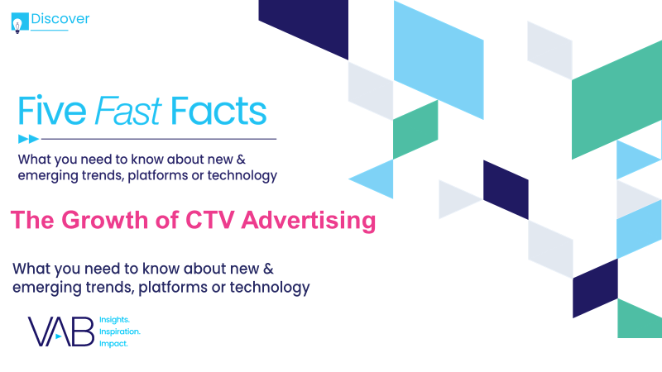

Creators
Jason Wiese
Leah Montner-Dixon
SVP, Director of Strategic Insights
jasonw@thevab.com
Associate Insights Director
leahm@thevab.com
Add links once LPs are created
Discover more
Looking for more data, insights and takeaways? Check out this related VAB content
Five Fast Facts
The Growth of CTV Advertising
Five Fast Facts
Data-Driven Opportunities in a Cookieless World
VAB Members, brand marketers and agencies get free and immediate access to VAB’s content library. Get access at theVAB.com
This information is exclusively provided to VAB members and qualified marketers. Further distribution is prohibited.
PAGE 12

Slide 13

About VAB
VAB is an insights-driven organization that inspires marketers to reimagine their media strategies resulting in fully informed decisions.
Drawing on our marketing expertise, we simplify the complexities in our industry and discover new insights that transform the way marketers look at their media strategy.
Discover
We keep you one step ahead with the latest thinking so you can create innovative, forward-looking strategies.
Simplify
We save you time by bringing you the latest data & actionable takeaways you can use to inform your marketing plans.
Transform
We help you build your brand by focusing on core marketing principles that will help drive tangible business outcomes.
We are committed to your business growth and proud to offer VAB members, brand marketers and agencies complimentary access to our continuously-growing Insights library. Get immediate access at theVAB.com.
This information is exclusively provided to VAB members and qualified marketers. Further distribution is prohibited.
PAGE 13

