Slide 1
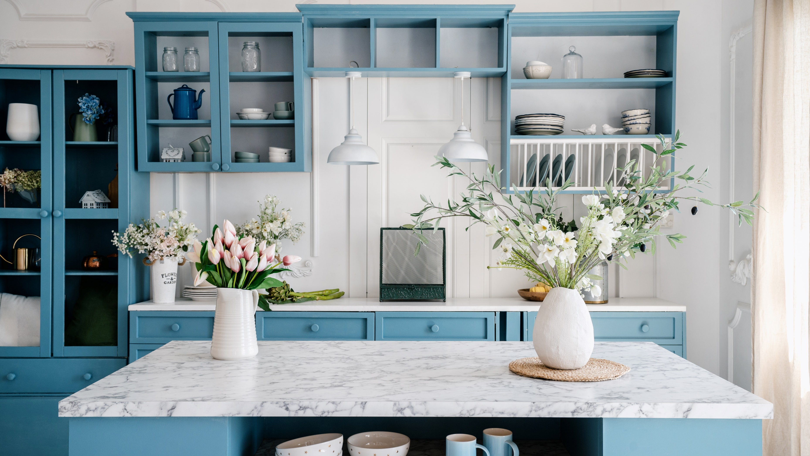


Case Study Corner
xx
Home Category
Brand success stories highlighted through real-world multiscreen TV case studies

Slide 2




6 Home category ‘real world’ case studies showcasing how multiscreen TV drives business outcomes across the funnel
Upper Funnel Outcomes
Awareness
Multiscreen TV campaigns that expand reach and drive brand recall against a brand’s best customer prospects*
Sampling of ‘awareness-based’ outcomes that can be measured:
Reach / Reach Extension / Incremental Reach
Ad / Brand Recall
Cost Efficiencies (Reach / Targeted IMPs)
Full-Funnel Outcomes
Awareness + Action
Multiscreen TV campaigns that expand reach and drive brand recall while also increasing the likelihood that the intended audience will be motivated to act*
Sampling of full-funnel outcomes:
Reach → Brand Recall → Conversion Rates → Sales → Optimizations →
Cost Efficiencies
*based on campaign KPIs
This information is exclusively provided to VAB members and qualified marketers.
PAGE 2

Slide 3
Upper Funnel
Case Studies
Awareness
Multiscreen TV campaigns expand reach
and drive brand recall against a brand’s
best customer prospects
Sampling of ‘awareness-based’ outcomes that can be measured:
    Reach / Reach Extension / Incremental Reach
    Ad / Brand Recall
    Cost Efficiencies (Reach / Targeted IMPs)
How Multiscreen TV drives
Awareness
This information is exclusively provided to VAB members and qualified marketers.
PAGE 3

Slide 4


Category:
Home Improvement
MiQ leveraged CTV to reach STIHL’s desired target audience and build awareness during their Spring campaign
Challenge
STIHL, a manufacturer of power tools and equipment, sought to drive awareness of their battery-powered outdoor power equipment to tap into their target audience and drive reach
Solution
MiQ’s Advanced TV solution provided an omnichannel approach to achieve this goal
With a 95% VCR KPI, CTV provided an opportunity to meet this goal and reach STIHL’s target audience in new ways
Results
MiQ ran and tested different creatives across channels including display, OLV and CTV
With competitive intelligence, STIHL was able to win SOV over their competitors
Company / Platform / Media Type
MiQ / Display, Online Video, Connected TV (CTV)
Results
98%
VCR on CTV
(>3.2% over KPI)
1.4M
CTV Impressions
Source: MiQ, Case study: STIHL leverages CTV for Spring Awareness Campaign. 2023.
This information is exclusively provided to VAB members and qualified marketers.
PAGE 4

Slide 5







Category:
Home Appliances
Whirlpool utilized CTV insights to identify optimal publishers to increase unique reach and cost efficiencies while managing frequency
Challenge
Looking to drive awareness, Whirlpool, utilized programmatic CTV to optimize reach, frequency and efficiencies across publishers
Solution
Whirlpool launched an awareness campaign across over 50 curated CTV publishers via custom PMPs*, utilizing Innovid as their video ad server and measurement provider
Target Segment
Third-party Homeowner Audience Segment
Results
Analysis found programmatic buys across multiple publishers (50+) can drive unique reach (87%) while maintaining low target average frequency (3.3X)
Demonstrated how programmatic CTV could drive cost savings while improving ROI; campaign had lower overall cost-per-unique-reach, outperforming ANA study benchmark** by 10%
Company / Platform / Media Type
Innovid / Streaming Only / Connected TV (CTV)
87%
~26%
+2.5%
3.3X
Unique Reach Percentage¹
Unique Reach Efficiency²
Benchmark Reach
of U.S. CTV Universe³
Average Campaign Frequency⁴
Source: Innovid, Case study: Innovid Insights Measures 87% Unique Reach Percentage for Whirlpool. Campaign time period: 4/1/2021 – 5/30/3021. 1. Unique Reach Percentage: The total number of unique or distinct households (only) reached during the campaign, displayed as a percentage. This included 3rd-party audience segments targeting homeowners. 2. Unique Reach Efficiency: A publisher overall efficiency in reaching unique households against delivered impressions. **3. Benchmark Reach of U.S. CTV Households: Benchmarks are Innovid-ANA’s State of Connected TV 2021 Report. 4. Average Campaign Frequency: The average number of times a single household was exposed during the campaign. *Private marketplace.
This information is exclusively provided to VAB members and qualified marketers.
PAGE 5

Slide 6
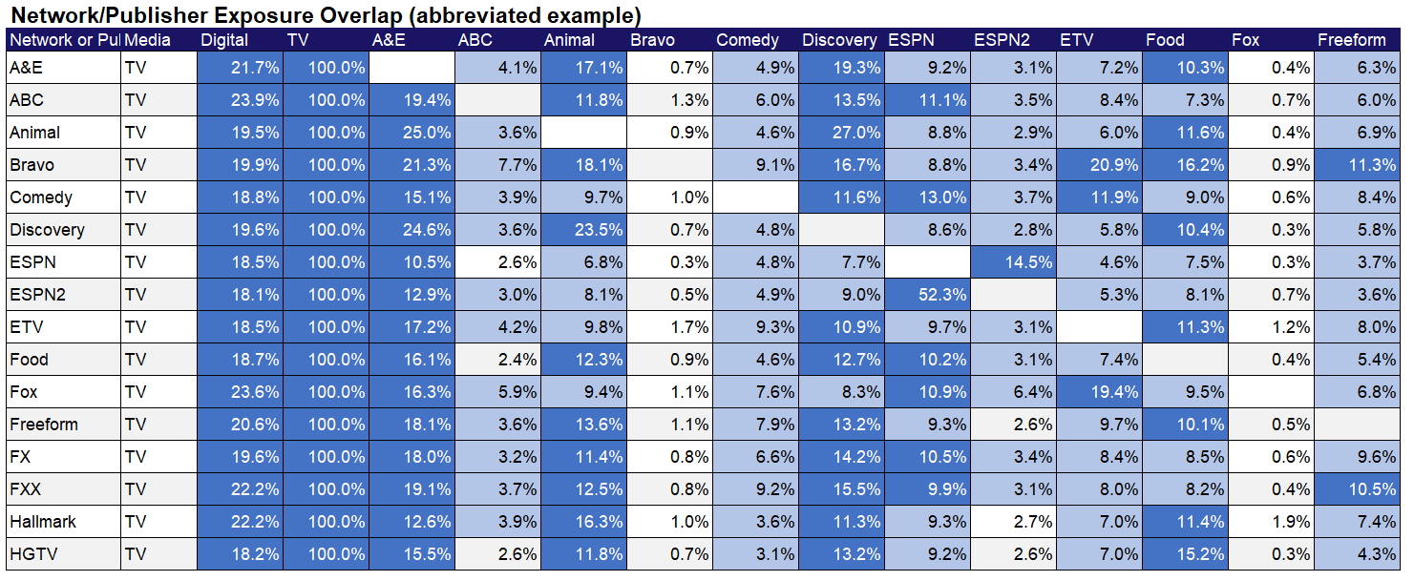
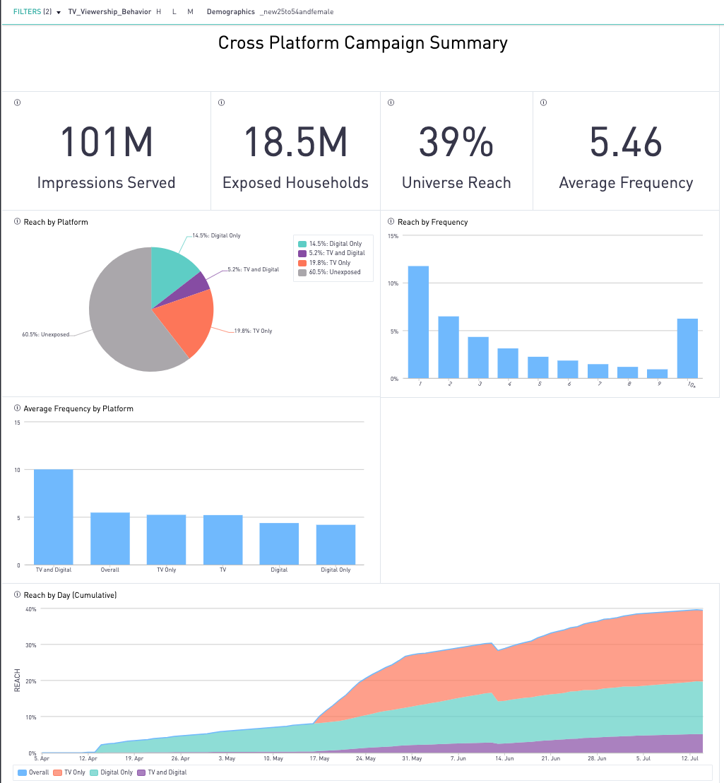
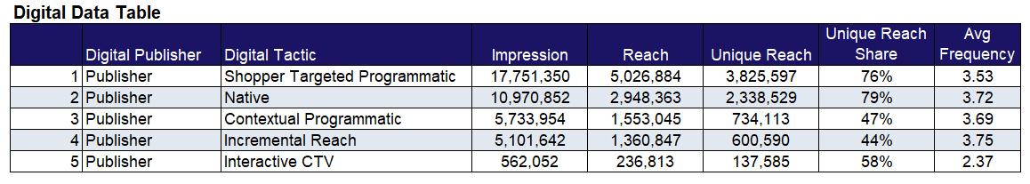

Category:
Home Appliances
An appliance manufacturer employed Samba TV’s deduplicated omni screen insights to optimize their publisher selection based on reach and frequency
Challenge
A major home appliance manufacturer wanted to know whether their Digital Media spend was contributing its “fair share” of impact, and what publishers and tactics were over/under-performing
Audience Measurement Innovation
Samba TV’s True Reach and Frequency (TRF) Measurement provided insights into how the campaign performed across TV and Digital tactics
Target Segment
U.S. households that include female adults
Results
Digital-only delivered significant unique reach (14.5%)
Television (5.2) frequency was appropriately balanced vs. Digital (4.4)
Shopper-targeted Programmatic and Native tactics delivered the most significant unique reach
ESPN and HGTV delivered the highest levels of
unique reach
Company / Viewing Source / Media Type
Samba TV / Automated Content Recognition (ACR) / Linear, CTV, Digital (CTV, OLV, Native Display)
Enabled by Samba TV’s True Reach & Frequency Measurement & Dashboards
Source: Samba TV, Home Appliances / Electronics Case Study. Campaign time period: April – July 2021.
This information is exclusively provided to VAB members and qualified marketers.
PAGE 6

Slide 7

Awareness
How Multiscreen TV drives
Full-Funnel Outcomes
Multiscreen TV campaigns expand reach
and drive brand recall against a brand’s
best customer prospects
Action
Multiscreen TV campaigns increase the likelihood
that the intended audience will be motivated to act
(e.g., visit a website, download an app, sign-up
for a subscription, make a purchase, etc.)
Case Studies
This information is exclusively provided to VAB members and qualified marketers.
PAGE 7

Slide 8





Category:
Home Furnishings
A furniture brand used insights from a local streaming campaign to ensure incremental reach at an optimal frequency while improving click-through rate
Challenge
A furniture brand wanted to increase unique reach in local markets within a 10-mile radius & extend their media investments by targeting advanced audiences on digital mediums
Solution
Measured to establish a baseline in the first 4 weeks of the campaign to understand audience composition per unique local market & tactic across channels
Activated custom suppression segments to remove households that were exposed to the brand’s linear campaign messages
Optimized campaign tactics and strategy in-flight, leveraging a combination of CTV and 3-screen activation to validate the use of suppression segments for driving incremental reach across the brand’s digital buy
Target Segment
Custom in-market target audience at local level
Results
VideoAmp measured 1.9MM incremental users and garnered a 1.94% click-through-rate (CTR) average per local market and a 93.96% video completion rate
Company / Platform / Media Type
VideoAmp / Streaming + Multiscreen (non-linear) / OTT
1.9MM
Incremental Users Reached
1.94%
Click-Through-Rate (CTR) Average Per Local Market
93.96%
Video Completion Rate
Source: VideoAmp, Case study: Furniture Brand Finds Comfort in Reaching Cross-Channel Local Audiences. Campaign time period: August 2020.
This information is exclusively provided to VAB members and qualified marketers.
PAGE 8

Slide 9
Category:
Home Improvement
A home improvement brand drove double-digit incremental reach and decreased their cost-per-visit through optimization
Challenge
A home improvement company was looking for a complement to their Direct Response (DR) TV buying strategy to find a solution that could reach more of their potential customers for a lower cost
Solution
Simulmedia utilized their patented predictive technology and direct integrations with national TV networks to maximize reach against the brand’s custom target audience. Within the approach, Simulmedia consistently optimized for incremental reach while also driving the cost-per-visit (CPV) down
Target Segment
Custom Home Target
Results
The data-driven linear TV campaign achieved an incremental reach of 21% with just 5% of the budget the DRTV plan had, and the brand has also seen their CPV decreased by 49%
Company / Platform
Simulmedia / Data-driven linear
Custom Target Audience Reach:
Optimized Audience-Based vs. Direct Response TV Plan
21%
Unique to Simulmedia
9%
Reached by Both
70%
Unique to Base
Since activating and optimizing with Simulmedia,
the brand has seen their cost-per-visit decrease by 49%
Source: Simulmedia, Case Study: How Simulmedia Drove Growth for a Leading Home Improvement Brand.
This information is exclusively provided to VAB members and qualified marketers.
PAGE 9

Slide 10








Category:
Furniture Retail
Premion delivers full-funnel results for a regional furniture retailer
Challenge
A growing regional furniture retailer wanted to drive awareness of their brand and grow sales within multiple markets. They sought to reach key ’furniture buyer’ audiences while proving the campaign generated measurable brand lift, drove both website and in-store sales and generated a positive return on ad spending.
Measurement Solution
Brand Lift
Sales Conversion and Website Attribution
Target Segment
Home Furnishing Intenders + Women 25-54
New Movers or Homeowners + Women 25-54
Spanish Speakers
Results
Results proved that PREMION drove roughly 20% brand lift across 3 KPIs, generated 37K website visits and 6.2K furniture transactions that resulted in $5M in sales revenue.
Viewing Source / Media Type
CTV/OTT
+22%
+23%
+17%
BRAND LIFT PERFORMANCE:
Aided Awareness
Ad Recall
Purchase Intent
WEBSITE ATTRIBUTION RESULTS
(within 7 days of exposure) :
37K
2.2K
Exposed Website Visits
Exposed Cart Page Visits
6.2K
$5M
$809
SALES CONVERSION RESULTS
(within 30 days of exposure):
# of Transactions
(online +in-store)
Generated Sales
Revenue
Average Revenue
Per Sale
Source: Premion, Case Study: How Premion Delivered Full-Funnel Results for a Furniture Brand.
This information is exclusively provided to VAB members and qualified marketers.
PAGE 10

Slide 11











Want more? VAB has a wealth of case studies across additional categories
Business-to-Business (B2B)
Consumer Packaged Goods (CPG)
Entertainment & Tune-In
Financial Services & Insurance
Health, Wellness & Beauty
Home
Pharmaceuticals
Restaurants
Retail
Technology
Travel
Access more case studies at www.thevab.com
This information is exclusively provided to VAB members and qualified marketers.
PAGE 11

Slide 12








Want more? VAB also has case studies organized across multiscreen TV platforms including linear TV and streaming / CTV
Stream On
How can a convergent TV strategy drive business
results for my brand?
Proven Strategies & Tactics In Audience-Based TV Buying
Opportunities in VOD Addressable
Q1 ‘22 Today’s Innovations in Measurement
Q2 ‘22 Today’s Innovations in Measurement
Q3 ‘22 Today’s Innovations in Measurement
Q4 ‘22 Today’s Innovations in Measurement
Access more case studies at www.thevab.com
This information is exclusively provided to VAB members and qualified marketers.
PAGE 12

Slide 13


About VAB
VAB plays a dual role in the video advertising industry. We are leading the change to bring about a more innovative and transparent marketplace. We also provide the insights and thought leadership that enables marketers to develop business-driving marketing strategies.
Drawing on our marketing expertise, we simplify the complexities in our industry and discover new insights that transform the way marketers look at their media strategy.
We are committed to your business growth and proud to offer VAB members, brand marketers and agencies complimentary access to our continuously-growing Insights library. Get immediate access at theVAB.com.
This information is exclusively provided to VAB members and qualified marketers.
PAGE 13

