Slide 1





It’s the Most Opportune
Time of the Year
Why consumers’ holiday spirit triumphs over economic uncertainty

Slide 2


No matter the circumstances, people love the holidays.
While inflation is a top concern for many, consumers continue to look forward to the holiday season as a special occasion to celebrate with family and friends. This includes opening their wallets to buy gifts and spend across holiday-related categories for social gatherings, despite economic uncertainties.
The holidays are especially important to Hispanic consumers, and marketers can best connect with this segment by creating authentic campaigns that highlight their unique cultural traditions and holiday celebrations to drive higher attention and deeper engagement.
This information is exclusively provided to VAB members and qualified marketers. Further distribution is prohibited.
PAGE 2

Slide 3

How can marketers capitalize on consumers’ love of the holidays?
While inflation and uncertainty continues to hover over
the economy, consumers are still willing to spend on
what matters to them the most – family, friends and revelry

Slide 4
Inflation continues to be the top concern for Americans today, even above gun violence, climate change and racism
% who say each of the following is ‘a very big problem’ in the country today
Download VAB’s Under Pressure to learn how marketers can adapt their strategies to best resonate with price sensitive consumers.
Source: Pew Research Center, By a wide margin, Americans view inflation as the top problem facing the country today, 5/12/22. Based on survey of U.S. adults conducted April 25 – May 1, 2022.
This information is exclusively provided to VAB members and qualified marketers. Further distribution is prohibited.
PAGE 4

Slide 5

Looking back at last year’s holiday season, consumers were eager to celebrate with their loved ones despite economic challenges, supply chain issues and Covid
“Despite supply chain problems, rising inflation, labor shortages and the omicron variant, retailers delivered a positive holiday experience to pandemic-fatigued consumers and their families. Consumers were backed by strong wages and record savings and began their shopping earlier [in 2021] than ever before.”
Matthew Shay, President and CEO, National Retail Federation
NRF Press Release, 1/14/2022
This information is exclusively provided to VAB members and qualified marketers. Further distribution is prohibited.
PAGE 5

Slide 6


The holiday season has year-round mindshare among consumers, which signifies the importance people place on celebrating cherished moments with loved ones, regardless of current economic conditions
In 2021, 61% of consumers started holiday shopping by early November*
‘Have you started planning for / thinking about how you will celebrate the following holidays?’
% who have started planning by January, only applies to those who celebrate
Source: Numerator, 2022 Holiday Preview. Based on survey fielded late January 2022 (1/26/22), n=11,578. *National Retail Federation, Holiday 2021 by the Numbers, December 2021.
This information is exclusively provided to VAB members and qualified marketers. Further distribution is prohibited.
PAGE 6

Slide 7



Consumers’ love of the holidays means that most are refusing to cut back on their traditions like gift giving and holiday travel, even in the face of ongoing inflationary pressures
% of U.S. adults who agree with the following statements
88%
76%
74%
Still plan to give gifts
Are not planning on canceling
or reducing holiday travel
Plan to spend the same or more this year on holiday shopping*
Source: VAB analysis of MRI-Simmons Q3 Trending Topics Study, A18+. *Samba TV, 2022 Holiday Report. Based on HarrisX online survey of 2,505 U.S. adults, fielded 8/29/22 – 9/1/22.
This information is exclusively provided to VAB members and qualified marketers. Further distribution is prohibited.
PAGE 7

Slide 8

Because of this, holiday seasonal spending is projected to be higher than last year’s record-setting sales, despite economic uncertainty
An important bellwether for the holidays, this year’s ‘Back-to-School’ season was projected to be up +3% vs. last year’s all-time high
Historical holiday season sales
$$$ in billions
+14%
YOY
+8%
YOY
2022 U.S. Holiday season projection
+5%
YOY
+2%
YOY
+4%
YOY
+8.5%
YOY projected growth in total holiday retail sales*
Pre-Pandemic
Pandemic
Source: National Retail Federation, NRF Says 2021 Holiday Sales Grew 14.1 Percent to Record $886.7 Billion, 1/14/22. *Cheetah Digital, The Relationship Marketer’s Playbook for Holiday Planning, 2022.
This information is exclusively provided to VAB members and qualified marketers. Further distribution is prohibited.
PAGE 8

Slide 9

Consumers will spend over $1K on average this holiday season and while gifts are the main priority, one-third of spending will be on holiday-related purchases which presents opportunities across a range of categories
Average Consumer Holiday % Share of Spend*
By Product Segment
Other holiday purchases for themselves or their families
$1,041
Non-gift holiday purchases (i.e., food and decorations)
Gifts for family, friends & co-workers
Spend on the holiday season by the average adult
Source: Samba TV, 2022 Holiday Report. Based on HarrisX online survey of 2,505 U.S. adults, fielded 8/29/22 – 9/1/22. *VAB analysis of National Retail Federation, Holiday 2021 by the Numbers, December 2021.
This information is exclusively provided to VAB members and qualified marketers. Further distribution is prohibited.
PAGE 9

Slide 10

In terms of gifts, consumers enjoy spreading the love during the holiday season and many are planning to buy for people across their circle
of friends, family and colleagues – as well as for themselves
This Year, Consumers Will Be Shopping For…
% who agree
(mine or others)
(realtor, mail carrier, etc.)
Source: INAMR intelligence, 2022 Holiday Trends Guide: Volume II, September 2022.
This information is exclusively provided to VAB members and qualified marketers. Further distribution is prohibited.
PAGE 10

Slide 11

















It’s not only ‘gifting’ categories like toys, games and electronics that are seasonal drivers but also ancillary categories like personal care, groceries and household supplies all in support of holiday-related festivities
2021 Seasonal Category Drivers
Categories with daily holiday sales over 3x their daily pre-holiday sales
5.4x
Toys
4.5x
Video games
3.6x
Gift cards
3.0x
Books
Categories with daily holiday sales with 2-3x their daily pre-holiday sales
2.7x
Grocery
2.3x
Home & garden
2.2x
Jewelry
2.2x
Personal care
2.2x
Electronics
2.1x
Baby & toddler
2.0x
Appliances
Categories with daily holiday sales with 1.5-2x their daily pre-holiday sales
1.9x
Sporting goods
1.9x
Housekeeping
supplies
1.8x
Apparel
1.7x
Tools / home improvements
1.6x
Pet products
1.5x
Alcohol
Source: Adobe, Unboxing the 2021 Holiday Shopping Results, based on online/ecommerce sales only, increases reflect average daily holiday sales between November-December 2021 compared to average daily sales in September 2021, based on data collected through December 2021. Green reflects categories that skew towards gift purchases, while magenta reflect categories that skew towards ancillary holiday-related purchases.
This information is exclusively provided to VAB members and qualified marketers. Further distribution is prohibited.
PAGE 11

Slide 12





Categories with higher-priced brands and products are projected to be up versus both last year and pre-pandemic as consumers eagerly return to a sense of normalcy and indulgence
Anticipated U.S. Holiday Retail Sales by Sector
Extended Holiday Season
2022 vs 2021
2022 vs 2019
Luxury
(excl. Jewelry)
+6.8%
+27.1%
Apparel
+5.3%
+24.9%
Electronics
+4.4%
+28.1%
+3.5%
+36.6%
Jewelry
Source: Mastercard, SpendingPulse: Holiday Season Retail Insights 2022, ‘Extended holiday season’ represents October 11 – December 24.
This information is exclusively provided to VAB members and qualified marketers. Further distribution is prohibited.
PAGE 12

Slide 13
In a post-pandemic world, additional opportunities are arising for brands
as consumers head back to ‘brick and mortar’ since in-store shoppers
are more likely to make impulse purchases and spend more overall
Consumers who primarily do their holiday shopping in-store plan to spend 51% more than more than shoppers who plan to mostly shop online*
Where do you plan to do your holiday shopping?
Source: Morning Consult, A Bright Spot for Retailers: Consumers Prioritize Holiday Gifts Amid Inflationary Pressures, 9/15/22. Note: figures may not add up to 100% due to rounding. *Samba TV, 2022 Holiday Report, based on HarrisX online survey of 2,505 U.S. adults, fielded 8/29/22 – 9/1/22, On average, people who plan to do the majority of their holiday shopping in-store plan to spend $1,286 this year, while shoppers who plan to mostly shop online plan to spend $853 this year.
This information is exclusively provided to VAB members and qualified marketers. Further distribution is prohibited.
PAGE 13

Slide 14



Consumers will continue spending on what they want to buy - even if its for someone else - but the key for brands is to cultivate relationships, build loyalty and make them feel valued
Consumers are willing to spend more on the items they want, even if it is for ‘gift giving,’ since that is an extension of themselves and their image
% of people who agree with the following statements
73%
71%
54%
‘I am willing to continue to buy from companies that increase their prices
if I feel valued as a customer’
‘I have empathy for companies where I’ve been a long-time customer when they need to increase their prices due
to inflation or shortages’
‘Even though prices are rising due
to inflation, I am not going to stop buying what I want’
Source: Ipsos, Here’s how inflation is affecting our shopping , June 2022. Ipsos Coronavirus Consumer Tracker, fielded May 24 25, 2022 among 1,120 U.S. adults. Q: How much do you agree or disagree with the following statements agree summary. Download VAB’s Under Pressure to learn how marketers can adapt their messaging, media and investment strategies to best resonate with price sensitive consumers.
This information is exclusively provided to VAB members and qualified marketers. Further distribution is prohibited.
PAGE 14

Slide 15

6 reasons Hispanics will be driving brand growth during the holidays
This passionate community, rooted in their culture and traditions, embraces all aspects of the holiday season

Slide 16






Reason 1: In addition to their population growth and larger household size, Hispanic consumers are a valuable audience for marketers due to their increased spending power
m
Hispanic population has grown by over 10 million people during
the last 10 years
Hispanics live in larger HHs than non-Hispanics*
Hispanic consumer buying power has increased 69% since 2001**
There will be an estimated
66.5 million Hispanics in the U.S. by January 2023, accounting for 20% of the total population
(vs. 54.5 MM, or 17%, in 2013)
3.8 average HH size vs. 2.8
for non-Hispanics
Average annual household expenditures
2001
2011
2021
$34,361
$42,086
$57,955
+22%
vs. 2001
+69%
vs. 2001
Source: Claritas, The 2022 Hispanic Market Report and VAB analysis of U.S. Census Bureau data, 2017. *VAB analysis of MRI-Simmons Spring 2022 Doublebase, Non-Hispanic A18+ vs. A18+ of Spanish or Hispanic origin (17% of A18+ population). **VAB analysis of Bureau of Labor Statistics data, Table 2200. Hispanic or Latino origin of reference person: Annual expenditure means, shares, standard errors, and coefficients of variation, Consumer Expenditure Surveys, 2001, 2011 & 2021.
This information is exclusively provided to VAB members and qualified marketers. Further distribution is prohibited.
PAGE 16

Slide 17
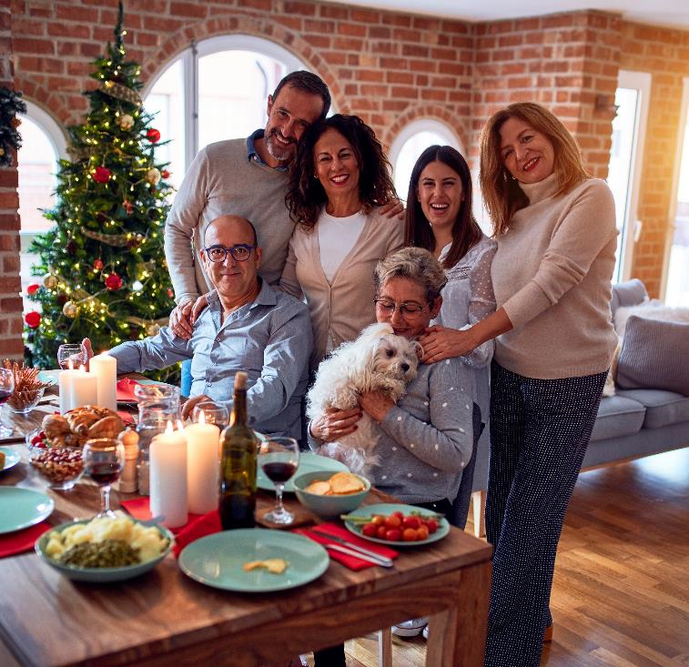







Reason 2: Hispanics have such an immense love for the holidays that even the most passionate fútbol fanatics rank Christmas above the
World Cup as their favorite celebration
Favorite celebrations among Hispanic enthusiasts
Percentage of enthusiasts who rank these celebrations as their top 3 favorites
Source: Telemundo, The Future is Fútbol, 2022 report. Based on 1,351 completed interviews among 967 Latinos and 384 non-Latinos, representative of soccer followers in the U.S., fielded February 2022.
This information is exclusively provided to VAB members and qualified marketers. Further distribution is prohibited.
PAGE 17

Slide 18



Reason 3: Their cultural heritage and traditions are a source of great pride and, as they gather to celebrate both American and Hispanic holidays,
they are willing to spend their time and money to make them extra special
Hispanics value their culture and heritage
and enjoy sharing it with others
Celebrating their heritage is a major part
of their holiday activities
84%
‘enjoy sharing my
Hispanic / Latino heritage
with other Hispanic / Latinos or
my non-Latino friends’
78%
agree that ‘my cultural / ethnic heritage is an important
part of who I am’
(vs. 56% NH)
88%
‘often celebrate U.S. National holidays such as the Fourth of July and President’s Day or holidays from Hispanic countries’
30%
are more likely to ‘include
cultural traditions in their holiday celebrations,’ - driving them to buy food items and decorations to make the festivities even more special
Source: VAB analysis of MRI-Simmons Spring 2022 Doublebase Study, based on non-Hispanic A18+ vs. A18+ of Spanish or Hispanic origin (17% of A18+ population).
This information is exclusively provided to VAB members and qualified marketers. Further distribution is prohibited.
PAGE 18

Slide 19
Reason 4: Their fervent holiday spirit means that Hispanic consumers
are planning to spend one-third more than the average adult on holiday shopping this year
Holiday Shopping Spend in 2022 vs. 2021
% of U.S. Adults
+34%
Spend on the holiday season
by Hispanic adults vs.
the average adult
$1,392 vs. $1,041
(+$351)
Source: Samba TV, 2022 Holiday Report. Based on HarrisX online survey of 2,505 U.S. adults, fielded 8/29/22 – 9/1/22.
This information is exclusively provided to VAB members and qualified marketers. Further distribution is prohibited.
PAGE 19

Slide 20












Reason 5: Hispanics are spending much more annually across many categories that are also popular during the holiday season – like toys, apparel and alcoholic beverages or food for communal gatherings
% Growth of Hispanic Annual Aggregate Expenditures by Category: 2021 vs. 2019 (pre-pandemic)
compared to growth among non-Hispanics
(2021 Hispanic aggregate expenditures in billions)
+84% YOY
vs. +10% NH
($10.6B)
+73% YOY
vs. +39% NH
($4.0B)
+33% YOY
vs. -11% NH
($14.9B)
+32% YOY
vs. +30% NH
($40.7B)
Pets
Toys, hobbies & playground equipment
Women & girls apparel
Household furnishings
+30% YOY
vs. +8% NH
($99.3B)
+20% YOY
vs. -9% NH
($11.9B)
+19% YOY
vs. -6% NH
($8.1B)
+19% YOY
vs. +9% NH
($4ll.0B)
Vehicle purchases
Men and boys apparel
Alcohol beverages
Housing
+19% YOY
vs. -1% NH
($17.3B)
+17% YOY
vs. +14% NH
($24.8B)
+8% YOY
vs. +6% NH
($13.0B)
+5% YOY
vs. +3% NH
($27.6B)
Audio & visual equipment & services
Meats, poultry, fish, and eggs
Housekeeping supplies
Cellphone services
Source: VAB analysis of Bureau of Labor Statistics data, Table 2200. Hispanic or Latino origin of reference person: Shares of annual aggregate expenditures and sources of income, Consumer Expenditure Surveys, 2019 & 2021.
This information is exclusively provided to VAB members and qualified marketers. Further distribution is prohibited.
PAGE 20

Slide 21




Reason 6: Hispanic consumers provide a halo effect for brands as their influence extends to a larger circle of non-Hispanic friends and online communities who look to them for advice, opinions and reviews
Hispanic Consumer Profile
Hispanic index vs. non-Hispanics
Early Adopters
Technology Ambassadors
146 index
‘I'm always one of the first of my friends to try new products or services’
147 index
‘People often ask my opinion when they are buying new technology’
Influential Advisors
Online Advocates
140 index
‘People come to me for advice before buying new things’
134 index
‘I like to share my opinions about products and services by posting reviews and ratings online’
How to read: Hispanics are 46% more likely to agree that ‘I’m always one of the first of my friends to try new products or services’ than non-Hispanics (146 index)
Source: VAB analysis of MRI-Simmons Summer 2022 USA Study. Based on psychographics and buying style data for Hispanic Americans (A18+ of Hispanic or Spanish origin (17% of A18+ population)) and non-Hispanic adults 18+. Indices based on ‘any agree’ responses for each question.
This information is exclusively provided to VAB members and qualified marketers. Further distribution is prohibited.
PAGE 21

Slide 22


Marketers looking to engage the growing, passionate, influential Hispanic segment can connect with them through impactful, authentic messaging

Slide 23




Marketers can drive engagement and sales by creating authentic campaigns that are inclusive of the Hispanic community’s cultural traditions
Hispanics are more likely to value authentic messaging in their native language, which drives greater memorability and higher purchase intent
% of Hispanics who agree with the following statements
65%
‘I believe that companies who advertise in Spanish respect my culture and want my business’
55%
‘I am more likely to be loyal to a company that makes an effort to advertise in Spanish’
50%
‘When a product or service is advertised in Spanish, I am more likely to pay attention to the advertisement and remember it later’
37%
‘Advertisements in Spanish are the best source of information when I’m purchasing products or services’
Source: MRI-Simmons, Spring 2022 Doublebase Study, A18+ of Spanish or Hispanic origin (17% of A18+ population).
This information is exclusively provided to VAB members and qualified marketers. Further distribution is prohibited.
PAGE 23

Slide 24



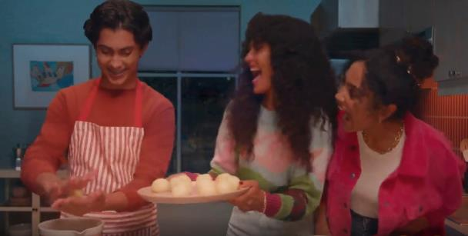
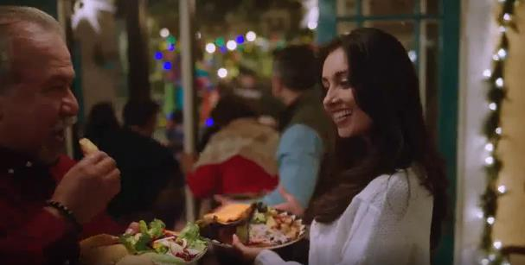
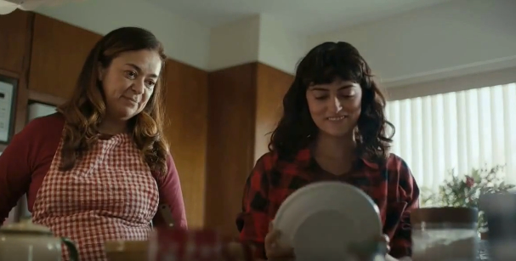
These real-world campaigns highlighting cultural traditions and authentic Hispanic celebrations show how brands who tailor their messaging with personalized, authentic stories can better engage with Hispanics
Holiday-related campaigns with Spanish-language messaging and authentic Hispanic stories
Ad Attention Index against total P18+
‘Ven por ingredientes’ TV Spot
(Flight duration: 11/7/2021-12/21/2021)
‘Navidea y come de todo’ TV Spot
(Flight duration: 11/8/2021-12/24/2021)
‘The Recipe’ TV Spot
(Flight duration: 11/1/2021-12/31/2021)
119
Ad Attention Index
110
Ad Attention Index
108
Ad Attention Index
How to read: ‘Ven por ingredientes’ (119 index) had 19% less interruptions than other ads in the context of the media placement with a 100 score being average.
Source: Creative from iSpot.tv, time period of airing 11/1/21 – 12/31/21, Ad Attention Index within iSpot.tv’s Attention Analytics. Index scale is 0-200 with an 100 index seeing ad performance as expected. Note: Ad Attention Index is based on total viewers, not specifically Hispanic or Spanish-language consumers. Click above images to watch TV spots.
This information is exclusively provided to VAB members and qualified marketers. Further distribution is prohibited.
PAGE 24

Slide 25

People love the holidays and value their time with family and friends to enjoy these moments of celebration which is why holiday-related spending
is projected to be even higher than last year’s record-setting sales
Although inflation continues to be a concern among consumers, people are eager to return to a sense of normalcy, even when it comes to buying high-priced luxury items (despite economic uncertainty) or going out and shopping at ‘brick and mortar’ stores again (despite higher gas prices)
During the holiday season, marketers can further engage with the growing, and influential, Hispanic community through authentic messaging and storytelling that embraces their cultural heritage
and interests in family, traditions and celebrations
Key Marketer Takeaways
This information is exclusively provided to VAB members and qualified marketers. Further distribution is prohibited.
PAGE 25

Slide 26
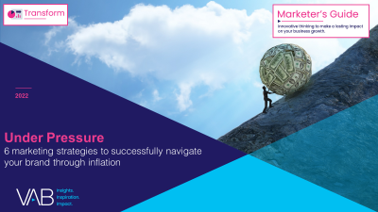
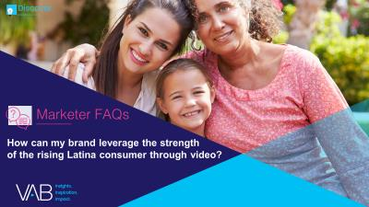
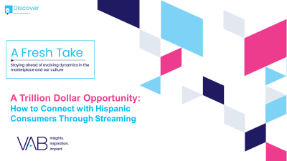

Creators
Jason Wiese
Leah Montner-Dixon
SVP, Director of Strategic Insights
jasonw@thevab.com
Associate Insights Director
leahm@thevab.com
Reed Kiely
Karolina Guillen
Associate Insights Director
reedk@thevab.com
Insights Manager
karolinag@thevab.com
Discover more
Looking for more data, insights and takeaways? Check out this related VAB content
Under Pressure
6 Marketing Strategies to Successfully Navigate Your Brand Through Inflation
How Can My Brand Leverage the Strength of the Rising Latina Consumer Through Video?
A Trillion Dollar Opportunity
How to Connect with Hispanic Consumers Through Streaming
Do The Right Thing
How Diversity & Inclusion Drives Brand Outcomes
VAB Members, brand marketers and agencies get free and immediate access to VAB’s content library. Get access at theVAB.com
This information is exclusively provided to VAB members and qualified marketers. Further distribution is prohibited.
PAGE 26

Slide 27


About VAB
VAB is an insights-driven organization that inspires marketers to reimagine their media strategies resulting in fully informed decisions.
Drawing on our marketing expertise, we simplify the complexities in our industry and discover new insights that transform the way marketers look at their media strategy.
We are committed to your business growth and proud to offer VAB members, brand marketers and agencies complimentary access to our continuously-growing Insights library. Get immediate access at theVAB.com.
Curious to learn more about VAB? Check out this quick video to see what we do and how we can help you develop business-driving marketing strategies.
This information is exclusively provided to VAB members and qualified marketers. Further distribution is prohibited.
PAGE 27

