Slide 1

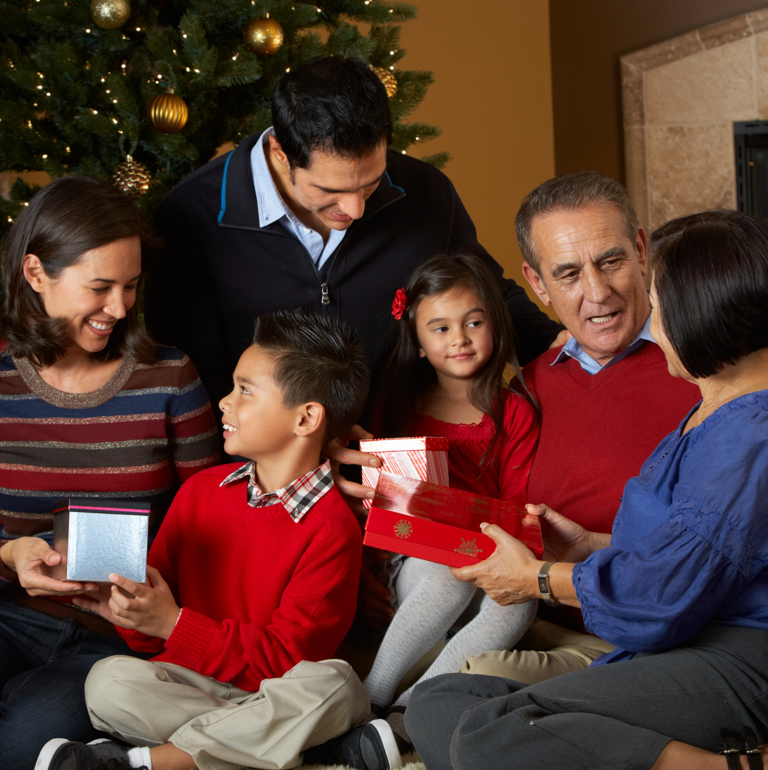




How will engaging Hispanic shoppers help me win the holiday season?
Marketer FAQs

Slide 2
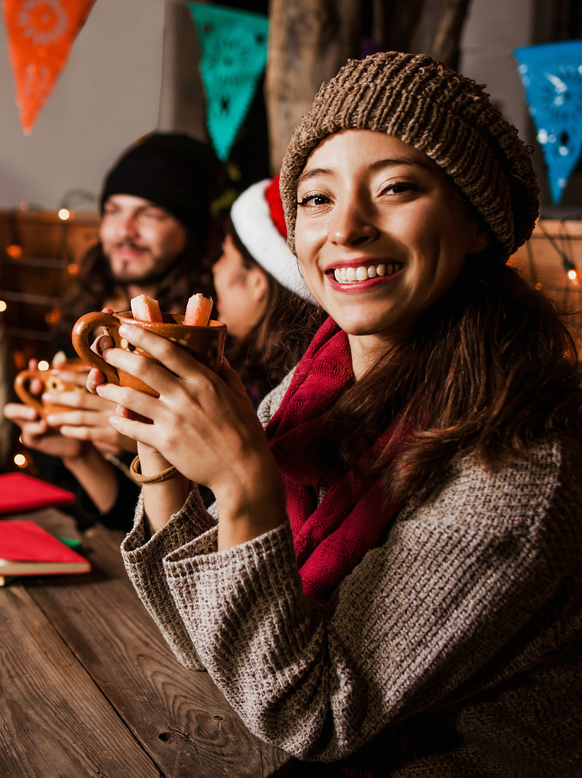

No matter the circumstances, people love the holidays.
While inflation is a top concern for many, consumers continue to look forward to the holiday season as a special occasion to celebrate with family and friends. This includes opening their wallets to buy gifts and spend across holiday-related categories for social gatherings, despite economic uncertainties.
The holidays are especially important to Hispanic consumers, and marketers can best connect with this segment by creating authentic campaigns that highlight their unique cultural traditions and holiday celebrations to drive higher attention and deeper engagement.
This information is exclusively provided to VAB members and qualified marketers. Further distribution is prohibited.
PAGE 2

Slide 3

6 reasons Hispanics will be driving brand growth during the holidays
This passionate community, rooted in their culture and traditions, embraces all aspects of the holiday season

Slide 4





Reason 1: In addition to their population growth and larger household size, Hispanic consumers are a valuable audience for marketers due to their increased spending power
m
Hispanic population has grown by over 10 million people during
the last 10 years
Hispanics live in larger HHs than non-Hispanics*
Hispanic consumer buying power has increased 69% since 2001**
There will be an estimated
66.5 million Hispanics in the U.S. by January 2023, accounting for 20% of the total population
(vs. 54.5 MM, or 17%, in 2013)
3.8 average HH size vs. 2.8
for non-Hispanics
Average annual household expenditures
2001
2011
2021
$34,361
$42,086
$57,955
+22%
vs. 2001
+69%
vs. 2001
Source: Claritas, The 2022 Hispanic Market Report and VAB analysis of U.S. Census Bureau data, 2017. *VAB analysis of MRI-Simmons Spring 2022 Doublebase, Non-Hispanic A18+ vs. A18+ of Spanish or Hispanic origin (17% of A18+ population). **VAB analysis of Bureau of Labor Statistics data, Table 2200. Hispanic or Latino origin of reference person: Annual expenditure means, shares, standard errors, and coefficients of variation, Consumer Expenditure Surveys, 2001, 2011 & 2021.
This information is exclusively provided to VAB members and qualified marketers. Further distribution is prohibited.
PAGE 4

Slide 5
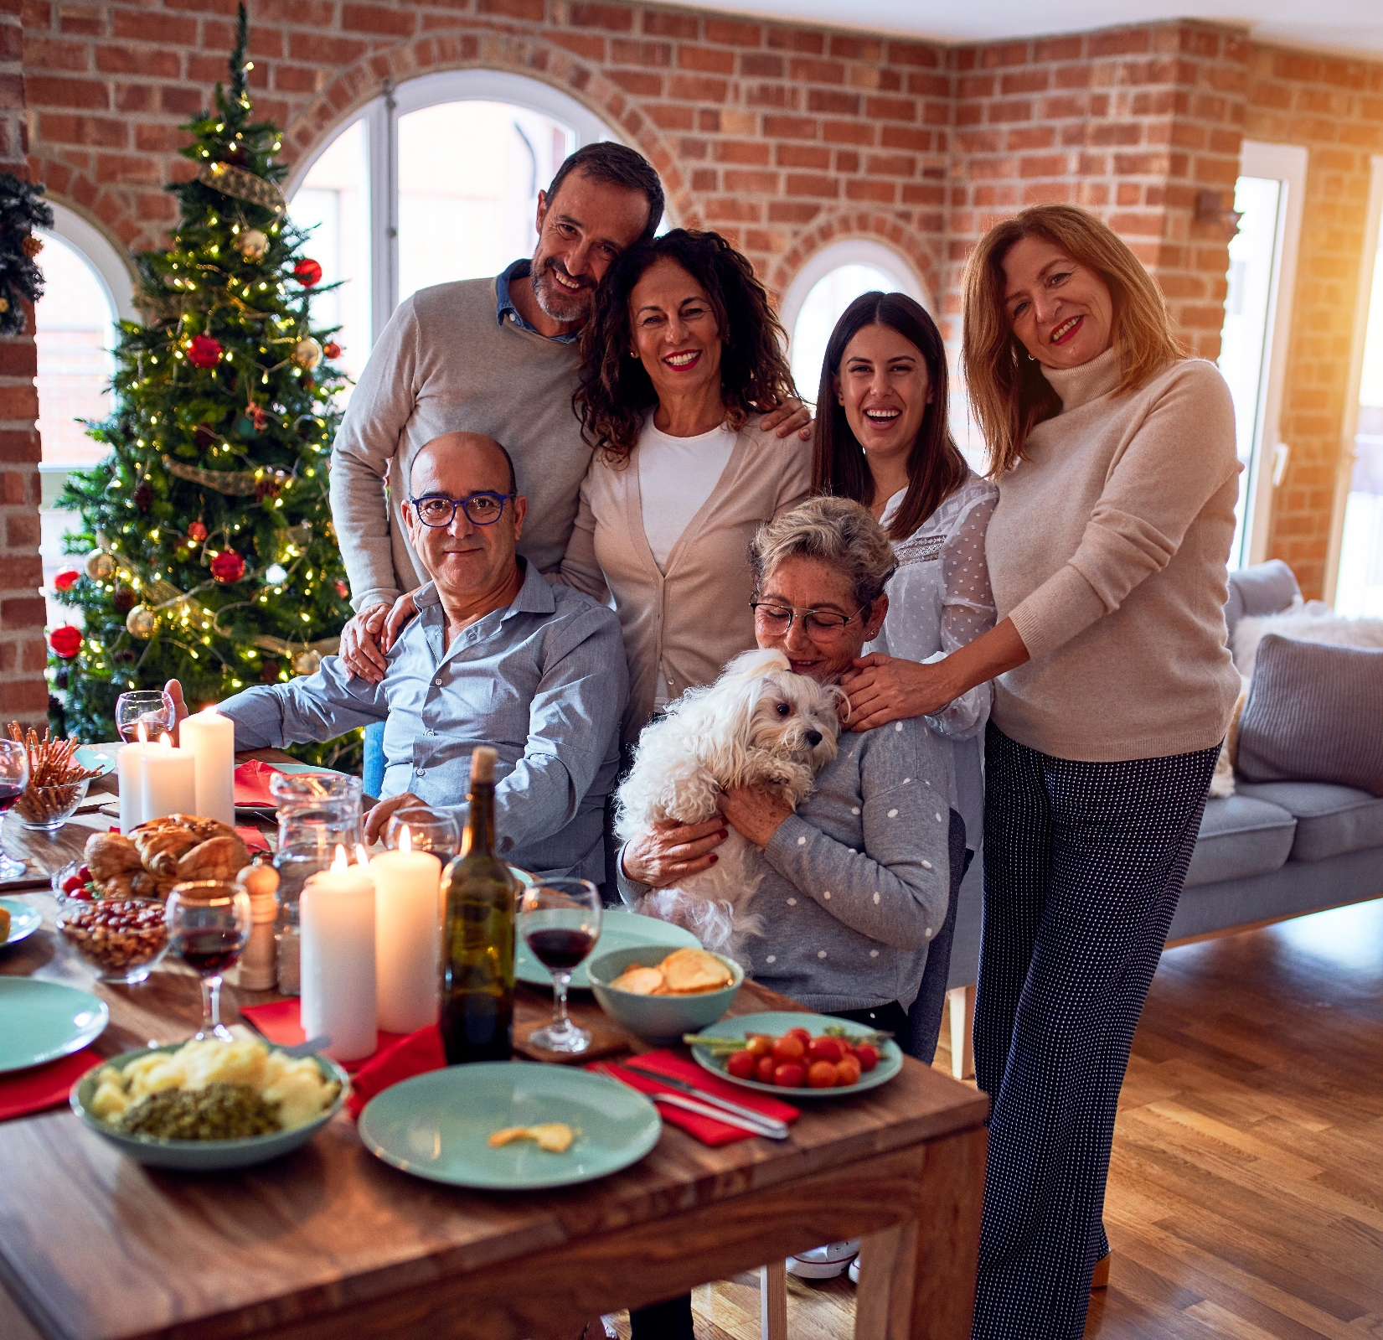







Reason 2: Hispanics have such an immense love for the holidays that even the most passionate fútbol fanatics rank Christmas above the
World Cup as their favorite celebration
Favorite celebrations among Hispanic enthusiasts
Percentage of enthusiasts who rank these celebrations as their top 3 favorites
Source: Telemundo, The Future is Fútbol, 2022 report. Based on 1,351 completed interviews among 967 Latinos and 384 non-Latinos, representative of soccer followers in the U.S., fielded February 2022.
This information is exclusively provided to VAB members and qualified marketers. Further distribution is prohibited.
PAGE 5

Slide 6



Reason 3: Their cultural heritage and traditions are a source of great pride and, as they gather to celebrate both American and Hispanic holidays,
they are willing to spend their time and money to make them extra special
Hispanics value their culture and heritage
and enjoy sharing it with others
Celebrating their heritage is a major part
of their holiday activities
84%
‘enjoy sharing my
Hispanic / Latino heritage
with other Hispanic / Latinos or
my non-Latino friends’
78%
agree that ‘my cultural / ethnic heritage is an important
part of who I am’
(vs. 56% NH)
88%
‘often celebrate U.S. National holidays such as the Fourth of July and President’s Day or holidays from Hispanic countries’
30%
are more likely to ‘include
cultural traditions in their holiday celebrations,’ - driving them to buy food items and decorations to make the festivities even more special
Source: VAB analysis of MRI-Simmons Spring 2022 Doublebase Study, based on non-Hispanic A18+ vs. A18+ of Spanish or Hispanic origin (17% of A18+ population).
This information is exclusively provided to VAB members and qualified marketers. Further distribution is prohibited.
PAGE 6

Slide 7

Reason 4: Their fervent holiday spirit means that Hispanic consumers
are planning to spend one-third more than the average adult on holiday shopping this year
Holiday Shopping Spend in 2022 vs. 2021
% of U.S. Adults
+34%
Spend on the holiday season
by Hispanic adults vs.
the average adult
$1,392 vs. $1,041
(+$351)
Source: Samba TV, 2022 Holiday Report. Based on HarrisX online survey of 2,505 U.S. adults, fielded 8/29/22 – 9/1/22.
This information is exclusively provided to VAB members and qualified marketers. Further distribution is prohibited.
PAGE 7

Slide 8












Reason 5: Hispanics are spending much more annually across many categories that are also popular during the holiday season – like toys, apparel and alcoholic beverages or food for communal gatherings
% Growth of Hispanic Annual Aggregate Expenditures by Category: 2021 vs. 2019 (pre-pandemic)
compared to growth among non-Hispanics
(2021 Hispanic aggregate expenditures in billions)
+84% YOY
vs. +10% NH
($10.6B)
+73% YOY
vs. +39% NH
($4.0B)
+33% YOY
vs. -11% NH
($14.9B)
+32% YOY
vs. +30% NH
($40.7B)
Pets
Toys, hobbies & playground equipment
Women & girls apparel
Household furnishings
+30% YOY
vs. +8% NH
($99.3B)
+20% YOY
vs. -9% NH
($11.9B)
+19% YOY
vs. -6% NH
($8.1B)
+19% YOY
vs. +9% NH
($4ll.0B)
Vehicle purchases
Men and boys apparel
Alcohol beverages
Housing
+19% YOY
vs. -1% NH
($17.3B)
+17% YOY
vs. +14% NH
($24.8B)
+8% YOY
vs. +6% NH
($13.0B)
+5% YOY
vs. +3% NH
($27.6B)
Audio & visual equipment & services
Meats, poultry, fish, and eggs
Housekeeping supplies
Cellphone services
Source: VAB analysis of Bureau of Labor Statistics data, Table 2200. Hispanic or Latino origin of reference person: Shares of annual aggregate expenditures and sources of income, Consumer Expenditure Surveys, 2019 & 2021.
This information is exclusively provided to VAB members and qualified marketers. Further distribution is prohibited.
PAGE 8

Slide 9




Reason 6: Hispanic consumers provide a halo effect for brands as their influence extends to a larger circle of non-Hispanic friends and online communities who look to them for advice, opinions and reviews
Hispanic Consumer Profile
Hispanic index vs. non-Hispanics
Early Adopters
Technology Ambassadors
146 index
‘I'm always one of the first of my friends to try new products or services’
147 index
‘People often ask my opinion when they are buying new technology’
Influential Advisors
Online Advocates
140 index
‘People come to me for advice before buying new things’
134 index
‘I like to share my opinions about products and services by posting reviews and ratings online’
How to read: Hispanics are 46% more likely to agree that ‘I’m always one of the first of my friends to try new products or services’ than non-Hispanics (146 index)
Source: VAB analysis of MRI-Simmons Summer 2022 USA Study. Based on psychographics and buying style data for Hispanic Americans (A18+ of Hispanic or Spanish origin (17% of A18+ population)) and non-Hispanic adults 18+. Indices based on ‘any agree’ responses for each question.
This information is exclusively provided to VAB members and qualified marketers. Further distribution is prohibited.
PAGE 9

Slide 10

Marketers looking to engage the growing, passionate, influential Hispanic segment can connect with them through impactful, authentic messaging

Slide 11


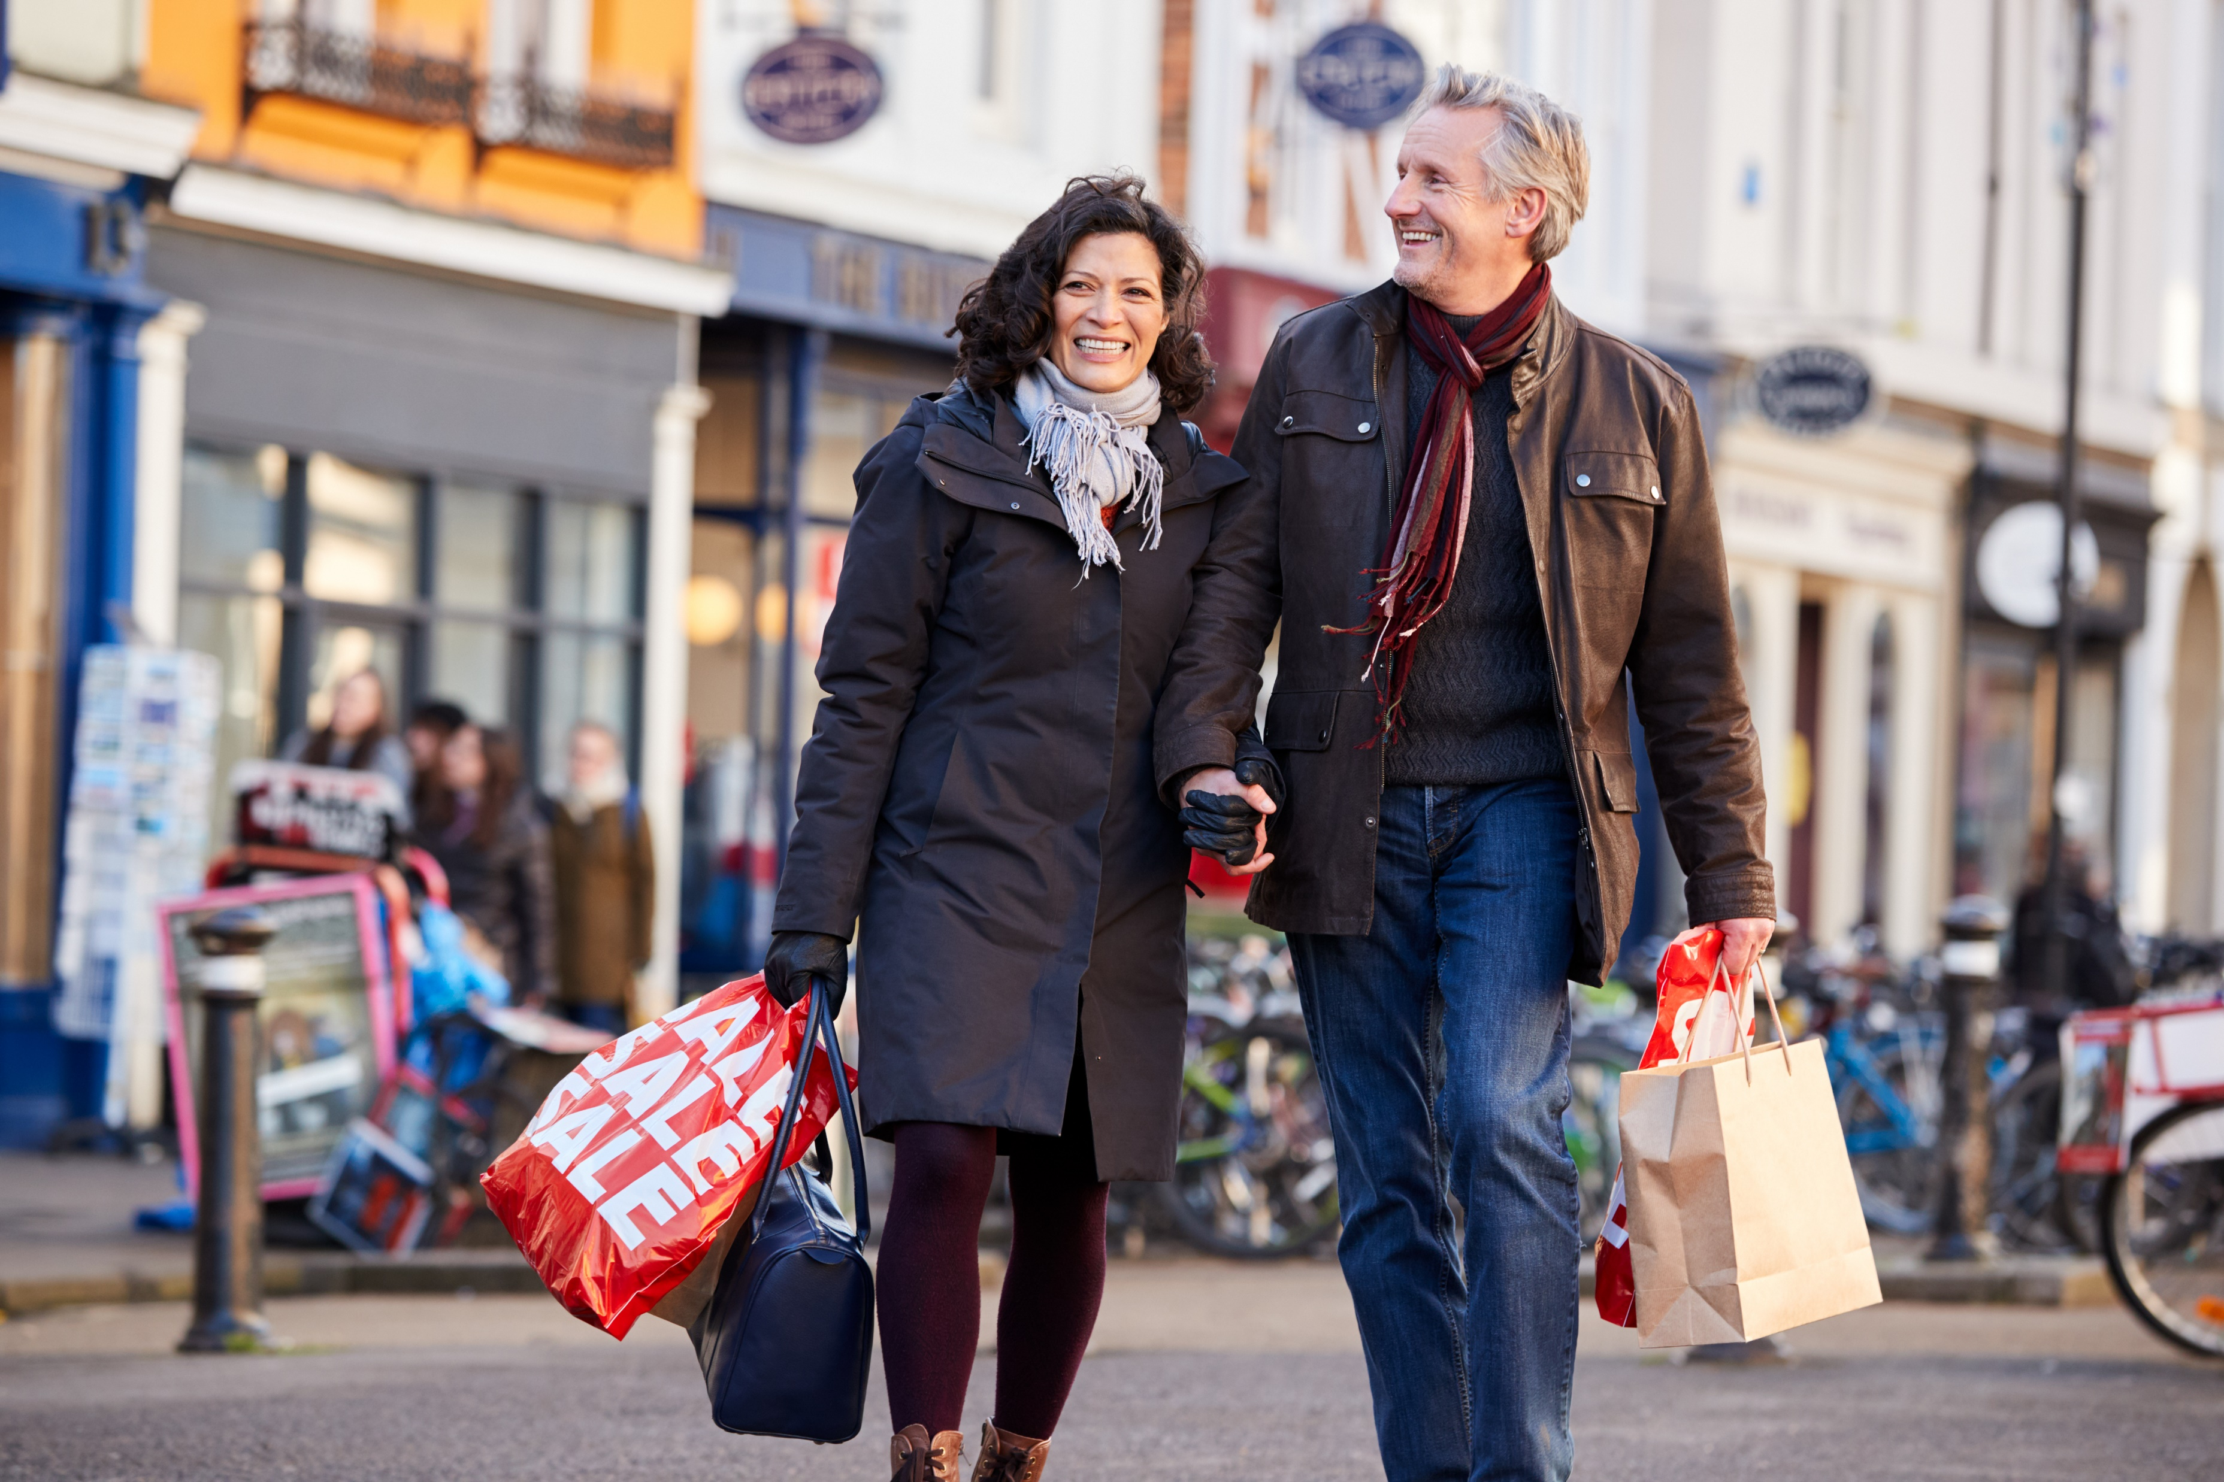


Marketers can drive engagement and sales by creating authentic campaigns that are inclusive of the Hispanic community’s cultural traditions
Hispanics are more likely to value authentic messaging in their native language, which drives greater memorability and higher purchase intent
% of Hispanics who agree with the following statements
65%
‘I believe that companies who advertise in Spanish respect my culture and want my business’
55%
‘I am more likely to be loyal to a company that makes an effort to advertise in Spanish’
50%
‘When a product or service is advertised in Spanish, I am more likely to pay attention to the advertisement and remember it later’
37%
‘Advertisements in Spanish are the best source of information when I’m purchasing products or services’
Source: MRI-Simmons, Spring 2022 Doublebase Study, A18+ of Spanish or Hispanic origin (17% of A18+ population).
This information is exclusively provided to VAB members and qualified marketers. Further distribution is prohibited.
PAGE 11

Slide 12



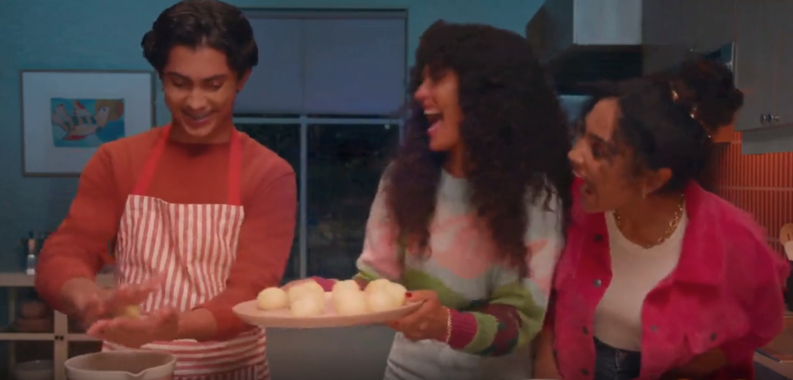
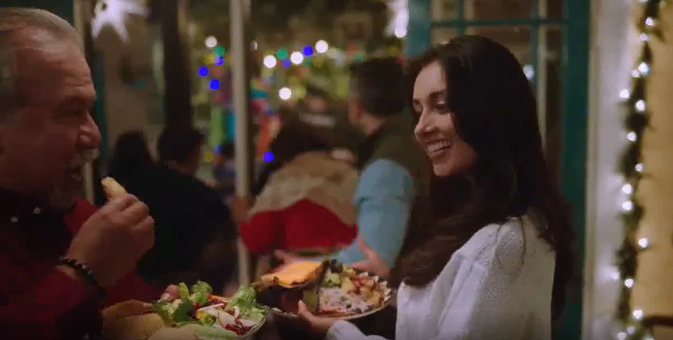
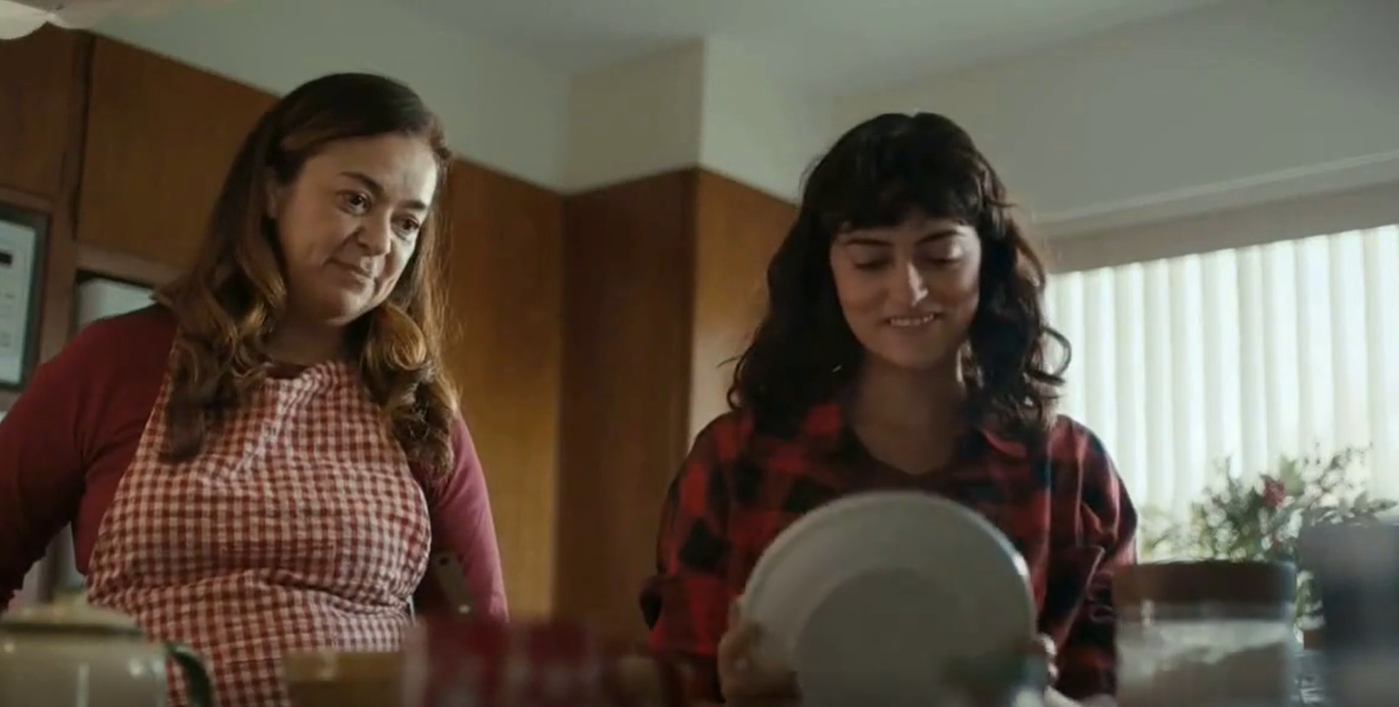
These real-world campaigns highlighting cultural traditions and authentic Hispanic celebrations show how brands who tailor their messaging with personalized, authentic stories can better engage with Hispanics
Holiday-related campaigns with Spanish-language messaging and authentic Hispanic stories
Ad Attention Index against total P18+
‘Ven por ingredientes’ TV Spot
(Flight duration: 11/7/2021-12/21/2021)
‘Navidea y come de todo’ TV Spot
(Flight duration: 11/8/2021-12/24/2021)
‘The Recipe’ TV Spot
(Flight duration: 11/1/2021-12/31/2021)
119
Ad Attention Index
110
Ad Attention Index
108
Ad Attention Index
How to read: ‘Ven por ingredientes’ (119 index) had 19% less interruptions than other ads in the context of the media placement with a 100 score being average.
Source: Creative from iSpot.tv, time period of airing 11/1/21 – 12/31/21, Ad Attention Index within iSpot.tv’s Attention Analytics. Index scale is 0-200 with an 100 index seeing ad performance as expected. Note: Ad Attention Index is based on total viewers, not specifically Hispanic or Spanish-language consumers. Click above images to watch TV spots.
This information is exclusively provided to VAB members and qualified marketers. Further distribution is prohibited.
PAGE 12

Slide 13
Hispanics are a valuable audience for marketers looking to drive growth this season because,
in addition to their increased buying power, they spend much more than the average adult during the holidays which is spread across a variety
of ‘gifting’ and other holiday-related categories
During the holiday season, marketers can further engage with the growing, and influential, Hispanic community through authentic messaging and storytelling that embraces their cultural heritage and interests in family, traditions and celebrations
Key Marketer Takeaways
This information is exclusively provided to VAB members and qualified marketers. Further distribution is prohibited.
PAGE 13

Slide 14

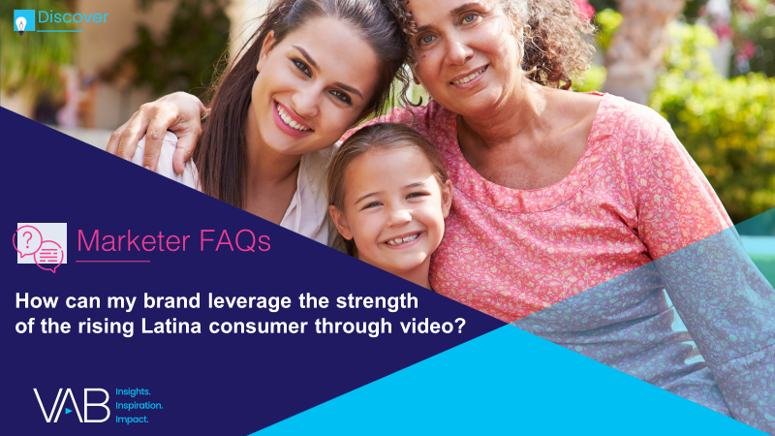
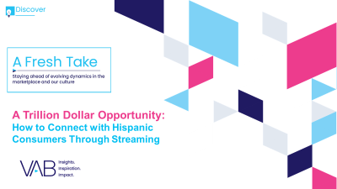
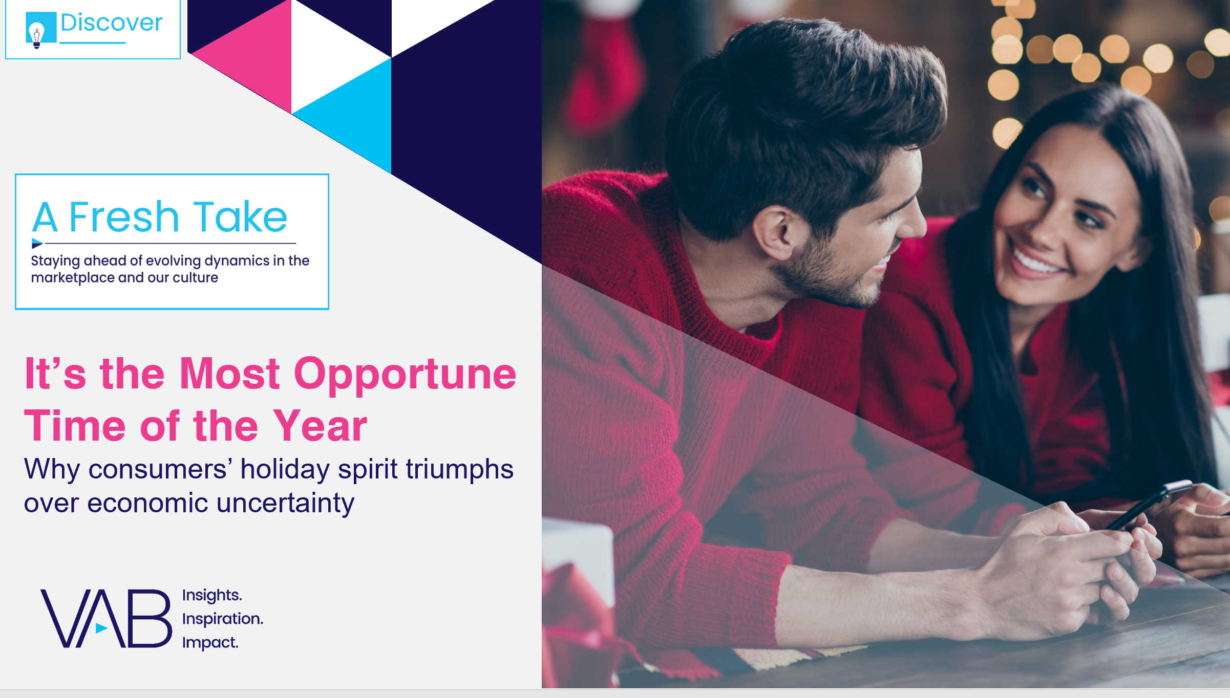
Creators
Jason Wiese
Leah Montner-Dixon
SVP, Director of Strategic Insights
jasonw@thevab.com
Associate Insights Director
leahm@thevab.com
Reed Kiely
Karolina Guillen
Associate Insights Director
reedk@thevab.com
Insights Manager
karolinag@thevab.com
Discover more
Looking for more data, insights and takeaways? Check out this related VAB content
Under Pressure
6 Marketing Strategies to Successfully Navigate Your Brand Through Inflation
How Can My Brand Leverage the Strength of the Rising Latina Consumer Through Video?
A Trillion Dollar Opportunity
How to Connect with Hispanic Consumers Through Streaming
It’s the Most Opportune Time of the Year
Why consumers’ holiday spirit triumphs over economic uncertainty
VAB Members, brand marketers and agencies get free and immediate access to VAB’s content library. Get access at theVAB.com
This information is exclusively provided to VAB members and qualified marketers. Further distribution is prohibited.
PAGE 14

Slide 15


About VAB
VAB is an insights-driven organization that inspires marketers to reimagine their media strategies resulting in fully informed decisions.
Drawing on our marketing expertise, we simplify the complexities in our industry and discover new insights that transform the way marketers look at their media strategy.
We are committed to your business growth and proud to offer VAB members, brand marketers and agencies complimentary access to our continuously-growing Insights library. Get immediate access at theVAB.com.
Curious to learn more about VAB? Check out this quick video to see what we do and how we can help you develop business-driving marketing strategies.
This information is exclusively provided to VAB members and qualified marketers. Further distribution is prohibited.
PAGE 15

