Slide 1





Hidden Costs
Three critical business ramifications
of digital ad fraud

Slide 2
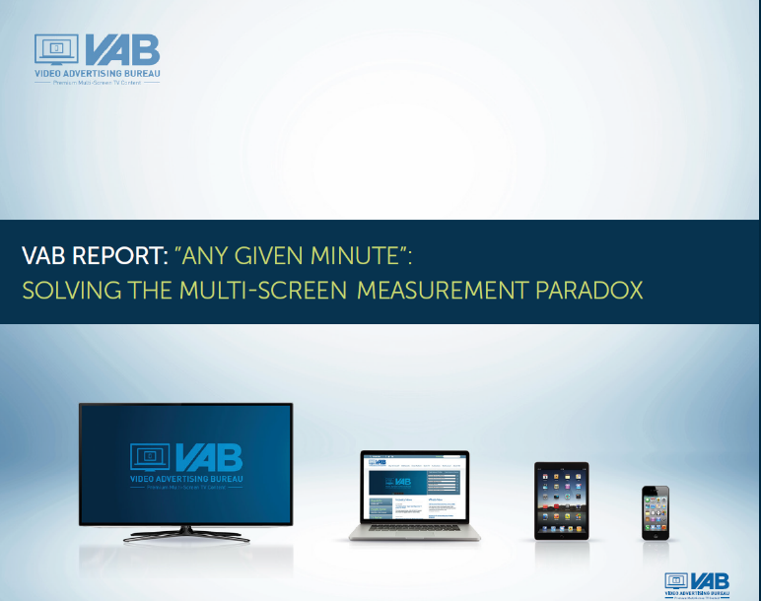
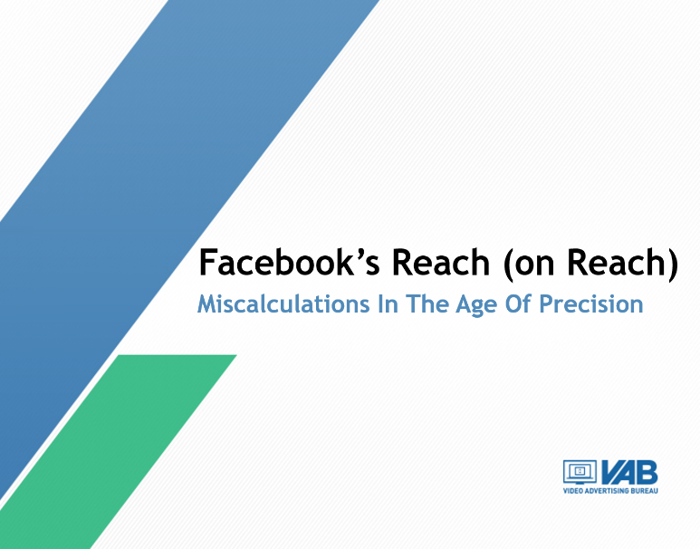
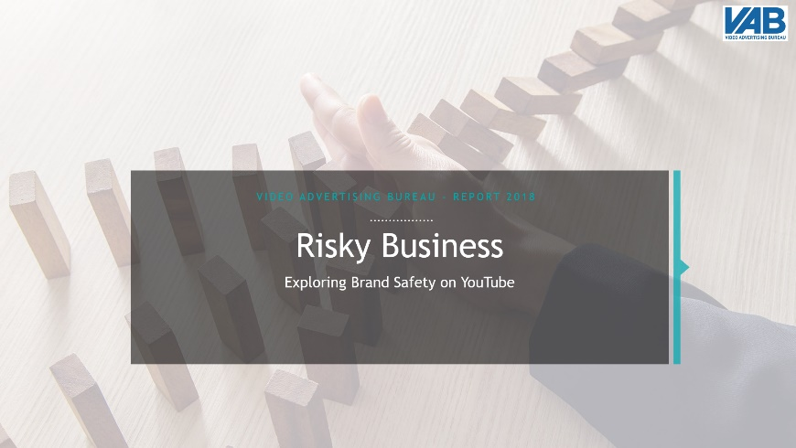
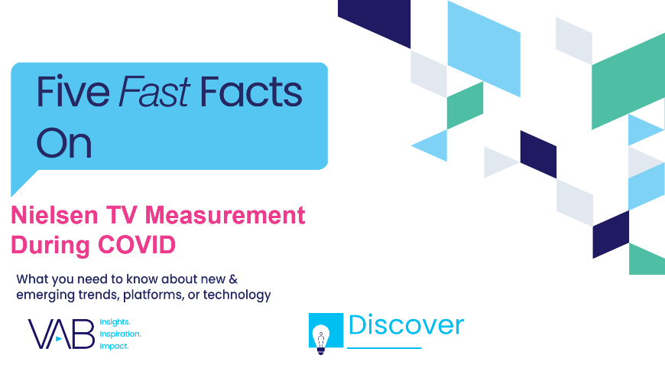
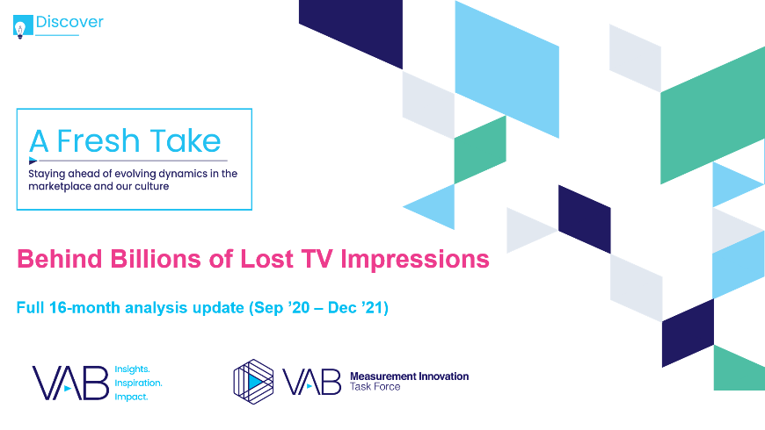
In the past decade, VAB has uncovered measurement disparities and inaccuracies hiding in plain sight
VAB insights reports on the advertiser impact of transparency issues across the video landscape
2016
2017
2018 & 2019
2021
2022
Any Given Minute:
Solving the Multi-Screen Measurement Paradox
Facebook’s Reach (on Reach): Miscalculations in the Age
of Precision
Risky Business:
Exploring Brand Safety
on YouTube
Five Fast Facts On:
Nielsen TV Measurement During Covid
A Fresh Take:
Behind Billions
of Lost TV Impressions
Analysis on comparable metrics and avg media consumption between multi-screen TV brands and digital ad-tech (like Yahoo!).
Analysis of Facebook’s reach inflation on the state, city and zip code level and potential implications for advertisers.
An in-depth look at YouTube and the brand safety issues that arose with several instances of advertisers running within highly objectionable video content.
Analysis on how the suspension of in-home maintenance for the Nielsen panel may have cost the Nat’l TV marketplace between $468MM - $2.3B in ad spend.
Analysis quantifying the extent of undercounting due to OOH TV viewing for BBO homes not being included in Nielsen estimates for 16 months (~$690MM).
This information is exclusively provided to VAB members and qualified marketers.
PAGE 2

Slide 3



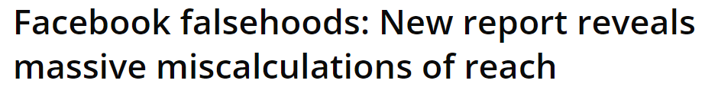
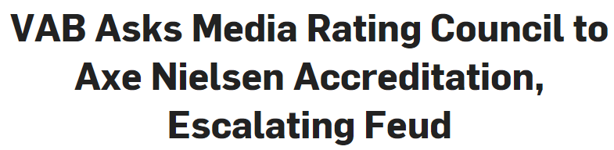
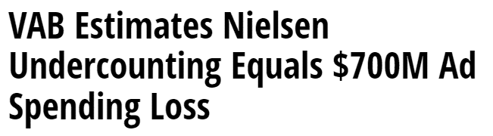

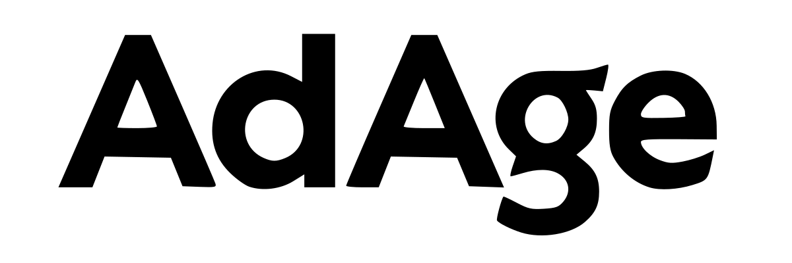
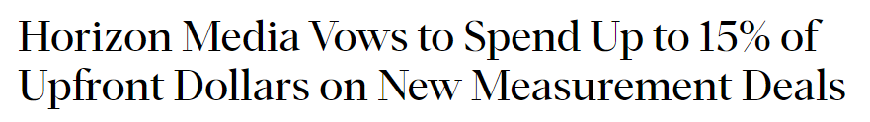
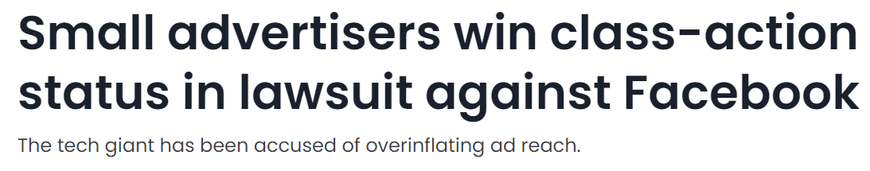

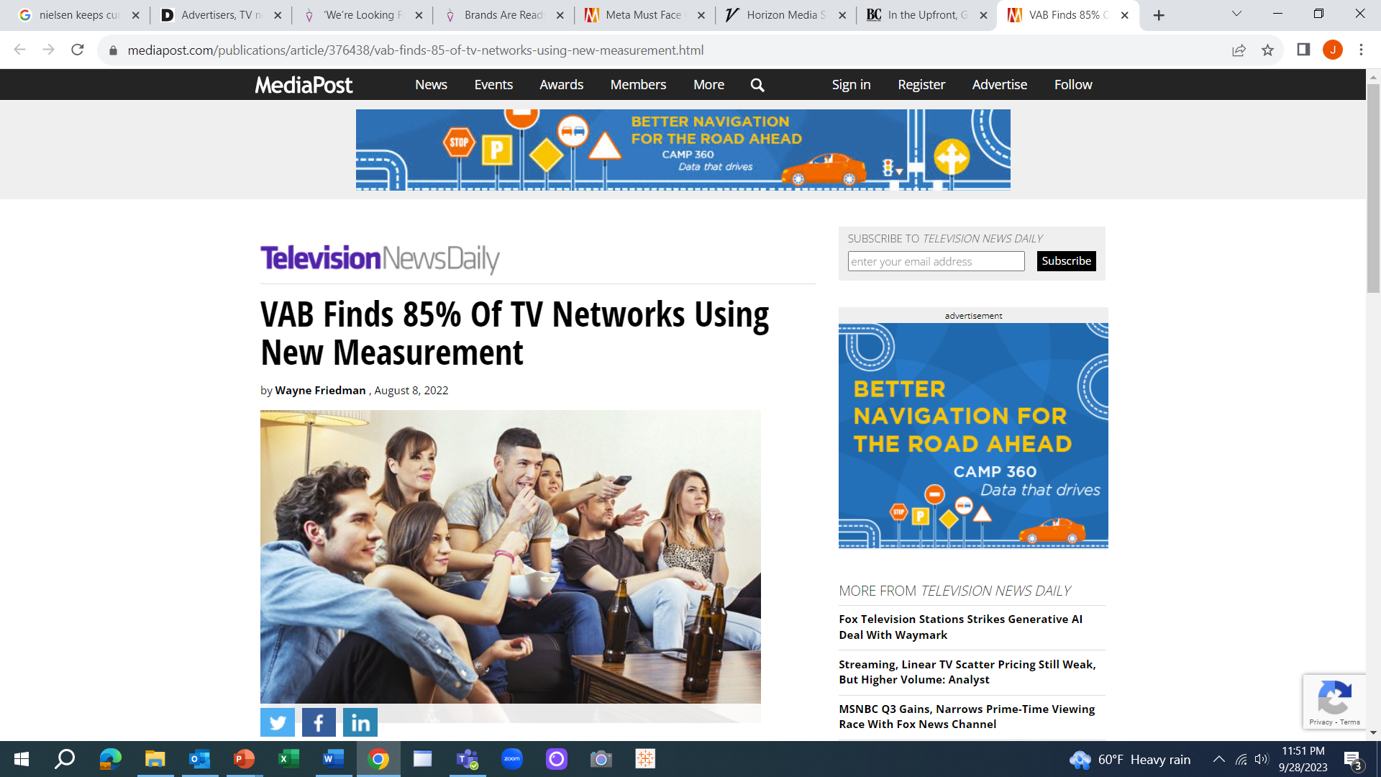
Our analyses have resulted in industry actions that were taken to improve transparency and evolve towards more modern measurement solutions
Facebook’s inflated reach metrics led to a class-action lawsuit
Nielsen Covid-era panel mismanagement led to accreditation suspension
Nielsen OOH TV undercounting led to the rise of alternative measurement solutions
October 5, 2017
July 21, 2021
January 26, 2022
April 1, 2022
April 19, 2022
April 19, 2022
September 1, 2021
August 8, 2022
This information is exclusively provided to VAB members and qualified marketers.
PAGE 3

Slide 4


In today’s converged world, we turn our attention to the $84 billion ad fraud marketplace
The impact of ad fraud, and the inherent transparency issues that come along with it, go well beyond lost advertising investment and a missed opportunity with customers.
There are serious financial, brand reputation and legal ramifications associated with fraudulent digital video campaigns.
This report seeks to explore these ‘hidden cost’ issues through tangible examples and provide guidance on how to avoid the corporate risk involved in the lack of transparency that often leads to fraudulent ad activity.
This information is exclusively provided to VAB members and qualified marketers.
PAGE 4

Slide 5
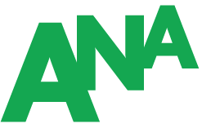
Although reports of rampant ad fraud have been well reported for over a decade, the issue and severity have escalated
Sampling of Major Digital Ad-Tech Transparency Issues & Ad Fraud Over the Last Decade
AppNexus
After filtering its ad inventory for fraud, AppNexus claims it saw transactions drop 65% due to the company encouraging sellers to only resell inventory bought directly from publishers.
Facebook Ad Manager
The platform inflated the ‘potential reach’ ad metric, which gave advertisers a false idea of campaign reach, which was even larger than populations of areas in some cases.
Click here to learn more in VAB’s
‘Facebook’s Reach (on Reach)’
Programmatic
Programmatic ad data shows that an estimated $2.6B is being sent to publishers of misinformation and disinformation annually (false health claims, anti-vaccine myths, election misinformation).
Google / YouTube
Google violated its standards in ad deals as Adalytics data uncovered that ~80% of Google’s video-ad placements on third-party sites violated promised standards for over 1,100 brands examined.
2015
2016
2017
2018
2019
2020
2021
2022
2023
YouTube
Marketers pulled their spending after finding their ads running alongside questionable content, including P&G airing before an ISIS recruitment video.
Click here to learn more in VAB’s
‘Risky Business: Exploring Brand Safety on YouTube’
Facebook Video
Facebook knowingly inflated their video metrics by 150% to 900% through falsely calculated viewership which inflated the advertiser metrics by 60% to 80%, leading to a $40 Million settlement.
Gannet
USA Today owned publishing company Gannett Co. misrepresented where billions
of ads were placed and
provided inaccurate information
to advertisers for nine months.
Programmatic
A study by the ANA found that
25% of open web programmatic advertising was wasted on spending in opaque supply chains and ‘Made for Advertising’ websites
Source: Digiday, After filtering for fraud, AppNexus transactions fell by 65 percent, 9/15/15. Human Security, The Drum, Procter & Gamble, Anheuser-Busch ads run with Isis recruitment videos on YouTube, 3/5/15. Methbot: Then and Now, 7/1/21. CNBC, Facebook knew ad metrics were inflated, but ignored the problem to make more money, lawsuit claims, 2/18/21. VAB, Facebook’s Reach (on reach), 10/2/17. Fortune, Facebook Will Pay $40 Million to Settle Advertiser Lawsuits Claiming It Inflated Video Views By Up to 900%, 10/7/19. NewsGuard, Special Report: Top brands are sending $2.6 billion to misinformation websites each year,’8/23/21. Wall Street Journal, USA Today Owner Gannett Co. Gave Advertisers Inaccurate Information for Nine Months, 3/11/22. New York Times, Google Violated Its Standards in Ad Deals, Research Finds, 6/27/23. ANA, Programmatic Media Supply Chain Transparency Study – Complete Report, December 2023.
This information is exclusively provided to VAB members and qualified marketers.
PAGE 5

Slide 6
It is now estimated marketers are collectively wasting billions of dollars on single platforms
Sampling of Major Digital Ad-Tech Transparency Issues & Ad Fraud Over the Last Decade
AppNexus
-65%
drop in transactions after shift to publisher direct purchasing
Facebook Ad Manager
60 Million
users overinflated in their ‘potential reach’ metric
Programmatic
$2.6 Billion
is being sent to publishers of misinformation annually
Google / YouTube
Billions
of dollars in ad spend that violated promised standards
2015
2016
2017
2018
2019
2020
2021
2022
2023
YouTube
Millions
of ad dollars pulled after ads ran alongside extremist content
Facebook Video
150% - 900%
inflation to their video metrics
Gannet
Billions
of ads had their placements misrepresented
Programmatic
$22 Billion
of ad spend wasted, 46% of which went to ‘Made For Advertising’ sites
Source: Digiday, After filtering for fraud, AppNexus transactions fell by 65 percent, 9/15/15. Human Security, The Drum, Procter & Gamble, Anheuser-Busch ads run with Isis recruitment videos on YouTube, 3/5/15. Methbot: Then and Now, 7/1/21. CNBC, Facebook knew ad metrics were inflated, but ignored the problem to make more money, lawsuit claims, 2/18/21. VAB, Facebook’s Reach (on reach), 10/2/17. Fortune, Facebook Will Pay $40 Million to Settle Advertiser Lawsuits Claiming It Inflated Video Views By Up to 900%, 10/7/19. NewsGuard, Special Report: Top brands are sending $2.6 billion to misinformation websites each year,’8/23/21. Wall Street Journal, USA Today Owner Gannett Co. Gave Advertisers Inaccurate Information for Nine Months, 3/11/22. New York Times, Google Violated Its Standards in Ad Deals, Research Finds, 6/27/23. ANA, Programmatic Media Supply Chain Transparency Study – Complete Report, December 2023.
This information is exclusively provided to VAB members and qualified marketers.
PAGE 6

Slide 7
Marketers acknowledge that trust, transparency and ad fraud are among the major challenges with their digital media activity
Which of the following will be major digital media challenges for your organization?
Source: Integral Ad Science (IAS), The 2023 Industry Pulse Report, December 2022. Based on October 2022 IAS / YouGov survey of U.S. digital media experts who use programmatic advertising (n=356). Q. Which of the following will be major digital media challenges for your organization in the next 12 months? (select up to three); reflects buy-side and ad-tech respondents, excludes publishers. *Includes high rates of consumers opting out of in-app data, data privacy legislation, deprecation of third-party cookies. **includes ads delivered alongside risky content, advertising adjacent to fake news and misinformation.
This information is exclusively provided to VAB members and qualified marketers.
PAGE 7

Slide 8

The concern for ad fraud among marketers is prevalent across digital channels
Which media types will be most vulnerable to ad fraud in the next 12 months?
Source: Integral Ad Science (IAS), The 2023 Industry Pulse Report, December 2022. Based on October 2022 IAS / YouGov survey of U.S. digital media experts who use programmatic advertising (n=356). Q. Which of the following media types will be most vulnerable to ad fraud in the next 12 months? (select up to three).
This information is exclusively provided to VAB members and qualified marketers.
PAGE 8

Slide 9
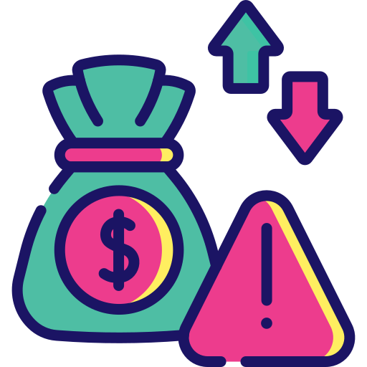



However, many marketers are not aware or prepared for the business ramifications associated with ad fraud and the lack of transparency
1
2
3
Financial
Risk
Brand Reputational
& Corporate Risk
Legal
Risk
This information is exclusively provided to VAB members and qualified marketers.
PAGE 9

Slide 10

1
Ad fraud and lack of digital ad-tech transparency put brands at financial risk

Slide 11
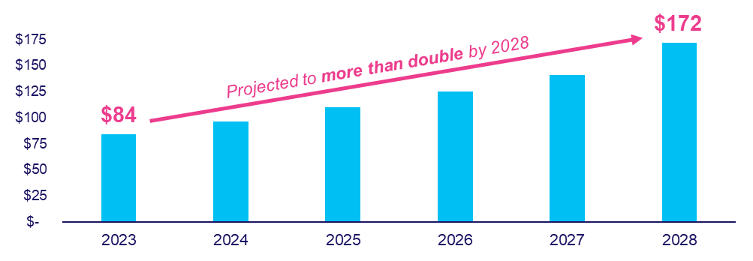
In 2023, the estimated global cost of digital ad fraud is $84 billion and is projected to more than double over the next five years
Estimated Global Cost of Digital Ad Fraud
$ in Billions
$35 billion projected in North America alone (2023)
$72 billion projected in North America alone (2028)
Source: Juniper Research, Quantifying the Cost of Ad Fraud: 2023-2028, 9/26/2023.
This information is exclusively provided to VAB members and qualified marketers.
PAGE 11

Slide 12


Ad fraud accounts for a significant share of digital ad spending and almost $1 out of every $3 dollars being spent in mobile is fraudulent
% of Global Digital Ad Spend Lost to Ad Fraud in 2023
by platform
22%
of digital ad spend
30%
of mobile ad spend
Source: Juniper Research, Quantifying the Cost of Ad Fraud: 2023-2028, 9/26/2023.
This information is exclusively provided to VAB members and qualified marketers.
PAGE 12

Slide 13

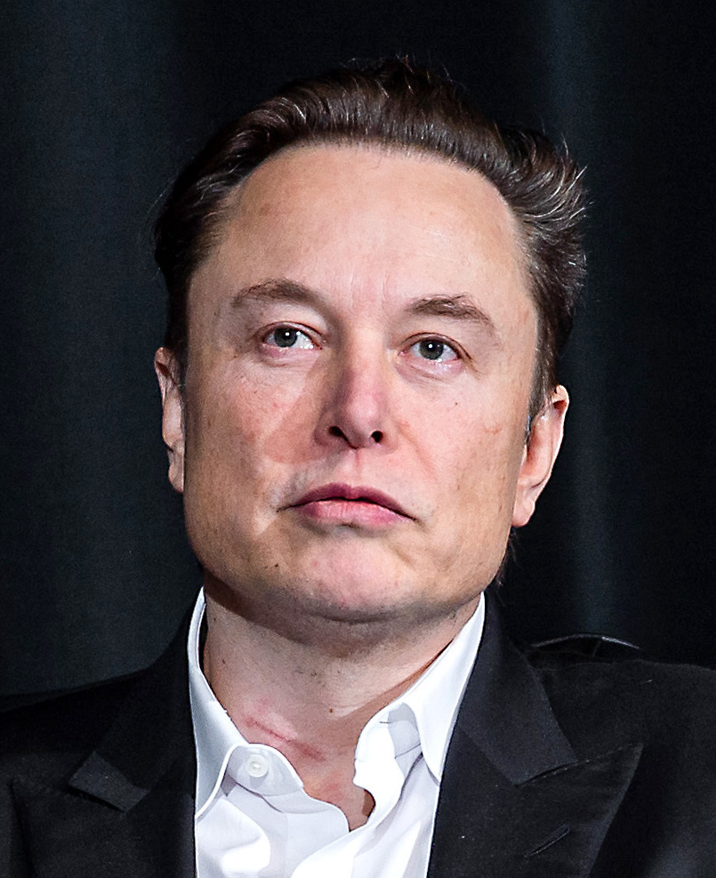
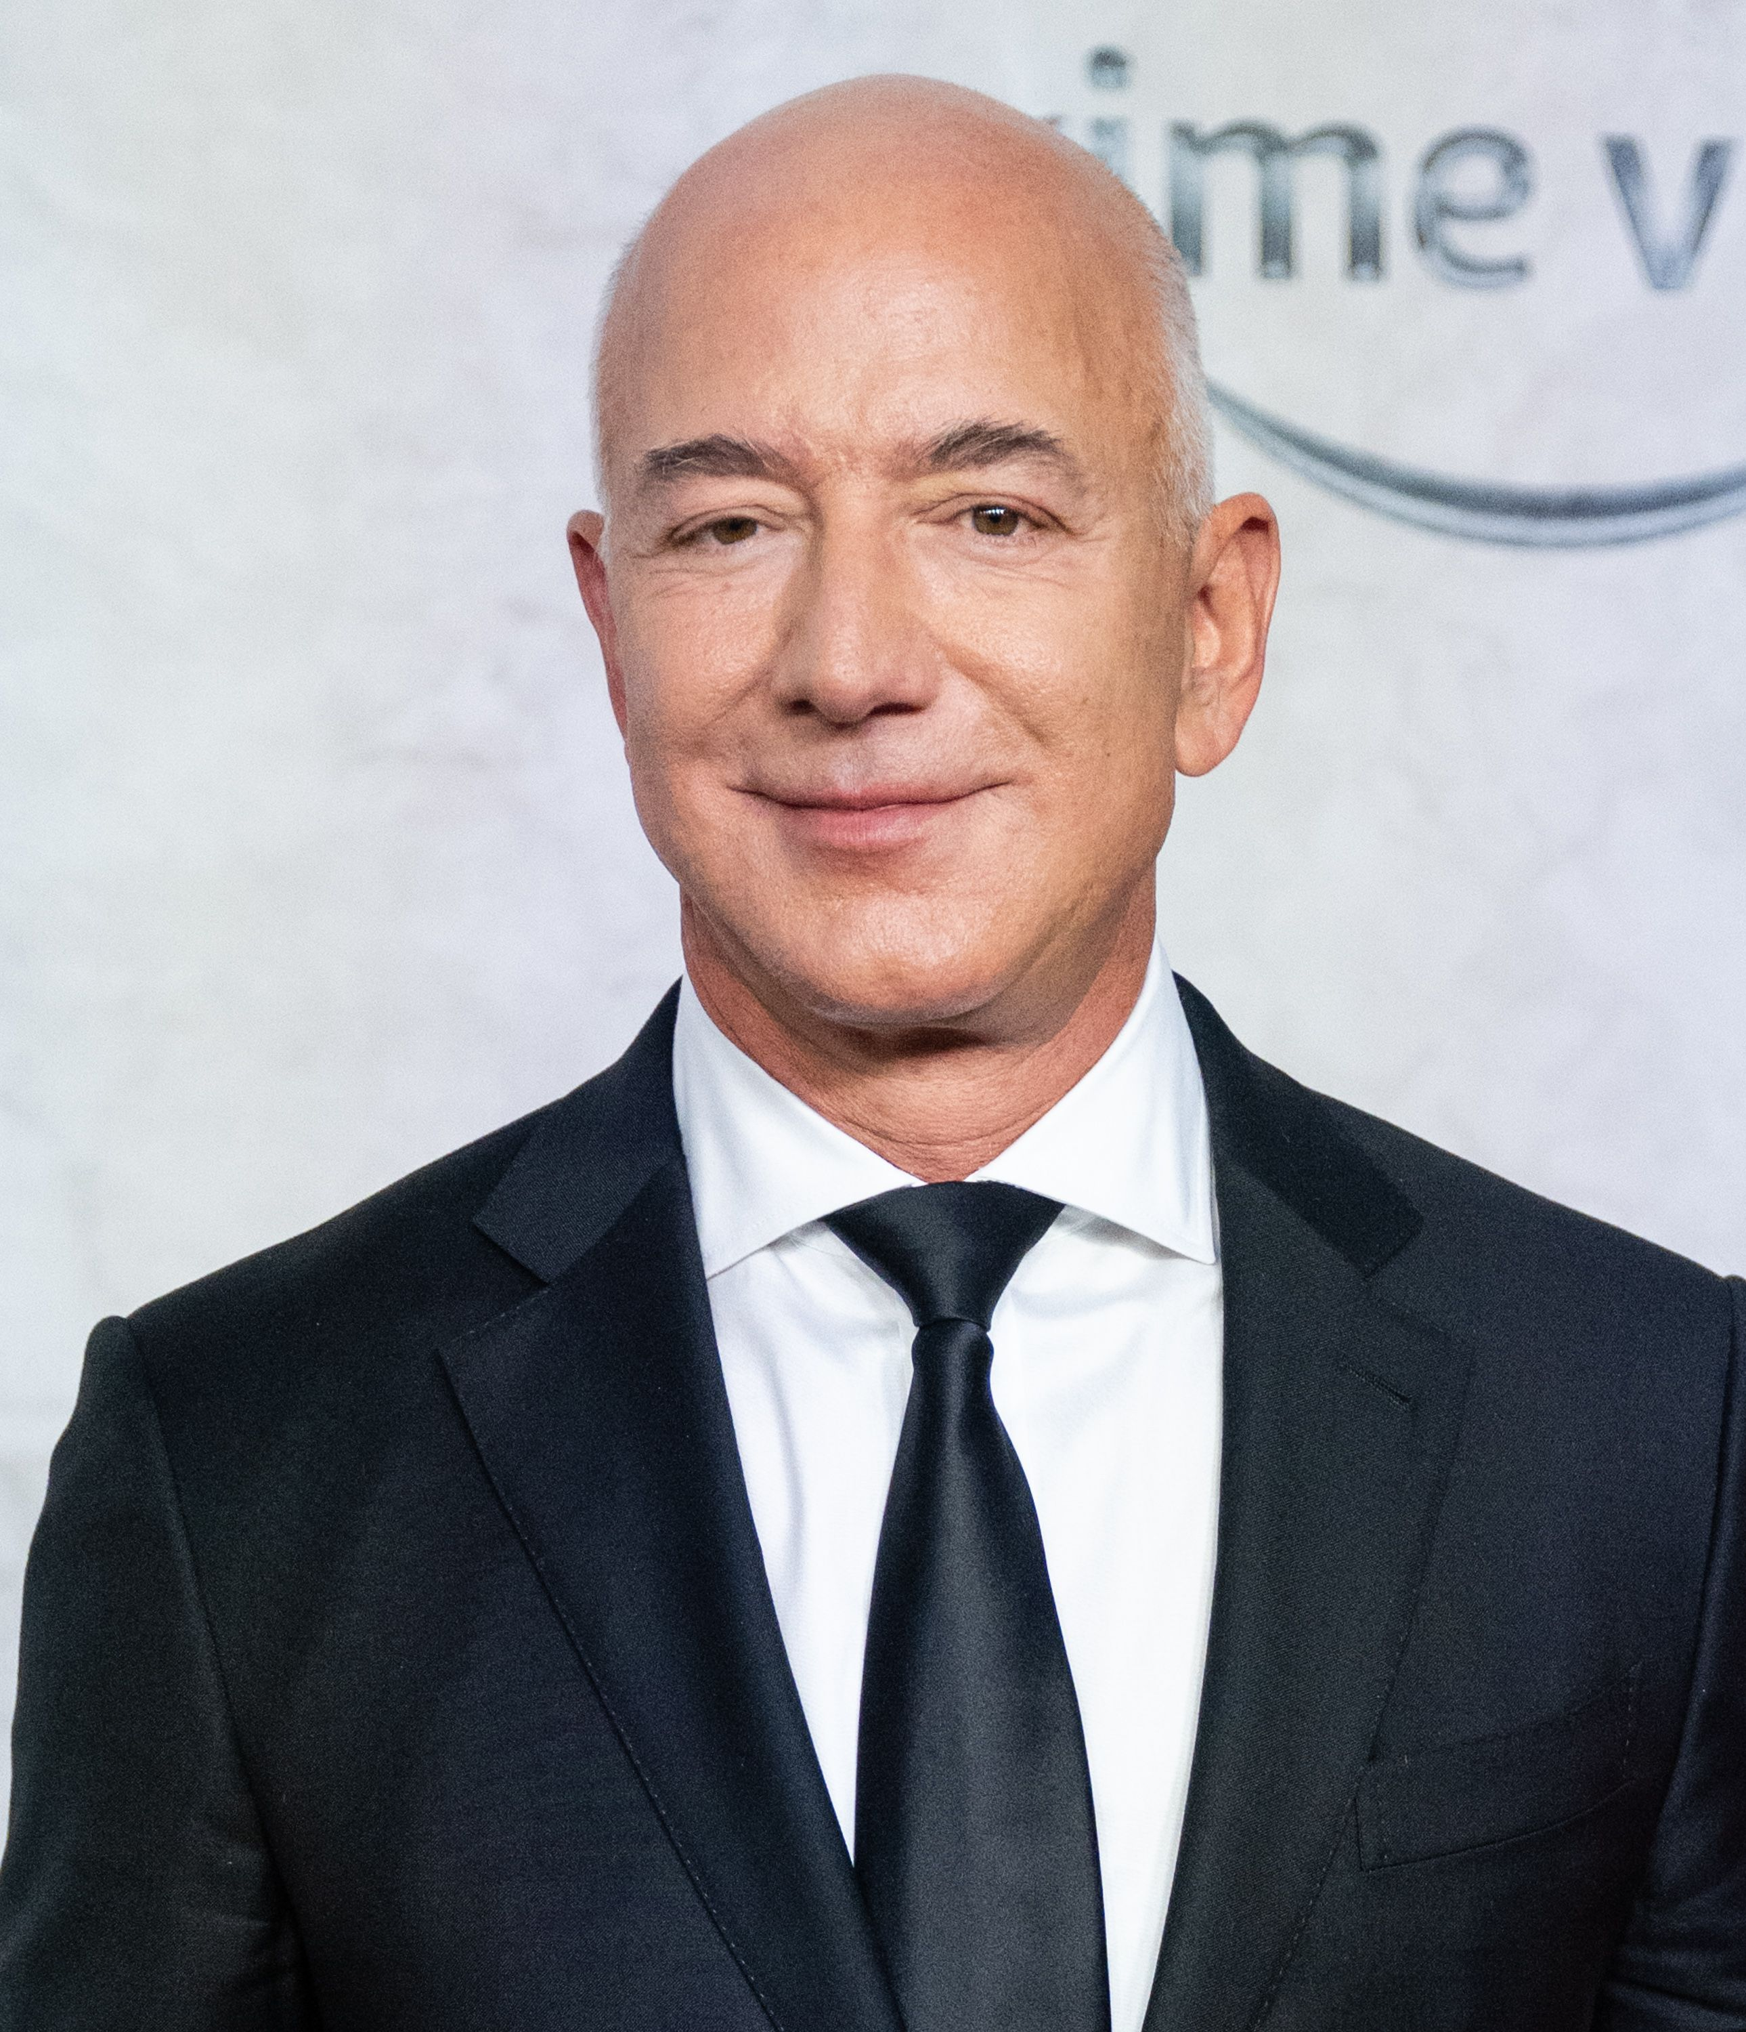
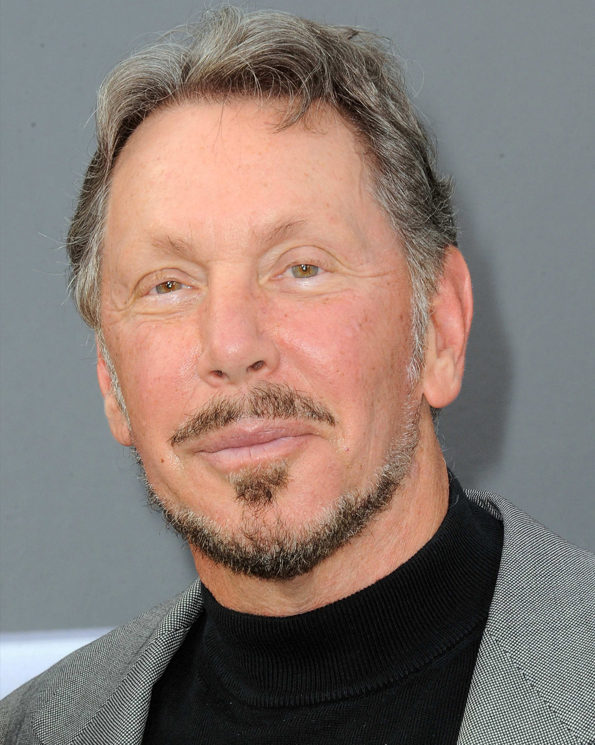
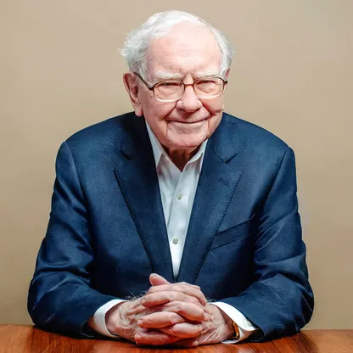

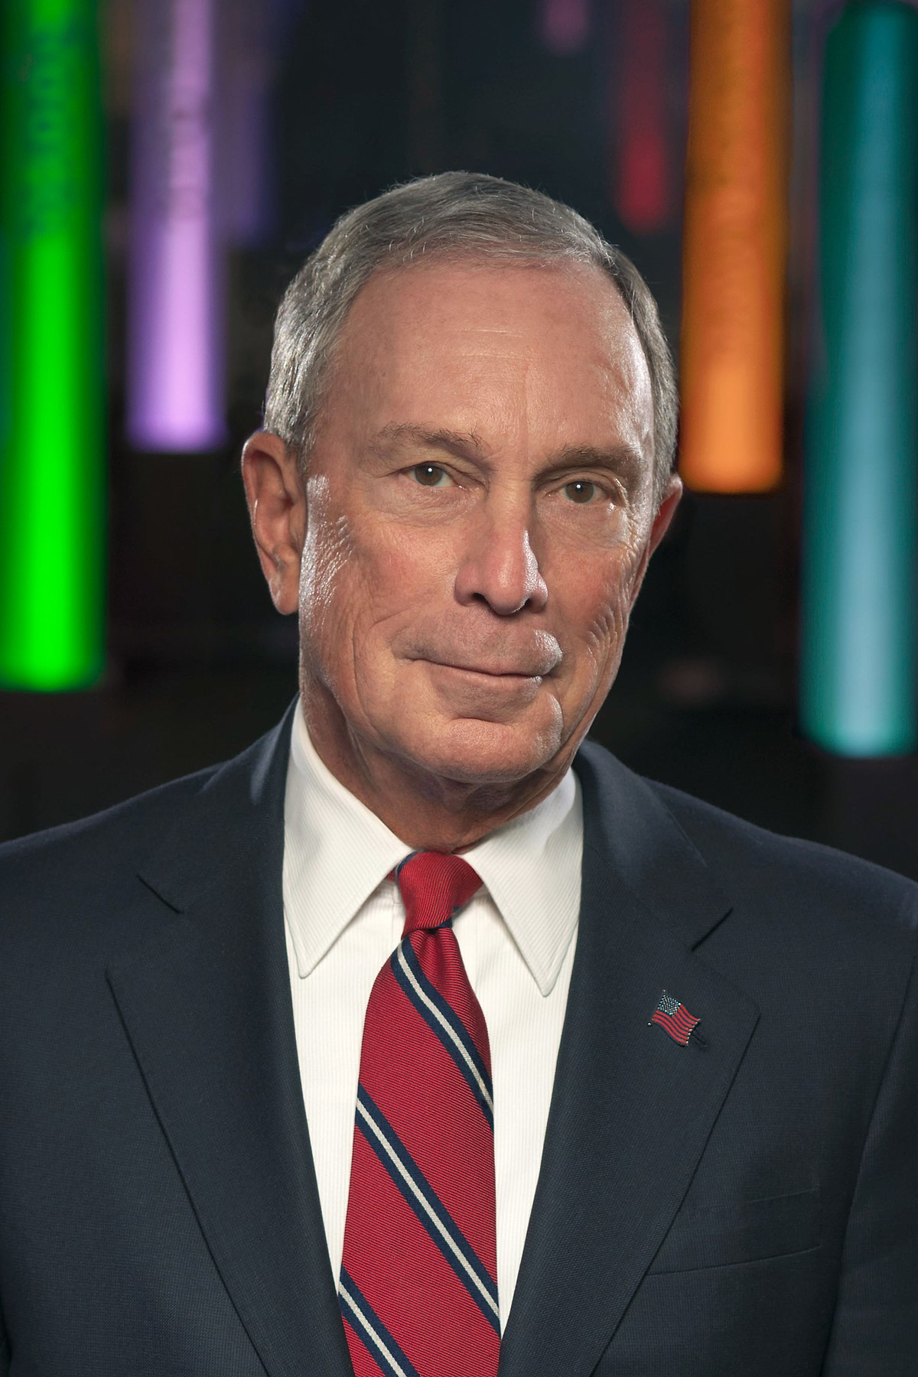
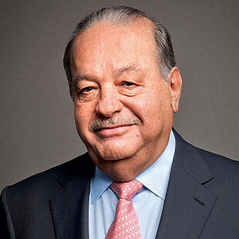



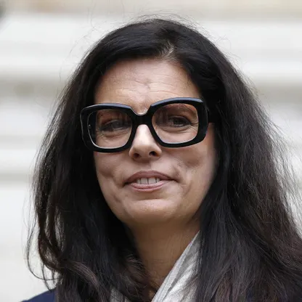




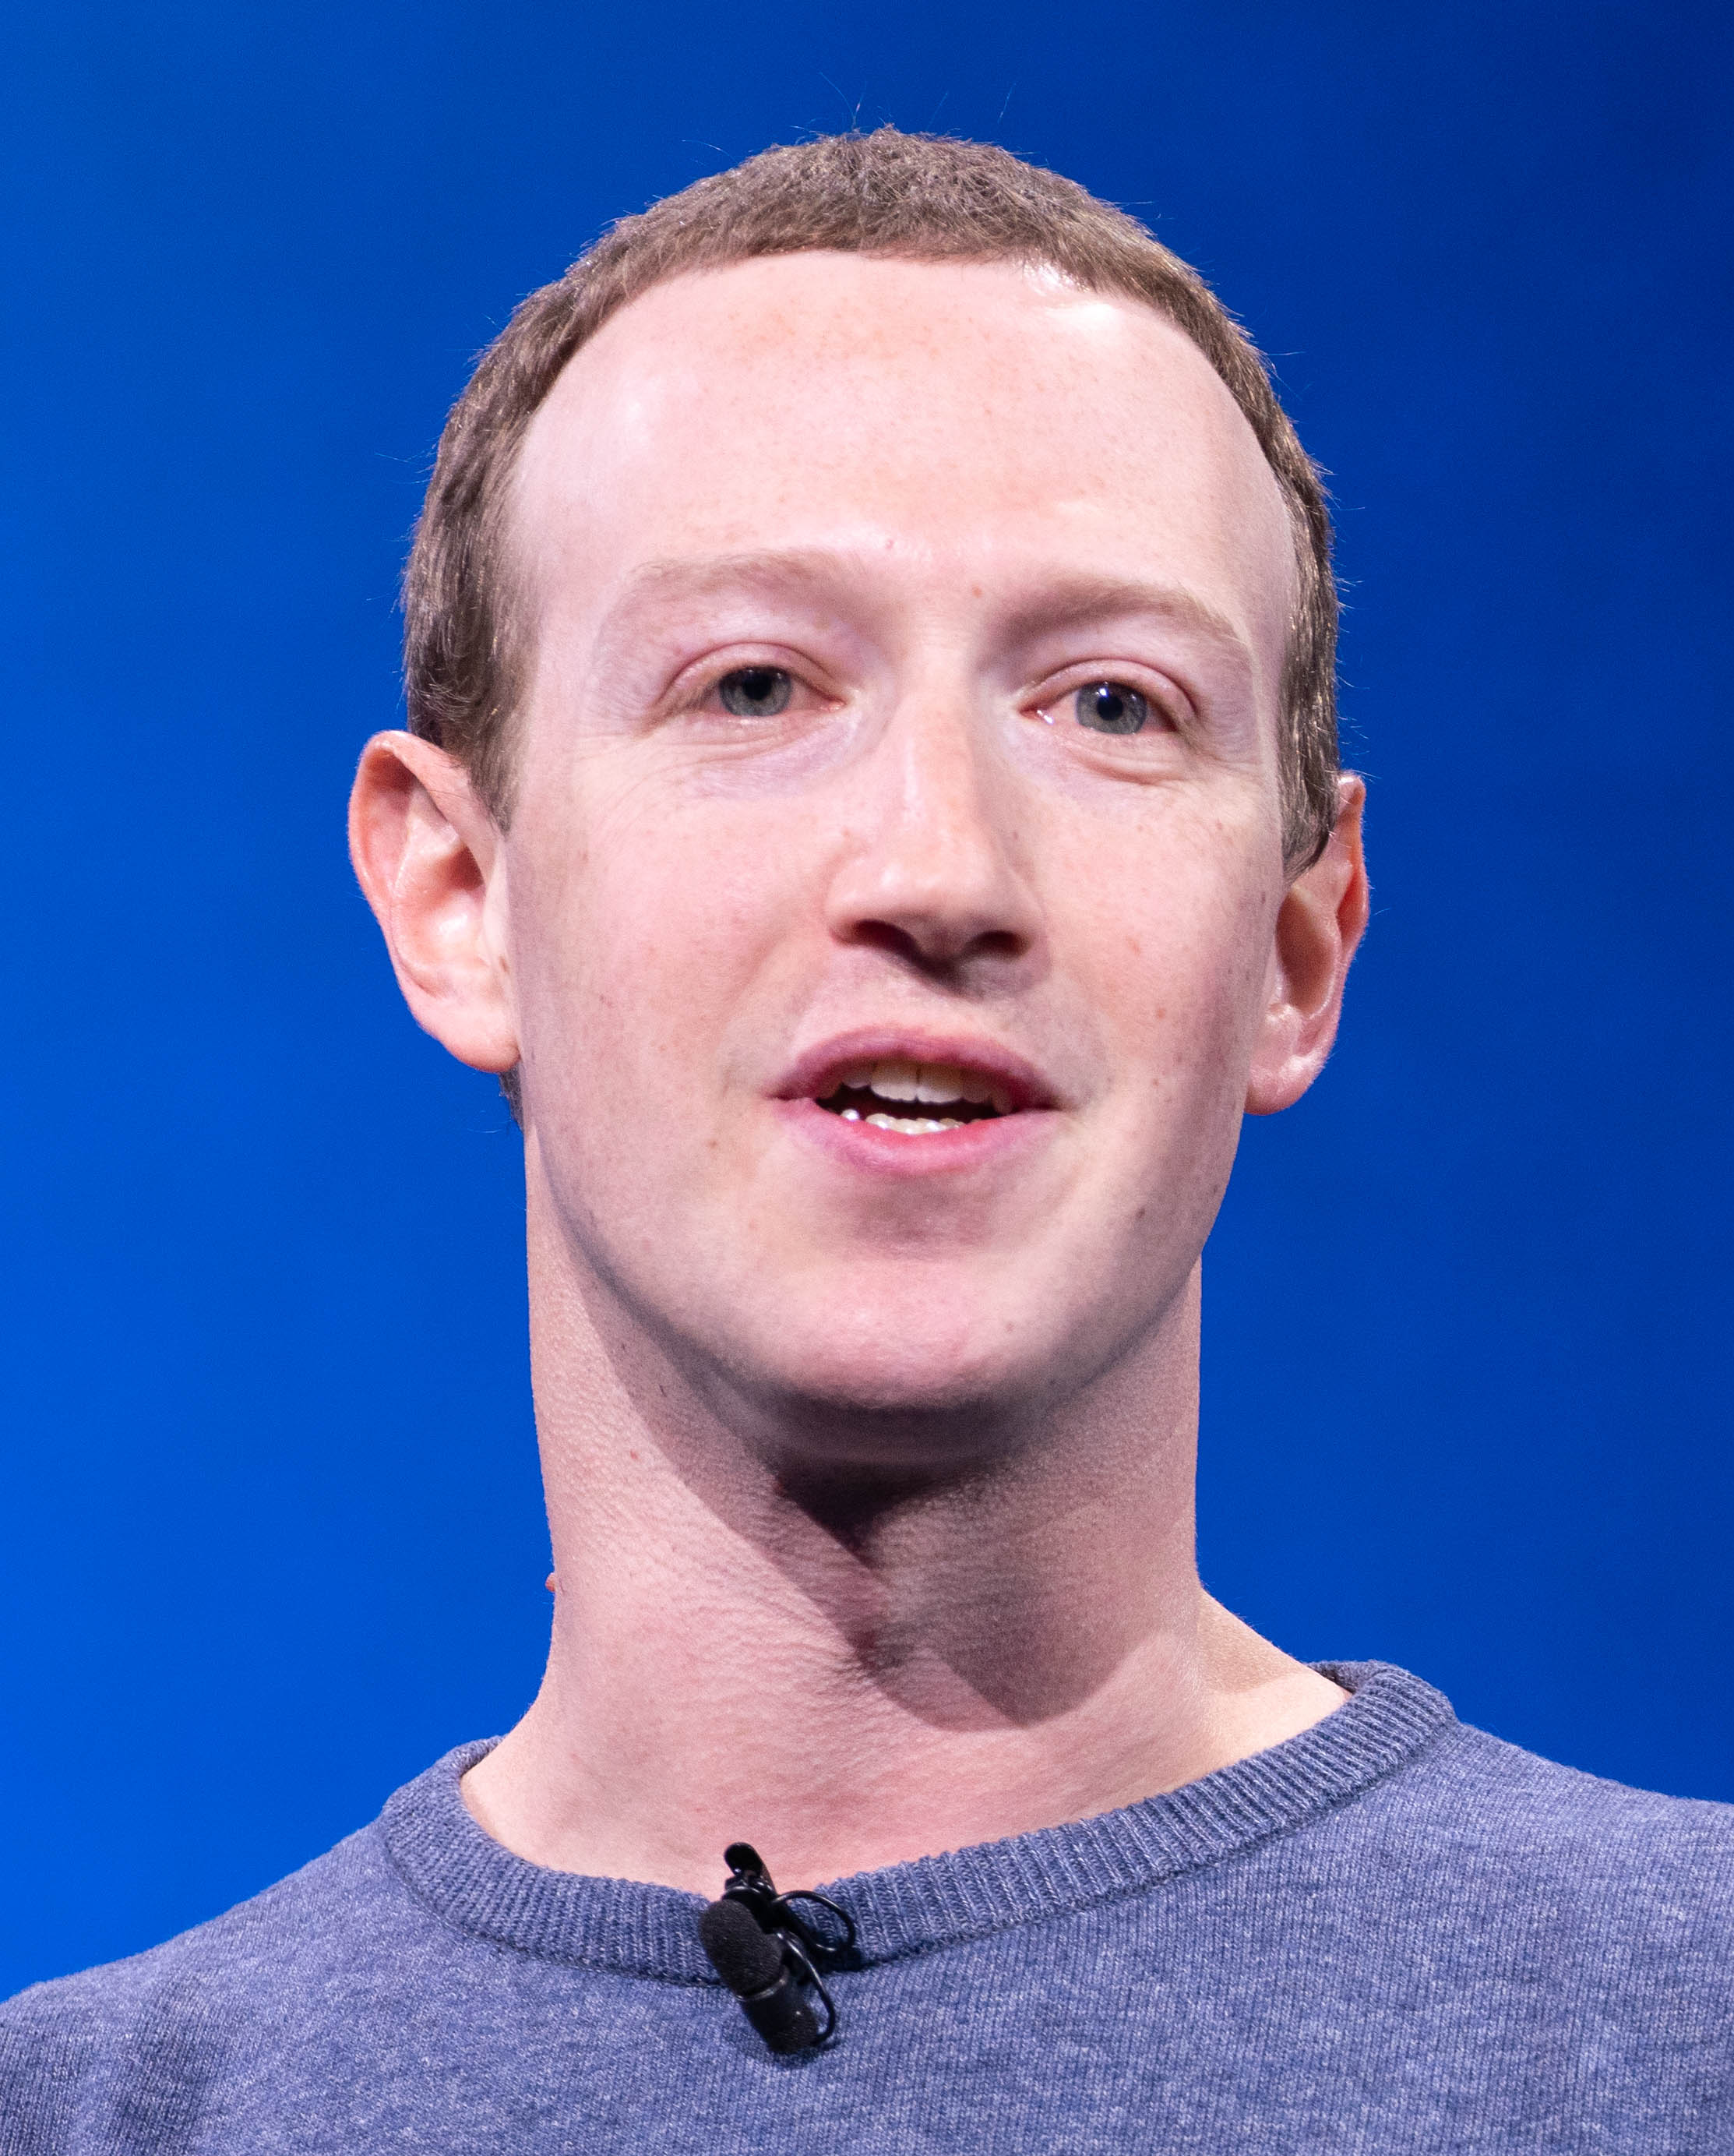
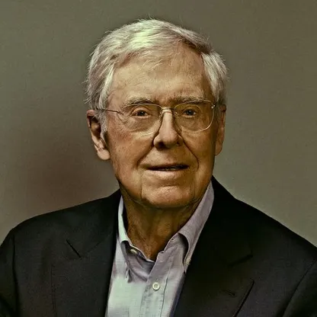
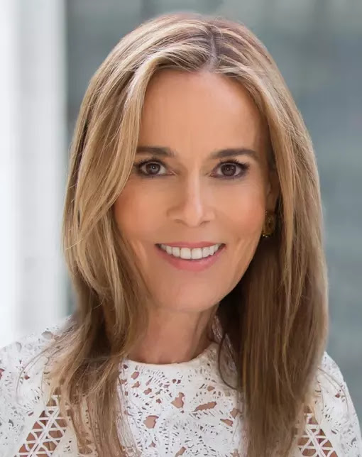


If the cost of global digital ad fraud was human, it would be the ninth richest person in the world
Interestingly, seven of the top 19 richest people (37%) built their wealth through, or are involved in, digital ad-tech and the digital supply chain*
Net Worth of the Wealthiest People in the World vs. Global Cost of Digital Ad Fraud
in billions
Rank #1
Rank #2
Rank #3
Rank #4
Rank #5
Rank #6
Rank #7
Rank #8
Rank #9
Rank #10
Bernard Arnault & family
$211B
Elon Musk
$180B
Jeff Bezos
$114B
Larry Ellison
$107B
Warren Buffett
$106B
Bill Gates
$104B
Michael Bloomberg
$95B
Carlos Slim Helú & family
$93B
Ad Fraud*
$84B
Mukesh Ambani
$83B
Rank #11
Rank #12
Rank #13
Rank #14
Rank #15
Rank #16
Rank #17
Rank #18t
Rank #18t
Rank #20
Steve Ballmer
$81B
Françoise Bettencourt Meyers & family
$81B
Larry Page
$79B
Amancio Ortega
$77B
Sergey Brin
$76B
Zhong Shanshan
$68B
Mark Zuckerberg
$64B
Charles Koch
$59B
Julia Koch
$59B
Jim Walton
$59B
Source: Forbes, The 25 Richest People In The World 2023, 4/4/2023. *Juniper Research, Quantifying the Cost of Ad Fraud: 2023-2028, 9/26/2023. *Includes Elon Musk (X/Twitter), Jeff Bezos (Amazon), Bill Gates & Steve Ballmer (Microsoft), Larry Page & Sergey Brin (Alphabet/Google), Mark Zuckerberg (Meta/Facebook)
This information is exclusively provided to VAB members and qualified marketers.
PAGE 13

Slide 14

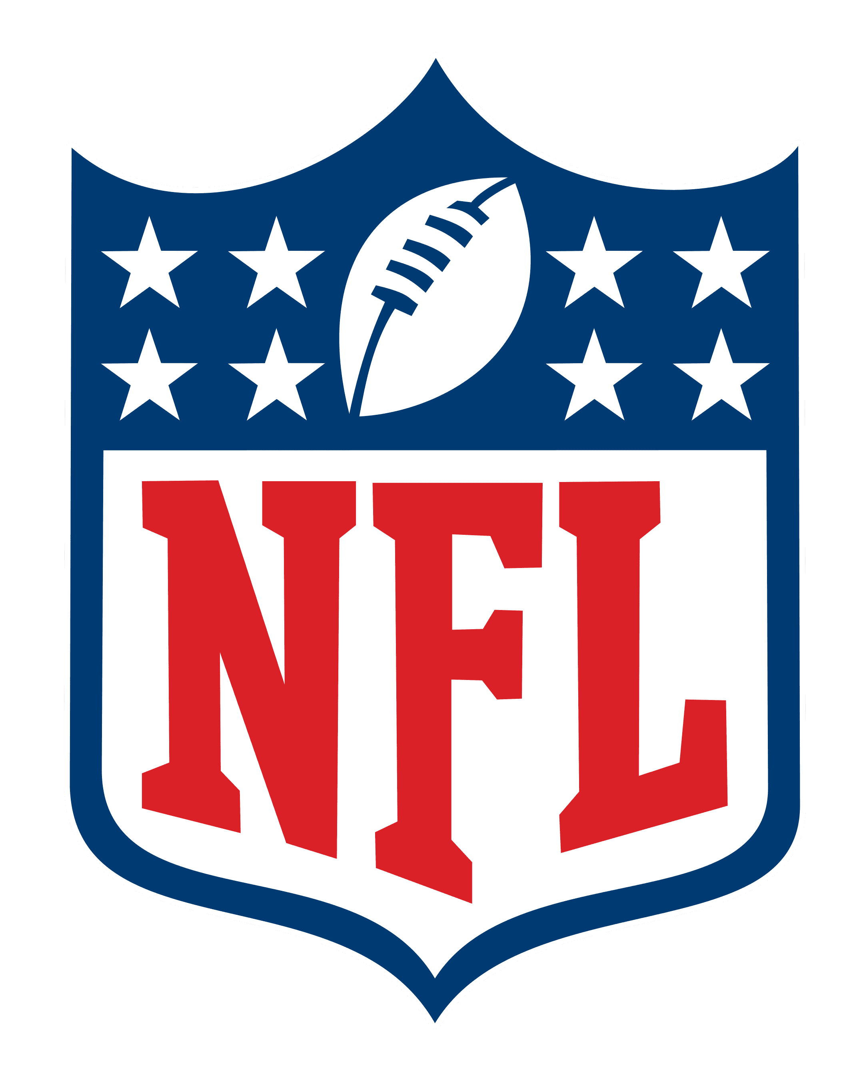
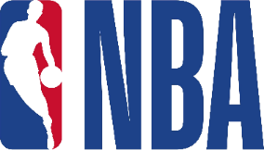

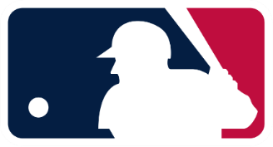








The global cost of digital ad fraud is greater than the total annual revenues for twelve of the most popular worldwide sports leagues combined
Global Cost of Digital Ad Fraud
Popular Sports League Total Revenues
North America
Europe
Asia
$76B
$84B
Combined annual revenues of NFL, MLB, NBA, NHL, MLS, English Premier League, Formula 1, DFL - Deutsche Fußball Liga (German Soccer), La Liga (Spanish Soccer), Ligue 1 (French Soccer), Serie A (Italian Soccer) and Indian Premier League
Source: Juniper Research, Quantifying the Cost of Ad Fraud: 2023-2028, 9/26/2023. NFL ($18.6 total revenue) – Statista, 2022, 9/5/23; MLB ($10.32B total revenue) – Statista, 2022, 9/14/23; NBA ($10.02B total revenue) - Statista, 2021-2022, 9/7/23; NHL ($5.93B total revenue) – Statista, 2022, 9/14/23. MLS ($0.21B total revenue) – Zippia, 2023; Formula 1 ($2.753B USD) – Forbes, Inside the Numbers That Show Formula 1’s Popularity And Financial Growth, 3/29/23; Premier League ($6.987B USD), La Liga ($3.49BUSD), Serie A ($2.75B USD), Ligue 1 ($2.22B USD) – Statista, 2022-2023 9/14/23; Deutsche Fußball Liga (DFL) ($4.74B USD) - DFL Economic Report, 2023 9/29/23; Indian Premier League ($8.4B USD) – Statista, 2022 5/21/23. Note: All Non-U.S. league revenues (other than Indian Premier League) which reported in local currencies were converted to USD as of 9/29/23.
This information is exclusively provided to VAB members and qualified marketers.
PAGE 14

Slide 15

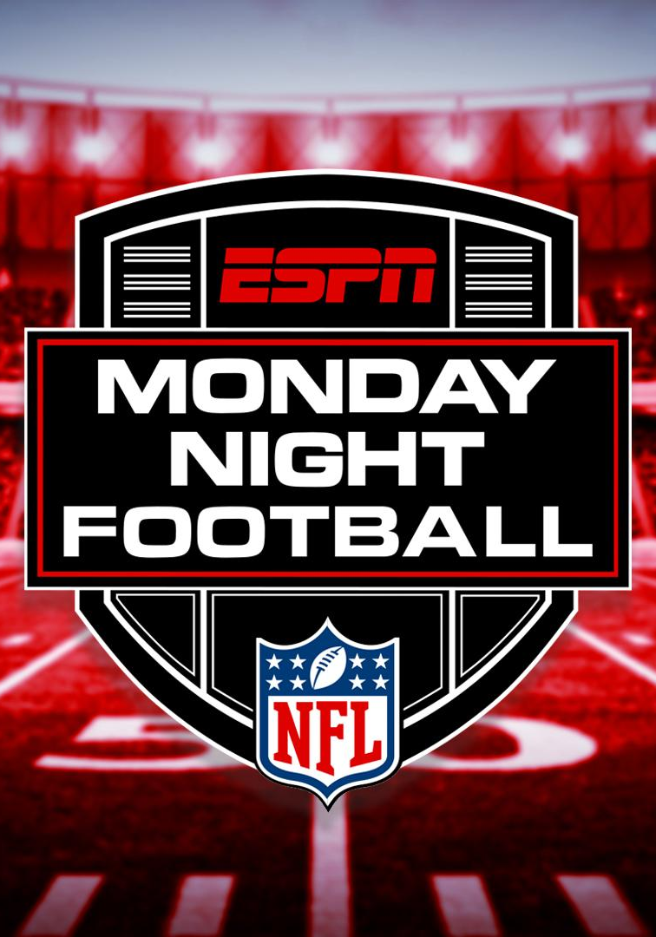



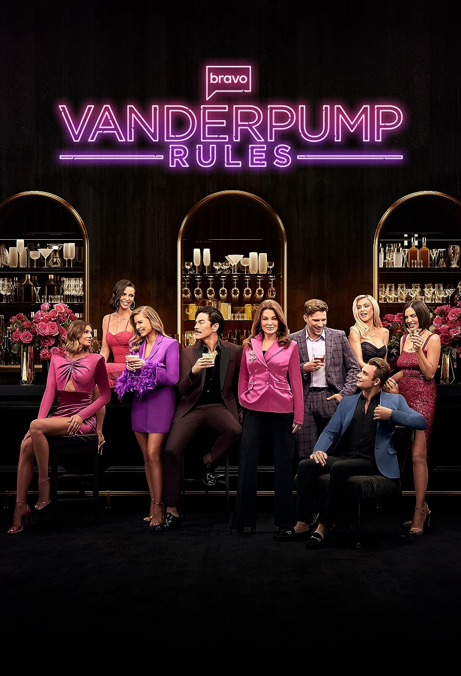
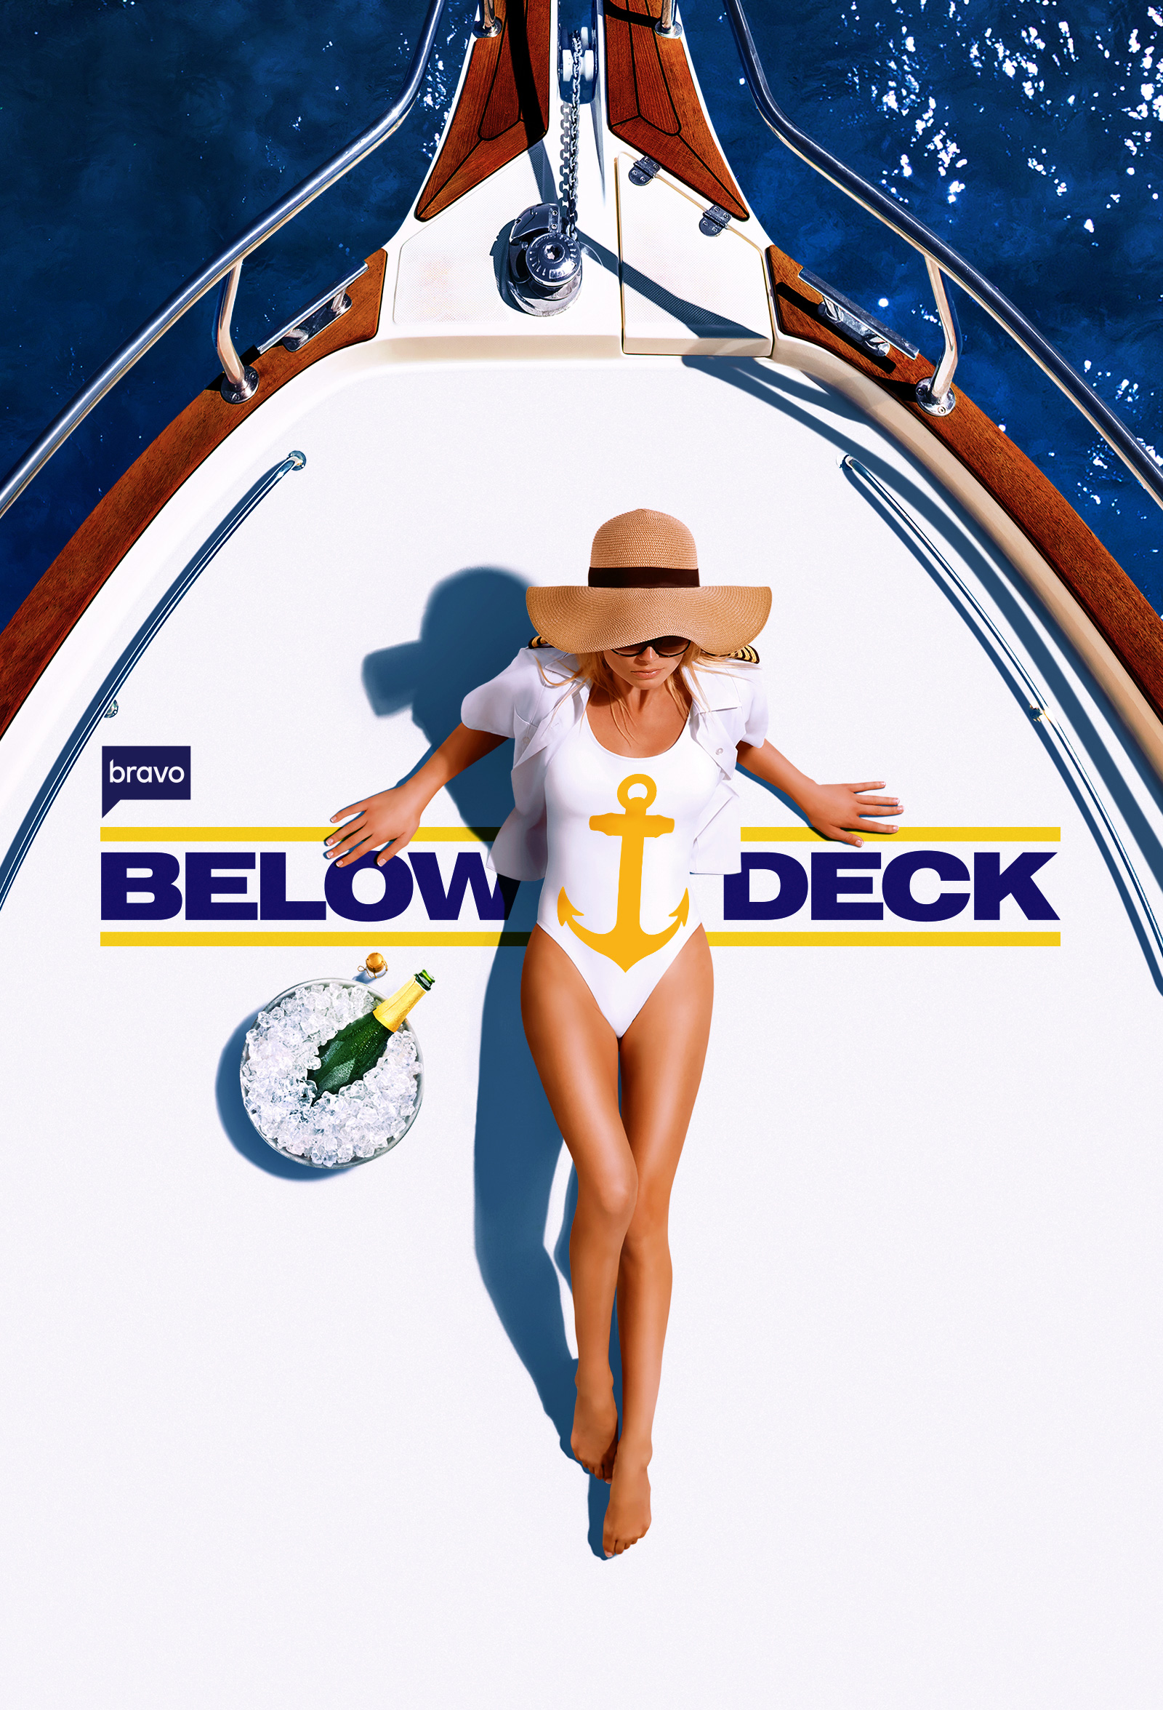



The North American cost of digital ad fraud is roughly equivalent to the total national & local cable TV ad spend in the U.S.
North America Cost of Digital Ad Fraud
U.S. National & Local Cable TV Ad Spend
$35B
$34B
Source: Juniper Research, Quantifying the Cost of Ad Fraud: 2023-2028, 9/26/2023. eMarketer Insider Intelligence, 2022 estimated based on MoffettNathanson analysis of company reports. Based on estimated TV ad spending; national cable ($28.5B total) and local cable ($5.3B total).
This information is exclusively provided to VAB members and qualified marketers.
PAGE 15

Slide 16


Brands at Financial Risk Through Wasted Ad Spend:
A Case Study
Does Google charge advertisers for premium placements when campaigns
run in non-premium inventory?

Slide 17
A study by researchers at Adalytics claimed advertisers may be paying premium pricing for non-premium placements
Distribution for YouTube TrueView In-stream Ad Campaign Budget Spend
on YouTube vs. Google Video Partner (GVP) Network
Major Infrastructure Brand
GVP Mobile App
Valid TrueView
Valid Placements
27% of YouTube buy spend were ‘valid TrueView, skippable,
in-stream video ads’
GVP Webpage
Valid TrueView
YouTube Channel
Valid TrueView
GVP Webpage
Invalid TrueView
Invalid Placements
73% of YouTube buy spend was misrepresented as ‘valid TrueView, skippable, in-stream video ads’ when they were not
GVP Mobile Application
Invalid TrueView
Source: Adalytics Research LLC, ‘Did Google Mislead Advertisers About TrueView Skippable In-Stream Ads for the Past Three Years?’ report, June 2023. Note: after the Adalytics report was released, YouTube changed the name of their ‘in-stream ads’ format to ‘skippable ads’ throughout Google Display and Video 360, according to a ‘What’s New: July 2023’ Google Blog Post and reported by Adweek on 8/7/23.
This information is exclusively provided to VAB members and qualified marketers.
PAGE 17

Slide 18
Due to Google allegedly breaking their own standards and guidelines, many media buyers feel cheated and are looking for financial reparations
In their own words, quotes from surveyed media buyers (anonymous)
‘How would you feel if YouTube was running large numbers of your ad campaign's YouTube TrueView in-stream video ads on: - 3rd party websites or apps, - with small, out-stream video players, - with sound off by default, - that were auto-playing with user involvement?’
‘I would demand a refund of all impression and third-party costs associated with buying those ads’
‘Cheated by YouTube. Not confident in future YouTube buys without plans to improve ad placements’
‘I would feel like I was ripped off’
‘I would demand that YouTube/Google block buying of these placements by default’
‘Cheated out of my money’
‘Betrayed and lied to’
‘(I should be) Owed a massive credit’
‘I would feel like the inventory was unreliable, and not worth paying for’
‘Would feel like it’s not a transparent investment’
Source: Adalytics Research LLC, ‘Did Google Mislead Advertisers About TrueView Skippable In-Stream Ads for the Past Three Years?’ report, June 2023. Note: after the Adalytics report was released, YouTube changed the name of their ‘in-stream ads’ format to ‘skippable ads’ throughout Google Display and Video 360, according to a ‘What’s New: July 2023’ Google Blog Post and reported by Adweek on 8/7/23.
This information is exclusively provided to VAB members and qualified marketers.
PAGE 18

Slide 19
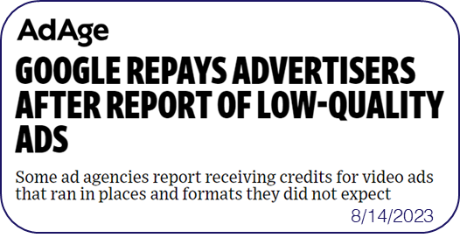
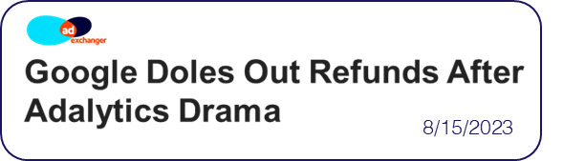

Several weeks after the release of the first Adalytics report, Google did begin refunding some advertisers to fix ‘billing discrepancies’
This information is exclusively provided to VAB members and qualified marketers.
PAGE 19

Slide 20
2
Ad fraud and lack of digital ad-tech transparency put brands at reputational risk

Slide 21





Major digital platforms offer audience network extensions but the lack
of transparency around these websites can cause brand safety concerns
Audience Networks (aka Audience Extensions)
A way to expand the reach of a digital campaign with a single publisher by using cookies to identify and track user’s activity on other websites/apps and then serving ads to the same audiences on those 3rd party websites/apps.
Examples of Audience Networks
‘Partners are publisher websites and mobile apps where you can show your video ads to viewers beyond YouTube’
‘Extends Meta's people-based advertising beyond the Facebook app’
‘Gain access to Pangle’s vast network of mobile apps’
‘Delivers ads beyond the LinkedIn feed to members
on trusted third-party apps
and sites’
‘Ad placements are cross-device and include premium sites like MSN, Outlook.com, Microsoft Edge, and other partners’
Google Video Partners Network
Meta Audience Network
Pangle
(TikTok)
LinkedIn Audience Network
Microsoft Audience Network
Source: Google Ads Help, About Google video partners’ Meta Business Help Center, How Meta Audience Network works; Pangle, How to level up your ad campaign on Pangle; LinkedIn Help, LinkedIn Audience Network FAQs; Microsoft Advertising Help, About Microsoft Audience Ads; To learn more about terminology and facts around digital advertising, click the link to download ‘What Is Digital Ad Fraud’
This information is exclusively provided to VAB members and qualified marketers.
PAGE 21

Slide 22
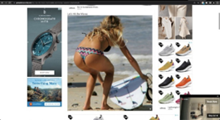
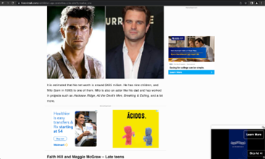
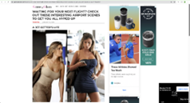
Audience networks can include several ‘Made for Advertising’ websites, which creates negative brand associations and wasted ad dollars
‘Made for Advertising’ (MFA) Websites
Websites that operate with the sole purpose of maximizing ad profits, leaving the actual content and user experience as afterthoughts. They are often filled with spam, clickbait, and stolen content.
$10B
What constitutes a ‘Made for Advertising’ website?
As defined by the ANA, 4A’s, WFA and ISBA (9/26/23)
estimated global advertising spend annually across 4,500+ ‘MFA’ sites
A high ad-to-content ratio – usually over twice the internet average
Rapidly auto-refreshing ad placements like banner ads and autoplay video ads
A high percentage of paid traffic sourcing with little to no organic audience
Generic, low-quality content that may be syndicated, dated and non-unique
Templated and poorly designed website
Examples of ‘Made for Advertising’ Websites
Source: The Drum, The ad industry’s most influential trade bodies have come together to spell out new definitions for ‘made for advertising’ websites, which still hoodwink many media buyers daily. Will they work?, 9/27/2023. ANA: Association of National Advertisers. 4A’s: American Association of Advertising Agencies. WTA: World Federation of Advertisers. ISBA: Incorporated Society of British Advertisers. ANA, Programmatic Media Supply Chain Transparency Study – Complete Report, December 2023. To learn more about terminology and facts around digital advertising, click the link to download ‘What Is Digital Ad Fraud’
This information is exclusively provided to VAB members and qualified marketers.
PAGE 22

Slide 23









A lack of campaign buy transparency can also mean that video ads may play in poor environments which can devalue brands
Examples of ads running in subpar placements
In a small corner or side of a page
In a fully muted video player
With little to no video content between consecutive ads
‘Auto-plays’ without any user interaction or initiation
Ad plays continuously on a loop
Multiple video ads playing simultaneously on the same page
The ‘skip’ button on a video ad is hidden or obscured
Runs out of sight while the audio plays
Ads served “stacked” on top of another ad
This information is exclusively provided to VAB members and qualified marketers.
PAGE 23

Slide 24

Marketers should ask themselves if the lack of transparency in their media buy is worth risking 20% of their company’s total valuation
The Contribution of ‘Brand’ to Enterprise Value
The Relative Contribution to Shareholder Value for the S&P 500
20%
of a company’s enterprise value is based on their ‘brand’
Source: Forbes, New Global Standards For Reporting Brand Value Can Help CEOs Grow Share Price, 5/3/2018. Applying the Marketing Accountability Standards Board (MASB) Brand Investment & Valuation Model, Marketing Accountability Standards Board, 2017. Ocean Tomo Annual Study of Intangible Assets, 2015. ‘Brand value’ is the worth of a brand as an asset for an entity. ‘Enterprise value’ is a measure of the value of a company’s business operations. ‘Intangible assets’ can include things like patents, trademarks and customer lists. ‘Tangible’ assets can include things like equipment, inventory and real estate. Note: totals may not equal 100% due to rounding.
This information is exclusively provided to VAB members and qualified marketers.
PAGE 24

Slide 25
Brands at Reputational Risk:
A Case Study
Does Google’s lack of transparency and alleged fraudulent practices around content environments put brands at reputational risk?

Slide 26

“Nobody goes to walled gardens like YouTube to run on audience networks which all have the same ***** inventory.
This is a method for YouTube and Google to extract more budget and manufacture scale in a way that is palatable to the advertiser because they don’t fully understand it.”
Media Buyer (Anonymous)
Excerpted from Adalytics’s ‘Did Google Mislead Advertisers About TrueView Skippable In-Stream Ads for the Past Three Years?’’ report, June 2023
This information is exclusively provided to VAB members and qualified marketers.
PAGE 26

Slide 27

An Adalytics study alleges that a significant share of YouTube ad spend was allocated to audience network sites that did not meet standard
Significant quantities of TrueView skippable in-stream ads appear to have been served on hundreds of thousands of websites and apps in which the consumer experience did not meet Google’s stated quality standards.
Many of these TrueView in-stream ads were served muted and auto-playing as out-stream video or as obscured video players and often there was little to no organic video media content between ads, the video units simply played ads only.
42% - 75%
of TrueView in-stream ad spend was allocated to GVP sites and apps which did not meet Google’s standards
Source: Adalytics Research LLC, ‘Did Google Mislead Advertisers About TrueView Skippable In-Stream Ads for the Past Three Years?’ report, June 2023. Note: after the Adalytics report was released, YouTube changed the name of their ‘in-stream ads’ format to ‘skippable ads’ throughout Google Display and Video 360, according to a ‘What’s New: July 2023’ Google Blog Post and reported by Adweek on 8/7/23.
This information is exclusively provided to VAB members and qualified marketers.
PAGE 27

Slide 28

The spending allocated towards audience networks also allegedly included over one thousand ‘Made for Advertising’ publishers
12.3%
of the budget spent on Google Video Partner sites is spent across 1,090 distinct MFA publishers that appeared in various brands’ TrueView campaign reports, according to DeepSee.io’s industry leading list of MFA domains
Source: Adalytics Research LLC, ‘Did Google Mislead Advertisers About TrueView Skippable In-Stream Ads for the Past Three Years?’ report, June 2023. Note: after the Adalytics report was released, YouTube changed the name of their ‘in-stream ads’ format to ‘skippable ads’ throughout Google Display and Video 360, according to a ‘What’s New: July 2023’ Google Blog Post and reported by Adweek on 8/7/23.
This information is exclusively provided to VAB members and qualified marketers.
PAGE 28

Slide 29



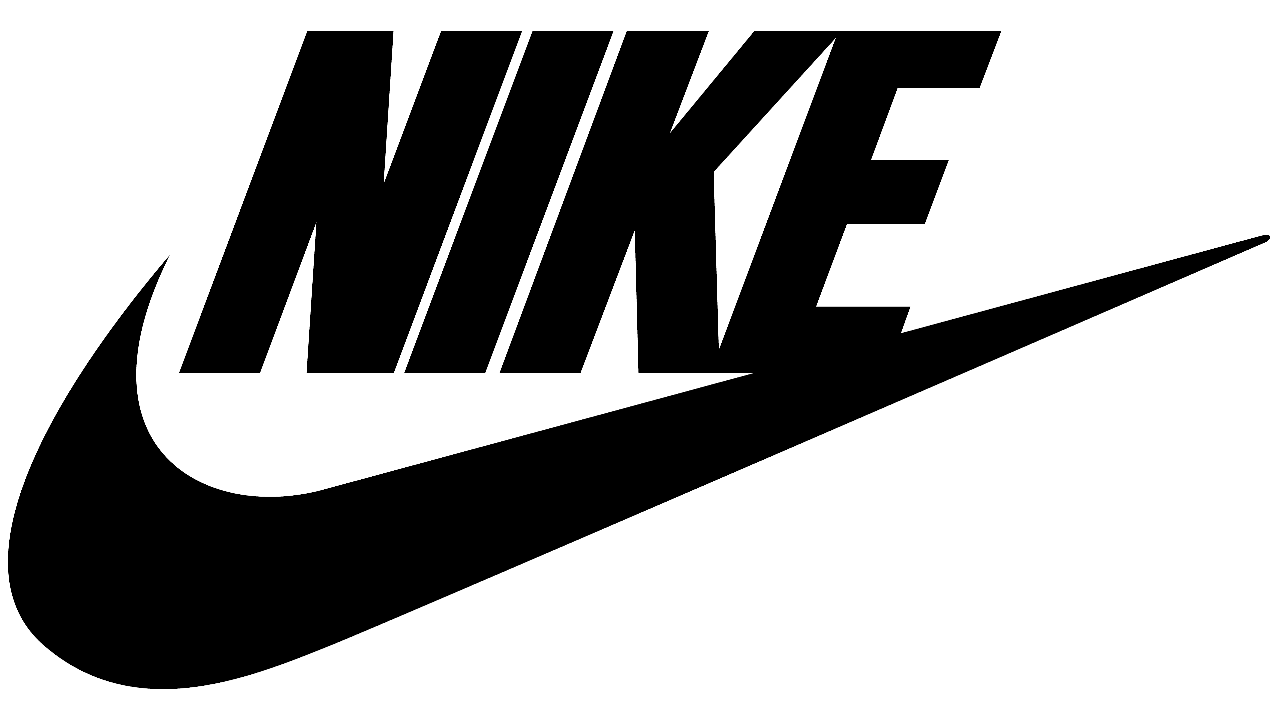






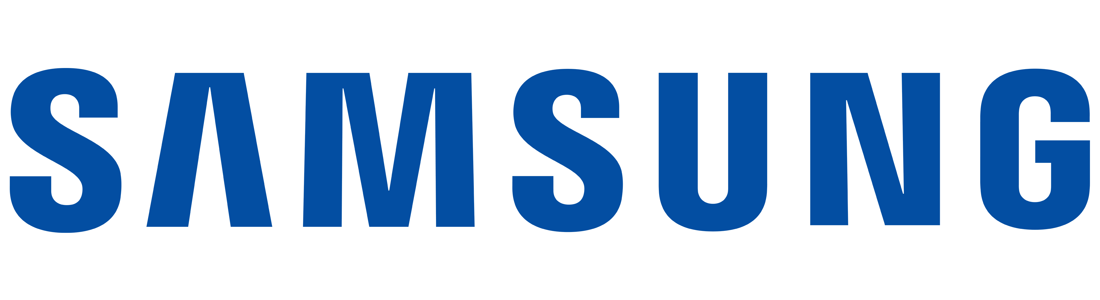


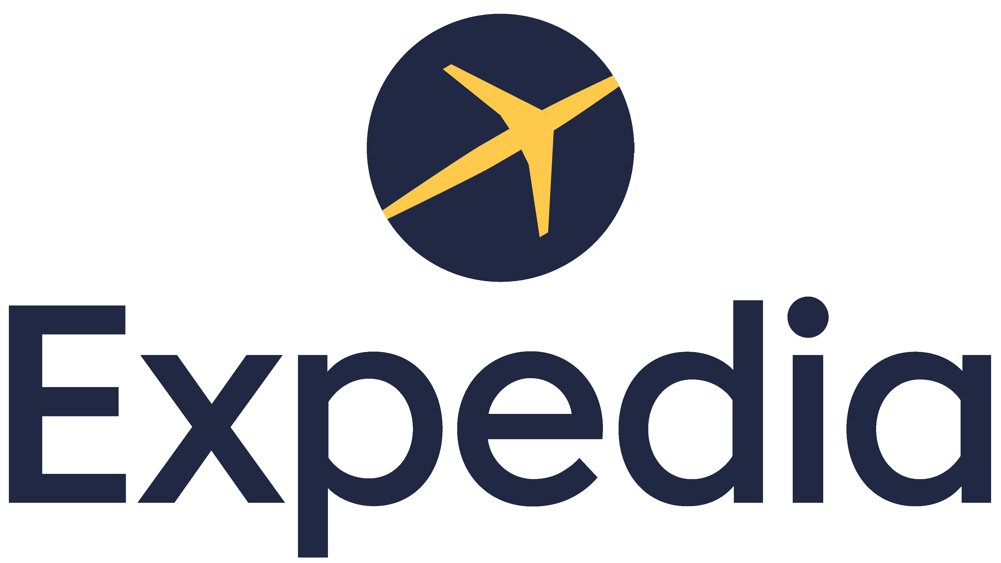


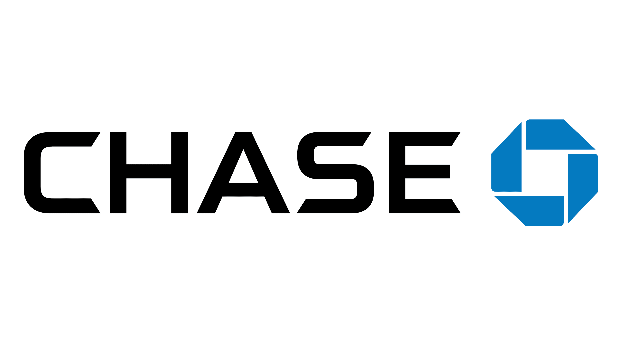




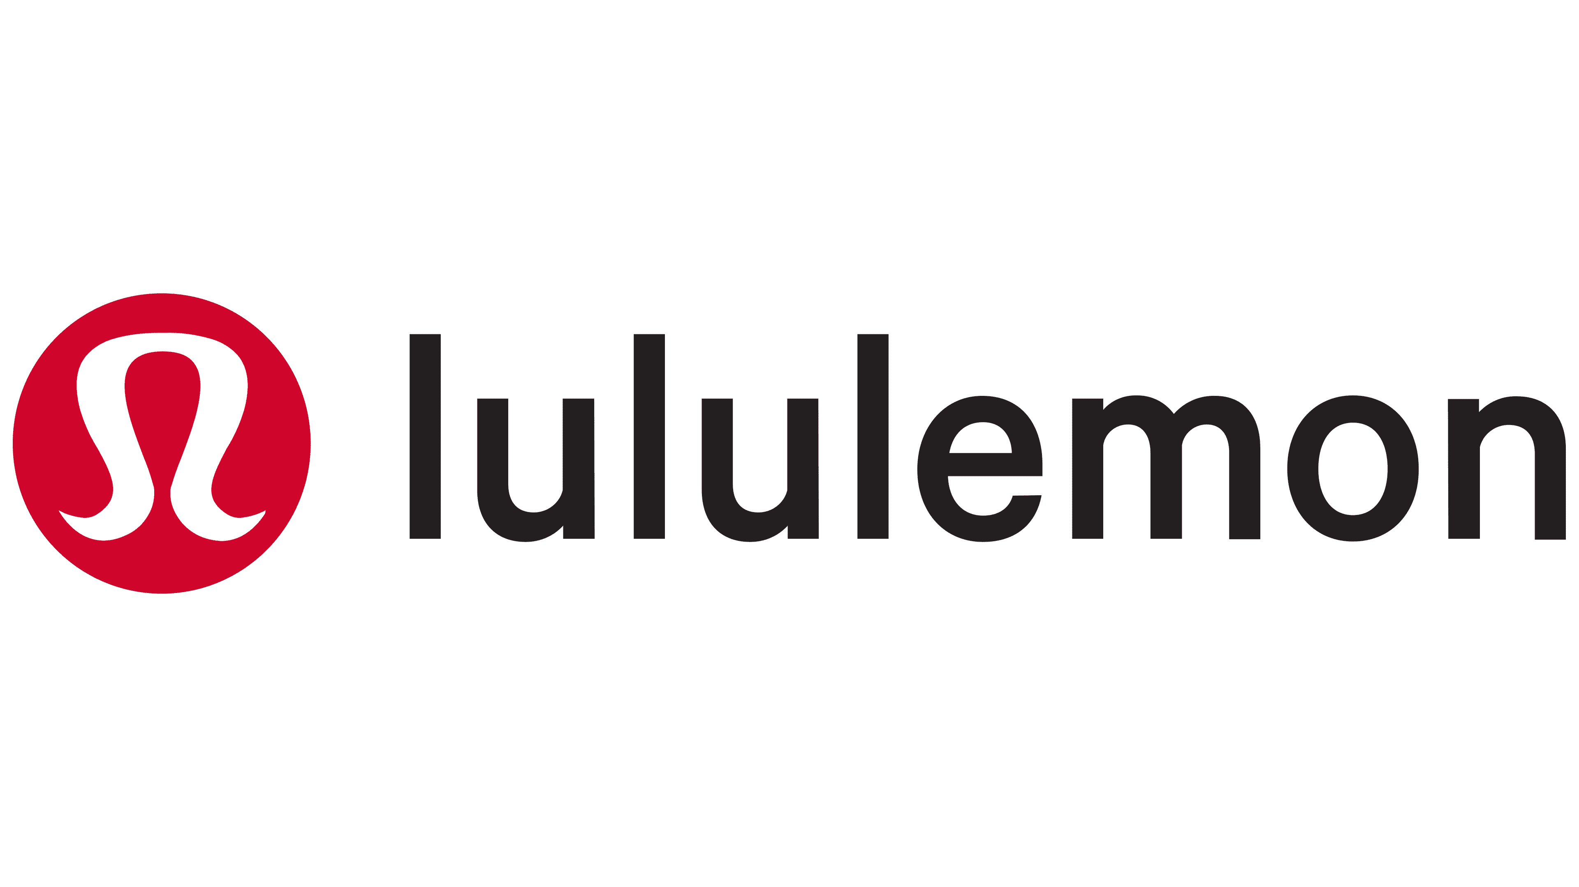






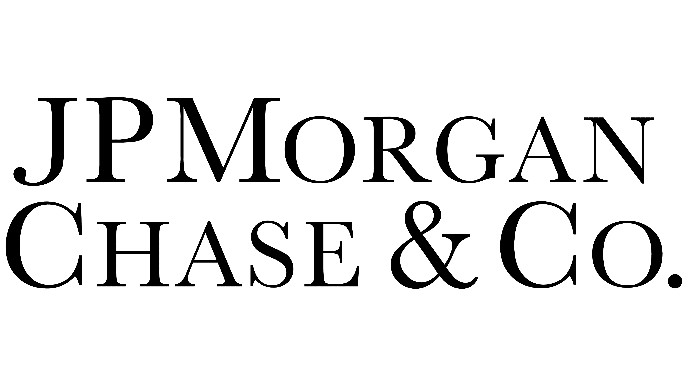
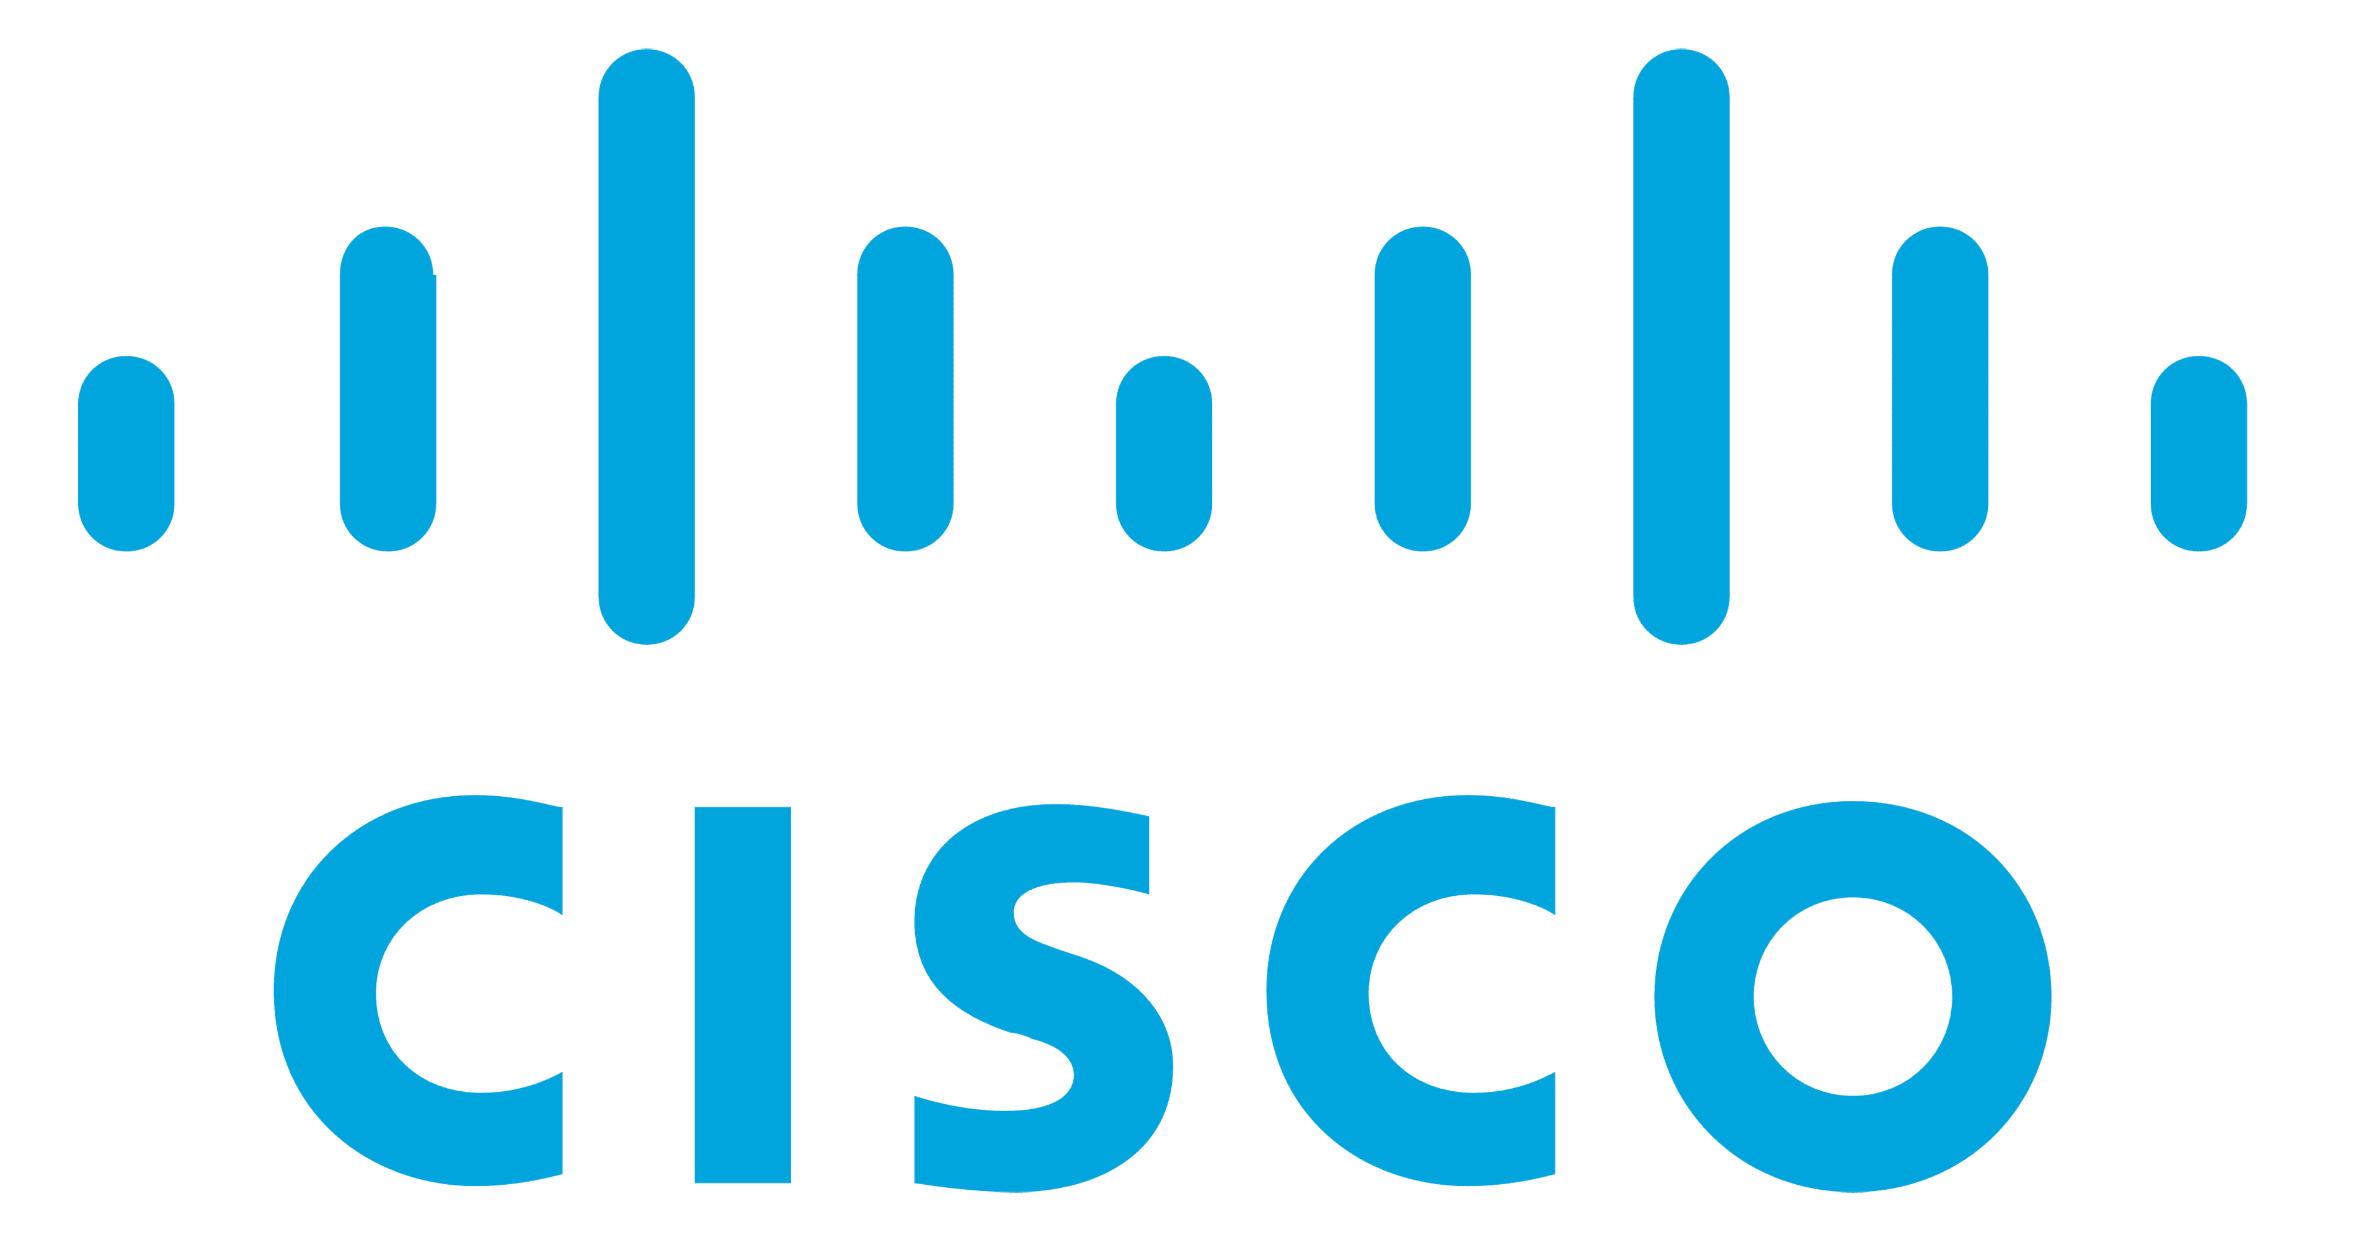
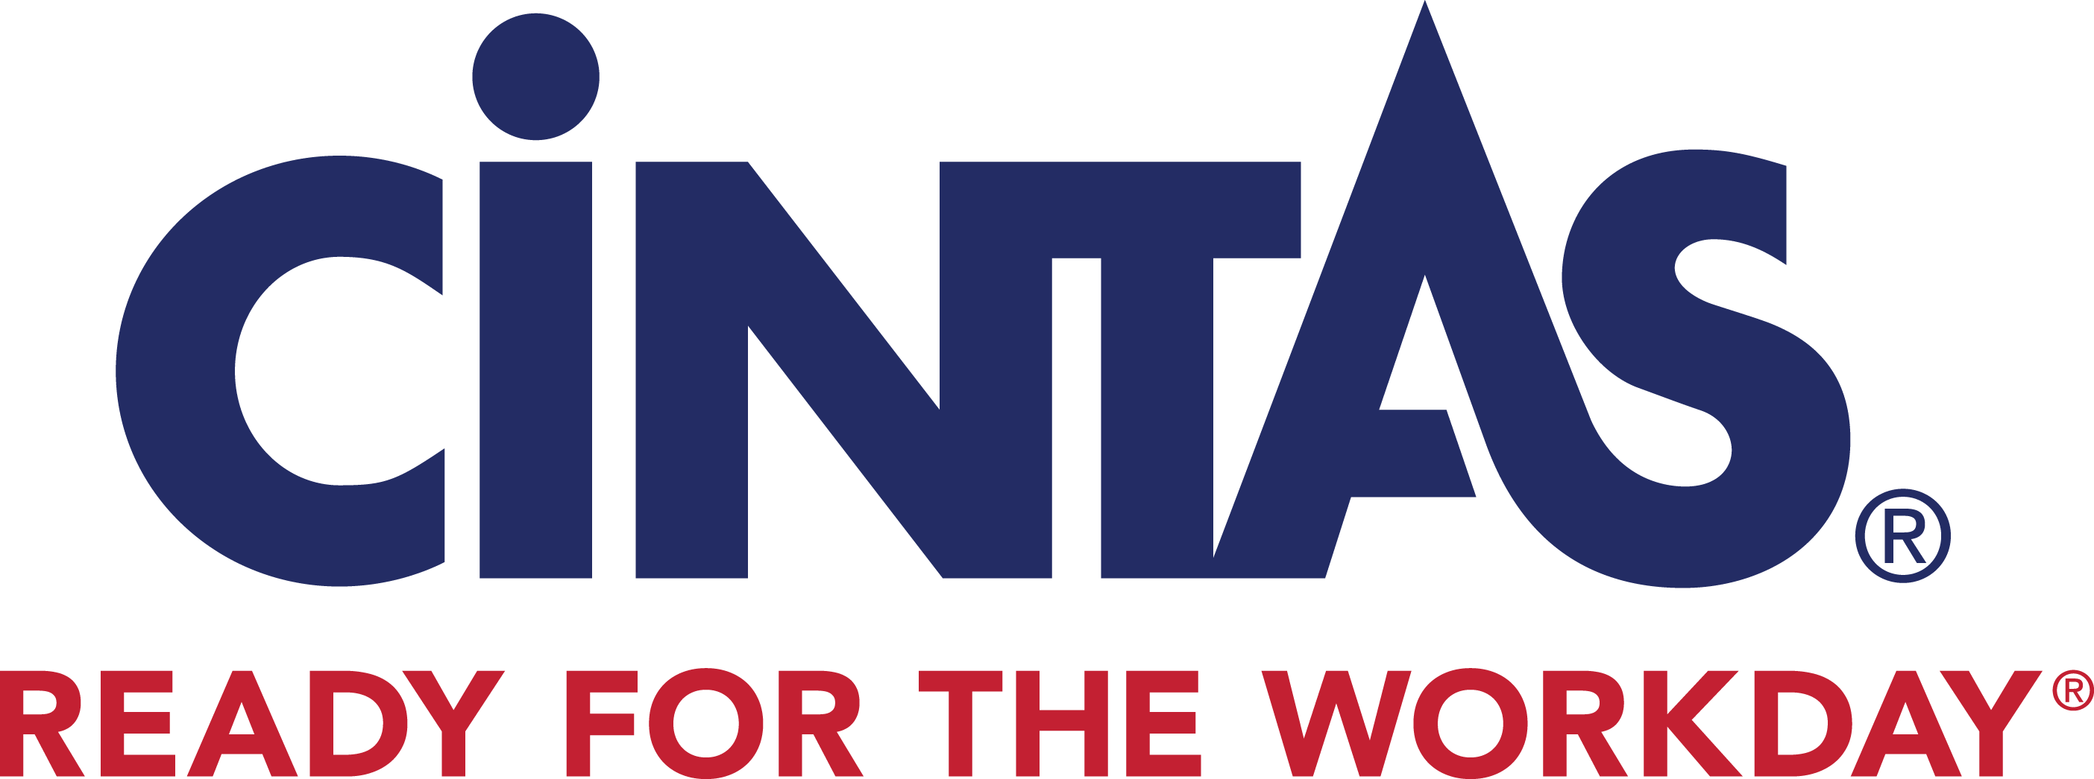

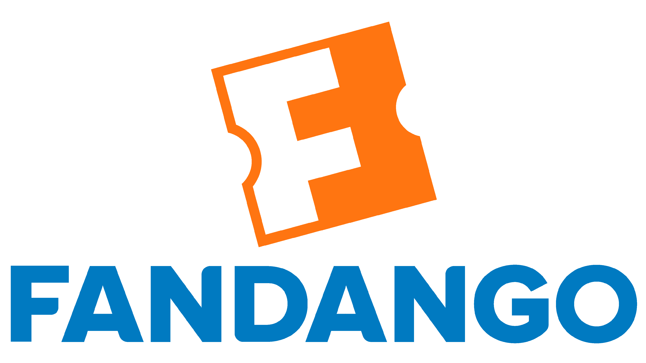

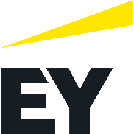

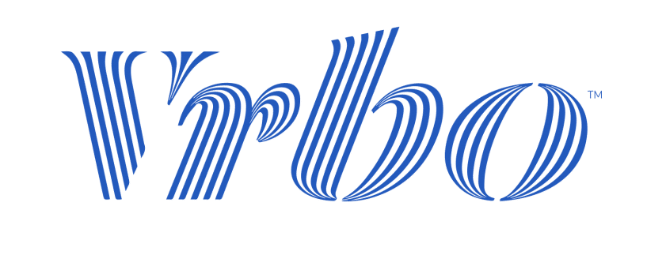
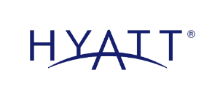

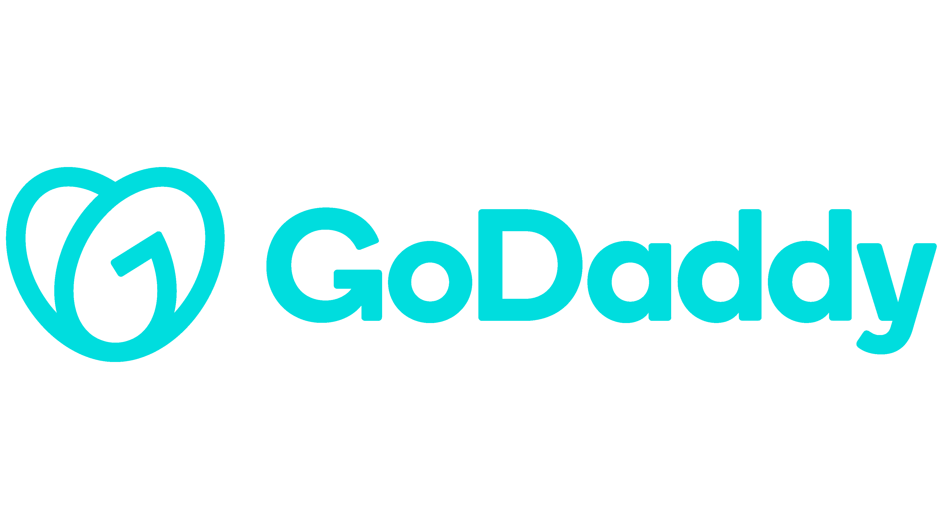


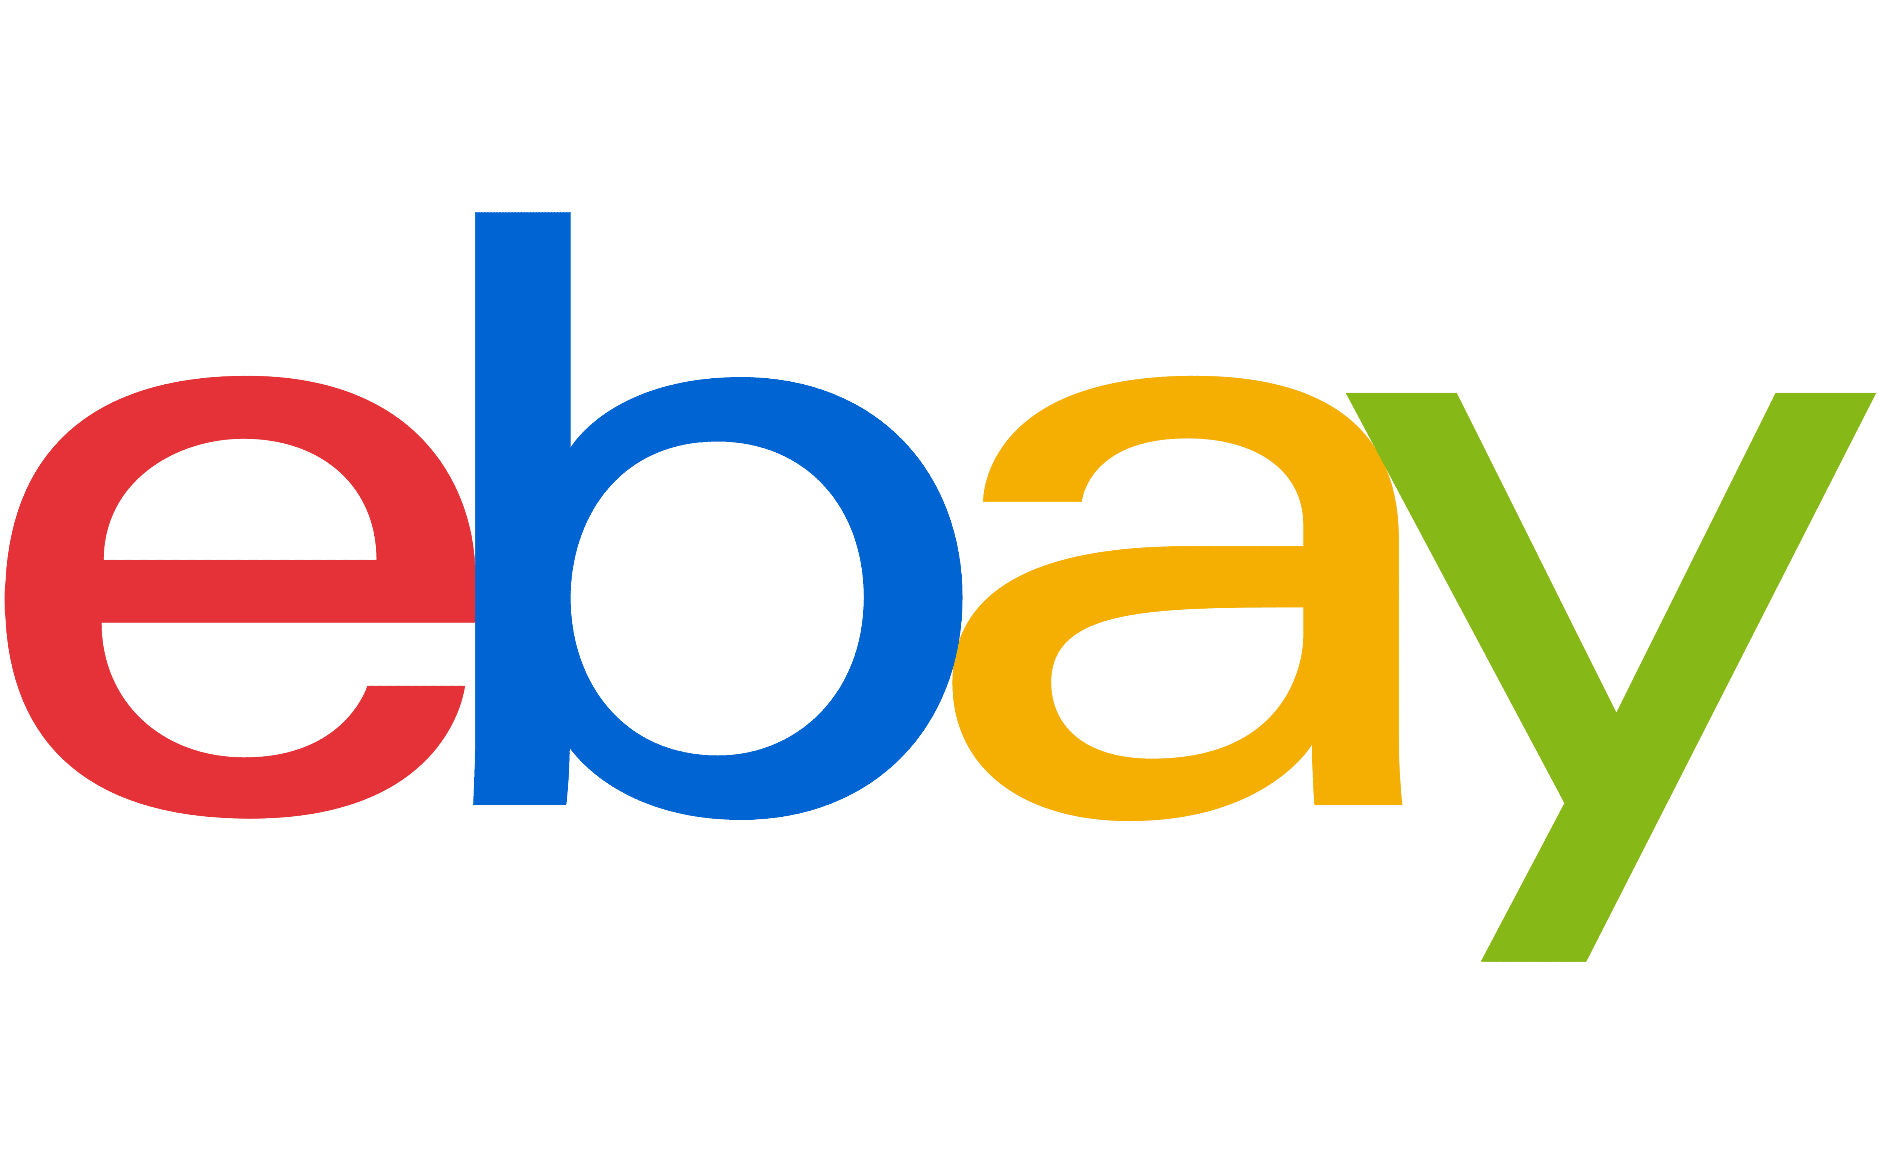























































Advertisers of all sizes were victims of this lack of transparency and ad fraud, from blue-chip national advertisers to local small businesses alike
Sampling of 100 Brands referenced in the Adalytics Report
Source: Adalytics Research LLC, ‘Did Google Mislead Advertisers About TrueView Skippable In-Stream Ads for the Past Three Years?’ report, June 2023.
This information is exclusively provided to VAB members and qualified marketers.
PAGE 29

Slide 30


A separate Adalytics report alleges that almost half of Google search ad impressions were served on non-transparent, third-party websites
6.7%
47.7%
of examined Google search campaign ad budget was spent on Google Search Partners & Display Expansion
of examined Google search campaign
ad impressions were observed on Google Search Partners & Display Expansion
Source: Adalytics Research LLC, ‘Does A Lack of Transparency Create Brand Safety Concerns For Search Advertisers?’ report, November 2023. Based on Adalytics dataset access to over a billion (USD) dollars’ worth of search ad campaigns data from various Fortune 500 brands, media agency, non-profits, and SMBs. For each of these brands, agencies, and non-profits, Adalytics analyzed how many impressions, conversions, clicks, and spend was distributed on Google search (such as google.com or google.co.uk), versus the Search Partners network. The search ad campaigns’ datasets included tens of thousands of search ad campaigns, over a billion USD (or foreign currency equivalents) in search media spend, tens of billions of search ad impressions and billions of ad clicks.
This information is exclusively provided to VAB members and qualified marketers.
PAGE 30

Slide 31
Google Search Partners allegedly included pornographic, animal abuse and US-sanctioned foreign websites which put brands at reputational risk
Marketer reactions to the third Adalytics report findings
“The adjacency to unsafe, unsuitable, and in some cases illegal sites would be a serious concern for brands, regardless of whether any money has changed hands.
Brands do not want to be seen to endorse the wrong type of content by appearing alongside it, because of the reputational damage it may cause.
Their ads appearing on objectionable sites is a significant problem in its own right, with or without monetization (i.e. a click).”
“Brand safety as a topic needs a thorough investigation especially given that search safety capabilities are not available/limited from current custodians of brand safety providers which should be a huge concern based on the safety issues in search as demonstrated by this report.
Given a huge part of brands’ investments are on search, the industry needs to put this topic as one of the priorities for 2024 and push for better products and measurement in the field of brand safety.”
‘Anonymous’ brand executive
Global head of media at a Fortune 500 company
Source: Adalytics Research LLC, ‘Does A Lack of Transparency Create Brand Safety Concerns For Search Advertisers?’ report, November 2023.
This information is exclusively provided to VAB members and qualified marketers.
PAGE 31

Slide 32
3
Ad fraud and lack of digital ad-tech transparency put brands at
legal risk

Slide 33

























Data leaks and breaches associated with digital activity can break consumer trust and cost companies in fines from government entities
August 14, 2023
July 4, 2022
May 25, 2022
January 22, 2020
October 30, 2020
October 16, 2020
February 1, 2023
September 14, 2023
January 25, 2021
March 2, 2023
October 24, 2022
May 30, 2021
May 10, 2020
This information is exclusively provided to VAB members and qualified marketers.
PAGE 33

Slide 34













Major digital platforms have also been hit with fines, some repeatedly, for breaking privacy laws and misusing data from children
May 31, 2023
June 6, 2023
September 5, 2022
December 19, 2022
April 4, 2023
February 27, 2019
September 19, 2023
September 15, 2023
This information is exclusively provided to VAB members and qualified marketers.
PAGE 34

Slide 35
Major digital platforms, and some brands that shared data with them, have incurred hundreds of millions of dollars in fines due to data misuse
Instagram
$402MM
in EU for allegedly mishandling children’s data
TikTok
$367MM
fine by Irish Data Protection Commission for allegedly mishandling children's data
Google
$155MM
in settlements over
location tracking
Twitter
$150MM
fine for allegedly breaking privacy promises
Amazon
$25MM
to settle charges that Amazon had violated COPPA
Microsoft
$20MM
for collecting and
retaining personal information from children
British Airways
£20MM
over breached data, some of which was shared with Google and Facebook
TikTok
$16MM
UK fine for misusing
children’s data
BetterHelp
$8MM
to online therapy users for alleged data misuse, including sharing metadata with Facebook and Google
GoodRx
$2MM
for sharing user’s health data with Google and Facebook
This information is exclusively provided to VAB members and qualified marketers.
PAGE 35

Slide 36
Brands at Legal Risk:
A Case Study
Do Google’s ad practices result in targeting kids, data misuses, copyright infringement, disinformation and advertising on US-sanctioned websites?

Slide 37


A large share of GVP sites & apps were created outside of the U.S. which poses a data risk from offshore criminal networks and other foreign entities
% of spend by developer ‘country of origin’
for sub-set of TrueView ad budget that was allocated to GVP network Android mobile apps
Source: Adalytics Research LLC, ‘Did Google Mislead Advertisers About TrueView Skippable In-Stream Ads for the Past Three Years?’ report, June 2023.
This information is exclusively provided to VAB members and qualified marketers.
PAGE 37

Slide 38




YouTube ads were allegedly served within questionable content, exposing brands to kids' videos, copyright infringement, disinformation and more
Sampling of TrueView In-stream Ads Served as Out-stream Ads through Google Video Partner Network (GVP)
Child-Targeted
Piracy
Ads on mobile apps for children as young as two years old
Website with over 101,000 DMCA copyright takedowns
Objectionable Content
Foreign Disinformation
Ads alongside objectionable content (such as pornography, animal abuse and adjacencies to children’s deaths)
Ads on foreign, and state-associated, news sites known
to publish disinformation
Source: Adalytics Research LLC, ‘Did Google Mislead Advertisers About TrueView Skippable In-Stream Ads for the Past Three Years?’ report, June 2023. Note: after the Adalytics report was released, YouTube changed the name of their ‘in-stream ads’ format to ‘skippable ads’ throughout Google Display and Video 360, according to a ‘What’s New: July 2023’ Google Blog Post and reported by Adweek on 8/7/23.
This information is exclusively provided to VAB members and qualified marketers.
PAGE 38

Slide 39




An Adalytics study alleges that ‘adult-targeted’ brands like credit cards, construction and personal injury played in ‘Made for Kids’ YouTube videos
Sampling of brand’s ads placed in YouTube ‘Made for Kids’ content
BMO Bank ad on the ‘Made for Kids’ YouTube video: ‘Diana Barbie and Roma Ken Pink vs. Blue Challenge’ on the channel ‘Kids Diana Show’
Caterpillar ad on the ‘Made for Kids’ YouTube video: ‘Booba Best Episodes Collection Most Interesting Cartoons Moolt Kids Toons Happy Bear’
Maxeon Solar Technologies (a solar panel manufacturer) ad on the ‘Made for Kids’ YouTube video:
‘The Farmer In The Dell + More Nursery Rhymes and Kids Song | Super Simple Songs’
Rothenberg personal injury law firm ad on the ‘Made for Kids’ YouTube video: ‘Dinosaurs Showdown! T-Rex Ranch Dinosaur Videos’. The law firm ad includes pictures of car crashes and medical injuries.
Source: Adalytics Research LLC, ‘Are YouTube advertisers inadvertently harvesting data from millions of children?’, August 2023.
This information is exclusively provided to VAB members and qualified marketers.
PAGE 39

Slide 40

Nearly one in five ad clickthroughs to brands’ websites appear to originate from YouTube channels that were labeled as ‘Made for Kids’
Clicks on ‘Made for Kids’ YouTube Channels
1,041 campaigns from 2014-2023
Source: Adalytics Research LLC, ‘Are YouTube advertisers inadvertently harvesting data from millions of children?’, August 2023. Adalytics analyzed a dataset of over 1,000 YouTube ad campaigns from several years. These campaigns had different demographic and behavioral targeting criteria and parameters, objectives, geographies and costs. The ad campaigns generated over a hundred thousand clicks.
This information is exclusively provided to VAB members and qualified marketers.
PAGE 40

Slide 41
Most marketers (78%) don’t want their brand ads in ‘young kids’ content and consider placements there as unethical and a waste of ad dollars
Additionally, 69% of marketers would ask for a refund if their brand’s targeted ads were served on content that is directed at young kids
In their own words, quotes from surveyed media buyers (anonymous)
‘Do you want to have your brand’s behaviorally targeted ads served on content that is specifically directed at young kids?’
‘The target audience on my brands are individuals 25-54 with a high HHI because the product is expensive. Delivering targeted ads to children is not only ethically wrong but a complete waste of my budget’
‘My brand assignment is focused on adult consumers and kids seeing some of our ads would be highly concerning’
‘Wastage of media budget, plus unethical’
‘No, I don’t want to be wasteful with my client’s budget since children generally don’t make purchases’
‘These channels are primarily for kids, I am concerned about COPPA compliance. I also use data for targeting so I should not be on these channels anyways’
Source: Adalytics Research LLC, ‘Are YouTube advertisers inadvertently harvesting data from millions of children?’, August 2023.
This information is exclusively provided to VAB members and qualified marketers.
PAGE 41

Slide 42







Shortly after the release of the second Adalytics study, Senators called for an FTC investigation into Google for alleged breaches of children's privacy
August 17, 2023
August 17, 2023
August 17, 2023
This information is exclusively provided to VAB members and qualified marketers.
PAGE 42

Slide 43
Marketers also reacted to the release of the third Adalytics report that exposed alleged risks with non-transparent Google Search Partner sites
Marketer reactions to the third Adalytics report findings
“While having our ads appear on virtually any of the sites listed in the study would be extremely problematic; financial services ads showing up on websites based in Iran, which is under sanction by the Federal Government would require the firm to alert the Office of the Comptroller of the Currency and trigger a process that would likely lead to fines and public scrutiny that would impact everything from reputation to share price to customer demand.”
“"It's interesting that the go-to-market materials which so effusively discuss the benefits and power of machine learning and automation neglect to mention that
platform reporting has now been so hobbled so as to effectively make it impossible to catch these kinds of issues on our own, forcing us to rely on pre-reads from analytical SWAT teams like Adalytics to ensure we're only reaching consumers on brand-safe environments and not those that will have our CMO being dragged before Congress."
Former head of global media for a major financial services institution
Senior Fortune 500 brand marketing executive
Source: Adalytics Research LLC, ‘Does A Lack of Transparency Create Brand Safety Concerns For Search Advertisers?’ report, November 2023.
This information is exclusively provided to VAB members and qualified marketers.
PAGE 43

Slide 44




The three Adalytics studies highlight the financial, reputational and legal risks involved when there is ad fraud and a lack of digital transparency
Wasted Impressions:
Counted & Invoiced
Brand Damage:
Ads in Really Bad Places
Data Misuse & Breaches:
Tempting Criminals
This information is exclusively provided to VAB members and qualified marketers.
PAGE 44

Slide 45





As marketers, it’s time to take back your digital video ad campaigns by demanding transparency and verification from your media partners
Complete transparency on…
True verification
The full lifecycle of all video ad units within your campaign by
media partner
All calculations
of video ad impressions by media partner
The granular details of exact ad placements, by type and inventory source, across each media partner
The composition of ad placement types and inventory sources in audience metrics such as reach calculations by media partner
Have media partners bring in a truly independent third party to provide transparency on
a now-permanent basis
This information is exclusively provided to VAB members and qualified marketers.
PAGE 45

Slide 46
Do you wonder if a lack of transparency and ad fraud from YouTube affects your brand? Verify your campaign data internally or contact Adalytics and they will do an analysis for your brand
Adalytics is looking to expand on their public interest research and is offering a complimentary opportunity for brands and agencies.
Adalytics will analyze your TrueView ad placement reports and give you insight into where and how your ads were served. In exchange, they will use
de-identified, non-attributable data in their aggregated research collective.
If you’re interested in a deeper analysis of the inventory you paid for,
please fill out this form and Adalytics will be in touch with you.
This information is exclusively provided to VAB members and qualified marketers.
PAGE 46

Slide 47






Creators
Jason Wiese
Leah Montner-Dixon
SVP, Director of Strategic Insights
jasonw@thevab.com
Director, Audience & Behavioral Insights
leahm@thevab.com
Reed Kiely
Karolina Guillen
An Interview with Adalytics
An insider's look at the latest Google
ad fraud allegations
Exposing the Double Standard
in Video Advertising
Advertising Week NY 2023 Presentation
Director, Data Insights & Trends reedk@thevab.com
Insights Manager
karolinag@thevab.com
Discover more
Looking for more data, insights and takeaways? Check out this related VAB content
VAB Investigation
Did YouTube allow for targeted campaigns
to be served on ‘Made for Kids’ channels?
The Credibility Crisis
How people find trusted news amidst
a wave of misinformation
VAB Members, brand marketers and agencies get free and immediate access to VAB’s content library.
Get access at theVAB.com
What is Digital Ad Fraud?
A Look Into Critical Issues
Impacting Marketers Today
What is The Digital Video
Supply Chain
Understanding the path of digital ad investments
This information is exclusively provided to VAB members and qualified marketers.
PAGE 47

Slide 48


About VAB
VAB plays a dual role in the video advertising industry. We are leading the change to bring about a more innovative and transparent marketplace. We also provide the insights and thought leadership that enables marketers to develop business-driving marketing strategies.
Drawing on our marketing expertise, we simplify the complexities in our industry and discover new insights that transform the way marketers look at their media strategy.
We are committed to your business growth and proud to offer VAB members, brand marketers and agencies complimentary access to our continuously-growing Insights library. Get immediate access at theVAB.com.
This information is exclusively provided to VAB members and qualified marketers.
PAGE 48

Slide 49

Who is Adalytics?
Adalytics is a next level transparency and advertising performance optimization platform built to analyze data across the digital technology landscape.
Many marketers strive to attain transparency into their media buys but view legacy brand safety and verification technologies as a cost center rather than a performance booster.
Advertisers shouldn’t settle for impressions that lack the comprehensive transparency brands of all sizes deserve. True transparency can drive digital media performance and efficiency while keeping brands protected from bad actors.
To deliver actionable insights that allow marketers to deliver against real KPIs, Adalytics integrates data from:
Impression level log files
Advanced measurement tags
Customer relationship management (CRM) systems
Web analytics
Built by industry leading researchers whose findings have been featured in the Wall Street Journal, Washington Post, Business Insider, Reuters, and several books. Members of the United States Senate Intelligence Committee also rely on their research and technology to understand the digital advertising ecosystem.
Click here to review a list of Adalytics recent initiatives and accomplishments and click here for their recent research reports.
This information is exclusively provided to VAB members and qualified marketers.
PAGE 49

