Slide 1



Case Study Corner
xx
Health, Wellness & Beauty Categories
Brand success stories highlighted through real-world multiscreen TV case studies

Slide 2





8 Health, Wellness & Beauty categories ‘real world’ case studies showcasing how multiscreen TV drives business outcomes across the funnel
Upper Funnel Outcomes
Awareness
Multiscreen TV campaigns that expand reach and drive brand recall against a brand’s best customer prospects*
Sampling of ‘awareness-based’ outcomes that can be measured:
Reach / Reach Extension / Incremental Reach
Ad / Brand Recall
Cost Efficiencies (Reach / Targeted IMPs)
Mid-to-Lower Funnel Outcomes
Action
Multiscreen TV campaigns that increase the likelihood the intended audience will be motivated to act*
Sampling of ‘action-based’ outcomes that can be measured:
Conversion Rates (website traffic,
app downloads, subscription sign-ups,
tune-in, foot traffic)
Sales / Revenues
Optimizations / ROI
Cost Efficiencies (Conversions)
Full-Funnel Outcomes
Awareness + Action
Multiscreen TV campaigns that expand reach and drive brand recall while also increasing the likelihood that the intended audience will be motivated to act*
Sampling of full-funnel outcomes:
Reach → Brand Recall → Conversion Rates → Sales → Optimizations →
Cost Efficiencies
*based on campaign KPIs
This information is exclusively provided to VAB members and qualified marketers.
PAGE 2

Slide 3
Upper Funnel
Case Studies
Awareness
Multiscreen TV campaigns expand reach
and drive brand recall against a brand’s
best customer prospects
Sampling of ‘awareness-based’ outcomes that can be measured:
    Reach / Reach Extension / Incremental Reach
    Ad / Brand Recall
    Cost Efficiencies (Reach / Targeted IMPs)
How Multiscreen TV drives
Awareness
This information is exclusively provided to VAB members and qualified marketers.
PAGE 3

Slide 4

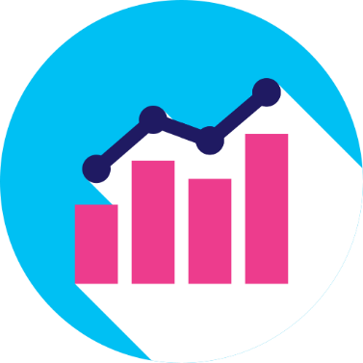



Category:
Health
A DTC Health Tech brand partnered with Tatari
to identify optimal ad frequency for streaming campaigns
Challenge
A Health Tech brand running local streaming campaigns had ad frequency concerns (over-serving ads to the same viewers). It sought to uncover the optimum frequency in order to expand its reach and increase lower-funnel metrics
Measurement Innovation
Tatari analyzed the impact different ad frequencies have on response and conversion rates
Net Funnel Efficiency (response rate x conversion rate), was used to identify the optimal weekly and daily frequency caps that should be put in place to drive lower-funnel impact
Target Segment
Streaming audiences that are incremental to linear TV DMA targets
Learnings
As a result of frequency implementation, the brand was able to increase the reach of it’s campaign by 95%, more effectively distributing impressions with the same budget
From a cost perspective, the brand saw a 65% reduction in Cost Per Website Sign-Up after implementing the above-mentioned caps
Company / Viewing Source / Media Type
Tatari / Streaming Platform / CTV
Overview Of Results for the Campaign
+65%
Reduction in Cost Per Website Sign-Up after implementing frequency caps
+95%
Increase in reach with impressions spread further with frequency caps
Source: Tatari, Case study: DTC Health Tech Case Study. Campaign dates: Q2 2020- Q2 2021.
This information is exclusively provided to VAB members and qualified marketers.
PAGE 4

Slide 5

Category:
Healthcare
Healthcare brand achieved scale and drove incremental users within premium OTT inventory, leading to growth in SOV
Challenge
A large healthcare brand wanted to optimize their cross-screen reach and increase share of voice (SOV) in the market with a focus on driving cost efficiencies
Solution
Build a custom data segment of consumers who were exposed to competitors’ ads on Linear TV
Reach exposed users across OTT, desktop, tablet, and mobile to ensure client was the second touchpoint across Digital screens
Measure success via a custom Competitive Insights report comparing competitors’ Linear reach, frequency, and SOV pre- and post- campaign activation
Target Segment
Custom target audience exposed to competitors' Linear TV ads on Digital
Results
VideoAmp measured +25% increase in video completion rate, a 33% larger share of voice than their competitors and +8MM incremental unique users reached
Company / Platform / Media Type
VideoAmp / Streaming + Multiscreen (non-linear) / OTT
+25%
+33%
8MM+
Video Completion Rate Increase
Larger Share of Voice vs. Competitors via Cross-Channel Unique Reach
Incremental Unique Users Reached
Source: VideoAmp, Case study: Healthcare Brand Captures Market Share with Conquesting Strategy Across Linear and Digital. Campaign time period: July 2020.
This information is exclusively provided to VAB members and qualified marketers.
PAGE 5

Slide 6

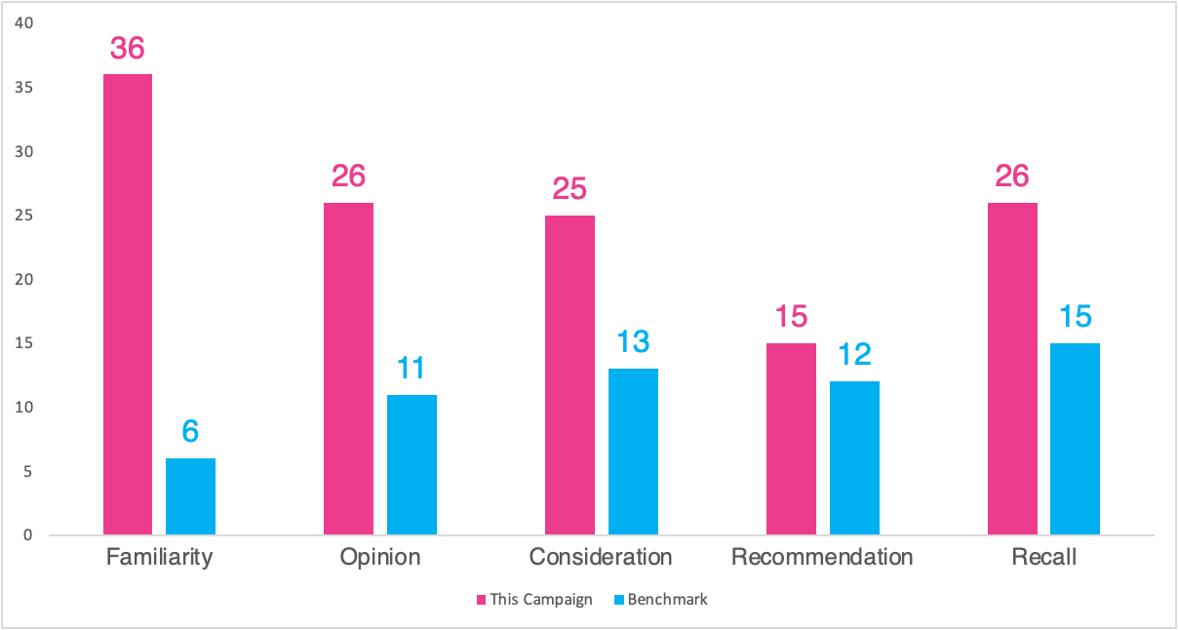
Category:
Beauty
A beauty brand partnered with Comscore and Univision
to quantify and drive brand perception
Challenge
A beauty brand sought to improve its brand perception among core 25-to 54-year-old Hispanic/Latinx females
Measurement Innovation
The brand ran a targeted branded content video campaign on Univision online platforms
To quantify the lift in positive brand association, Univision employed Comscore’s Social Media BrandLift™
This survey-based solution delivers verified information on how the activated audience thinks and feels about the brand partner
It also enables advertisers, publishers or influencer partners to measure industry-accepted, as well as bespoke KPIs across branded content campaigns
Target Segment
Hispanic/Latinx Females A25-54
Ethnicity included: 65% Mexican, 5% Puerto Rican, 4% Cuban, 25% Other
Learnings
The brand was able to understand how the campaign:
  Impacted positive brand sentiment across 5 areas, with double-digit increases across all metrics
  Positively impacted key brand association metrics and recall among its key Latinx target
Company / Viewing Source / Media Type
Comscore / Univision / Digital Video, Social Media
68% of the Latino female segment aged 25-34 associate the beauty brand with hydrating skin
60% of Latino social engagers recalled Univision’s premium branded content
96% of the Latino female segment aged 25-34, exposed to Univision’s campaign expressed ’more interest’ in beauty product brand
86% of surveyed Hispanic audiences reported being more interested in the beauty product brand after seeing the Univision campaign
pts
pts
pts
pts
pts
pts
pts
pts
pts
pts
*Shareablee’s Overall Survey benchmarks calculate the average percentage point change lifts from Non-Engaged to Engaged survey respondents across key survey questions (such as Recall or Purchase Consideration) for campaign assessment
Source: Comscore, Case study: Blinded Beauty Brand. Campaign dates: 10/15/21- 11/19/21.
This information is exclusively provided to VAB members and qualified marketers.
PAGE 6

Slide 7

Category:
Healthcare
A healthcare brand worked with Samba TV to quantify the impact of their CTV campaign on 5 KPIs
Challenge
A major healthcare company sought to understand how their CTV campaign drove brand perception metrics across key audiences, with a focus on brand awareness and action intent
Measurement Innovation
Pairing Samba TV’s ACR viewership measurement with Lucid’s Brand Lift tool allows for deeper insights into campaign impact on awareness and consideration
Using Lucid’s Propensity Matched Control Methodology, Samba TV created an unexposed control group to measure campaign lift among those who were exposed to the advertising
Target Segment
A25+ including light TV-viewing cohorts, parents, African Americans & Hispanics
Learnings
The brand was able to determine campaign impact across 5 key brand perception metrics and compare to benchmarks. They saw lift in 4 out of 5 metrics, including brand awareness, ad recall, and action intent
The analysis revealed which target groups were most responsive, allowing for future target refinement. Key demographic groups (male, 25-54) responded best to the CTV Messaging
Company / Viewing Source / Media Type
Samba TV & Lucid / Pixel Tags / CTV
Control
Exposed
Lift
Significance
Benchmark lift*: 30.2%
Benchmark lift*: 12.1%
Source: Samba TV, Healthcare Case Study. Campaign time period: October 2021 – December 2021. *Benchmarks are provided at a category level from Brand Lift partner Lucid.
This information is exclusively provided to VAB members and qualified marketers.
PAGE 7

Slide 8
Mid-To-Lower Funnel
Case Studies
Action
Multiscreen TV campaigns increase the likelihood that the intended audience will be motivated to act
(e.g., make a purchase, download an app, sign-up
for a subscription, make a booking, etc.)
Sampling of ‘action-based’ outcomes that can be measured:
    Conversion Rates (website traffic, app downloads, subscription sign-ups, tune-in, foot traffic)
    Sales / Revenues
    Optimizations / ROI
    Cost Efficiencies (Conversions)
How Multiscreen TV drives
Action
This information is exclusively provided to VAB members and qualified marketers.
PAGE 8

Slide 9



Category:
Wellness
Audience-based buying outperformed traditional linear TV in online sales lift and conversion efficiency for a wellness brand
Challenge
A wellness brand sought to improve the online conversion performance of their traditional linear TV plan
Solution
The brand utilized A+E Network’s Precision solution to follow the custom target’s journey from where they were engaged and from engagement to conversion. Then A+E’s Performance solution was utilized for:
  TV Lift Performance (TLP): measures the relative performance of a campaign component’s contribution and impact on TV Lift
  Conversion Efficiency (Index): compares estimated spend (via iSpot) divided by the attributed campaign conversions to TV norms
Target Segment
Health-Conscious Adults
Results
Through audience-based targeting and measurement, A+E Networks contributed to a +42% lift in TV performance and +15% in conversion efficiency
Company / Platform
A+E Networks’ Precision+Performance / Data-driven linear
Outcome: Online Purchases
TV Lift Performance %
Conversion Efficiency Index
+42%
+15%
(IMP)
Traditional Linear
A+E Precision
Traditional Linear
A+E Precision
A+E Precision optimization increases vs. the cable TV average:
Lift performance: +27%
Conversion Efficiency Index: +41%
Source: A+E Networks, Case Study: Digital Conversion From Linear Campaign. Traditional Linear = consists of A+E networks and competitors where the brand is running advertisements. TV Lift Performance (TLP): Measure the relative performance of a campaign component's contribution and impact on TV Lift. Conversion Efficiency (Index): Index comparing estimated spend (via iSpot) divided by the attributed campaign conversions to TV norms.
This information is exclusively provided to VAB members and qualified marketers.
PAGE 9

Slide 10



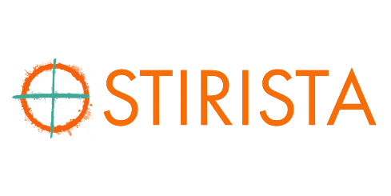
Category:
Wellness & Fitness
Stirista helped a brand target in-market customers on CTV and measure the impact on website visits and sales
Challenge
A wellness & fitness company wanted to efficiently scale its growth beyond linear TV and traditional direct response digital channels
Measurement Innovation
The brand sought to increase ROAS through audience-based targeting across CTV by using Stirista’s CTV targeting and view-through attribution reports
The brand leveraged Stirista’s Visitor Id Graph (VIG) website identity tool to conduct an audience profile analysis of their purchasers and create “targeting buckets” representing different high-indexing characteristics
Stirista targeted specific households that matched the high-indexing characteristics with CTV, while retargeting website visitors with Display advertising
Stirista’s VIG was also leveraged to source conversion data used for attribution and optimization
Target Segments
Proprietary Stirista modeled prospect segments
People with most stationary & most physical occupations
Gamers
People interested in natural medicine
People interested in sport the advertiser was a major sponsorship of
Learnings
Targeting specific households that matched the high-indexing characteristics with CTV combined with measurement and optimization of campaign, creative, target segment, geography, daypart, and publisher led to significant increases in ROAS for the brand
Stirista's View-Through Attribution reports allowed the brand to match and identify the number of website visitors and purchasers, the cost per purchaser, and the revenue generated and ROAS for the campaign
Company / Viewing Source / Media Type
Stirista / CTV / Programmatic CTV via AdStir DSP
Campaign Results
+67%
Increase in Return on Ad Spend
$4.28
Average Return on Ad Spend
Source: Stirista, Wellness & Fitness Case study. Campaign time period: November 1 2021 – October 4, 2022.
This information is exclusively provided to VAB members and qualified marketers.
PAGE 10

Slide 11
Awareness
How Multiscreen TV drives
Full-Funnel Outcomes
Multiscreen TV campaigns expand reach
and drive brand recall against a brand’s
best customer prospects
Action
Multiscreen TV campaigns increase the likelihood
that the intended audience will be motivated to act
(e.g., visit a website, download an app, sign-up
for a subscription, make a purchase, etc.)
Case Studies
This information is exclusively provided to VAB members and qualified marketers.
PAGE 11

Slide 12


Category:
Fitness
A fitness advertiser was able to monitor & optimize a cross-platform campaign aimed at driving incremental reach and online registrations
Challenge
A fitness advertiser launched a 2-part cross-platform TV campaign & needed a single source for converged TV measurement and attribution to track reach, frequency and incremental reach of linear and Connected TV (CTV)
Solution
Brand leveraged TVSquared’s ADvantage XP platform for 1:1 deterministic measurement & attribution for a unified view of performance & delivery metrics for all inventory sources including national broadcast & local cable for linear and streaming platforms like Roku, Hulu, Tubi, etc.
Target Segment
Custom Audience Target*
Results
Adjustments to inventory led to a greater share of impressions on streaming in 2nd campaign (+87%)
Increasing CTV impressions and diversifying across additional publishers increased unique CTV household reach by a further 22% (vs. earlier campaign)
Company / Platform / Media Type
TVSquared’s ADvantage XP platform / Streaming + Linear TV / Connected TV (CTV), Linear TV
OVERLAP – 4%
Impression split | CTV | Linear
Campaign 1 | 14% | 86%
Campaign 2 | 58% | 42%
CTV
LINEAR
*represents overlap of second campaign
Transforming Insights into Actionable Results
78%
of CTV Households Were Incremental to Linear
By increasing CTV impression share
4x
Response Rate for CTV
vs. Linear in Campaign 1
Influenced greater impression share for CTV in Campaign 2
-37%
Cost per Registration for CTV
Following adjustments across inventory sources
+116%
Increase in TV driven registrations for CTV
Optimizations drove increase
+93%
Uplift in HHs engaged
due to Linear TV
Optimizations drove lift
-39%
Cost per Registration for Linear TV
Following adjustments across inventory sources
Source: TVSquared, Case study: ADvantage XP: Delivering a Single Source of Truth for Converged TV . Campaign time period: Campaign 1 - January–March 2021 vs. Campaign 2 - May–July 2021. *Custom target built based on the number and variety of channels and genres they used.
This information is exclusively provided to VAB members and qualified marketers.
PAGE 12

Slide 13

Category:
Fitness
A fitness app leveraged a targeted addressable streaming campaign to increase familiarity, consideration and website traffic
Challenge
A leading online cycling and running virtual training app wanted to drive brand impact and website traffic for their app on a global scale
Solution
Using addressable advertising, powered by AdSmart, an audience-targeted campaign was launched to reach cycling audiences refined for each market across NBCU + Sky
Targeted impressions were delivered dynamically through set-top boxes internationally and through NBCU’s FEP content across O&O CTV apps, STB VOD, and Hulu in the U.S.
Target Segment
Cycling Custom Target
Results
Campaign generated significant brand awareness, internationally and in the U.S., including lift in familiarity, visitation rates and consideration intent
Company / Platform / Media Type
NBCU + Sky / Streaming + Multiscreen / NBCU O&O apps on Connected Devices, NBCU on Hulu (CTV, Desktop, Mobile), NBCU STB VOD, Sky STB VOD
Global brand metrics across Germany, U.K. and & U.S.
+100%
lift in unaided ad recall
+39%
lift in brand familiarity
+24%
lift in brand favorability
+19%
lift in consideration intent
+14%
lift in recommendation intent
Global impact on website traffic U.S.
+141%
lift in site visitation rate
+113%
lift in click rate to account creation page
+146%
lift in click rate to subscription page
Source: NBCU, Fitness Case Study. Campaign time period: Q4 2020 - Q1 2021. FEP = full episode player.
This information is exclusively provided to VAB members and qualified marketers.
PAGE 13

Slide 14

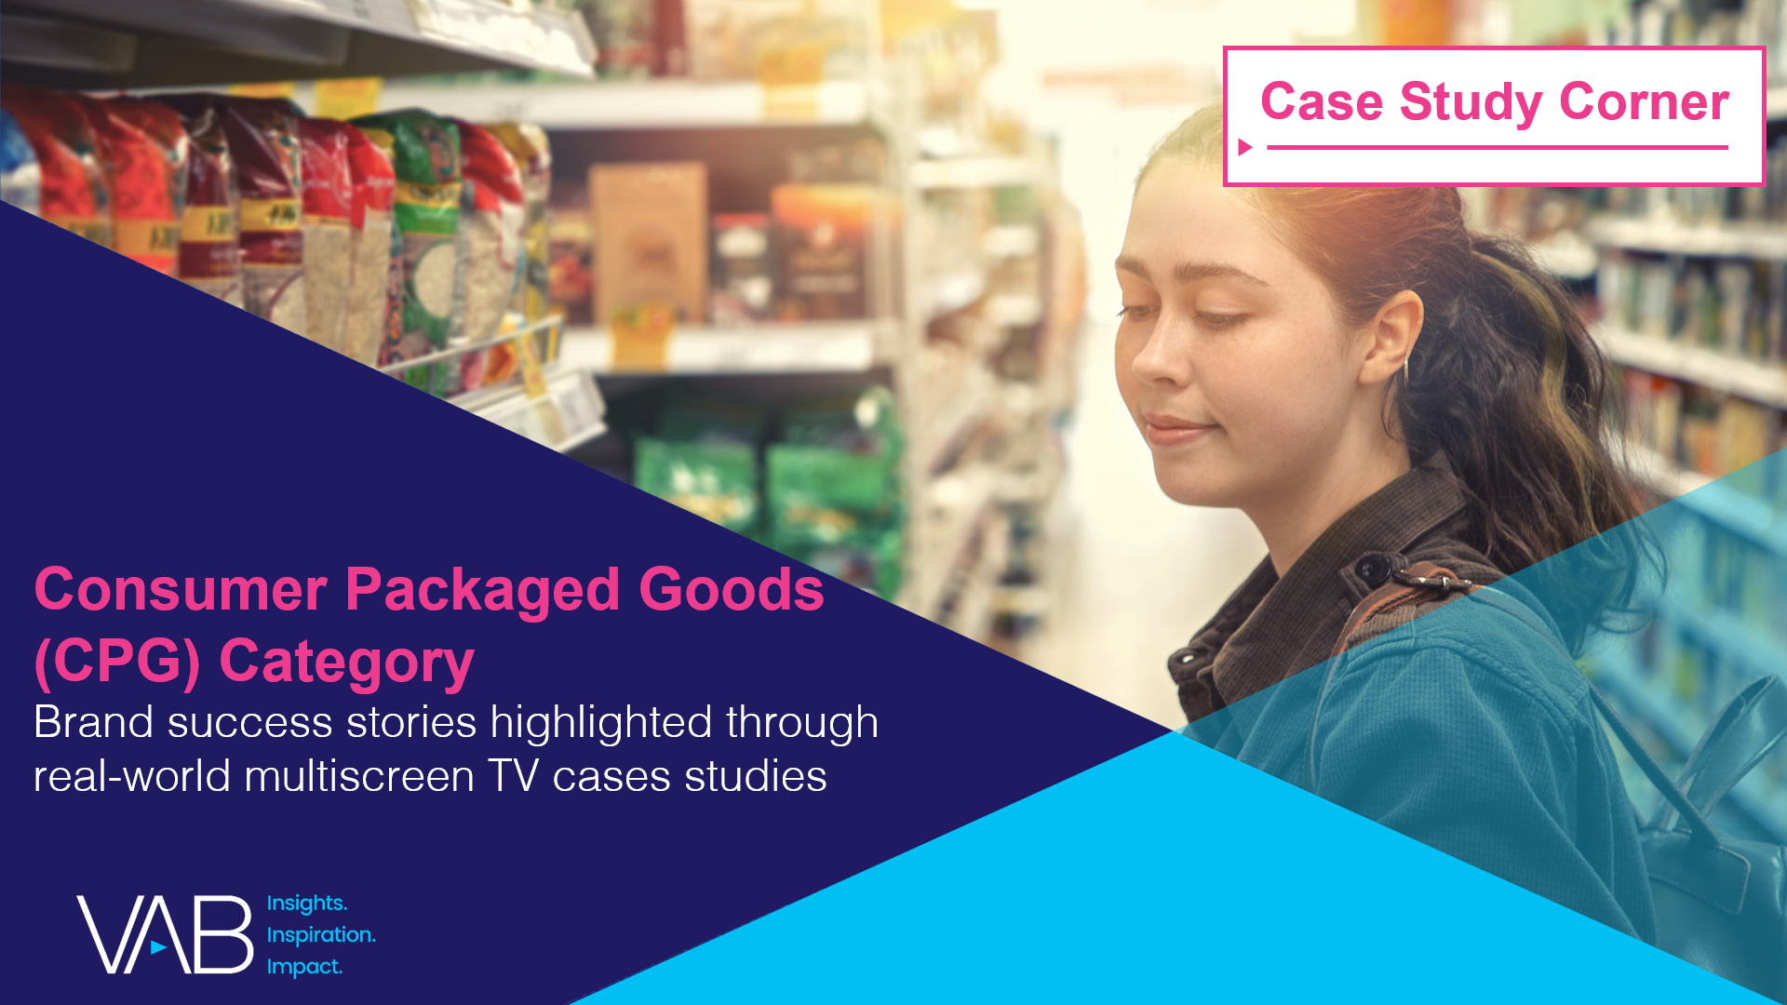


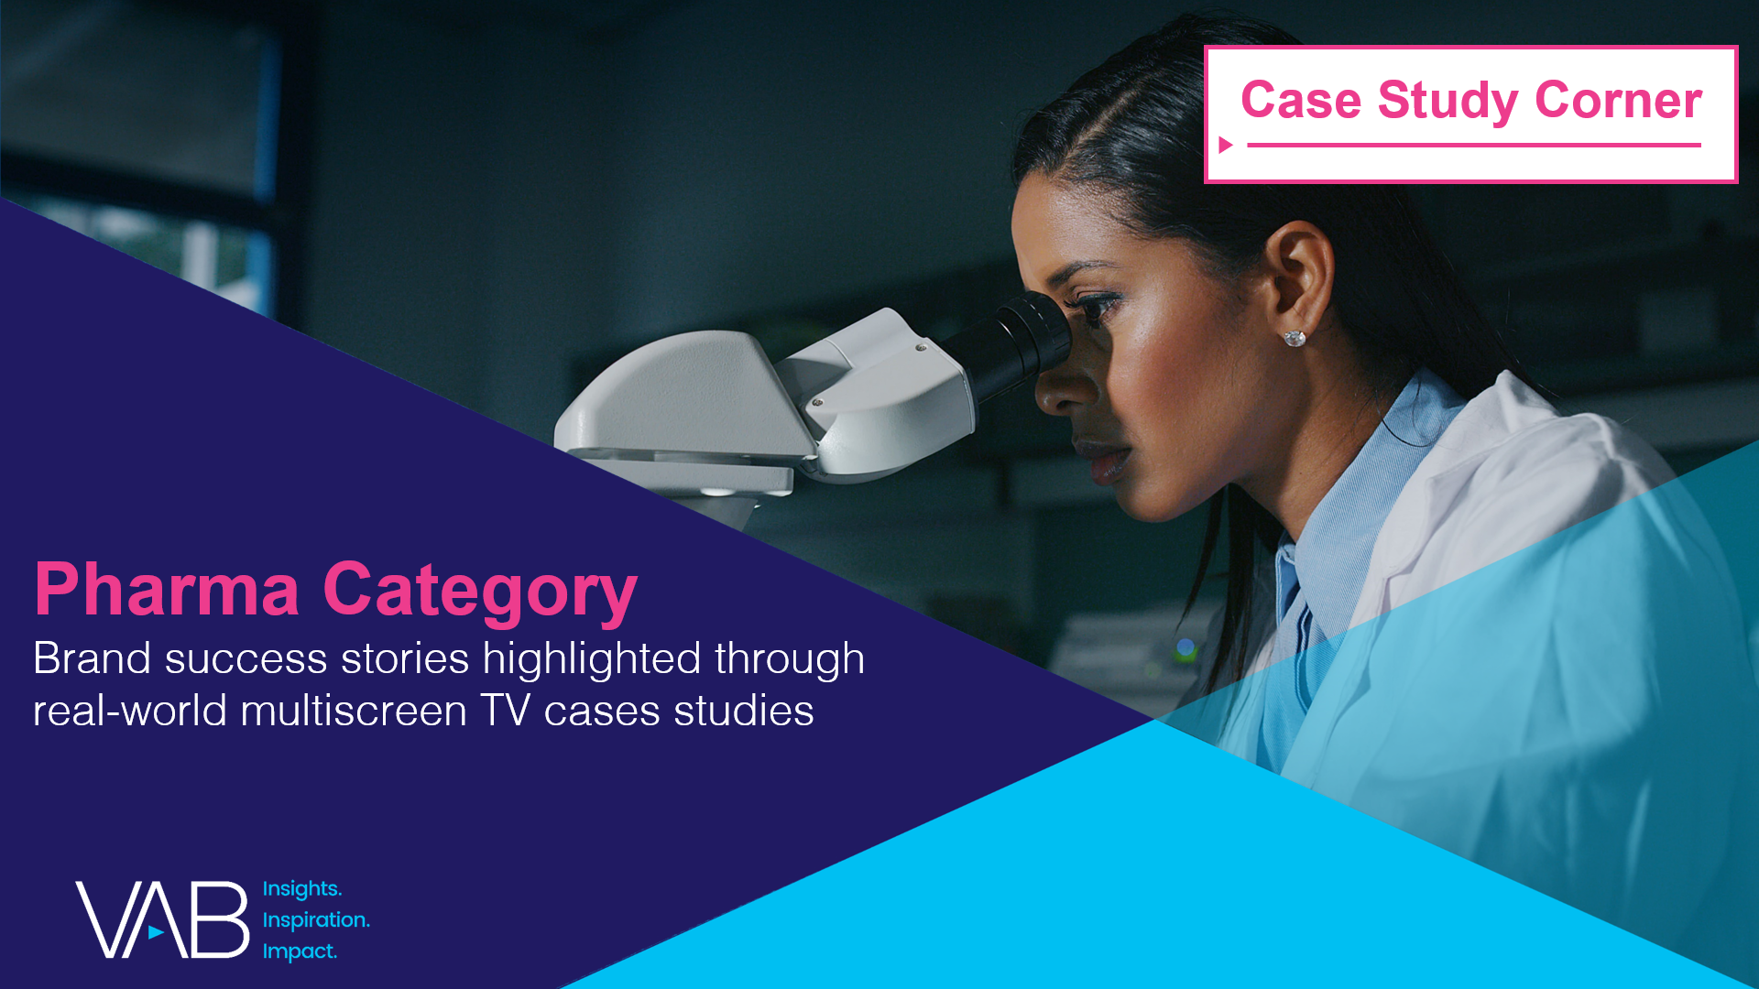
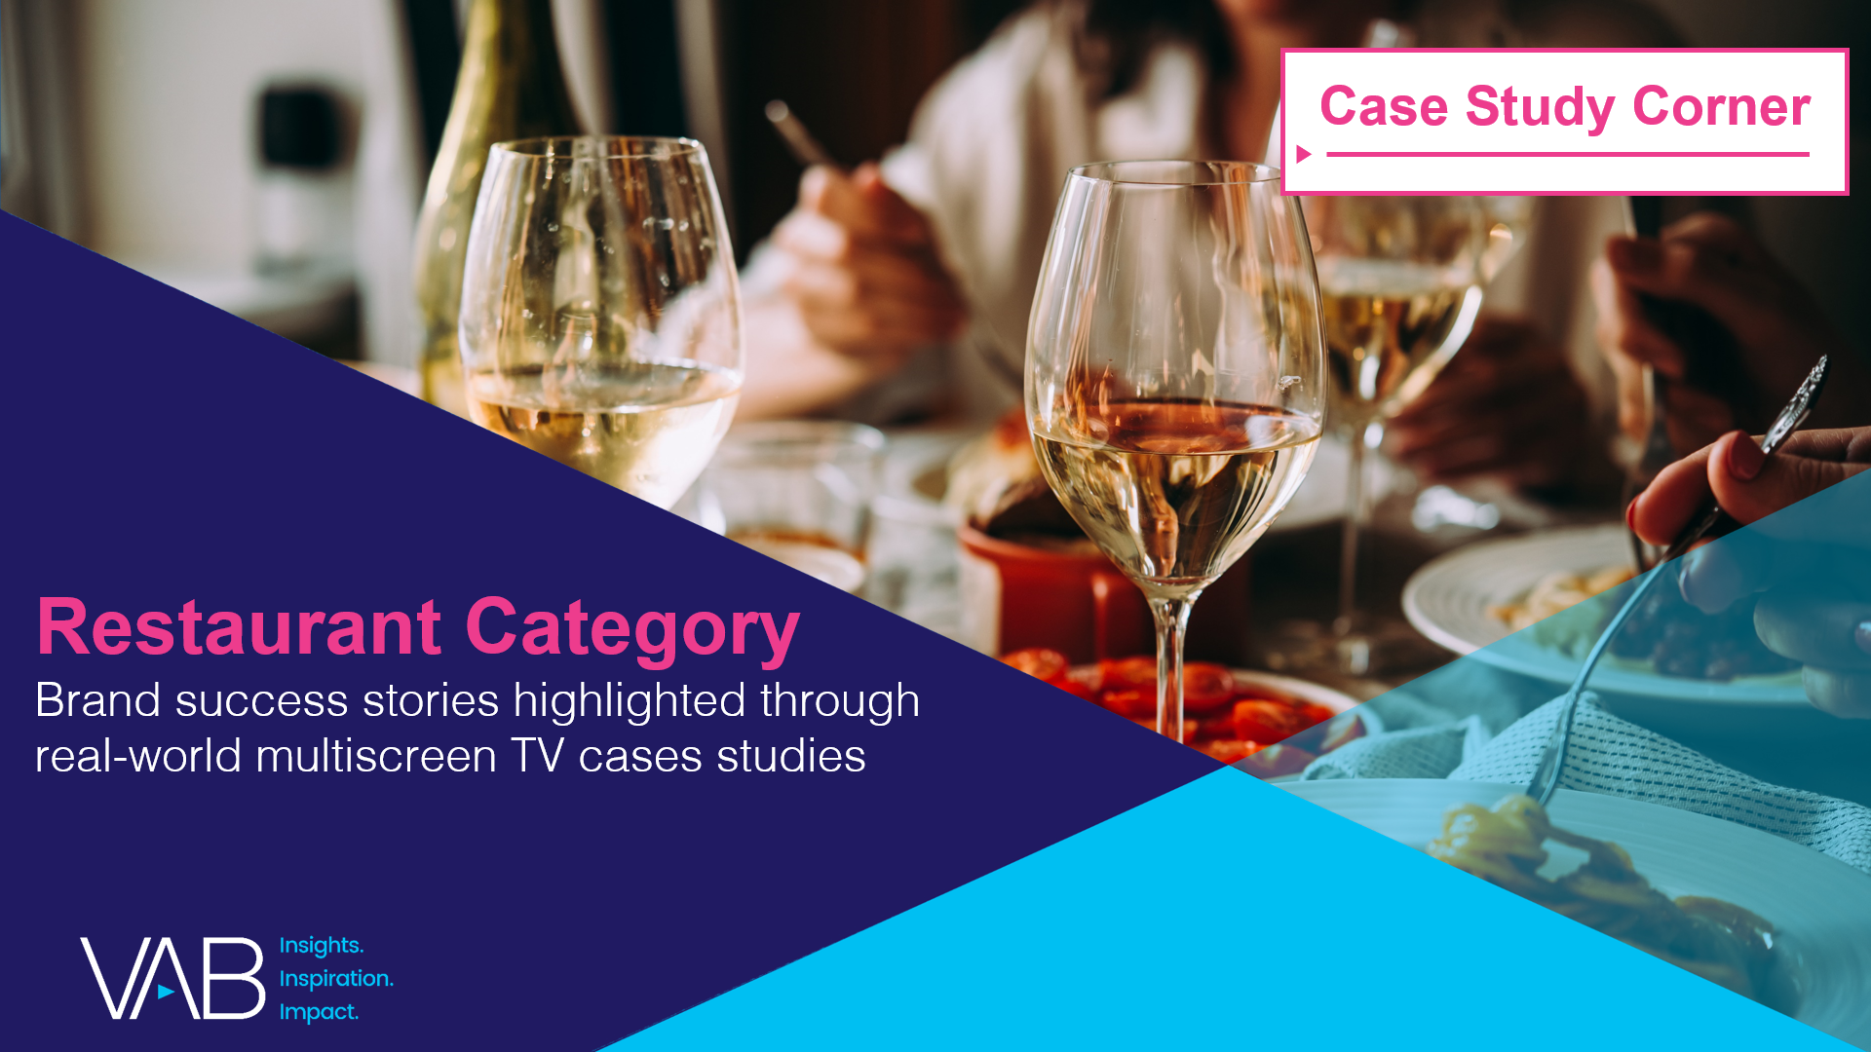
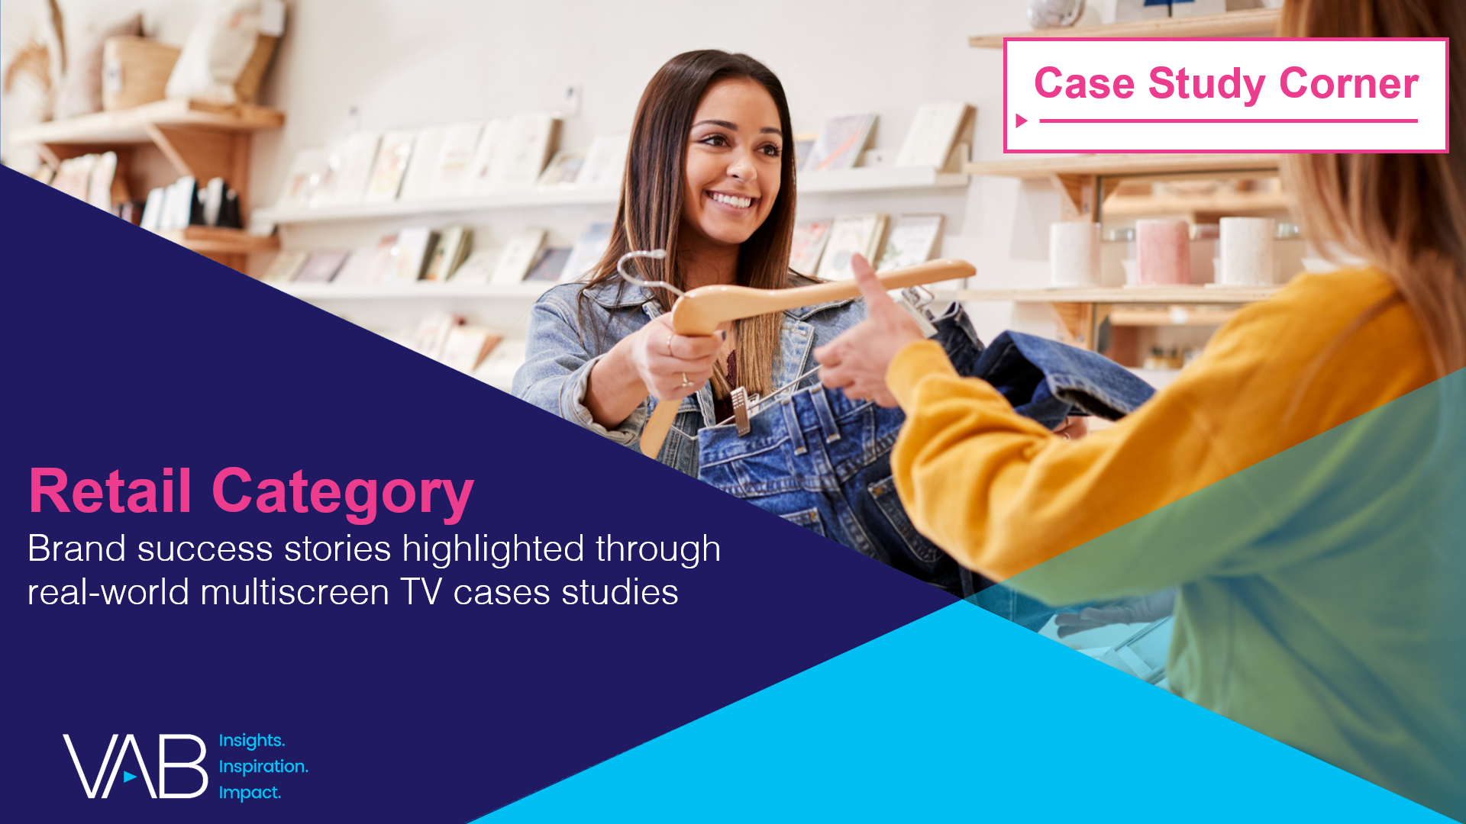
Want more? VAB has a wealth of case studies across additional categories
Automotive
Consumer Packaged Goods (CPG)
Entertainment & Tune-In
Financial Services & Insurance
Pharmaceuticals
Restaurants
Retail
Access more case studies at www.thevab.com
This information is exclusively provided to VAB members and qualified marketers.
PAGE 14

Slide 15


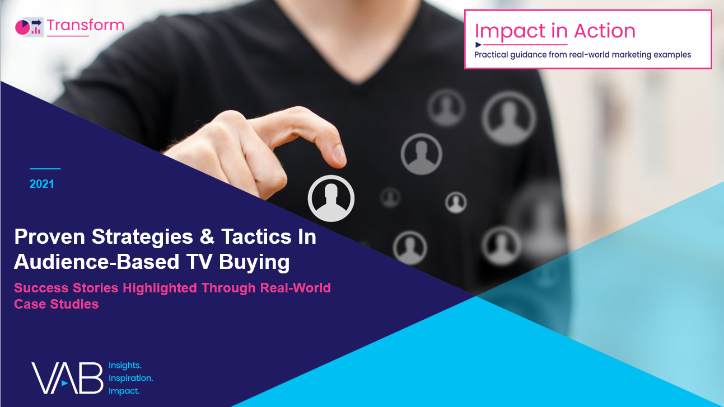


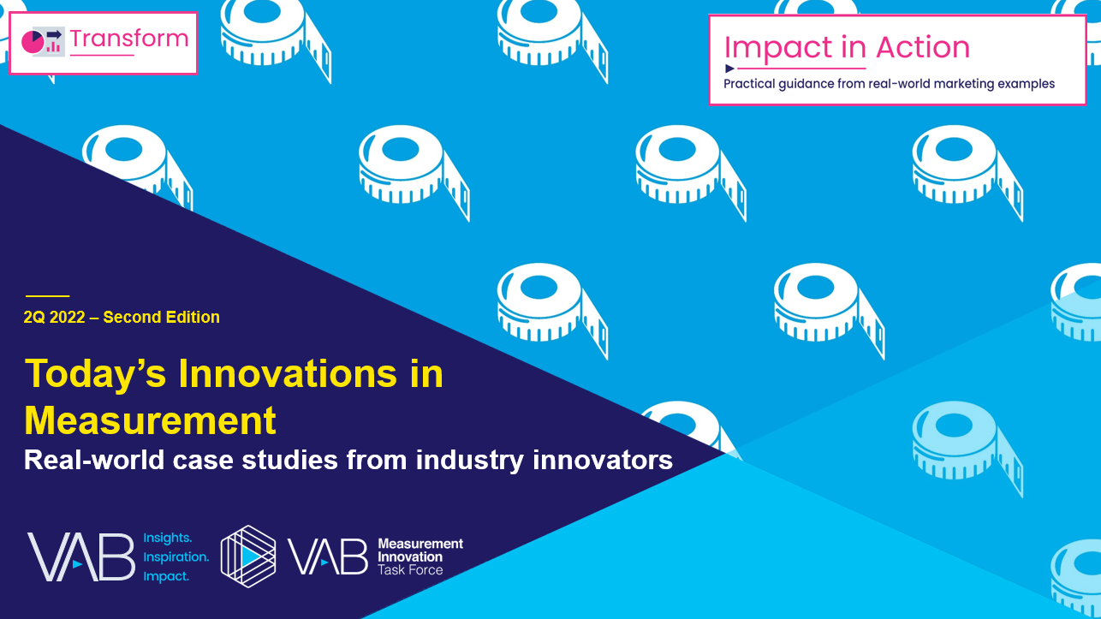

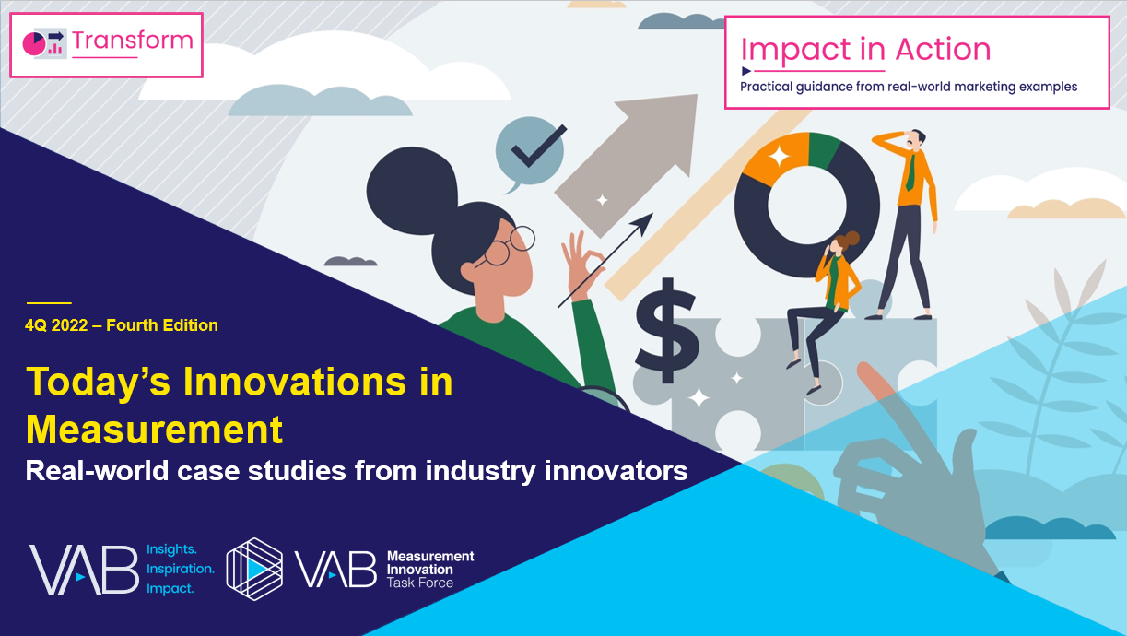
Want more? VAB also has case studies organized across multiscreen TV platforms including linear TV and streaming / CTV
Stream On
How can a convergent TV strategy drive business
results for my brand?
Proven Strategies & Tactics In Audience-Based TV Buying
Opportunities in VOD Addressable
Q1 ‘22 Today’s Innovations in Measurement
Q2 ‘22 Today’s Innovations in Measurement
Q3 ‘22 Today’s Innovations in Measurement
Q4 ‘22 Today’s Innovations in Measurement
Access more case studies at www.thevab.com
This information is exclusively provided to VAB members and qualified marketers.
PAGE 15

Slide 16


About VAB
VAB plays a dual role in the video advertising industry. We are leading the change to bring about a more innovative and transparent marketplace. We also provide the insights and thought leadership that enables marketers to develop business-driving marketing strategies.
Drawing on our marketing expertise, we simplify the complexities in our industry and discover new insights that transform the way marketers look at their media strategy.
We are committed to your business growth and proud to offer VAB members, brand marketers and agencies complimentary access to our continuously-growing Insights library. Get immediate access at theVAB.com.
This information is exclusively provided to VAB members and qualified marketers.
PAGE 16

