Slide 1




The Growth of CTV Advertising

Slide 2


Marketers have been shifting their media investment towards streaming in recent years as connected TV penetration builds and usage grows. These Five Fast Facts explore the
CTV advertising opportunity, highlight how marketers are expanding their video campaigns to achieve incremental reach and showcase the business outcomes achieved by implementing audience-based buying strategies.
This information is exclusively provided to VAB members and qualified marketers. Further distribution is prohibited.
PAGE 2

Slide 3
1
P2+ Total Time Spent With Television by Source
June 2021
While Linear TV captures
two-thirds of total time spent with television, streaming has increased its share and now accounts for over one-quarter of total TV time.
30% of streaming time is now devoted to services outside of
the ‘big five.’
Other Streaming: 8%
Netflix: 7%
YouTube: 6%
Hulu: 3%
Prime Video: 2%
Disney+: 2%
Source: Nielsen Gauge, analysis of June 2021 (5/31/2021-6/27/2021), Nielsen National TV Panel Data plus Streaming Video Ratings, Total Day, P2+.
This information is exclusively provided to VAB members and qualified marketers. Further distribution is prohibited.
PAGE 3

Slide 4
2
The primary drivers of streaming are connected TV devices which are now in over 80% of homes, up from just half of all households seven years ago.
During this time, daily usage has more than tripled with
four out of ten adults becoming habitual users of connected TV.
% of U.S. TV HHs With At Least One Internet-Connected TV Device
11%
12%
19%
25%
29%
31%
40%
39%
% of adults who watch video on a TV via a connected device daily
Source: Leichtman Research Group, June 2021. Data is based on April-May 2021 survey of roughly 2,000 adults 18+ throughout the continental U.S. in households with a TV set.
This information is exclusively provided to VAB members and qualified marketers. Further distribution is prohibited.
PAGE 4

Slide 5
3
Connected TV: Annual Advertising Spend
The growth in penetration and increase in viewing occasions has established connected TV
as a strong advertising opportunity with marketers flocking to the platform.
In fact, two-thirds of marketers began shifting some of their media investment into connected TVs within the last three years.
Two-thirds of marketers began shifting their media investment to connected TV within the last three years
24%
41%
11%
24%
> One year ago
1-3 years ago
< 3 years ago
Have not started
shifting strategy
Source: eMarketer’s Connected TV Ad Spending in the U.S., June 2020 & March 2021. Innovid: The State of CTV Advertising, May 2021.
This information is exclusively provided to VAB members and qualified marketers. Further distribution is prohibited.
PAGE 5

Slide 6
4
As the number of streaming platforms increase and the
ad opportunity becomes greater, marketers are planning to expand their video campaigns to build incremental reach and more deeply engage their consumers
How many streaming platforms are advertisers using?
Source: VAB analysis of TV Squared’s CTV Accelerated, 2021. The number of streaming platforms advertisers used in 2020 vs. their 2022 outlook. Percentages do not add up to 100% because ‘none’ (7% - 2020; 2% - 2022) was excluded.
This information is exclusively provided to VAB members and qualified marketers. Further distribution is prohibited.
PAGE 6

Slide 7



5
Almost three-quarters of CTV marketers are implementing audience-based targeting strategies within their campaigns to drive positive business outcomes across awareness and engagement KPIs
70%
of CTV marketers are using audience-based targeting strategies to improve their advertising performance
How has investing in CTV advertising impacted your business?
59%
49%
Increased brand awareness
Increased brand engagement
(website, store visits, etc.)
Source: Innovid - The State of CTV Advertising, May 2021.
This information is exclusively provided to VAB members and qualified marketers. Further distribution is prohibited.
PAGE 7

Slide 8
Marketers can seize an opportunity for incremental reach and build consumer engagement by expanding their video plans into CTV and across more ad-supported streaming platforms
Integrating audience-based targeting and buying strategies within CTV campaigns can improve advertising performance, drive greater brand awareness and positive business outcomes across the funnel
What does this mean for marketers?
This information is exclusively provided to VAB members and qualified marketers. Further distribution is prohibited.
PAGE 8

Slide 9

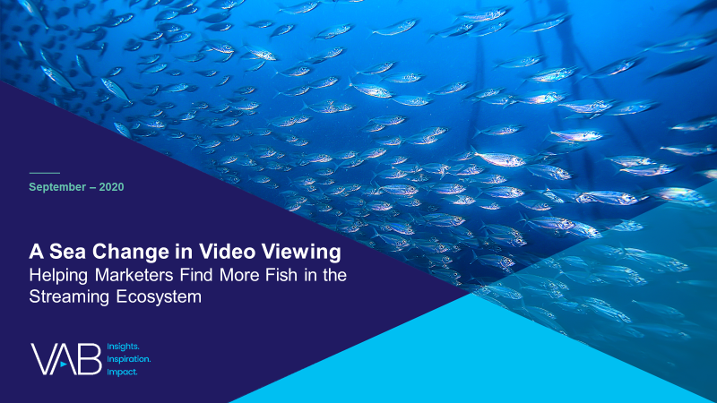



Discover more
Looking for more data, insights and takeaways? Check out this related VAB content
Beyond the Headlines
The State of TV Today and
the Opportunities of Tomorrow
A Sea Change in Video Viewing
Helping Marketers Find More Fish in the Streaming Ecosystem
Five Fast Facts On Video Streaming
Untangling Terminology with Streaming
VAB Members, brand marketers and agencies get free and immediate access to VAB’s content library. Get access at theVAB.com
This information is exclusively provided to VAB members and qualified marketers. Further distribution is prohibited.
PAGE 9

Slide 10

About VAB
VAB is an insights-driven organization that inspires marketers to reimagine their media strategies resulting in fully informed decisions.
Drawing on our marketing expertise, we simplify the complexities in our industry and discover new insights that transform the way marketers look at their media strategy.
Discover
We keep you one step ahead with the latest thinking so you can create innovative, forward-looking strategies.
Simplify
We save you time by bringing you the latest data & actionable takeaways you can use to inform your marketing plans.
Transform
We help you build your brand by focusing on core marketing principles that will help drive tangible business outcomes.
We are committed to your business growth and proud to offer VAB members, brand marketers and agencies complimentary access to our continuously-growing Insights library. Get immediate access at theVAB.com.
This information is exclusively provided to VAB members and qualified marketers. Further distribution is prohibited.
PAGE 10

