Slide 1
Good Fortune:
A Look At The Behaviors & Media Consumption Of Affluent Americans

Slide 2
Overview
Many marketers speak of the Affluent in America as “time poor, but cash rich.”
Affluents have the motivation and means to design their lives – including how they consume media – on their terms. The concern we have heard from advertisers and their agencies is that this can result in Affluent households moving away from TV platforms and adopting behaviors of ad avoidance.
Join us as we explore the lifestyle traits and media behavior of the Affluent and evaluate the implications for TV/Video and advertising:
How dissimilar (or similar) are Affluent households demographically and attitudinally?
To what degree are the affluent watching TV?
To what extent are they adopting new forms of video consumption – time shifting, use of OTT devices, viewing on other digital platforms?
How do they perceive advertising, and are TV ads effective for them?
Ultimately, we will answer the question of whether this “time poor, but cash rich” condition impacts how Affluents consume media. It may surprise you to learn that, when it comes to media behavior, the Affluent look a lot like the average person!
VAB: GOOD FORTUNE

Slide 3
Agenda
Affluence in America: An Overview
  Definitions & breakouts by income, lifestage, region
Demographic, Attitudinal, & Lifestyle Traits: How do the Affluent Compare with the Average American?
A Closer Look: The Affluent and TV/Video Usage
The Affluent and Advertising: Perceptions and Impact
Good Fortune Key Takeaways
VAB: GOOD FORTUNE

Slide 4
Affluence in America: An Overview

Slide 5

“Affluent” vs. “Wealthy” – A Quick Level-Set
“Affluence” is defined by most marketers as household with an income over $100k+.
At times, this is interchanged with “wealthy household.”
There is a big distinction in the amount of wealth, and one that is important to understand when thinking about the behaviors of the “Affluent” consumer.
Affluent ($100k+ HHI)
72 Million People (29% of adults)
This report focuses on the Affluent group as it represents just over one-quarter of all Adults and is also the income target of many premium brands
Wealthy
($1M+ in personal liquid assets)
19M People
(8%)
10 Million
overlap with
Affluent
VAB: GOOD FORTUNE
Source: “All Affluent, Wealthy, And Luxury Consumers Are Not The Same” - The Shullman Research Center, 6/16/17 – data based on US Bureau of Labor Statistics

Slide 6
Affluent Households Represent 28% Of All U.S. Households
# of Households by Income Bracket (000)
Total Affluent HHs: 34,969M (28%)
Moderate Affluent HHs ($100-200k):
26,129M (21%)
Ultra Affluent HHs ($200k+):
8,836M (7%)
43%
17%
12%
14%
7%
7%
For reference, the median US Household Income is $59,039
VAB: GOOD FORTUNE
Source: US census 2016 data, Table A-1 Households by Total Money Income

Slide 7
The Majority Of Affluent Households Belong To Gen X (A35-49) or Boomers (A35-64)
Households within the Gen X and Boomer generations have a higher likelihood of being affluent than those of younger and older age groups
Generation Income
Index
58
75
94
132
115
Young Millennials
Generation X
Boomers
Seniors
VAB: GOOD FORTUNE
Source: 2017 GfK MRI Doublebase, Affluent defined as Adults + HHI $100k+; Index as compared to each generation’s size of the population

Slide 8
While Affluence Skews Towards West And Northeast, Affluent Households Live Throughout The U.S.
Comp = % of HHs in the region that are Affluent
Northeast
Median HHI:$62,314
Affluent HH Comp: 29.9%
WA
ME
MT
ND
VT
MN
NH
OR
Midwest
Median HHI:$53,593
Affluent HH Comp: 22%
NY
MA
SD
WI
CT
West
Median HHI:$60,124
Affluent HH Comp: 27.7%
RI
ID
MI
RI
WY
PA
NJ
IA
NE
OH
MD
NV
IL
IN
DE
UT
WV
For significant coverage of Affluent HHs, the top 25 DMAs would need to be covered
CO
VA
CA
KS
MO
KY
TN
NC
OK
SC
DMA Rank | % of total Affluent HHs (indexed to total HHs in those markets)
1-10 | 42% (131 index)
11-25 | 20% (100 index)
26-49 | 16% (94 index)
50+ | 22% (69 index)
South
Median HHI:$51,236
Affluent HH Comp: 21.8%
AZ
NM
AR
MS
AL
GA
AK
LA
TX
FL
HI
VAB: GOOD FORTUNE
Source: US Census Bureau, 2016 American Community Survey; DMA Rank Data: Nielsen UE Report, December 2017

Slide 9
Demographic, Attitudinal, & Lifestyle Traits: How do the Affluent Compare with the Average American?

Slide 10
Demographically, The Affluent Are More Likely To Be Married And Live Within Large Metropolitan Areas
% Affluent and Index vs. Adults 18+
(76)
(106)
(90)
(98)
(115)
(132)
(94)
(115)
(125)
(94)
VAB: GOOD FORTUNE
Source: GfK MRI, 2017 Doublebase. Affluent defined as HHI $100k+, Indices are vs. Total Adults 18+

Slide 11
They Are Higher Educated, More Likely To Work Full Time, And Hold Professional And Management Positions
% Affluent and Index vs. Adults 18+
(206)
(53)
Top Occupation Segments
(97)
(169)
(96)
(138)
(180)
(215)
(115)
(115)
(115)
(239)
(94)
(50)
VAB: GOOD FORTUNE
Source: GfK MRI, 2017 Doublebase. Affluent defined as HHI $100k+, Indices are vs. Total Adults 18+

Slide 12
Just like the average adult, the affluent view themselves as sociable and invested in their families and communities.
Although they Have Different Demographic Characteristics, Their Values Are Largely The Same As The Average Person
103
101
100
104
102
102
100
% Affluent Agree and Index vs. Adults 18+
Traits they value
How they view themselves
VAB: GOOD FORTUNE
Source: GfK MRI Doublebase; Affluent Adults ($100k+ HHI) = Self-reliance – “Being self-reliant is very important to me”; Modest – “Being modest is very important to me”; Social Tolerance – “Social tolerance and respect is very important to me”; Family-Oriented – “My family is my top priority”; Creative “Being creative/imaginative is very important to me”, Sociable – “I consider myself to be very sociable”, Environmentally-aware – “I am interested in finding out how I can help the environment.”

Slide 13
And Just Like The Average Adult, One Of Their Core Tensions Is Being Time-Pressed As They Struggle To Maintain A Work/Life Balance
% Affluent Agree and Index vs. Adults 18+
140
100
95
104
108
94
99
107
100
Just like adults generally, work is a priority to them…
…at the same time, both Affluents and the average adult seek time with family and for themselves…
…and so both groups feel the tension of balancing everything they need & want to do in a day
VAB: GOOD FORTUNE
Source: GfK MRI, 2017 Doublebase. Affluent defined as HHI $100k+, Indices are vs. Total Adults 18+

Slide 14
And Therefore, Just Like The Average Adult, The Affluent Seek Out Ways To Keep Their Lives Organized And Streamlined
102
105
99
% Affluent Agree and Index vs. Adults 18+
“Keeping a neat, organized home is a priority for me”
“I purchase products that help to organize my life”
“I seek simplicity - like to keep my life and my mind uncluttered”
VAB: GOOD FORTUNE
Source: GfK MRI, 2017 Doublebase. Affluent defined as HHI $100k+, Indices are vs. Total Adults 18+

Slide 15
What Differentiates The Affluents Is Their Disposable Income
Their income
allows them to spend significantly more than the average person
And they are able to spend on conveniences to help manage their time
% Affluent Behavior and Index vs. Adults 18+
Affluent Index vs. Adults 18+
184
167
163
124
115
194
139
163
$700+/month
$700+/month
$150+/month
VAB: GOOD FORTUNE
Source: Source: GfK MRI Doublebase; Affluent defined as HHI $100k+; Dry Cleaning – any expenditure; Housekeeper – any expenditure; Online Clothes Shopping - any expenditure; Beauty Salon - any expenditure; Expenditures is an aggregate score of spending $150+ in last 6 months across over 25 product categories such as apparel, laundry services, personal grooming, goods & services.

Slide 16
Their Discretionary Income Enables Them To Indulge Their Many Interests, Which Increases Their “Busy-ness” But Also Their Self Fulfillment
Affluent Index vs. Adults 18+
152
149
136
128
116
111
150
138
129
138
125
131
Arts, Culture, Self Improvement
Sports & Fitness
Socializing
Entertaining at Home
Creativity
VAB: GOOD FORTUNE
Source: GfK MRI 2017 Doublebase; Affluent (HHI $100k+) participation in last 12 months

Slide 17



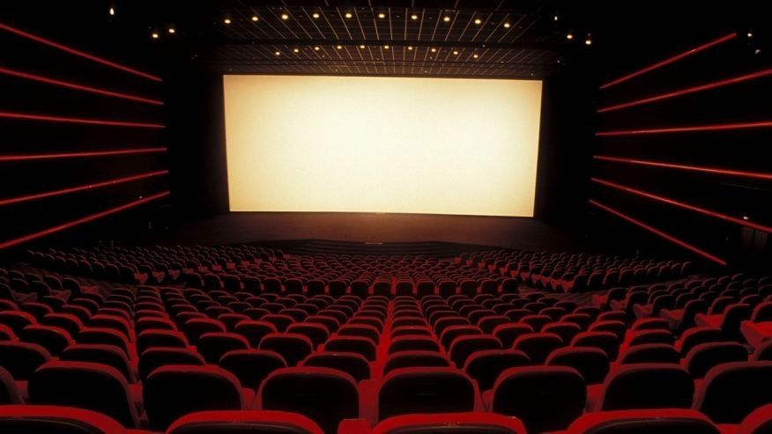
It Allows Them To Enjoy “Upgraded” Experiences…
Affluent Index vs. Adults 18+
They seek luxury when on vacation
Spent $6k+ on foreign vacations: 222
Spent $6k+ on domestic vacations: 223
Stayed at a luxury hotel property: 178
They opt for fine dining
Visit fine dining restaurants twice a month: 173
They invest in their sporting pursuits
Spent $75+ on fitness sneakers: 167
Spent $75+ on golf shoes: 223
Spent $100+ on swimsuit: 214
They go to the cineplex to watch movies
Watch a movie in the theatre at least once a month: 132
VAB: GOOD FORTUNE
Source: GfK MRI 2017 doublebase: Affluent Households $100k+ vs. Adults 18+; All expenditures, except fine dining, are within the last 12 months

Slide 18

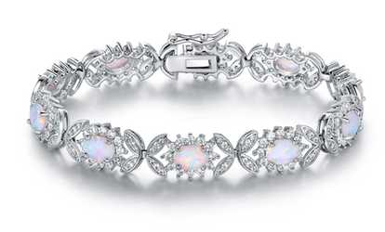
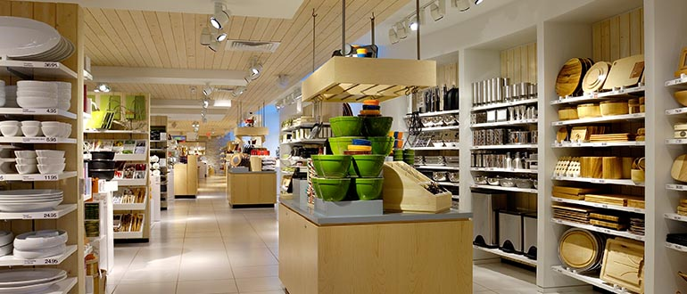
…As Well As Finer Material Possessions…
Affluent Index vs. Adults 18+
Own a 2nd or vacation home: 196
Home value is $500K or more: 239
Most recent auto purchase/lease was a luxury car: 191
They indulge in their homes and cars
They purchase accessories and jewelry that reflect their style
Spent $250+ on handbags: 177
Spent $1,500+ on fine jewelry: 179
Spent $250+ on designer jeans: 186
Pay more for the quality goods sold at upscale shops
Shop at Crate & Barrel (185), Williams-Sonoma (171), J. Crew (175), Lord & Taylor (159), Ulta (147)
VAB: GOOD FORTUNE
Source: GfK MRI 2017 Doublebase: Affluent Households $100k+ vs. Adults 18+; Luxury car is aggregate weighted index of Mercedes, BMW, Cadillac, Infiniti, and Lexus; Handbag, jewelry, and designer men’s jeans expenditures are within the last 12 months

Slide 19
Affluent Traits - Key Takeaways
1
Demographically, Affluent adults are different from average adults - better educated, more likely to live in urban areas & work in white collar jobs.
However, at their core, Affluent adults have similar values & beliefs as the average person - work and family are important and therefore they struggle with creating a work/life balance.
2
Money allows affluent adults the ability to address their “stresses” differently – they invest in time-saving conveniences which enables them to spend quality time with loved ones, and indulge in a variety of life-enriching leisure pursuits.
3
VAB: GOOD FORTUNE

Slide 20
A Closer Look: The Affluent and TV/Video Usage

Slide 21
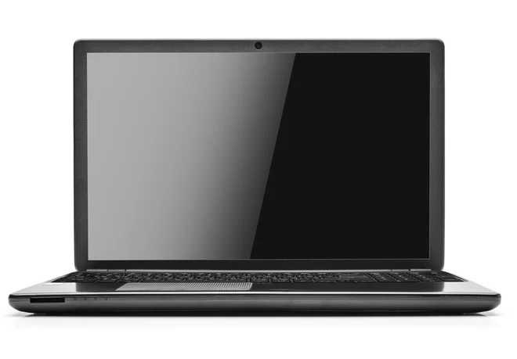

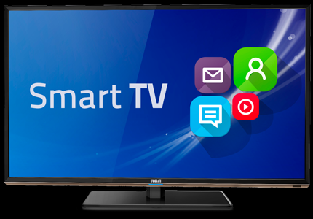
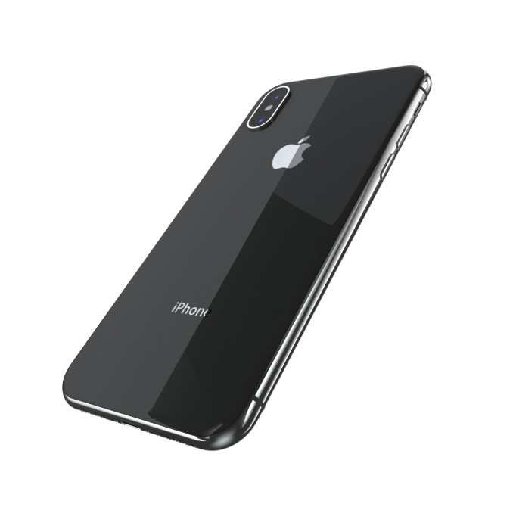
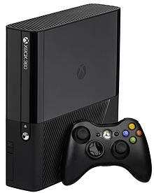

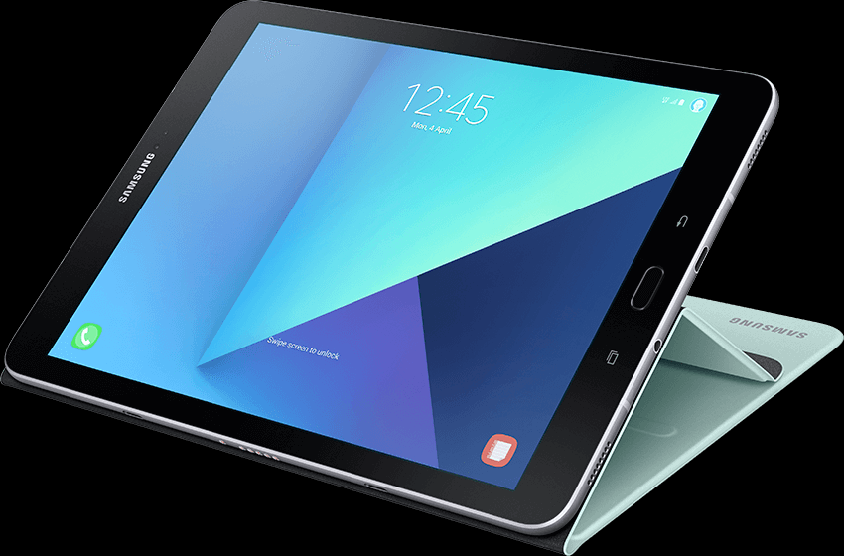
With More Disposable Income, Affluent Americans Have The Means To Invest In The Latest Technology (or own everything…)
High-End Home PC: 183
Spent $2k+ in last year on a PC
PC Software: 140
Spent $500+ in last year
Smart TV: 139
Smart TV most recent TV purchase
iPhone: 155
Xbox 360: 121
eReader: 156
Tablet: 136
VAB: GOOD FORTUNE
Source: GfK MRI 2017 Doublebase; Index of Affluent HHI $100k+ vs. Total Adults 18+

Slide 22
Although They Own All These Devices, They Aren’t (And Don’t Consider Themselves To Be) Significantly More “Tech Savvy” Than The Average Person
In fact, “tech” ranks behind several other areas they consider themselves to be more of an expert in, and they aren’t readily consulted for their opinions in this area either.
Index Affluent Adults vs. Total Adults
VAB: GOOD FORTUNE
Source: GfK MRI 2017 Doublebase; Index of Affluent HHI $100k+ vs. Total Adults 18+

Slide 23
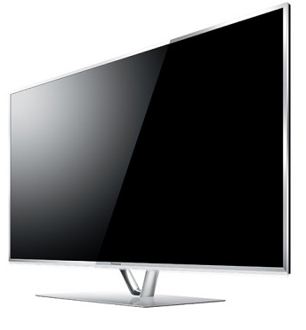
One Area They Invest Heavily In Is Video/TV Related Devices
Index vs. Total Adults 18+
150
Own a 4K or Ultra HDTV
139
Most recent purchase was a Smart TV
128
Have 3+ TVs in their home
131
Have an XL or XXL (43”+) TV screen
VAB: GOOD FORTUNE
Source: GfK MRI 2017 Doublebase; Index of Affluent HHI $100k+ vs. Total Adults 18+

Slide 24
Affluents Are More Likely To Own Connected-TV Devices, However, They Don’t Own Them In Large Numbers
Index: Affluents vs. Total Adults
139
190
153
153
149
162
128
VAB: GOOD FORTUNE
Source: GfK MRI 2017 Doublebase; Index of Affluent HHI $100k+; Index is vs. Total Adults 18+
Q. Does your household own this device? Percentages are of total Affluent population.

Slide 25

As 74% Of Affluent Households Have A Cable+ Subscription, Connected-TV Devices Are Largely Supplementary Viewing
Affluents want choice, and the ability to view where/when/how they want.
74% of Affluent Households have a Cable+ Subscription
25.7 Million HHs
% Affluent Ownership Of Connected-TV Devices
“Does your household own this device”
8.7 Million
9.1 Million
6.5 Million
5.8 Million
.5 Million
.5 Million
VAB: GOOD FORTUNE
Source: Cable+ subscription: Nielsen Universe Estimate, Cable+ = Cable, Satellite, or Fiber Optic Subscription, 12/1/17-12/31/17, A18+; Connected-TV Device data - 2017 GfK MRI Doublebase, Affluent = HHI $100k+; Q. Does your household own this device? Percentages are of total Affluent population.

Slide 26
Since Cost Is Not An Issue, Affluent Adults Want As Many Different Options As Possible To Watch TV Content
As such, “Cord cutter/Never” households tend to be lower income, not affluent
Cord Cutters
Average Household Income - $52k
Cord Nevers
Average Household Income - $41k
(indices are vs. population size)
85% of consumers said price (not ad avoidance or disinterest in content) was the primary reason they cut the cord
VAB: GOOD FORTUNE
Source: SNL Kagan, 2017 S&P Global Market Intelligence, 2017 cord cutter and cord never updates, May 2017; Gfk MRI “Cord Evolution”, 4/24/17; Index is vs % total US households for each HHI bracket; TiVo Q3 2017 Video Trends Report

Slide 27
The Affluent Demonstrate A Commitment To TV Content And Their Viewing Behavior Looks A Lot Like That Of The Average Adult
VAB: Good Fortune

Slide 28
Just Like The Average Adult, The Television Clearly Continues To Be The Affluents’ Preferred Screen To Watch TV Programs
Due to their active lifestyle, Affluents, particularly the Ultra Affluent, are more likely than the average person to view on other devices, however they most enjoy TV programming on the television.
“How do you watch TV Programs compared to 12 months ago?”
Response: ‘More or the Same Amount’
Total Affluents
Moderate Affluents
Ultra Affluents
100
116
137
150
128
100
99
98
94
99
97
109
108
123
102
(index vs. total Adults)
(index vs. total Affluents)
(index vs. total Affluents)
VAB: GOOD FORTUNE
Source: 2017 GfK MRI Doublebase, Affluent Households HHI $100k+, Moderate Affluents, HHI $100k-$200k, Ultra Affluents HHI $200k+

Slide 29











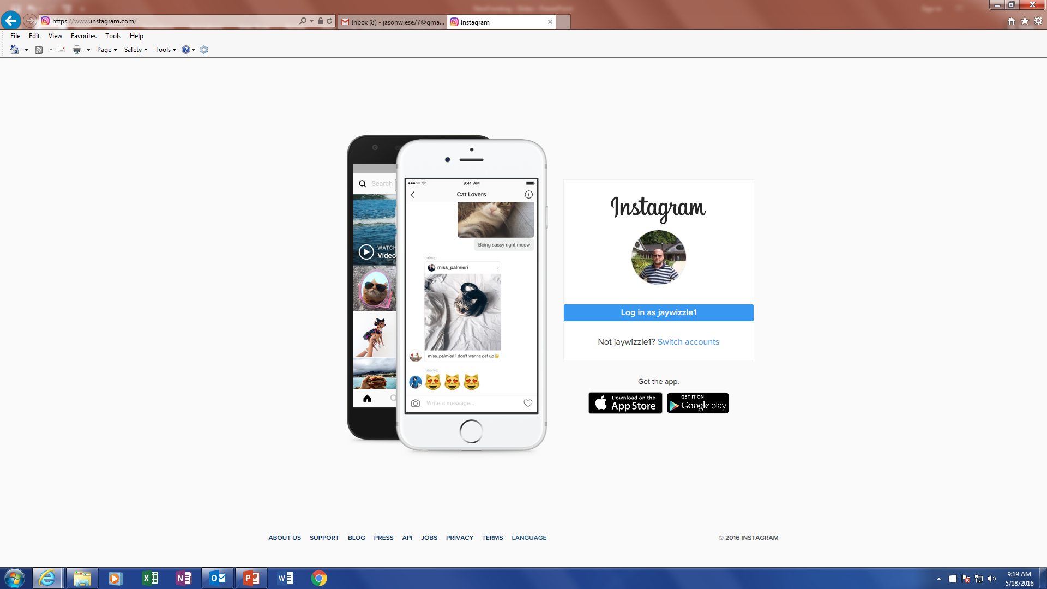
From A Platform Perspective, Affluent Adults Spend Over 4x More Time Watching TV Than With YouTube and Facebook Combined
Time spent with TV dwarfs that spent on other top digital platforms
Average Monthly Time Spent
Minutes per viewer, Affluent Adults 18+
Television
VAB: GOOD FORTUNE
Sources: Affluent Adults 18+ - Nielsen R&F Report, Nov 1-Nov 30 2017, Live+7, P18+ & HHI of 100k+ Average Monthly Time Spent – TV = Live + DVR + Time-shifted TV (Ad-Supported TV only); comScore Media Metrix Multi-Platform Data, P18+ & HHI $100k+, November 2017, Average Min Per Visitor; note comScore data for digital platforms does not include mobile video

Slide 30
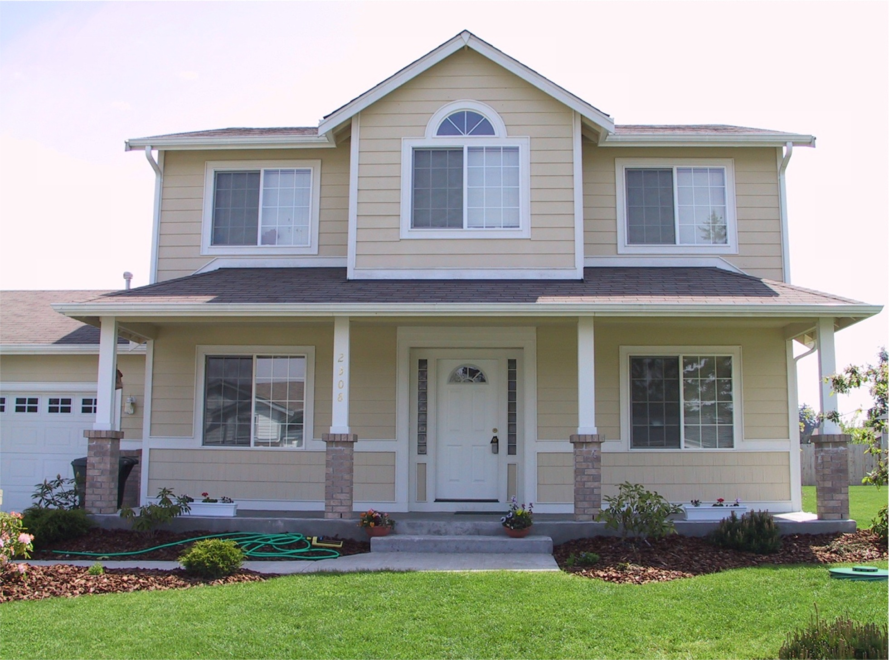
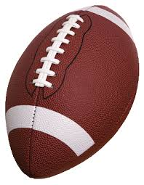






Affluent Consumers Are Passionate About TV And Can Be Reached In Larger Numbers Than On Other Enthusiast Platforms
TV brands are the “go-to” authority across a variety of subjects, offering significant Affluent reach.
Affluent Reach of Enthusiast Platforms
Affluent A18+ Monthly (000)
HGTV
Home
CafeMedia.com (#1)
Better Homes & Garden (#1)
ESPN
Sports
USA Today Sports (#5)
Sports Illustrated (#2)
Science/
Tech
Discovery
CNET.com (#4)
Popular Science (#2)
News
CNN
Buzzfeed.com (#7)
Time (#1)
Disney
Family
Roblox.com (#2)
Family Circle (#1)
TV (000): Audience Reach
Ad Tech: Unique visitors (Ad Tech sites are highest ranked by Uniques in their category, after any TV brand sites
Magazines: Affluent Circulation, largest pub in category, after any TV brand pubs
Food/ Cooking
Food Network
AllRecipes.com (#1)
Cooking Light (#1)
VAB: GOOD FORTUNE
Sources: TV data - Nielsen Npower Live+7, Total Day, P18+ & HHI of $100k+ 11/1/17-11/30/17, TV - Linear with VOD; Ad Tech data - comScore November 2017 Total Unique Visitors; P18+ & HHI of 100k+; Magazine data – GfK MRI Doublebase, response “I take note of the advertising in this publication” HHI $100k+; Ad Tech sites and publications selected are the highest reaching in their category, after any TV brand sites/pubs

Slide 31
The Affluent Are As Knowledgeable About TV Shows And Movies As The Average Person
Parity with the average
Category Influential Index
(index vs. total adults)
(index vs. total Affluents)
(index vs. total Affluents)
VAB: GOOD FORTUNE
Source: 2017 GfK MRI Doublebase, Affluent Households HHI $100k+, Moderate Affluents HHI $100k-$200k, Ultra Affluents HHI $200k+;

Slide 32
This Is Because, Just Like The Average Adult, The Affluent Enjoy A Wide Variety Of Programming
VAB performed an analysis looking at the top 200 TV programs for Adults and Affluent Adults.
While Affluents skew more towards Sports and less News, their preferences compared to their peers are very similar in enjoying a robust and diverse slate of programming.
Top 200 TV Programs Grouped By Genre
Adults (18+)
Affluent Adults 18+
VAB: GOOD FORTUNE
Source: VAB analysis of Nielsen Npower PowerPlay, Total Day, Live+7, 10/1/17-10/31/17; Demos – Adult = Adult 18+, Millennials = 18-34

Slide 33




























In Fact, The Affluent Have The Same Favorite Programs As The Average Adult…23 Of The Top 25 Programs Overlap
Affluent Adults Top Program Ranker
Adults Top Program Ranker
#1
#13
#1
#13
#2
#14
#2
#14
#3
#15
#3
#15
#4
#16
#4
#16
#5
#17
#5
#17
#6
#18
#6
#18
#7
#19
#7
#19
#8
#20
#20
#8
#9
#21
#9
#21
#22
#22
#10
#10
#23
#23
#11
#24
#11
#24
#12
#25
#12
#25
VAB: GOOD FORTUNE
Source: “Average 18+ population” data based on Nielsen NPower, Oct 1 – Dec 31 2017, P18+, Live+7 for cable + broadcast, excludes specials and sports. “Affluent 18+ population” data based on Nielsen NPower, Oct 1 – Dec 31 2017, P18+, HHI of 100k+, Live+7 for cable + broadcast, excludes specials and sports. If program airs multiple times a week, the highest rated airing is reflected.

Slide 34
Their Interest And Commitment To TV Programming Results In Following Their Favorite TV Content Online
VAB: GOOD FORTUNE

Slide 35
Due To Their Active, On-The-Go Lifestyle, Affluent Adults Spend More Time Viewing Ad-Supported TV Digital Content Than the Average Person
An affluent adult spends nearly 20% more time with TV content online than the average person
Average Adult
Affluent Adult
VAB: GOOD FORTUNE
Source: VAB analysis of Media Metrix Audience Duplication comScore data, December 2017; Adults 18+, Affluent Adults 18+ ($100k+), “Ad-Supported TV” custom group.

Slide 36
























Across A Variety Of Genres, Affluent Adults Seek Out Ad-Supported TV Brand Content Online
Top 5 Rank on “Total Minutes Viewed” By Genre
Affluent Adults 18+
Sports
Sports
Comedy
TV Entertainment - Black
General News
Finance News
The Chive
Yahoo Finance
9GAG
MSN Money
Fandom TV
Dow Jones
Cracked
College Humor
Home
Weather
TV Entertainment
Food
Family
MSN Food & Drink
Roblox
Houzz
AccuWeather
Hometalk
WeatherBug
Allrecipes
Café Media Home
MSN Weather
MyRecipes
PBS Kids
Family Handyman
Yahoo Weather
MSN TV
Open Table
ABCYA.com
VAB: GOOD FORTUNE
Source: VAB analysis of Media Metrix multi-platform comScore data, January 2017 (Ranking based on “Total Minutes Viewed”)
Affluent Adults = P18+ & HHI of $100k+

Slide 37
Due To Their Hectic Schedules, The Affluent Are Somewhat More Likely Than The Average Adult To Explore Alternative Means Of Viewing TV Programs
Index: Affluents vs. All Adults
VAB: GOOD FORTUNE
Source: 2017 GfK MRI Doublebase, Affluent HHI $100k+ vs. Adults 18+

Slide 38
TV/Video Usage - Key Takeaways
1
While their disposable income allows the Affluent to own the latest technology, they don’t consider themselves to be (and aren’t viewed by others as) particularly tech savvy.
Due to their means and on-the-go schedules, the Affluent are more likely to explore other ways of accessing TV content (streaming, OTT, viewership on mobile devices), however they do so in small numbers, and so it is supplementary to - not a replacement of – their TV viewing.
2
3
Their commitment to TV content & their active lifestyle result in spending more time with TV brand content online than the average person.
VAB: GOOD FORTUNE

Slide 39
The Affluent and Advertising: Perceptions and Impact

Slide 40
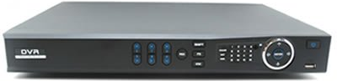
60% Of Affluent Households Own a DVR
Affluent households are slightly more likely than the average household to own a DVR (9% more likely).
Interestingly, Affluent DVR homes spend +27% more time watching TV than Affluent non-DVR households
VAB: GOOD FORTUNE
Source: VAB Analysis of Nielsen NPower Live+7 HUT/PUT; Weekly Time Spent of Affluent (HH w/ $100K+) DVR vs. Non-DVR HH; Prime=M-Sa 8-11&Su 7-11p; M-Su 6a-6a; 9/25/2017 – 1/14/2018.

Slide 41
Although Affluent Homes Are More Likely To Own a DVR, The Majority Of Their Viewing Is Enjoyed Live, Just Like In The Average Household
Despite having the means to ‘customize’ their viewing Affluents watch the majority of their TV live.
% Time Spent With Live TV v. Timeshifted
VAB: GOOD FORTUNE
Source: Nielsen Ratings Analysis Time Period Report- Playback Time Period: Live | TV | Linear with VOD( Live|TV|Linear with VOD ), Playback Only within 7 Days | TV | Linear with VOD( Playback Only within 7 Days|TV|Linear with VOD ), Measurement Interval: 09/25/2017 - 12/31/2017; Affluent defined as Adults 18+ & HHI $100k+, Moderate Affluents defined as HHI $100k-$200k, Ultra Affluent defined as HHI $200k+

Slide 42
Given Their Demanding Schedules, Affluents Are Likely To Look To TV Advertising For Information, On Par With The Average Person
“Advertising in this medium provides me with useful information about products or services”
Total Affluents
Moderate Affluents
Ultra Affluents
95
97
102
94
91
87
99
98
100
100
100
102
102
105
99
100
97
90
(index vs. total adults)
(index vs. total Affluent)
(index vs. total Affluent)
VAB: GOOD FORTUNE
Source: 2017 GfK MRI Doublebase, Affluent Households HHI $100k+, Moderate Affluents HHI $100-$200k, Ultra Affluents HHI $200k+; response “any agree”

Slide 43
Similarly, Across Media, Affluents Are Most Likely To Find TV Advertising Amusing, On Par With The Average Adult
“Advertising in this medium is amusing”
Total Affluents
Moderate Affluents
Ultra Affluents
98
90
90
88
80
81
99
100
100
100
102
102
105
99
100
99
91
93
(index vs. total adults)
(index vs. total Affluents)
(index vs. total Affluents)
Affluents and Affluent Millennials are on par with their peers in finding TV ads amusing
Those that may be most likely to be cynical about advertising have a fairly positive view, on par with all affluents
VAB: GOOD FORTUNE
Source: 2017 GfK MRI Doublebase, Affluent Households HHI $100k+, Moderate Affluents HHI $100-$200k+, Ultra Affluents HHI $200k+; response “any agree”

Slide 44


As A Result, TV Advertising Is Proven To Stir Action For Premium Brands
VAB conducted a custom analysis using TV attribution research, iSpot. In this analysis, the 2017 monthly TV spend for a variety of premium brands was compared to the monthly Search & Social Actions (e.g. likes, posts, comments in social media) for those brands. Via the attribution model, it can be determined how many Searches & Social Actions were taken as a direct result of the TV ad.
Spend: -31%
Actions: -73%
Spend: +78%
Actions: +119%
Spend: +61%
Actions: +118%
Spend: +606%
Actions: +265%
Spend: +100%
Actions: +595%
Spend: -97%
Actions: -70%
VAB: GOOD FORTUNE
Source: VAB analysis of iSpot.tv data, Reflects brand’s total monthly TV ad spend from 1/1/17-12/31/17. Actions = Social Actions & Searches attributed to the TV advertising activity

Slide 45


As A Result, TV Advertising Is Proven To Stir Action For Premium Brands: Tech & Fragrance
Spend: +$18MM
Actions: +59,000
Spend: +$18MM
Actions: +127,000
Spend: +840%
Actions: +426%
Spend: -100%
Actions: -33%
Spend: +100%
Actions: +90%
VAB: GOOD FORTUNE
Source: VAB analysis of iSpot.tv data, Reflects brand’s total monthly TV ad spend from July – December 2017 (Bose) and 1/1/17-12/31/17 (Chanel). Actions = Social Actions & Searches attributed to the TV advertising activity

Slide 46
When It Comes To Advertising Opportunities Outside The Home, Affluents Are More Likely Than The Average Adult To Be Interested in Cinema
Despite their on-the-go lifestyle, they are fairly disengaged in many OOH formats
“I have considerable or some interest in ads in these places”
Index: Affluent Adults vs. Total Adults
VAB: GOOD FORTUNE
Source: 2017 GfK MRI Doublebase, Affluent Households HHI $100k vs. total Adults 18+

Slide 47
Advertising Perceptions & Behaviors – Key Takeaways
1
Time-shifted viewing is not impacted by Affluence. While Affluent households are slightly more likely to own a DVR, the majority of their viewing is live, just like the average household.
2
Similarly, their higher income does not impact ad-tolerance. Affluents have favorable opinions of TV advertising relative to other vehicles and on par with the average adult.
3
Affluents respond to TV advertising, with correlations found between TV advertising and consumer searches/social actions for a variety of premium brands.
VAB: GOOD FORTUNE

Slide 48
Good Fortune Key Takeaways
Demographically, Affluents are different than the average adult, but their values are similar.
The Affluent lead complex lives, filled with work and family demands, as well as a variety of self-enriching leisure activities. As such, they want the convenience of more ways to watch the content they love.
Even though their means allows them to own devices and gadgets, ultimately their video consumption is no different than the average adult.
The overwhelming majority hold a Cable+ subscription, and they dedicate more of their time to watching TV than they do to the major digital platforms.
Although their income allows them to customize their viewing, that doesn’t translate to ad avoidance or lower ad tolerance.
VAB: GOOD FORTUNE

Slide 49


Slide 50

Additional Member Slides

Slide 51
Generation X and Boomers Are Most Likely To Be Affluent
Percentage of each generation – affluent vs. non affluent
Millennials
Millennials
Adults 18-24
Adults 25-34
Gen X
Adults 35-49
Boomers
Adults 50-64
Seniors
Adults 65+
Source: 2017 GfK MRI Doublebase, % of households within each generation earning more and less than $100k+/year. Average HHI from 2016 US Census

Slide 52
Looking At OTT Devices, With The Exception Of Apple TV, Less Than Half Of The Households Who Own Connected Devices Are Affluent
OTT devices allow viewers to stream video content (both ad supported and not) to their TVs or other device. Looking at affluent owners, the majority are the more moderate Affluents, not the higher income Ultra Affluents
Source: 2017 GfK MRI Doublebase, Of those who own these devices, which % fall into the following HH types: Non-Affluent Households Under HHI $100k+, Moderate Affluents HHI $100k-$200k, Ultra Affluents HHI $200k+.

Slide 53
Lifestage Rather Than Affluence, Looks To Be The Primary Driver In OTT Device Ownerships
% owners who are Affluent
% owners who are Not Affluent
Amazon
Fire TV Stick
Sling
Google Chromecast
% ownership
by generation
For example, 36%
of those who own a Firestick are Millennials and 40% of Millennial Fire TV stick owners are affluent.
36%
34%
22%
8%
37%
30%
27%
7%
43%
31%
19%
7%
Apple TV
Roku
Smart TVs
% ownership
by generation
35%
30%
24%
11%
30%
30%
26%
14%
36%
34%
22%
8%
Source: 2017 GfK MRI Doublebase, Q. Does your household own this device? Owners of devices who have HHI $100k+ and less than $100k, by generation. Millennials = 18-34; Gen X = 35-49; Boomers = 50-64, Seniors = 65+

Slide 54
Studies That Say Cost (Not Content or Ad Avoidance) Is The Primary Reason People Seek Out Alternate Ways Of Receiving Video Programming
Cost is the overwhelming reason
Less than half view streaming service as a reason to eliminate MVPD subscription
Source: TiVo; Q4 2017 Video Trends Report

Slide 55
Just Like The Average Millennial, The Affluent Enjoy A Wide Variety Of Programming
VAB performed an analysis looking at the top 200 TV programs Millennials and Affluent Millennials.
Top 200 TV Programs Grouped By Genre (Millennials)
Affluent Millennials (18-34)
Source: VAB analysis of Nielsen Npower PowerPlay, Total Day, Live+7, 10/1/17-10/31/17; Demos – Millennials = 18-34 & Millennials 18-34 + $100k+

