Slide 1




For the Love of Gaming

Slide 2


The gaming category has achieved massive scale and engagement with mobile and social video, in particular, creating opportunities for marketers to connect with audiences beyond GenZ and millennial males.
These Five Fast Facts size the gaming marketplace, device usage and demographics to help marketers identify the opportunities that exist, and the unique audiences that can be reached, within this highly engaging category.
This information is exclusively provided to VAB members and qualified marketers. Further distribution is prohibited.
PAGE 2

Slide 3



1
The gaming category delivers mass scale and high reach with continued growing engagement across audiences as its popularity increased during the pandemic.
230 MM
83%
+16%
Monthly unique visitors to gaming category websites
Reach of Online Users*
Growth in Time Spent on Gaming Sites in June 2021 (vs. June 2018)
Source: Comscore, State of Gaming 2021, *Online Users represents P2+ desktop users & P18+ mobile users.
This information is exclusively provided to VAB members and qualified marketers. Further distribution is prohibited.
PAGE 3

Slide 4



2
2020 U.S. Annual Revenue by Source
$ in Billions
As people spent more time at home, doing fewer in-person activities, many consumers turned to other sources of entertainment like gaming, whose growth accelerated during 2020.
Globally, 48% of gaming revenues are driven by mobile gaming, nearly doubling both console and PC.
vs. $36.6 B
in 2019
vs. $36.1 B
in 2019
vs. $11.1 B
in 2019
Source: Gaming - Newzoo 2020 Global Games Market Report, includes mobile, PC and console gaming; Movies - MPA THEME Report 2020, includes Digital home/mobile (electronic sell-through, VOD, subscription streaming): $26.5 B, Physical home/mobile (Blu-Ray and DVD rentals & sales): $3.5 B, Theatrical $2.2 B; Music - RIAA, Year End 2020 RIAA Revenue Statistics, includes Streaming: $10.1 B, Digital Download: $674 MM, Physical: $1.1 B.
This information is exclusively provided to VAB members and qualified marketers. Further distribution is prohibited.
PAGE 4

Slide 5



3
Video Game Usage by Platform
Adults 18+
Gamers are most actively engaged on mobile devices with 53% playing on these platforms at least several times
a week compared to 27% and 26% of people playing on consoles or PCs respectively.
Mobile doesn’t only attract casual gamers as 71% of avid gamers play on mobile as part of their
7+ hours spent gaming weekly.
At 31% and 25% respectively, Gen Z and Millennials are much more likely to be habitual daily gamers on consoles
(playing daily / several times a day).
Source: Morning Consult, Video Game Landscape 2021. ‘How often, if ever, do you play video games on the following?’ Total respondents = 2,200 adults; poll conducted between October 4-6, 2021. Morning Consult, The State of Gaming 2021 – ‘Console Is Still King’, ‘avid gamers’ play at least seven hours of video gamers per week, ‘casual gamers’ play less than seven hours a week. Gen Z were born between 1997-2012; Millennials were born between 1981-1996.
This information is exclusively provided to VAB members and qualified marketers. Further distribution is prohibited.
PAGE 5

Slide 6
4
Mobile Video Game Usage by Platform
Mobile offers marketers an opportunity to incrementally reach a gaming audience well beyond Gen Z and millennial males that play regularly.
Mobile-only gamers are 75% women and 66% are between the ages of 35-65.
68%
(1997-2012)
69%
(1981-1996)
59%
(1965-1980)
Mobile gaming represents gaming activity across mobile devices.
Mobile Game Examples:
Call of Duty Mobile, Pokémon Go, FIFA Mobile, Clash of Clans, Hearthstone, Angry Birds, Madden NFL Mobile, Candy Crush
34%
(1946-1964)
Source: Morning Consult, Video Game Landscape 2021. ‘How often, if ever, do you play video games on the following?’ Total respondents = 2,200 adults; Gen Z (n=201), Millennials (n=665), Gen X (n=514), Baby Boomers (n=730); poll conducted between October 4-6, 2021. Years represent birth year range for each generation. Comscore, State of Gaming 2021, used for mobile-only gamer statistics.
This information is exclusively provided to VAB members and qualified marketers. Further distribution is prohibited.
PAGE 6

Slide 7
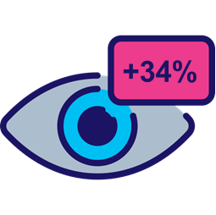
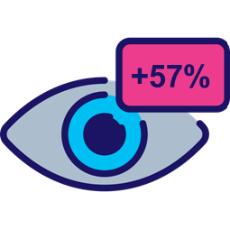

5
Social Video Views
Beyond mobile, social video engagement continues to surge for gamers as it provided an opportunity to connect with gaming communities during Covid, which opened more opportunities for marketers
to reach highly engaged audiences across additional platforms.
+
+
+34%
+57%
Views growth in gaming category from 2019 to 2020*
Views growth in gaming category from 2020 to 2021**
+58%
Views growth in esports content from 2020 to 2021**
Source: Tubular, Ready Player Two: Gaming and Social Video, ‘social video’ represents YouTube, *Reflects August 2018-July 2019 vs. August 2019-July 2020 time frame. **Reflects August 2019-July 2020 vs. August 2020-July 2021 time frame.
This information is exclusively provided to VAB members and qualified marketers. Further distribution is prohibited.
PAGE 7

Slide 8
The pandemic accelerated gaming’s already surging growth making it a top entertainment choice with high reach and engagement across audiences
Gamers are most actively engaged on mobile
and their communities continue to grow through connection on social video platforms
Mobile gaming provides opportunities to create engaging ad experiences in lean-in environments with audiences beyond young males
What does this mean for marketers?
This information is exclusively provided to VAB members and qualified marketers. Further distribution is prohibited.
PAGE 8

Slide 9
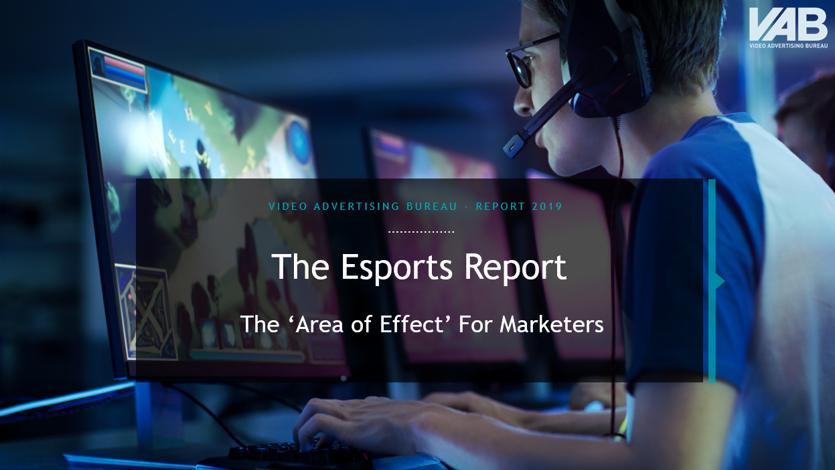
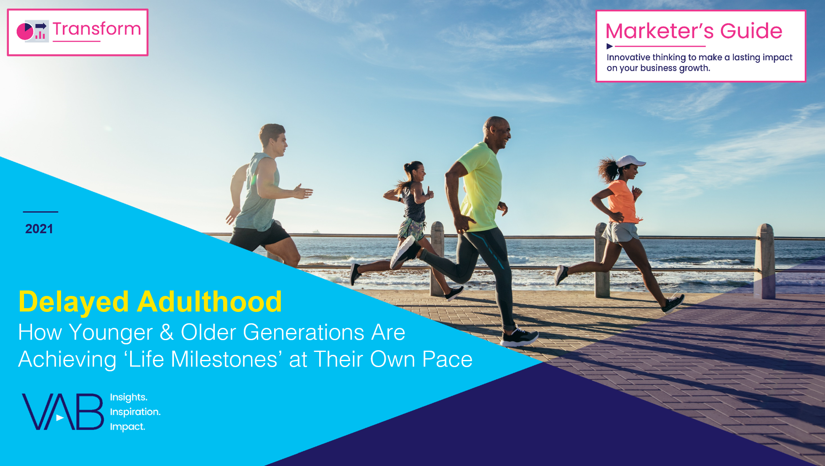


Discover more
Looking for more data, insights and takeaways? Check out this related VAB content
The Esports Report
The ‘Area of Effect’ For Marketers
Delayed Adulthood
How Younger & Older Generations Are Achieving ‘Life Milestones’ at Their Own Pace
The VAB Top 10
A top-line view of how the industry is adopting audience-based buying
Five Fast Facts On The Ad Opportunity in Premium Digital Video
VAB Members, brand marketers and agencies get free and immediate access to VAB’s content library. Get access at theVAB.com
This information is exclusively provided to VAB members and qualified marketers. Further distribution is prohibited.
PAGE 9

Slide 10

About VAB
VAB is an insights-driven organization that inspires marketers to reimagine their media strategies resulting in fully informed decisions.
Drawing on our marketing expertise, we simplify the complexities in our industry and discover new insights that transform the way marketers look at their media strategy.
Discover
We keep you one step ahead with the latest thinking so you can create innovative, forward-looking strategies.
Simplify
We save you time by bringing you the latest data & actionable takeaways you can use to inform your marketing plans.
Transform
We help you build your brand by focusing on core marketing principles that will help drive tangible business outcomes.
We are committed to your business growth and proud to offer VAB members, brand marketers and agencies complimentary access to our continuously-growing Insights library. Get immediate access at theVAB.com.
This information is exclusively provided to VAB members and qualified marketers. Further distribution is prohibited.
PAGE 10

