Slide 1


Five Insights
July 2025

Slide 2





Sports fandom encourages obsessive emotion and creates high, habitual engagement
Download our full report, Fast Break: 20 Facts on Sports Fandom, Viewership & Advertising Impact, to learn more
% of sports fans that…
Nearly 60%
say rituals (like wearing their lucky jersey) and superstitions play some role in their fandom
56%
watch some type of sporting event at
least once a week
51%
reported that their
favorite team or athlete’s performance affects their overall mood at least moderately
46%
say they show off their fandom by getting together with friends
and family
(Sports fans spend 3.2 hours watching sports content weekly on average)*
Source: PMG, State of Sports Report - Beyond the Game: Connecting with the Modern Sports Fan, May 2025. *Comcast Advertising, Behind the Remote: A Deep Dive into Sports Viewership & Fandom, October 2024. Base: Watched sports content (game, highlights, talk show, etc.) in the past six months.
This information is exclusively provided to VAB members and qualified marketers.
PAGE 2

Slide 3
Smaller businesses prioritize lower-funnel KPIs to drive immediate returns, while larger brands focus on upper-funnel metrics to build brand equity
Download our Question of the Week, ‘What KPIs do marketers use to evaluate the impact of their video campaigns?', to learn more
Top 5 KPIs Used to Measure Effectiveness of Video Ad Campaigns
% of brand marketer respondents
‘Small-Sized’ Businesses
‘Medium-Sized’ Businesses
‘Large-Sized’ Businesses
Source: VAB / Advertiser Perceptions ‘Marketer KPI Survey,’ February 2025, fielded January 27 – February 7, 2025 (n=200). Survey base: Brand marketers directly involved in influencing or executing video advertising. Q12. What are the main KPIs you currently use to measure the effectiveness of your company’s video advertising? Based on respondents selecting up to 3 choices. ‘Small-Sized’ Businesses: Less than $1MM in annual ad spend, ‘Medium-Sized’ Businesses: $1MM to less than $25MM in annual ad spend, ‘Large-Sized’ Businesses: $25MM or more in annual ad spend. *Perception, memorability, favorability, consideration, etc. Dotted line across chart denotes the top 3.
This information is exclusively provided to VAB members and qualified marketers.
PAGE 3

Slide 4





Businesses of all sizes expect their media partners to deliver precision, attribution and innovation in trusted, transparent, high-quality content
Download our Question of the Week, ‘What do marketers expect from their media partners to help achieve campaign success?’, for more
Top 5 Criteria Brand Marketers Expect Their Media Partners to Deliver on
% of brand marketer respondents
‘Small-Sized’ Businesses
‘Medium-Sized’ Businesses
‘Large-Sized’ Businesses
Effective targeting
64%
Effective targeting
58%
Effective targeting
43%
High quality content / brand safe ad environment
45%
Campaign measurement / attribution
37%
Campaign measurement / attribution
38%
Innovative solutions*
34%
Innovative solutions*
36%
Innovative solutions*
34%
Campaign measurement / attribution
32%
High quality content / brand safe ad environment
35%
High quality content / brand safe ad environment
32%
Transparency**
27%
Transparency**
29%
Transparency**
31%
Source: VAB / Advertiser Perceptions ‘Marketer KPI Survey,’ February 2025, fielded January 27 – February 7, 2025 (n=200). Survey base: Brand marketers directly involved in influencing or executing video advertising. Q11. As a brand marketer, which of the following criteria do you expect your media partners to deliver on the most? Based on respondents selecting up to 3 choices. ‘Small-Sized’ Businesses: Less than $1MM in annual ad spend, ‘Medium-Sized’ Businesses: $1MM to less than $25MM in annual ad spend, ‘Large-Sized’ Businesses: $25MM or more in annual ad spend. *Media, creative, measurement, etc. **Buying, placements, reporting, etc. Dotted line across chart denotes the top 3.
This information is exclusively provided to VAB members and qualified marketers.
PAGE 4

Slide 5
Marketers view outcomes tied to ‘brand’ like customer satisfaction, trust, loyalty and identity as the top drivers of business success
Download our full report, Performance Starts With Brand: How marketers are looking to balance short-term sales with long-term growth, to learn more
Top 5 Factors That Contribute to the Success of a Brand
% of brand marketers
‘Small-Sized’ Businesses
‘Medium-Sized’ Businesses
‘Large-Sized’ Businesses
Source: VAB / Advertiser Perceptions ‘Marketer KPI Survey,’ February 2025, fielded January 27 – February 7, 2025 (n=200). Survey base: Brand marketers directly involved in influencing or executing video advertising. Q10. How does your brand contribute to your company's overall growth strategy? [Rank 1-5]. ‘Small-Sized’ Businesses: Less than $1MM in annual ad spend, ‘Medium-Sized’ Businesses: $1MM to less than $25MM in annual ad spend, ‘Large-Sized’ Businesses: $25MM or more in annual ad spend.
This information is exclusively provided to VAB members and qualified marketers.
PAGE 5

Slide 6
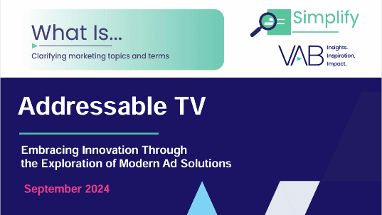
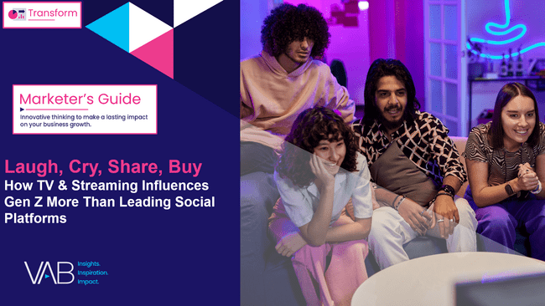
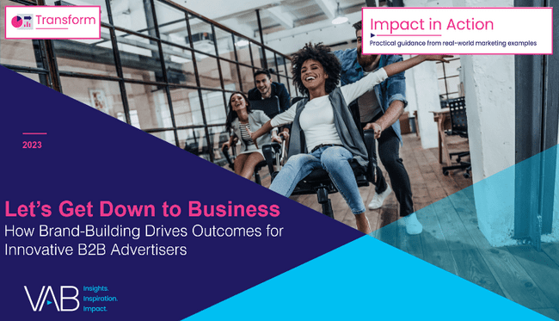
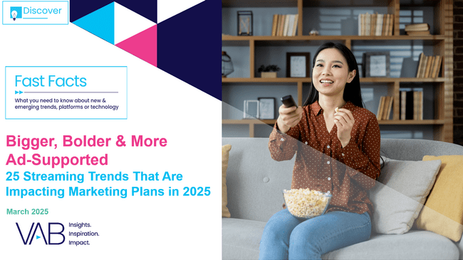


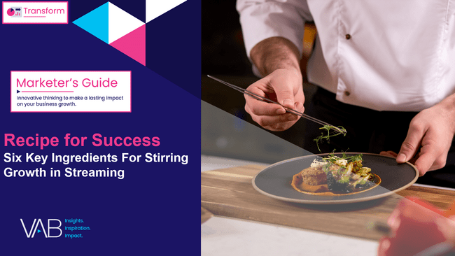
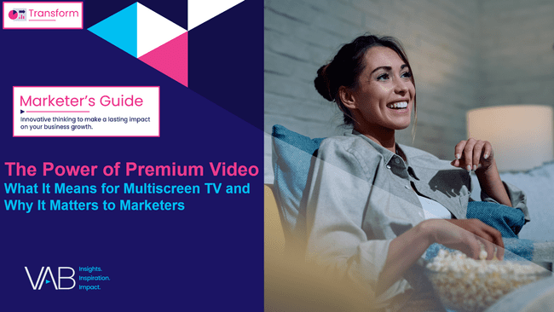
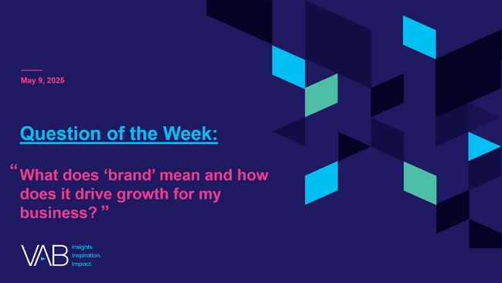
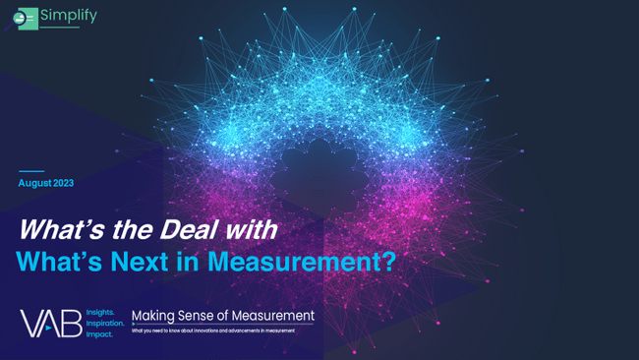
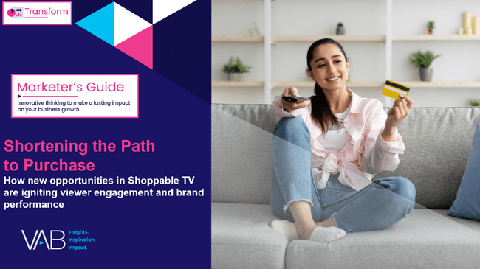
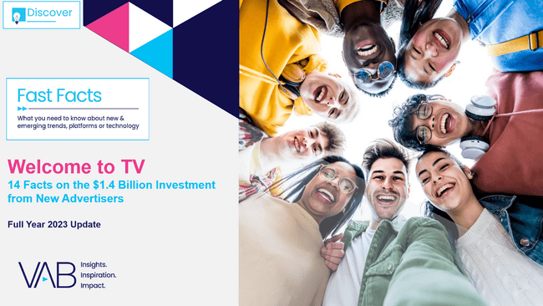
We have over 380 content pieces available in our Insights Library
(Media consumption behaviors, streaming insights, multiscreen TV attribution, measurement, advanced TV technology and innovation, cinema insights, marketing principles, transparency, educational resources, and other important industry topics)
Insights content is released on Tuesdays and ‘Question of the Week’ on Fridays - available on www.thevab.com
thevab.com/insights
PAGE 6

Slide 7
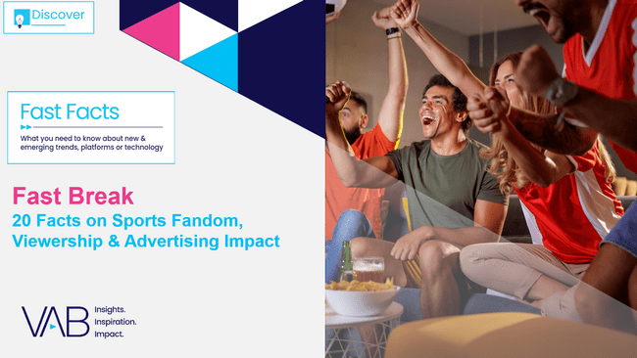
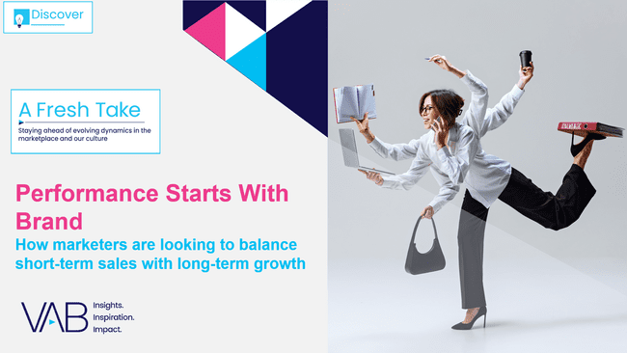

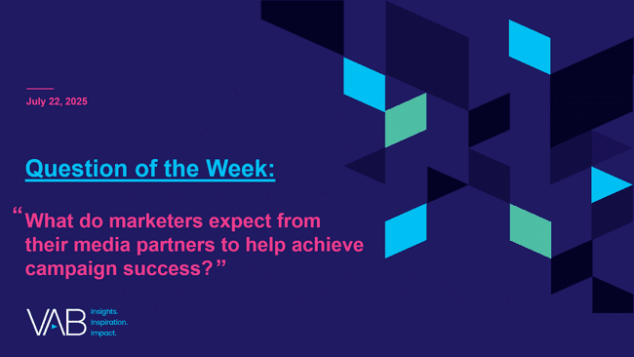
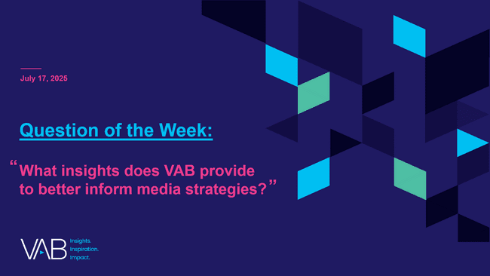
Click on the covers below to download our insights releases from July!
This information is exclusively provided to VAB members and qualified marketers.
PAGE 7

Slide 8


About VAB
VAB plays a dual role in the video advertising industry. We are leading the change to bring about a more innovative and transparent marketplace. We also provide the insights and thought leadership that enables marketers to develop business-driving marketing strategies.
Drawing on our marketing expertise, we simplify the complexities in our industry and discover new insights that transform the way marketers look at their media strategy.
We are committed to your business growth and proud to offer VAB members, brand marketers and agencies complimentary access to our continuously-growing Insights library. Get immediate access at theVAB.com.
PAGE 8

