Slide 1


Six Insights
August 2025

Slide 2


The last two years have seen an increasing number of videos taken down from YouTube, with more than 30 million videos removed in 2023 & 2024
Download our full report, ‘Deleted Scenes: Analyzing How Much ‘Unsafe’ Content YouTube Removes From Their Platform', to learn why these videos were taken down for violating YouTube’s community guidelines
YouTube Videos Removed by Year
178.5 MM
Videos Removed
From 2019 - 2024
Source: VAB analysis of Google Transparency Report, YouTube Community Guidelines enforcement, as of 7/8/25.
This information is exclusively provided to VAB members and qualified marketers.
PAGE 2

Slide 3
2024 featured the most data-driven, digital-native DTC brands investing
the highest amount of dollars collectively on multiscreen TV platforms ever
Download our full ‘VAB members only’ report, Direct-to-Consumer Historical TV Spend Advertiser List: CY 2013 - 2024, to see the TV spending trends for all 789 DTC advertisers monitored
Digital-Native, Direct-to-Consumer (DTC) Brands U.S. Total TV* Spend
$ in millions
+9%
vs. 2023
# of Brands:
41
63
90
113
143
181
259
332
428
424
411
435
Source: VAB analysis of Nielsen AdIntel as of 7/14/25 (*includes all six measured TV media: nat'l cable TV, nat'l broadcast TV, Spanish language broadcast TV, Spanish Language cable TV, spot TV, syndication TV; and streaming as of 2022-2024); excludes promos and PSAs.
Direct to Consumer – a company that sells their product or service online directly to end customers without involving third-party retailers, wholesalers or other parts of the traditional consumer supply chain. Number of DTC brands reflect active on U.S. TV each year.
This information is exclusively provided to VAB members and qualified marketers.
PAGE 3

Slide 4

Minority groups are much more likely to take an action after seeing an ad like searching for more info, visiting a website or consulting a doctor
Download our full report, ‘Why banning Pharma TV ads would disproportionately affect minority groups', to learn more
% Who Have Taken An Action After Seeing a Healthcare Ad
Adults 18+
Non-Hispanic White
32%
Hispanic
40%
Black
39%
Asian
35%
Source: VAB analysis of MRI-Simmons, Spring USA Doublebase Study 2024, Non-Hispanic White Adults 18+, Hispanic Adults 18+, Non-Hispanic Black Adults 18+, Non-Hispanic Asian Adults 18+. *Prescription remedy includes both branded and generic remedies. Note: ‘an action’ represents: Bought a non-prescription product, refilled a prescription, made an appointment to see a doctor, Discussed an ad with your doctor, discussed an ad with a friend or relative, asked your doctor for a specific vaccine, asked your doctor to prescribe a specific drug, consulted a pharmacist, visited health information website, visited a product or drug website, visited another website, requested a free sample, requested a specific test/procedure, called a toll-free number for information, or other.
This information is exclusively provided to VAB members and qualified marketers.
PAGE 4

Slide 5
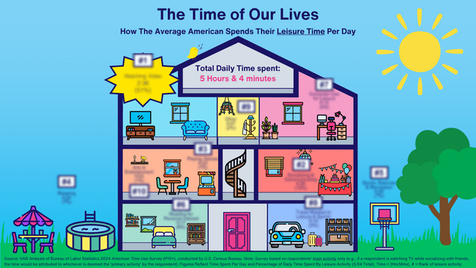
The Average American spends five hours and four minutes per day on leisure activities
Download our infographic, 'The Time of Our Lives’, to learn how much time is devoted to watching videos and other activities like sports, exercise & recreation, socializing, reading and relaxing
This information is exclusively provided to VAB members and qualified marketers.
PAGE 5

Slide 6
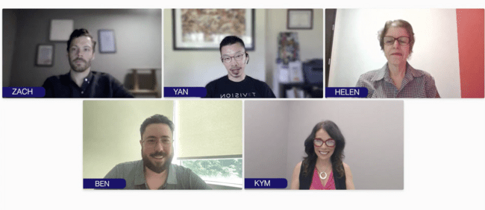
TV campaign measurement requires a holistic approach using a variety of tools and balancing real-time performance with long-term outcomes
Click the screenshot down below to hear more from industry experts as they take a deep dive into the future of TV measurement – the evolution, innovations and what’s next - and learn how to navigate change and unlock impact in this ever-changing environment
Real Time Results: Measuring Converged Outcomes & Future-Proofing Success
Panelists
Helen Katz, EVP, Research, Publicis Media
Kym Frank, SVP, Research & Data,
Ad Sales, Fox
Zachery Farrell, Principal Product Manager, Measurement Enablement, IQVIA Digital
Yan Liu, CEO & Co-Founder, TVision
Benjamin Vandegrift, VP, Measurement Strategy & Innovation, VAB (moderator)
This information is exclusively provided to VAB members and qualified marketers.
PAGE 6

Slide 7
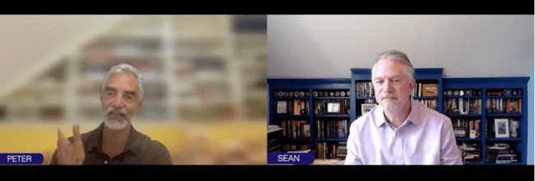
The industry has reached a crossroads in measurement and currency, where relying on a single standard is no longer sustainable
Click the screenshot down below for this fireside chat on the industry’s seismic shift from panel-only methodologies to a new era driven by big data and the marketer implications of this inflection point
The Measurement Crossroads: Navigating Volatility and Opportunity
Fireside Chat
Peter Liguori, CEO, VideoAmp
Sean Cunningham, President & CEO, VAB
This information is exclusively provided to VAB members and qualified marketers.
PAGE 7

Slide 8
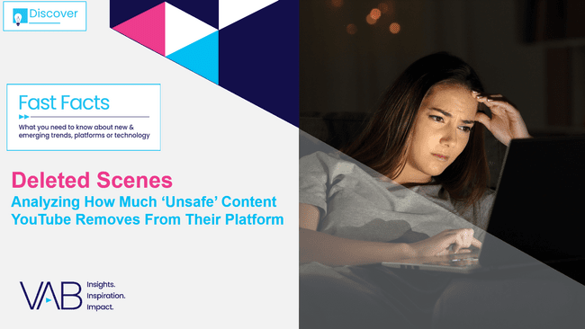

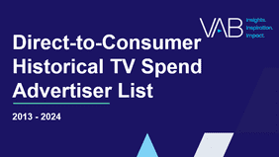
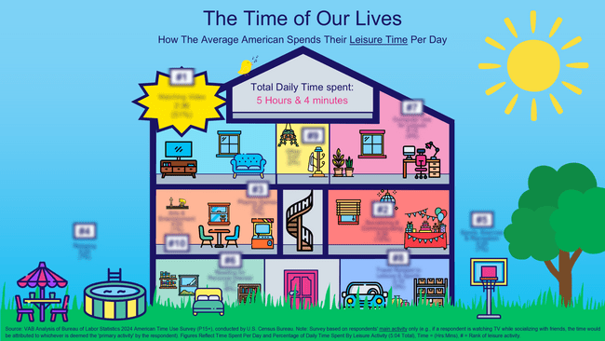
Click on the covers below to download our insights releases from August!
This information is exclusively provided to VAB members and qualified marketers.
PAGE 8

Slide 9
Click on the screenshots below to watch our two webinars from August!
Real Time Results:
Measuring Converged Outcomes & Future-Proofing Success
The Measurement Crossroads:
Navigating Volatility and Opportunity
Featuring
Helen Katz - EVP Research, Publicis Media
Kym Frank – SVP, Research & Data, Ad Sales, Fox
Yan Lui – CEO & Co-Founder, TVision
Zachary Farrell – Principal Product Manager, Measurement Enablement, IQVIA Digital
Ben Vandegrift – VP, Measurement Strategy & Innovation, VAB
Featuring
Peter Ligouri – CEO, Videoamp
Sean Cunningham – President & CEO, VAB
This information is exclusively provided to VAB members and qualified marketers.
PAGE 9

Slide 10


About VAB
VAB plays a dual role in the video advertising industry. We are leading the change to bring about a more innovative and transparent marketplace. We also provide the insights and thought leadership that enables marketers to develop business-driving marketing strategies.
Drawing on our marketing expertise, we simplify the complexities in our industry and discover new insights that transform the way marketers look at their media strategy.
We are committed to your business growth and proud to offer VAB members, brand marketers and agencies complimentary access to our continuously-growing Insights library. Get immediate access at theVAB.com.
This information is exclusively provided to VAB members and qualified marketers.
PAGE 10

