Slide 1


VIDEO ADVERTISING BUREAU - REPORT - 2019
.................
Finding Your Niche
Uncovering Advertiser Value Within
Specialized Cable Networks

Slide 2



Why Niche Cable?
“Niche Cable” refers to the long tail, specialized networks with a cume audience under the average cable TV network monthly cume reach. Niche networks complement a marketer’s TV plan by driving value against targeted consumers.
Reach – Niche cable networks collectively offer significant audience reach, as well as incremental reach potential.
Commitment & Engagement – Viewers devote a significant amount of time to watching niche cable programming across a wide variety of engaging topics. Viewers are so drawn in by specialized content, that the overwhelming majority is watching live.
Opportunity for Advertisers – Niche cable networks appeal to advertisers across a wide variety of company sizes, industries, and business models. Niche cable is also relied upon by Direct-to-Consumer (DTC) brands who are performance-driven, data-focused and obsessed with buying media that deliver outcomes.
So, let’s take a closer look at the relevancy and impact of these niche networks
2

Slide 3
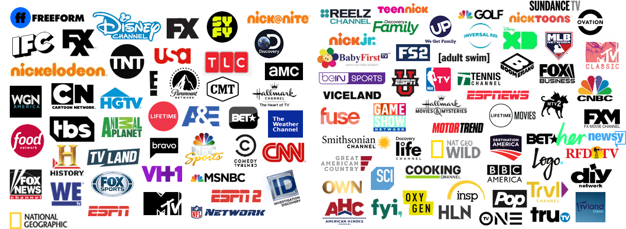
Defining Niche Cable
45,650M
Average Network Monthly Cume Reach, P2+
A network is classified as niche if its audience size is below the average cable network monthly cume reach.
The average cable monthly cume reach is the average cume reach of all Nielsen measured cable networks.
Larger Networks
Niche Networks
(44 measured networks)
(55 measured networks)
Source: Nielsen Npower R&F Time Period Report, Persons 2+, Playback Time Period: Live +7 Days (+168 hours) | TV | Linear with VOD, Measurement Interval: 12/1 - 12/31-2018.
3

Slide 4






















































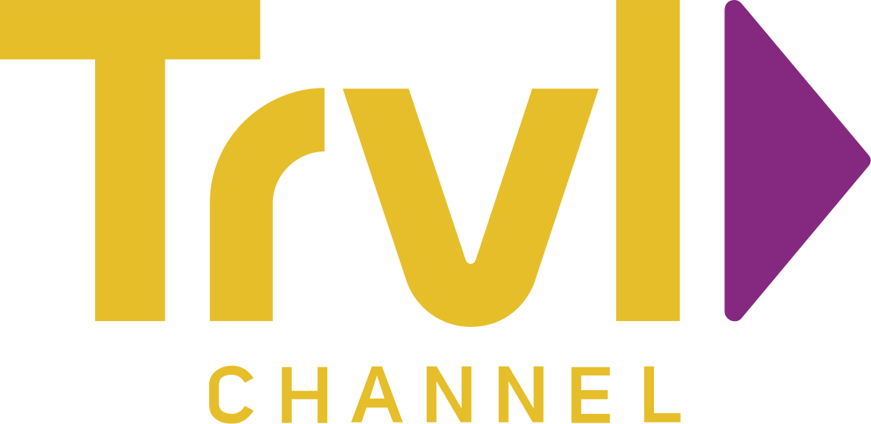
Cable’s Niche Networks Offer A Diverse Mix Of Programming, Allowing Marketers To Target A Variety of Enthusiast Groups
Sports
Film
Kids/Family Entertainment
News
Music
Home & Food
Science
General Entertainment
4

Slide 5
Collectively, Niche Networks Reach Over Half Of The Total Population Each Month During Prime And More Than Two-Thirds Each Month At Any Point During The Day
Source: VAB analysis of Nielsen Npower R&F Time Period Report, Persons 2+, Playback Time Period: Live +7 Days (+168 hours) | TV | Linear with VOD, Total Day, Measurement Interval: 12/1 – 12/31 2018. Network set reflects the identified 2018 niche cable networks and large cable networks.
5

Slide 6








Niche Cable Offers Incremental Reach Opportunities Against People Who Are Not Regularly Watching Larger Cable Networks
Relying upon the major Cable network to “cover off” each genre often means leaving audience on the table
Incremental
Reach Opportunity
83%
…of the Niche Cable film audience isn’t watching
64%
…of the Niche Cable family/kids entertainment audience isn’t watching
39%
…of the Niche Cable news audience isn’t watching
41%
…of the Niche Cable music audience isn’t watching
39%
…of the Niche Cable science/nature/tech audience isn’t watching
24%
…of the Niche Cable home improvement audience isn’t watching
18%
…of the Niche Cable food audience isn’t watching
23%
…of the Niche Cable sports audience isn’t watching
Source: GfK MRI duplication analysis. 2018 Doublebase; Niche audience segment designations as per slide 4.
6

Slide 7
In Aggregate, Viewers Spent Over Three And A Half Billion Hours Watching Niche Cable Programs Each Month, More Than Double The Amount Of Time They Spent Watching 10 Years Ago
Source: VAB analysis of Nielsen Npower R&F Time Period Report, Persons 2+, Playback Time Period: Live +7 Days (+168 hours) | TV | Linear with VOD, Total Day, Measurement Interval: 1/1 – 12/31, 2008, 2013, 2018. Network set reflects the identified 2018 niche cable networks, however not all were measured in the 2008 and 2013 time periods.
7

Slide 8
The Increase In Viewership Over The Last 10 Years Is Even More Pronounced During Prime Where Aggregated ‘Time Spent’ Viewing Niche Cable TV Programming Has More Than Tripled
Source: VAB analysis of Nielsen Npower R&F Time Period Report, Persons 2+, Playback Time Period: Live +7 Days (+168 hours) | TV | Linear with VOD, Prime, Measurement Interval: 1/1 – 12/31, 2008, 2013, 2018. Network set reflects the identified 2018 niche cable networks, however not all were measured in the 2008 and 2013 time periods.
8

Slide 9
The Growth In Viewership Means That Niche Networks Now Collectively Account For One-Quarter Of Aggregated Total Day Ad-Supported Cable TV Viewing
Source: VAB analysis of Nielsen Npower R&F Time Period Report, Persons 2+, Playback Time Period: Live +7 Days (+168 hours) | TV | Linear with VOD, Total Day, Measurement Interval: 1/1 – 12/31, 2008, 2013, 2018. Network set reflects the identified 2018 niche cable networks, however not all were measured in the 2008 and 2013 time periods.
9

Slide 10
Although The Primetime Share For Niche Networks Is Slightly Lower Than Total Day, The Share Growth Has Been Larger For This Daypart Over The Last 10 Years
Source: VAB analysis of Nielsen Npower R&F Time Period Report, Persons 2+, Playback Time Period: Live +7 Days (+168 hours) | TV | Linear with VOD, Total Day, Measurement Interval: 1/1 – 12/31, 2008, 2013, 2018. Network set reflects the identified 2018 niche cable networks, however not all were measured in the 2008 and 2013 time periods.
10

Slide 11
On Average, Niche Entertainment Networks ‘Tune-In’ Viewing Sessions Are Virtually On Par With Viewers Of Larger Cable Entertainment Networks
Source: VAB analysis of Nielsen Npower Length of Tune Time Period Report, Persons 2+, Viewing Source: Ad-Supported Cable, Total Day, Measurement Interval: 12/1/18 – 12/31/18; Average Length of Viewing Session = Average Length of Tuning Events: The average length of all tuning events to the selected viewing source, daypart and feed pattern. The Average Length of Tune calculation is: Number of Minutes Viewed / Total Number of Events Tuned; 20 Niche Networks reflect those included in “General Entertainment” on slide 4; 22 Large Networks include: A&E, AMC, Animal Planet, Bravo, Comedy Central, E!, Freeform, FX, FXX, Hallmark Channel, History Channel, Investigation Discovery, Lifetime, Nick @ Nite, Paramount Network, Syfy, TBS, TLC, TNT, TV Land, WEtv & WGN America.
11

Slide 12
Niche Cable Networks’ Ability To Capture Viewer’s Attention And Captivate Their Innate Curiosity Leads To A Very High Level Of ‘Live’ Viewing
Specialized cable content allows viewers to immediately indulge their wide variety of interests & passions - and inspires new ones. While most TV is watched live, live viewing for niche cable is greater, including for Millennials.
Television Primetime Viewing: % “Live” vs. “Time-Shifted”
Total Niche Cable
Total Ad-Supported Cable
Live
Playback
Source: Nielsen NPower R&F Time Period Report, Primetime, Live vs. Live+7, Niche Networks, ad-supported cable TV, broadcast TV, 1/1/2018 – 12/31/2018. P2+ & P18-34 (Millennials). Cable networks are those niche networks defined on slide 3.
12

Slide 13

From A Social Standpoint, Although There Are Pronounced Differences Between Ratings For Niche Cable Nets vs. Broadcast Nets, Niche Networks’ Average Facebook Following Is Virtually On Par With Broadcast Which Speaks To Viewers’ Passion And Engagement Around ‘Enthusiast’ TV Content
Average # of Facebook Page Likes
Source: 2019 Data: Network list reflects 52 of the 55 identified 2019 niche cable networks, with the exception of the following 3 for which there is no current Facebook page - ESPN News, FS2 & Nicktoons. Broadcast Networks include ABC, CBS, CW, FOX, ION and NBC. Data sourced in February 2019.
13

Slide 14
The Share Of Measured Advertising Impressions On Niche Networks Has Almost Doubled Over The Last 10 Years And Now Account For Over One-Quarter Of All Delivered Ad-Supported Cable TV Impressions
% Share of Total Ad-Supported Available Impressions (C3) – Total Day
Source: Nielsen Ad Intel, Persons 2+, C3 IMPs, Total Day, CY 2008 and CY 2018. Time Period Based on Standard Calendar. Niche Cable Network set reflects the identified 2019 niche cable networks, however not all were measured in the 2008 time period.
14

Slide 15

























































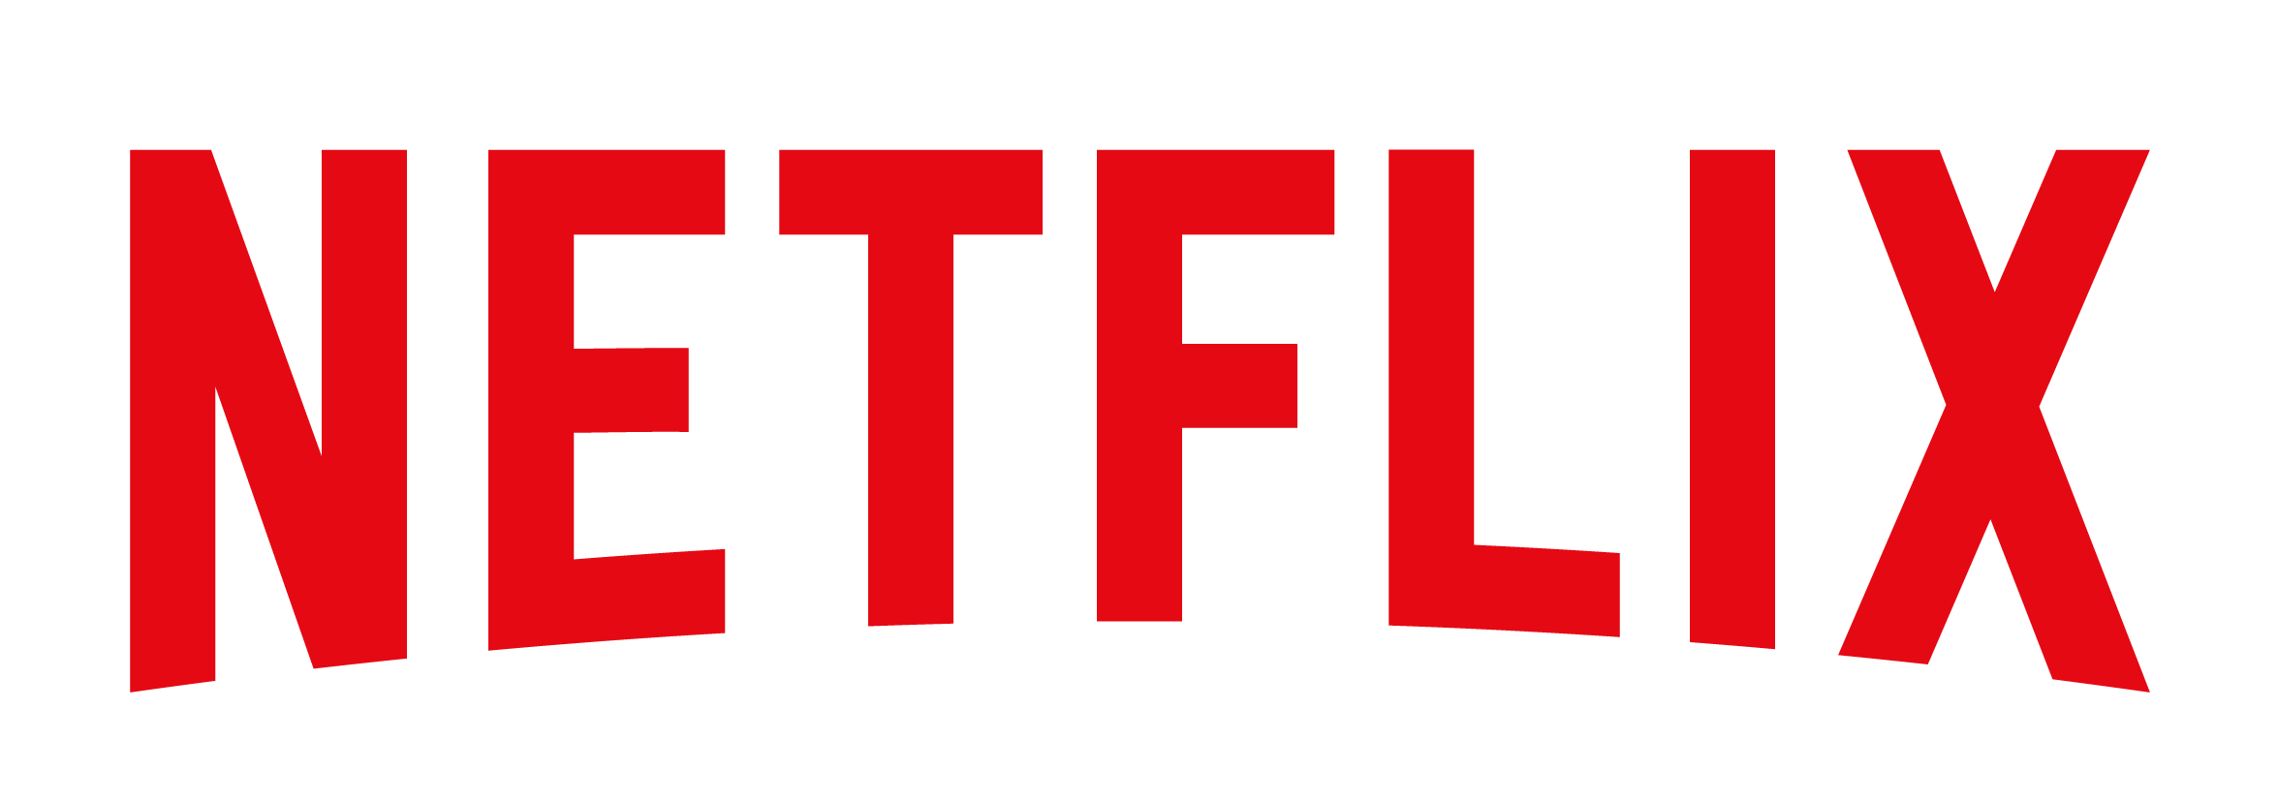




Niche Cable Networks Appeal To A Range Of Advertisers Across Major Categories Who Are Seeking Premium Content, Targeted Audiences And Incremental Reach
Advertisers span categories, ranging from major retailers to packaged goods and tech brands
Telecom
Fast Food
Beverages
Retail
Automotive
Services
Electronics
Food/Food Delivery
Pharmaceutical
Insurance/Financial
FAANG
Source: Nielsen Ad Intel 2018. Chart reflects an abbreviated list of select advertisers by category.
15

Slide 16




















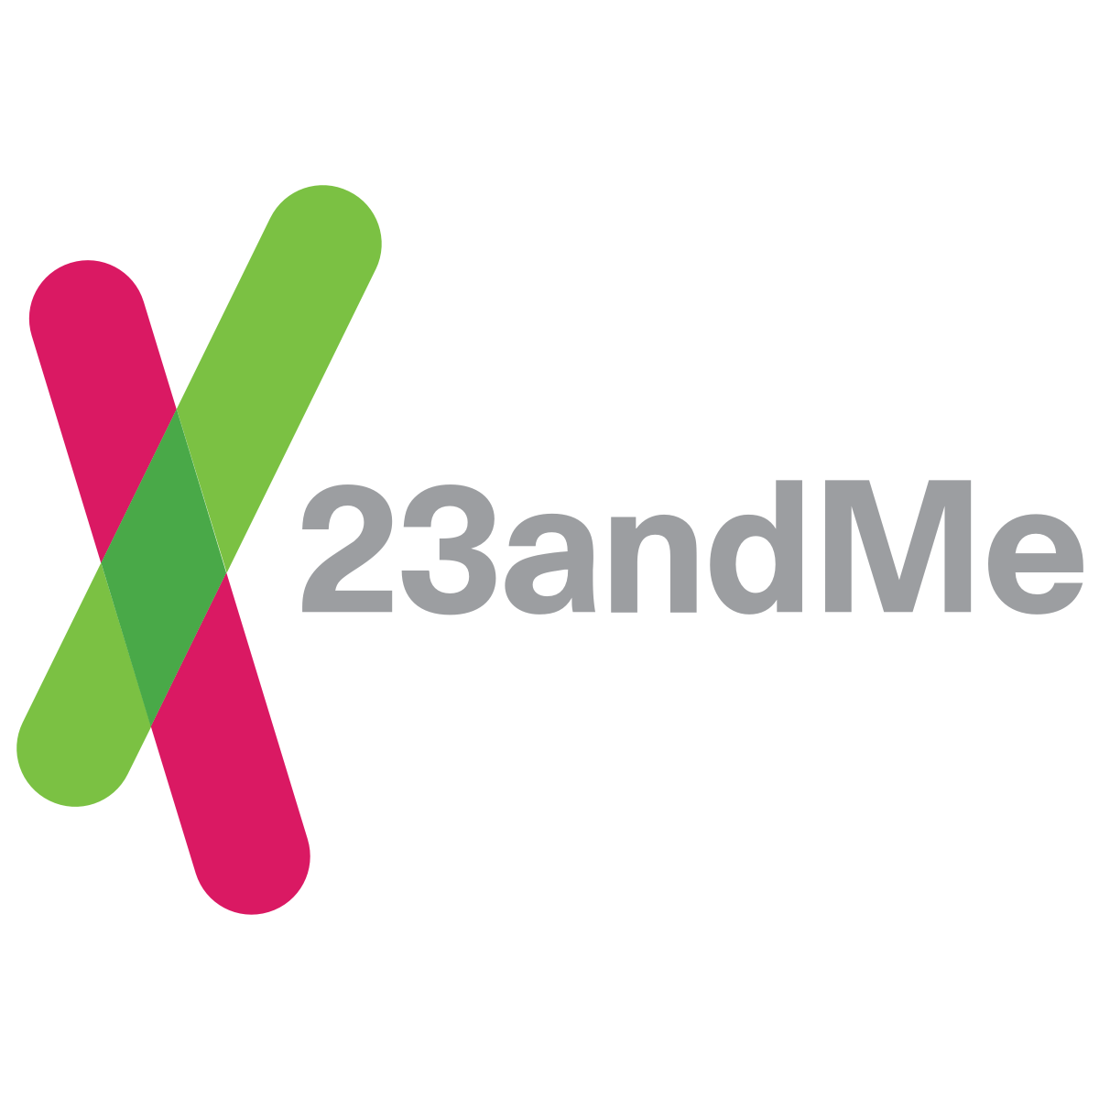









Niche Cable Networks Are Also A Popular Destination For Direct-To-Consumer Brands Who Are Performance-Driven, Data-Focused And Obsessed With Buying Media That Deliver Outcomes
These 30 DTC Brands Alone Spent Over $125 Million On Niche Cable Networks In 2018, An Increase Of 28% vs. The Year Prior
Source: Nielsen Ad Intel 2018. Chart reflects an abbreviated list of select advertisers by category.
16

Slide 17

Niche Cable TV Networks vs. ‘Enthusiast’ Digital Platforms

Slide 18
On Average, Niche Cable Networks Reach More Viewers Each Month Than Similarly Focused Digital Video Platforms
Niche Cable Networks’ Average Monthly Reach vs. Digital Platforms’ Monthly Unique Visitors
December 2018
(in millions)
Source: VAB analysis of Nielsen Npower R&F Time Period Report, Persons 2+, Playback Time Period: Live +7 Days (+168 hours) | TV | Linear with VOD, Total Day, Measurement Interval: December 2018; VAB analysis of comScore MediaMetrix Key Measures multiplatform (desktop, P2+; mobile, P18+) data, December 2018, P2+.
18

Slide 19










From An Engagement Perspective, People Typically Spend Much More Time Consuming ‘Enthusiast’ Content On Niche Cable TV Networks Than They Do With Similar Content On ‘Enthusiast’ Digital Platforms
Music
Total Audience (Monthly Minutes per Visitor)
on Top Enthusiast Platforms
Home
LGBTQ
News /
Finance
Beauty / Lifestyle
Cooking
Sports
Film
Family / Kids
Niche Cable TV Network Average
#1
Home Site
#2
LGBTQ Site
#1
Finance Site
#1
Beauty Site
#1
Food Site
#5
Sports Site
#1
Film Site
#3
Kids Site
#3
Music Site
Sources: TV data – Nielsen NPower, Total Audience 2+, Total Day, Live+SD; December 2018, 147 Billion minutes based upon P2+ cume total minutes for the defined Niche Cable networks herewith; Niche Cable Network Average minutes per month based upon AA Average Minutes for the defined Niche Cable networks. Digital Data - comScore MediaMetrix Multi-Platform, Total Audience = Desktop P2+ & Mobile P18+ . Site rank based on Total Unique Users December 2018, LGBTQ: #1 – Grindr.com; Finance: #1 – Yahoo Finance; Sports: #1-4 sites are TV Brands; Kids: #1-Roblox.com, #2-Disney; Music: #1- Spotify, #2-Pandora; Data reflects Average Time Spent per Visitor on those sites.
Digital platforms
TV
19

Slide 20
Why Niche Cable?
Reach
Niche cable networks collectively offer significant audience reach,
as well as incremental reach potential.
Commitment & Engagement
Viewers devote a significant amount of time to watching niche cable programming across a wide variety of engaging topics. Viewers are so drawn in by specialized content, that the overwhelming majority is watching live.
Opportunity For Advertisers
Niche cable networks appeal to advertisers across a wide variety of company sizes, industries, and business models. Niche cable is also relied upon by Direct-to-Consumer (DTC) brands who are performance-driven, data-focused and obsessed with buying media that deliver outcomes.
20

Slide 21



Contact Us
Jason Wiese
SVP, Director of Strategic Insights
jasonw@thevab.com
Join Our Email List
Marianne Vita
VP, Strategic Insights
mariannev@thevab.com
Leah Montner-Dixon
Senior Multi-Platform Video Analyst leahm@thevab.com
VAB
(Video Advertising Bureau)
@VideoAdBureau

