Slide 1





2022
Episode 4
The FAST and the Curious
How can marketers harness the rapid growth
of FAST?

Slide 2

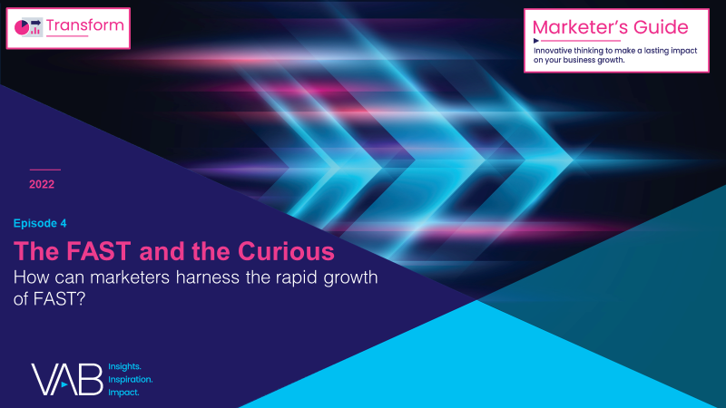
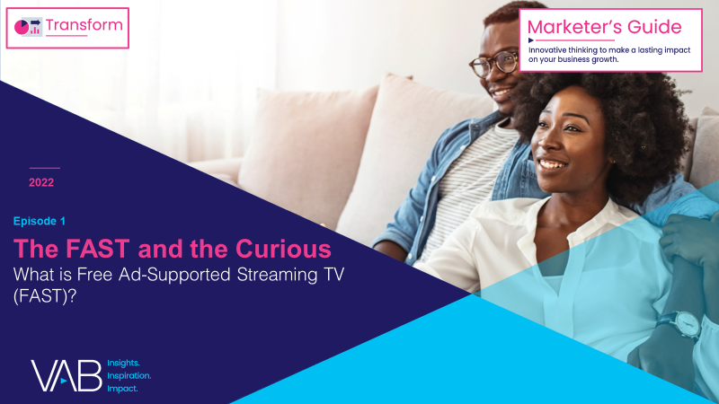
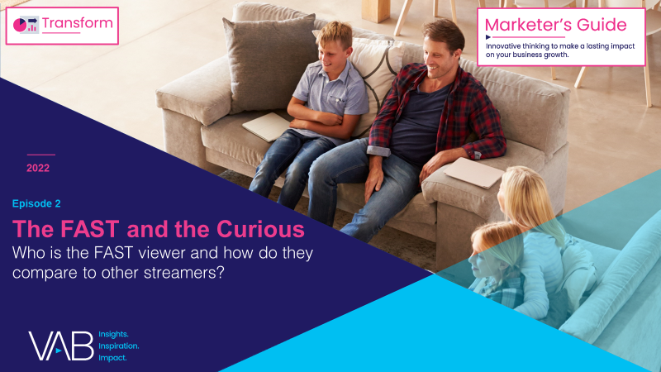
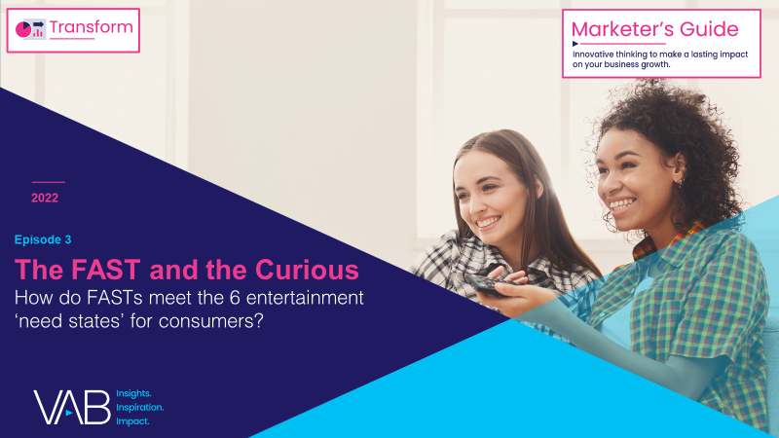
Over the last few years, FAST (free ad-supported streaming TV) has
emerged as a promising new video platform for audiences and advertisers.
Many consumers are increasingly feeling "maxed-out" with their number of paid subscriptions, yet they still crave video content. As a result, the ecosystem of ad-supported streaming options, including FASTs, is rapidly growing.
This 4-part guide, The FAST and the Curious, equips you with
what you need to know about the growing opportunity of FASTs.
How can marketers harness the rapid growth of FAST?
What is Free Ad-Supported Streaming TV (FAST)?
Who is the FAST viewer and how do they compare to other streamers?
How do FASTs meet the 6 entertainment ‘need states’ for consumers?
This information is exclusively provided to VAB members and qualified marketers. Further distribution is prohibited.
PAGE 2

Slide 3


What is FAST (Free Ad-Supported Streaming TV)?
Click here to learn more about FAST
Free ad-supported streaming TV (FAST) services enable audiences to stream video content via
a broadband connection in a linear TV-like environment without needing a subscription.
As the name implies, the content is free to watch because it is ad-supported.
FAST platforms’ defining feature is an “unplanned channel surfing” viewing experience via live scheduled programming delivered to viewers across designated channels.
Note: The first documented use of the acronym 'free ad-supported streaming TV’ is attributed to Alan Wolk at TVREV in 2019.
This information is exclusively provided to VAB members and qualified marketers. Further distribution is prohibited.
PAGE 3

Slide 4


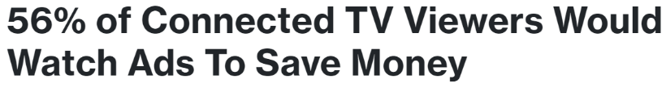

Audiences’ increasing acceptance of, and even preference for, ad-supported streaming services is likely contributing to growth of FAST platforms
Examples of sources reporting on rising preferences for ad-supported services
Hub Entertainment Research
LG Ads Solutions*
Which statement comes closest to how you feel about ads?
Ad Receptivity Among FAST Channel Viewers
65%
‘Medium’ to ‘High’ Ad Receptivity
If there is an ad-free option, I’ll almost always choose it even if it costs $4-$5 more per month
If watching ads will cost $4-$5 less than watching ad-free, I’ll almost always choose that option
Source: Hub Entertainment Research, 2022 TV Advertising: Fact vs. Fiction (Q2 2022). Data based on interviews with 3,004 U.S. consumers age 14-74 who watch a minimum of 1 hour of TV per week. *LG Ads Solutions, FASTs Are The Next Big Thing For TV Viewers, 8/2/2022.
This information is exclusively provided to VAB members and qualified marketers. Further distribution is prohibited.
PAGE 4

Slide 5

“As advertisers look to efficiently maximize their reach
in an increasingly fragmented viewing landscape,
FAST services are a valuable complement to traditional TV and other AVOD streaming options
as part of a holistic multi-screen media plan.”
James Rooke
President, Comcast Advertising
How F.A.S.T. is Changing the TV Advertising Landscape, 7/21/2022
This information is exclusively provided to VAB members and qualified marketers. Further distribution is prohibited.
PAGE 5

Slide 6

FAST services can deliver incremental reach for marketers by engaging new audiences within their convergent TV (linear + streaming) campaigns
% of Audience Overlap by Video Platform
FAST vs. Other Platforms
Audience Duplication % | FAST
AVOD | 59%
TV Everywhere | 24%
vMVPD | 18%
Traditional MVPD | 44%
SVOD | 87%
*How to read: 59% of FAST viewers also watch AVOD services
Source: VAB analysis of MRI-Simmons August 2022 Cord Evolution Study, A18+. Base = streamed in the past 12 months. FAST (41% of A18+ streaming population) = used any of the following streaming services in the past 30 days: Peacock (free service w/ limited commercials), Roku Channel, Tubi TV, Freevee (formerly IMDb TV), Pluto, Samsung TV Plus, Xumo, Local Now. SVOD (83% of A18+ streaming population) = used any of the following streaming services in the past 30 days: Apple TV+, Discovery+, Disney+, HBO Max (commercial free), Hulu (commercial free), Netflix, Paramount+ (commercial free), Amazon Prime Video. AVOD (44% of A18+ streaming population) = used any of the following streaming services in the past 30 days: Hulu (limited commercial), Paramount+ (limited commercial), Peacock (limited commercial), HBO Max (limited commercia), Crackle, Vudu, Discovery+ (limited commercial). TVE (20% of A18+ streaming population) = used any of the following streaming services in the past 30 days: ESPN, Hallmark TV, History, Lifetime, CNN, A&E, MTV, Bravo. vMVPD (14% of a18+ streaming population) = used any of the following streaming services in the past 30 days: DirecTV Stream, Frndly TV, Fubo TV, Hulu + Live TV, Philo, Sling TV, Spectrum TV Choice, YouTube. Traditional MVPD (46% of A18+ streaming population) = household subscribes to cable, satellite or fiber optic TV.
This information is exclusively provided to VAB members and qualified marketers. Further distribution is prohibited.
PAGE 6

Slide 7
Especially as streaming audiences can often be found across multiple platforms, driven by their appetite for video content
% of Audience Overlap by Video Platform
Audience Duplication % | FAST | AVOD | TV Everywhere | vMVPD | Traditional MVPD | SVOD
FAST |  | 55% | 50% | 52% | 40% | 43%
AVOD | 59% |  | 56% | 59% | 40% | 49%
TV Everywhere | 24% | 25% |  | 32% | 24% | 22%
vMVPD | 18% | 19% | 23% |  | 11% | 16%
Traditional MVPD | 44% | 41% | 55% | 35% |  | 45%
SVOD | 87% | 92% | 90% | 90% | 82%
*How to read: 59% of FAST viewers also watch AVOD services vs. 55% of AVOD viewers who also watch FAST services.
This means marketers can reach new audiences and achieve incremental reach across both ad-supported streaming models.
Source: VAB analysis of MRI-Simmons August 2022 Cord Evolution Study, A18+. Base = streamed in the past 12 months. FAST (41% of A18+ streaming population) = used any of the following streaming services in the past 30 days: Peacock (free service w/ limited commercials), Roku Channel, Tubi TV, Freevee (formerly IMDb TV), Pluto, Samsung TV Plus, Xumo, Local Now. SVOD (83% of A18+ streaming population) = used any of the following streaming services in the past 30 days: Apple TV+, Discovery+, Disney+, HBO Max (commercial free), Hulu (commercial free), Netflix, Paramount+ (commercial free), Amazon Prime Video. AVOD (44% of A18+ streaming population) = used any of the following streaming services in the past 30 days: Hulu (limited commercial), Paramount+ (limited commercial), Peacock (limited commercial), HBO Max (limited commercia), Crackle, Vudu, Discovery+ (limited commercial). TVE (20% of A18+ streaming population) = used any of the following streaming services in the past 30 days: ESPN, Hallmark TV, History, Lifetime, CNN, A&E, MTV, Bravo. vMVPD (14% of a18+ streaming population) = used any of the following streaming services in the past 30 days: DirecTV Stream, Frndly TV, Fubo TV, Hulu + Live TV, Philo, Sling TV, Spectrum TV Choice, YouTube. Traditional MVPD (46% of A18+ streaming population) = household subscribes to cable, satellite or fiber optic TV.
This information is exclusively provided to VAB members and qualified marketers. Further distribution is prohibited.
PAGE 7

Slide 8


Marketers can engage with FAST audiences via traditional TV ads, like :15s and :30s units, or sponsor channels to showcase their own branded content
62% of streamers prefer viewing standard video ads, making it the most preferred format within a streaming environment*
Traditional TV Ads
Comprised of :15s or :30s units
Branded Channels
Channels sponsored by brands that host content which aligns with the brand’s own messaging
As FAST is a relatively new space, many advertisers appear to be using the same :15 second or :30 second creative on FAST services as they do for their linear TV campaigns.
For marketers, the ability to trial a new platform without having to modify their existing ads
can make for an easy entry to FAST.
Some media brands (e.g., Funny or Die) and consumer brands (e.g., Dove) sponsor channels on FAST services, where they air their own branded content or related programming. With a direct connection to viewers, brands can engagement and their affinity among consumers.
Currently, there are not many active consumer brand channels; however, it is expected that opportunities will grow as FAST channels look to expand their content libraries.
Source: *Magid national AVOD & SVOD streamer study (n=2,000), commissioned on behalf of Tubi, Q3 2022; respondents must stream AVOD & SVOD. Preferred ad formats amongst AVOD & SVOD streamers: standard video ad (62%), split screen (43%), pause ad (41%), interactive (30%), QR ad (24%). Note: information above on ‘traditional TV ads’ and ‘branded channels’ based on review of a sampling of brand ads viewed across various FAST services with comparisons to the brands’ linear TV creative, available via iSpot.TV.
This information is exclusively provided to VAB members and qualified marketers. Further distribution is prohibited.
PAGE 8

Slide 9




Similar to AVOD viewers, FAST audiences accept and appreciate the value exchange between content and ads
% of streamers who agree with the following statements, based on streaming service type
‘I prefer streaming free video content with ads/commercials instead of paying for a subscription without ads / commercials’
‘I enjoy streaming TV shows that
have ads/commercials’
‘The ads / commercials I see on streaming services I use are relevant to me’
71% / 68%
42% / 40%
42% / 43%
vs. A18+ streamer: 63%
vs. A18+ streamer: 36%
vs. A18+ streamer: 38%
Source: VAB analysis of MRI-Simmons August 2022 Cord Evolution Study, A18+. Base = streamed in the past 12 months. FAST Viewers (41% of A18+ streaming population) = used any of the following streaming services in the past 30 days: Peacock (free service w/ limited commercials), Roku Channel, Tubi TV, Freevee (formerly IMDb TV), Pluto, Samsung TV Plus, Xumo, Local Now. AVOD Viewers (44% of A18+ streaming population) = used any of the following streaming services in the past 30 days: Hulu (limited commercial), Paramount+ (limited commercial), Peacock (limited commercial), HBO Max (limited commercial), Crackle, Vudu, Discovery+ (limited commercial). Reflects respondents who answered ‘somewhat agree’ or ‘strongly agree’.
This information is exclusively provided to VAB members and qualified marketers. Further distribution is prohibited.
PAGE 9

Slide 10
There is ripe opportunity for greater personalization of advertising on platforms like FAST as people are more willing to exchange their viewing history than any of their other information in order to get relevant ads
% of A18+ Who Say it is Acceptable* to Receive More Relevant Ads Based on Your Information
Source: The Advertising Research Foundation, 5th Annual Privacy Study, September 2022. Based on survey of 1,273 American consumers, fielded 5/14/22 – 5/27/22. *Based on respondents who answered ‘somewhat acceptable’ or ‘acceptable’.
This information is exclusively provided to VAB members and qualified marketers. Further distribution is prohibited.
PAGE 10

Slide 11

FAST Forward
What does the future of FAST hold?

Slide 12
The channel expansion of FAST is fueling comparatively high audience growth, which creates more opportunities for marketers as services continue to increase and additional content agreements are formed
Total number of FAST channels in the U.S.*
(Exclusive to & Shared Across Services)
+58%
vs. June ‘20
YoY FAST audience increased
+73%
From July 2020 to August 2022
Source: VAB analysis of MRI-Simmons Cord Evolution Study, July 2020 vs. August 2022, A18+. Base = streamed in the past 12 months. FAST Viewers (41% of A18+ streaming population) = used any of the following streaming services in the past 30 days: Peacock (free service w/ limited commercials), Roku Channel, Tubi TV, Freevee (formerly IMDb TV), Pluto, Samsung TV Plus, Xumo, Local Now. *VIP+ Variety Intelligence Platform, Life in the FAST Lane, July 2022. VIP+ analysis includes DistroTV, Freevee, Haystack News, LG Channels+, Local Now, News by Fire TV, Peacock, Plex, Pluto, Prime Video Channels, Redbox, Roku Channel, Samsung TV Plus, Sling Free, Sports.TV, STIRR, Tubi, Very Lcoal, ViX, Vizio WatchFree+, Xumo.
This information is exclusively provided to VAB members and qualified marketers. Further distribution is prohibited.
PAGE 12

Slide 13

Advertisers across categories, many of which align with the FAST consumers’ behaviors, are already investing significantly to build
their brand’s presence on these increasingly popular platforms
Top 10 Categories for U.S. Ad Spend on Pluto and Tubi Combined
May 2022 (in millions)
Source: VIP+ Variety Intelligence Platform, Life in the FAST Lane, July 2022. Category data from SensorTower via VIP+.
This information is exclusively provided to VAB members and qualified marketers. Further distribution is prohibited.
PAGE 13

Slide 14
With the continued expansion of access points and viewership growth, FAST advertising spend is projected to more than double over a five-year span to $6 billion annually in 2025
Estimated Annual U.S. FAST Ad Revenue
in billions
+135%
vs. 2021
Source: VIP+ Variety Intelligence Platform, What to Expect Next in FAST, 7/11/22. Based on Variety Intelligence Platform analysis.
This information is exclusively provided to VAB members and qualified marketers. Further distribution is prohibited.
PAGE 14

Slide 15
“Right now, the FAST ecosystem is still developing.
It’s early on and folks are trying to figure things out, but I think that standards are developing over time as the market matures. And I do think the industry is maturing in a positive way, and certainly has been doing so over the last couple of years. So, things are on the right track.”
Sean Buckley
Chief Revenue Officer, Magnite
TVREV, FASTs are the New Cable
This information is exclusively provided to VAB members and qualified marketers. Further distribution is prohibited.
PAGE 15

Slide 16



Key Takeaways For Marketing Plans
FASTs offer an incremental reach
and engagement opportunity
FASTs provide a ‘Share of Voice’ opportunity
FASTs present opportunities for creativity
FAST, AVOD and linear TV combined can maximize reach and frequency opportunities within premium environments for brands within
their holistic video campaigns
With ad spend on FASTs increasing, the platform can be an important component of holistic video campaigns for brands looking
to defend or grow their SOV
Brands can connect with FAST audiences via their existing :15s / :30s video creative, and as FAST continues
to grow there will be more opportunities
for branded content and creative
ad experiences
This information is exclusively provided to VAB members and qualified marketers. Further distribution is prohibited.
PAGE 16

Slide 17

Download all four releases of VAB’s ‘The FAST and the Curious’ series to learn about FAST, their audience, the opportunities and the future
Download VAB’s entire ‘The FAST and the Curious’ series to get up to speed on FAST and its audiences
What is Free Ad-Supported Streaming TV (FAST)?
Who is the FAST viewer and how do they compare to other streamers?
How do FASTs meet the 6 entertainment ‘need states’ for consumers?
How can marketers harness
the rapid growth of FAST?
This information is exclusively provided to VAB members and qualified marketers. Further distribution is prohibited.
PAGE 17

Slide 18

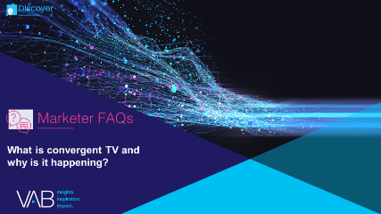
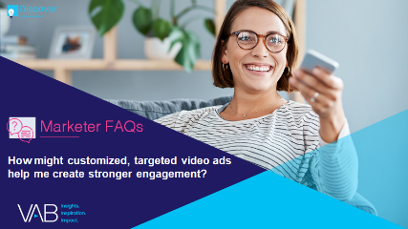
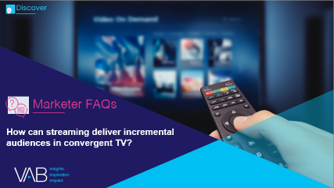

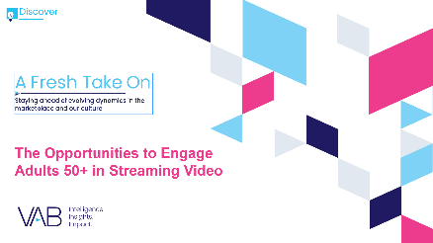
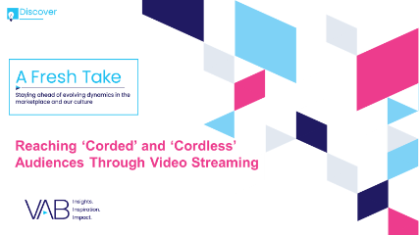

Jason Wiese
Leah Montner-Dixon
SVP, Director of Strategic Insights
jasonw@thevab.com
Associate Insights Director
leahm@thevab.com
Discover more
Looking for more data, insights and takeaways? Check out this related VAB content
What is convergent TV and why is it happening?
How might customized, targeted video ads help me create stronger engagement?
How can streaming deliver incremental audiences in convergent TV?
How can a convergent TV strategy drive business results for my brand?
A Fresh Take On
The Opportunities to Engage Adults 50+ in Streaming Video
Reaching ‘Corded’
and ‘Cordless’ Audiences Through Video Streaming
VAB Members, brand marketers and agencies get free and immediate access to VAB’s content library. Get access at theVAB.com
This information is exclusively provided to VAB members and qualified marketers. Further distribution is prohibited.
PAGE 18

Slide 19


About VAB
VAB is an insights-driven organization that inspires marketers to reimagine their media strategies resulting in fully informed decisions.
Drawing on our marketing expertise, we simplify the complexities in our industry and discover new insights that transform the way marketers look at their media strategy.
We are committed to your business growth and proud to offer VAB members, brand marketers and agencies complimentary access to our continuously-growing Insights library. Get immediate access at theVAB.com.
Curious to learn more about VAB? Check out this quick video to see what we do and how we can help you develop business-driving marketing strategies.
This information is exclusively provided to VAB members and qualified marketers. Further distribution is prohibited.
PAGE 19

