Slide 1





2022
Episode 3
The FAST and the Curious
How do FASTs meet the 6 entertainment ‘need states’ for consumers?

Slide 2

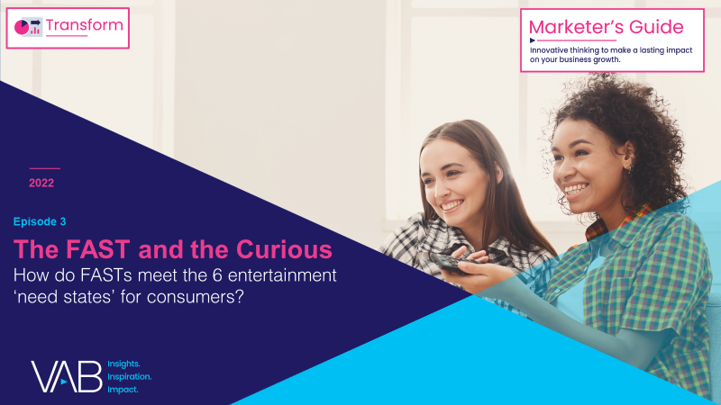
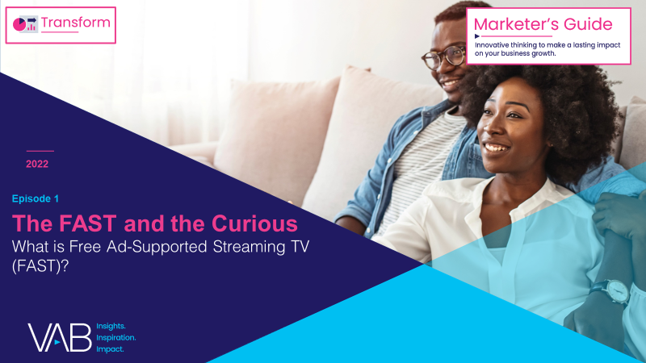
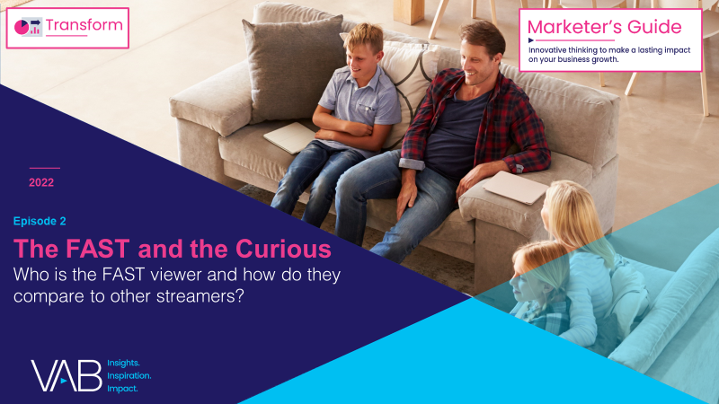
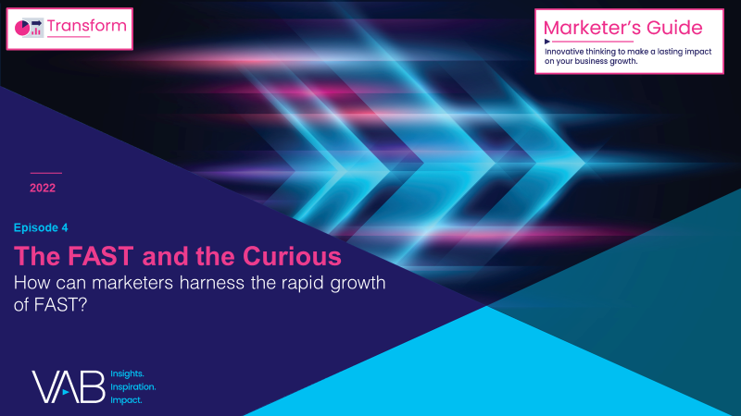
Over the last few years, FAST (free ad-supported streaming TV) has
emerged as a promising new video platform for audiences and advertisers.
Many consumers are increasingly feeling "maxed-out" with their number of paid subscriptions, yet they still crave video content. As a result, the ecosystem of ad-supported streaming options, including FASTs, is rapidly growing.
This 4-part guide, The FAST and the Curious, equips you with
what you need to know about the growing opportunity of FASTs.
How do FASTs meet the 6 entertainment ‘need states’ for consumers?
What is Free Ad-Supported Streaming TV (FAST)?
Who is the FAST viewer and how
do they compare to other streamers?
How can marketers harness the rapid growth of FAST?
This information is exclusively provided to VAB members and qualified marketers. Further distribution is prohibited.
PAGE 2

Slide 3


What is FAST (Free Ad-Supported Streaming TV)?
Click here to learn more about FAST
Free ad-supported streaming TV (FAST) services enable audiences to stream video content via
a broadband connection in a linear TV-like environment without needing a subscription.
As the name implies, the content is free to watch because it is ad-supported.
FAST platforms’ defining feature is an “unplanned channel surfing” viewing experience via live scheduled programming delivered to viewers across designated channels.
Note: The first documented use of the acronym 'free ad-supported streaming TV’ is attributed to Alan Wolk at TVREV in 2019.
This information is exclusively provided to VAB members and qualified marketers. Further distribution is prohibited.
PAGE 3

Slide 4






FAST delivers on six common entertainment needs of consumers
6 Entertainment ‘Need States’ for Consumers
Indulge My Interests
(interest in niche / specialty topics)
‘Comfort Food’ for the Soul
(desire for comfort / familiarity)
Keep It Simple
(desire for convenience)
Let’s Make a Deal
(interest in a value exchange)
Relieve My ‘Choice Paralysis’
(desire for a curated life)
Make Things Exciting
(desire for more variety)
Source: VAB analysis of attitudinal & behavioral statements within MRI-Simmons 2022 Spring Doublebase Study to identify the six consumer needs.
This information is exclusively provided to VAB members and qualified marketers. Further distribution is prohibited.
PAGE 4

Slide 5

FAST services are attracting audiences because they provide ‘frictionless’ access
to a variety of easily accessible and
cost-efficient entertainment for when
they want to lean back and engage.
In turn, FAST viewers are voracious consumers whose set of related behaviors tie into many major categories.
This information is exclusively provided to VAB members and qualified marketers. Further distribution is prohibited.
PAGE 5

Slide 6

Indulge My Interests (interest in niche / specialty topics)
FAST viewers have varied tastes and they love learning for the sake of learning or getting exposed to new experiences because it keeps their lives exciting
% of FAST viewers who agree with the following statements
Travel
Education
Culture
84% say they like to try local cuisine when they travel
83% are interested in learning about things just for fun
74% like to learn about foreign cultures
Food
Technology
69% say they enjoy eating foods from different cultures
52% say living in a foreign country is something they would like to experience
Source: VAB analysis of MRI-Simmons August 2022 Cord Evolution Study, A18+. Base = streamed in the past 12 months. FAST Viewers (41% of A18+ streaming population) = used any of the following streaming services in the past 30 days: Peacock (free service w/ limited commercials), Roku Channel, Tubi TV, Freevee (formerly IMDb TV), Pluto, Samsung TV Plus, Xumo, Local Now. Reflects respondents who answered ‘somewhat agree’ or ‘strongly agree’.
This information is exclusively provided to VAB members and qualified marketers. Further distribution is prohibited.
PAGE 6

Slide 7

‘Comfort Food’ for the Soul (desire for comfort / familiarity)
FAST viewers know what they like and get enjoyment out of comfort and familiarity, often turning to their favorite brands or vacation spots
% of FAST viewers who agree with the following statements
Experiences
Apparel & Accessories
Automotive
93% believe that doing things because they enjoy them is very important
92% say comfort is one of the most important factors when selecting fashion products to purchase
72% say comfort is the most important thing in a car
Food
Travel
Retail
57% say they snack often
70% say when they find a vacation spot
they like, they go back whenever they can
40% buy the brands they grew up with, the ones their parents used
Source: VAB analysis of MRI-Simmons August 2022 Cord Evolution Study, A18+. Base = streamed in the past 12 months. FAST Viewers (41% of A18+ streaming population) = used any of the following streaming services in the past 30 days: Peacock (free service w/ limited commercials), Roku Channel, Tubi TV, Freevee (formerly IMDb TV), Pluto, Samsung TV Plus, Xumo, Local Now. Reflects respondents who answered ‘somewhat agree’ or ‘strongly agree’.
This information is exclusively provided to VAB members and qualified marketers. Further distribution is prohibited.
PAGE 7

Slide 8

Keep It Simple (desire for convenience)
The way FAST viewers make decisions is often designed around efficiency and they seek out products and services that make their daily lives run smoother
% of FAST viewers who agree with the following statements
Automotive
Travel
Food
82% say when buying a vehicle, how well
it meets their needs matters more than whether it's foreign or domestic
82% would rather book a trip over the Internet than meet with a travel agent
76% are always on the lookout for quick and ‘easy to prepare’ meal options
Mobile Apps
Online Shopping
Consumer Tech
69% say apps have made their life so much more convenient
63% are more likely to purchase a product online than in a store
33% say ‘smart’ home devices / appliances have become an important part of their life
Source: VAB analysis of MRI-Simmons August 2022 Cord Evolution Study, A18+. Base = streamed in the past 12 months. FAST Viewers (41% of A18+ streaming population) = used any of the following streaming services in the past 30 days: Peacock (free service w/ limited commercials), Roku Channel, Tubi TV, Freevee (formerly IMDb TV), Pluto, Samsung TV Plus, Xumo, Local Now. Reflects respondents who answered ‘somewhat agree’ or ‘strongly agree’.
This information is exclusively provided to VAB members and qualified marketers. Further distribution is prohibited.
PAGE 8

Slide 9

Let’s Make a Deal (interest in a value exchange)
At times FAST viewers are creatures of habit who enjoy a good loyalty program, but they can also be swayed by a good deal or be willing to try a new product if they have an incentive to do so, like a discount
% of FAST viewers who agree with the following statements
Technology
Travel
Retail
75% say they always shop for the best deal in electronic equipment
68% say travel and hotel discounts have a strong influence on where they choose to travel and where they choose to stay
64% say they prefer to shop at stores that offer loyalty rewards
Food
Automotive
Health
52% say they can often be swayed by coupons to try new food products
49% say rebates & incentives strongly influence their new vehicle purchase decision
44% say a coupon would encourage them to try a different prescription drug brand
Source: VAB analysis of MRI-Simmons August 2022 Cord Evolution Study, A18+. Base = streamed in the past 12 months. FAST Viewers (41% of A18+ streaming population) = used any of the following streaming services in the past 30 days: Peacock (free service w/ limited commercials), Roku Channel, Tubi TV, Freevee (formerly IMDb TV), Pluto, Samsung TV Plus, Xumo, Local Now. Reflects respondents who answered ‘somewhat agree’ or ‘strongly agree’.
This information is exclusively provided to VAB members and qualified marketers. Further distribution is prohibited.
PAGE 9

Slide 10

Relieve My ‘Choice Paralysis’ (desire for a curated life)
FAST viewers seek out curated experiences and like to rely on the advice of experts, professionals, trusted brands or recommended products and services to make informed decisions
% of FAST viewers who agree with the following statements
Mobile
Automotive
Travel
83% say they rely on their cell phone for maps and directions
66% say they always follow the advice of their mechanic
61% believe packaged deals are great because they don't have to plan out the details too much
Financial
Technology
41% say they often ask the advice of others when it comes to financial products or services
40% say when they need to solve a problem, they ask people online what they would do
Source: VAB analysis of MRI-Simmons August 2022 Cord Evolution Study, A18+. Base = streamed in the past 12 months. FAST Viewers (41% of A18+ streaming population) = used any of the following streaming services in the past 30 days: Peacock (free service w/ limited commercials), Roku Channel, Tubi TV, Freevee (formerly IMDb TV), Pluto, Samsung TV Plus, Xumo, Local Now. Reflects respondents who answered ‘somewhat agree’ or ‘strongly agree’.
This information is exclusively provided to VAB members and qualified marketers. Further distribution is prohibited.
PAGE 10

Slide 11

Keep Things Exciting (desire for more variety)
FAST viewers expect the products and services they purchase to help give their lives more variety and excitement, from their vacations and experiences to how they decorate their home or dress themselves
% of FAST viewers who agree with the following statements
Travel
Home
Experiences
78% say on their vacations, they prefer traveling to places they've never been
72% say they are always looking for new ideas to improve their home
58% say they seek out variety in their everyday life
Fitness
Retail
Apparel & Accessories
53% frequently look for new ways to change up their exercise routine
50% say when they shop they usually visit a variety of stores
31% like to experiment with new clothing styles
Source: VAB analysis of MRI-Simmons August 2022 Cord Evolution Study, A18+. Base = streamed in the past 12 months. FAST Viewers (41% of A18+ streaming population) = used any of the following streaming services in the past 30 days: Peacock (free service w/ limited commercials), Roku Channel, Tubi TV, Freevee (formerly IMDb TV), Pluto, Samsung TV Plus, Xumo, Local Now. Reflects respondents who answered ‘somewhat agree’ or ‘strongly agree’.
This information is exclusively provided to VAB members and qualified marketers. Further distribution is prohibited.
PAGE 11

Slide 12


Key Takeaways For Marketing Plans
Leverage FASTs’ ability to deliver
on common entertainment needs
Utilize FAST advertising to highlight the rational benefits of your brand or product
FASTs are amassing a growing audience because they tap into consumers’ cravings for ease and convenience, especially when they are looking to relax while watching some of their favorite content
The FAST viewer ensures that the brands they buy add efficiency and ease to their lives, which applies to most categories – from automotive and travel to consumer technology and health, as well as streaming
This information is exclusively provided to VAB members and qualified marketers. Further distribution is prohibited.
PAGE 12

Slide 13

Download all four releases of VAB’s ‘The FAST and the Curious’ series to learn about FAST, their audience, the opportunities and the future
Download VAB’s entire ‘The FAST and the Curious’ series to get up to speed on FAST and its audiences
What is Free Ad-Supported Streaming TV (FAST)?
Who is the FAST viewer and how do they compare to other streamers?
How do FASTs meet the 6 entertainment ‘need states’ for consumers?
How can marketers harness
the rapid growth of FAST?
This information is exclusively provided to VAB members and qualified marketers. Further distribution is prohibited.
PAGE 13

Slide 14


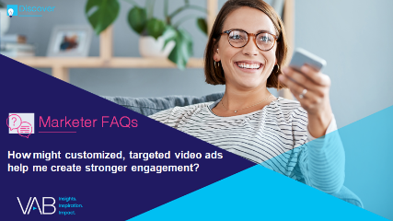
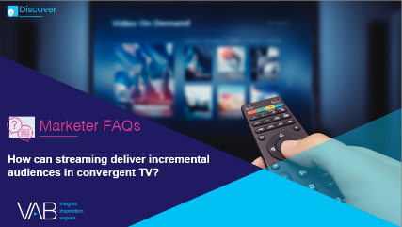


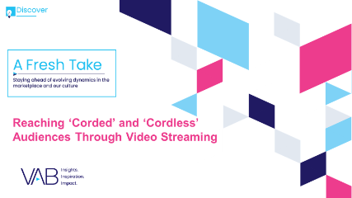

Jason Wiese
Leah Montner-Dixon
SVP, Director of Strategic Insights
jasonw@thevab.com
Associate Insights Director
leahm@thevab.com
Discover more
Looking for more data, insights and takeaways? Check out this related VAB content
What is convergent TV and why is it happening?
How might customized, targeted video ads help me create stronger engagement?
How can streaming deliver incremental audiences in convergent TV?
How can a convergent TV strategy drive business results for my brand?
A Fresh Take On
The Opportunities to Engage Adults 50+ in Streaming Video
Reaching ‘Corded’
and ‘Cordless’ Audiences Through Video Streaming
VAB Members, brand marketers and agencies get free and immediate access to VAB’s content library. Get access at theVAB.com
This information is exclusively provided to VAB members and qualified marketers. Further distribution is prohibited.
PAGE 14

Slide 15


About VAB
VAB is an insights-driven organization that inspires marketers to reimagine their media strategies resulting in fully informed decisions.
Drawing on our marketing expertise, we simplify the complexities in our industry and discover new insights that transform the way marketers look at their media strategy.
We are committed to your business growth and proud to offer VAB members, brand marketers and agencies complimentary access to our continuously-growing Insights library. Get immediate access at theVAB.com.
Curious to learn more about VAB? Check out this quick video to see what we do and how we can help you develop business-driving marketing strategies.
This information is exclusively provided to VAB members and qualified marketers. Further distribution is prohibited.
PAGE 15

