Slide 1





2022
Episode 2
The FAST and the Curious
Who is the FAST viewer and how do they compare to other streamers?

Slide 2

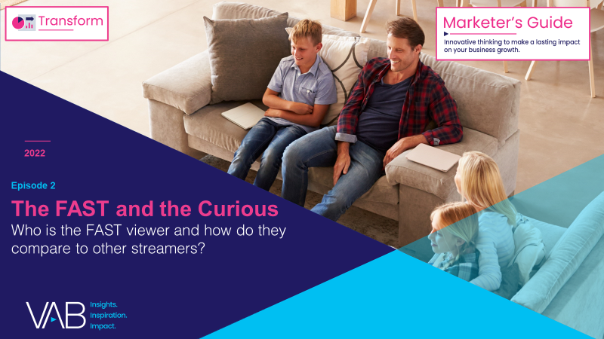
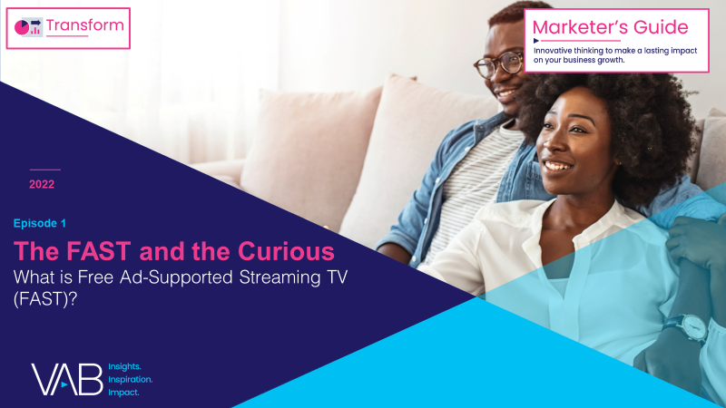
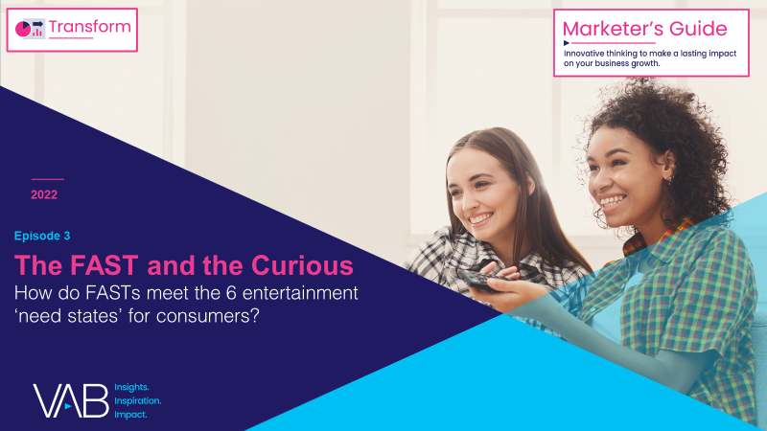
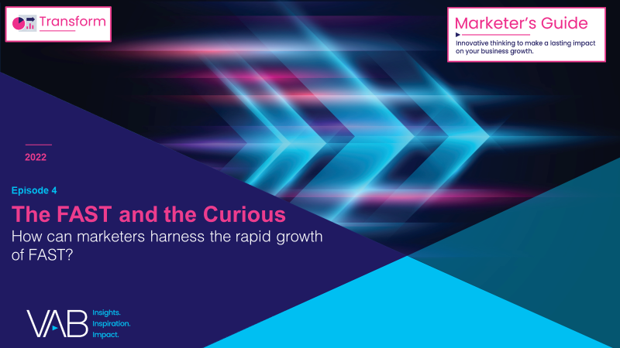
Over the last few years, FAST (free ad-supported streaming TV) has
emerged as a promising new video platform for audiences and advertisers.
Many consumers are increasingly feeling "maxed-out" with their number of paid subscriptions, yet they still crave video content. As a result, the ecosystem of ad-supported streaming options, including FASTs, is rapidly growing.
This 4-part guide, The FAST and the Curious, equips you with
what you need to know about the growing opportunity of FASTs.
Who is the FAST viewer and how
do they compare to other streamers?
What is Free Ad-Supported Streaming TV (FAST)?
How do FASTs meet the 6 entertainment ‘need states’ for consumers?
How can marketers harness the rapid growth of FAST?
This information is exclusively provided to VAB members and qualified marketers. Further distribution is prohibited.
PAGE 2

Slide 3


What is FAST (Free Ad-Supported Streaming TV)?
Click here to learn more about FAST
Free ad-supported streaming TV (FAST) services enable audiences to stream video content via
a broadband connection in a linear TV-like environment without needing a subscription.
As the name implies, the content is free to watch because it is ad-supported.
FAST platforms’ defining feature is an “unplanned channel surfing” viewing experience via live scheduled programming delivered to viewers across designated channels.
Note: The first documented use of the acronym 'free ad-supported streaming TV’ is attributed to Alan Wolk at TVREV in 2019.
This information is exclusively provided to VAB members and qualified marketers. Further distribution is prohibited.
PAGE 3

Slide 4

With the largest year-over-year growth of all platforms, 4 out of 10 adult streamers are now watching FAST services
% of U.S. adult 18+ streamers that watch the following types of streaming services
+8%
YoY
+20%
YoY
+41%
YoY
Source: VAB analysis of MRI-Simmons August 2022 Cord Evolution Study, A18+. Base = streamed in the past 12 months. SVOD Viewers (72% of A18+ population / 83% of A18+ streaming population) = used any of the following streaming services in the past 30 days: Apple TV+, Discovery+, Disney+, HBO Max (commercial free), Hulu (commercial free), Netflix, Paramount+ (commercial free), Amazon Prime Video. AVOD Viewers (38% of A18+ population / 44% of A18+ streaming population) = used any of the following streaming services in the past 30 days: Hulu (limited commercial), Paramount+ (limited commercial), Peacock (limited commercial), HBO Max (limited commercial), Crackle, Vudu, Discovery+ (limited commercial). FAST (36% of A18+ population / 41% of A18+ streaming population) = used any of the following streaming services in the past 30 days: Peacock (free service w/ limited commercials), Roku Channel, Tubi TV, Freevee (formerly IMDb TV), Pluto, Samsung TV Plus, Xumo, Local Now.
This information is exclusively provided to VAB members and qualified marketers. Further distribution is prohibited.
PAGE 4

Slide 5

To understand the mindset
of FAST viewers, VAB explored
their core characteristics and
viewing behaviors based on
who they are and what motivates them
This information is exclusively provided to VAB members and qualified marketers. Further distribution is prohibited.
PAGE 5

Slide 6
Although a free ad-supported platform, the demographic characteristics
of FAST viewers do not differ much from the viewers of paid subscription services
Key Characteristics of FAST vs. SVOD Viewers
Age
Household Income
Education
They skew slightly older than SVOD audiences, which highlights the role
FAST is playing as an entry to streaming for viewers that may be more accustomed to a traditional MVPD viewing experience
FAST audiences’ income is comparable to SVOD audiences, contrary to the notion that free services may only appeal to those with a lower income
Their level of education is also comparable to SVOD audiences, with over 1/3 of FAST viewers having received a bachelor’s degree or higher
Median Age: 45 years
(vs. 43 years for SVOD viewers)
A18-34: 32% (91); A35-49: 27% (99); A50+: 41% (109)
Median HH Income: $82K
(vs. $87K for SVOD viewers)
HHI Under $50K: 30% (103); $50K - $75K: 17% (105); $75K+: 54% (97); $100K+: 41% (94)
Bachelor’s Degree+: 34%
(vs. 36% for SVOD viewers)
High school or less: 36% (102); some college: 18% (104); Associate’s Degree: 11% (102); Bachelor’s+*: 34% (93)
% = percent of FAST viewers; (xxx) = index vs. SVOD viewers
Source: VAB analysis of MRI-Simmons August 2022 Cord Evolution Study. Base = ‘regularly binge’. FAST Viewers (41% of A18+ streaming population) = used any of the following streaming services in the past 30 days: Peacock (free service w/ limited commercials), Roku Channel, Tubi TV, Freevee (formerly IMDb TV), Pluto, Samsung TV Plus, Xumo, Local Now. SVOD Viewers (83% of A18+ streaming population) = used any of the following streaming services in the past 30 days: Apple TV+, Discovery+, Disney+, HBO Max (commercial free), Hulu (commercial free), Netflix, Paramount+ (commercial free), Amazon Prime Video. *’Bachelor’s+’ includes Bachelor’s degree, Master's degree, Professional school degree or Doctorate degree.
This information is exclusively provided to VAB members and qualified marketers. Further distribution is prohibited.
PAGE 6

Slide 7

FAST viewers, along with AVOD viewers, are more likely to be ‘cord cutters’ who are drawn to a ‘cable-like’ experience without the commitment
FAST viewers are also least likely to be ‘cord nevers’ which also shows the skew towards those familiar with the ‘cable-like’ experience
Source: VAB analysis of MRI-Simmons August 2022 Cord Evolution Study, A18+. Base = streamed in the past 12 months. SVOD Viewers (83% of A18+ streaming population) = used any of the following streaming services in the past 30 days: Apple TV+, Discovery+, Disney+, HBO Max (commercial free), Hulu (commercial free), Netflix, Paramount+ (commercial free), Amazon Prime Video. AVOD Viewers (44% of A18+ streaming population) = used any of the following streaming services in the past 30 days: Hulu (limited commercial), Paramount+ (limited commercial), Peacock (limited commercial), HBO Max (limited commercial), Crackle, Vudu, Discovery+ (limited commercial). FAST Viewers (41% of A18+ streaming population) = used any of the following streaming services in the past 30 days: Peacock (free service w/ limited commercials), Roku Channel, Tubi TV, Freevee (formerly IMDb TV), Pluto, Samsung TV Plus, Xumo, Local Now. Does not include those not surveyed / no TV, Cord Shaver Intender, Cord Returner, Cord Cutter Intender, Cord Increaser, Cord Increaser Intender and Cord Cutting Regretter.
This information is exclusively provided to VAB members and qualified marketers. Further distribution is prohibited.
PAGE 7

Slide 8
With a mix of corded and cordless viewers, a slight majority of FAST viewers define TV as anything they can watch on their TV set, which aligns closely with AVOD viewers and overall streamers
How do you personally define TV?
% of streamers, based on streaming service type
“Anything I can watch on my TV set whether it's via streaming or cable, satellite, fiber optic provider”
“Anything I can watch on any device”
“Any shows available via cable, satellite, fiber optic provider”
“Any shows created by a TV network”
53% / 52%
29% / 26%
10% / 12%
9% / 11%
vs. A18+ streamer: 51%
vs. A18+ streamer: 26%
vs. A18+ streamer: 12%
vs. A18+ streamer: 11%
Source: VAB analysis of MRI-Simmons August 2022 Cord Evolution Study, A18+. Base = streamed in the past 12 months. FAST Viewers (41% of A18+ streaming population) = used any of the following streaming services in the past 30 days: Peacock (free service w/ limited commercials), Roku Channel, Tubi TV, Freevee (formerly IMDb TV), Pluto, Samsung TV Plus, Xumo, Local Now. AVOD Viewers (44% of A18+ streaming population) = used any of the following streaming services in the past 30 days: Hulu (limited commercial), Paramount+ (limited commercial), Peacock (limited commercial), HBO Max (limited commercial), Crackle, Vudu, Discovery+ (limited commercial).
This information is exclusively provided to VAB members and qualified marketers. Further distribution is prohibited.
PAGE 8

Slide 9



FAST viewers are more likely to be heavy streamers who enjoy watching live, long-form, premium video programming
Among streamers, FAST viewers are 24% more likely to be ‘very heavy streamers’
% of FAST viewers who agree with the following statements
89%
62%
22%
say they love streaming TV shows
say they love to watch live TV
of FAST viewers are among the heaviest streamers*
vs. 83% of A18+ Streamers
vs. 59% of AVOD Viewers
vs. 18% of A18+ Streamers
Source: VAB analysis of MRI-Simmons August 2022 Cord Evolution Study, A18+. Base = streamed in the past 12 months. FAST Viewers (41% of A18+ streaming population) = used any of the following streaming services in the past 30 days: Peacock (free service w/ limited commercials), Roku Channel, Tubi TV, Freevee (formerly IMDb TV), Pluto, Samsung TV Plus, Xumo, Local Now. AVOD Viewers (44% of A18+ streaming population) = used any of the following streaming services in the past 30 days: Hulu (limited commercial), Paramount+ (limited commercial), Peacock (limited commercial), HBO Max (limited commercial), Crackle, Vudu, Discovery+ (limited commercial). Reflects respondents who answered ‘somewhat agree’ or ‘strongly agree’. *Streaming Viewers: 1st Quintile (Heaviest).
This information is exclusively provided to VAB members and qualified marketers. Further distribution is prohibited.
PAGE 9

Slide 10

The interface and programming of FAST feeds into their binge habits, which allows them to engage with content for an extended amount of time
67% of FAST viewers binge watch more than half of the time they watch TV
Reasons for Binge Viewing
FAST viewer index vs. A18+ streamers
122 index
‘Because it's convenient / easier than searching for another show’
121 index
‘To catch up to shows currently airing new episodes’
114 index
‘It's a faster way to knock out a season instead of watching week to week’
How to read: FAST viewers are 22% more likely to binge view because ‘it's convenient/easier than searching for another show’ than the average streamer
Source: VAB analysis of MRI-Simmons August 2022 Cord Evolution Study. Base = ‘regularly binge’. FAST Viewers (41% of A18+ streaming population) = used any of the following streaming services in the past 30 days: Peacock (free service w/ limited commercials), Roku Channel, Tubi TV, Freevee (formerly IMDb TV), Pluto, Samsung TV Plus, Xumo, Local Now. AVOD Viewers (44% of A18+ streaming population) = used any of the following streaming services in the past 30 days: Hulu (limited commercial), Paramount+ (limited commercial), Peacock (limited commercial), HBO Max (limited commercial), Crackle, Vudu, Discovery+ (limited commercial). *Respondents who binge view more than half of the time they watch TV (‘almost / almost always’ or ‘frequently’).
This information is exclusively provided to VAB members and qualified marketers. Further distribution is prohibited.
PAGE 10

Slide 11





FAST services provide a mix of ‘new’ and ‘nostalgia’ to meet viewers’ needs through their curation of TV shows and movies across live linear channels
‘What drives you to want to use a new streaming service?’
% of FAST viewers (top 5 ranked)
56%
50%
37%
34%
22%
Access to movies
(old and new)
Access to original series exclusive to service
Access to series that no longer air on traditional
TV networks
(e.g., Friends, How I Met Your Mother,
Friday Night Lights, etc.)
Access to series that are currently airing on traditional TV networks
(e.g., The Walking Dead, The Good Place, This Is Us, etc.)
Access to sports events the service streams
vs. 49% of AVOD Viewers
vs. 31% of AVOD Viewers
Source: VAB analysis of MRI-Simmons August 2022 Cord Evolution Study, A18+. Base = streamed in the past 12 months. FAST Viewers (41% of A18+ streaming population) = used any of the following streaming services in the past 30 days: Peacock (free service w/ limited commercials), Roku Channel, Tubi TV, Freevee (formerly IMDb TV), Pluto, Samsung TV Plus, Xumo, Local Now. AVOD Viewers (44% of A18+ streaming population) = used any of the following streaming services in the past 30 days: Hulu (limited commercial), Paramount+ (limited commercial), Peacock (limited commercial), HBO Max (limited commercial), Crackle, Vudu, Discovery+ (limited commercial).
This information is exclusively provided to VAB members and qualified marketers. Further distribution is prohibited.
PAGE 11

Slide 12

FAST viewers are drawn to the services for ‘easy’ viewing and indulging in their favorite genres - like reality competitions, game shows and sitcoms
In addition to an array of recognizable networks, FAST services offer themed channels focused on genres like true crime and Bollywood, or even channels branded around specific programs like The Addams Family or Degrassi, airing only these or related programs
‘In general, what types of TV programming do you typically watch?’
Top 10 genres among FAST viewers by % (Index vs. A18+ Streamer)
…and FAST viewers are more likely to enjoy unscripted reality shows vs. other streamers
Index vs. A18+ Streamer
Reality - Lifestyle Competition
(e.g., Project Runway, Making the Cut, Interior Design Masters, etc.)
(138 index)
Reality - Celebrities
(e.g., The Kardashians, Jersey Shore, Chrisley Knows Best, etc.)
(133 index)
Reality - Real Life
(e.g., Deadliest Catch, Hoarders, etc.)
(129 index)
Reality - Dating Competition
(e.g., Big Brother, The Bachelor /
Bachelorette, etc.)
(126 index)
Reality - Cooking Competition
(e.g., Top Chef, Cupcake Wars, etc.)
(119 index)
Game Shows
(e.g., Jeopardy, Family Feud, etc.)
(119 index)
Source: VAB analysis of MRI-Simmons August 2022 Cord Evolution Study, A18+. Base = streamed in the past 12 months. FAST Viewers (41% of A18+ streaming population) = used any of the following streaming services in the past 30 days: Peacock (free service w/ limited commercials), Roku Channel, Tubi TV, Freevee (formerly IMDb TV), Pluto, Samsung TV Plus, Xumo, Local Now.
This information is exclusively provided to VAB members and qualified marketers. Further distribution is prohibited.
PAGE 12

Slide 13



Key Takeaways For Marketing Plans
FASTs’ rapid growth is creating real scale for advertisers
FASTs offer an attractive consumer, on par with that of SVOD
FASTs provide an opportunity to engage with ad sequencing strategies
FAST services are now being used by four out of ten streamers with year-over-year growth far outpacing all other streaming platforms
Viewers of FAST are demographically very similar to paid streaming viewers despite the platform being free and
ad-supported
FAST audiences are heavy streamers and are driven by their love for long-form, premium programming and ability to watch their ‘favorites’ during extended viewing sessions
This information is exclusively provided to VAB members and qualified marketers. Further distribution is prohibited.
PAGE 13

Slide 14

Download all four releases of VAB’s ‘The FAST and the Curious’ series to learn about FAST, their audience, the opportunities and the future
Download VAB’s entire ‘The FAST and the Curious’ series to get up to speed on FAST and its audiences
What is Free Ad-Supported Streaming TV (FAST)?
Who is the FAST viewer and how do they compare to other streamers?
How do FASTs meet the 6 entertainment ‘need states’ for consumers?
How can marketers harness
the rapid growth of FAST?
This information is exclusively provided to VAB members and qualified marketers. Further distribution is prohibited.
PAGE 14

Slide 15

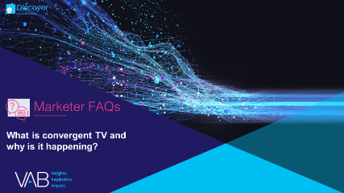
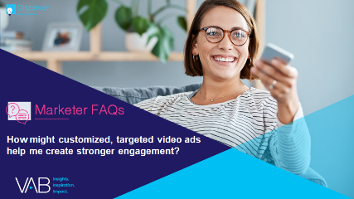
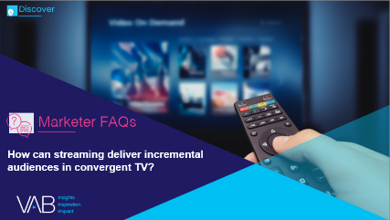

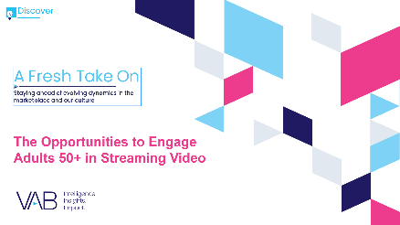
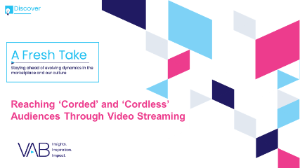

Jason Wiese
Leah Montner-Dixon
SVP, Director of Strategic Insights
jasonw@thevab.com
Associate Insights Director
leahm@thevab.com
Discover more
Looking for more data, insights and takeaways? Check out this related VAB content
What is convergent TV and why is it happening?
How might customized, targeted video ads help me create stronger engagement?
How can streaming deliver incremental audiences in convergent TV?
How can a convergent TV strategy drive business results for my brand?
A Fresh Take On
The Opportunities to Engage Adults 50+ in Streaming Video
Reaching ‘Corded’
and ‘Cordless’ Audiences Through Video Streaming
VAB Members, brand marketers and agencies get free and immediate access to VAB’s content library. Get access at theVAB.com
This information is exclusively provided to VAB members and qualified marketers. Further distribution is prohibited.
PAGE 15

Slide 16


About VAB
VAB is an insights-driven organization that inspires marketers to reimagine their media strategies resulting in fully informed decisions.
Drawing on our marketing expertise, we simplify the complexities in our industry and discover new insights that transform the way marketers look at their media strategy.
We are committed to your business growth and proud to offer VAB members, brand marketers and agencies complimentary access to our continuously-growing Insights library. Get immediate access at theVAB.com.
Curious to learn more about VAB? Check out this quick video to see what we do and how we can help you develop business-driving marketing strategies.
This information is exclusively provided to VAB members and qualified marketers. Further distribution is prohibited.
PAGE 16

