Slide 1





2022
Episode 1
The FAST and the Curious
What is Free Ad-Supported Streaming TV (FAST)?

Slide 2

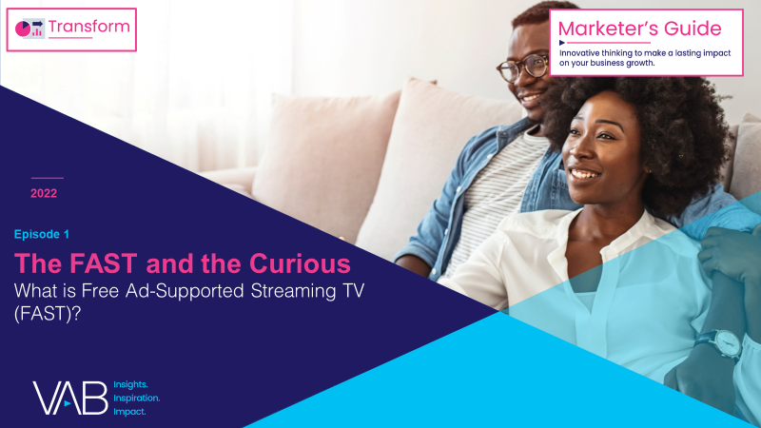
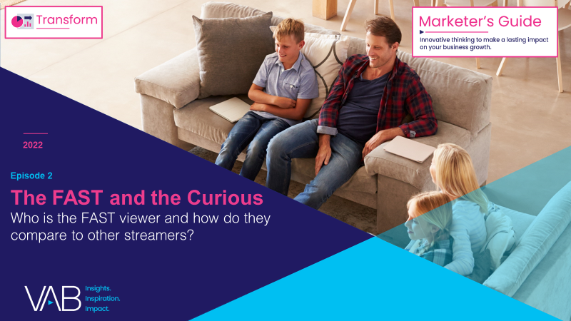
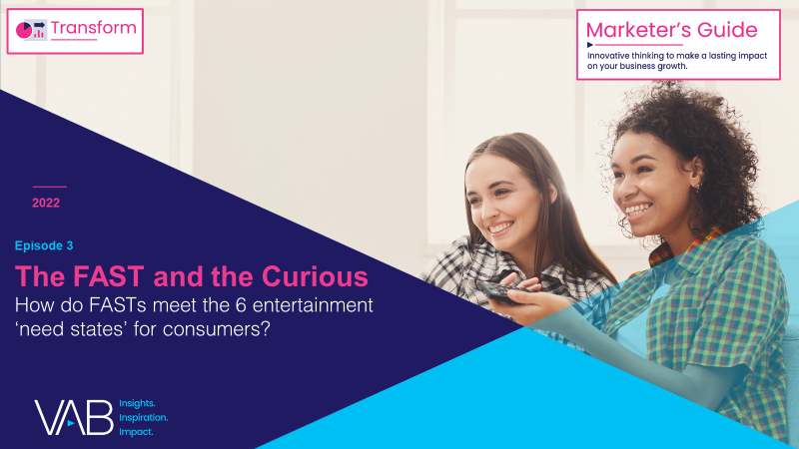
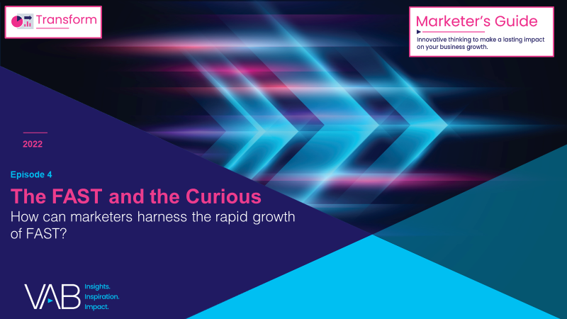
Over the last few years, FAST (free ad-supported streaming TV) has
emerged as a promising new video platform for audiences and advertisers.
Many consumers are increasingly feeling "maxed-out" with their number of paid subscriptions, yet they still crave video content. As a result, the ecosystem of ad-supported streaming options, including FASTs, is rapidly growing.
This 4-part guide, The FAST and the Curious, equips you with
what you need to know about the growing opportunity of FASTs.
What is Free Ad-Supported Streaming TV (FAST)?
Who is the FAST viewer and how do they compare to other streamers?
How do FASTs meet the 6 entertainment ‘need states’ for consumers?
How can marketers harness the rapid growth of FAST?
This information is exclusively provided to VAB members and qualified marketers. Further distribution is prohibited.
PAGE 2

Slide 3


While consumers have embraced the flexibility of on-demand video, ‘choice overload’ has brought about a renewed desire for channel surfing
Depending on the type of experience they are looking for audiences can choose between…
On-Demand Viewing
Viewer actively selects what they want
to watch on their own schedule
(e.g., SVOD & AVOD services, Linear VOD, TV Everywhere)
Unplanned Channel Surfing
Viewer browses available live channels
and chooses from what is currently airing
(e.g., traditional MVPDs, vMVPDs, FAST services)
This information is exclusively provided to VAB members and qualified marketers. Further distribution is prohibited.
PAGE 3

Slide 4
With many on-demand and paid video services available, FAST presents a ‘frictionless’ viewing experience at no cost with no sign ups needed
SVOD
AVOD
FAST
vMVPD
Linear TV
MVPD VOD
TV Everywhere
Option to stream either live linear channels or on-demand content
Option to
stream either
live feeds of linear channels or on-demand content
Watch live or time-shifted content through an MVPD or antenna
Option to
stream either
live feeds of linear channels or on-demand content
Viewing Experience
On-Demand vs. Live Scheduled Programming
Stream content on-demand
on viewer’s schedule
Stream content on-demand
on viewer’s schedule
Watch content on-demand on viewer’s schedule through an MVPD
Ad Experience
Ad-Free vs. Ad-supported
Ad-supported
(‘limited ad’ options also available)
Ad-free
Ad-supported
Ad-supported
Ad-supported
Ad-supported
Ad-supported
Some services are free &
ad-supported, while others are offered as part of a SVOD / AVOD hybrid service at a lower cost with limited ads
Paid MVPD subscription or free channels through
Over-the-Air (OTA) access
Free to watch in exchange for viewing ads
(Log-ins are available but
not necessary)
Business Model
Paid vs. Free
Paid monthly or annual subscription
Paid monthly or annual subscription
Paid MVPD subscription
Paid MVPD subscription
MVPD (Multichannel Video Programming Distributor) reflects a cable, telco, or satellite provider.
This information is exclusively provided to VAB members and qualified marketers. Further distribution is prohibited.
PAGE 4

Slide 5

What is FAST (Free Ad-Supported Streaming TV)?
Free ad-supported streaming TV (FAST) services enable audiences to stream video content via
a broadband connection in a linear TV-like environment without needing a subscription.
As the name implies, the content is free to watch because it is ad-supported.
FAST platforms’ defining feature is an “unplanned channel surfing” viewing experience via live scheduled programming delivered to viewers across designated channels.
Note: The first documented use of the acronym 'free ad-supported streaming TV’ is attributed to Alan Wolk at TVREV in 2019.
This information is exclusively provided to VAB members and qualified marketers. Further distribution is prohibited.
PAGE 5

Slide 6

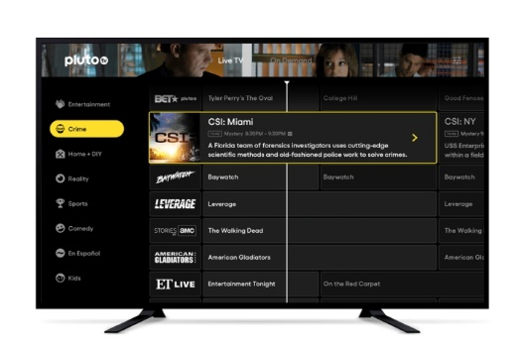

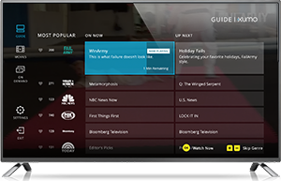

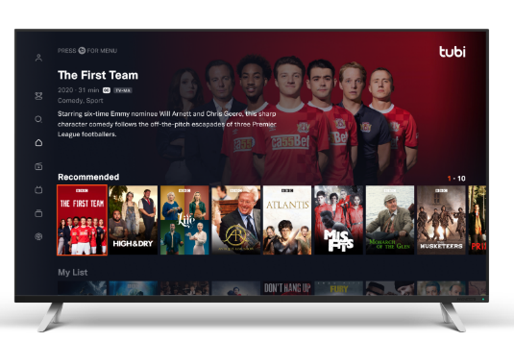

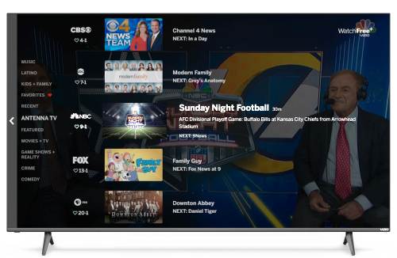
What does FAST look like?
To access, the viewer simply opens their preferred FAST service app using their Smart TV or other connected device and chooses a channel to watch by scrolling through what is currently airing using an interface that looks similar to a program guide.
The types of ‘channels’ available range from dedicated live news (e.g., CBS News, Newsy) to series-based or intellectual property-based channels (e.g., Survivor, The Walking Dead)
to aggregated content across curated genres (e.g., home improvement, true crime, reality, etc.).
Additionally, some FAST services also offer on-demand content, which viewers can browse via interfaces that look
like those of SVOD or AVOD services.
Note: Above screenshots reflect a sampling of FAST service interfaces.
This information is exclusively provided to VAB members and qualified marketers. Further distribution is prohibited.
PAGE 6

Slide 7








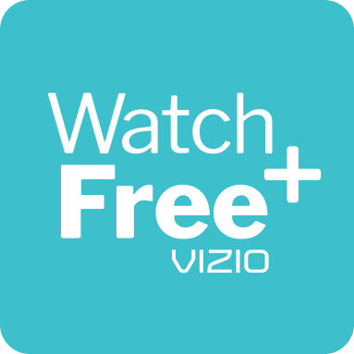


































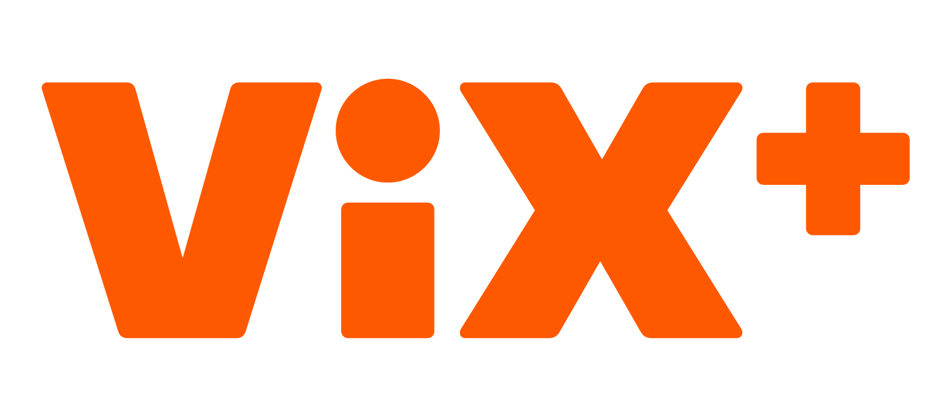






FAST services are a relatively new part of the broader streaming ecosystem, differentiating themselves from the others by offering linear-like channels
Other Streaming Models vs. FAST
FAST (Free Ad-Supported Streaming TV): Free streaming services
that allow viewers to watch live scheduled content via a broadband connection on ad-supported linear-like channels without an account or subscription (e.g., Pluto TV, Xumo).
SVOD (Subscription Video on Demand): Subscription-based streaming services that gives users access to a wide range of premium, usually ad-free, video content for a monthly or annual fee (e.g., Disney+, Netflix).
AVOD (Ad-Supported Video on Demand): Streaming services that offer content with advertising that can either be free or at a discounted subscription tier for registered users (e.g., HBO Max, Peacock).
vMVPD (Virtual Multichannel Programming Distributors): Digital platforms that provide multiple linear TV channels packaged together as an OTT service via a subscription (e.g., Fubo TV, Sling).
‘TV Everywhere’: Network & MVPD apps with authentication access through a pay-TV provider (e.g., ESPN app, Spectrum app).
FAST Services
AVOD / SVOD Hybrid
Tiered Services
vMVPD Services
‘TV Everywhere’ Apps
SVOD Services
Unlike other streaming models, FAST services do not require viewers to have a subscription, contract or log-in
Note: the above reflects just a sampling of services by segment. Netflix ad-supported tier expected launch date: 11/3/22. Disney+ ad-supported tier expected launch date: 12/8/22.
This information is exclusively provided to VAB members and qualified marketers. Further distribution is prohibited.
PAGE 7

Slide 8











































Media companies and device manufacturers have increased the footprint of FAST by acquiring existing services or launching their own
These services are further solidifying their position thanks to a growing number of content providers seeking wider distribution and new audiences
Associated Devices & Providers for FAST
FAST Services
Media Company-Owned FAST Services
Devices
can be used to access FAST services
(Paramount)
(Comcast)
(Fox Corp.)
(NBCUniversal)
(Altice)
(Sinclair Broadcast Group)
Smart TV OEMs
Connected Device Manufacturers
(TelevisaUnivision)
(Dish)
(Canela Media)
(Chicken Soup for the Soul)
(The Weather Group LLC)
Device / OEM-Owned FAST Services
Content Providers
distribute their programming to FAST channels
(Roku)
(LG)
(Samsung)
(Amazon)
(Amazon)
(Amazon)
(Vizio)
(Xperi)
Independent FAST Services
Note: the above reflects just a sampling of providers.
This information is exclusively provided to VAB members and qualified marketers. Further distribution is prohibited.
PAGE 8

Slide 9































Content is focused around professionally-produced, premium, long-form programming across a mix of popular contemporary and classic favorites
Examples of ‘Contemporary’ Programs
Modern TV shows that are either currently airing
or aired in recent years
Examples of ‘Classic’ Programs
Nostalgic TV shows from previous decades that hold a special place
in viewers’ hearts and minds
This information is exclusively provided to VAB members and qualified marketers. Further distribution is prohibited.
PAGE 9

Slide 10






FASTs offer a breadth of programming that can be viewed live or
on-demand, while more services are also offering their own exclusive originals in addition to linear channels with library content
Scheduled Programming
via linear channels
Library Content
TV shows & movies
FAST Services can* offer…
Original Content
new trend, expected to grow
On-Demand Content
collections of TV shows & movies
Sports
more live sports agreements expected in the future
All content is ad-supported; They do not offer ad-free content
*Note: Not all available FAST services have all these features.
This information is exclusively provided to VAB members and qualified marketers. Further distribution is prohibited.
PAGE 10

Slide 11



Key Takeaways For Marketing Plans
FASTs can complement a holistic video campaign
FASTs connect advertisers
to an engaged viewer
FASTs are relevant to a variety
of brands and target audiences
FAST is a free, purely ad-supported, long-form, premium video streaming destination that has recently emerged as an alternative viewing experience to
paid subscription services
Combining the best of both linear TV and streaming, FAST gives the viewer control by allowing the flexibility of either ‘channel surfing’ or ‘leaning back’ depending on their mindset, mood or interests
FAST provides something for everyone through a variety of highly-engaging, brand-safe contemporary and classic programming featuring a mix of mainstream and niche content that appeals to audiences across genres
This information is exclusively provided to VAB members and qualified marketers. Further distribution is prohibited.
PAGE 11

Slide 12

Download all four releases of VAB’s ‘The FAST and the Curious’ series to learn about FAST, their audience, the opportunities and the future
Download VAB’s entire ‘The FAST and the Curious’ series to get up to speed on FAST and its audiences
What is Free Ad-Supported Streaming TV (FAST)?
Who is the FAST viewer and how do they compare to other streamers?
How do FASTs meet the 6 entertainment ‘need states’ for consumers?
How can marketers harness
the rapid growth of FAST?
This information is exclusively provided to VAB members and qualified marketers. Further distribution is prohibited.
PAGE 12

Slide 13

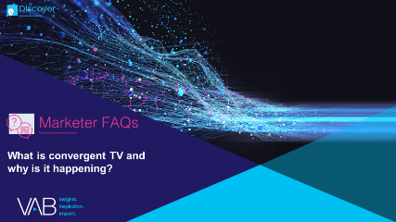
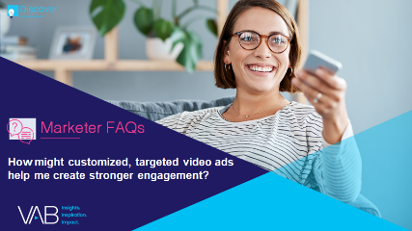
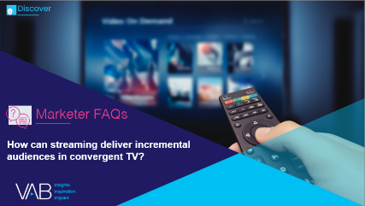

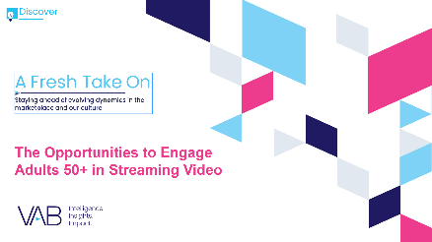
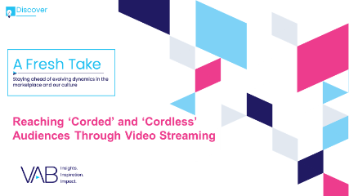

Jason Wiese
Leah Montner-Dixon
SVP, Director of Strategic Insights
jasonw@thevab.com
Associate Insights Director
leahm@thevab.com
Discover more
Looking for more data, insights and takeaways? Check out this related VAB content
What is convergent TV and why is it happening?
How might customized, targeted video ads help me create stronger engagement?
How can streaming deliver incremental audiences in convergent TV?
How can a convergent TV strategy drive business results for my brand?
A Fresh Take On
The Opportunities to Engage Adults 50+ in Streaming Video
Reaching ‘Corded’
and ‘Cordless’ Audiences Through Video Streaming
VAB Members, brand marketers and agencies get free and immediate access to VAB’s content library. Get access at theVAB.com
This information is exclusively provided to VAB members and qualified marketers. Further distribution is prohibited.
PAGE 13

Slide 14


About VAB
VAB is an insights-driven organization that inspires marketers to reimagine their media strategies resulting in fully informed decisions.
Drawing on our marketing expertise, we simplify the complexities in our industry and discover new insights that transform the way marketers look at their media strategy.
We are committed to your business growth and proud to offer VAB members, brand marketers and agencies complimentary access to our continuously-growing Insights library. Get immediate access at theVAB.com.
Curious to learn more about VAB? Check out this quick video to see what we do and how we can help you develop business-driving marketing strategies.
This information is exclusively provided to VAB members and qualified marketers. Further distribution is prohibited.
PAGE 14

