Slide 1

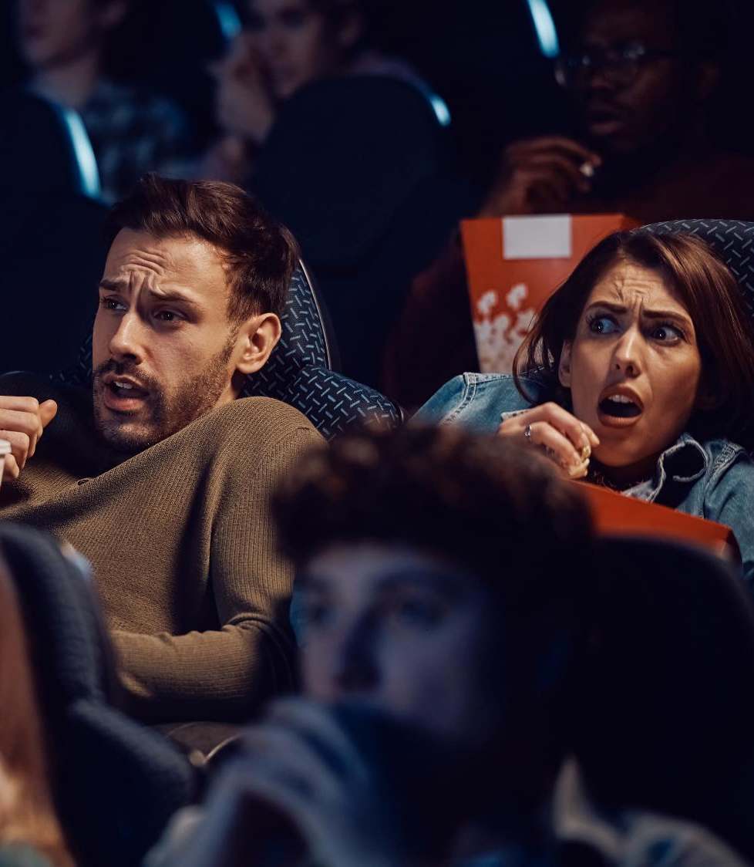



Fandom in Focus
How Cinema Will Captivate Passionate Audiences in 2026

Slide 2


Cinema delivers cultural moments and community for passionate fandoms
Over the years, American society has evolved from a more traditional monoculture to a fragmented pop culture scene where consumers are identifying more with communities and niche fandoms that feed their personal passions and interests.
For Gen Z and Millennials, this means a particular interest in things like horror, anime, gaming and book clubs, all of which enables them to
curate their own cultural moments and personal identity.
Younger audiences have a desire for content that speaks to their passions and communities which foster a sense of belonging with people that have shared interests. Cinema serves as a central gathering place that delivers the most desirable content and community for these passionate audiences which creates many opportunities for brands.
Continue reading to learn how the 2026 theatrical release slate will deliver a continuous pipeline of content aligned with eight key fandoms that we’ve identified for Gen Z and Millennials and how marketers can align with these passionate fans to drive increased brand relevancy and
full-funnel outcomes lifts through cinema advertising.
This information is exclusively provided to VAB members and qualified marketers.
PAGE 2

Slide 3

How are consumers defining cultural identity today and how are brands capitalizing on this?

Slide 4


There is a growing sentiment among American adults that there is no such thing as ‘mainstream’ pop culture anymore
91% of adults 18-25 say a single pop culture “mainstream” no longer exists*
61%
of adults say that there’s
no such thing as mainstream
pop culture anymore
(+15% increase since 2023)
Source: Horizon Futures, The 2025 Subculture Field Guide, November 2025. *Horizon Futures, The 2024 Subculture Field Guide, November 2024.
This information is exclusively provided to VAB members and qualified marketers.
PAGE 4

Slide 5




Instead, consumers are identifying more with passionate communities and niche fandoms as society evolves beyond a traditional monoculture
% of Adults Who Say That…
81%
65%
+9%
Prefer to be identified
by their interests
My identity is defined by the communities I share passions with*
Most of my interests wouldn’t be considered ‘mainstream’ to people*
(vs. 2023)
Source: Vox Media, Insights & Innovation, 2024. *Horizon Futures, The 2025 Subculture Field Guide, November 2025.
This information is exclusively provided to VAB members and qualified marketers.
PAGE 5

Slide 6




Consumers’ passion extends to brands as they are more likely to buy, and even pay a premium for, those that align with their fandom communities
When a brand aligns with someone’s passions, people are…
C
C
C
78%
More likely to consider them
3.7x
More likely to
prefer them
78%
More likely to purchase from them
64%
Willing to pay at least a little more for them
Consideration
Intent
Purchase
Source: Horizon Futures, The 2025 Subculture Field Guide, August 2025
This information is exclusively provided to VAB members and qualified marketers.
PAGE 6

Slide 7
As culture becomes more personalized and fragmented, what are some of the important ‘fandoms’ for audiences between the ages of 18-44?

Slide 8








We identified eight key fandoms - including horror, anime, gaming and more – that are particularly culturally significant to younger audiences
Eight Popular Fandoms
Horror
Anime
Gaming
Comics
Animation
Performing Arts
Books
Millennial Nostalgia
This information is exclusively provided to VAB members and qualified marketers.
PAGE 8

Slide 9




Horror: Younger adults are deeply connected to the screams and scares of horror across premium video platforms
% more likely than A18+
Watched a horror movie in theaters in the last six months
Typically watch horror
shows on TV
Typically binge watch
horror shows*
A18-24: +79%
A25-34: +32%
A35-44: +14%
A18-24: +20%
A25-34: +19%
A35-44: +20%
A18-24: +27%
A25-34: +18%
A35-44: +22%
How to read: A18-24 are 79% more likely to have watched a horror movie in theaters in the last six months than A18+
Source: VAB analysis of MRI-Simmons Cord Evolution Study, August 2025, A18+, A18-24, A25-34, A35-44. *’Binge watch’ is defined by watching three or more episodes in a single setting.
This information is exclusively provided to VAB members and qualified marketers.
PAGE 9

Slide 10

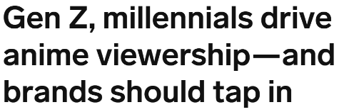


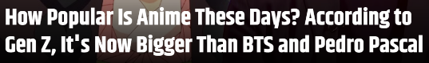
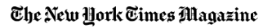
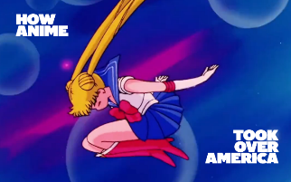
Anime: A surge in interest and viewership is being drawn to life by young adults, with adults 18-34 far more likely to watch and binge anime content
% more likely than A18+
July 3, 2025
May 21, 2025
Typically watch anime
shows on TV
Typically binge watch
anime shows*
A18-24: +120%
A25-34: +119%
A35-44: -25%
A18-24: +136%
A25-34: +114%
A35-44: -20%
September 3, 2025
How to read: A18-24 are 120% more likely to typically watch anime shows on TV than A18+
Source: VAB analysis of MRI-Simmons Cord Evolution Study, August 2025, A18+, A18-24, A25-34, A35-44. *’Binge watch’ is defined by watching three or more episodes in a single setting. Note: Anime is a visually expressive style of Japanese animation known for bold art, imaginative worlds, and emotionally driven storytelling.
This information is exclusively provided to VAB members and qualified marketers.
PAGE 10

Slide 11



Gaming: Video games attract players into interactive worlds, as they play online with friends, dive deep into fandom and watch Esports competitions
% more likely than A18+
Used online gaming service
in the last 30 days*
Have a ‘high level of experience’ playing video games
Watch Esports competitions on TV or online in last 12 months**
A18-24: +132%
A25-34: +90%
A35-44: +34%
A18-24: +118%
A25-34: +80%
A35-44: +32%
A18-24: +136%
A25-34: +82%
A35-44: +16%
How to read: A18-24 are 132% more likely to have used an online gaming service in the last 30 days than A18+
Source: VAB analysis of MRI-Simmons Cord Evolution Study, August 2025, A18+, A18-24, A25-34, A35-44. *Includes: Nintendo Switch Online, PlayStation Network and Xbox Network. **Esports are professionally organized multi-player video game competitions. Note: Newzoo’s 2024 Global Gamer Study found that 75% of Gen Z gamers say gaming is how they stay connected to friends.
This information is exclusively provided to VAB members and qualified marketers.
PAGE 11

Slide 12
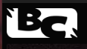

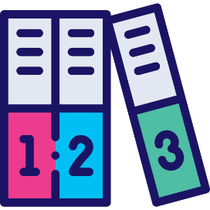
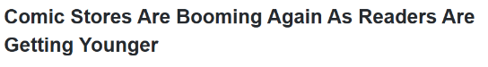
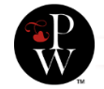
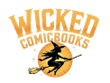
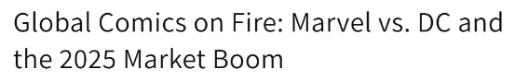
Comics: Passionate fans, especially younger audiences, are driving a recent resurgence in comic books
% more likely than A18+
October 16, 2025
October 15, 2025
In a ‘New World,’ Comics Are Making A Comeback
Read comic books
in the last 12 months
Collect comic books
A18-24: +55%
A25-34: +63%
A35-44: +33%
A18-24: +45%
A25-34: +35%
A35-44: +20%
May 23, 2025
How to read: A18-24 are 55% more likely to have read comic books in the last 12 months than A18+
Source: VAB analysis of MRI-Simmons Cord Evolution Study, August 2025, A18+, A18-24, A25-34, A35-44.
This information is exclusively provided to VAB members and qualified marketers.
PAGE 12

Slide 13





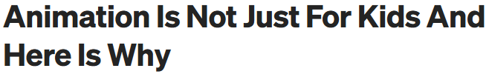

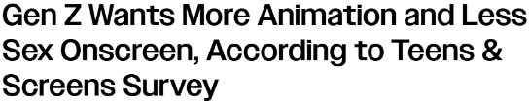
Animation: Wide, cross-generational audiences are attracted to these fandoms that deliver hyper-engaging content across platforms
% more likely than A18+
in the last 6 months
February 14, 2024
November 4, 2024
Watched an animated
movie in theaters
Watched an animated
movie outside of theaters
A18-24: +57%
A25-34: +40%
A35-44: +40%
A18-24: +33%
A25-34: +48%
A35-44: +53%
October 22, 2025
How to read: A18-24 are 57% more likely to have watched an animated movie in theaters in the last six months than A18+
Source: VAB analysis of MRI-Simmons Cord Evolution Study, August 2025, A18+, A18-24, A25-34, A35-44.
This information is exclusively provided to VAB members and qualified marketers.
PAGE 13

Slide 14



Performing Arts: Young adults have particular interests in the arts and are more likely to be into music, creating art and participating in local theater
% more likely than A18+
in the last 12 months
Attended a music festival
Painted, drawn or sculpted
Participate in local theater
A18-24: +41%
A25-34: +34%
A35-44: +11%
A18-24: +41%
A25-34: +36%
A35-44: +22%
A18-24: +34%
A25-34: +26%
A35-44: +25%
*How to read: A18-24 are 41% more likely to have attended a music festival in the last 12 months than A18+
Source: VAB analysis of MRI-Simmons Cord Evolution Study, August 2025, A18+, A18-24, A25-34, A35-44.
This information is exclusively provided to VAB members and qualified marketers.
PAGE 14

Slide 15
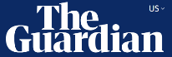


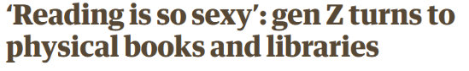
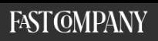
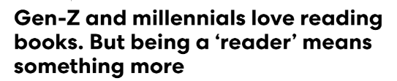

Books: Reading is being redefined by younger audiences who are creating a social culture with others around literary worlds and immersive stories
% more likely than A18+
February 9, 2024
May 1, 2024
Have a ‘great level of
experience’ reading books
Used book apps on mobile phone or tablet in last 30 days
A18-24: +10%
A25-34: +10%
A35-44: +5%
A18-24: +0%
A25-34: +7%
A35-44: +15%
April 13, 2025
The hottest new social scene might be a book club
How to read: A18-24 are 10% more likely to have a great level of experience with books than A18+
Source: VAB analysis of MRI-Simmons Cord Evolution Study, August 2025, A18+, A18-24, A25-34, A35-44
This information is exclusively provided to VAB members and qualified marketers.
PAGE 15

Slide 16
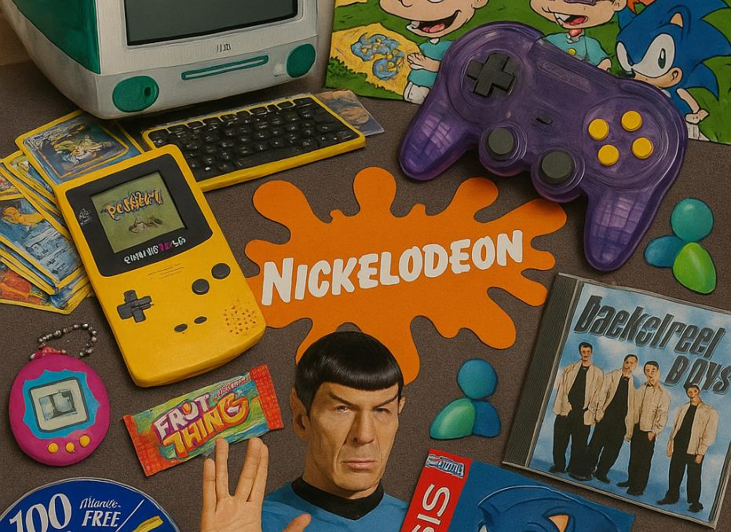
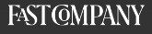

Millennial Nostalgia: A wave of reminiscence is shaping millennial viewing habits, pushing them toward remakes, sequels and revived franchises
76%
of millennials
experience nostalgia
% more likely to have seen each movie in last 6 months*
A30-44 vs. A18+
Saw X
Furiosa: A Mad Max Saga
+45%
+37%
Mean Girls
(2025)
Deadpool & Wolverine
+36%
+33%
September 8, 2024
How to read: A30-44 are 45% more likely to have recently seen Saw X than A18+
Source: Human Flourishing Lab, Historical Nostalgia in Modern America, May 2025. *VAB analysis of MRI-Simmons Cord Evolution Study, August 2025, A30-44 & A18+.
This information is exclusively provided to VAB members and qualified marketers.
PAGE 16

Slide 17
Cinema super serves these passionate fandom communities by creating a big screen, theatrical experience for the most desired content

Slide 18



Younger audiences are more likely to be frequent moviegoers who are excited to see new theatrical releases immediately
% more likely than A18+
Go to the movie theater monthly
See a movie during
opening weekend
A18-24: +35%
A25-34: +28%
A35-44: +15%
A18-24: +49%
A25-34: +34%
A35-44: +30%
Source: VAB analysis of MRI-Simmons Cord Evolution Study, August 2025, A18+, A18-24, A25-34, A35-44.
This information is exclusively provided to VAB members and qualified marketers.
PAGE 18

Slide 19



For Gen Z and Millennials, theatrical releases impact their culture and the cinema creates a sense of community which is even more important now
% of Gen Z and Millennials who agree that…
80%
72%
A movie is more
impactful in culture
if it’s available in theaters
The togetherness of seeing a movie in theaters has become more important post-pandemic
Source: United Talent Agency IQ, Culture IQ, October 2025
This information is exclusively provided to VAB members and qualified marketers.
PAGE 19

Slide 20




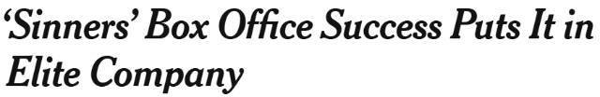









2025 featured many popular theatrical releases across the eight key fandoms that deeply resonated across younger audiences
Sampling of 2025 Theatrical Releases by Genre
Horror
Sinners
Anime
KPop Demon Hunters
Gaming
A Minecraft Movie
Superhero / Comic
Fantastic Four: First Steps
5/10/25
7/28/25
8/24/25
4/4/25
‘Fantastic Four: First Steps’ Lands At $117M+, Opening Reps Record For Franchise, Stars & Director Matt Shakman – Box Office Update
Weekend Box Office: KPOP DEMON HUNTERS Stuns in First Place Finish
Minecraft Movie Box Office Breaks Video Game Movie Record One Day Into Release
5/11/25
Animation
Lilo & Stitch
Arthouse / Independent
Materialists
Book Adaptations
How to Train Your Dragon
Millennial Nostalgia
Final Destination Bloodlines
5/29/25
5/18/25
‘Lilo & Stitch’: All The Box Office Records Broken
9/18/25
8/11/25
‘Final Destination Bloodlines’ Coursing To Franchise-Best $51M Bow; Nobody Is Rushing To ‘Hurry Up Tomorrow’ – Sunday AM Box Office Update
‘How To Train Your Dragon’ Rises To Franchise-Best $84M+ Box Office Opening, Eyes $40M+ 2nd Weekend
Biggest 4-Day Memorial Day Weekend
Biggest 3-day Opening for a PG Movie In May
Biggest Tuesday In May for a PG Movie
‘Materialists’ Is First Indie Movie of 2025 to Surpass $100 Million at Global Box Office
5/28/25
Final Destination Bloodlines Box Office Breaks The Horror Franchise's 16-Year Highest-Grossing Record
This information is exclusively provided to VAB members and qualified marketers.
PAGE 20

Slide 21



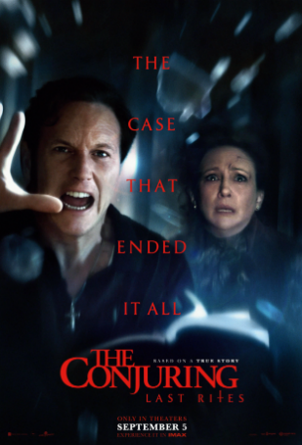






Films within these fandoms deliver highly concentrated, passionate younger audiences for brand to connect and engage with
Adults 18-34 make up 29% of the A18+ population, but they can be reached in much higher concentration in cinemas*
2025 Theatrical Releases:
% A18-34 Audience Composition (A18+)
Demon Slayer:
Infinity Castle
The Conjuring: Last Rites
Caught Stealing
Tron: Ares
Jurassic World Rebirth
71%
69%
65%
52%
51%
Source: Deadline, Demon Slayer: Infinity Castle – ‘‘Demon Slayer: Infinity Castle’ Huge With $70M Opening: A Record For Anime & Crunchyroll; 6th Best For September, Sony’s Biggest YTD”, 9/14/25; The Conjuring: Last Rites – “‘The Conjuring: Last Rites’ Possesses $83M U.S.: 3rd Biggest Horror Opening Ever, Breaks Franchise Records, Warner Bros. Ascends To Top Of Global B.O. With $3.77B Marketshare”, 9/7/25; Caught Stealing – “Summer Ending With $3.67B Near Even With Last Year Thanks To ‘Weapons’ Labor Day; Misses $4B Projection – Update”, 8/31/25; Tron: Ares – “‘Tron: Ares’ Box Office Grid Dims To $33M+ Opening – Sunday Update”, 10/12/25; Jurassic World Rebirth – “‘Jurassic World Rebirth’: Dinosaur Gets Bigger With $36M+ Saturday; 5-Day Opening Now Roaring To $147M+; Promo Campaign Clocks $150M – Update”, 7/6/25. *VAB analysis of MRI-Simmon Cord Evolution Study, August 2025, A18-34 & A18+.
This information is exclusively provided to VAB members and qualified marketers.
PAGE 21

Slide 22












These passionate fandoms have driven outsized box office success, vastly overperforming industry experts’ top-end revenue projections
Domestic Box Office Projections vs. Opening Weekend Box Office
$ in MM
+149%
+28%
+27%
+16%
+60%
+69%
Source: Projections based on VAB analysis of Screendollars, Wednesday Report Forecast, 1/15/25, 1/29/25, 4/2/25, 5/14/25, 8/6/25 & 9/10/25. Chart projections reflect a median of projection range (A Minecraft Movie’s 4/2 projection was $65MM to $70MM, with a median of $60MM). Opening Weekend Revenue based on finalized opening weekend box office per boxofficemojo.com, as of 11/21/25.
This information is exclusively provided to VAB members and qualified marketers.
PAGE 22

Slide 23
Cinema will continue super serving passionate audiences, and advertisers, throughout 2026 with a consistent theatrical release slate aligned with
the eight key fandom communities

Slide 24





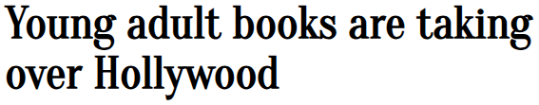


The film industry is investing heavily in content within the eight key fandoms to engage passionate communities at movie theaters in 2026
August 25, 2025
November 24, 2025
November 30, 2025
Walk into any movie theater, and you'll likely find at least one superhero film commanding the biggest screen
2025's Record-Breaking Horror Movie Box Office Will Be Even Harder To Beat After Next Month
Zootopia 2’s Box Office Success Proves Animation Deserves More Respect in Theaters
July 27, 2025
March 3, 2025
November 19, 2025
Small But Mighty: Indie Filmmaking Triumphed at the 2025 Oscars
Nostalgia takes over the
box office
September 3, 2025
October 13, 2025
August 9, 2025
The film industry is investing heavily in anime, so much so that its distinctive style is now seemingly everywhere
Video Game Movies: The Future of Cinema's Box Office Success
From TV show reboots of classic sitcoms to blockbuster movie remakes, studios are doubling down on the emotional pull of the past
This information is exclusively provided to VAB members and qualified marketers.
PAGE 24

Slide 25

Brands can tap into these cultural moments coming soon to a theater near you…

Slide 26




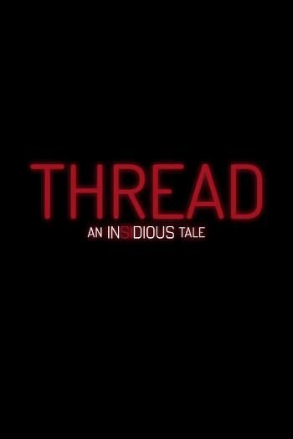
‘Horror’ Theatrical Releases: New movies like Soulm8te and The Bride and the latest installments from the 28 Days Later and Insidious franchises
Sampling of Planned 2026 Theatrical Releases
28 Days Later:
The Bone Temple
Thread:
An Insidious Tale
Soulm8te
Psycho Killer
The Bride
1/9/26
1/16/26
2/20/26
3/6/26
8/21/26
Source: IMDb, Upcoming Releases, 2026. Note: Release dates planned as of 11/18/2025 and subject to change.
PAGE 26
This information is exclusively provided to VAB members and qualified marketers.

Slide 27





‘Anime’ Theatrical Releases: Fan favorite stories heading to the big screen like All You Need Is Kill, Mononoke and Expelled from Paradise
Sampling of Planned 2026 Theatrical Releases
All You Need
Is Kill
Gekijoban Mononoke Dai-San-Sho: Hebigami
Expelled from Paradise:
Resonance of the Heart
Puella Magi Madoka Magica
Scarlet
1/16/26
2/6/26
Spring 2026 (TBD)
11/13/26
2026 (TBD)
Source: IMDb, Upcoming Releases, 2026. Note: Release dates planned as of 11/18/2025 and subject to change.
This information is exclusively provided to VAB members and qualified marketers.
PAGE 27

Slide 28





‘Video Game Adaptation’ Theatrical Releases: Gamers are gearing up for films from the popular Super Mario, Street Fighter & Call of Duty universes
Sampling of Planned 2026 Theatrical Releases
The Super Mario Galaxy Movie
Return to Silent Hill
Street Fighter
Dune: Part Three
Watch Dogs
1/23/26
4/3/26
10/16/26
12/18/26
2026 (TBD)
Source: IMDb, Upcoming Releases, 2026. Note: Release dates planned as of 11/18/2025 and subject to change.
This information is exclusively provided to VAB members and qualified marketers.
PAGE 28

Slide 29

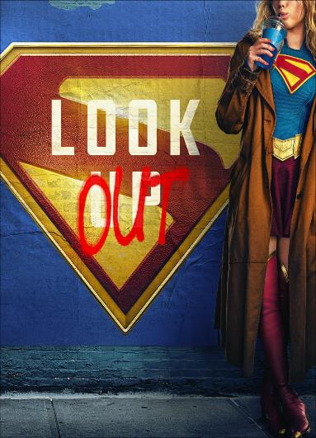



‘Comics & Superheroes’ Theatrical Releases: Comic fanatics have their calendars marked for new Star Wars, Spider-Man and Avengers movies
Sampling of Planned 2026 Theatrical Releases
Star Wars: The Mandalorian and Grogu
Spider-Man: Brand New Day
Avengers: Doomsday
Supergirl
Clayface
5/22/26
6/26/26
7/31/26
9/11/26
12/18/26
Source: IMDb, Upcoming Releases, 2026. Note: Release dates planned as of 11/18/2025 and subject to change.
This information is exclusively provided to VAB members and qualified marketers.
PAGE 29

Slide 30
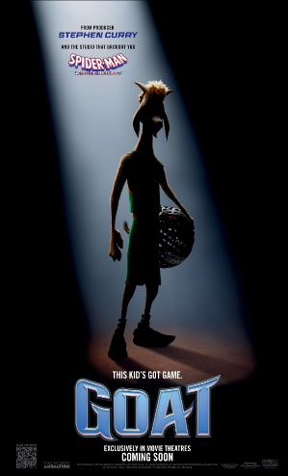
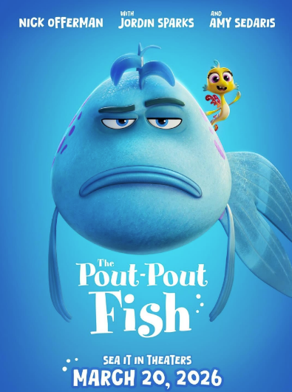
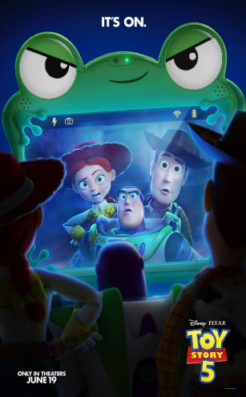
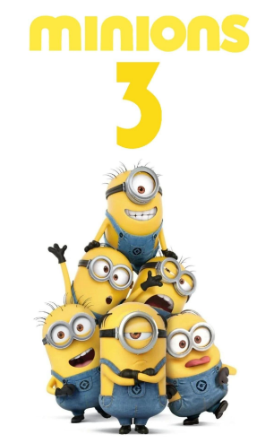
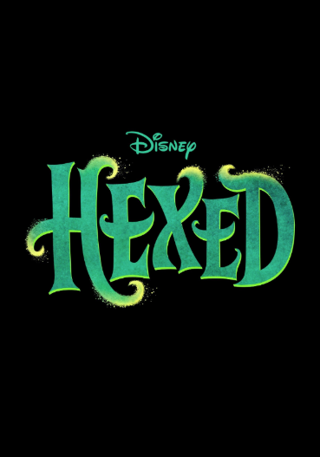
‘Animated’ Theatrical Releases: Audiences of all ages are looking forward to new movies from the Toy Story and Minions franchises and more
Sampling of Planned 2026 Theatrical Releases
GOAT
The Pout-Pout Fish
Toy Story 5
Minions 3
Hexed
2/13/26
3/20/26
6/19/26
7/1/26
11/25/26
Source: IMDb, Upcoming Releases, 2026. Note: Release dates planned as of 11/18/2025 and subject to change.
This information is exclusively provided to VAB members and qualified marketers.
PAGE 30

Slide 31
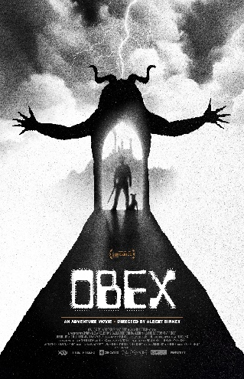




‘Performing Arts’ Theatrical Releases: Film buffs, music fans and thespians are looking forward to OBEX, Michael and a new Camp Rock movie
Sampling of Planned 2026 Theatrical Releases
Good Luck,
Have Fun, Don’t Die
OBEX
Dead Man’s Wire
Michael
Camp Rock 3
1/9/26
1/16/26
2/13/26
4/24/26
2026 (TBD)
Source: IMDb, Upcoming Releases, 2026. Note: Release dates planned as of 11/18/2025 and subject to change.
This information is exclusively provided to VAB members and qualified marketers.
PAGE 31

Slide 32





‘Book Adaptation’ Theatrical Releases: Wuthering Heights, Project Hail Mary, The Odyssey and more will be engaging bibliophiles at the movies
Sampling of Planned 2026 Theatrical Releases
Wuthering Heights
Reminders of Him
Project Hail Mary
The Odyssey
Verity
2/13/26
3/13/26
3/20/26
7/17/26
10/2/26
Source: IMDb, Upcoming Releases, 2026. Note: Release dates planned as of 11/18/2025 and subject to change.
This information is exclusively provided to VAB members and qualified marketers.
PAGE 32

Slide 33





‘Millennial Nostalgia’ Theatrical Releases: New films from well-known nostalgic properties like Masters of the Universe, Scream and Scary Movie
Sampling of Planned 2026 Theatrical Releases
The Devil Wears Prada 2
Masters
of the Universe
Scream 7
Scary Movie 6
The Cat in the Hat
2/27/26
5/1/26
6/5/26
6/12/26
11/6/26
Source: IMDb, Upcoming Releases, 2026. Note: Release dates planned as of 11/18/2025 and subject to change.
This information is exclusively provided to VAB members and qualified marketers.
PAGE 33

Slide 34







































In summary, Cinema will offer constant cultural moments across the eight key fandom communities throughout 2026
Sampling of Planned 2026 Theatrical Releases
1/9/26
1/9/26
1/16/26
1/16/26
1/16/26
1/23/26
2/6/26
2/13/26
2/13/26
2/13/26
2/20/26
2/27/26
Feb ‘26
3/6/26
3/20/26
3/20/26
4/3/26
4/24/26
5/1/26
5/22/26
6/5/26
6/12/26
6/19/26
6/26/26
7/1/26
7/17/26
7/31/26
8/21/26
9/11/26
10/2/26
10/16/26
11/6/26
11/13/26
11/25/26
12/18/26
12/18/26
2026 (TBD)
2026 (TBD)
2026 (TBD)
Source: IMDb, Upcoming Releases, 2026. Note: Release dates planned as of 11/18/2025 and subject to change.
Color Code: Horror, Anime, Video Game Adaptation, Comics & Superheroes, Animation, Performing Arts, Book Adaptation, Millennial Nostalgia.
This information is exclusively provided to VAB members and qualified marketers.
PAGE 34

Slide 35
Cinema delivers cultural moments and community for passionate fandoms
In a world of cultural fragmentation, consumers find individual identity through their fandoms. Most adults no longer see a single ‘mainstream’ pop culture and instead are identifying more with their personal passions and the communities built around them.
Cinema is where young audiences feel a deep cultural impact. Gen Z and Millennials view theaters as the most meaningful way to experience content and immerse themselves in relevant cultural moments.
Fandoms come together in theaters to connect as a community. Audiences across fandoms come together with fellow passionate fans at movie theaters to engage in the shared experience of watching their most desired content.
2026 theatrical releases provide scalable, passion-aligned marketing opportunities. As the theatrical slate takes shape, marketers can align themselves with passionate fans to drive increased brand relevancy and full-funnel outcomes lifts through cinema advertising.
Key Marketer Takeaways
This information is exclusively provided to VAB members and qualified marketers.
PAGE 35

Slide 36
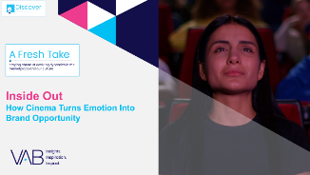
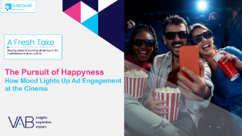






Creators
Jason Wiese
Reed Kiely
EVP, Strategic Insights & Measurement
jasonw@thevab.com
Director, Data Insights & Trends
reedk@thevab.com
Inside Out
How Cinema Turns Emotion Into Brand Opportunity
The Pursuit of Happyness
How Mood Lights Up
Ad Engagement at the Cinema
Karolina Guillen
Associate Director, Insights, Strategy & Analytics karolinag@thevab.com
The Power of Premium Video
What It Means for Multiscreen TV
and Why It Matters to Marketers
Disconnect to Reconnect
How Real-Life Shared Experiences Are the Antidote for Social Media Isolation Among Gen Z
Discover more
Looking for more data, insights and takeaways? Check out this related VAB content
Reel Talk
20 Trends Exploring the Resurgence & Heightened Value of Cinema
Show Me the Money
Highlighting the Value of Moviegoers Across 20 Major Categories
VAB Members, brand marketers and agencies get free and immediate access to VAB’s content library. Get access at theVAB.com
This information is exclusively provided to VAB members and qualified marketers.
PAGE 36

Slide 37


About VAB
VAB is an insights-driven organization that inspires marketers to reimagine their media strategies resulting in fully informed decisions.
Drawing on our marketing expertise, we simplify the complexities in our industry and discover new insights that transform the way marketers look at their media strategy.
We are committed to your business growth and proud to offer VAB members, brand marketers and agencies complimentary access to our continuously-growing Insights library. Get immediate access at theVAB.com.
This information is exclusively provided to VAB members and qualified marketers.
PAGE 37

