Slide 1
Facebook’s Reach (on Reach)
Miscalculations In The Age Of Precision

Slide 2
Summary
In what’s seemingly become a regular occurrence as of late, Facebook was recently forced again to publicly defend some of their key metrics to the advertising community. This time it involved the estimated reach numbers that Facebook reflects in their Ads Manager product after global reports surfaced that the potential reach for younger demos in several countries was higher than current Census population data.
This discrepancy was brought to the forefront in the United States when a respected Wall Street analyst did the same analysis at the country level for the investor community. This “potential reach” inflation should be important to advertisers since the metric lives in the Facebook Ads Manager product; a self-serve tool that allows anyone to plan, budget, buy and optimize their own campaigns across Facebook platforms.
In this report, we set out to confirm the numbers that were being reported in the press and then we drilled down further into several geographies – states, cities, zip codes - to see if this reach inflation is a nationwide issue or if it’s just isolated to a few areas throughout the country.
Finally, we set forth an example of executing an advertising schedule through Facebook Ads Manager to show the potential impact that reach inflation could have on an advertiser’s campaign.
FACEBOOK’S REACH (on Reach)

Slide 3
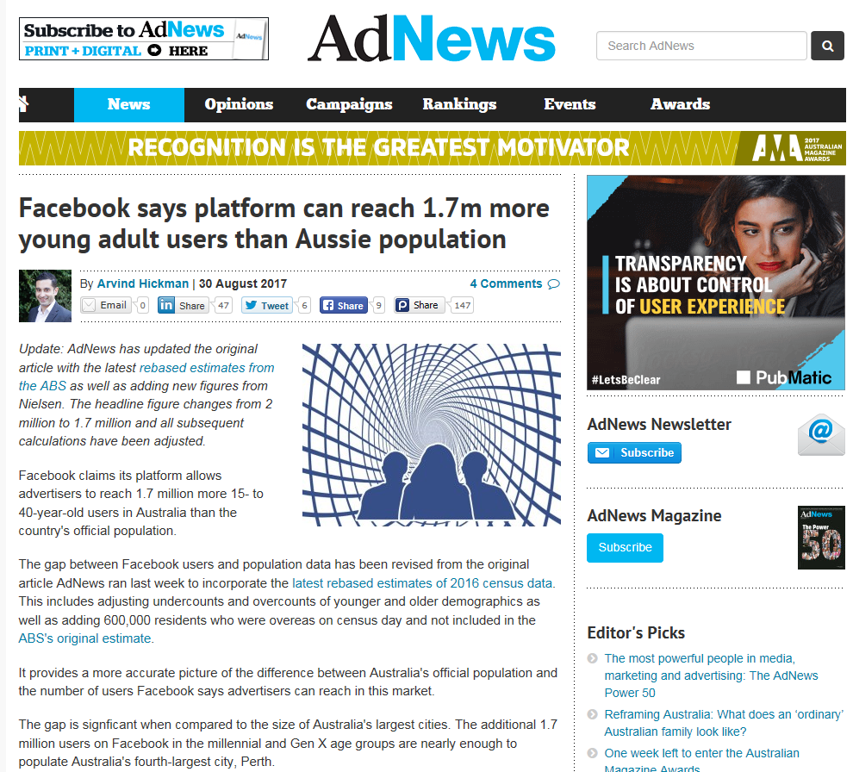
In August, AdNews In Australia Revealed That Facebook Claims It Can Reach More Young People Than What The Census Reports
FACEBOOK’S REACH (on Reach)

Slide 4
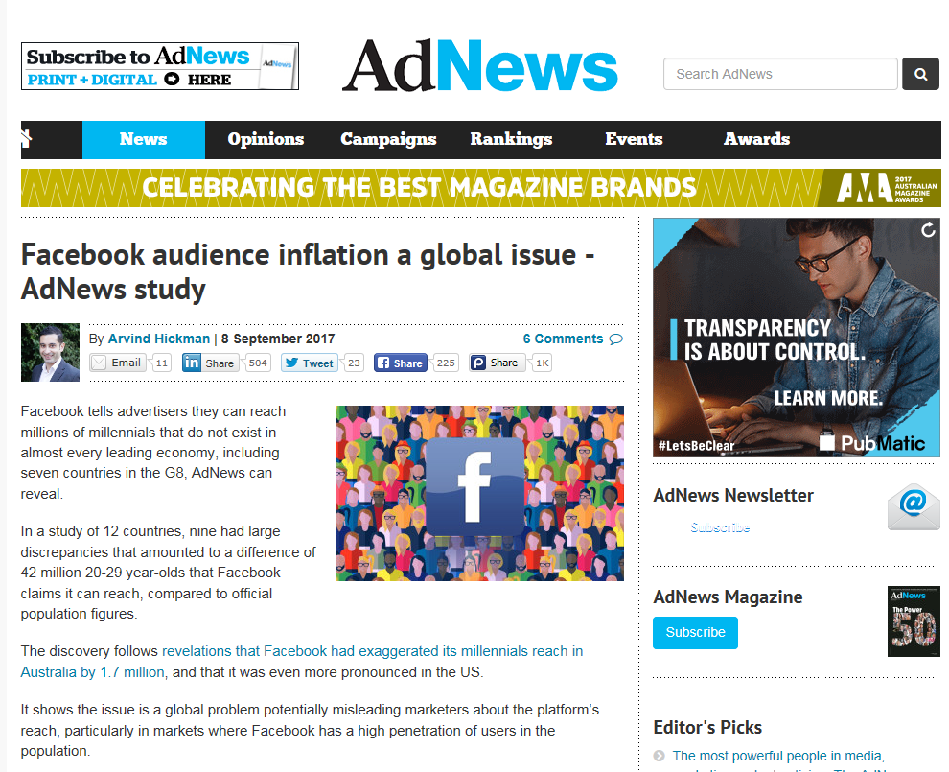







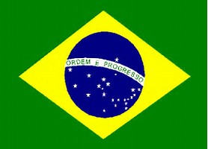

In Fact, This Facebook Reach Inflation Occurs Globally
P18-24
P25-34
FB
Potential Reach
FB
Potential Reach
Census
Diff
Census
Diff
United Kingdom
5.6MM
7.6MM
+2.0MM
8.9MM
11.0MM
+2.1MM
Germany
5.8MM
7.8MM
+2.0MM
9.9MM
10.0MM
+97K
France
5.5MM
7.3MM
+1.8MM
8.0MM
9.3MM
+1.3MM
Canada
3.1MM
4.1MM
+1.0MM
4.8MM
6.0MM
+1.2MM
Italy
4.3MM
5.6MM
+1.3MM
7.0MM
7.6MM
+0.6MM
Australia
2.1MM
3.0MM
+0.9MM
3.3MM
4.3MM
+1.0MM
Mexico
15.2MM
23.0MM
+7.8MM
19.9MM
22.0MM
+2.1MM
Brazil
23.5MM
33.0MM
+9.5MM
34.0MM
34.0MM
-----
Argentina
4.7MM
7.9MM
+3.2MM
6.6MM
8.8MM
+2.2MM
FACEBOOK’S REACH (on reach)
Source: 2017 estimated Global Census; Facebook Ads Manager. “FB Potential Reach” includes Facebook + Instagram + Audience Network + Messenger platforms and reflects “everyone in this location” data pulled on September 22nd, 2017 (Facebook numbers are fluid and are subject to change based on the date when numbers are pulled).

Slide 5
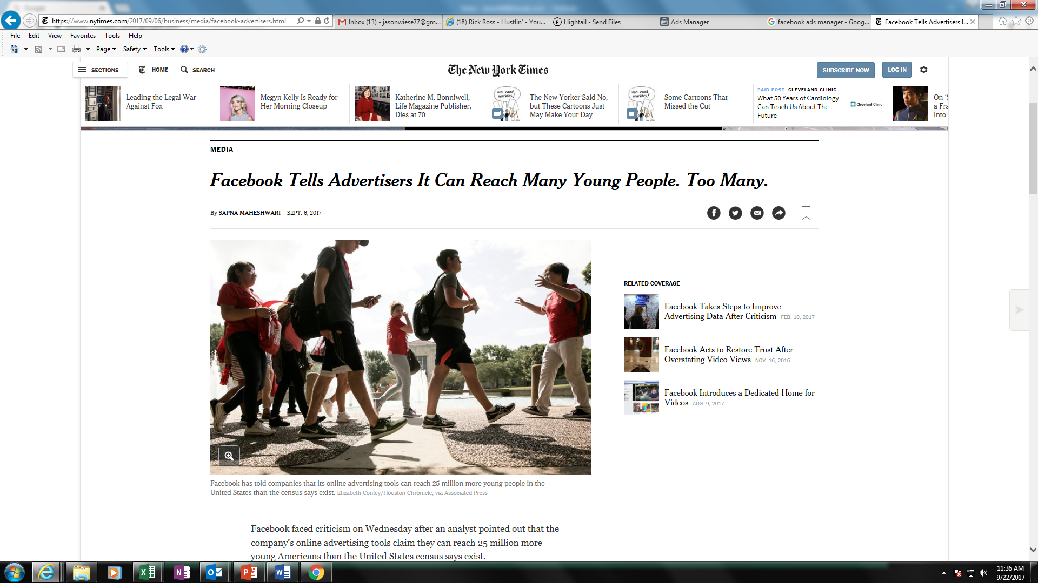
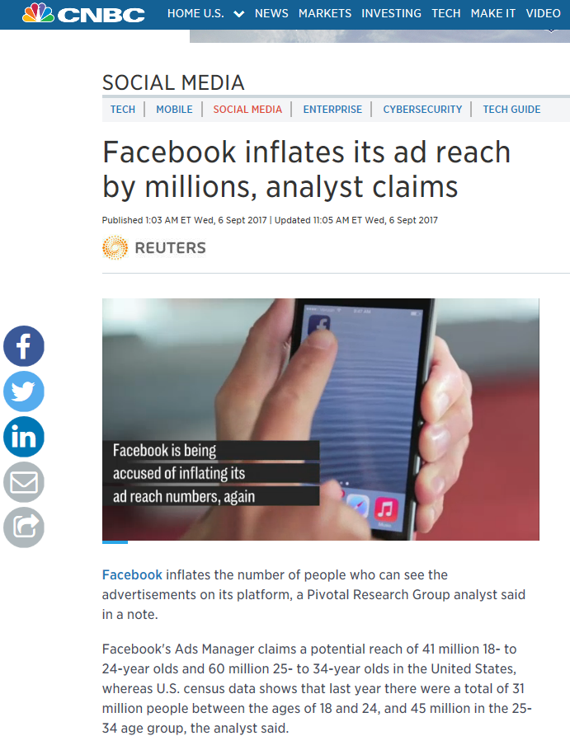
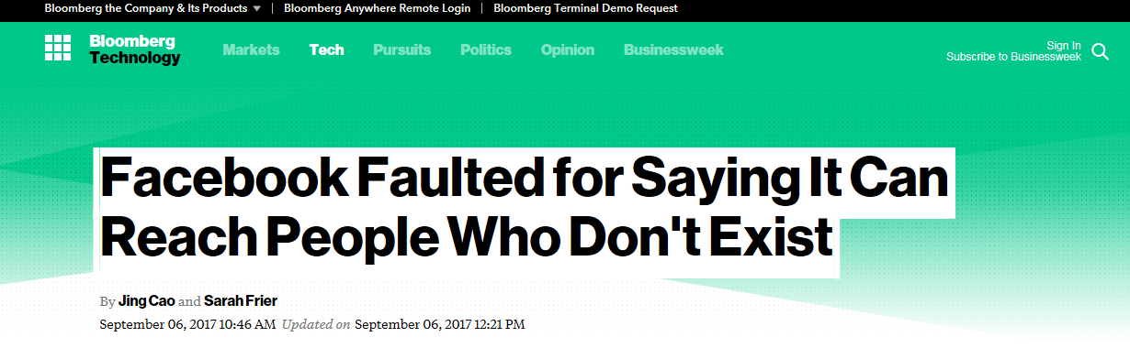
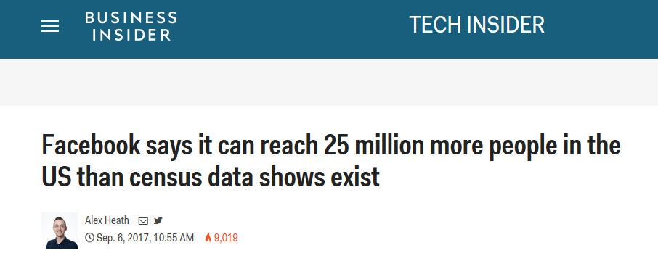
This Became A Big Topic In The United States When A Respected Analyst Brought It To The Industry’s Attention
FACEBOOK’S REACH (on Reach)

Slide 6
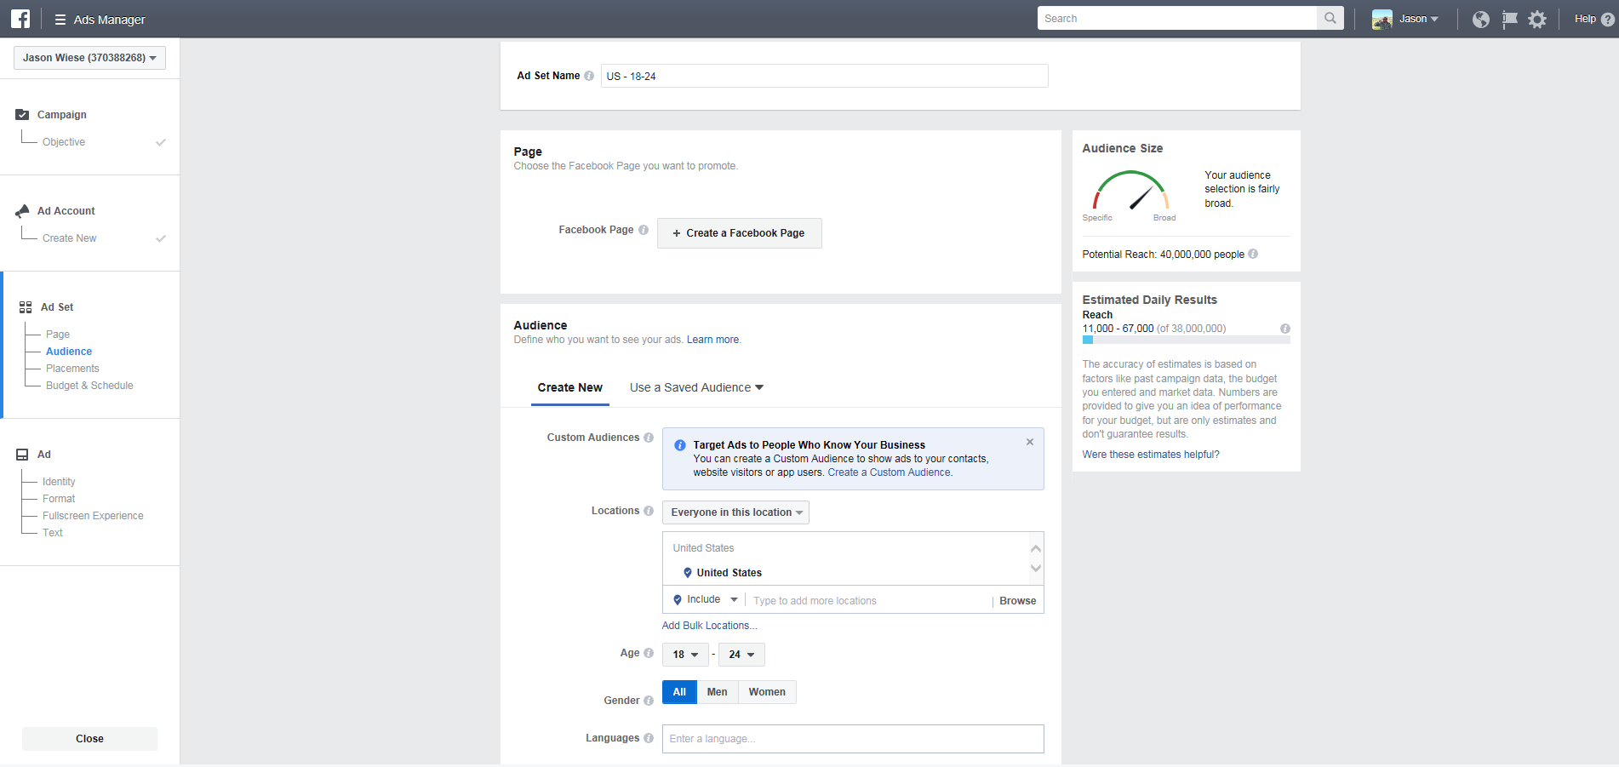
Using The Publicly Accessible Ads Manager, Anyone With A Facebook Account Can Review The Platform’s Estimated Reach
https://www.facebook.com/ads/manager/creation
FACEBOOK’S REACH (on Reach)

Slide 7

So We Were Able To Confirm The Numbers That Were Reported In The Press
Facebook’s potential reach against Adults 18-34 in the United States is almost 22 Million higher than the U.S. Census A18-34 population
Facebook Platforms - Potential Reach
(FB + Instagram + Audience Network + Messenger)
Demo
2016 Census
“Everyone In This Location”
P18-24
31,020,241
39,000,000
+8.0MM
P25-34
44,268,470
58,000,000
+13.7MM
P18-34 Diff:
+21.7MM
FACEBOOK’S REACH (on Reach)
Source: 2016 U.S. Census (American Community Survey, 1-year estimate); Facebook Ads Manager. Based on “everyone in this location” United States data pulled on September 22nd, 2017. (Facebook numbers are fluid and are subject to change based on the date when numbers are pulled).

Slide 8
One Of The More Common Explanations For Why There Is This Reach Overage Is Due To Visits From Travelers Outside The Geography…
But Is This True?

Slide 9
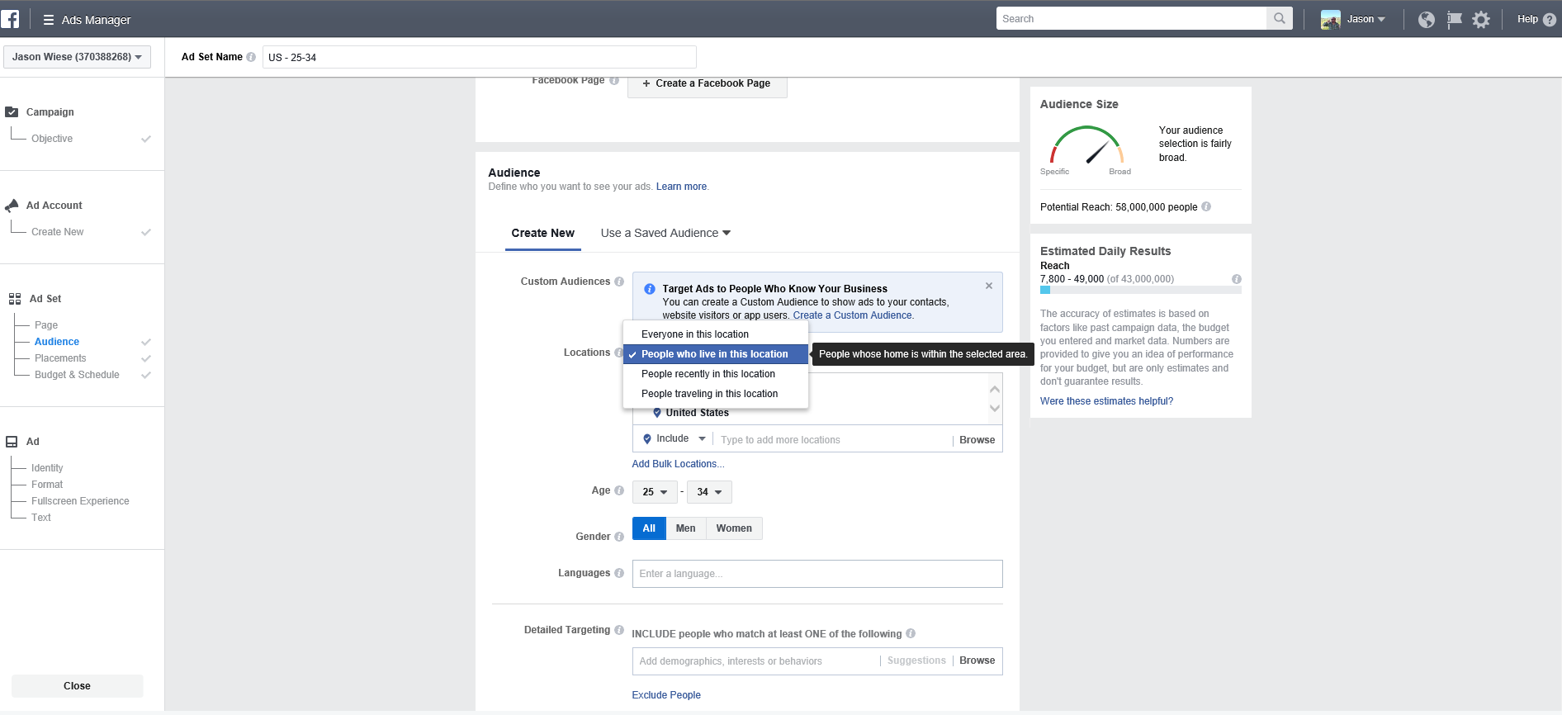
From An Audience Perspective, The Ads Manager Tool Allows You To Select Just Those People Who Live In A Specific Location
Naturally by selecting “people who live in this location,” travelers should be excluded from the target audience
https://www.facebook.com/ads/manager/creation
FACEBOOK’S REACH (on Reach)

Slide 10
Interestingly, There’s No Difference In The Potential Reach Between “Everyone” In The U.S. & Those That “Live” Here
Although it’d be expected that “everyone in this location” would include non-resident travelers, this universe within Facebook Ads Manager reflects the same size as “people who live in this location”
Facebook Platforms - Potential Reach
(FB + Instagram + Audience Network + Messenger)
“Everyone In This Location”
“People Who Live In This Location”
Demo
P18-24
39,000,000
39,000,000
P25-34
58,000,000
58,000,000
In theory, “everyone” should include travelers as well even though the country-wide numbers are the same as the resident totals (i.e., “people who live in this location”)
Note: there are only 670K and 940K identified within the potential reach as those who are “traveling in this location” among P18-24 & P25-34, respectively
FACEBOOK’S REACH (on reach)
Source: 2016 U.S. Census (American Community Survey, 1-year estimate); Facebook Ads Manager. Based on “everyone in this location” and “people who live in this location” data pulled on September 22nd, 2017. (Facebook numbers are fluid and are subject to change based on the date when numbers are pulled).

Slide 11

Is This Reach Inflation Issue Nationwide Or Just Isolated To A Few Areas?
To Answer This We Conducted The Below P18-34 Analysis On Several Geographical Levels:
2016 U.S. Census Data
Vs.
“People Who Live In This Location” Data
From Facebook Ads Manager

Slide 12
In Every State, Facebook Claims They Can Reach More P18-34 Residents Than What Is Reported By The U.S. Census Bureau
% Overage of Facebook Platforms’ Potential Reach Vs. U.S. Census Population Data
P18-34
WA
ME
+27%
MT
ND
+16%
+23%
+18%
+12%
VT
MN
NH
+15%
OR
+20%
WI
NY
MA
+27%
+17%
ID
SD
+16%
MI
+42%
RI
+29%
+21%
WY
+22%
+26%
PA
+19%
IA
CT
+18%
+33%
NJ
NE
+22%
OH
+3%
NV
+28%
IL
IN
+28%
DE
+21%
UT
+34%
+19%
WV
+16%
+30%
+21%
CO
+24%
VA
DC
+164%
CA
+24%
KS
MO
KY
+15%
+30%
+31%
NC
+31%
MD
+16%
+34%
TN
+33%
OK
AR
SC
AZ
NM
+19%
+25%
+25%
+15%
+20%
AL
GA
AK
MS
+33%
+16%
+29%
+17%
LA
TX
+16%
+39%
FL
HI
+34%
+31%
FACEBOOK’S REACH
FACEBOOK’S REACH (on Reach)
Source: 2016 U.S. Census (American Community Survey, 1-year estimate); Facebook Ads Manager based on data pulled on September 22nd, 2017; P18-34. “FB Potential Reach” includes Facebook + Instagram + Audience Network + Messenger platforms. Facebook data based on “People who live in this location.”

Slide 13
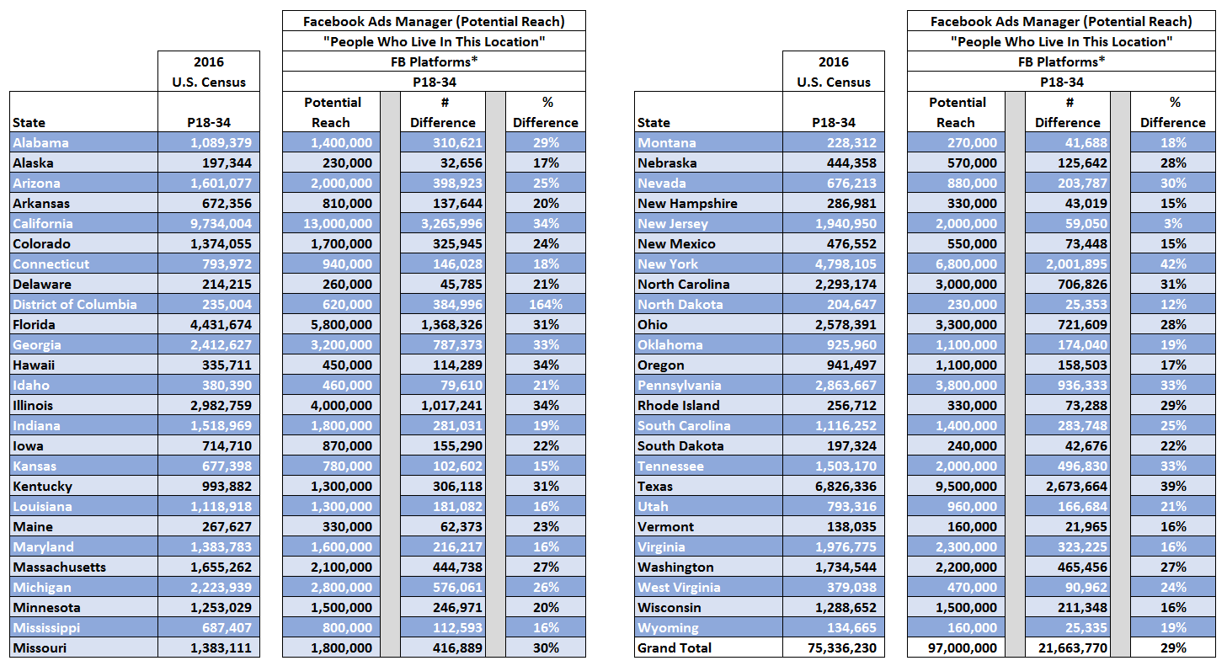
Facebook Platforms’ Reach Inflation Stretches Anywhere Between 3% - 42% By State Vs. The U.S. Census
P18-34 Population By State: 2016 U.S. Census vs. Facebook Platforms’ Potential Reach
FACEBOOK’S REACH (on Reach)
Source: 2016 U.S. Census (American Community Survey, 1-year estimate); Facebook Ads Manager based on data pulled on September 22nd, 2017; P18-34. “FB Potential Reach” includes Facebook + Instagram + Audience Network + Messenger platforms. Facebook data based on “People who live in this location.” (Facebook numbers are fluid and are subject to change based on the date when numbers are pulled).

Slide 14
The Facebook P18-34 Reach Inflation Is Much More Pronounced Within The Ten Most Populous Cities
P18-34
WA
ME
MT
ND
New York
U.S. Census Pop: 2,305,171
FB Potential Reach: 4,100,000
Overage: +1,794,829 (+78%)
VT
MN
NH
OR
Chicago
U.S. Census Pop: 808,785
FB Potential Reach: 1,900,000
Overage: +1,091,215 (+135%)
WI
NY
MA
SD
CT
ID
MI
RI
San Jose
U.S. Census Pop: 256,343
FB Potential Reach: 490,000
Overage: +233,657 (+91%)
WY
PA
IA
NJ
NE
OH
MD
IL
IN
Philadelphia
U.S. Census Pop: 459,386
FB Potential Reach: 1,100,000
Overage: +640,614 (+139%)
NV
UT
WV
DE
CO
VA
CA
KS
MO
KY
Los Angeles
U.S. Census Pop: 1,125,300
FB Potential Reach: 2,700,000
Overage: +1,574,700 (+140%)
NC
Phoenix
U.S. Census Pop: 410,220
FB Potential Reach: 720,000
Overage: +309,780 (+76%)
TN
Dallas
U.S. Census Pop: 379,567
FB Potential Reach: 1,200,000
Overage: +820,433 (+216%)
SC
AZ
OK
AR
NM
MS
AL
GA
AK
LA
San Diego
U.S. Census Pop: 434,646
FB Potential Reach: 760,000
Overage: +325,354 (+75%)
TX
San Antonio
U.S. Census Pop: 401,801
FB Potential Reach: 690,000
Overage: +288,199 (+72%)
Houston
U.S. Census Pop: 645,229
FB Potential Reach: 1,800,000
Overage: +1,154,771 (+179%)
FL
HI
FACEBOOK’S REACH (on Reach)
Source: 2016 U.S. Census (American Community Survey, 1-year estimate); Facebook Ads Manager based on data pulled on September 22nd, 2017; P18-34. “FB Potential Reach” includes Facebook + Instagram + Audience Network + Messenger platforms. Facebook data based on “People who live in this location” and reflects the city with no radius added. The 10 most populous cities are based on total population. (Facebook numbers are fluid and are subject to change based on the date when numbers are pulled).

Slide 15
Similar P18-34 Reach Inflation Is Seen Among “Mid-Sized” Cities As Well
P18-34
WA
Green Bay, WI
U.S. Census Pop: 28,809
FB Potential Reach: 57,000
Overage: +28,191 (+98%)
ME
MT
Waterbury, CT
U.S. Census Pop: 28,366
FB Potential Reach: 46,000
Overage: +17,634 (+62%)
ND
VT
Renton, WA
U.S. Census Pop: 26,449
FB Potential Reach: 34,000
Overage: +7,551 (+29%)
MN
NH
OR
WI
NY
MA
SD
CT
ID
MI
RI
WY
PA
NJ
IA
Davenport, IA
U.S. Census Pop: 26,781
FB Potential Reach: 39,000
Overage: +12,219 (+46%)
NE
OH
MD
NV
IL
IN
DE
UT
WV
CO
Broken Arrow, OK
U.S. Census Pop: 23,201
FB Potential Reach: 27,000
Overage: +3,799 (+16%)
VA
CA
KS
MO
KY
San Mateo, CA
U.S. Census Pop: 24,638
FB Potential Reach: 30,000
Overage: +5,362 (+22%)
Greeley, CO
U.S. Census Pop: 32,345
FB Potential Reach: 49,000
Overage: +16,655 (+51%)
TN
NC
OK
AR
SC
AZ
NM
AL
GA
MS
Lakeland, FL
U.S. Census Pop: 23,731
FB Potential Reach: 71,000
Overage: +47,269 (+199%)
AK
LA
TX
Las Cruces, NM
U.S. Census Pop: 30,935
FB Potential Reach: 46,000
Overage: +15,065 (+49%)
Tyler, TX
U.S. Census Pop: 30,181
FB Potential Reach: 55,000
Overage: +24,819 (+82%)
FL
HI
FACEBOOK’S REACH (on Reach)
Source: 2016 U.S. Census (American Community Survey, 1-year estimate); Facebook Ads Manager based on data pulled on September 22nd, 2017; P18-34. “FB Potential Reach” includes Facebook + Instagram + Audience Network + Messenger platforms. Facebook data based on “People who live in this location” and reflects the city with no radius added. “Mid-Sized” cities are based on a diverse cross-section of 10 cities with a total population between 100K – 110K with no more than one city reflected per state. (Facebook numbers are fluid and are subject to change based on the date when numbers are pulled).

Slide 16
These P18-34 Reach Inflation Trends Are Also Seen Among “Smaller” Cities Throughout The Country
P18-34
WA
ME
Marysville, WA
U.S. Census Pop: 13,998
FB Potential Reach: 23,000
Overage: +9,002 (+64%)
MT
ND
VT
Oshkosh, WI
U.S. Census Pop: 23,832
FB Potential Reach: 26,000
Overage: +2,168 (+9%)
Youngstown, OH
U.S. Census Pop: 14,403
FB Potential Reach: 30,000
Overage: +15,597 (+108%)
MN
NH
OR
WI
NY
MA
SD
CT
ID
MI
RI
WY
Schenectady, NY
U.S. Census Pop: 18,888
FB Potential Reach: 30,000
Overage: +11,112 (+59%)
IA
PA
NJ
Bismarck, ND
U.S. Census Pop: 16,645
FB Potential Reach: 31,000
Overage: +14,355 (+86%)
NE
OH
MD
NV
IL
IN
DE
UT
WV
CO
VA
KS
MO
Muncie, IN
U.S. Census Pop: 27,277
FB Potential Reach: 31,000
Overage: +3,723 (+14%)
CA
KY
TN
NC
Rogers, AR
U.S. Census Pop: 13,198
FB Potential Reach: 26,000
Overage: +12,802 (+97%)
OK
AR
SC
AZ
NM
MS
AL
GA
Laguna Niguel, CA
U.S. Census Pop: 12,739
FB Potential Reach: 13,000
Overage: +261 (+2%)
AK
LA
Alpharetta, GA
U.S. Census Pop: 10,976
FB Potential Reach: 20,000
Overage: +9,024 (+82%)
TX
Harlingen, TX
U.S. Census Pop: 16,252
FB Potential Reach: 28,000
Overage: +11,748 (+72%)
FL
HI
FACEBOOK’S REACH (on reach)
Source: 2016 U.S. Census (American Community Survey, 1-year estimate); Facebook Ads Manager based on data pulled on September 22nd, 2017; P18-34. “FB Potential Reach” includes Facebook + Instagram + Audience Network + Messenger platforms. Facebook data based on “People who live in this location” and reflects the city with no radius added. “Smaller” cities are based on a diverse cross-section of ten cities with a total population between 60K – 70K, with no more than one city reflected per state. (Facebook numbers are fluid and are subject to change based on the date when numbers are pulled).

Slide 17
Facebook Also Overestimates Their Potential Reach Among The Young & Affluent Within Targeted Zip Codes
P18-34
Weston, CT (06883)
U.S. Census Pop: 819
FB Potential Reach: 1,700
Overage: +881 (+108%)
WA
Darien, CT (06820)
U.S. Census Pop: 2,481
FB Potential Reach: 3,600
Overage: +1,119 (+45%)
ME
MT
ND
VT
MN
NH
OR
WI
NY
MA
SD
CT
ID
MI
RI
Aspen, CO (81611)
U.S. Census Pop: 2,347
FB Potential Reach: 4,300
Overage: +1,953 (+83%)
Chappaqua, NY (10514)
U.S. Census Pop: 1,351
FB Potential Reach: 2,000
Overage: +649 (+48%)
Atherton, CA (94027)
U.S. Census Pop: 1,108
FB Potential Reach: 1,300
Overage: +192 (+17%)
WY
PA
NJ
IA
NE
OH
MD
Short Hills, NJ (07078)
U.S. Census Pop: 887
FB Potential Reach: 1,700
Overage: +813 (+92%)
NV
IL
IN
DE
UT
WV
CO
Potomac, MD (20854)
U.S. Census Pop: 5,504
FB Potential Reach: 7,800
Overage: +2,296 (+42%)
VA
CA
KS
MO
KY
TN
NC
Great Falls, VA (22066)
U.S. Census Pop: 2,020
FB Potential Reach: 2,700
Overage: +680 (+34%)
Southlake, TX (76092)
U.S. Census Pop: 2,412
FB Potential Reach: 5,800
Overage: +3,388 (+140%)
SC
AZ
OK
AR
NM
Beverly Hills, CA (90210)
U.S. Census Pop: 3,859
FB Potential Reach: 9,500
Overage: +5,641 (+146%)
MS
AL
GA
AK
LA
TX
FL
HI
FACEBOOK’S REACH (on Reach)
Source: 2015 U.S. Census (2016 data at the zip code level had not been released as of September 2017); Facebook Ads Manager based on data pulled on September 22nd, 2017; P18-34. “FB Potential Reach” includes Facebook + Instagram + Audience Network + Messenger platforms. Facebook data based on “People who live in this location.” “Affluent” zip codes were selected based on metrics like median home values as reported by sources such as Forbes. (Facebook numbers are fluid and are subject to change based on the date when numbers are pulled).

Slide 18
OK, So Reach Is Overstated…
So What?

Slide 19
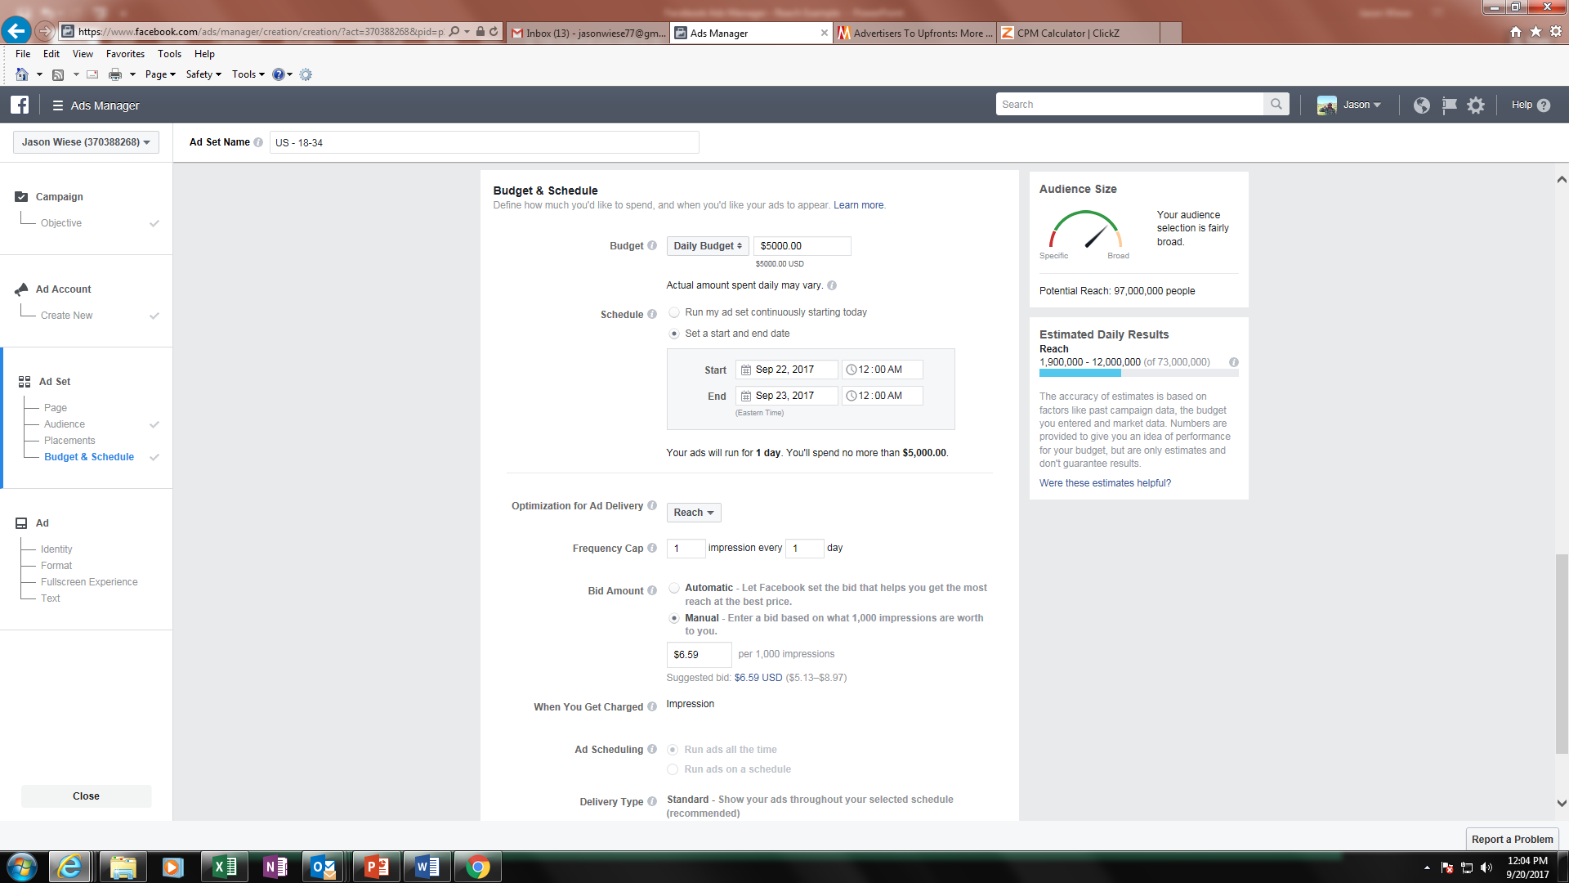
There’s A Potential For Facebook Reach Inflation To Have Real Consequences For An Advertiser’s Overall Communications Plan
In addition to providing audience and targeting data, more importantly Facebook Ads Manager functions as a tool for an advertiser to plan, budget, buy and optimize their own campaigns across Facebook platforms.
FACEBOOK’S REACH (on Reach)
https://www.facebook.com/ads/manager/creation
Source: Facebook Ads Manager based on data pulled on September 20th, 2017; P18-34, United States, “people who live in this location.” “FB Potential Reach” includes Facebook + Instagram + Audience Network + Messenger platforms. (Facebook numbers are fluid and are subject to change based on the date when numbers are pulled).

Slide 20
To Make A Buy, It’s As “Simple” As Selecting Your Target Then Setting The Budget, Campaign Dates And Entering A Bid Amount
Once all buy parameters are set, Facebook will calculate the estimated daily reach of your campaign based on “past campaign data, the budget entered and market data”
Select target in the “Audience” section
Set Your Budget
Set Your Desired Campaign Dates
Decide how often people see your ad
Select an automatic bid or enter a bid amount yourself
based on 1,000 impressions,
i.e. CPM (cost-per-thousand)
FACEBOOK’S REACH (on Reach)
https://www.facebook.com/ads/manager/creation
Source: Facebook Ads Manager based on data pulled on September 20th, 2017; P18-34, United States, “people who live in this location.” “FB Potential Reach” includes Facebook + Instagram + Audience Network + Messenger platforms. (Facebook numbers are fluid and are subject to change based on the date when numbers are pulled).

Slide 21
To Verify The Accuracy Of The Estimated Daily Reach Metric, We Built A One-Day Campaign Designed To Maximize Reach
While a one-day schedule is not a “typical” campaign length, we were limited to this time period for comparison purposes since Facebook only reports estimated reach results at the daily level
$5,000
Daily Budget
P18-34
One-Day schedule
1x Frequency cap to maximize reach
The manual bid option includes both a Facebook suggested bid / CPM and range
“Low Range” Bid / CPM = $5.13
“Suggested” Bid / CPM = $6.59
“High Range” Bid / CPM = $8.97
FACEBOOK’S REACH (on reach)
https://www.facebook.com/ads/manager/creation
Source: Facebook Ads Manager based on data pulled on September 20th, 2017; P18-34, United States, “people who live in this location.” “FB Potential Reach” includes Facebook + Instagram + Audience Network + Messenger platforms. (Facebook numbers are fluid and are subject to change based on the date when numbers are pulled).

Slide 22
Based On The Budget & Bid, An Advertiser Can Use Media Math To Figure Out Their Expected Campaign Impressions
Budget / CPM x 1,000 = Impressions
$5,000
Daily Budget
At a $5K budget, below reflects the Impressions* to be delivered based on the CPMs:
“Low Range” Bid / CPM = $5.13
“Suggested” Bid / CPM = $6.59
“High Range” Bid / CPM = $8.97
=
974,659 IMPs
758,725 IMPs
557,414 IMPs
=
=
*in theory, impressions should be interchangeable with unique reach with a 1x frequency cap.
FACEBOOK’S REACH (on reach)
https://www.facebook.com/ads/manager/creation
Source: Facebook Ads Manager based on data pulled on September 20th, 2017; P18-34, United States, “people who live in this location.” “FB Potential Reach” includes Facebook + Instagram + Audience Network + Messenger platforms. (Facebook numbers are fluid and are subject to change based on the date when numbers are pulled).

Slide 23

From The Math, An Advertiser Would See That The Impressions Are Much Lower Than Facebook’s Estimated Reach Results
It’s important to note that in a one-day campaign with a 1x frequency cap (as reflected below), the term “impressions” can be used interchangeably with “reach”
At a $5K budget, below reflects the Impressions* to be delivered based on the CPMs:
“Low Range” Bid / CPM = $5.13
“Suggested” Bid / CPM = $6.59
“High Range” Bid / CPM = $8.97
=
974,659 IMPs
758,725 IMPs
557,414 IMPs
=
=
*in theory, impressions should be interchangeable with unique reach with a 1x frequency cap.
FACEBOOK’S REACH (on reach)
https://www.facebook.com/ads/manager/creation
Source: Facebook Ads Manager based on data pulled on September 20th, 2017; P18-34, United States, “people who live in this location.” “FB Potential Reach” includes Facebook + Instagram + Audience Network + Messenger platforms. (Facebook numbers are fluid and are subject to change based on the date when numbers are pulled).

Slide 24
Notably, There Is Also A Very Wide Gap Within The Estimated Daily Reach Range For A Platform That Often Touts Its’ Precision Targeting
There is a gap of over 10 million A18-34’s (1.9MM – 12.0MM) between the low & high range for a demo-targeted, one-day $5K buy
At a $5K budget, below reflects the Impressions* to be delivered based on the CPMs:
“Low Range” Bid / CPM = $5.13
“Suggested” Bid / CPM = $6.59
“High Range” Bid / CPM = $8.97
=
974,659 IMPs
758,725 IMPs
557,414 IMPs
=
=
*in theory, impressions should be interchangeable with unique reach with a 1x frequency cap.
FACEBOOK’S REACH (on reach)
https://www.facebook.com/ads/manager/creation
Source: Facebook Ads Manager based on data pulled on September 20th, 2017; P18-34, United States, “people who live in this location.” “FB Potential Reach” includes Facebook + Instagram + Audience Network + Messenger platforms. (Facebook numbers are fluid and are subject to change based on the date when numbers are pulled).

Slide 25
Key Question: How Can Facebook’s Estimated Daily Reach Be 2x – 12x Times Larger Than What It Should Be Based On Basic Media Math?
Impressions Based On Budget & Bid/CPM: 557.4K – 974.7K
Facebook’s Estimated Daily Reach: 1.9MM – 12.0MM
Question:
How can FB’s estimated daily reach be between 1.9MM – 12.0MM for a one-day $5K schedule with a 1x freq cap when media math ($$$ / CPM = IMPs) says the impressions range for the campaign based on the suggested bid range would be between 557.4K – 974.7K?
At a $5K budget, below reflects the Impressions* to be delivered based on the CPMs:
“Low Range” Bid / CPM = $5.13
“Suggested” Bid / CPM = $6.59
“High Range” Bid / CPM = $8.97
=
974,659 IMPs
758,725 IMPs
557,414 IMPs
=
=
*in theory, impressions should be interchangeable with unique reach with a 1x frequency cap.
FACEBOOK’S REACH (on reach)
https://www.facebook.com/ads/manager/creation
Source: Facebook Ads Manager based on data pulled on September 20th, 2017; P18-34, United States, “people who live in this location.” “FB Potential Reach” includes Facebook + Instagram + Audience Network + Messenger platforms. (Facebook numbers are fluid and are subject to change based on the date when numbers are pulled).

Slide 26
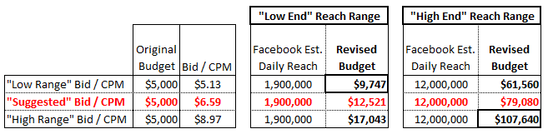
According To The Math, It Would Take A Lot More Than The
$5K Budget To Achieve The Campaign Reach Facebook Estimates
Based on Facebook’s suggested bid (CPM) range, it would actually cost anywhere between $9.7K - $107.6K to deliver against their own P18-34 estimated daily reach for a one-day campaign schedule
FACEBOOK’S REACH (on reach)
Source: Facebook Ads Manager based on data pulled on September 20th, 2017; P18-34, United States, “people who live in this location.” “FB Potential Reach” includes Facebook + Instagram + Audience Network + Messenger platforms. (Facebook numbers are fluid and are subject to change based on the date when numbers are pulled).

Slide 27
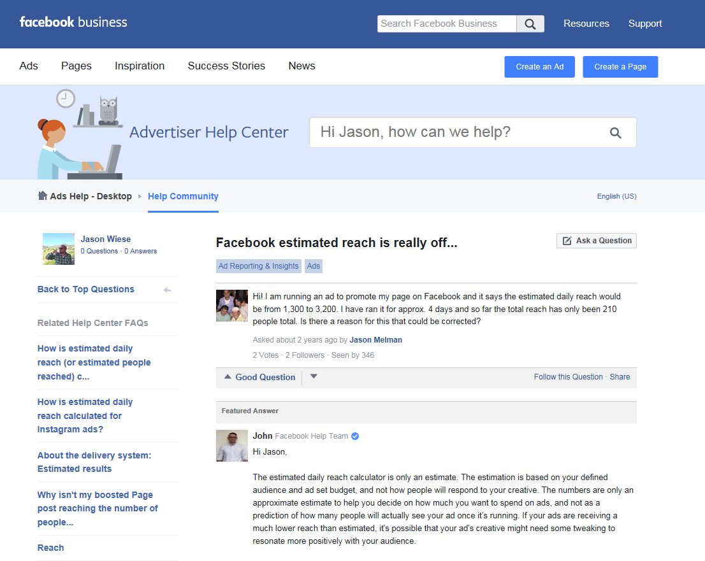
Apparently Other People Have Noticed This Reach Discrepancy As Well
What does the ad’s creative have to do with Reach?
FACEBOOK’S REACH (on reach)

Slide 28
Closing Thoughts
Whether this is truly another metrics glitch remains to be seen. However, with questions of trust regarding ad-tech platforms at an all-time high among many marketers, our analysis provides another instance where first-party data should at least be questioned, or even challenged, particularly when the numbers don’t align with universally accepted metrics such as U.S. Census Bureau population data and basic media math.
Advertisers and their agencies must remain vigilant with all their media partners when it comes to their campaign executions and deliveries. We believe in complete transparency as an industry and for advertisers to verify their campaign metrics and results through independent, third party data sources.
And for everyone, both advertisers and agencies, as you plan your campaigns, execute your schedules and evaluate your post-buy analyses across your multiplatform media partners, our advice continues to remain the same:
Assume Nothing, Investigate Everything
FACEBOOK’S REACH (on reach)

Slide 29


For More Information Visit Us Online
TheVAB.com
Follow us:
@VideoAdBureau
Like us:
facebook.com/VideoAdvertisingBureau

