Slide 1


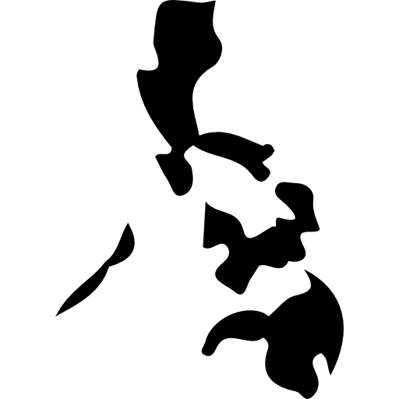
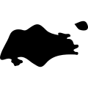


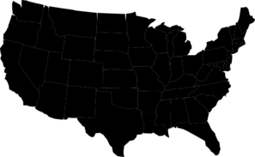


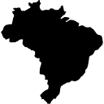


Duplicate Or False Accounts Have Been A Growing Issue For Facebook And Are Now Collectively Larger Than The Population Of The United States & U.K. Combined
399.7
371.2
287.4
124.1
145.1
102.5
108.7
76.0
Facebook’s Duplicate or False Accounts Are Equivalent To The Population Of These Countries
76.5MM
98.5MM
105.6MM
125.9MM
144.0MM
285.7MM
363.7MM
396.6MM
Iran
Philippines
Philippines & Singapore
Mexico
Russia
Brazil, Argentina & Peru
U.S. & Canada
U.S. & U.K.
Source: VAB analysis of Facebook data from their 2019 10-K SEC filing (Facebook divides false accounts into two categories: user-misclassified or “undesirable”); comparable country population figures based on data from United Nations, Department of Economic & Social Affairs (DESA) / Population Division, World Population Prospects, 2012 – 2019. The country population data is based on their appropriate year within the analysis.
This information is exclusively provided to VAB members and qualified marketers. Further distribution is prohibited.
PAGE 1

