Slide 1

VAB – MARKETER’S GUIDE - 2019
.................
A Culture of Extremes
Exposing The Myths About Video Viewing Behavior
Notes:
https://www.istockphoto.com/photo/watching-movie-home-first-person-point-of-view-leisure-home-con-gm924069516-253621158

Slide 2












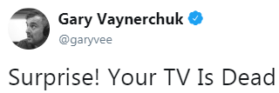

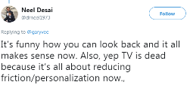










A Culture Of Extremes
From time to time, the video advertising industry can suffer from a ‘culture of extremes’ fueled by an assortment of distorted ‘truths’ that attempt to be passed off as fact.
A tell-tale sign of industry extremism in action is when words like ‘everyone,’ ‘no one,’ or ‘only’ are used by an individual or entity when referencing American media consumption habits or device usage.
However, in today’s video environment, behaviors are much more nuanced and require a thorough investigation to understand the myths vs. realities.
This guide is designed to help brand marketers and their agencies cut through the noise by providing fact-based responses to some of the more distorted ‘truths’ that echo throughout our industry.
Continue reading as we expose 15 myths about video viewing behavior with real-world facts culled from credible and verifiable data sources…
2

Slide 3



15 Myths Within Today’s Video Environment
“Everyone is cutting the cord”
“Everyone is moving away from TV towards mobile video”
“Everyone is spending more time on Facebook & YouTube than TV”
“No one under 35 watches Linear TV”
“OTT platforms can be a replacement for Linear TV”
“No one watches ‘live’ TV anymore”
“Younger demos are much more engaged with YouTube than TV”
“The most talked-about content is on Netflix, Amazon & YouTube”
“Digital-native brands only need to invest in digital advertising to grow big”
“TV is only effective at building awareness”
“No one goes to the movies anymore due to streaming services”
“Cinema is driven by only a handful of ‘Superhero’ blockbusters”
“People only go to the movies during summer & holidays”
“Online-based platforms are more Millennial-targeted than Cinema”
“Cinema advertising doesn’t drive people to take direct action”
For PowerPoint version, put in presentation mode and click on a box to see slides that combat each myth with facts and stats
Click the icon on a slide in presentation mode to return to this navigation page
3
This information is exclusively provided to VAB members and qualified marketers. Further distribution is prohibited.

Slide 4
Let’s Break Out of the Culture of Extremes…
…By Exposing The Myths About Video Viewing Behavior
4

Slide 5

Myth:
"Everyone is cutting the cord and moving away from cable for other video substitutes & subscriptions”
The Reality Of Today’s Video Viewing Behavior…
5

Slide 6

The Vast Majority Of Households Have An MVPD Subscription And It’s, By Far, The Leading Video Distribution Access Point For Consumers
Households’ Access Point for Multiscreen TV Content
HHs (in Millions)
Source: VAB analysis of S&P Global Intelligence, SNL Kagan, April 2019, Projections. MVPD (Cable, Telco, Satellite), OTA (Over-the-Air), OTT (Over-the-Top), vMVPD (Virtual Multichannel)
6
This information is exclusively provided to VAB members and qualified marketers. Further distribution is prohibited.

Slide 7
Myth:
“Everyone is moving away from TV and getting their
video content from other, more mobile, devices”
The Reality Of Today’s Video Viewing Behavior…
7

Slide 8
While People Watch Over Five Hours of Video Each Day,
The Large Majority Of Video Time (78%) Is Spent With Linear TV
% Share Of Weekly “Time Spent” By Video Device – 1Q ’19
(Hrs:Mins Among U.S. Adult 18+ Population)
Live TV accounted for 69% of total video viewing in 1Q ‘19
Keep in mind: ad-supported TV content is also viewed on TV-connected devices, computers and mobile screens as well
Source: VAB analysis of data from the Nielsen Total Audience Report Q1 2019; based on hours:minutes among population; Only includes video capable platforms. Internet-Connected Device = devices connected to the TV that are used to stream content such as Apple TV, Roku, Google Chromecast, Amazon Fire TV, Smartphone, Computer/Laptops, etc. (inclusive of smart TV app usage). Charts exclude time spent with DVD/Blue-ray devices.
8
This information is exclusively provided to VAB members and qualified marketers. Further distribution is prohibited.

Slide 9
In Any Given Minute, Television’s Audience (46.4 Million) In The U.S.
Far Surpasses That Of Any Other Video Device
Keep in mind: ad-supported TV content is also viewed on TV-connected devices, computers and mobile screens as well
Source: VAB analysis of Nielsen Total Audience Report Q1 2019; Data based on weekly time spent averages among U.S. population, P18+. TV-Connected Device = DVD, smart TVs, game console, internet connected device; Internet Connected Device = devices connected to the TV that are used to stream content such as Apple TV, Roku, Google Chromecast, Amazon Fire TV, Smartphone, Computer/Laptops, etc. (inclusive of smart TV app usage).
9
This information is exclusively provided to VAB members and qualified marketers. Further distribution is prohibited.

Slide 10
Myth:
“Everyone is spending more of their time on platforms like Facebook & YouTube than ad-supported multiscreen TV”
The Reality Of Today’s Video Viewing Behavior…
10

Slide 11
















P18+ Average Audience (000)
“Average Audience” During Any Given Minute Highlights The Engagement Gap Between Ad-Supported Multiscreen TV & Popular Digital Platforms Among Adults
7x more P18+ are watching ad-supported TV content than are on YouTube in any given minute
13x more P18+ are watching ad-supported TV content than are on Facebook in any given minute
Multiscreen (TV + online)
Source: VAB analysis of comScore MediaMetrix Key Measures multiplatform (desktop + mobile) data, March 2019; P18+. VAB analysis of Nielsen R&F Time Period Report, Live + SD, Total Day. March 1-31, 2019; P18+. “Average Audience” is based on the average minute, which is factored across the full month for websites and TV. TV Brands include linear TV and TV-related websites. comScore MediaMetrix data includes all visitor activity except for mobile video.
11
This information is exclusively provided to VAB members and qualified marketers. Further distribution is prohibited.

Slide 12
Myth:
“No one under 35 watches Linear TV anymore because they are living on SVOD platforms, digital sites &
social media”
The Reality Of Today’s Video Viewing Behavior…
12

Slide 13
50% of Video Consumption By Adults 18-34 Is Through Linear TV
(Nearly Two Hours Per Day)
% Share Of Weekly “Time Spent” By Video Device – 1Q ’19
(Hrs:Mins Among U.S. Adult 18-34 Population)
Live TV accounted for 44% of total video viewing in 1Q ‘19
Keep in mind: ad-supported TV content is also viewed on TV-connected devices, computers and mobile screens as well
Source: VAB analysis of data from the Nielsen Total Audience Report Q1 2019; based on hours:minutes among population. Only includes video capable platforms. Internet-Connected Device = devices connected to the TV that are used to stream content such as Apple TV, Roku, Google Chromecast, Amazon Fire TV, Smartphone, Computer/Laptops, etc. (inclusive of smart TV app usage). Charts exclude time spent with DVD/Blue-ray devices.
13
This information is exclusively provided to VAB members and qualified marketers. Further distribution is prohibited.

Slide 14
In Any Given Minute, Television’s Adult 18-34 Audience (5.9 Million)
In The U.S. Also Surpasses That Of Any Other Video Device
Keep in mind: ad-supported TV content is also viewed on TV-connected devices, computers and mobile screens as well
Source: VAB analysis of Nielsen Total Audience Report Q1 2019; Data based on weekly time spent averages among U.S. population, P18-34. TV-Connected Device = DVD, smart TVs, game console, internet connected device; Internet Connected Device = devices connected to the TV that are used to stream content such as Apple TV, Roku, Google Chromecast, Amazon Fire TV, Smartphone, Computer/Laptops, etc. (inclusive of smart TV app usage).
14
This information is exclusively provided to VAB members and qualified marketers. Further distribution is prohibited.

Slide 15





P18-34 Average Audience (000)
More Adults 18-34 Are Engaged With Multiscreen TV Brands
In Any Given Minute Than Any Other Digital Platform
Over 1.5x more P18-34 are watching ad-supported TV content than are on YouTube in any given minute
Over 5x more P18-34 are watching ad-supported TV content than are on Facebook in any given minute
Multiscreen (TV + online)
Source: VAB analysis of comScore MediaMetrix Key Measures multiplatform (desktop + mobile) data, March 2019; P18-34. VAB analysis of Nielsen R&F Time Period Report, Live + SD, Total Day. March 1-31 2019; P18-34. “Average Audience” is based on the average minute, which is factored across the full month for websites and TV. TV Brands include linear TV and TV-related websites. comScore MediaMetrix data includes all visitor activity except for mobile video.
15
This information is exclusively provided to VAB members and qualified marketers. Further distribution is prohibited.

Slide 16
Myth:
“OTT platforms have the scale and can be a replacement for Linear TV”
The Reality Of Today’s Video Viewing Behavior…
16

Slide 17
The analysis below for Adults 18+ indicates that 73% of reach is derived from linear TV alone, 22% is derived from those reached by a combination of linear TV + OTT, and 6% is derived from those reached by ad-supported OTT only
Custom Analysis:
Quantifying the Reach opportunity across linear TV & OTT
Reach Duplication, Adults 18+
Linear TV, Linear TV + OTT, OTT-only
OTT-
Only
6%
Linear TV Only
Primary Reach driver
Linear TV + OTT
Reinforcement & Relevance Opportunity
OTT-Only
Incremental Reach Opportunity
Source: Nielsen Media Impact; A18+. 4/1-4/30/18, Linear TV = Include Cable and Broadcast TV Programs, Live viewing plus 7 days after the broadcast; OTT = Desktop and laptop video streaming, does not include the two major subscription (non-ad supported) video platforms, Netflix and Amazon; TV + OTT = those reached on OTT and Linear TV
17
This information is exclusively provided to VAB members and qualified marketers. Further distribution is prohibited.

Slide 18
While the vast majority of reach is achieved through Linear TV, OTT provides an opportunity to drive incremental reach, as well as message reinforcement cross-platform
Custom Analysis:
While linear TV is the big reach driver, it can be complemented by an OTT schedule which can deliver an incremental audience across buying targets, particularly younger demos
Reach Duplication, by Demo
Linear TV, Linear TV + OTT, OTT-only
Linear TV Only
Primary Reach Driver
Linear TV + OTT
Reinforcement & Relevance Opportunity
OTT-Only
Incremental Reach Opportunity
Source: Nielsen Media Impact; A18+. 4/1-4/30/18, Linear TV = Include Cable and Broadcast TV Programs, Live viewing plus 7 days after the broadcast; OTT = Desktop and laptop video streaming, does not include the two major subscription (non-ad supported) video platforms, Netflix and Amazon; TV + OTT = those reached on OTT and Linear TV
18
This information is exclusively provided to VAB members and qualified marketers. Further distribution is prohibited.

Slide 19
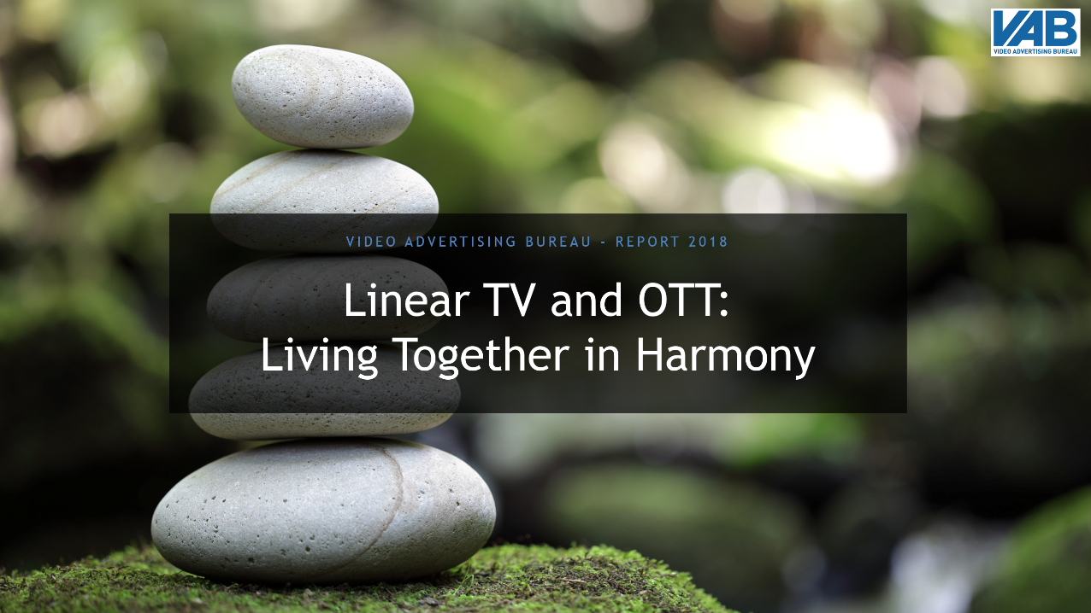
Ad-Supported OTT Is A Complement To TV, Not A Replacement
Download Our “Living Together In Harmony” Marketer’s Guide To Learn More
(49-page Marketer’s Guide)
(click above in presentation mode to download report)
19

Slide 20
Myth:
“No one watches ‘live’ TV anymore outside of sports”
The Reality Of Today’s Video Viewing Behavior…
20

Slide 21
The Vast Majority Of TV Viewing Across All Major Demos Is Watched “Live”
(85% - 89%)
Average Weekly TV Time Spent: “Live” vs. “Time-Shifted” Viewing
1Q ‘19
Source: VAB analysis of Nielsen Total Audience Report 1Q 2019; based on U.S. population.
21
This information is exclusively provided to VAB members and qualified marketers. Further distribution is prohibited.

Slide 22
Myth:
“Younger audiences are much more engaged with
YouTube content than TV programming”
The Reality Of Today’s Video Viewing Behavior…
22

Slide 23






Millennials Are More Emotionally Invested In TV Programs Than They Are In Original YouTube Content
Millennials’ Emotional Response to TV Programs and YouTube Original Content
“Laughed Out Loud Because Of Something That Happened On A TV Program”
“Sat Through An Episode Of A TV Program In Anticipation / Worry About What's Going To Happen Next"
“Cried Because Of A Character's Death on a
TV Program”
“Gotten Angry Or Upset About A Plot Twist On A
TV Program”
73%
65%
53%
48%
“Laughed Out Loud Because Of Something That A YouTube Personality Did”
“Sat Through A Video Of A YouTube Personality In Anticipation / Worry About What's Going To Happen Next”
“Cried Because Of Something That Happened In A Video Of An Original YouTube Personality”
“Gotten Angry Or Upset About Something A YouTube Personality Did”
59%
43%
36%
33%
  YouTube Original Content: videos that were produced by an established YouTube personality that are only available on YouTube and do not appear on broadcast or cable TV (Smosh, Jenna Marbles, GoodMythicalMorning, PewDiePie, Dude Perfect, Ryan’s Toy Review)
Source: VAB / Research Now “Program Engagement” Survey, April 2018. TV: Q8: Which of the following statements are true for you? YouTube: Q17: Which of the following statements are true for you? Check any that apply. Base = Those who regularly watch original content on YouTube; Millennials = A18-34. Total Respondents=1,001
23
This information is exclusively provided to VAB members and qualified marketers. Further distribution is prohibited.

Slide 24


Millennials Also Feel a Stronger Connection With TV Characters & Actors Than to YouTube Personalities
“I feel personally connected to the characters of my favorite TV programs”
“I have looked up the actors in a TV program to learn more about them 'off the screen’”
“I have watched other shows or movies because an actor from one of my favorite TV programs was in it”
47%
58%
57%
“I feel personally connected to my favorite YouTube personality”
“I have looked up my favorite YouTube Personality to learn more about them 'off the screen’”
“I have watched other shows or movies because my favorite YouTube personality was in it”
42%
51%
47%
  YouTube Original Content: videos that were produced by an established YouTube personality that are only available on YouTube and do not appear on broadcast or cable TV (Smosh, Jenna Marbles, GoodMythicalMorning, PewDiePie, Dude Perfect, Ryan’s Toy Review)
Source: VAB / Research Now “Program Engagement” Survey, April 2018. TV: Q14: Again, keeping your favorite TV programs in mind, which of the following statements do you believe are true for you? YouTube: Q19: Again, keeping your favorite YouTube personalities in mind, which of the following statements do you believe are true for you? Check any that apply. Base=Those who regularly watch original content on YouTube. Millennials = A18-34. Total Respondents=1,001.
24
This information is exclusively provided to VAB members and qualified marketers. Further distribution is prohibited.

Slide 25




Most Importantly, Given Their Greater Commitment To Television Content,
TV Programming Is More Likely Than YouTube Original Content To Inspire Purchase
Millennials are 19% more likely to purchase a product that’s been shown or featured during ad-supported TV than they are a product featured by their favorite YouTube personality
43%
36%
of Millennials have purchased a product that has been shown / featured on a TV show
of Millennials have purchased a product that their favorite YouTube personality has shown / featured during a video
Source: VAB / Research Now “Program Engagement” Survey, April 2018. TV: Q10: Which of the following statements are true for you? YouTube: Q19: Again, keeping your favorite YouTube personalities in mind, which of the following statements do you believe are true for you? Check any that apply. Millennials = A18-34. Total Respondents=1,001.
25

Slide 26

Download Our “Committed” Custom Study To Discover More About The
Deep Connections Millennials’ Have With Ad-Supported TV Programming
(40-page Custom Study on ‘Program Engagement’)
(click above in presentation mode to download report)
26

Slide 27
Myth:
“The real buzzworthy video content is on Netflix, Amazon and YouTube and that’s what everyone is talking about”
The Reality Of Today’s Video Viewing Behavior…
27

Slide 28
84%
Overall Total % of TV-topics in Top 10 During Primetime
Ad-Supported TV accounted for over 8 of the top 10 trending Twitter topics at night through a four-week time period
Ad-supported TV dominates the top social conversations on Twitter deeper into the night as more primetime shows and sporting events air
8:30p
Total % of
TV-topics In Top 10: 73%
9:30p
Total % of
TV-topics In Top 10: 86%
10:30p
Total % of
TV-topics In Top 10: 88%
11:30p
Total % of
TV-topics In Top 10: 88%
Date Range: 9/24/18 – 10/21/18
Source: VAB custom analysis of Top 10 trending Twitter Topics each night (8:30p, 9:30p, 10:30p, 11:30p) aggregated during 4-week time period (9/24/2018 – 10/21/2018). Results include both “direct” and “related” TV topics.
28
This information is exclusively provided to VAB members and qualified marketers. Further distribution is prohibited.

Slide 29
Four Week Average: % of Top 10 Trending Topics That Are Based On TV Content
Monday
Tuesday
Wednesday
Thursday
Friday
Saturday
Sunday
Overall
84%
84%
88%
88%
68%
86%
87%
At least two-thirds of the top 10 trending Twitter topics on any night
were based on
ad-supported TV content
8:30p
65% 78% 75% 68% 43% 90% 93%
9:30p
90% 83% 90% 93% 70% 85% 93%
10:30p
90% 85% 90% 95% 80% 90% 88%
11:30p
93% 93% 98% 95% 80% 80% 75%
Source: VAB custom analysis of Top 10 trending Twitter Topics each night (8:30p, 9:30p, 10:30p, 11:30p) aggregated during 4-week time period (9/24/2018 – 10/21/2018). Results include both “direct” and “related” TV topics.
29
This information is exclusively provided to VAB members and qualified marketers. Further distribution is prohibited.

Slide 30
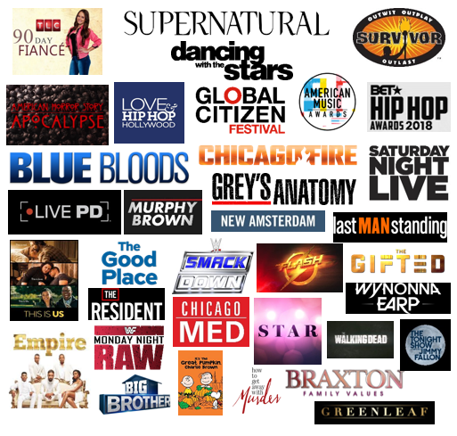
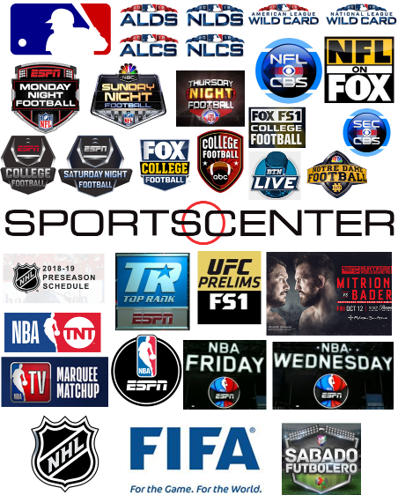
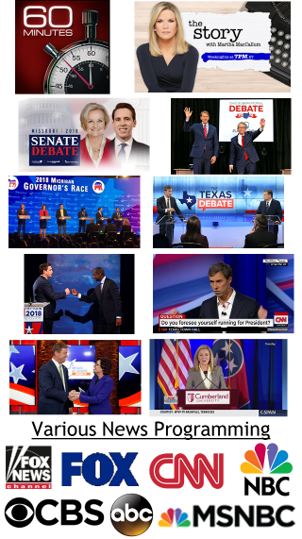
Over 87 TV programs trended in the top 10 during the four-week primetime analysis
Entertainment (36)
Sports (39)
News (12+)
Sports and entertainment account for nearly
the same number
of programs that trended
On average, six different ad-supported TV programs trended in the Top 10
during each night
Source: VAB custom analysis of Top 10 trending Twitter Topics each night (8:30p, 9:30p, 10:30p, 11:30p) during 4-week time period (9/24/2018 – 10/21/2018). Results include both “direct” and “related” TV topics.
30
This information is exclusively provided to VAB members and qualified marketers. Further distribution is prohibited.

Slide 31
The reality is that nothing else gets people talking online like ad-supported TV programs
This is what the country is really talking about every night
Movies tend to trend on Blockbuster opening weekends, when popular trailers are released and when major production / casting news is announced.
Ad-Supported TV Accounts For Over 80% Of The Media Content That Trended In The Top 10
Four-Week Time Period
# of Top 10 Trending Programs / Content By Platform
Lil’ Wayne:
Tha Carter V
Brockhampton
BTS (K-pop)
Quavo
Jennie (K-pop)
Aladdin
Wild Bunch
Hocus Pocus
Yes Theory:
Will Smith Grand 111Canyon Jump
Shane Dawson:
The Mind of Jake Paul
Insecure
The Shop
Iron Fist
Luke Cage
DAZN: Bellator 206
UFC 229
Queen Radio:
Niki Minaj
Interestingly, the two Netflix shows that trended on Twitter did so because the streaming service announced their cancellation; while one of the reasons YouTube trended was because the platform went down one night (#YouTubeDOWN)
*Music excludes Apple Music which is a separate entry
Source: VAB custom analysis of Top 10 trending Twitter Topics each night (8:30p, 9:30p, 10:30p, 11:30p) during 4-week time period (9/24/2018 – 10/21/2018). Based on unique program counts. For the purposes of this chart, “program / content” is an all-encompassing definition for individual pieces of content on each platform (albums & singles for music, channel on YouTube, etc).
31
This information is exclusively provided to VAB members and qualified marketers. Further distribution is prohibited.

Slide 32
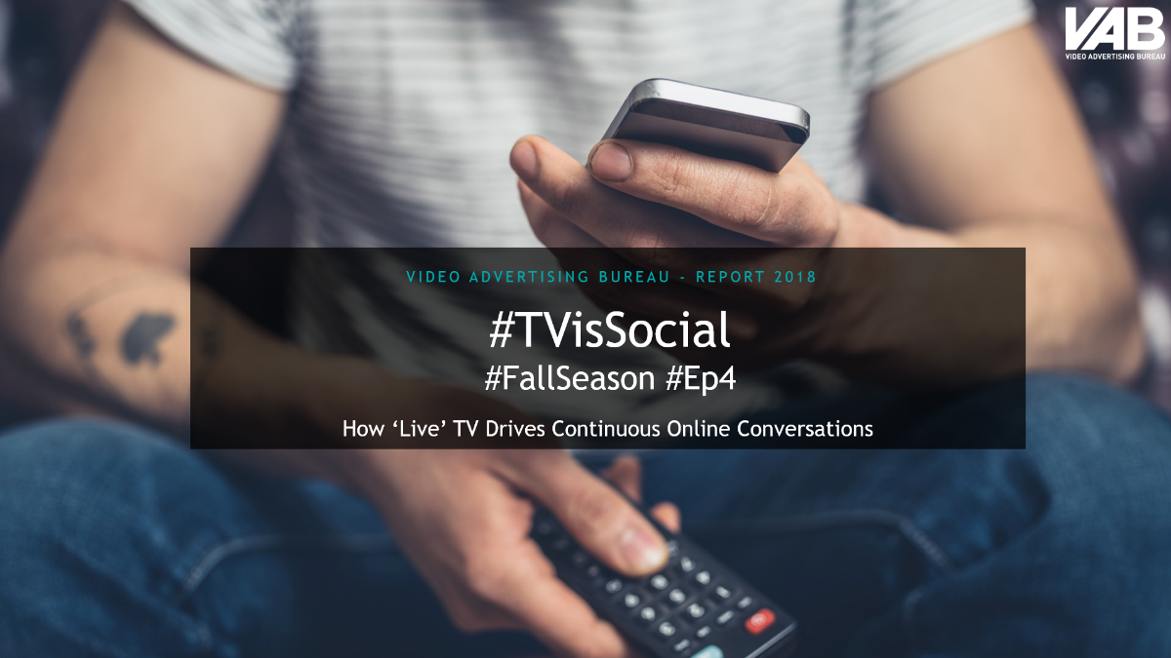
Download Our “#TVisSocial” Custom Analysis To Learn More About
The Popularity Of Ad-Supported TV Programs On Social Platforms Like Twitter
(four-part custom analysis series )
(click above in presentation mode to download report)
32

Slide 33
Myths:
“Digital-native, direct-to-consumer brands only need to invest in digital advertising to grow big”
“TV is only effective at building brand awareness among consumers but it doesn’t directly drive sales”
The Reality Of Today’s Video Viewing Behavior…
33

Slide 34
125 ‘Direct-to-Consumer’ brands’ TV spend analyzed across 52 categories
When challenged to grow big and increase their customer base and build revenues they all made the ‘Big Bet’ on TV
DTC brands have accelerated spending recently - the 125 brands analyzed added $1.4 Billion to the TV advertising marketplace over the last year
125 ‘Direct-to-Consumer’ Brands
+60%
+54%
+30%
In fact, these 125 DTC brands collectively spent almost $3.8 Billion on TV in 2018, 2.5x what was invested in 2016
+37%
+63%
# of Existing Brands
100
109
116
121
125
125
Source: VAB analysis of Nielsen Ad Intel data, calendar years 2013-2018. TV spend includes national cable TV, broadcast TV, Spanish language cable TV, Spanish language broadcast TV, spot TV, syndication TV. Reflects the cume TV spend of the 125 brands identified in this report. Not all companies existed since 2013 as reflected at the bottom of the chart. Existing brands = the number of brands that had launched publicly by that year out of the 125 brand grouping.
34
This information is exclusively provided to VAB members and qualified marketers. Further distribution is prohibited.

Slide 35
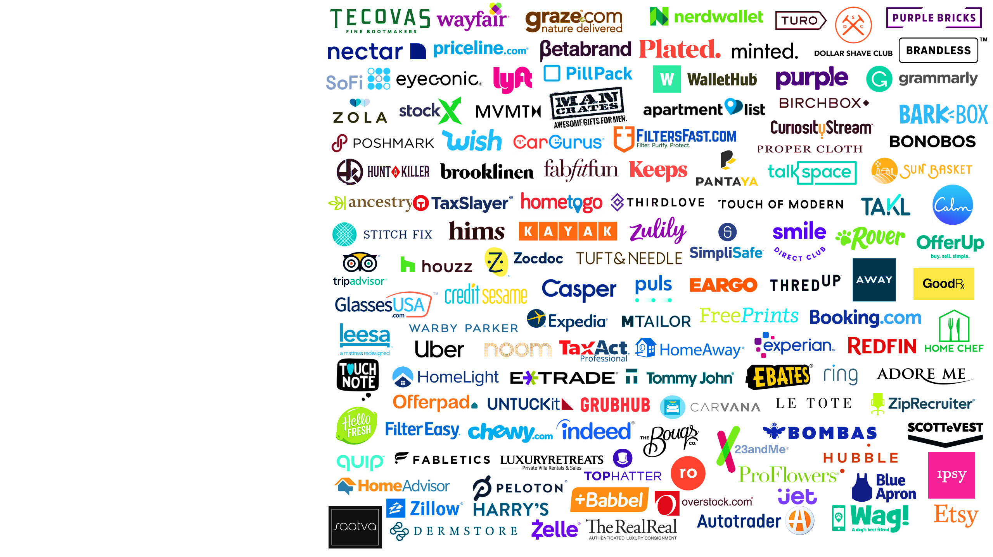


125 Direct-to-Consumer Brands Analyzed
‘Emerging’ Brands
(63 Brands)
Newer brands with an average age of 8 years old who only began investing in TV within the last three years (last two years on average)
‘Expanding’ Brands
(62 Brands)
Brands with an average age of 13 years old who have been investing in TV for at least the last four years (eight years on average)
For the purposes of this marketer’s guide,
we’ll focus on results for the ‘emerging’ brands only
35
This information is exclusively provided to VAB members and qualified marketers. Further distribution is prohibited.
Notes:
https://

Slide 36
DIGITAL INTERACTIONS
‘Emerging’ Segment
TV is the catalyst that jumpstarts consideration around a brand in the form of more exploration and additional viewing of their advertising online
These digital actions far outpace the collective increase in TV spend across the 38 measured brands
‘Emerging’ DTC Brands*:
TV Spend vs. ‘Digital Actions’ YOY % Increase
2017 vs. 2018
*Reflects the 38 brands that are measured in iSpot.tv and had TV spending in both 2017 & 2018 for comparison purposes.
Source: TV spending based on VAB analysis of Nielsen Ad Intel data, TV spend (national cable TV, national broadcast TV, Spanish language broadcast TV, Spanish language cable TV, spot TV, syndication TV), calendar years 2017 & 2018. Digital actions based on VAB analysis of iSpot.tv data and reflects TV commercial-related searches (Google, Bing, Yahoo!) and earned, not promoted, online video views of TV ads (YouTube, iSpot.tv). Digital actions are correlated to TV ad airing data.
36
This information is exclusively provided to VAB members and qualified marketers. Further distribution is prohibited.

Slide 37
WEBSITE TRAFFIC
‘Emerging’ Segment
On average, monthly unique visitors see an immediate surge upon the launch of a TV campaign and this audience only continues to grow through the duration of a brand’s TV flight:
The average ‘Emerging’ brand saw an 84% increase in their unique website traffic during their TV launch month and a 93% average monthly increase from launch month to present day
‘Emerging’ DTC Brands*:
Average Monthly Website Unique Visitors (000)
Based Over A Four-Year Time Period: Mar ‘15 – Feb ‘19
+93%
(+2.5 MM
monthly uniques)
vs. monthly average prior to TV launch
(Monthly Average)
(Monthly Average)
*Reflects the 39 brands that are measured in Comscore and had reported monthly unique visitors in at least one month prior to their TV campaign launch
Source: VAB analysis of Nielsen Ad Intel data, TV spend (national cable TV, national broadcast TV, Spanish language broadcast TV, Spanish language cable TV, spot TV, syndication TV), March ‘15 – February ‘19 (calendar months). VAB analysis of Comscore mediametrix multiplatform media trend data, total audience (Desktop P2+, Mobile 18+), March ’15 – February ’19 (calendar months). ‘Prior to TV Launch’ reflects the average monthly unique visitors based on when each brand’s website began being measured by Comscore, or starting from March 2015 if measurement began before that month. Three brands within the 63 ‘emerging’ brand groupings were not measured as of February 2019: Brooklinen, Hunt-A-Killer, Keeps.
37
This information is exclusively provided to VAB members and qualified marketers. Further distribution is prohibited.

Slide 38














WEBSITE TRAFFIC
‘Emerging’ Segment
Sampling of Brands: Monthly Website Unique Visitors (000) Comparison
Based Over A Four-Year Time Period (Mar ‘15 – Feb ‘19)
While most DTC brands start with a social media-dominant strategy (Facebook, Instagram, etc), website traffic skyrocketed for many ‘Emerging’ brands
once they launched
a TV campaign
Monthly Average:
Prior To TV Launch
Monthly Average:
TV Launch – Feb ‘19
#
Diff
%
Diff
Brand
1,190
2,000
+810
+68%
188
377
+189
+101%
33
88
+55
+165%
12,142
20,862
+8,720
+72%
1,791
8,338
+6,547
+366%
35,314
48,192
+12,878
+36%
149
247
+98
+66%
1,835
5,199
+3,365
+183%
98
205
+107
+109%
2,471
10,549
+8,078
+327%
4,430
10,363
+5,932
+134%
1,245
3,006
+1,761
+141%
5,978
13,812
+7,833
+131%
1,309
1,630
+321
+25%
260
606
+346
+133%
1,113
2,254
+1,141
+102%
549
1,013
+464
+85%
18,307
40,463
+22,156
+121%
1,584
3,008
+1,424
+90%
254
1,324
+1,070
+422%
Source: VAB analysis of Nielsen Ad Intel data, TV spend (national cable TV, national broadcast TV, Spanish language broadcast TV, Spanish language cable TV, spot TV, syndication TV), March ‘15 – February ‘19 (calendar months). VAB analysis of Comscore mediametrix multiplatform media trend data, total audience (Desktop P2+, Mobile 18+), March ’15 – February ’19 (calendar months). ‘Prior to TV Launch’ reflects the average monthly unique visitors based on when each brand’s website began being measured by Comscore, or starting from March 2015 if measurement began before that month.
38
This information is exclusively provided to VAB members and qualified marketers. Further distribution is prohibited.

Slide 39



REVENUES
‘Emerging’ Segment
In Regards To Sales, ‘Emerging’ DTC Brands Often See Their Revenues Take Off When They Launch Their First TV Campaign
Year Founded
TV Launch
‘17 vs. ‘18
YoY Diff
Brand
2016
2017
2018
TV Spend (000):
---
$852
$33,871
+$33,019
2009
2017
Revenue (000):
$118,000
$150,000
$200,000
+$50,000
+33%
TV Spend (000):
---
$15,538
$50,560
+$35,022
2006
2017
Revenue (000):
$171,302
$282,664
$405,780
+$123,116
+44%
TV Spend (000):
$85,433
$99,405
$137,282
+$37,877
2011
2016
Revenue (000):
$880,000
$1,500,000
$2,600,000
+$1,100,000
+73%
TV Spend (000):
---
$3,023
$13,195
+$10,172
2013
2017
Revenue (000):
$20,000
$80,000
$160,000
+$80,000
+100%
TV Spend (000):
---
---
$7,662
+$7,662
2005
2018
Revenue (000):
$276,537
$317,755
$425,841
+$108,086
+34%
Source: TV spend based on VAB analysis of Nielsen Ad Intel data, TV spend (national cable TV, national broadcast TV, Spanish language broadcast TV, Spanish language cable TV, spot TV, syndication TV), CY 2016-2018. Revenues for public companies are based on company filings (10-K) for U.S. revenue via SEC.gov (EDGAR). Revenues for private companies are based on reports/projections/guidance provided publicly by company founders/representatives, or analyst estimates/forecasts, and reported within business/technology news outlets such as Bloomberg, CNBC, Digiday, Forbes, Inc., Recode, TechCrunch, WSJ, etc.
39
This information is exclusively provided to VAB members and qualified marketers. Further distribution is prohibited.

Slide 40
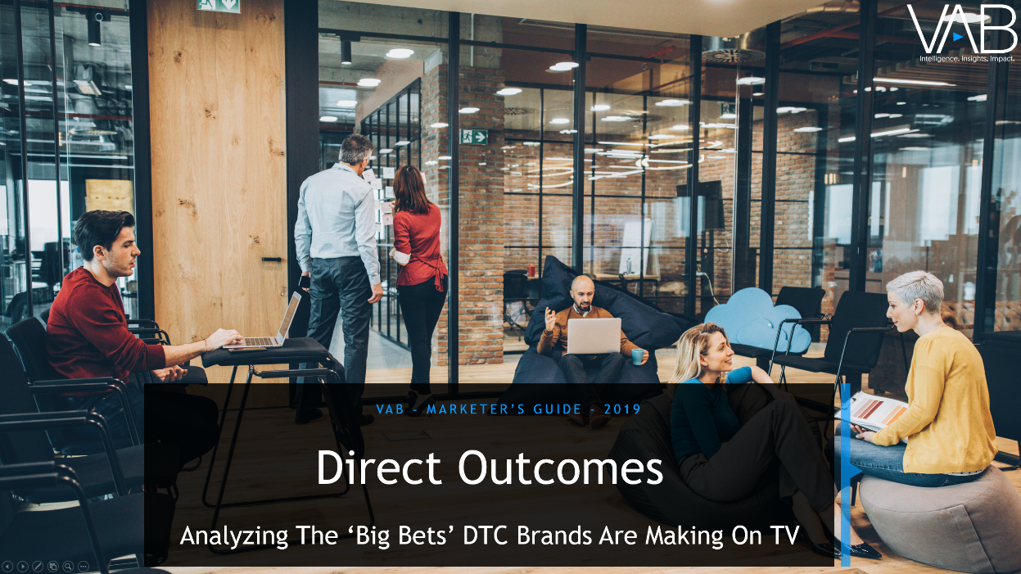
Download Our “Direct Outcomes” Marketer’s Guide To Learn More About How TV Drives Consumer Action & Brand Results Through The Purchase Funnel
(55-page Marketer’s Guide)
(click above in presentation mode to download report)
40

Slide 41
Myth:
“No one goes to the movies anymore because of
Netflix, Amazon, Hulu and other streaming services”
The Reality Of Today’s Video Viewing Behavior…
41

Slide 42

2018 Marked A Record Breaking Year For Domestic Box Office Revenues With Almost $12 Billion In Ticket Sales Which Equated To Over 1.3 Billion Admissions
In the last decade, box office revenue has grown by 24%
Source: VAB analysis of Box Office Mojo; Calendar years
42
This information is exclusively provided to VAB members and qualified marketers. Further distribution is prohibited.

Slide 43
Myth:
“Cinema is driven by only a handful of blockbusters,
mostly comic book ‘Superhero’ movies”
The Reality Of Today’s Video Viewing Behavior…
43

Slide 44






























Comic Book ‘Superhero’ Movies Made Up Seven Out Of The Top 30 Highest Grossing Films In 2018 And Accounted For Only 22% Of The Total Box Office
$700.1MM
$678.8MM
$608.6MM
$417.7MM
$335.1MM
$318.5MM
$270.6MM
$220.2MM
$216.6MM
$216.4MM
1
2
3
4
5
6
7
8
9
10
$215.3MM
$213.8MM
$213.5MM
$201.1MM
$190.2MM
$188.0MM
$174.5MM
$172.0MM
$167.5.MM
$159.6MM
11
12
13
14
15
16
17
18
19
20
$159.3MM
$145.4MM
$140.2MM
$137.7MM
$127.2MM
$120.6MM
$117.5MM
$115.7MM
$115.3MM
$103.8MM
21
22
23
24
25
26
27
28
29
30
Source: VAB Analysis of Box Office Mojo, 2018, Total Revenues. List above reflects the top 20 Domestic Box Office grossing films of 2018, non-”Comic Book Superhero” Top 30 Movies are in outlined in blue.
In 2018, 34 movies surpassed $100+ MM in domestic box office grosses.
44
This information is exclusively provided to VAB members and qualified marketers. Further distribution is prohibited.

Slide 45
Myth:
“People only go to the movies on holiday weekends and during the summer”
The Reality Of Today’s Video Viewing Behavior…
45

Slide 46


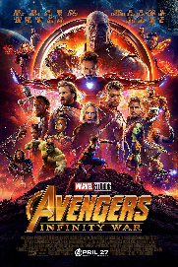














Cinema Admissions Are Fairly Equivalent Across Each Quarter With
Only A Slight Bump In Early Summer
Source: VAB Analysis of Nielsen National Cinema Audience Report, Q1 – Q4 2018, Admissions cumed across months in period
46
This information is exclusively provided to VAB members and qualified marketers. Further distribution is prohibited.

Slide 47
Myth:
“Online-based platforms are more targeted towards Millennials than Cinema”
The Reality Of Today’s Video Viewing Behavior…
47

Slide 48
Cinema Has A Much Higher Composition Of Millennials Than Other Digital-Based Platforms Like TV-Connected Devices & Smartphones
Weekly Reach Composition % By Platform
P18+, Q1 2019
Source: VAB Analysis of Nielsen Total Audience Report Q1 2019
48
This information is exclusively provided to VAB members and qualified marketers. Further distribution is prohibited.

Slide 49
Myth:
“Cinema advertising is purely to build brand awareness and doesn’t drive people to take direct action”
The Reality Of Today’s Video Viewing Behavior…
49

Slide 50
Almost Half Of Moviegoers Have Visited A Brand Advertiser’s Website &
Over One-Third Have Purchased A Product They Saw Advertised At The Cinema
% Who Are “Likely” or “Very Likely” To Take A Specific Action As A Result of Seeing A Cinema Advertisement
Q4 2018
(interactive polling, games, trivia, etc.)
Source: VAB analysis of Nielsen National Cinema Audience Report, October-December 2018, VAB Custom Questions: QM39.1018V Likely to interact with cinema advertising through interactive polling, games, trivia, etc. (top 2 box – Likely & Very Likely)
QM38.1018V. Likely to Visit Brand Website on Mobile Phone (top 2 box – Likely & Very Likely). QM35: Likelihood of purchasing a product as a result of seeing an advertisement in movie theater/theater lobby (top 2 box – Likely & Very Likely)
50
This information is exclusively provided to VAB members and qualified marketers. Further distribution is prohibited.

Slide 51
‘A Culture of Extremes’
Summary
51

Slide 52
Ad-Supported TV
Myths
Realities
“Everyone is cutting the cord and moving away from cable for other video substitutes & subscriptions”
82 MM HHs have an MVPD subscription in 2019, far more than any other video access point
“Everyone is moving away from TV and getting their video content from other, more mobile, devices”
46 MM+ Adults watch TV in any given minute vs. 1.1 MM watching video on a smartphone
“Everyone is spending more time on Facebook & YouTube than ad-supported multiscreen TV”
13x more Adults 18-34 are engaged with TV content in any given minute than with Facebook
“No one under 35 watches Linear TV because they are on SVOD platforms, digital sites & social media”
50% of video consumed by Adults 18-34 is on TV
“OTT platforms have the scale and can be a replacement for Linear TV”
Only 28% of Adults are reached by ad-supported OTT; 95% are reached by TV
52
This information is exclusively provided to VAB members and qualified marketers. Further distribution is prohibited.

Slide 53
Ad-Supported TV
Myths
Realities
“No one watches ‘live’ TV anymore besides sports”
87% of all TV is viewed ‘Live’
“Younger audiences are much more engaged with YouTube content than TV programming”
Millennials are 19% more likely to purchase a product shown on TV than one featured by a YouTube personality
“The real buzzworthy video content is on Netflix, Amazon and YouTube and that’s what everyone is talking about”
84% of top-10 Twitter topics are about
ad-supported TV programs
“Digital-native, DTC brands only need to invest in advertising on social platforms to grow big”
125 DTC brands spent $3.8 Billion on TV
in 2018; a 60% increase YoY
“TV is only effective for building brand awareness among consumers but it doesn’t directly drive sales”
93% average lift in monthly unique website visitors after TV launch
53
This information is exclusively provided to VAB members and qualified marketers. Further distribution is prohibited.

Slide 54
Cinema
Myths
Realities
“No one goes to the movies anymore because of Netflix, Amazon and other streaming services”
Domestic Box Office record in 2018 with
$11.9 Billion in revenues; 1.3 Billion tickets sold
“Cinema is driven by only a handful of blockbusters, mostly comic book ‘Superhero’ movies”
Superhero (‘comic book’) movies made up only 22% of the total Domestic Box Office in 2018
“People only go to the movies on holiday weekends and during the summer”
Quarterly Admissions breakout:
1Q - 25%, 2Q - 27%, 3Q - 23%, 4Q - 25%
“Online-based platforms are more targeted towards Millennials than Cinema”
56% of moviegoers are millennial compared to 34% of TV-connected device users
“Cinema advertising is purely to build awareness and doesn’t drive people to take direct action”
38% of millennial moviegoers are likely to purchase a product they saw advertised at the cinema
54
This information is exclusively provided to VAB members and qualified marketers. Further distribution is prohibited.

Slide 55
For Marketers To Reach Their Consumer,
They Must Create A Holistic Video Agnostic Plan…
…So Don’t Get Caught Up In The Extremes…
Assume Nothing, Investigate Everything
55

Slide 56




Contact Us
Jason Wiese
SVP, Director of Strategic Insights
jasonw@thevab.com
Join Our Email List
Leah Montner-Dixon
Insights Manager
leahm@thevab.com
Reed Kiely
Senior Multiplatform Video Analyst reedk@thevab.com
VAB
@VABintel
56

