Slide 1

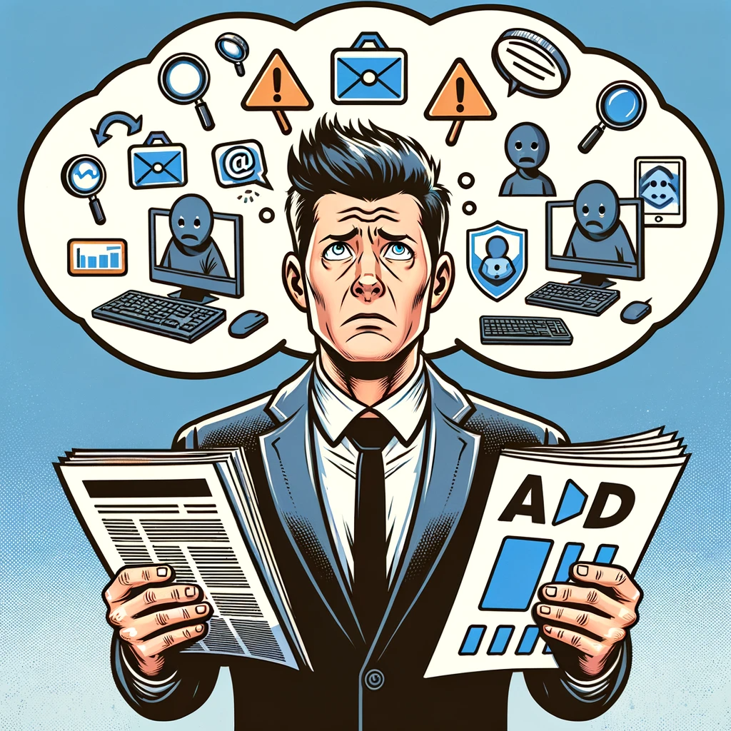



Exposed
5 Inconvenient Truths We Learned From Marketers

Slide 2


Revealing the Inconvenient Truth…
In the past year, it’s become impossible to ignore the issue of advertising transparency. Headlines are littered with explosive investigative research reports, inflated metrics scandals, children’s data being compromised, ads running in wildly inappropriate content and more.
Yet, marketers have been relatively quiet on these scandals, especially when compared to other, less serious topics that dominate the industry narrative.
We wondered, why? As Ad Age reported, do marketers suffer from a ‘fear of finding out’?
This information is exclusively provided to VAB members and qualified marketers.
PAGE 2

Slide 3

Do marketers suffer from the ‘fear of finding out?’
To understand their (lack of) response, we partnered with Advertiser Perceptions and conducted interviews and surveys with agencies and brand marketers.*
We quickly found there were common misconceptions and misunderstandings around transparency, ad fraud and brand safety that hold back agencies and brand marketers from effectively addressing the rampant digital ad fraud impacting the industry.
And perhaps, most telling, there is confusion regarding who is ultimately responsible for monitoring these issues.
*See appendix for full details on methodology behind interviews and custom survey
This information is exclusively provided to VAB members and qualified marketers.
PAGE 3

Slide 4

How aware and worried are brand marketers and agencies about ad fraud?

Slide 5

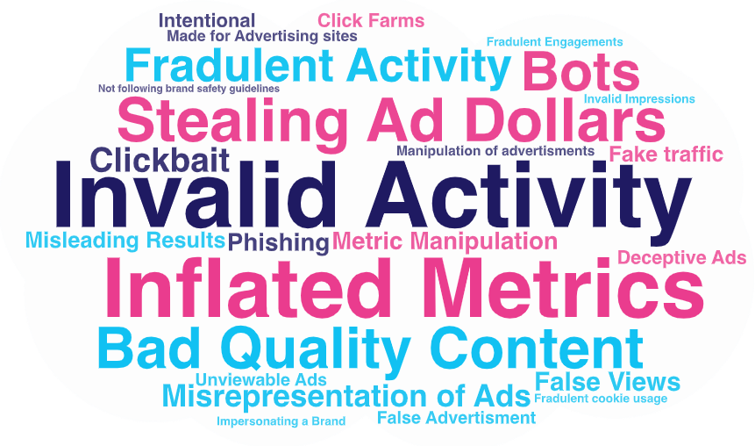
We found agreement from agencies and brand marketers on the definition of ad fraud, with both equating it with some kind of ‘theft’…
How marketers define ‘digital ad fraud’
Source: VAB / Advertiser Perceptions ‘Marketer Sentiment on Ad Fraud’ Survey, November 2023. Survey base: Marketer and agency contacts from the Advertiser Perceptions ‘Senior Marketer’ and ‘Streaming Video’ online communities.
Q1A: What constitutes digital ad fraud? [open ended] Base = Total Respondents.
This information is exclusively provided to VAB members and qualified marketers.
PAGE 5

Slide 6
Over 40% of brand marketers and agencies know ad fraud affected their brand; another 20% wonder
Has digital ad fraud affected [your/your client’s] brand?
% of respondents
"I don't know [if ad fraud has affected my business]. I bet it has, but I can't quantify it.
It has caused us to overspend. Reduces ROAS.”
- Director of Marketing, B2B Category (Anonymous)*
Almost six of out every 10 marketers either know or wonder if they were affected by ad fraud
Source: VAB / Advertiser Perceptions ‘Marketer Sentiment on Ad Fraud’ Survey, November 2023. Survey base: Marketer and agency contacts from the Advertiser Perceptions ‘Senior Marketer’ and ‘Streaming Video’ online communities.
Q7. Had digital ad fraud affected [your/your client’s] brand? Base = Total Respondents. *VAB / Advertiser Perceptions ‘Marketer Sentiment on Ad Fraud’ Survey, based on in-depth interviews, fielded October 2023. Survey base: Marketer and agency contacts from the Advertiser Perceptions ‘Senior Marketer’ and ‘Streaming Video’ online communities.
This information is exclusively provided to VAB members and qualified marketers.
PAGE 6

Slide 7




Yet, only 13% of brand marketers and agencies are extremely concerned about this ‘theft’
Level of digital ad fraud concern among marketers
% of respondents
13%
extremely concerned
41%
slightly concerned
44%
moderately concerned
Source: VAB / Advertiser Perceptions ‘Marketer Sentiment on Ad Fraud’ Survey, November 2023. Survey base: Marketer and agency contacts from the Advertiser Perceptions ‘Senior Marketer’ and ‘Streaming Video’ online communities. Q9. How concerned are you about digital ad fraud? (extremely concerned / moderately concerned / slightly concerned). Base = Total Respondents.
This information is exclusively provided to VAB members and qualified marketers.
PAGE 7

Slide 8




By comparison, consumers are more concerned about online fraud in their daily lives than digital savvy marketers investing corporate dollars
% of consumers who are concerned about the following types of fraud
32%
64%
Identity Theft
Stolen Credit Card Info
61%
of consumers are very concerned about online security due to
fraud-related issues
60%
Online Privacy
Fake and Phishing Emails
49%
Source: VAB analysis of data from Experian’s 2023 U.S. Identity + Fraud Report: Identity, Experience and the Evolving Fraud Landscape. Based on a survey of more than 2,000. U.S. consumers about their online interactions and expectations regarding security and customer experience.
This information is exclusively provided to VAB members and qualified marketers.
PAGE 8

Slide 9
Why are the majority of marketers overlooking the ‘theft’ of their advertising funds?

Slide 10

5 Inconvenient Truths We Learned From Marketers
1
2
3
4
5
Don’t Blame Me
The lack of culpability means no single party is willing to assume responsibility for addressing ad fraud
Lose Control
Marketers face persistent ad fraud with little recourse or power to address it
Under Pressure
By prioritizing low costs in campaigns, quality and brand safety are put at extreme risk
Hazy Shade of Winter
A lack of transparency prevents marketers from understanding and identifying where the many risks of ad fraud exist
Smooth Criminal
Marketers are unaware that digital ad dollars are being inadvertently funneled to ‘bad actors’ who fund illegal operations, extremist content and other harmful activities
This information is exclusively provided to VAB members and qualified marketers.
PAGE 10

Slide 11
Marketers typically delegate oversight, resulting in a lack of clear accountability
1
2
3
4
5
Don’t Blame Me
The lack of culpability means no single party is willing to assume responsibility for addressing ad fraud
Lose Control
Marketers face persistent ad fraud with little recourse or power to address it
Under Pressure
By prioritizing low costs in campaigns, quality and brand safety are put at extreme risk
Hazy Shade of Winter
A lack of transparency prevents marketers from understanding and identifying where the many risks of ad fraud exist
Smooth Criminal
Marketers are unaware that digital ad dollars are being inadvertently funneled to ‘bad actors’ who fund illegal operations, extremist content and other harmful activities
This information is exclusively provided to VAB members and qualified marketers.
PAGE 11

Slide 12



1 out of 3 industry professionals hold brand marketers responsible for preventing ad fraud, yet they typically only take limited internal actions
% of brand marketer respondents who
use the following solutions to prevent digital ad fraud*
32%
of industry professionals believe advertisers are responsible for preventing digital ad fraud
39%
29%
39%
Closely monitoring campaigns for increased activity which may be due to bots
Establishing clear brand safety guidelines and ensuring all our partners adhere to them
Maintaining a whitelist of trusted sites
Source: VAB / Advertiser Perceptions ‘Marketer Sentiment on Ad Fraud’ Survey, November 2023. Survey base: Marketer and agency contacts from the Advertiser Perceptions ‘Senior Marketer’ and ‘Streaming Video’ online communities. Q10. Please rank the following based on who you believe is most responsible for preventing digital ad fraud? Base = Total Respondents. *Q6. What solutions [is your company/are your clients] using to prevent digital ad fraud? Base = Total Respondents.
This information is exclusively provided to VAB members and qualified marketers.
PAGE 12

Slide 13






Brand marketers often assign monitoring ad fraud to third-party vendors or publishers, absolving themselves and their agencies
% of brand marketer respondents who believe the following are responsible for preventing digital ad fraud
Trade Associations
Only 22% hold
agencies or advertisers accountable
(i.e., those most directly responsible
for the brand’s business)
Agencies
Digital supply chain vendors
Advertisers
Ad verification companies
Publishers
Source: VAB / Advertiser Perceptions ‘Marketer Sentiment on Ad Fraud’ Survey, November 2023. Survey base: Marketer and agency contacts from the Advertiser Perceptions ‘Senior Marketer’ and ‘Streaming Video’ online communities. Q10. Please rank the following based on who you believe is most responsible for preventing digital ad fraud? Base = Brand Marketer Respondents.
This information is exclusively provided to VAB members and qualified marketers.
PAGE 13

Slide 14
Without internal checks, brand marketers underestimate the seriousness and impact of industry-wide issues
% of brand marketer respondents who are concerned about…
Ranked within top 3 digital ad fraud concerns
Their Business / Client’s Businesses
The Advertising Industry Overall*
Unknowingly appearing on 'Made for Advertising' (MFA) websites
18%
32%
Targeted / tracked ads running alongside children's content
11%
18%
Source: VAB / Advertiser Perceptions ‘Marketer Sentiment on Ad Fraud’ Survey, November 2023. Survey base: Marketer and agency contacts from the Advertiser Perceptions ‘Senior Marketer’ and ‘Streaming Video’ online communities. Q3A. What are your top 3 concerns surrounding digital ad fraud regarding [your business/your clients' businesses]? *Q3B. What are your top 3 concerns surrounding digital ad fraud regarding the advertising industry overall? Base = Brand Marketer Respondents.
This information is exclusively provided to VAB members and qualified marketers.
PAGE 14

Slide 15


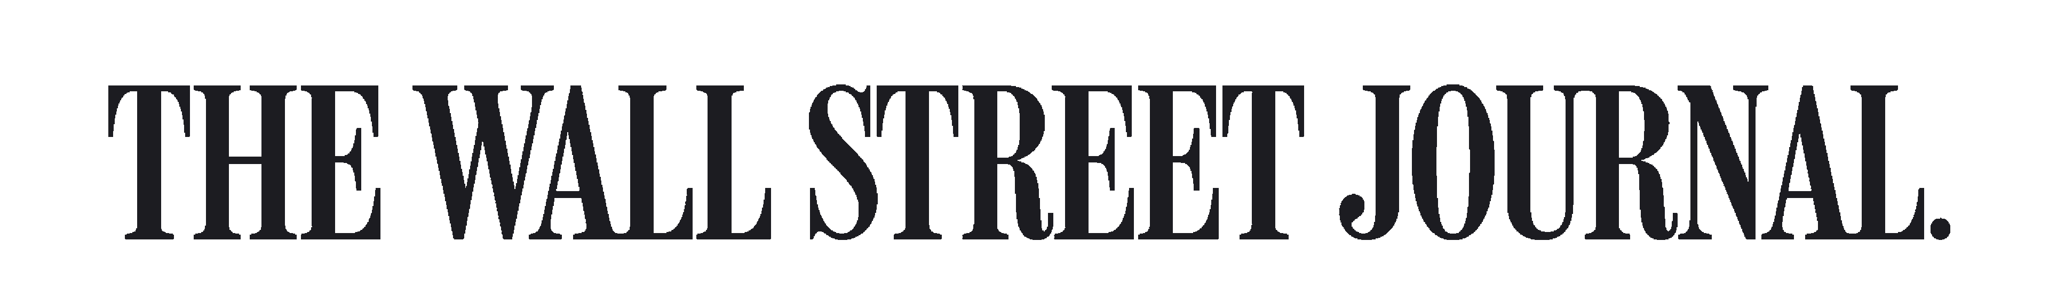
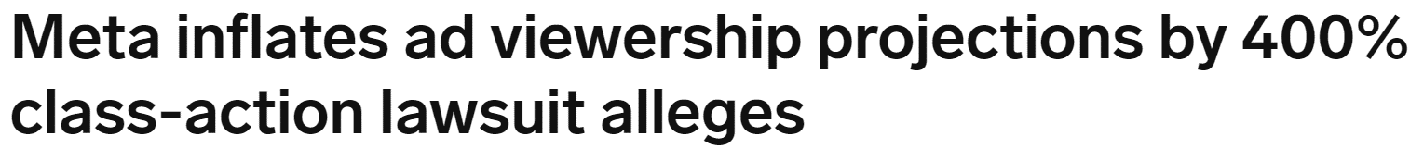
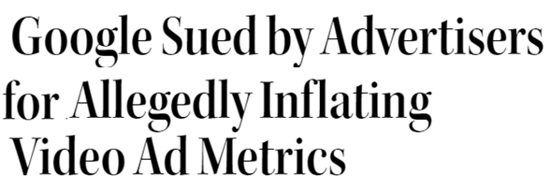
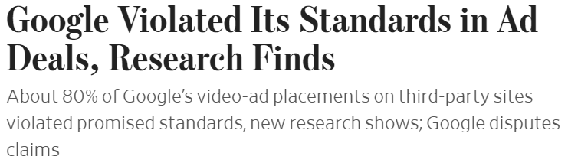

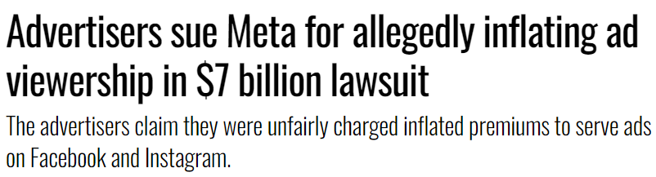


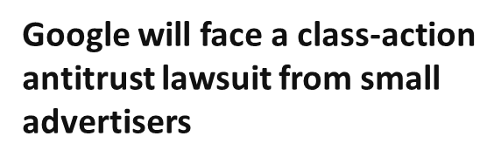
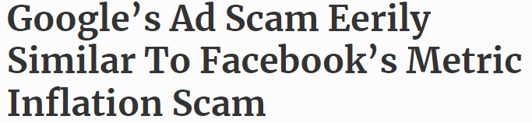





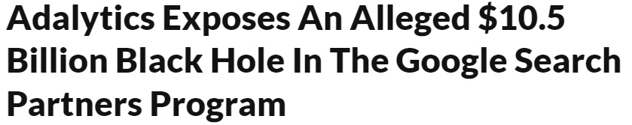
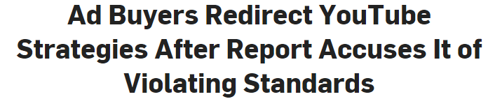
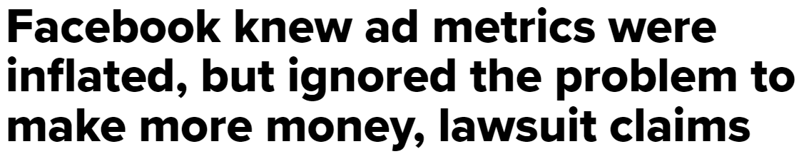
They assume their trusted partners protect them from alleged fraudulent advertising activities, including metric inflation and ad misrepresentation
April 2, 2024
July 26, 2023
June 27, 2023
March 29, 2024
June 28, 2023
December 15, 2023
August 20, 2018
November 28, 2023
July 11, 2023
February 19, 2021
This information is exclusively provided to VAB members and qualified marketers.
PAGE 15

Slide 16
Agencies, with their experience in monitoring campaigns and access to evaluation tools, generally feel more culpable for the results
% of respondents who use the following solutions to prevent digital ad fraud…
Brand
Marketers
Agency
Professionals
Closely monitoring campaigns for increased activity which may be due to bots
39%
82%
Establishing clear brand safety guidelines and ensuring all our partners adhere to them
29%
73%
Maintaining a whitelist of trusted sites
39%
36%
Partnering with '3rd Party' ad verification vendors / fraud detection vendors
32%
45%
Using only direct premium publisher relationships
32%
36%
Source: VAB / Advertiser Perceptions ‘Marketer Sentiment on Ad Fraud’ Survey, November 2023. Survey base: Marketer and agency contacts from the Advertiser Perceptions ‘Senior Marketer’ and ‘Streaming Video’ online communities. Q6. What solutions [is your company/are your clients] using to prevent digital ad fraud? Base = Total Respondents.
This information is exclusively provided to VAB members and qualified marketers.
PAGE 16

Slide 17

Yet, in the end, everyone is pointing fingers in different directions with no accountability in sight
% of total respondents
32%
believe advertisers are responsible for preventing digital ad fraud
27%
believe agencies
are responsible for preventing digital ad fraud
Source: VAB / Advertiser Perceptions ‘Marketer Sentiment on Ad Fraud’ Survey, November 2023. Survey base: Marketer and agency contacts from the Advertiser Perceptions ‘Senior Marketer’ and ‘Streaming Video’ online communities. Q10. Please rank the following based on who you believe is most responsible for preventing digital ad fraud? Base = Total Respondents.
This information is exclusively provided to VAB members and qualified marketers.
PAGE 17

Slide 18
Marketers often face a web of conflicts of interests leading to limited actionable solutions
1
2
3
4
5
Don’t Blame Me
The lack of culpability means no single party is willing to assume responsibility for addressing ad fraud
Lose Control
Marketers face persistent ad fraud with little recourse or power to address it
Under Pressure
By prioritizing low costs in campaigns, quality and brand safety are put at extreme risk
Hazy Shade of Winter
A lack of transparency prevents marketers from understanding and identifying where the many risks of ad fraud exist
Smooth Criminal
Marketers are unaware that digital ad dollars are being inadvertently funneled to ‘bad actors’ who fund illegal operations, extremist content and other harmful activities
This information is exclusively provided to VAB members and qualified marketers.
PAGE 18

Slide 19

When ad fraud is caught in campaigns, most marketers’ main recourse is to shift some ad dollars away from the offending digital platform
88%
of marketer respondents have shifted some of their ad budget to another platform as a result of discovering digital ad fraud
Source: VAB / Advertiser Perceptions ‘Marketer Sentiment on Ad Fraud’ Survey, November 2023. Survey base: Marketer and agency contacts from the Advertiser Perceptions ‘Senior Marketer’ and ‘Streaming Video’ online communities. Q7A. How did the discovery of digital ad fraud affect [your company's/your client's] relationship with the culpable media platform(s)? Base = Digital Ad Fraud Affected Brand.
This information is exclusively provided to VAB members and qualified marketers.
PAGE 19

Slide 20

However, most admit shifting dollars and ‘conversations’ do not improve their trust and transparency with the platform
Among respondents who were impacted by digital ad fraud…
38%
6%
had conversations with the media platform
about how to prevent fraud and improve accountability
Said it actually improved their trust and transparency once the ad fraud was addressed
Source: VAB / Advertiser Perceptions ‘Marketer Sentiment on Ad Fraud’ Survey, November 2023. Survey base: Marketer and agency contacts from the Advertiser Perceptions ‘Senior Marketer’ and ‘Streaming Video’ online communities. Q7A. How did the discovery of digital ad fraud affect [your company's/your client's] relationship with the culpable media platform(s)? Base = Digital Ad Fraud Affected Brand.
This information is exclusively provided to VAB members and qualified marketers.
PAGE 20

Slide 21
Agencies are also often powerless, implementing more checks and balances but achieving little additional transparency
% of respondents who use the following solutions to prevent digital ad fraud…
Brand
Marketers
Agency
Professionals
Closely monitoring campaigns for increased activity which may be due to bots
39%
82%
Establishing clear brand safety guidelines and ensuring all our partners adhere to them
29%
73%
Using programmatic providers that utilize in-house or '1st Party' comprehensive ad fraud solutions
39%
64%
Partnering with '3rd Party' ad verification vendors / fraud detection vendors
32%
45%
Maintaining a blacklist of discredited sites
14%
27%
Source: VAB / Advertiser Perceptions ‘Marketer Sentiment on Ad Fraud’ Survey, November 2023. Survey base: Marketer and agency contacts from the Advertiser Perceptions ‘Senior Marketer’ and ‘Streaming Video’ online communities.
Q6. What solutions [is your company/are your clients] using to prevent digital ad fraud? Base = Total Respondents.
This information is exclusively provided to VAB members and qualified marketers.
PAGE 21

Slide 22
It can be especially challenging when ad verification companies' revenues are dependent on the platforms they ‘independently’ monitor
Ad Verification Company Revenues by Type
DoubleVerify & Integral Ad Science (Aggregated), Full Year 2023
in millions
‘Supply-side’ revenue = earnings from platforms / publishers using services to evaluate their own inventory & facilitate campaigns
(ad-tech walled gardens are ad platforms / publishers)
‘Programmatic’ revenue = earnings from advertisers using services to evaluate ad inventory quality or optimize campaign inventory from programmatic platforms
(many ad-tech walled gardens have their own programmatic platforms, e.g., Google Display & Video 360)
‘Advertiser-direct’ revenue = earnings from advertisers using services to measure campaign quality & performance on digital platforms
(ad-tech walled gardens are some of the top digital platforms and provide data for measurement as intermediaries, they are also major advertisers themselves)
Source: VAB analysis of DoubleVerify and Integral Ad Science (IAS) company financial reports, Full Year 2023. DoubleVerify refers to revenues by type as follows: ‘Programmatic’ = ‘Activation’, ‘Advertiser Direct’ = ‘Measurement’, ‘Supply-Side’ = ‘Supply-Side Customer’. Integral Ad Science refers to revenues by type as follows: ‘Programmatic’ = ‘Optimization’, ‘Advertiser Direct’ = ‘Measurement’, ‘Supply-Side’ = ‘Publisher’.
This information is exclusively provided to VAB members and qualified marketers.
PAGE 22

Slide 23
Marketers that prioritize low costs put quality and brand safety at risk by spending in less transparent platforms
1
2
3
4
5
Don’t Blame Me
The lack of culpability means no single party is willing to assume responsibility for addressing ad fraud
Lose Control
Marketers face persistent ad fraud with little recourse or power to address it
Under Pressure
By prioritizing low costs in campaigns, quality and brand safety are put at extreme risk
Hazy Shade of Winter
A lack of transparency prevents marketers from understanding and identifying where the many risks of ad fraud exist
Smooth Criminal
Marketers are unaware that digital ad dollars are being inadvertently funneled to ‘bad actors’ who fund illegal operations, extremist content and other harmful activities
This information is exclusively provided to VAB members and qualified marketers.
PAGE 23

Slide 24
Consumers and marketers both prioritize the context and environment in which ads appear
nearly
82%
over
90%
80%
of consumers feel that
brands bear responsibility
for ensuring their ads run
beside content that is safe
of consumers say it is important that a brand’s ads appear on content that is safe, accurate
and trustworthy
of marketing professionals believe brand safety is a major concern for their organization*
Source: DoubleVerify & Harris Poll, Consumers Reject Brands That Advertise on ‘Fake News’ and Objectionable Content Online, June 2019. *WARC Journal of Advertising Research, Is your brand protected? Assessing brand safety risks in digital campaigns, November 2023. Based on an online survey of advertising and brand management professionals with decision-making authority over the purchasing or spending for brands with at least $10 million in annual advertising spend. Download VAB’s ‘What is Brand Safety’ to learn more.
This information is exclusively provided to VAB members and qualified marketers.
PAGE 24

Slide 25



Yet, more than two out of three brand marketers and agencies rank cost over brand safety
% of respondents who are prioritizing brand safety over lower CPMs
Brand Marketers
Agency Professionals
32%
27%
Brands and agencies have different reasons to push for lower costs including cost suppression tied to compensation or KPI directives
Source: VAB / Advertiser Perceptions ‘Marketer Sentiment on Ad Fraud’ Survey, November 2023. Survey base: Marketer and agency contacts from the Advertiser Perceptions ‘Senior Marketer’ and ‘Streaming Video’ online communities. Q6. What solutions [is your company/are your clients] using to prevent digital ad fraud? Base = Total Respondents.
This information is exclusively provided to VAB members and qualified marketers.
PAGE 25

Slide 26

Under enormous pressure to deliver efficiencies, clicks are a higher priority than brand safety, child privacy violations, disinformation, etc.
% of respondents who are concerned about the following
For Their Business / Client’s Businesses
Click fraud*
Lack of transparency on campaign details and placements
Unknowingly appearing on websites with objectionable, offensive content
Unknowingly appearing on websites that deliberately serve disinformation / misinformation
Targeted/tracked ads running alongside children's content
Unknowingly appearing on 'Made for Advertising' (MFA) websites
Source: VAB / Advertiser Perceptions ‘Marketer Sentiment on Ad Fraud’ Survey, November 2023. Survey base: Marketer and agency contacts from the Advertiser Perceptions ‘Senior Marketer’ and ‘Streaming Video’ online communities.
Q3A. What are your top 3 concerns surrounding digital ad fraud regarding [your business/your clients' businesses]? Base = Total Respondents. *‘Click fraud’ refers to bots, click farms, etc. that generate fake clicks on an ad or website.
This information is exclusively provided to VAB members and qualified marketers.
PAGE 26

Slide 27

Beyond the ethical and legal implications of running in harmful content, brand safe ads have proven to drive superior conversion rates
+233%
lift in conversions for
brand safe impressions vs.
non brand safe impressions
Source: Integral Ad Science, Does Media Quality Drive Attention and Outcomes?, March 2022. Download VAB’s ‘What is Brand Safety’ to learn more.
This information is exclusively provided to VAB members and qualified marketers.
PAGE 27

Slide 28
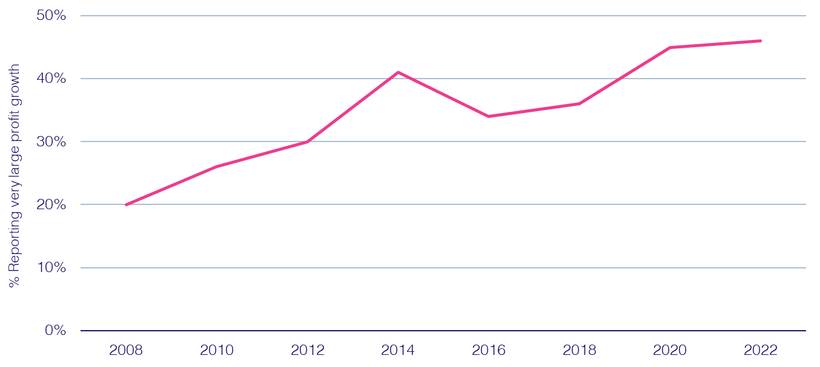
And the ability of a ‘brand safe’ ad to build trust in today’s increasingly skeptical society has a direct, positive effect on profitability
% cases with strong ‘trust’ growth reporting strong ‘profit’ growth
67%
of consumers would be likely to
stop using the brand if they viewed the brand’s digital advertising beside false, objectionable
or inflammatory content*
Source: Peter Field, Why TV is Still at the Heart of Effectiveness, presented at ‘The Future of TV Advertising Global’ conference in December 2023. Base: IPA Databank 2004-2022 for profit cases reporting very large trust improvements. NB: insufficient data prior to 2008. Click here to view Peter Field’s full presentation online. *DoubleVerify & Harris Poll, Consumers Reject Brands That Advertise on ‘Fake News’ and Objectionable Content Online, June 2019.
This information is exclusively provided to VAB members and qualified marketers.
PAGE 28

Slide 29
Still, marketers are shifting ad investment from known brand-safe, transparent media platforms including TV
‘Transparent’ Media Ad Spend
in billions
-6%
vs. ‘17
-14%
vs. ‘19
-6%
vs. ‘21
-4%
vs. ‘23
% of total U.S. ad spending**
57%
44%
30%
25%
20%
Source: eMarketer Insider Intelligence, Total Media Ad Spending, by Media, October 2023. Note: ‘Transparent media’ includes linear TV, directories, magazines, newspapers, out-of-home, radio; TV, newspapers, magazines and directories exclude digital; Radio excludes off-air radio and digital. *Total U.S. ad spend includes digital (desktop/laptop, mobile, and other internet-connected devices), directories, magazines, newspapers, out-of-home, radio, and TV.
This information is exclusively provided to VAB members and qualified marketers.
PAGE 29

Slide 30
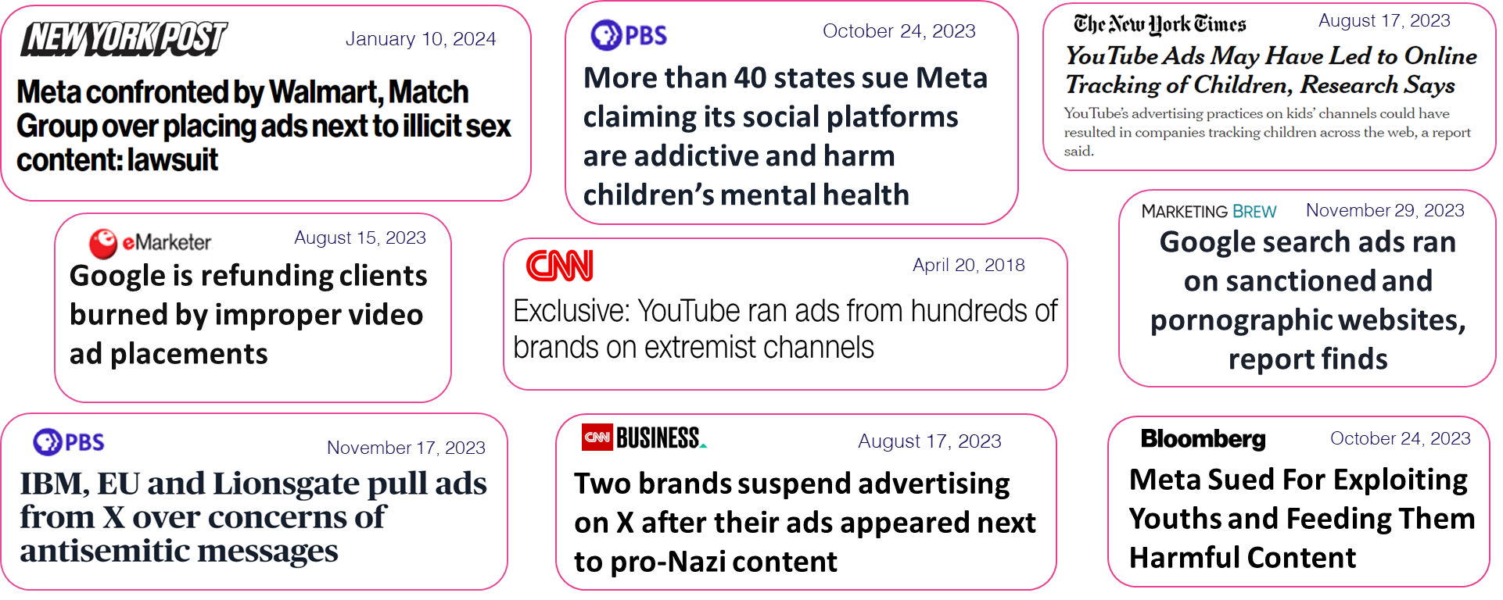
To opaque walled gardens which have been plagued by brand safety scandals
Major ‘Walled Garden’ Global Advertising Revenues
Aggregated Alphabet & Meta Revenues (in billions)
+46%
vs. 2020
Source: Alphabet and Meta SEC company 10-K filings via SEC Edgar Search.
This information is exclusively provided to VAB members and qualified marketers.
PAGE 30

Slide 31

In their own words: Even though marketers don’t believe the ‘Big Tech’ walled gardens would dare to engage in fraudulent activity
“For large entities (Google and Facebook) that incentive is still theoretically there, but they would have to be very foolish to engage in outright fraud at this point. So, I think you're less at risk if you're running on those versus syndicating your content out to thousands or millions of different smaller sites."
CMO, Consumer Electronics Category (Anonymous)
Source: VAB / Advertiser Perceptions ‘Marketer Sentiment on Ad Fraud’ Survey, based on in-depth interviews, fielded October 2023. Survey base: Marketer and agency contacts from the Advertiser Perceptions ‘Senior Marketer’ and ‘Streaming Video’ online communities.
This information is exclusively provided to VAB members and qualified marketers.
PAGE 31

Slide 32
Opaque ad practices not only obscure the many risks of ad
fraud but also lead marketers to undervalue premium inventory
1
2
3
4
5
Don’t Blame Me
The lack of culpability means no single party is willing to assume responsibility for addressing ad fraud
Lose Control
Marketers face persistent ad fraud with little recourse or power to address it
Under Pressure
By prioritizing low costs in campaigns, quality and brand safety are put at extreme risk
Hazy Shade of Winter
A lack of transparency prevents marketers from understanding and identifying where the many risks of ad fraud exist
Smooth Criminal
Marketers are unaware that digital ad dollars are being inadvertently funneled to ‘bad actors’ who fund illegal operations, extremist content and other harmful activities
This information is exclusively provided to VAB members and qualified marketers.
PAGE 32

Slide 33

More than half of marketers believe the cost of their ad placements has no bearing on the likelihood of ad fraud
% of respondents who feel lower cost and premium-priced digital ad platforms are equally at risk for fraud
Brand Marketers
Agency Professionals
54%
55%
Source: VAB / Advertiser Perceptions ‘Marketer Sentiment on Ad Fraud’ Survey, November 2023. Survey base: Marketer and agency contacts from the Advertiser Perceptions ‘Senior Marketer’ and ‘Streaming Video’ online communities. Q2A. Which of the following statements do you agree with most? (Lower cost digital advertising platforms and premium-priced digital advertising platforms are equally at risk for ad fraud). Base = Total Respondents.
This information is exclusively provided to VAB members and qualified marketers.
PAGE 33

Slide 34
Misunderstandings regarding the extent of ad fraud were prevalent in ‘traditional channels’ typically managed by an advertising agency
% of respondents who think traditional platforms
are just as vulnerable to ad fraud than digital media
Brand marketers are
4x
more likely to believe linear TV is vulnerable to fraud compared to agency professionals who have greater visibility into campaign details
Source: VAB / Advertiser Perceptions ‘Marketer Sentiment on Ad Fraud’ Survey, November 2023. Survey base: Marketer and agency contacts from the Advertiser Perceptions ‘Senior Marketer’ and ‘Streaming Video’ online communities. Q1. Are these traditional media channels more vulnerable, just as vulnerable or less vulnerable to ad fraud than digital media channels? Base = Total Respondents.
This information is exclusively provided to VAB members and qualified marketers.
PAGE 34

Slide 35
Those who believe linear TV is vulnerable to ad fraud are equal to those who see social media as being least prone to digital ad fraud
36%
39%
of brand marketers believe linear TV is just as vulnerable to ad fraud than digital media
of brand marketers believe social media platforms are least prone to digital ad fraud*
Source: VAB / Advertiser Perceptions ‘Marketer Sentiment on Ad Fraud’ Survey, November 2023. Survey base: Marketer and agency contacts from the Advertiser Perceptions ‘Senior Marketer’ and ‘Streaming Video’ online communities.
Q1. Are these traditional media channels more vulnerable, just as vulnerable or less vulnerable to ad fraud than digital media channels? Base = Total Respondents. *Q2. Please rank the following media platforms in order of which are the most to the least prone to digital ad fraud? Based on rank 1. Base = Total Respondents.
This information is exclusively provided to VAB members and qualified marketers.
PAGE 35

Slide 36
Despite understanding the dangers of longer-tail, lower-priced inventory, the advantages of premium placements are not fully appreciated or valued
“Where you go out further on the reach curve, that's where you get the problems. There isn't a lot of risk of fraud where most people are "gathering" online. The more obscure the publisher, the bigger the risk.”
only
18%
of brand marketers believe that premium priced digital ad platforms are less prone to fraud*
VP, Brand & Media, DTC e-commerce Category (Anonymous)
Source: VAB / Advertiser Perceptions ‘Marketer Sentiment on Ad Fraud’ Survey, based on in-depth interviews, fielded October 2023. Survey base: Marketer and agency contacts from the Advertiser Perceptions ‘Senior Marketer’ and ‘Streaming Video’ online communities. *VAB / Advertiser Perceptions ‘Marketer Sentiment on Ad Fraud’ Survey, November 2023. Survey base: Marketer and agency contacts from the Advertiser Perceptions ‘Senior Marketer’ and ‘Streaming Video’ online communities. Q2A. Which of the following statements do you agree with most? (Premium-priced digital advertising platforms are less prone to ad fraud). Base = Total Respondents.
This information is exclusively provided to VAB members and qualified marketers.
PAGE 36

Slide 37


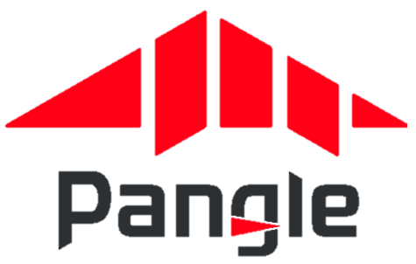


Long-tail websites, which are frequently included within ‘walled gardens’ audience network extensions, can raise brand safety and fraud concerns
Audience Networks (aka Audience Extensions)
A way to expand the reach of a digital campaign with a single publisher by using cookies to identify and track user’s activity on other websites/apps and then serving ads to the same audiences on those 3rd party websites/apps.
Examples of Audience Networks
‘Partners are publisher websites and mobile apps where you can show your video ads to viewers
beyond YouTube’
‘Extends Meta's people-based advertising beyond the Facebook app’
‘Gain access to Pangle’s vast network of mobile apps’
‘Delivers ads beyond the LinkedIn feed to members
on trusted third-party apps
and sites’
‘Ad placements are cross-device and include premium sites like MSN, Outlook.com, Microsoft Edge, and other partners’
Google Video Partners Network
Meta Audience Network
Pangle
(TikTok)
LinkedIn Audience Network
Microsoft Audience Network
Source: Google Ads Help, About Google video partners’ Meta Business Help Center, How Meta Audience Network works; Pangle, How to level up your ad campaign on Pangle; LinkedIn Help, LinkedIn Audience Network FAQs; Microsoft Advertising Help, About Microsoft Audience Ads; To learn more about terminology and facts around digital advertising, click the link to download ‘What Is Digital Ad Fraud’
This information is exclusively provided to VAB members and qualified marketers.
PAGE 37

Slide 38
Audience networks can also include many ‘Made for Advertising’ websites, which create negative brand associations and wasted ad dollars
4,500+
“The most problematic are going to be display ads shown on a variety of third-party websites. All of those individual website owners, publishers are actually incentivized to engage in fraudulent activity.”
projected number of existing
‘Made for Advertising’ Sites*
CMO, Consumer Electronics Category (Anonymous)
$10B estimated annual
global advertising spend
Source: VAB / Advertiser Perceptions ‘Marketer Sentiment on Ad Fraud’ Survey, based on in-depth interviews, fielded October 2023. Survey base: Marketer and agency contacts from the Advertiser Perceptions ‘Senior Marketer’ and ‘Streaming Video’ online communities. *ANA (Association of National Advertisers), Programmatic Media Supply Chain Transparency Study – Complete Report, December 2023. To learn more about terminology and facts around digital advertising, click the link to download ‘What Is Digital Ad Fraud’
This information is exclusively provided to VAB members and qualified marketers.
PAGE 38

Slide 39

Most concerning, the ‘solve’ for these issues - industry-wide campaign transparency standards - isn’t a top concern among marketers
% of respondents who are concerned about the
lack of transparency on campaign details and placements
Ranked within top 3 digital ad fraud concerns for the advertising industry overall
Brand Marketers
Agency Professionals
45%
29%
Source: VAB / Advertiser Perceptions ‘Marketer Sentiment on Ad Fraud’ Survey, November 2023. Survey base: Marketer and agency contacts from the Advertiser Perceptions ‘Senior Marketer’ and ‘Streaming Video’ online communities.
Q3B. What are your top 3 concerns surrounding digital ad fraud regarding the advertising industry overall? Base = Total Respondents. Brand Marketers = ranks tied for #3 behind ‘click fraud’ (82%), ‘inflation of campaign metrics’ (55%), ‘misrepresented ad placements’ (45%). Agency Professionals = ranks #5 behind ‘click fraud’ (68%), ‘misrepresented ad placements’ (39%), ‘inflation of campaign metrics’ (36%), ‘unknowingly appearing on 'Made for Advertising' (MFA) websites’ (32%).
This information is exclusively provided to VAB members and qualified marketers.
PAGE 39

Slide 40
Brands, often isolated from the center of the advertising community, believe a lack of transparency is their issue and not an industry-wide one
% of brand marketers who are concerned about…
Ranked within top 3 digital ad fraud concerns
Their Business / Client’s Businesses
The Advertising Industry Overall*
Lack of transparency on campaign details and placements
43%
29%
Unknowingly appearing on websites that deliberately serve disinformation / misinformation
32%
25%
Source: VAB / Advertiser Perceptions ‘Marketer Sentiment on Ad Fraud’ Survey, November 2023. Survey base: Marketer and agency contacts from the Advertiser Perceptions ‘Senior Marketer’ and ‘Streaming Video’ online communities. Q3A. What are your top 3 concerns surrounding digital ad fraud regarding [your business/your clients' businesses]? *Q3B. What are your top 3 concerns surrounding digital ad fraud regarding the advertising industry overall? Base = Total Respondents.
This information is exclusively provided to VAB members and qualified marketers.
PAGE 40

Slide 41
Unknowingly, marketers’ digital ad dollars are inadvertently funding criminal operations and other illicit activities
1
2
3
4
5
Don’t Blame Me
The lack of culpability means no single party is willing to assume responsibility for addressing ad fraud
Lose Control
Marketers face persistent ad fraud with little recourse or power to address it
Under Pressure
By prioritizing low costs in campaigns, quality and brand safety are put at extreme risk
Hazy Shade of Winter
A lack of transparency prevents marketers from understanding and identifying where the many risks of ad fraud exist
Smooth Criminal
Marketers are unaware that digital ad dollars are being inadvertently funneled to ‘bad actors’ who fund illegal operations, extremist content and other harmful activities
This information is exclusively provided to VAB members and qualified marketers.
PAGE 41

Slide 42

During the in-depth interviews conducted in our survey, none of the respondents expressed concerns about the possibility that their advertising dollars might inadvertently support illegal activities, extremist content or even oppressive regimes.
This finding was particularly noteworthy, given that the interviews were conducted after the release of several Adalytics reports highlighting the financial, reputational and legal risks advertisers face when engaging with walled gardens.
Source: VAB / Advertiser Perceptions ‘Marketer Sentiment on Ad Fraud’ Survey, based on in-depth interviews, fielded October 2023. Survey base: Marketer and agency contacts from the Advertiser Perceptions ‘Senior Marketer’ and ‘Streaming Video’ online communities.
This information is exclusively provided to VAB members and qualified marketers.
PAGE 42

Slide 43

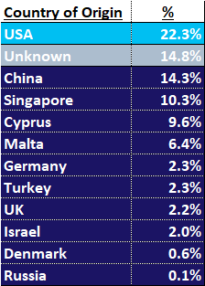
Ad dollars spent in ‘Big Tech’ walled gardens may expose brands to data risks from offshore criminal networks and foreign entities
% of spend by developer ‘country of origin’
for sub-set of YouTube TrueView ad budget that was allocated
to Google Video Partner Network (GVP) Android mobile apps
Source: Adalytics Research LLC, ‘Did Google Mislead Advertisers About TrueView Skippable In-Stream Ads for the Past Three Years?’ report, June 2023. Download VAB’s ‘Hidden Costs’ to learn more.
This information is exclusively provided to VAB members and qualified marketers.
PAGE 43

Slide 44


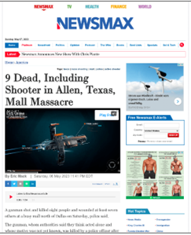

Ads can be served in objectionable content, exposing brands to issues like foreign disinformation, copyright infringement and more
Sampling of TrueView In-stream Ads Served as Out-stream Ads through Google Video Partner Network (GVP)
Foreign Disinformation
Piracy
Ads on foreign, and state-associated, news sites known
to publish disinformation
Website with over 101,000 DMCA copyright takedowns
Objectionable Content
Child-Targeted
Ads alongside objectionable content (such as pornography, animal abuse and adjacencies to children’s deaths)
Ads on mobile apps for children as young as two years old
Source: Adalytics Research LLC, ‘Did Google Mislead Advertisers About TrueView Skippable In-Stream Ads for the Past Three Years?’ report, June 2023. Note: after the Adalytics report was released, YouTube changed the name of their ‘in-stream ads’ format to ‘skippable ads’ throughout Google Display and Video 360, according to a ‘What’s New: July 2023’ Google Blog Post and reported by Adweek on 8/7/23. Download VAB’s ‘Hidden Costs’ to learn more.
This information is exclusively provided to VAB members and qualified marketers.
PAGE 44

Slide 45



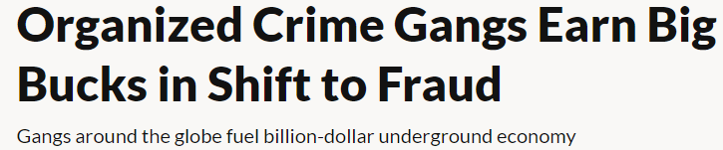
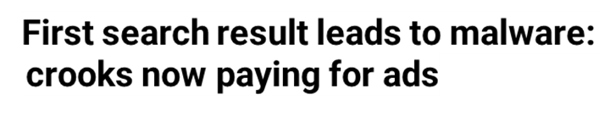
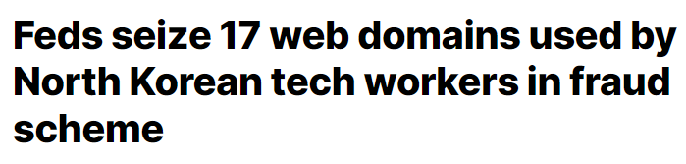


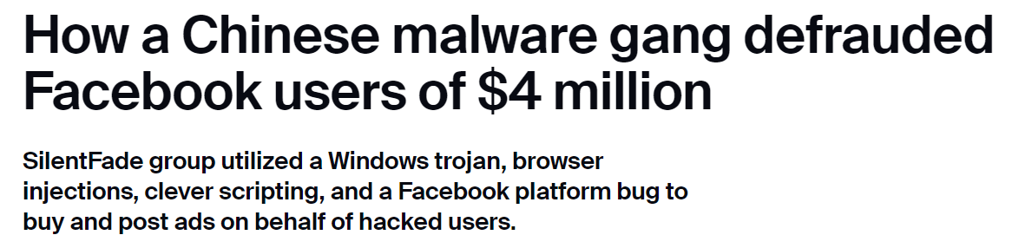
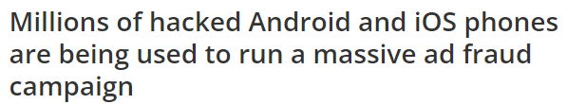
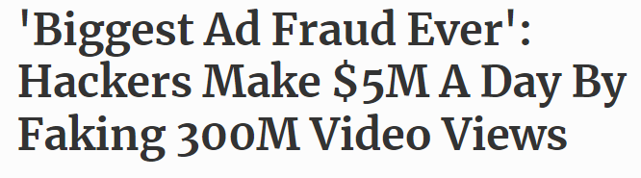



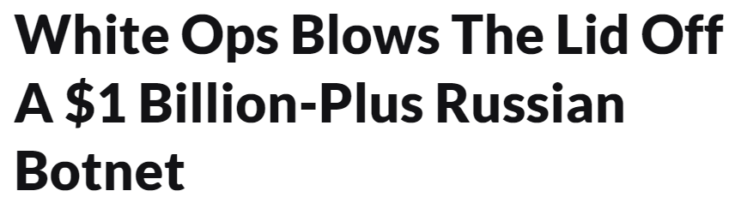
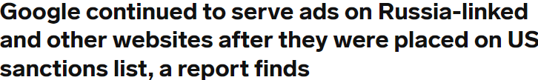
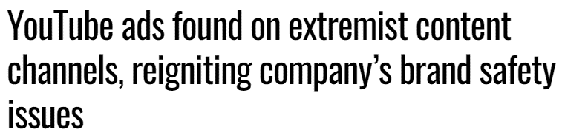


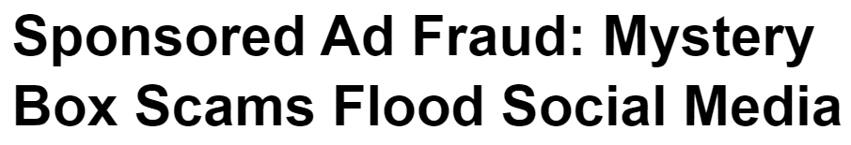
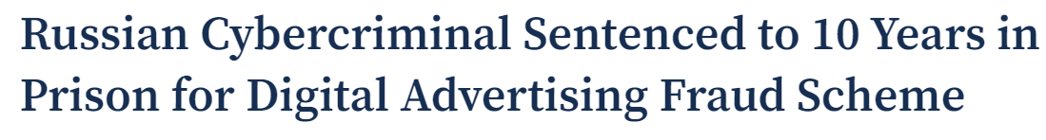
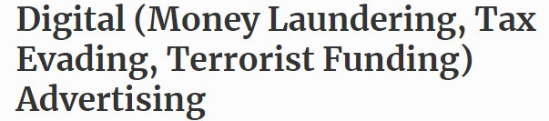
Many instances exist of brands’ digital ad dollars funding ‘bad actors’ involved in organized crime, oppressive regimes and other illicit activities
April 20, 2022
November 15, 2023
October 19, 2023
October 1, 2020
October 10, 2023
November 10, 2021
December 20, 2016
April 20, 2022
April 20, 2018
PAGE 45
February 29, 2024
November 10, 2021
January 1, 2021
This information is exclusively provided to VAB members and qualified marketers.
PAGE 45

Slide 46
In their own words: Marketers agree on the need for transparency and accountability, and expect as much from media partners
“I think it's our job to really demand of our partners that they treat us well. I think the way that we hold them to that is we look for a lot of granularity in the data we get back. We ask questions on what they're doing to prevent fraud and when we see something that looks strange, we bring it to their attention.
If they don't have a good answer, we find a different partner.”
CMO, Consumer Electronics Category (Anonymous)
“On the advertiser side, it's on me. It's my budget, I own the money, I represent the company so it's on me to confirm that I'm doing things right. The publisher is equally responsible. It's on me to figure out if they're sketchy, but if they're operating illegally or immorally, then it's the publisher's fault. I buy from an intermediary/DSP and it's on them as well. Everyone is culpable.”
VP, Brand & Media, e-commerce Category (Anonymous)
Source: VAB / Advertiser Perceptions ‘Marketer Sentiment on Ad Fraud’ Survey, based on in-depth interviews, fielded October 2023. Survey base: Marketer and agency contacts from the Advertiser Perceptions ‘Senior Marketer’ and ‘Streaming Video’ online communities.
This information is exclusively provided to VAB members and qualified marketers.
PAGE 46

Slide 47

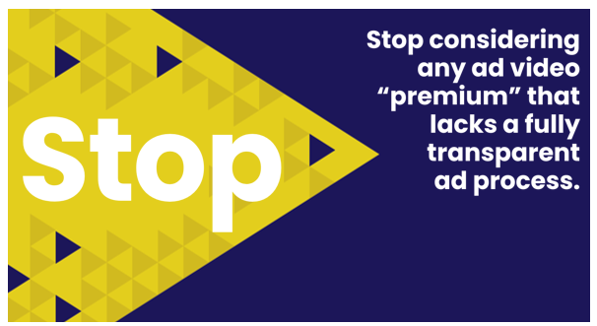

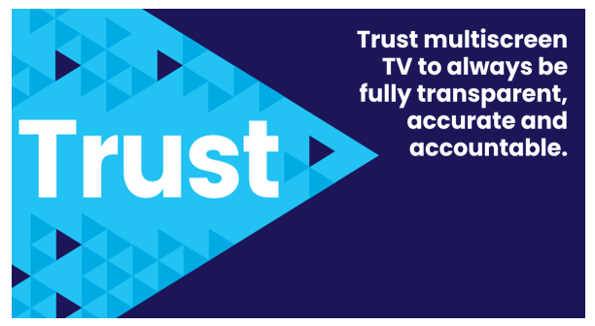
Adults over 50 account for 36% of the total population and nearly half of all adults
Marketers can move the industry forward and enact real change by demanding transparency across all their media & verification partners
Also, the FreeWheel Council for Premium Video and the VAB have partnered to advocate
for the value of premium standards. Click below to download and learn more!
Buying Premium Video:
A Definitive Checklist
This information is exclusively provided to VAB members and qualified marketers.
PAGE 47

Slide 48
Adults over 50 account for 36% of the total population and nearly half of all adults
There is a lack of culpability within the industry when it comes to addressing ad fraud and while marketers' main recourse is to reallocate budgets, these conversations don’t typically improve trust or transparency with the offending platform
Prioritizing cost over safety compromises ad quality and brand reputation, with marketers underestimating the value of premium, brand-safe inventory despite its proven ability to foster consumer action and drive profitability
A general lack of transparency in the advertising industry not only prevents marketers from understanding the true extent and risks of ad fraud, but also potentially facilitates the funding of illicit activities, leading to misguided decisions and undervaluation of safer, more transparent advertising options
By actively demanding transparency from media partners
and adopting proactive measures, marketers can help combat digital ad fraud and ensure brand safety across platforms
Key Marketer Takeaways
This information is exclusively provided to VAB members and qualified marketers.
PAGE 48

Slide 49


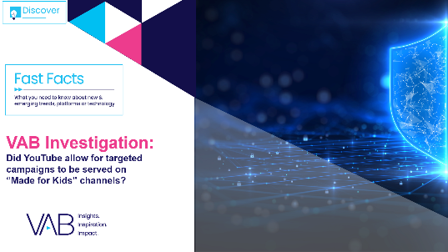

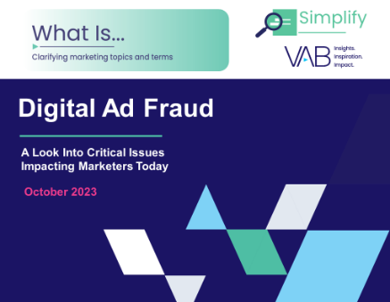


Creators
Danielle DeLauro
Leah Montner-Dixon
Executive Vice President
danielled@thevab.com
Director, Audience & Behavioral Insights
leahm@thevab.com
Jason Wiese
Karolina Guillen
Hidden Costs
Three Critical Business Ramifications of Digital Ad Fraud
Exposing the Double Standard
in Video Advertising
Advertising Week NY 2023 Presentation
SVP, Director of Strategic Insights
jasonw@thevab.com
Associate Director, Insights, Strategy & Analytics
karolinag@thevab.com
Discover more
Looking for more data, insights and takeaways? Check out this related VAB content
VAB Investigation
Did YouTube allow for targeted campaigns
to be served on ‘Made for Kids’ channels?
The Consumer Connection
Understanding the Effect of Quality Across Media Platforms
What is Digital Ad Fraud?
A Look Into Critical Issues
Impacting Marketers Today
What is The Digital Video
Supply Chain
Understanding the path of digital ad investments
This information is exclusively provided to VAB members and qualified marketers.
PAGE 49

Slide 50


About VAB
VAB plays a dual role in the video advertising industry. We are leading the change to bring about a more innovative and transparent marketplace. We also provide the insights and thought leadership that enables marketers to develop business-driving marketing strategies.
Drawing on our marketing expertise, we simplify the complexities in our industry and discover new insights that transform the way marketers look at their media strategy.
We are committed to your business growth and proud to offer VAB members, brand marketers and agencies complimentary access to our continuously-growing Insights library. Get immediate access at theVAB.com.
This information is exclusively provided to VAB members and qualified marketers.
PAGE 50

Slide 51



To learn what marketers think about advertising transparency, ad fraud and brand safety we conducted independent research
VAB’s custom study results are based on responses from senior brand marketers and high-level agency professionals. These individuals are part of Advertiser Perceptions’ Insights Community, a distinguished panel of industry experts who are deeply experienced and constantly tuned into the latest trends and developments.
Their keen awareness and understanding of the ever-evolving advertising landscape make them uniquely positioned to identify the industry's most pressing challenges.
  Part I: in-depth interviews of 5 select respondents
    September 26 – October 2, 2023
  Part II: quantitative survey of 39 respondents
    November 10 - 14, 2023
Respondent Qualifications:
  Senior level decision-makers involved in digital video, CTV and / or linear TV campaigns
  Mix of category verticals
  Mix of annual media spend levels
  Senior job level / title
This information is exclusively provided to VAB members and qualified marketers.
PAGE 51

