Slide 1





Does ad fraud pose any risks beyond affecting my campaign metrics?
Marketer FAQs

Slide 2


Marketers might be unknowingly funding criminal activity through digital ad fraud
In the past year, it’s become impossible to ignore the issue of advertising transparency. Headlines are littered with explosive investigative research reports, revelations around ad dollars funding illegal activities, inflated metrics scandals, children’s data being compromised, ads running in wildly inappropriate content and more.
Yet, marketers have been relatively quiet on these scandals, especially when compared to other, less serious topics that dominate the industry narrative.
We wondered, why?
Could it be due to marketers being unaware that some digital ad dollars are funneled to fund illegal operations, extremist content and other harmful activities?
To understand their (lack of) response, we partnered with Advertiser Perceptions and conducted interviews and surveys with agencies and brand marketers.*
*See appendix for full details on methodology behind interviews and custom survey
This information is exclusively provided to VAB members and qualified marketers.
PAGE 2

Slide 3

During the in-depth interviews conducted in our survey, none of the respondents expressed concerns about the possibility that their advertising dollars might inadvertently support illegal activities, extremist content or even oppressive regimes.
This finding was particularly noteworthy, given that the interviews were conducted after the release of several Adalytics reports highlighting the financial, reputational and legal risks advertisers face when engaging with walled gardens.
Source: VAB / Advertiser Perceptions ‘Marketer Sentiment on Ad Fraud’ Survey, based on in-depth interviews, fielded October 2023. Survey base: Marketer and agency contacts from the Advertiser Perceptions ‘Senior Marketer’ and ‘Streaming Video’ online communities.
This information is exclusively provided to VAB members and qualified marketers.
PAGE 3

Slide 4

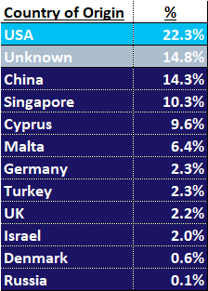
Ad dollars spent in ‘Big Tech’ walled gardens may expose brands to data risks from offshore criminal networks and foreign entities
% of spend by developer ‘country of origin’
for sub-set of YouTube TrueView ad budget that was allocated
to Google Video Partner Network (GVP) Android mobile apps
Source: Adalytics Research LLC, ‘Did Google Mislead Advertisers About TrueView Skippable In-Stream Ads for the Past Three Years?’ report, June 2023. Download VAB’s ‘Hidden Costs’ to learn more.
This information is exclusively provided to VAB members and qualified marketers.
PAGE 4

Slide 5


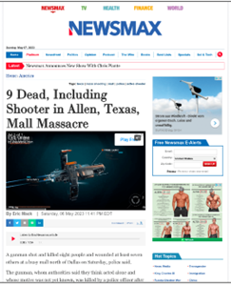

Ads can be served in objectionable content, exposing brands to issues like foreign disinformation, copyright infringement and more
Sampling of TrueView In-stream Ads Served as Out-stream Ads through Google Video Partner Network (GVP)
Foreign Disinformation
Piracy
Ads on foreign, and state-associated, news sites known
to publish disinformation
Website with over 101,000 DMCA copyright takedowns
Objectionable Content
Child-Targeted
Ads alongside objectionable content (such as pornography, animal abuse and adjacencies to children’s deaths)
Ads on mobile apps for children as young as two years old
Source: Adalytics Research LLC, ‘Did Google Mislead Advertisers About TrueView Skippable In-Stream Ads for the Past Three Years?’ report, June 2023. Note: after the Adalytics report was released, YouTube changed the name of their ‘in-stream ads’ format to ‘skippable ads’ throughout Google Display and Video 360, according to a ‘What’s New: July 2023’ Google Blog Post and reported by Adweek on 8/7/23. Download VAB’s ‘Hidden Costs’ to learn more.
This information is exclusively provided to VAB members and qualified marketers.
PAGE 5

Slide 6



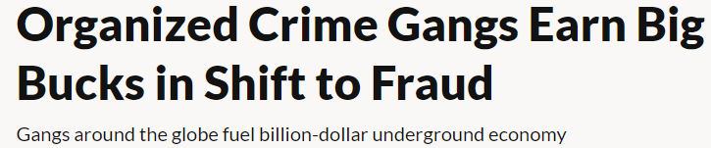
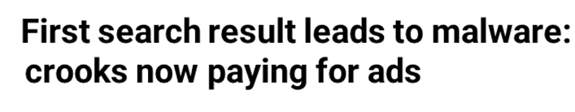
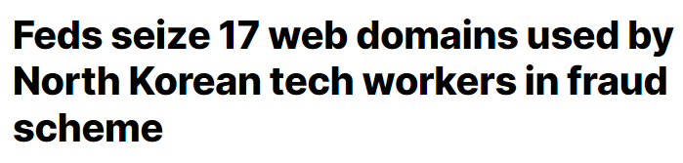



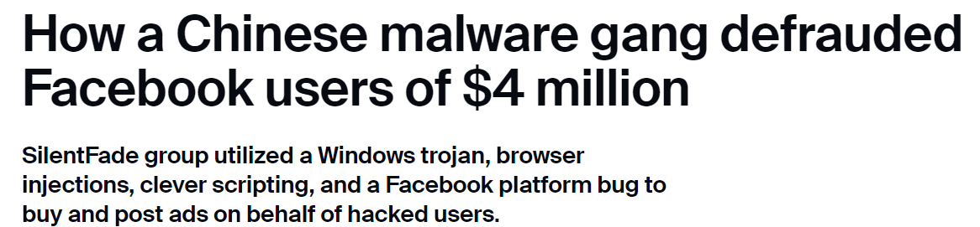
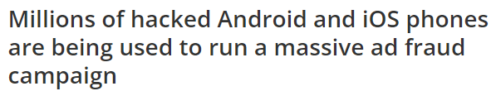
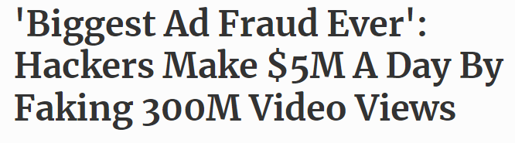



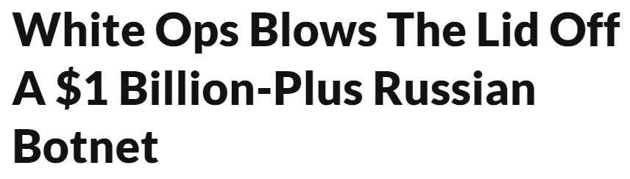
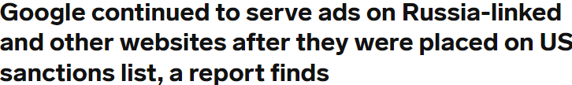
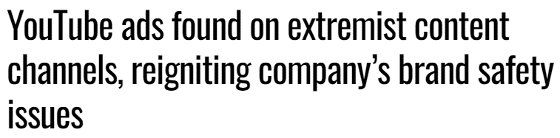


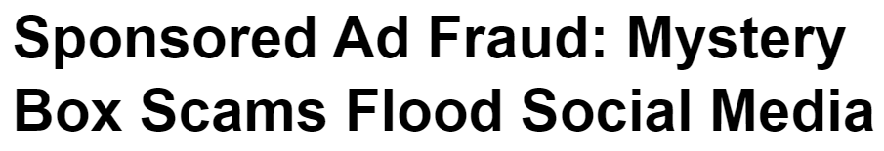
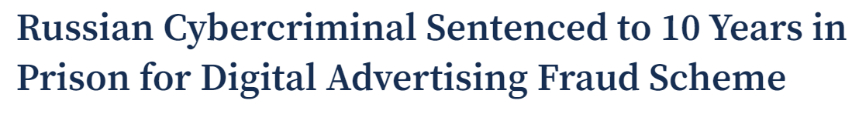
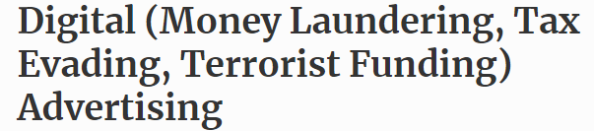
Many instances exist of brands’ digital ad dollars funding ‘bad actors’ involved in organized crime, oppressive regimes and other illicit activities
April 20, 2022
November 15, 2023
October 19, 2023
October 1, 2020
October 10, 2023
November 10, 2021
December 20, 2016
April 20, 2022
April 20, 2018
PAGE 6
February 29, 2024
November 10, 2021
January 1, 2021
This information is exclusively provided to VAB members and qualified marketers.
PAGE 6

Slide 7

In their own words: Marketers agree on the need for transparency and accountability, and expect as much from media partners
“I think it's our job to really demand of our partners that they treat us well. I think the way that we hold them to that is we look for a lot of granularity in the data we get back. We ask questions on what they're doing to prevent fraud and when we see something that looks strange, we bring it to their attention.
If they don't have a good answer, we find a different partner.”
CMO, Consumer Electronics Category (Anonymous)
“On the advertiser side, it's on me. It's my budget, I own the money, I represent the company so it's on me to confirm that I'm doing things right. The publisher is equally responsible. It's on me to figure out if they're sketchy, but if they're operating illegally or immorally, then it's the publisher's fault. I buy from an intermediary/DSP and it's on them as well. Everyone is culpable.”
VP, Brand & Media, e-commerce Category (Anonymous)
Source: VAB / Advertiser Perceptions ‘Marketer Sentiment on Ad Fraud’ Survey, based on in-depth interviews, fielded October 2023. Survey base: Marketer and agency contacts from the Advertiser Perceptions ‘Senior Marketer’ and ‘Streaming Video’ online communities.
This information is exclusively provided to VAB members and qualified marketers.
PAGE 7

Slide 8



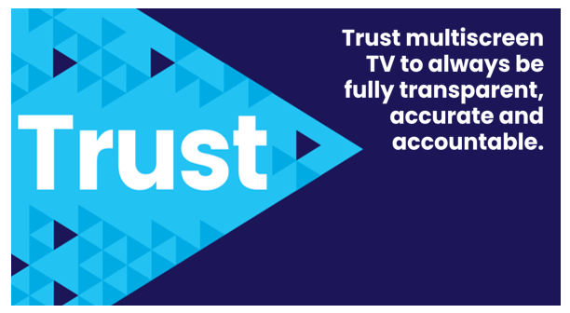
Adults over 50 account for 36% of the total population and nearly half of all adults
Marketers can move the industry forward and enact real change by asking questions about their ad placements and making transparency a priority across the industry
Also, the FreeWheel Council for Premium Video and the VAB have partnered to advocate
for the value of premium standards. Click below to download and learn more!
Buying Premium Video:
A Definitive Checklist
This information is exclusively provided to VAB members and qualified marketers.
PAGE 8

Slide 9
Adults over 50 account for 36% of the total population and nearly half of all adults
Many marketers are unaware that some of their digital ad dollars might be indirectly supporting illegal activities and harmful content despite existing evidence and reports highlighting these risks
Ad dollars invested in major ‘Big Tech’ digital platforms can potentially expose brands to significant data risks, including exploitation by offshore criminal networks
Numerous, and continual, instances of ad fraud and data misuse highlight the pervasive nature of these issues, demonstrating that brands’ digital ad dollars can end up funding illicit activities which raises serious ethical and
legal concerns
To stem the flow of dollars to illicit activities, marketers need to be vigilant by asking questions about their ad placements and prioritizing transparency across the industry
Key Marketer Takeaways
This information is exclusively provided to VAB members and qualified marketers.
PAGE 9

Slide 10
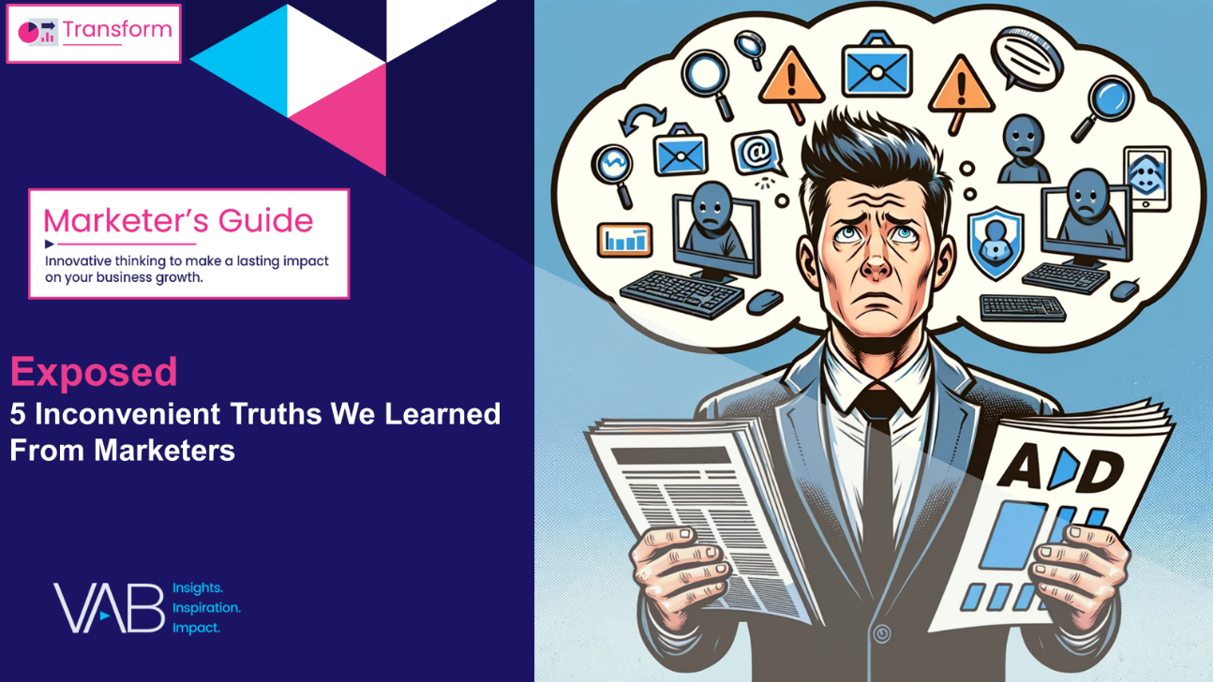
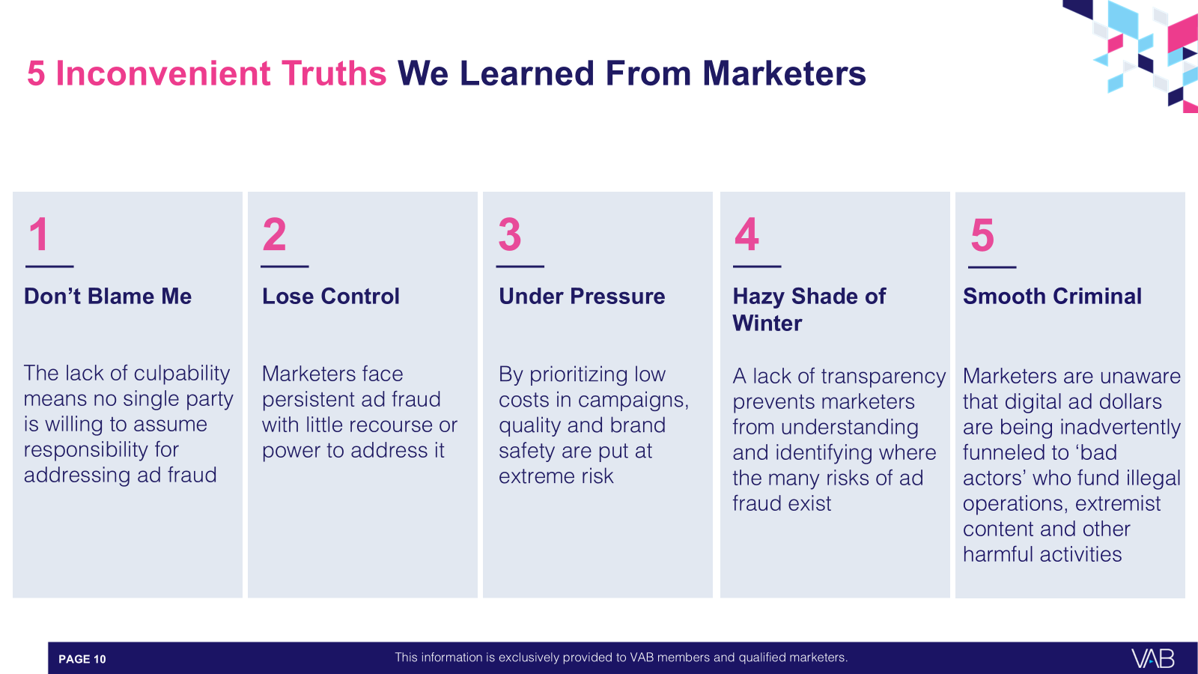

Download our full guide ‘Exposed’ to learn more about all five of the inconvenient truths we learned from marketers through our custom survey
Click here to download ‘Exposed’
This information is exclusively provided to VAB members and qualified marketers.
PAGE 10

Slide 11

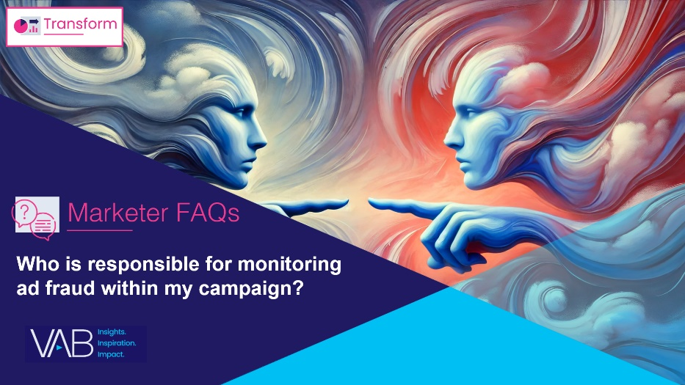
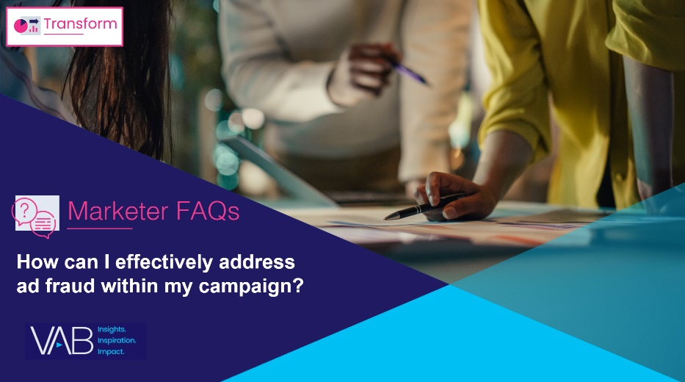
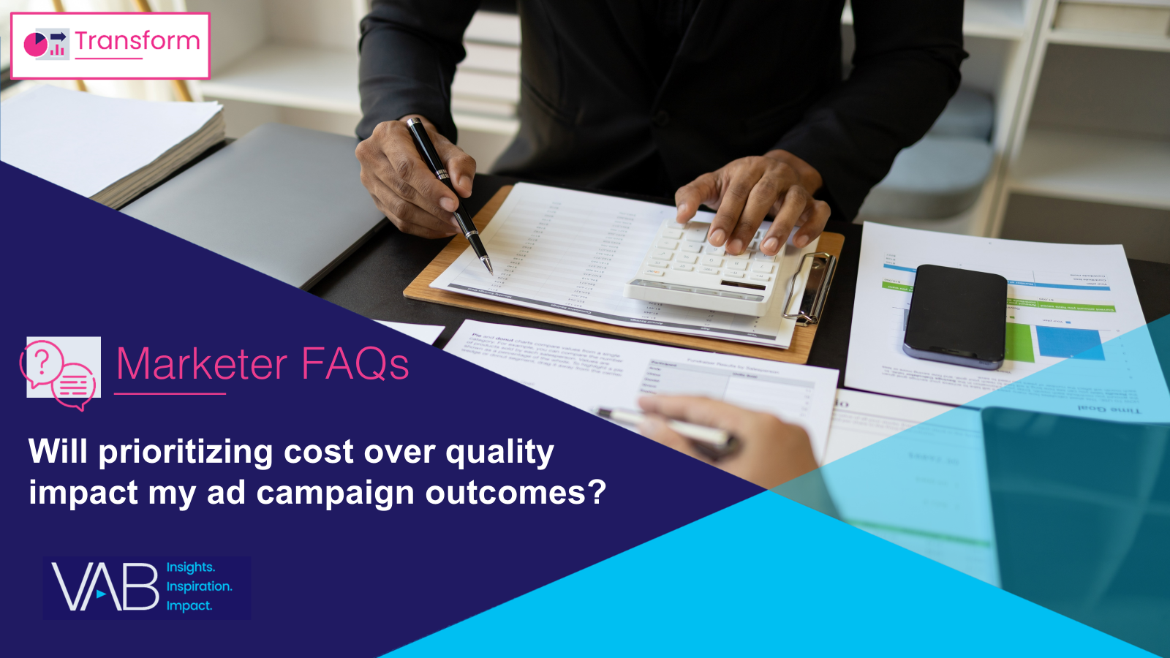
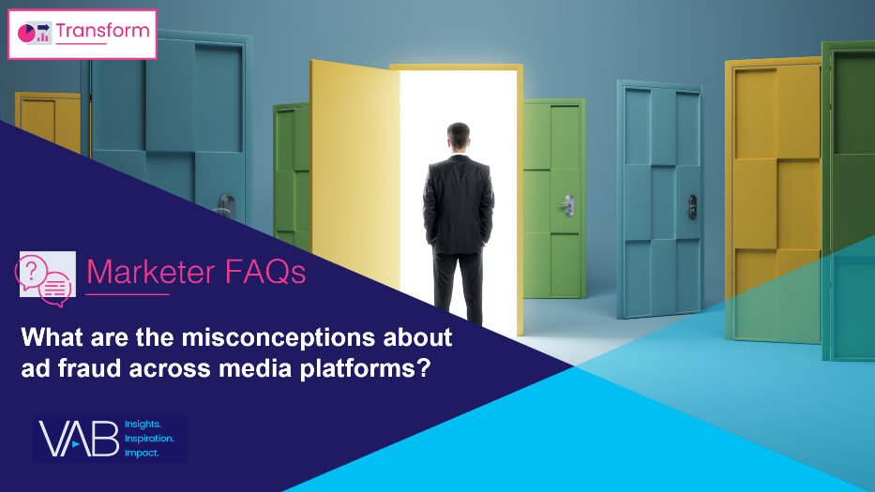
Creators
Danielle DeLauro
Leah Montner-Dixon
Executive Vice President
danielled@thevab.com
Director, Audience & Behavioral Insights
leahm@thevab.com
Jason Wiese
Karolina Guillen
SVP, Director of Strategic Insights
jasonw@thevab.com
Associate Director, Insights, Strategy & Analytics
karolinag@thevab.com
Who is responsible for monitoring ad fraud within my campaign?
How can I effectively address
ad fraud within my campaign?
Discover more
Looking for more data, insights and takeaways? Check out this related VAB content
To learn more about the methodology of our custom study, download the full report
Exposed: 5 Inconvenient Truths
We Learned From Marketers
Will prioritizing cost over quality impact my ad campaign outcomes?
What are the misconceptions about ad fraud across media platforms?
This information is exclusively provided to VAB members and qualified marketers.
PAGE 11

Slide 12


About VAB
VAB plays a dual role in the video advertising industry. We are leading the change to bring about a more innovative and transparent marketplace. We also provide the insights and thought leadership that enables marketers to develop business-driving marketing strategies.
Drawing on our marketing expertise, we simplify the complexities in our industry and discover new insights that transform the way marketers look at their media strategy.
We are committed to your business growth and proud to offer VAB members, brand marketers and agencies complimentary access to our continuously-growing Insights library. Get immediate access at theVAB.com.
This information is exclusively provided to VAB members and qualified marketers.
PAGE 12

Slide 13



To learn what marketers think about advertising transparency, ad fraud and brand safety we conducted independent research
VAB’s custom study results are based on responses from senior brand marketers and high-level agency professionals. These individuals are part of Advertiser Perceptions’ Insights Community, a distinguished panel of industry experts who are deeply experienced and constantly tuned into the latest trends and developments.
Their keen awareness and understanding of the ever-evolving advertising landscape make them uniquely positioned to identify the industry's most pressing challenges.
  Part I: in-depth interviews of 5 select respondents
    September 26 – October 2, 2023
  Part II: quantitative survey of 39 respondents
    November 10 - 14, 2023
Respondent Qualifications:
  Senior level decision-makers involved in digital video, CTV and / or linear TV campaigns
  Mix of category verticals
  Mix of annual media spend levels
  Senior job level / title
This information is exclusively provided to VAB members and qualified marketers.
PAGE 13

