Slide 1





What are the misconceptions about ad fraud across media platforms?
Marketer FAQs

Slide 2


Many marketers underestimate the prevalence of ad fraud on digital platforms
In the past year, it’s become impossible to ignore the issue of advertising transparency. Headlines are littered with explosive investigative research reports, inflated metrics scandals,
children’s data being compromised, ads running in wildly inappropriate content and more.
Yet, marketers have been relatively quiet on these scandals, especially when compared to other, less serious topics that dominate the industry narrative.
We wondered, why?
Could it be due to a lack of transparency that marketers struggle to understand and identify the various risks of
ad fraud?
To understand their (lack of) response, we partnered with
Advertiser Perceptions and conducted interviews and surveys
with agencies and brand marketers.*
*See appendix for full details on methodology behind interviews and custom survey
This information is exclusively provided to VAB members and qualified marketers.
PAGE 2

Slide 3



More than half of marketers believe the cost of their ad placements has no bearing on the likelihood of ad fraud
% of respondents who feel lower cost and premium-priced digital ad platforms are equally at risk for fraud
Brand Marketers
Agency Professionals
54%
55%
Source: VAB / Advertiser Perceptions ‘Marketer Sentiment on Ad Fraud’ Survey, November 2023. Survey base: Marketer and agency contacts from the Advertiser Perceptions ‘Senior Marketer’ and ‘Streaming Video’ online communities. Q2A. Which of the following statements do you agree with most? (Lower cost digital advertising platforms and premium-priced digital advertising platforms are equally at risk for ad fraud). Base = Total Respondents.
This information is exclusively provided to VAB members and qualified marketers.
PAGE 3

Slide 4
Misunderstandings regarding the extent of ad fraud were prevalent in ‘traditional channels’ typically managed by an advertising agency
% of respondents who think traditional platforms
are just as vulnerable to ad fraud than digital media
Brand marketers are
4x
more likely to believe linear TV is vulnerable to fraud compared to agency professionals who have greater visibility into campaign details
Source: VAB / Advertiser Perceptions ‘Marketer Sentiment on Ad Fraud’ Survey, November 2023. Survey base: Marketer and agency contacts from the Advertiser Perceptions ‘Senior Marketer’ and ‘Streaming Video’ online communities. Q1. Are these traditional media channels more vulnerable, just as vulnerable or less vulnerable to ad fraud than digital media channels? Base = Total Respondents.
This information is exclusively provided to VAB members and qualified marketers.
PAGE 4

Slide 5
Those who believe linear TV is vulnerable to ad fraud are equal to those who see social media as being least prone to digital ad fraud
36%
39%
of brand marketers believe linear TV is just as vulnerable to ad fraud than digital media
of brand marketers believe social media platforms are least prone to digital ad fraud*
Source: VAB / Advertiser Perceptions ‘Marketer Sentiment on Ad Fraud’ Survey, November 2023. Survey base: Marketer and agency contacts from the Advertiser Perceptions ‘Senior Marketer’ and ‘Streaming Video’ online communities.
Q1. Are these traditional media channels more vulnerable, just as vulnerable or less vulnerable to ad fraud than digital media channels? Base = Total Respondents. *Q2. Please rank the following media platforms in order of which are the most to the least prone to digital ad fraud? Based on rank 1. Base = Total Respondents.
This information is exclusively provided to VAB members and qualified marketers.
PAGE 5

Slide 6
Despite understanding the dangers of longer-tail, lower-priced inventory, the advantages of premium placements are not fully appreciated or valued
“Where you go out further on the reach curve, that's where you get the problems. There isn't a lot of risk of fraud where most people are "gathering" online. The more obscure the publisher, the bigger the risk.”
only
18%
of brand marketers believe that premium priced digital ad platforms are less prone to fraud*
VP, Brand & Media, DTC e-commerce Category (Anonymous)
Source: VAB / Advertiser Perceptions ‘Marketer Sentiment on Ad Fraud’ Survey, based on in-depth interviews, fielded October 2023. Survey base: Marketer and agency contacts from the Advertiser Perceptions ‘Senior Marketer’ and ‘Streaming Video’ online communities. *VAB / Advertiser Perceptions ‘Marketer Sentiment on Ad Fraud’ Survey, November 2023. Survey base: Marketer and agency contacts from the Advertiser Perceptions ‘Senior Marketer’ and ‘Streaming Video’ online communities. Q2A. Which of the following statements do you agree with most? (Premium-priced digital advertising platforms are less prone to ad fraud). Base = Total Respondents.
This information is exclusively provided to VAB members and qualified marketers.
PAGE 6

Slide 7


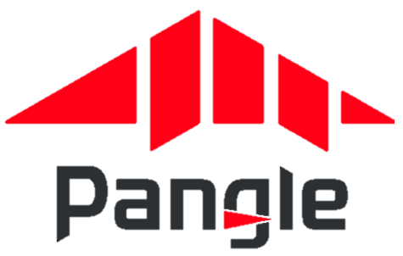


Long-tail websites, which are frequently included within ‘walled gardens’ audience network extensions, can raise brand safety and fraud concerns
Audience Networks (aka Audience Extensions)
A way to expand the reach of a digital campaign with a single publisher by using cookies to identify and track user’s activity on other websites/apps and then serving ads to the same audiences on those 3rd party websites/apps.
Examples of Audience Networks
‘Partners are publisher websites and mobile apps where you can show your video ads to viewers
beyond YouTube’
‘Extends Meta's people-based advertising beyond the Facebook app’
‘Gain access to Pangle’s vast network of mobile apps’
‘Delivers ads beyond the LinkedIn feed to members
on trusted third-party apps
and sites’
‘Ad placements are cross-device and include premium sites like MSN, Outlook.com, Microsoft Edge, and other partners’
Google Video Partners Network
Meta Audience Network
Pangle
(TikTok)
LinkedIn Audience Network
Microsoft Audience Network
Source: Google Ads Help, About Google video partners’ Meta Business Help Center, How Meta Audience Network works; Pangle, How to level up your ad campaign on Pangle; LinkedIn Help, LinkedIn Audience Network FAQs; Microsoft Advertising Help, About Microsoft Audience Ads; To learn more about terminology and facts around digital advertising, click the link to download ‘What Is Digital Ad Fraud’
This information is exclusively provided to VAB members and qualified marketers.
PAGE 7

Slide 8
Audience networks can also include many ‘Made for Advertising’ websites, which create negative brand associations and wasted ad dollars
4,500+
“The most problematic are going to be display ads shown on a variety of third-party websites. All of those individual website owners, publishers are actually incentivized to engage in fraudulent activity.”
projected number of existing
‘Made for Advertising’ Sites*
CMO, Consumer Electronics Category (Anonymous)
$10B estimated annual
global advertising spend
Source: VAB / Advertiser Perceptions ‘Marketer Sentiment on Ad Fraud’ Survey, based on in-depth interviews, fielded October 2023. Survey base: Marketer and agency contacts from the Advertiser Perceptions ‘Senior Marketer’ and ‘Streaming Video’ online communities. *ANA (Association of National Advertisers), Programmatic Media Supply Chain Transparency Study – Complete Report, December 2023. To learn more about terminology and facts around digital advertising, click the link to download ‘What Is Digital Ad Fraud’
This information is exclusively provided to VAB members and qualified marketers.
PAGE 8

Slide 9

Most concerning, the ‘solve’ for these issues - industry-wide campaign transparency standards - isn’t a top concern among marketers
% of respondents who are concerned about the
lack of transparency on campaign details and placements
Ranked within top 3 digital ad fraud concerns for the advertising industry overall
Brand Marketers
Agency Professionals
45%
29%
Source: VAB / Advertiser Perceptions ‘Marketer Sentiment on Ad Fraud’ Survey, November 2023. Survey base: Marketer and agency contacts from the Advertiser Perceptions ‘Senior Marketer’ and ‘Streaming Video’ online communities.
Q3B. What are your top 3 concerns surrounding digital ad fraud regarding the advertising industry overall? Base = Total Respondents. Brand Marketers = ranks tied for #3 behind ‘click fraud’ (82%), ‘inflation of campaign metrics’ (55%), ‘misrepresented ad placements’ (45%). Agency Professionals = ranks #5 behind ‘click fraud’ (68%), ‘misrepresented ad placements’ (39%), ‘inflation of campaign metrics’ (36%), ‘unknowingly appearing on 'Made for Advertising' (MFA) websites’ (32%).
This information is exclusively provided to VAB members and qualified marketers.
PAGE 9

Slide 10
Brands, often isolated from the center of the advertising community, believe a lack of transparency is their issue and not an industry-wide one
% of brand marketers who are concerned about…
Ranked within top 3 digital ad fraud concerns
Their Business / Client’s Businesses
The Advertising Industry Overall*
Lack of transparency on campaign details and placements
43%
29%
Unknowingly appearing on websites that deliberately serve disinformation / misinformation
32%
25%
Source: VAB / Advertiser Perceptions ‘Marketer Sentiment on Ad Fraud’ Survey, November 2023. Survey base: Marketer and agency contacts from the Advertiser Perceptions ‘Senior Marketer’ and ‘Streaming Video’ online communities. Q3A. What are your top 3 concerns surrounding digital ad fraud regarding [your business/your clients' businesses]? *Q3B. What are your top 3 concerns surrounding digital ad fraud regarding the advertising industry overall? Base = Total Respondents.
This information is exclusively provided to VAB members and qualified marketers.
PAGE 10

Slide 11
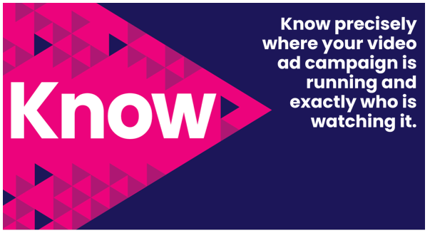
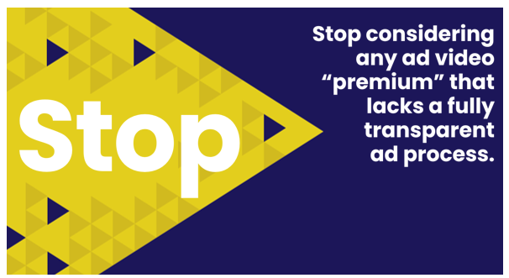

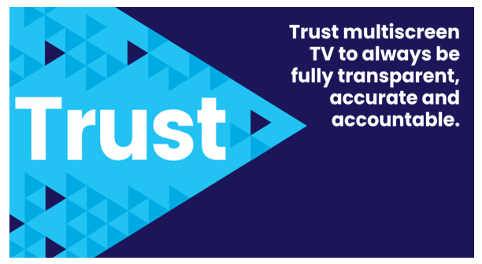
Adults over 50 account for 36% of the total population and nearly half of all adults
Marketers can move the industry forward and enact real change by making transparency a priority across the advertising industry along with all
their media & verification partners
Also, the FreeWheel Council for Premium Video and the VAB have partnered to advocate
for the value of premium standards. Click below to download and learn more!
Buying Premium Video:
A Definitive Checklist
This information is exclusively provided to VAB members and qualified marketers.
PAGE 11

Slide 12
Adults over 50 account for 36% of the total population and nearly half of all adults
Many marketers believe the cost of ad placements does not influence the risk of ad fraud, indicating a widespread misperception of equal vulnerability across platforms
There is a significant misunderstanding among brand marketers about the susceptibility of traditional media to ad fraud compared to digital platforms
The use of audience networks and long-tail websites within walled gardens can heighten issues around brand safety and fraud
Marketers' concerns about transparency and fraud are not always aligned with the broader advertising industry's standards, highlighting a gap in unified strategies and the need to prioritize transparency across the entire ad industry
Key Marketer Takeaways
This information is exclusively provided to VAB members and qualified marketers.
PAGE 12

Slide 13
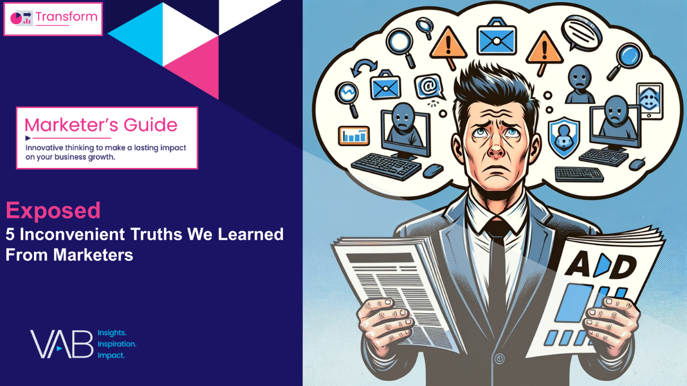
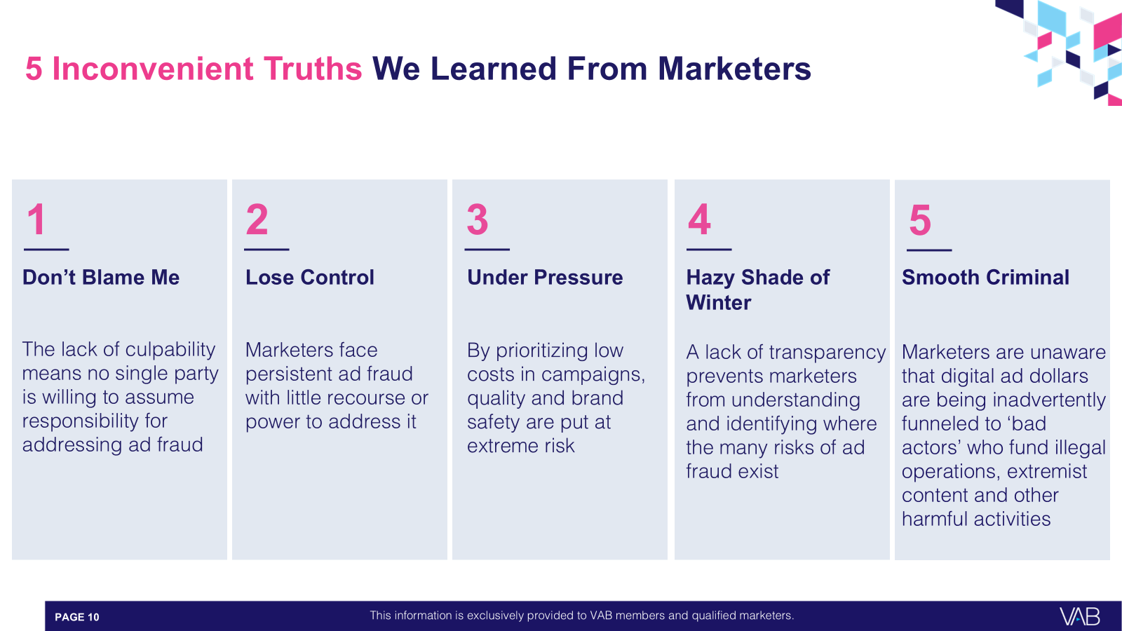

Download our full guide ‘Exposed’ to learn more about all five of the inconvenient truths we learned from marketers through our custom survey
Click here to download ‘Exposed’
This information is exclusively provided to VAB members and qualified marketers.
PAGE 13

Slide 14

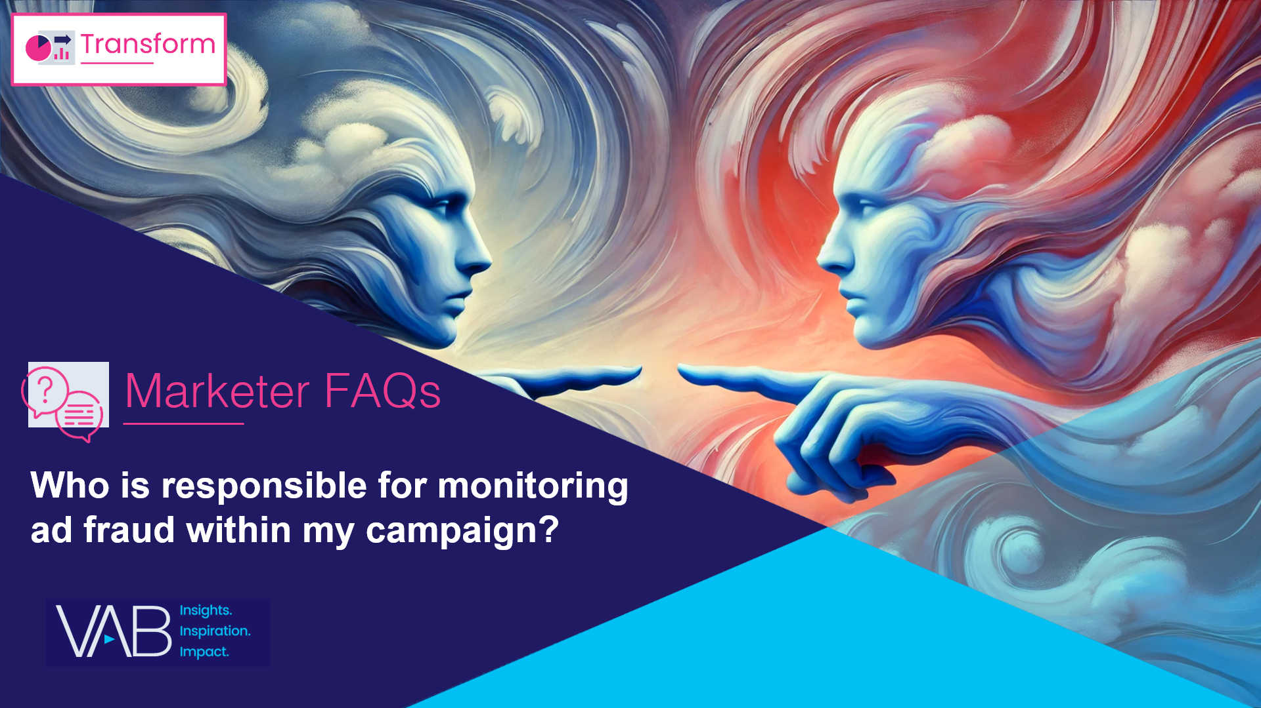


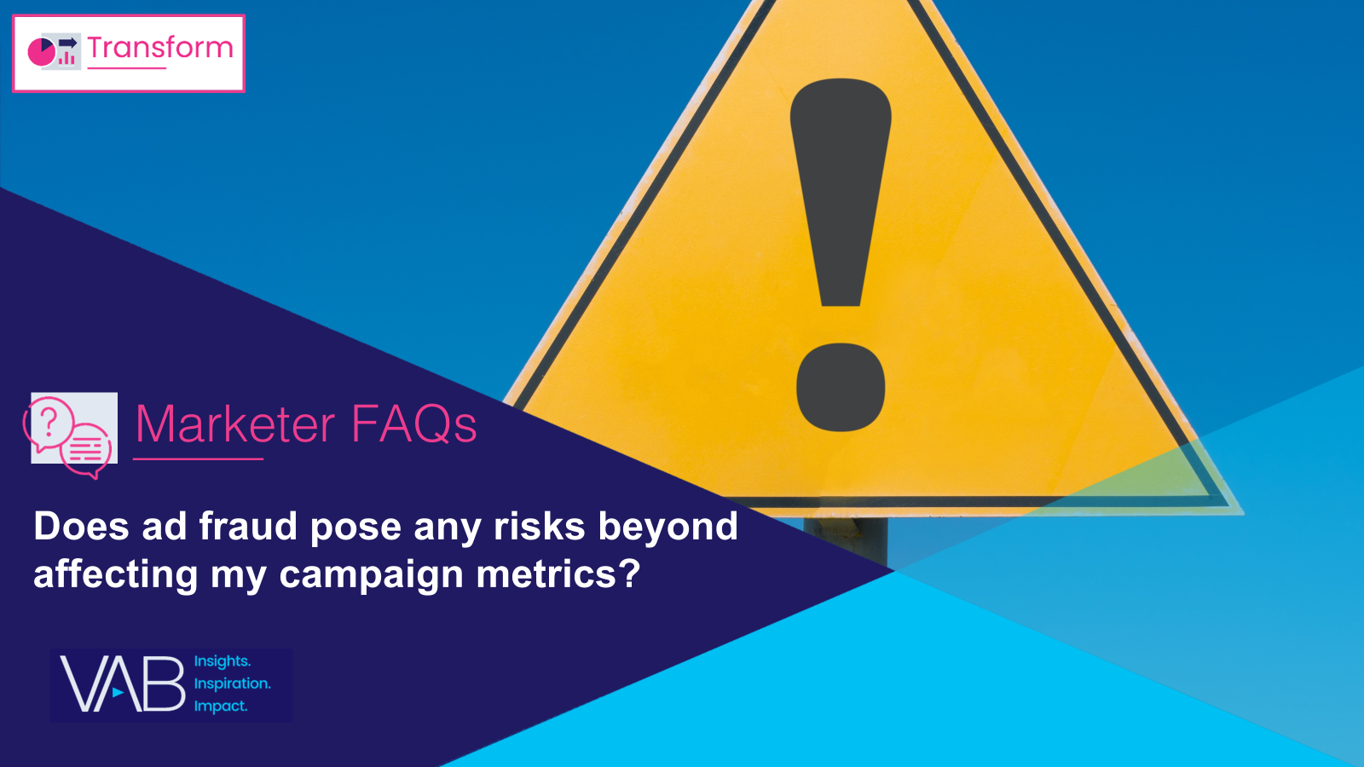
Creators
Danielle DeLauro
Leah Montner-Dixon
Executive Vice President
danielled@thevab.com
Director, Audience & Behavioral Insights
leahm@thevab.com
Jason Wiese
Karolina Guillen
SVP, Director of Strategic Insights
jasonw@thevab.com
Associate Director, Insights, Strategy & Analytics
karolinag@thevab.com
Who is responsible for monitoring ad fraud within my campaign?
How can I effectively address
ad fraud within my campaign?
Discover more
Looking for more data, insights and takeaways? Check out this related VAB content
To learn more about the methodology of our custom study, download the full report
Exposed: 5 Inconvenient Truths
We Learned From Marketers
Will prioritizing cost over quality impact my ad campaign outcomes?
Does ad fraud pose any risks beyond affecting my campaign metrics?
This information is exclusively provided to VAB members and qualified marketers.
PAGE 14

Slide 15


About VAB
VAB plays a dual role in the video advertising industry. We are leading the change to bring about a more innovative and transparent marketplace. We also provide the insights and thought leadership that enables marketers to develop business-driving marketing strategies.
Drawing on our marketing expertise, we simplify the complexities in our industry and discover new insights that transform the way marketers look at their media strategy.
We are committed to your business growth and proud to offer VAB members, brand marketers and agencies complimentary access to our continuously-growing Insights library. Get immediate access at theVAB.com.
This information is exclusively provided to VAB members and qualified marketers.
PAGE 15

Slide 16



To learn what marketers think about advertising transparency, ad fraud and brand safety we conducted independent research
VAB’s custom study results are based on responses from senior brand marketers and high-level agency professionals. These individuals are part of Advertiser Perceptions’ Insights Community, a distinguished panel of industry experts who are deeply experienced and constantly tuned into the latest trends and developments.
Their keen awareness and understanding of the ever-evolving advertising landscape make them uniquely positioned to identify the industry's most pressing challenges.
  Part I: in-depth interviews of 5 select respondents
    September 26 – October 2, 2023
  Part II: quantitative survey of 39 respondents
    November 10 - 14, 2023
Respondent Qualifications:
  Senior level decision-makers involved in digital video, CTV and / or linear TV campaigns
  Mix of category verticals
  Mix of annual media spend levels
  Senior job level / title
This information is exclusively provided to VAB members and qualified marketers.
PAGE 16

