Slide 1





Will prioritizing cost over quality impact my ad campaign outcomes?
Marketer FAQs

Slide 2


Ads placed in trusted, brand safe media platforms drive much better business results
In the past year, it’s become impossible to ignore the issue of advertising transparency. Headlines are littered with explosive investigative research reports, inflated metrics scandals, children’s data being compromised, ads running in wildly inappropriate content and more.
Yet, marketers have been relatively quiet on these scandals, especially when compared to other, less serious topics that dominate the industry narrative.
We wondered, why?
Could it be due to the pressure many marketers are feeling
to prioritize cost over quality?
To understand their (lack of) response, we partnered with Advertiser Perceptions and conducted interviews and surveys with agencies and brand marketers.*
*See appendix for full details on methodology behind interviews and custom survey
This information is exclusively provided to VAB members and qualified marketers.
PAGE 2

Slide 3
Consumers and marketers both prioritize the context and environment in which ads appear
nearly
82%
over
90%
80%
of consumers feel that
brands bear responsibility
for ensuring their ads run
beside content that is safe
of consumers say it is important that a brand’s ads appear on content that is safe, accurate
and trustworthy
of marketing professionals believe brand safety is a major concern for their organization*
Source: DoubleVerify & Harris Poll, Consumers Reject Brands That Advertise on ‘Fake News’ and Objectionable Content Online, June 2019. *WARC Journal of Advertising Research, Is your brand protected? Assessing brand safety risks in digital campaigns, November 2023. Based on an online survey of advertising and brand management professionals with decision-making authority over the purchasing or spending for brands with at least $10 million in annual advertising spend. Download VAB’s ‘What is Brand Safety’ to learn more.
This information is exclusively provided to VAB members and qualified marketers.
PAGE 3

Slide 4



Yet, more than two out of three brand marketers and agencies rank cost over brand safety
% of respondents who are prioritizing brand safety over lower CPMs
Brand Marketers
Agency Professionals
32%
27%
Brands and agencies have different reasons to push for lower costs including cost suppression tied to compensation or KPI directives
Source: VAB / Advertiser Perceptions ‘Marketer Sentiment on Ad Fraud’ Survey, November 2023. Survey base: Marketer and agency contacts from the Advertiser Perceptions ‘Senior Marketer’ and ‘Streaming Video’ online communities. Q6. What solutions [is your company/are your clients] using to prevent digital ad fraud? Base = Total Respondents.
This information is exclusively provided to VAB members and qualified marketers.
PAGE 4

Slide 5

Under enormous pressure to deliver efficiencies, clicks are a higher priority than brand safety, child privacy violations, disinformation, etc.
% of respondents who are concerned about the following
For Their Business / Client’s Businesses
Click fraud*
Lack of transparency on campaign details and placements
Unknowingly appearing on websites with objectionable, offensive content
Unknowingly appearing on websites that deliberately serve disinformation / misinformation
Targeted/tracked ads running alongside children's content
Unknowingly appearing on 'Made for Advertising' (MFA) websites
Source: VAB / Advertiser Perceptions ‘Marketer Sentiment on Ad Fraud’ Survey, November 2023. Survey base: Marketer and agency contacts from the Advertiser Perceptions ‘Senior Marketer’ and ‘Streaming Video’ online communities.
Q3A. What are your top 3 concerns surrounding digital ad fraud regarding [your business/your clients' businesses]? Base = Total Respondents. *‘Click fraud’ refers to bots, click farms, etc. that generate fake clicks on an ad or website.
This information is exclusively provided to VAB members and qualified marketers.
PAGE 5

Slide 6

Beyond the ethical and legal implications of running in harmful content, brand safe ads have proven to drive superior conversion rates
+233%
lift in conversions for
brand safe impressions vs.
non brand safe impressions
Source: Integral Ad Science, Does Media Quality Drive Attention and Outcomes?, March 2022. Download VAB’s ‘What is Brand Safety’ to learn more.
This information is exclusively provided to VAB members and qualified marketers.
PAGE 6

Slide 7
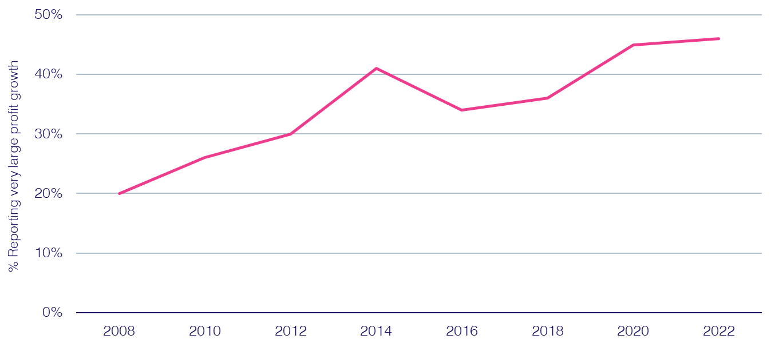
And the ability of a ‘brand safe’ ad to build trust in today’s increasingly skeptical society has a direct, positive effect on profitability
% cases with strong ‘trust’ growth reporting strong ‘profit’ growth
67%
of consumers would be likely to
stop using the brand if they viewed the brand’s digital advertising beside false, objectionable
or inflammatory content*
Source: Peter Field, Why TV is Still at the Heart of Effectiveness, presented at ‘The Future of TV Advertising Global’ conference in December 2023. Base: IPA Databank 2004-2022 for profit cases reporting very large trust improvements. NB: insufficient data prior to 2008. Click here to view Peter Field’s full presentation online. *DoubleVerify & Harris Poll, Consumers Reject Brands That Advertise on ‘Fake News’ and Objectionable Content Online, June 2019.
This information is exclusively provided to VAB members and qualified marketers.
PAGE 7

Slide 8
Still, marketers are shifting ad investment from known brand-safe, transparent media platforms including TV
‘Transparent’ Media Ad Spend
in billions
-6%
vs. ‘17
-14%
vs. ‘19
-6%
vs. ‘21
-4%
vs. ‘23
% of total U.S. ad spending**
57%
44%
30%
25%
20%
Source: eMarketer Insider Intelligence, Total Media Ad Spending, by Media, October 2023. Note: ‘Transparent media’ includes linear TV, directories, magazines, newspapers, out-of-home, radio; TV, newspapers, magazines and directories exclude digital; Radio excludes off-air radio and digital. *Total U.S. ad spend includes digital (desktop/laptop, mobile, and other internet-connected devices), directories, magazines, newspapers, out-of-home, radio, and TV.
This information is exclusively provided to VAB members and qualified marketers.
PAGE 8

Slide 9
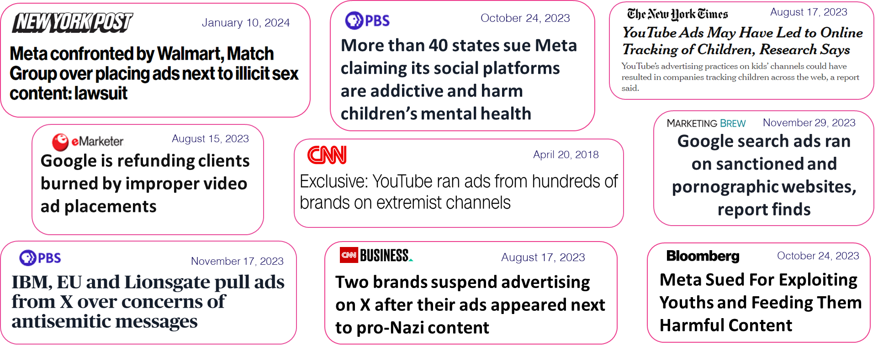
To opaque walled gardens which have been plagued by brand safety scandals
Major ‘Walled Garden’ Global Advertising Revenues
Aggregated Alphabet & Meta Revenues (in billions)
+46%
vs. 2020
Source: Alphabet and Meta SEC company 10-K filings via SEC Edgar Search.
This information is exclusively provided to VAB members and qualified marketers.
PAGE 9

Slide 10

In their own words: Even though marketers don’t believe the ‘Big Tech’ walled gardens would dare to engage in fraudulent activity
“For large entities (Google and Facebook) that incentive is still theoretically there, but they would have to be very foolish to engage in outright fraud at this point. So, I think you're less at risk if you're running on those versus syndicating your content out to thousands or millions of different smaller sites."
CMO, Consumer Electronics Category (Anonymous)
Source: VAB / Advertiser Perceptions ‘Marketer Sentiment on Ad Fraud’ Survey, based on in-depth interviews, fielded October 2023. Survey base: Marketer and agency contacts from the Advertiser Perceptions ‘Senior Marketer’ and ‘Streaming Video’ online communities.
This information is exclusively provided to VAB members and qualified marketers.
PAGE 10

Slide 11
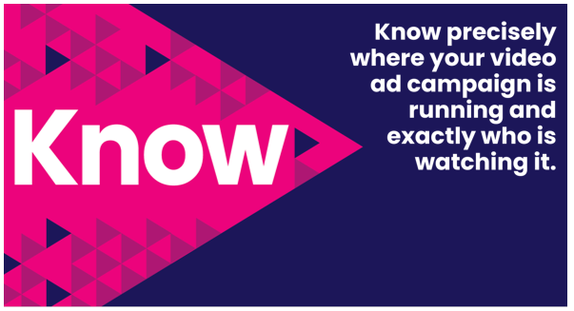
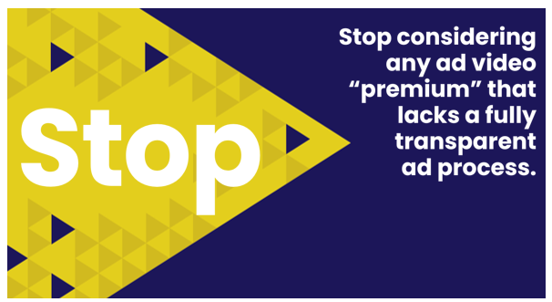

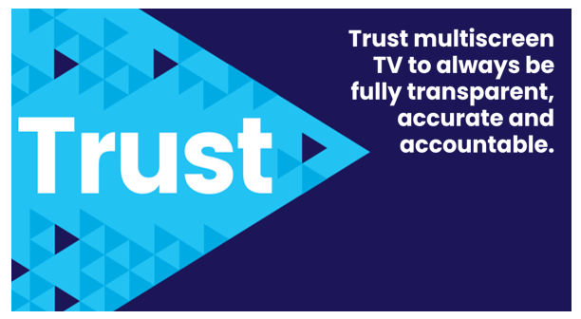
Adults over 50 account for 36% of the total population and nearly half of all adults
Marketers can move the industry forward and enact real change by asking questions about their ad placements and demanding transparency across all their media & verification partners
Also, the FreeWheel Council for Premium Video and the VAB have partnered to advocate
for the value of premium standards. Click below to download and learn more!
Buying Premium Video:
A Definitive Checklist
This information is exclusively provided to VAB members and qualified marketers.
PAGE 11

Slide 12
Adults over 50 account for 36% of the total population and nearly half of all adults
Despite strong consumer and marketer concern around ad context and environment, many decision makers are still prioritizing cost over brand safety
Ads placed in brand-safe environments perform significantly better, driving much higher conversion rates compared to those in non-brand-safe settings
Maintaining brand safety is crucial for long-term profitability, as a significant portion of consumers are likely to abandon brands that place ads alongside objectionable content
Key Marketer Takeaways
This information is exclusively provided to VAB members and qualified marketers.
PAGE 12

Slide 13
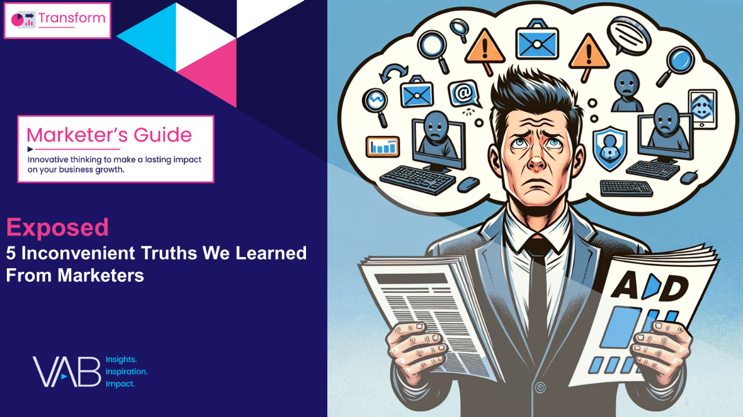
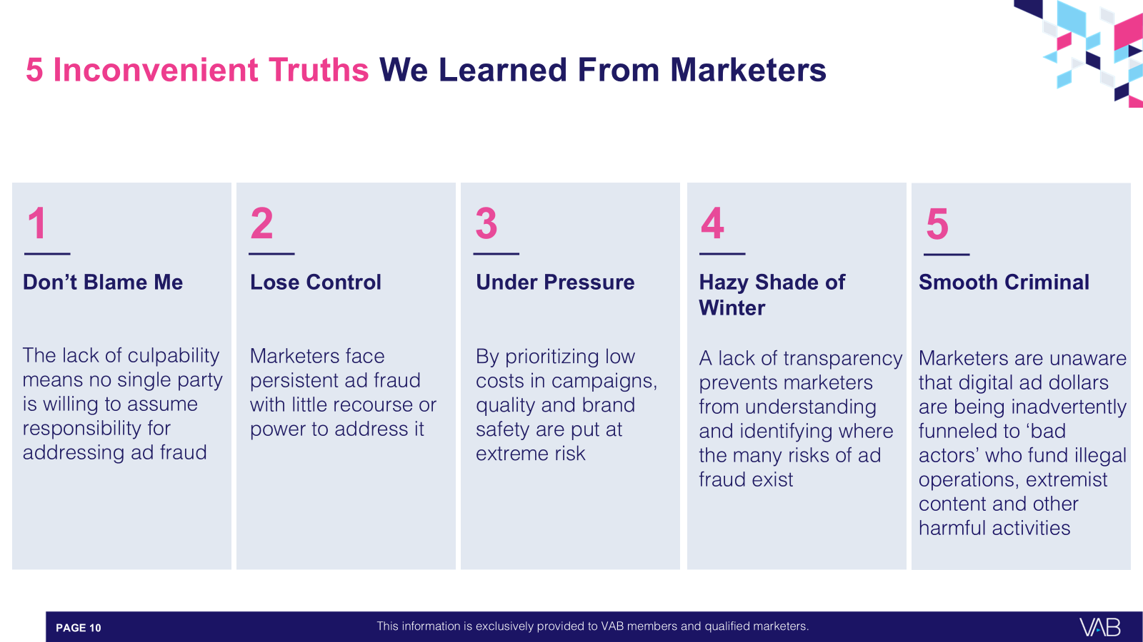
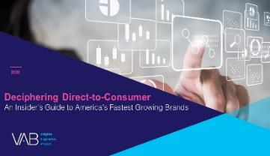
Download our full guide ‘Exposed’ to learn more about all five of the inconvenient truths we learned from marketers through our custom survey
Click here to download ‘Exposed’
This information is exclusively provided to VAB members and qualified marketers.
PAGE 13

Slide 14

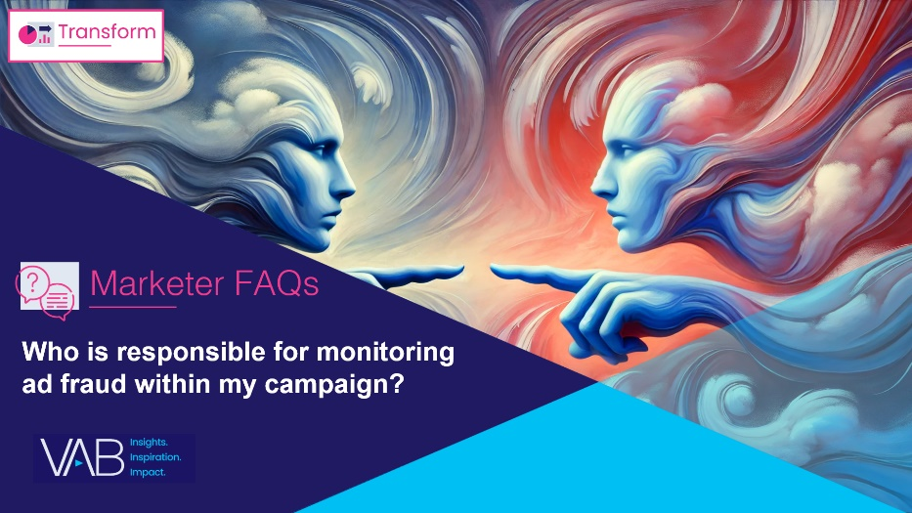
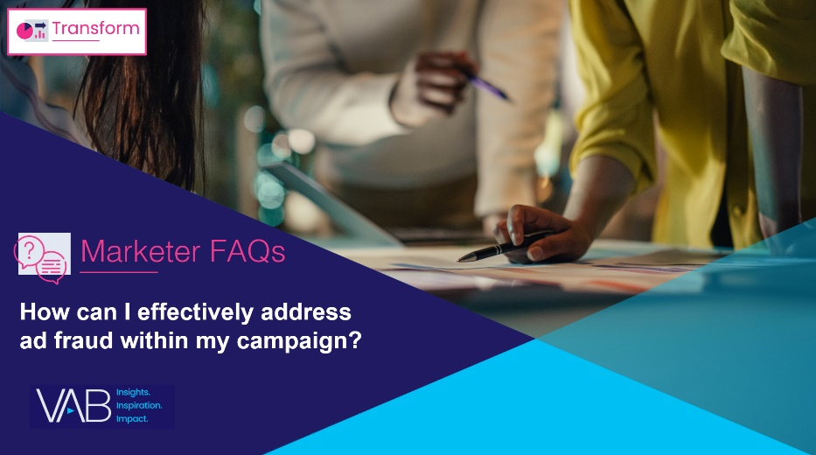
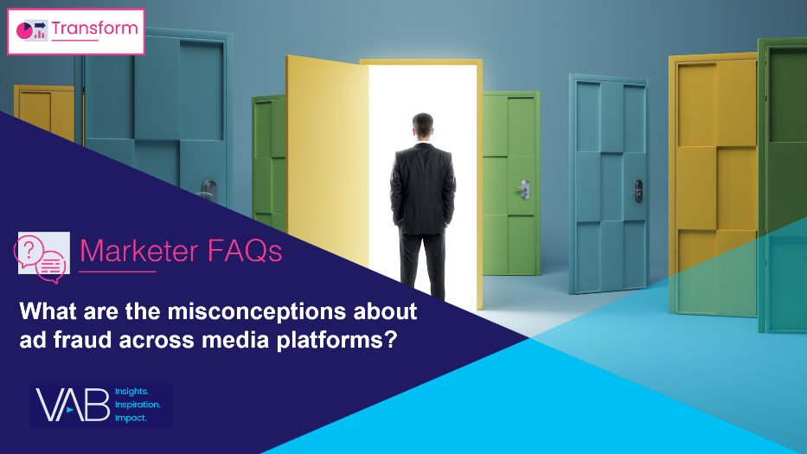
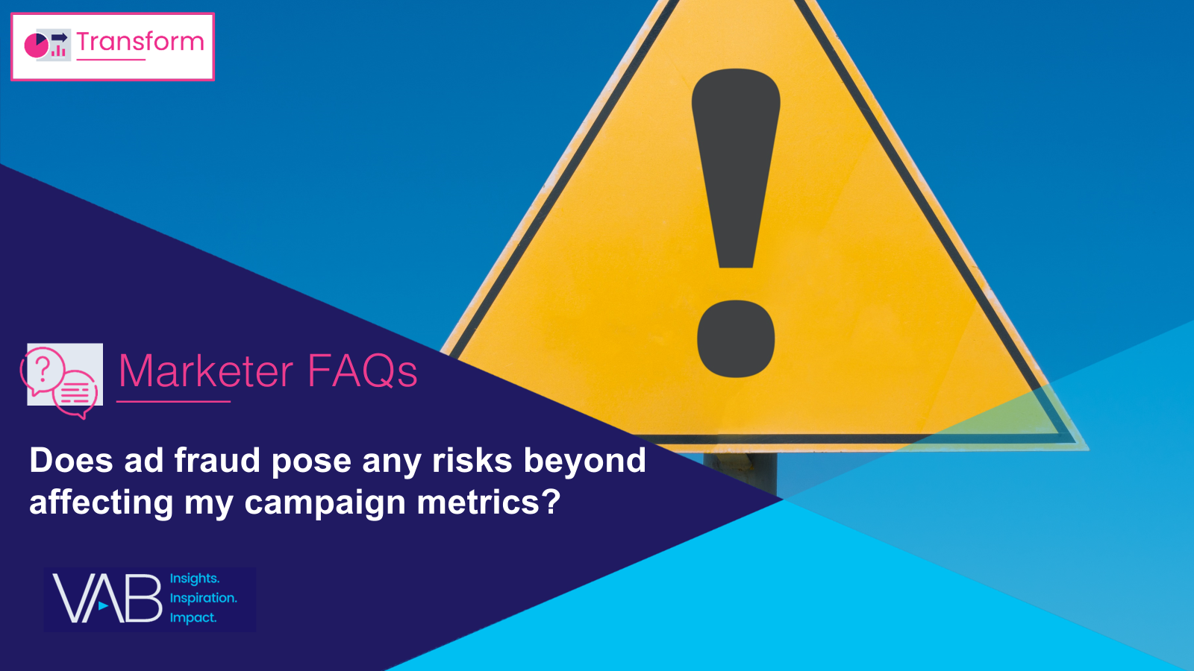
Creators
Danielle DeLauro
Leah Montner-Dixon
Executive Vice President
danielled@thevab.com
Director, Audience & Behavioral Insights
leahm@thevab.com
Jason Wiese
Karolina Guillen
SVP, Director of Strategic Insights
jasonw@thevab.com
Associate Director, Insights, Strategy & Analytics
karolinag@thevab.com
Who is responsible for monitoring ad fraud within my campaign?
How can I effectively address
ad fraud within my campaign?
Discover more
Looking for more data, insights and takeaways? Check out this related VAB content
To learn more about the methodology of our custom study, download the full report
Exposed: 5 Inconvenient Truths
We Learned From Marketers
What are the misconceptions about ad fraud across media platforms?
Does ad fraud pose any risks beyond affecting my campaign metrics?
This information is exclusively provided to VAB members and qualified marketers.
PAGE 14

Slide 15


About VAB
VAB plays a dual role in the video advertising industry. We are leading the change to bring about a more innovative and transparent marketplace. We also provide the insights and thought leadership that enables marketers to develop business-driving marketing strategies.
Drawing on our marketing expertise, we simplify the complexities in our industry and discover new insights that transform the way marketers look at their media strategy.
We are committed to your business growth and proud to offer VAB members, brand marketers and agencies complimentary access to our continuously-growing Insights library. Get immediate access at theVAB.com.
This information is exclusively provided to VAB members and qualified marketers.
PAGE 15

Slide 16



To learn what marketers think about advertising transparency, ad fraud and brand safety we conducted independent research
VAB’s custom study results are based on responses from senior brand marketers and high-level agency professionals. These individuals are part of Advertiser Perceptions’ Insights Community, a distinguished panel of industry experts who are deeply experienced and constantly tuned into the latest trends and developments.
Their keen awareness and understanding of the ever-evolving advertising landscape make them uniquely positioned to identify the industry's most pressing challenges.
  Part I: in-depth interviews of 5 select respondents
    September 26 – October 2, 2023
  Part II: quantitative survey of 39 respondents
    November 10 - 14, 2023
Respondent Qualifications:
  Senior level decision-makers involved in digital video, CTV and / or linear TV campaigns
  Mix of category verticals
  Mix of annual media spend levels
  Senior job level / title
This information is exclusively provided to VAB members and qualified marketers.
PAGE 16

