Slide 1





Who is responsible for monitoring ad fraud within my campaign?
Marketer FAQs

Slide 2


Marketers need to take an active role in demanding transparency from media partners
In the past year, it’s become impossible to ignore the issue of advertising transparency. Headlines are littered with explosive investigative research reports, inflated metrics scandals, children’s data being compromised, ads running in wildly inappropriate content and more.
Yet, marketers have been relatively quiet on these scandals, especially when compared to other, less serious topics that dominate the industry narrative.
We wondered, why?
Could it be due to confusion regarding who is ultimately responsible for monitoring these issues?
To understand their (lack of) response, we partnered with Advertiser Perceptions and conducted interviews and surveys with agencies and brand marketers.*
*See appendix for full details on methodology behind interviews and custom survey
This information is exclusively provided to VAB members and qualified marketers.
PAGE 2

Slide 3



1 out of 3 industry professionals hold brand marketers responsible for preventing ad fraud, yet they typically only take limited internal actions
% of brand marketer respondents who
use the following solutions to prevent digital ad fraud*
32%
of industry professionals believe advertisers are responsible for preventing digital ad fraud
39%
29%
39%
Closely monitoring campaigns for increased activity which may be due to bots
Establishing clear brand safety guidelines and ensuring all our partners adhere to them
Maintaining a whitelist of trusted sites
Source: VAB / Advertiser Perceptions ‘Marketer Sentiment on Ad Fraud’ Survey, November 2023. Survey base: Marketer and agency contacts from the Advertiser Perceptions ‘Senior Marketer’ and ‘Streaming Video’ online communities. Q10. Please rank the following based on who you believe is most responsible for preventing digital ad fraud? Base = Total Respondents. *Q6. What solutions [is your company/are your clients] using to prevent digital ad fraud? Base = Total Respondents.
This information is exclusively provided to VAB members and qualified marketers.
PAGE 3

Slide 4






Brand marketers often assign monitoring ad fraud to third-party vendors or publishers, absolving themselves and their agencies
% of brand marketer respondents who believe the following are responsible for preventing digital ad fraud
Trade Associations
Only 22% hold
agencies or advertisers accountable
(i.e., those most directly responsible
for the brand’s business)
Agencies
Digital supply chain vendors
Advertisers
Ad verification companies
Publishers
Source: VAB / Advertiser Perceptions ‘Marketer Sentiment on Ad Fraud’ Survey, November 2023. Survey base: Marketer and agency contacts from the Advertiser Perceptions ‘Senior Marketer’ and ‘Streaming Video’ online communities. Q10. Please rank the following based on who you believe is most responsible for preventing digital ad fraud? Base = Brand Marketer Respondents.
This information is exclusively provided to VAB members and qualified marketers.
PAGE 4

Slide 5
Without internal checks, brand marketers underestimate the seriousness and impact of industry-wide issues
% of brand marketer respondents who are concerned about…
Ranked within top 3 digital ad fraud concerns
Their Business / Client’s Businesses
The Advertising Industry Overall*
Unknowingly appearing on 'Made for Advertising' (MFA) websites
18%
32%
Targeted / tracked ads running alongside children's content
11%
18%
Source: VAB / Advertiser Perceptions ‘Marketer Sentiment on Ad Fraud’ Survey, November 2023. Survey base: Marketer and agency contacts from the Advertiser Perceptions ‘Senior Marketer’ and ‘Streaming Video’ online communities. Q3A. What are your top 3 concerns surrounding digital ad fraud regarding [your business/your clients' businesses]? *Q3B. What are your top 3 concerns surrounding digital ad fraud regarding the advertising industry overall? Base = Brand Marketer Respondents.
This information is exclusively provided to VAB members and qualified marketers.
PAGE 5

Slide 6


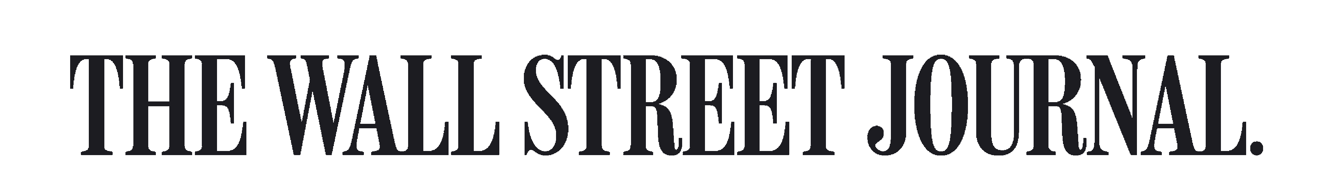
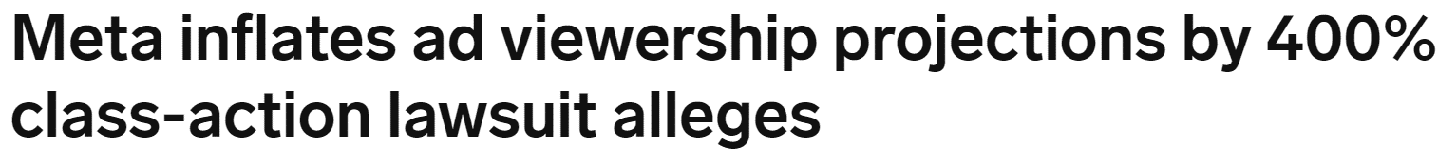
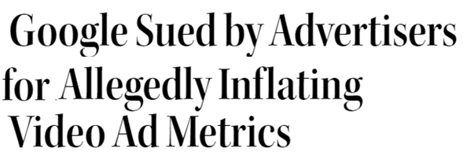
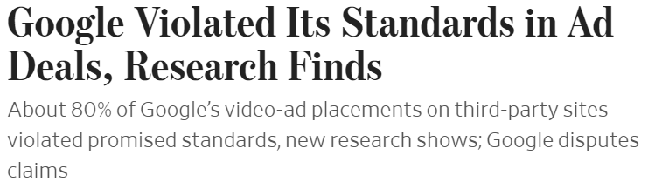

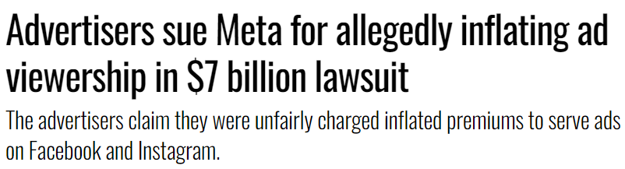


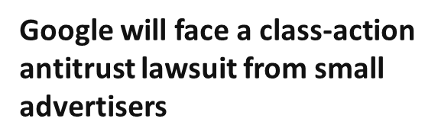
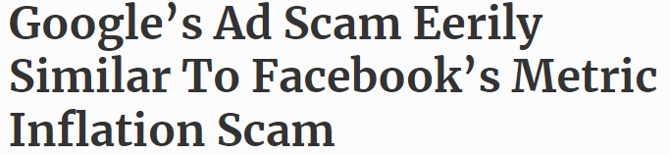





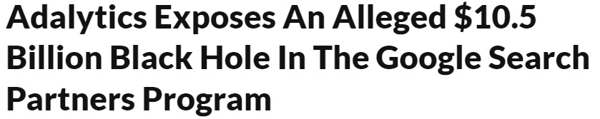
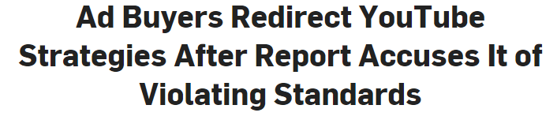
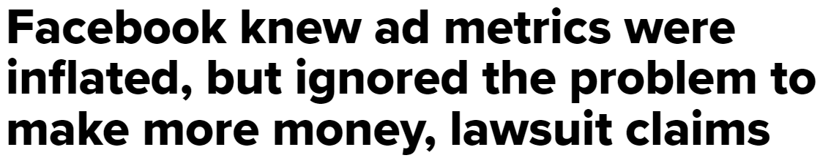
They assume their trusted partners protect them from alleged fraudulent advertising activities, including metric inflation and ad misrepresentation
April 2, 2024
July 26, 2023
June 27, 2023
March 29, 2024
June 28, 2023
December 15, 2023
August 20, 2018
November 28, 2023
July 11, 2023
February 19, 2021
This information is exclusively provided to VAB members and qualified marketers.
PAGE 6

Slide 7
Agencies, with their experience in monitoring campaigns and access to evaluation tools, generally feel more culpable for the results
% of respondents who use the following solutions to prevent digital ad fraud…
Brand
Marketers
Agency
Professionals
Closely monitoring campaigns for increased activity which may be due to bots
39%
82%
Establishing clear brand safety guidelines and ensuring all our partners adhere to them
29%
73%
Maintaining a whitelist of trusted sites
39%
36%
Partnering with '3rd Party' ad verification vendors / fraud detection vendors
32%
45%
Using only direct premium publisher relationships
32%
36%
Source: VAB / Advertiser Perceptions ‘Marketer Sentiment on Ad Fraud’ Survey, November 2023. Survey base: Marketer and agency contacts from the Advertiser Perceptions ‘Senior Marketer’ and ‘Streaming Video’ online communities. Q6. What solutions [is your company/are your clients] using to prevent digital ad fraud? Base = Total Respondents.
This information is exclusively provided to VAB members and qualified marketers.
PAGE 7

Slide 8

Yet, in the end, everyone is pointing fingers in different directions with no accountability in sight
% of total respondents
32%
believe advertisers are responsible for preventing digital ad fraud
27%
believe agencies
are responsible for preventing digital ad fraud
Source: VAB / Advertiser Perceptions ‘Marketer Sentiment on Ad Fraud’ Survey, November 2023. Survey base: Marketer and agency contacts from the Advertiser Perceptions ‘Senior Marketer’ and ‘Streaming Video’ online communities. Q10. Please rank the following based on who you believe is most responsible for preventing digital ad fraud? Base = Total Respondents.
This information is exclusively provided to VAB members and qualified marketers.
PAGE 8

Slide 9

In their own words: Marketers agree on the need for transparency and accountability, and expect as much from media partners
“I think it's our job to really demand of our partners that they treat us well. I think the way that we hold them to that is we look for a lot of granularity in the data we get back. We ask questions on what they're doing to prevent fraud and when we see something that looks strange, we bring it to their attention.
If they don't have a good answer, we find a different partner.”
CMO, Consumer Electronics Category (Anonymous)
“On the advertiser side, it's on me. It's my budget, I own the money, I represent the company so it's on me to confirm that I'm doing things right. The publisher is equally responsible. It's on me to figure out if they're sketchy, but if they're operating illegally or immorally, then it's the publisher's fault. I buy from an intermediary/DSP and it's on them as well. Everyone is culpable.”
VP, Brand & Media, e-commerce Category (Anonymous)
Source: VAB / Advertiser Perceptions ‘Marketer Sentiment on Ad Fraud’ Survey, based on in-depth interviews, fielded October 2023. Survey base: Marketer and agency contacts from the Advertiser Perceptions ‘Senior Marketer’ and ‘Streaming Video’ online communities.
This information is exclusively provided to VAB members and qualified marketers.
PAGE 9

Slide 10
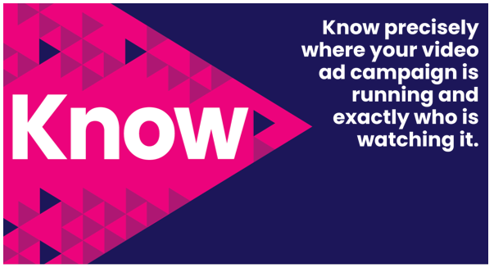
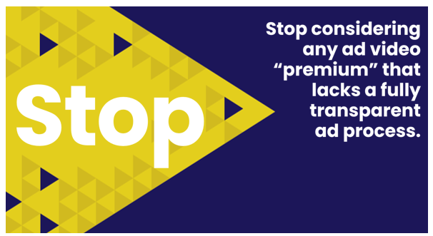

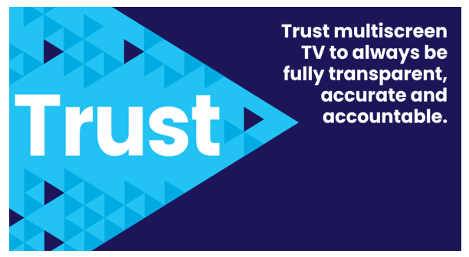
Adults over 50 account for 36% of the total population and nearly half of all adults
Marketers can move the industry forward and enact real change by taking an active role in demanding transparency across all their media & verification partners
Also, the FreeWheel Council for Premium Video and the VAB have partnered to advocate
for the value of premium standards. Click below to download and learn more!
Buying Premium Video:
A Definitive Checklist
This information is exclusively provided to VAB members and qualified marketers.
PAGE 10

Slide 11
Adults over 50 account for 36% of the total population and nearly half of all adults
A relatively small portion of industry professionals hold themselves or their agencies responsible for preventing ad fraud, leading to challenges in taking coordinated action
Many brand marketers prefer to delegate ad fraud monitoring to third-party vendors, which may result in less emphasis on internal efforts to address the issue directly
Although there is awareness of ad fraud, the measures currently taken by brand marketers and agencies could benefit from more consistency and action to effectively mitigate the issue, including taking an active role in demanding transparency across all media partners
Key Marketer Takeaways
This information is exclusively provided to VAB members and qualified marketers.
PAGE 11

Slide 12
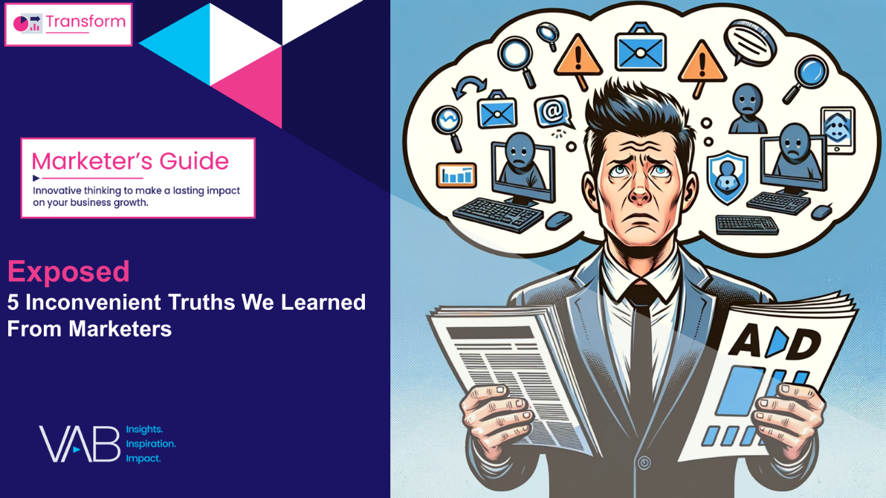
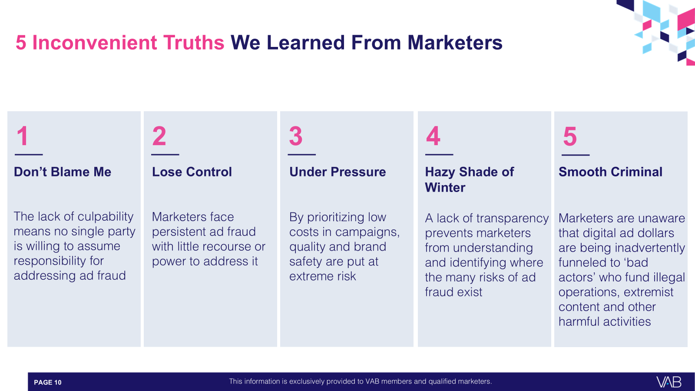

Download our full guide ‘Exposed’ to learn more about all five of the inconvenient truths we learned from marketers through our custom survey
Click here to download ‘Exposed’
This information is exclusively provided to VAB members and qualified marketers.
PAGE 12

Slide 13


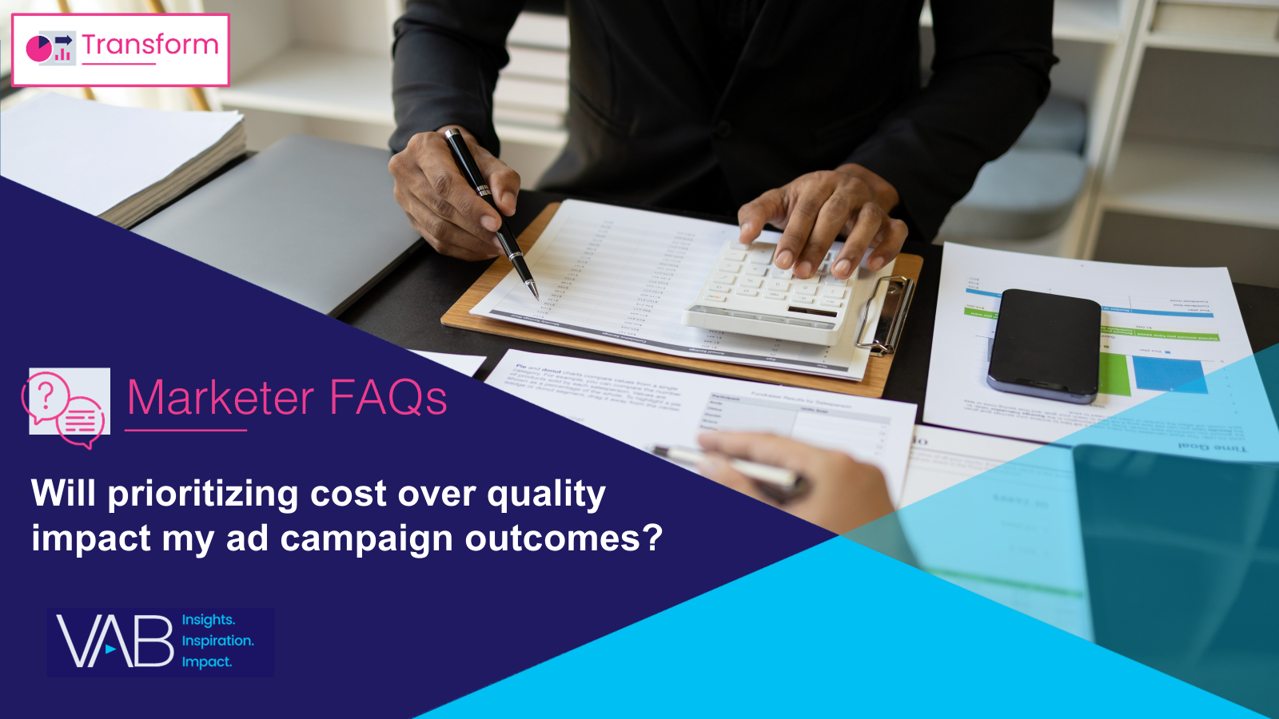
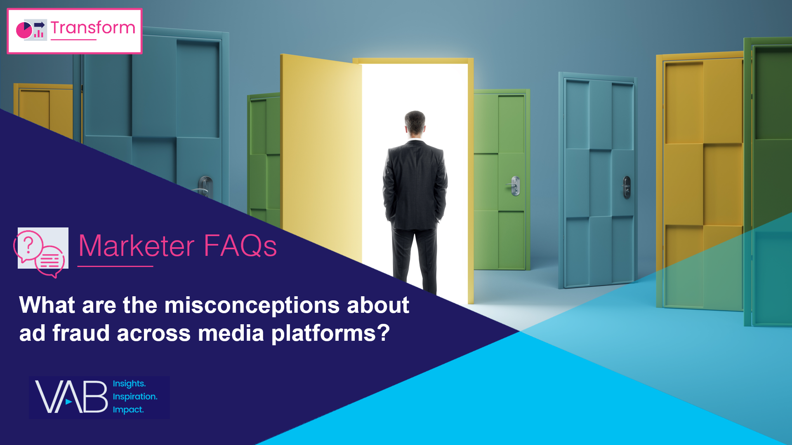
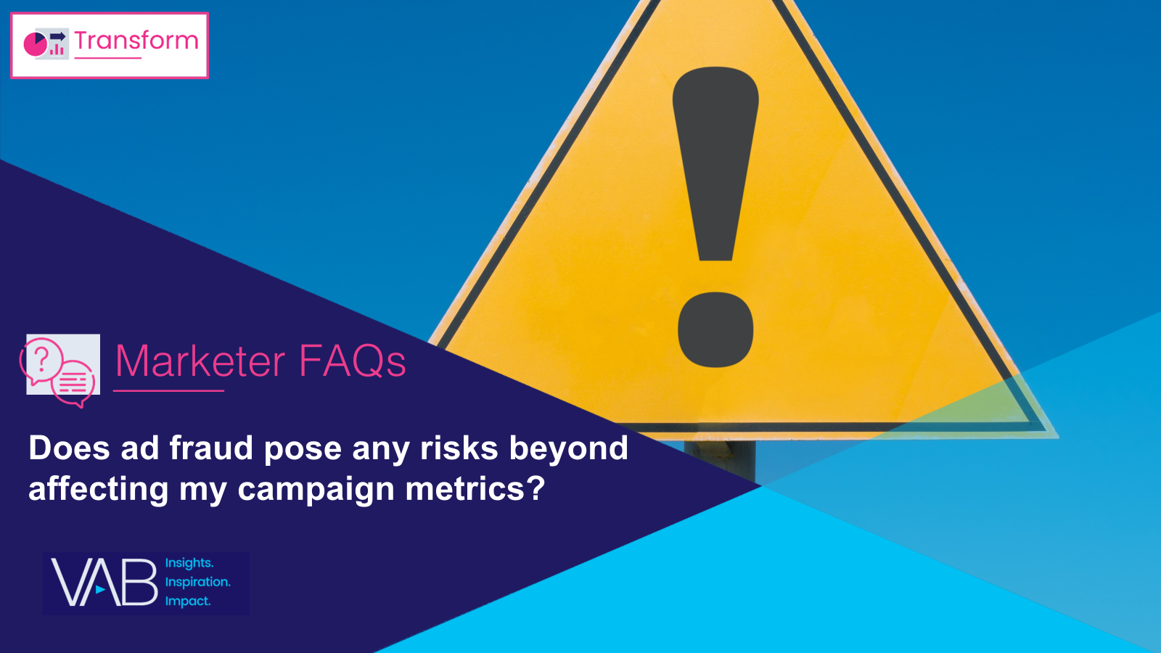
Creators
Danielle DeLauro
Leah Montner-Dixon
Executive Vice President
danielled@thevab.com
Director, Audience & Behavioral Insights
leahm@thevab.com
Jason Wiese
Karolina Guillen
SVP, Director of Strategic Insights
jasonw@thevab.com
Associate Director, Insights, Strategy & Analytics
karolinag@thevab.com
How can I effectively address
ad fraud within my campaign?
Will prioritizing cost over quality impact my ad campaign outcomes?
Discover more
Looking for more data, insights and takeaways? Check out this related VAB content
To learn more about the methodology of our custom study, download the full report
Exposed: 5 Inconvenient Truths
We Learned From Marketers
What are the misconceptions about ad fraud across media platforms?
Does ad fraud pose any risks beyond affecting my campaign metrics?
This information is exclusively provided to VAB members and qualified marketers.
PAGE 13

Slide 14


About VAB
VAB plays a dual role in the video advertising industry. We are leading the change to bring about a more innovative and transparent marketplace. We also provide the insights and thought leadership that enables marketers to develop business-driving marketing strategies.
Drawing on our marketing expertise, we simplify the complexities in our industry and discover new insights that transform the way marketers look at their media strategy.
We are committed to your business growth and proud to offer VAB members, brand marketers and agencies complimentary access to our continuously-growing Insights library. Get immediate access at theVAB.com.
This information is exclusively provided to VAB members and qualified marketers.
PAGE 14

Slide 15



To learn what marketers think about advertising transparency, ad fraud and brand safety we conducted independent research
VAB’s custom study results are based on responses from senior brand marketers and high-level agency professionals. These individuals are part of Advertiser Perceptions’ Insights Community, a distinguished panel of industry experts who are deeply experienced and constantly tuned into the latest trends and developments.
Their keen awareness and understanding of the ever-evolving advertising landscape make them uniquely positioned to identify the industry's most pressing challenges.
  Part I: in-depth interviews of 5 select respondents
    September 26 – October 2, 2023
  Part II: quantitative survey of 39 respondents
    November 10 - 14, 2023
Respondent Qualifications:
  Senior level decision-makers involved in digital video, CTV and / or linear TV campaigns
  Mix of category verticals
  Mix of annual media spend levels
  Senior job level / title
This information is exclusively provided to VAB members and qualified marketers.
PAGE 15

