Slide 1
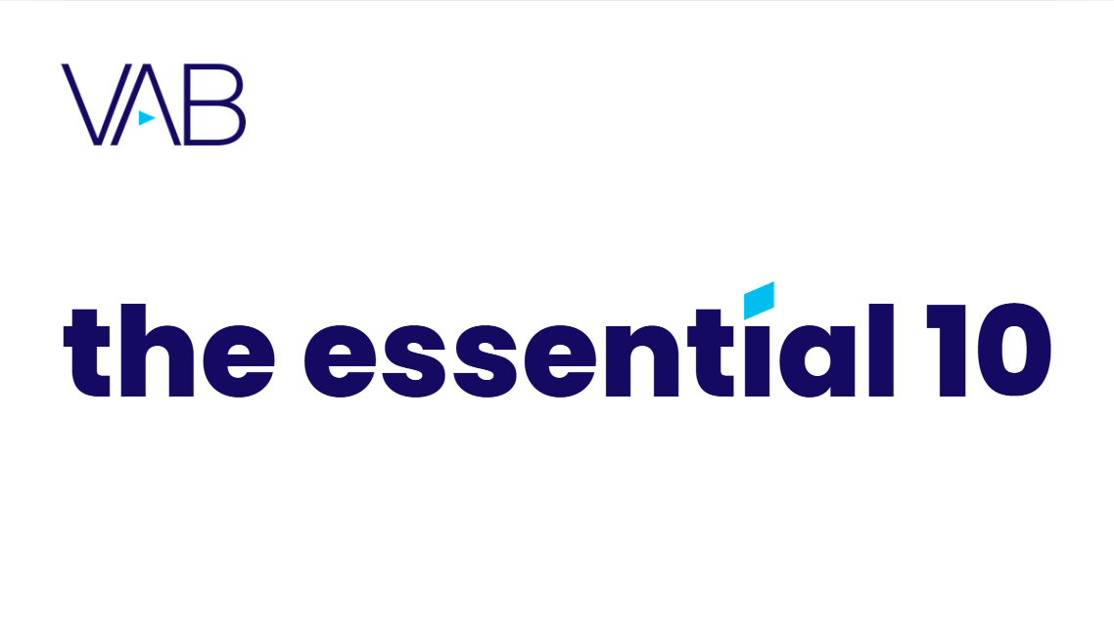

Q1 2026
Our 10 must-read Insights charts of the quarter

Slide 2
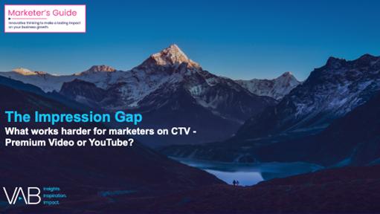



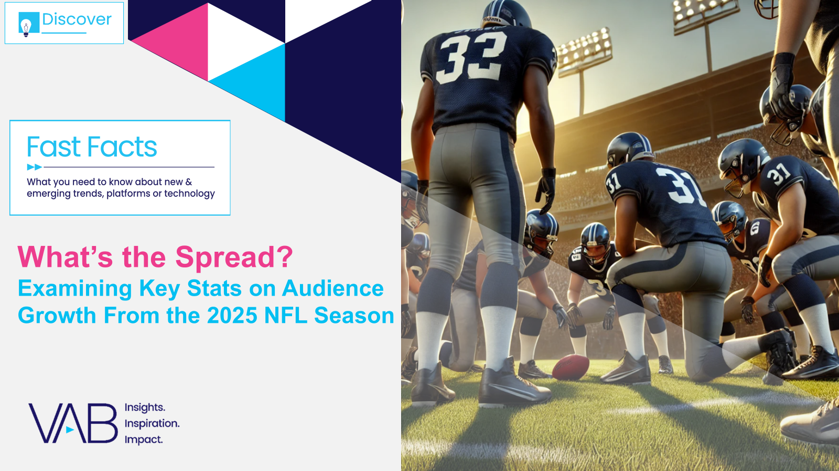
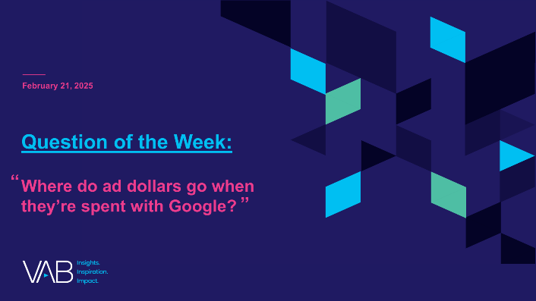
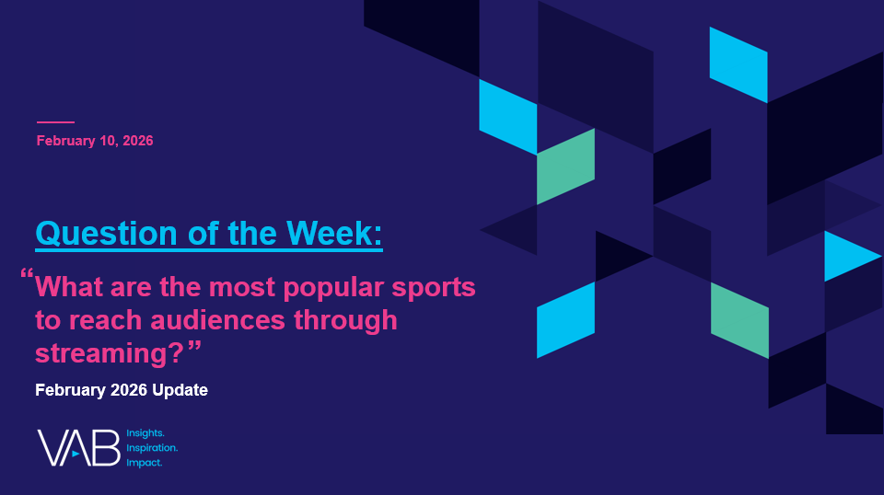

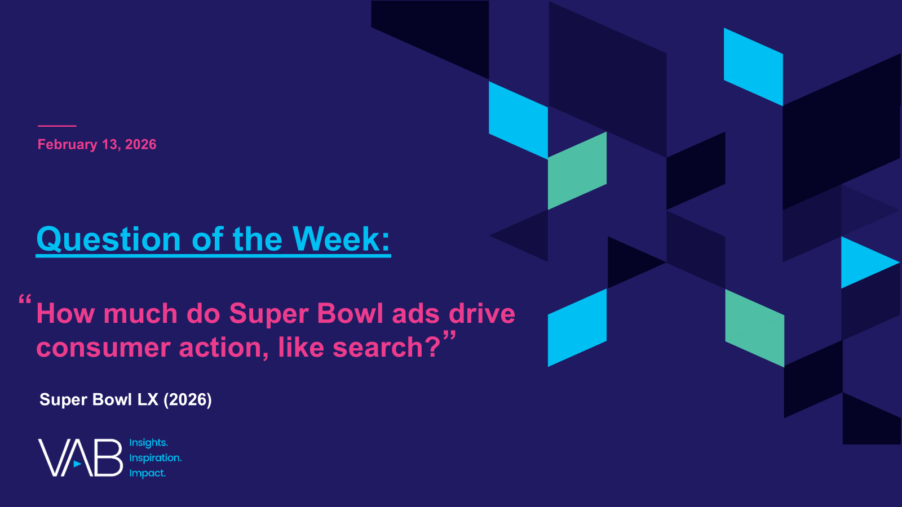
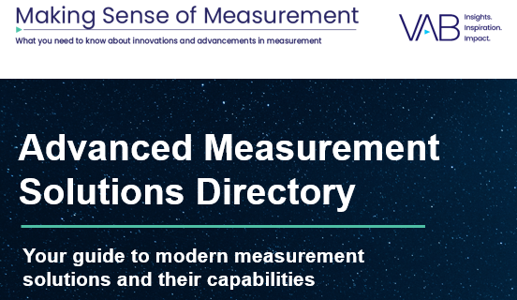
In Q1 2026, VAB released insights covering attention on CTV, political advertising, realities of the internet, AI, measurement solutions and more
The Impression Gap
What works harder for marketers on CTV – Premium Video or YouTube?
The Lead Story
How Multiscreen TV Drives Cross-Partisan Engagement for Political Ad Campaigns
The Illusions of the Internet
Uncovering the Fallacies & Realities of Audience, Advertising & Content
Left To Your Own (Connected) Devices
Examining How Consumers Are Embracing Smart Technology In Their Everyday Lives
What’s the Spread?
Examining Key Stats on Audience Growth From the 2025 NFL Season
Where do ad dollars go when they’re spent with Google?
What are the most popular sports to reach audiences through streaming?
February 2026 Update
What Is…AI Fluency?
A foundational guide to key terms
and concepts
How much do Super Bowl ads drive consumer action,
like search?
Advanced Measurement Solutions Directory –
January 2026 Update
Your guide to modern measurement solutions and their capabilities
Keep reading to check out our top 10 ‘must read’ charts of the quarter…
This information is exclusively provided to VAB members and qualified marketers
PAGE 2

Slide 3







CTV Viewer Attention: Premium Video Platforms keep viewers engaged with their ‘eyes on screen’ for longer than YouTube
Click here for the full report
Average Premium Video Platform Lift vs YouTube on CTV
+5%
+14%
+18%
more likely to be in the
room when the TV is on
more likely to have their eyes on screen
more likely to keep
their eyes on screen
*Max PVP vs YT : +20%
*Max PVP vs YT : +33%
*Max PVP vs YT : +88%
Source: VAB + TVision Custom Study. July 2024 – June 2025. P2+. Premium Video Platforms represent an average of the 21 Premium Video Platforms. Weighted based on duration of session. | *PVP refers to Premium Video Platforms. Max PVP means the Premium Video Platform with the highest index.
This information is exclusively provided to VAB members and qualified marketers
PAGE 3

Slide 4
Trusted News Sources: Americans overwhelmingly trust TV news over any other digital media source like social or AI
Click here for the full report
% of respondents who trust the following media sources the most
50%
of total respondents rank AI lowest for trust
Source: Dynata, Media Consumption and Political Sentiment survey, fielded December 2025 (n=2,319). Survey base: A18+ U.S. respondents. Q11. Please rank your level of trust with information from the following sources. Based on respondents who ranked media #1 = ‘I trust this source the most’. Base = All News Respondents (n=1,276). Voter respondents (n=988), Non-Voter respondents (n=226), Republican respondents (n=413), Democrat respondents (n=389), Independent respondents (n=309).
This information is exclusively provided to VAB members and qualified marketers
PAGE 4

Slide 5





Consumer Fraud: Social media scams that tug at the wallet, heart and mind cost U.S. consumers nearly $2 billion annually
Click here for the full report
U.S. Consumer Social Media Fraud Losses by Type*
2024
Investment-related
Romance Scams
52%
15%
$1.9 Billion
in consumer losses from
social media scams in 2024, accounting for the highest overall source of losses to scams
Online Shopping
Other
6%
27%
Source: U.S. Federal Trade Commission, A Scammy Snapshot of 2024, March 2025. Based on reports to Consumer Sentinel. *U.S. Federal Trade Commission, All Fraud Reports by Contact Method – Top Subcategories by Total Losses for Contact Method: Social Media, Q1-Q4 2024, as of 1/30/26.
This information is exclusively provided to VAB members and qualified marketers
PAGE 5

Slide 6


Connected TV Penetration: Growth continues as the prevalence of homes with multiple smart TVs increases
Click here for the full report
Smart TV Set Installed Base
In millions
Average # of Smart TVs per HH
% of Total TV Households
Smart TV % of Total TV Set Installed Base
45%
55%
63%
74%
76%
79%
82%
83%
25%
36%
45%
56%
64%
72%
78%
85%
Source: Industry data; S&P Global Market Intelligence Kagan estimates.. Data compiled October 2025. ‘Installed Base’ refers to the total number of units of a product currently in use by customers. Compound Annual Growth Rate (CAGR): 9.0%.
This information is exclusively provided to VAB members and qualified marketers
PAGE 6

Slide 7
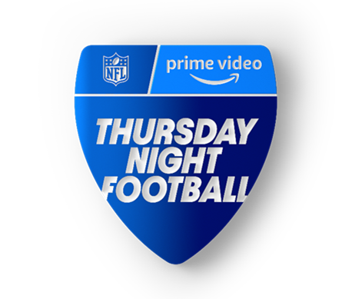
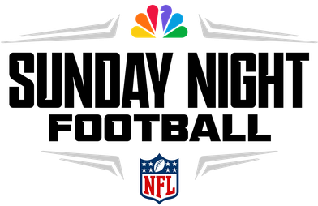

NFL Viewership Insights: Divisional matchups deliver double-digit audience lifts as fans flock to watch established rivalries
Click here for the full report
P2+ Average Audience (000)
2025 NFL Regular Season
(10 Divisional Games)
(4 Divisional Game)
(4 Divisional Games)
BD+P
vs.
PO
% Diff
BD+P
vs.
PO
% Diff
BD+P
vs.
PO
% Diff
Divisional Game Average:
15.3 MM
14.0 MM
+9%
22.6 MM
21.8 MM
+4%
18.7 MM
17.9 MM
+5%
Non-Divisional Game Average:
13.1 MM
12.6 MM
+4%
16.4 MM
15.6 MM
+5%
15.9 MM
15.0 MM
+6%
Divisional Game Diff:
+16%
+11%
+38%
+40%
+18%
+19%
Source: VAB analysis of Nielsen Ratings Analysis Program Report, Thursday Night Football (Amazon Prime Video), Sunday Night Football (NBC), Monday Night Football (ESPN, ESPN2, ABC), excludes pre- & post-game shows. Live+SD, P2+, Updated Big Data Plus Panel data, National Panel data. 2025 regular season (9/4/25 – 1/4/26). NBC, ESPN, ESPN2 and ABC reflect linear TV audience only and does not include audiences gained from their digital / streaming apps. ‘BD+P’ = Big Data Plus Panel, ‘PO’ = National Panel Only. See appendix for a game-by-game breakout of ABC, ESPN, ESPN2 airings.
This information is exclusively provided to VAB members and qualified marketers
PAGE 7

Slide 8
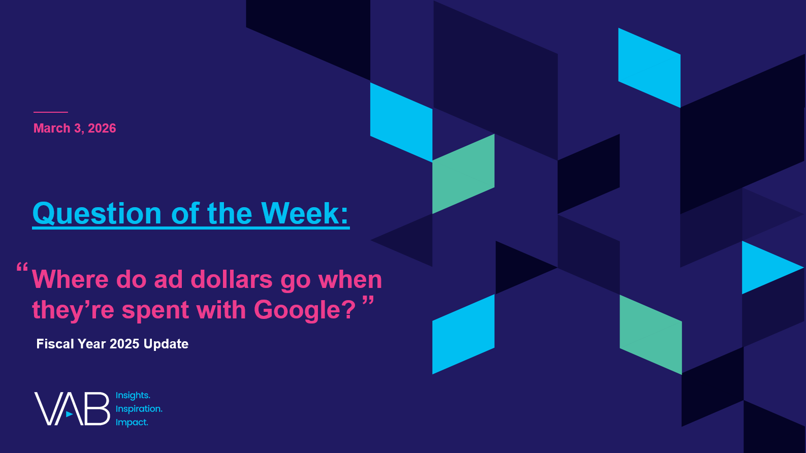
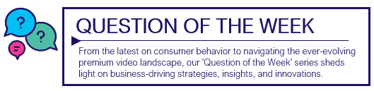




Google’s Ad Revenue: Ad dollars in ‘undefined platforms’ are more than the total global spend in other major media platforms
Click here for the full report
Estimated Global Advertising Revenues by Media
2025
Google Network & ‘Other’
Print
Outdoor
Radio
$44.8
Billion
$43.0
Billion
$35.9
Billion
$28.7
Billion
Download to understand where ad dollars go when they’re spent with Google
Source: Alphabet SEC company 10-K filings via SEC Edgar Search, for fiscal year ended 12/31/25. ‘Google Network’ includes revenues generated on Google Network properties participating in AdMob, AdSense, and Google Ad Manager. Reflects gross revenue which includes the dollars that Google pays in traffic acquisition costs (TAC) to partner sites. Totaled numbers may equal not total due to rounding. Adalytics Research LLC, ‘Does A Lack of Transparency Create Brand Safety Concerns For Search Advertisers?’ report, November 2023, for more methodological details see page 6, for ‘Other’ methodology see page 7. S&P Global Market Intelligence Kagan, Global Advertising Expenditure Forecasts, December 2025.
This information is exclusively provided to VAB members and qualified marketers
PAGE 8

Slide 9
Sports Streaming By Multicultural Audiences: Hispanic, Black and Asian all over index against basketball and boxing
Click here for the full report
Which of the following sports have you streamed live in the last 12 months?
% of sports streamers
Summer or Winter
Source: VAB analysis of MRI-Simmons Cord Evolution November 2025 (fielded Sep 30, 2025 - Oct 20, 2025) studies, Base: has streamed live sports in the last 30 days. NH = Non-Hispanic. Note: Data sorted on NH White. Note: Olympics can include people streaming relevant content such as replays, highlights and other related programming after the Olympics have aired.
This information is exclusively provided to VAB members and qualified marketers
PAGE 9

Slide 10
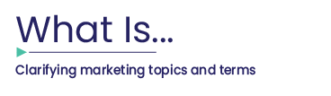
The Need for AI Fluency: The growth of AI-driven advertising is a sign of how important AI education should be for marketers
Click here for the full report
Estimated U.S. AI-Powered Advertising Revenue
(in billions)
AI-Powered Advertising Revenue is expected to increase
154%
From 2026 to 2030
Source: Madison & Wall; How AI-Powered Advertising Totals $142 Billion by 2030: February 2026. To quantify AI-driven spending, Madison & Wall defined AI-powered advertising narrowly based on campaign spending that flows through platforms where AI controls targeting, bidding, budget allocation, placement, and ongoing optimization with minimal human intervention.
This information is exclusively provided to VAB members and qualified marketers
PAGE 10

Slide 11

Super Bowl Drives Online Engagement: A first-time advertiser in the ‘Big Game’ more than doubled their branded search
Click here for the full report
2.3x
Weekly Google Trends Index: Ro
12-month trend leading up to the Superbowl (Weeks of 2/9/2025 – 2/8/2026)
vs. prior week
Super Bowl
(100 index)
“As soon as the spot airs, we know we’re going to see a whole lot of traffic come to our site, but what we are really expecting and hoping for is to reshape how we’re perceived in the category."
Second Highest Week
(71 index)
Week Before Super Bowl
(44 index)
Will Flaherty
SVP of Growth, Ro
(AdExchanger, 2/6/26)
Source: VAB analysis of Google Trends, United States only, All Categories, Web Search, Weeks of 2/9/25 – 2/8/26. Google Search Index represents search interest relative to the highest point on the chart for the given region and time period, a value of 100 is the peak popularity for the term, a value of 50 means that the term is half as popular. Note: Light blue line marks the date of Super Bowl LX. Click here to view Ro's Super Bowl commercial (via iSpot.tv). Search trend based on ro.co.
This information is exclusively provided to VAB members and qualified marketers
PAGE 11

Slide 12

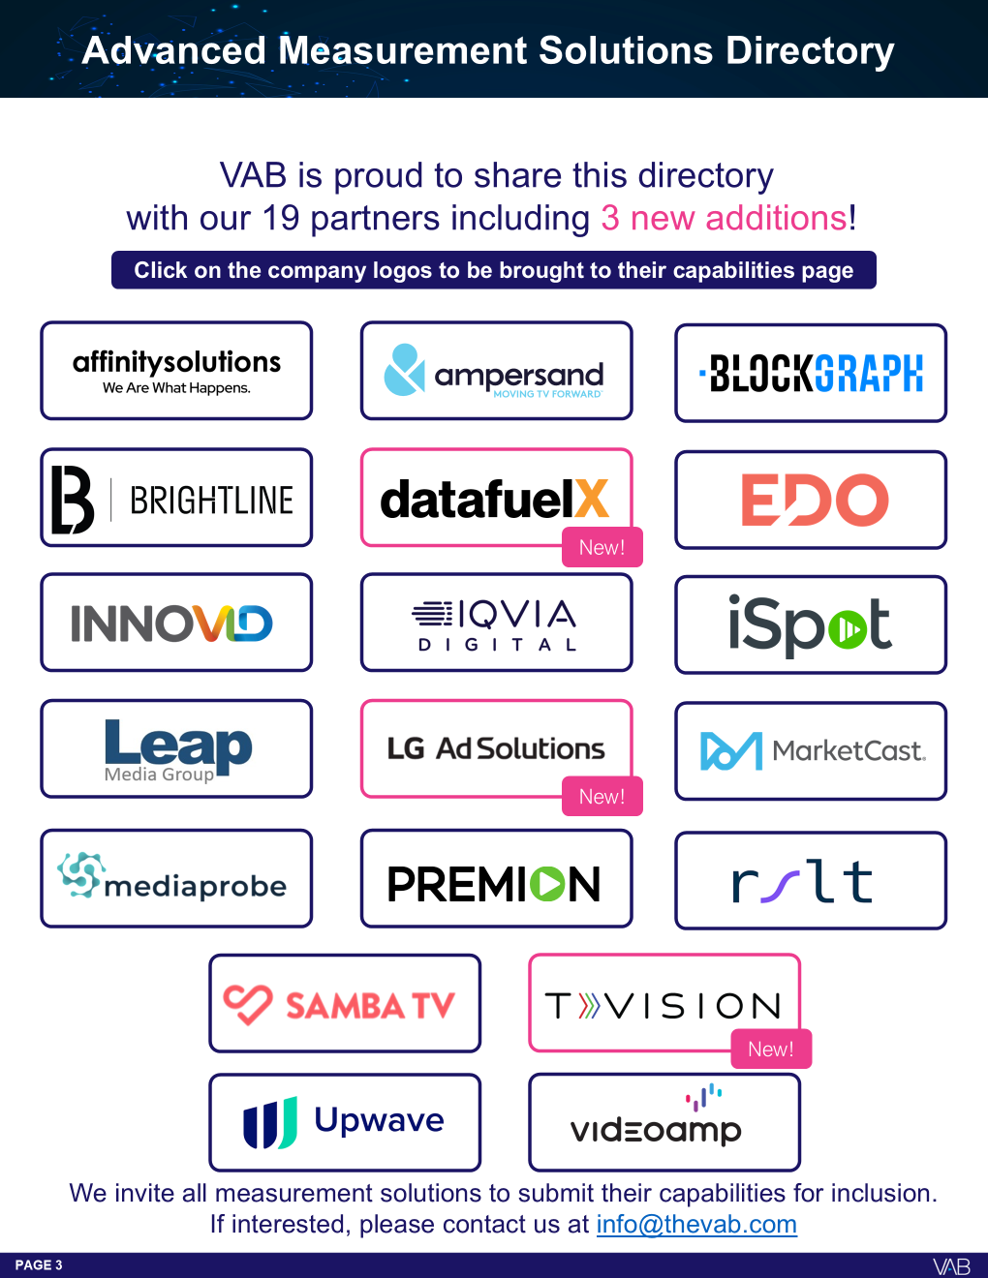
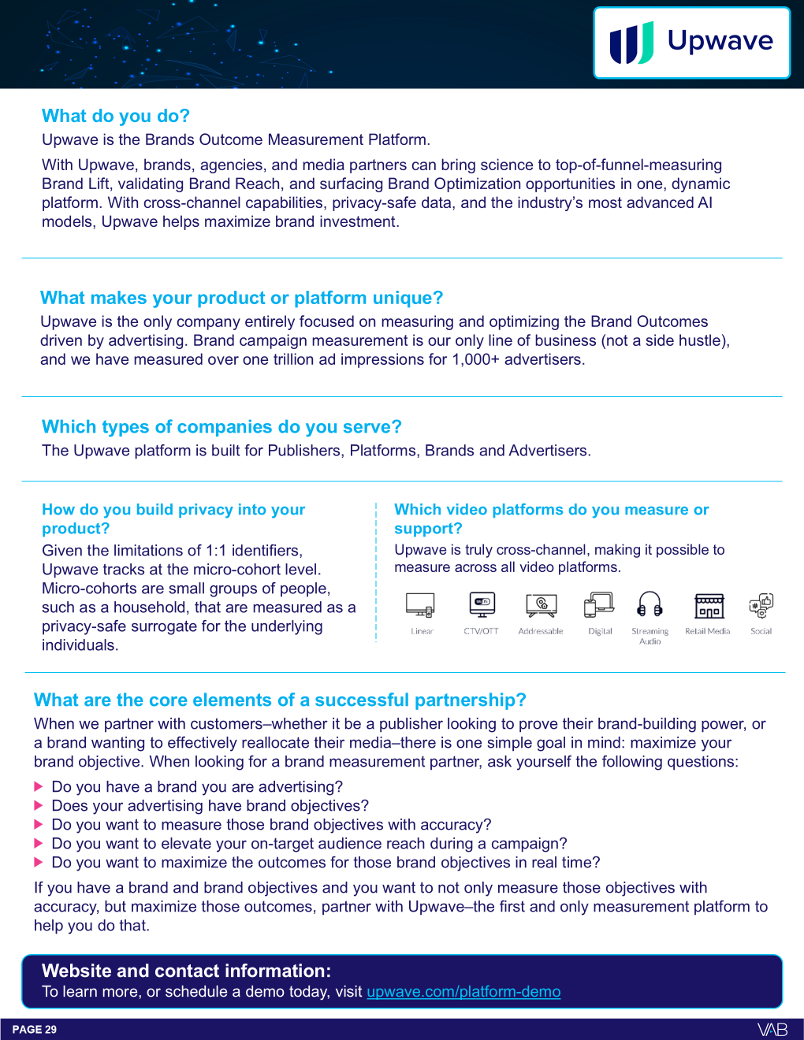
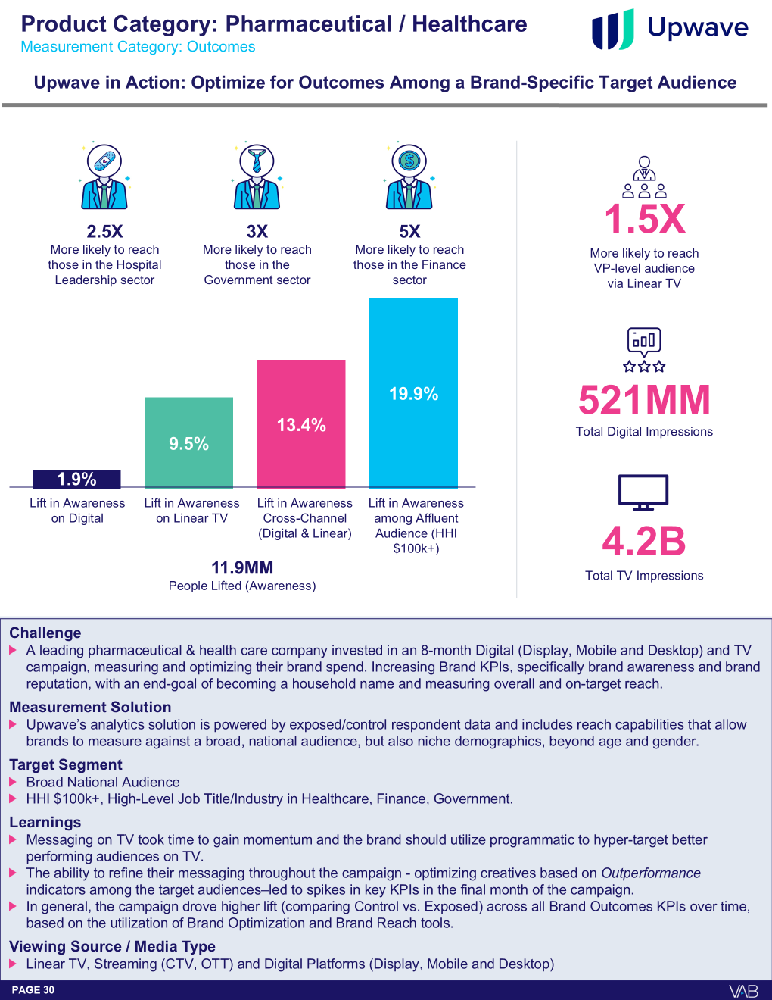
VAB’s Advanced Measurement Solutions Directory: An update to our guide of measurement companies and their capabilities
Click here for the full directory
Directory preview
Example of a measurement solution & their capabilities
The Advanced Measurement Solutions Directory serves as a reference guide to simplify and provide clarity in measurement solutions so that you can keep informed.
Developed in partnership with the solutions themselves, the directory is a compilation of the topline capabilities and several applicable case studies.
We welcome all measurement companies that would like to contribute.
This information is exclusively provided to VAB members and qualified marketers
PAGE 12

Slide 13
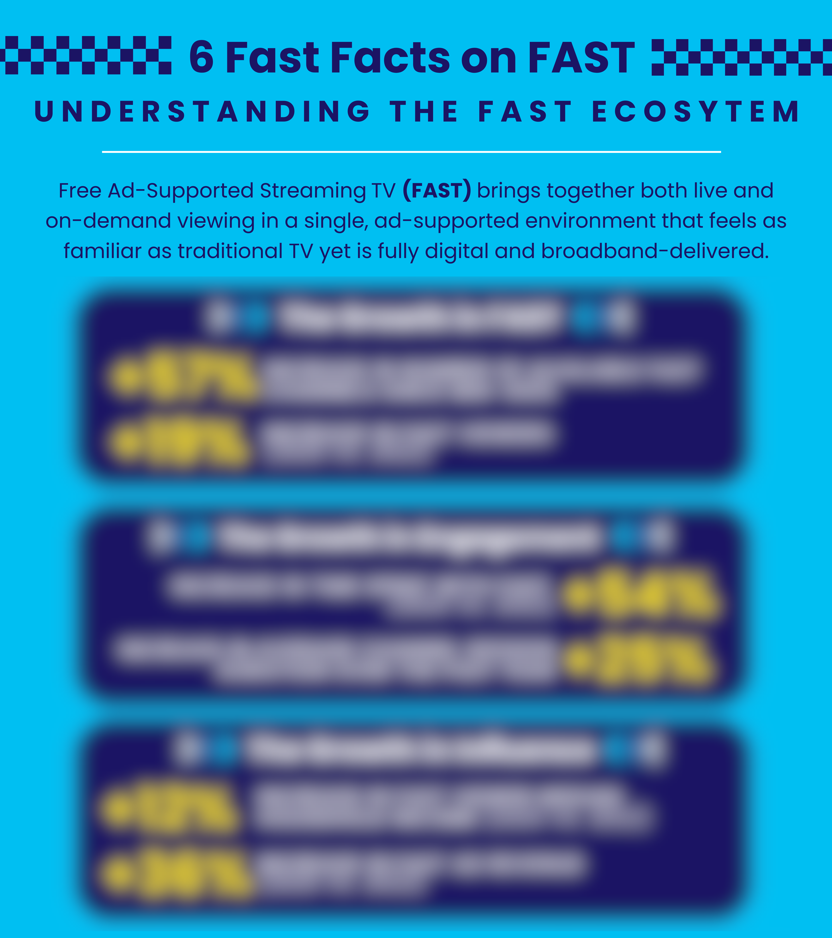
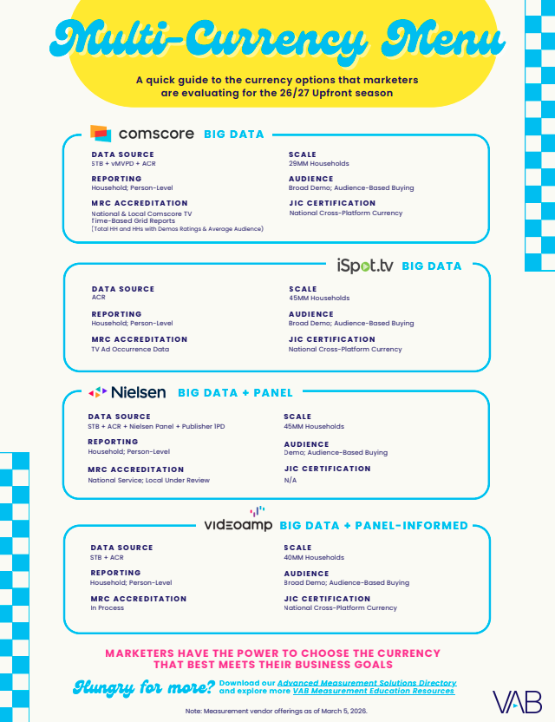
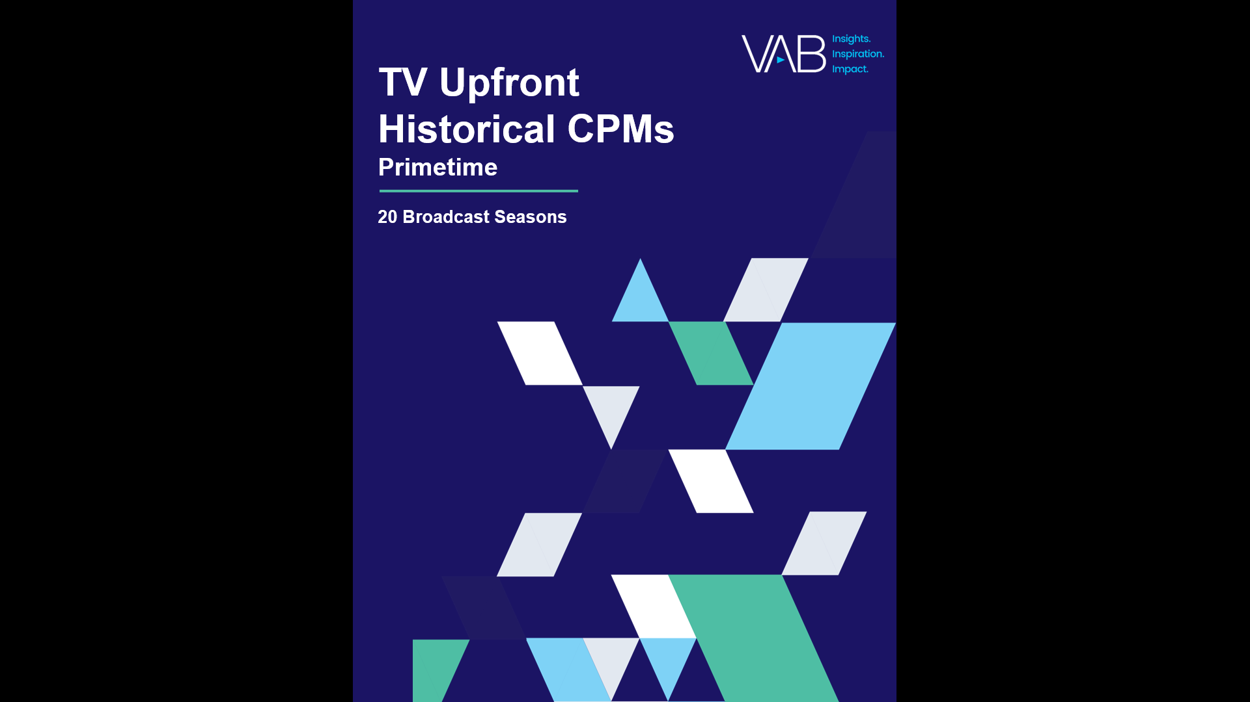
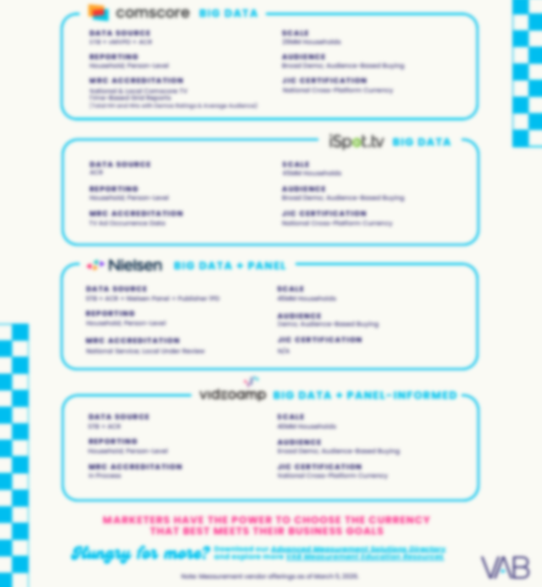
Essential one-sheeters: Be prepared for the Upfront with the latest info on streaming, currency providers and historical TV CPMs. Download Now!
Bonus Slide!
Download to learn more about the FAST ecosystem!
Download for an updated look at currency solutions!
For VAB Members only
This information is exclusively provided to VAB members and qualified marketers
PAGE 13

Slide 14

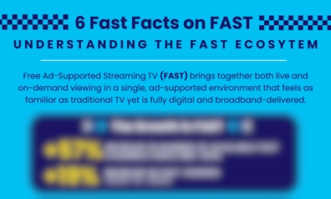

Jason Wiese
Benjamin Vandegrift
Q1 2026 Insights & Measurement Content Releases
EVP, Strategic Insights & Measurement
jasonw@thevab.com
SVP, Measurement Strategy & Innovation benjaminv@thevab.com
Leah Pujalte
Reed Kiely
VP, Audience & Behavioral Insights
leahm@thevab.com
VP, Data Insights & Trends
reedk@thevab.com
Karolina Guillen
Rohan Gosalia
Associate Director, Insights, Strategy & Analytics karolinag@thevab.com
Associate Director, Measurement Intelligence
rohang@thevab.com
Amanda Cashman
Insights Analyst
amandac@thevab.com
Discover more
Looking for more data, insights and takeaways? Check out this related VAB content
VAB Members, brand marketers and agencies get free and immediate access to VAB’s content library. Get access at theVAB.com
This information is exclusively provided to VAB members and qualified marketers
PAGE 14

Slide 15


About VAB
VAB plays a dual role in the video advertising industry. We are leading the change to bring about a more innovative and transparent marketplace. We also provide the insights and thought leadership that enables marketers to develop business-driving marketing strategies.
Drawing on our marketing expertise, we simplify the complexities in our industry and discover new insights that transform the way marketers look at their media strategy.
We are committed to your business growth and proud to offer VAB members, brand marketers and agencies complimentary access to our continuously-growing Insights library. Get immediate access at theVAB.com.
This information is exclusively provided to VAB members and qualified marketers
PAGE 15

