Slide 1


VIDEO ADVERTISING BUREAU - REPORT 2019
.................
The Esports Report
The ‘Area of Effect’ For Marketers

Slide 2

Definitions
Area Of Effect (AoE)
In esports…
“A video game spell or attack that affects everything within a specified area”
For marketers…
Esports’ area of effect delivers a passionate, desirable, elusive but receptive audience that complements a marketer’s communications plan
2

Slide 3
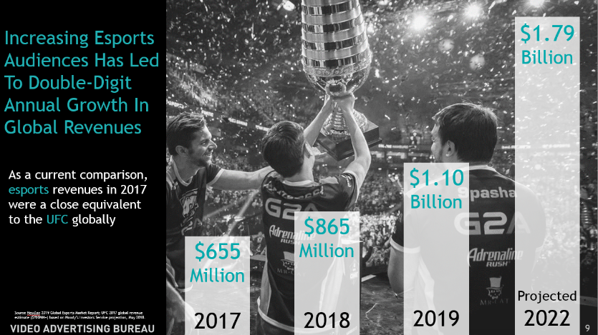
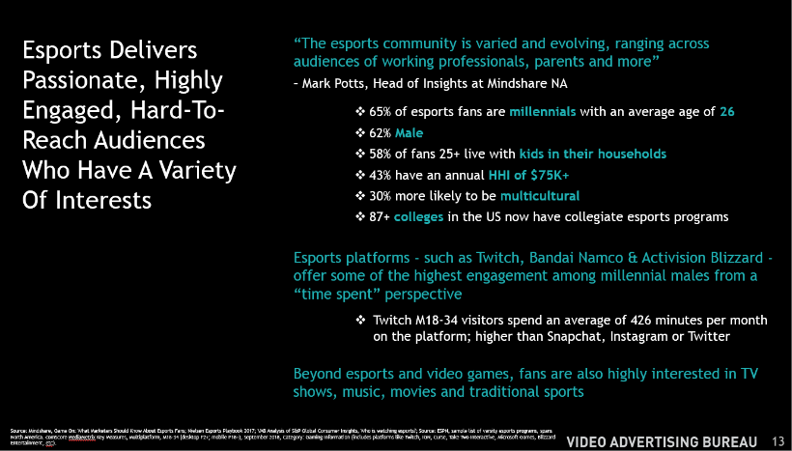
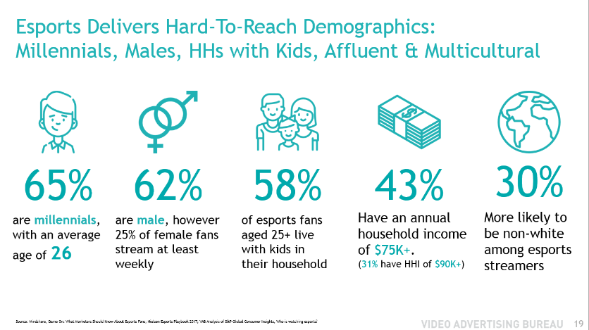
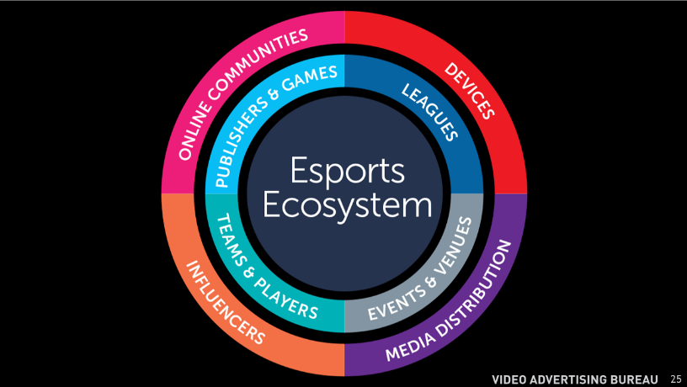
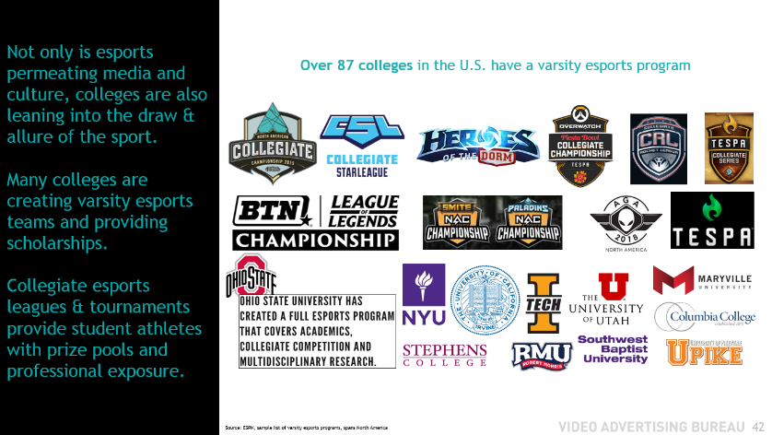
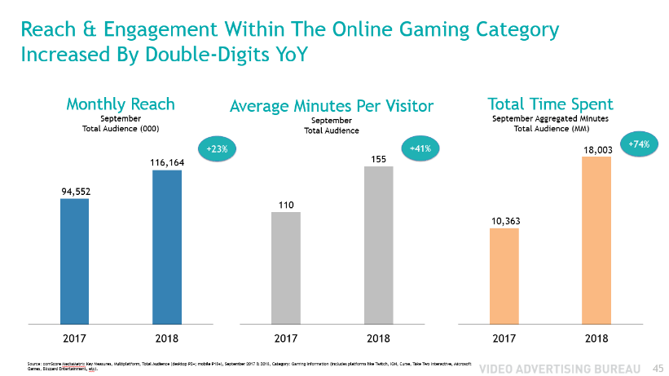
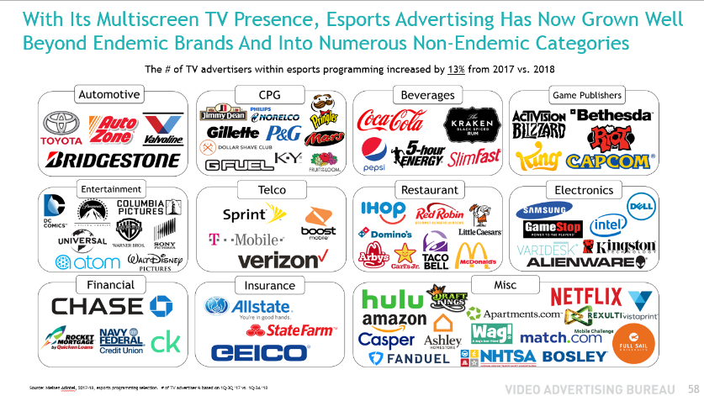
Contents
1
2
1
Esports Overview
3
2
Why Should Marketers Invest In Esports?
4
3
Who Is The Esports Fan?
5
4
Esports Ecosystem
5
The ‘Mainstreaming’ Of Esports
6
6
Growth In Multiscreen Engagement
7
7
Esports Advertising & Opportunities
3

Slide 4
Esports Highlights
Esports is one of the fastest-growing, content-driven video platforms in the U.S. today and is experiencing double-digital annual growth in audience and revenues globally
  23% of esports fans in the U.S. have started following the sport between 2017 & 2018
  In 2019, esports global revenues are projected to increase 27% over the prior year
This dynamic sport, which features all the organizational structure and competitive hallmarks of more traditional sports leagues, has quickly gained mainstream interest and cultural relevancy among audiences and advertisers
With a millennial male skew, esports delivers a passionate, desirable, elusive audience that is brand loyal and receptive to integrated advertising
Viewers are highly engaged with content across screens including Television where the hours of programming have grown significantly over the past year alone
  Over 18 Billion minutes are spent online monthly with gaming platforms, an increase of 74% vs. a year ago
  Over 300 hours of esports TV programming aired during the ‘17-‘18 broadcast season, up almost 50% vs. the prior season
Source NewZoo 2019 Global Esports Market Report; Source: Nielsen NPower Reach & Frequency Report, Live+7, based on broadcast year ‘16-’17 vs. ‘17-’18; Nielsen NPower PowerPlay Report, based on broadcast year ‘16-’17 vs. ‘17-’18. comScore MediaMetrix Key Measures, Multiplatform, Total Audience (desktop P2+; mobile P18+), September 2017 & 2018, Category: Gaming Information (includes platforms like Twitch, IGN, Curse, Take Two Interactive, Microsoft Games, Blizzard Entertainment, etc).
4

Slide 5








1
3
5
6
Esports Is A Fresh, Exciting Platform And Is The Newest Organized Sport With Competitive Leagues Around The World
Esports
MLB
NFL
NBA
UFC
1903
1920
1946
1993
Now
1917
1929
1948
1995
NHL
PGA
NASCAR
MLS
2
4
6
7
Based on founding dates
5

Slide 6



What Are Esports?
All Esports are video games
Esports are not that different from traditional sports and have all the conventional defining elements of competitive sports.
Esports is an abbreviation of ‘electronic sports’, where players & teams battle against each other in competitive video games.
Player vs Player or Team vs Team
Clear Win Condition
Active Professional Scene & Tournaments
Clear Win Condition = a fair and objective way to determine a winner and an “end” to a match.
6

Slide 7





















Popular Esports Genres & Titles
What Games Are Esports?
MOBA
(Multiplayer Online Battle Arena)
RTS
(Real Time Strategy)
There are several popular genres of video games with competitive scenes.
It is important to understand that while all esports are video games, not all video games are esports.
Games are not esports if they don’t have organized competitions (player vs. player; team vs. team), a clear win condition or an active professional scene.
Card Games
Shooters &
Battle Royale
Sports
Fighting
Games That Are Not Esports
7

Slide 8
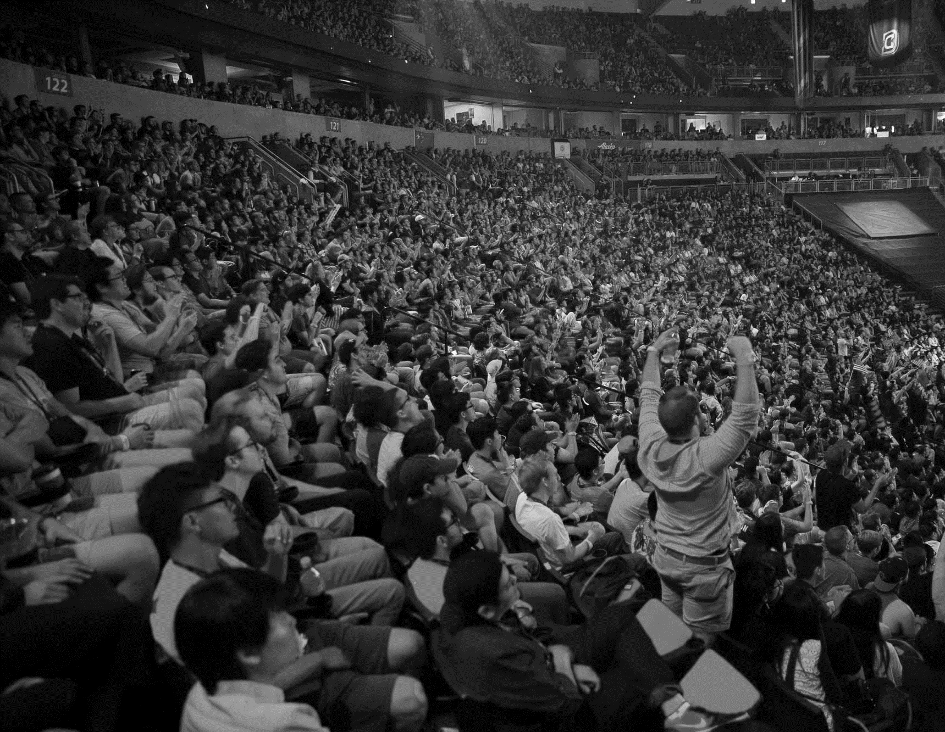
645
Million
The Global Esports Audience Is Soon Expected To Grow To Over Half A Billion People
454
Million
In the US, 23% of esports fans started following the sport between 2017 and 2018
395
Million
335
Million
As a scale comparison, there are 139MM global Netflix subscribers and 447MM global subscriptions to any online video service
Projected
2022
Source: Nielsen, The Esports Playbook 2017; NewZoo 2019 Global Esports Market Report; Netflix 4Q 2018 Financial Statements; MPAA 2017 Theatrical & Home Entertainment Market Environment (THEME) report.
2017
2018
2019
8

Slide 9
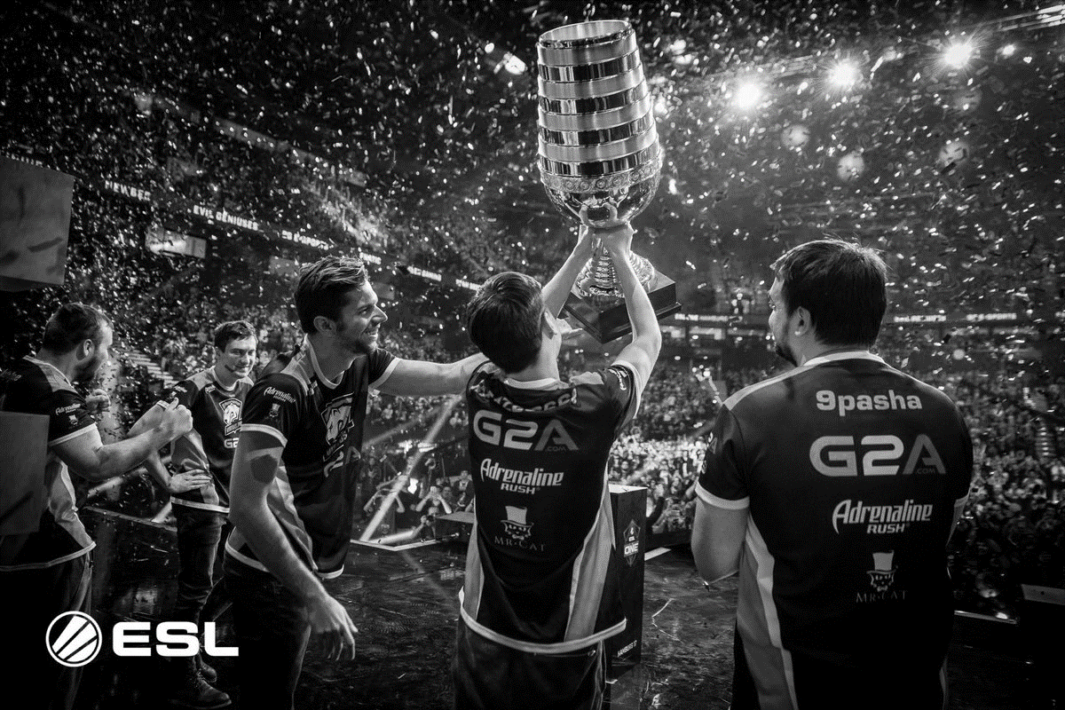
$1.8
Billion
Increasing Esports Audiences Has Led To Double-Digit Annual Growth In Global Revenues
As a recent comparison, 2017 esports revenues were a close equivalent to the UFC globally in 2017
$1.1
Billion
$865
Million
$655
Million
Projected
2022
2017
2018
2019
Source NewZoo 2019 Global Esports Market Report; UFC 2017 global revenue estimate ($700MM+) based on Moody’s Investors Service projection, May 2018.
9

Slide 10
Esports Global Revenue Is Driven by Sponsorship & Advertising
17%
2019 Global Total
$1,096MM
42%
Sponsorship, Advertising and Media Rights Revenues Are Projected To Reach
$1.5 Billion By 2022, a 67% increase vs. 2019
9%
9%
North America alone will generate $409MM of total global revenues in 2019
Source: NewZoo 2019 Global Esports Market Report, excludes revenues from betting, fantasy leagues and similar cash payouts, as well as revenues generated within games.
10

Slide 11


Why Should Marketers Invest in Esports?

Slide 12

America’s ‘Most Elusive Demographic’
Is Found In Esports
Millennial Males
Esports deliver a millennial male-skewing fan base with a deep ‘scale of attention.’ This hard-to-reach audience is passionate and highly-engaged with their favorite teams, players, games and leagues across digital & TV platforms.
Most fans are multi-dimensional with a variety of interests well beyond esports and video games. Most importantly, they have a positive attitude towards advertising and are very willing to sample products from sponsors.
12

Slide 13
Esports Delivers Passionate, Highly Engaged, Hard-To-Reach Audiences Who Have A Variety Of Interests
“The esports community is varied and evolving, ranging across audiences of working professionals, parents and more”
– Mark Potts, Head of Insights at Mindshare NA
  65% of esports fans are millennials with an average age of 26
  62% Male
  58% of fans 25+ live with kids in their households
  43% have an annual HHI of $75K+
  30% more likely to be multicultural
  87+ colleges in the US now have collegiate esports programs
Esports platforms - such as Twitch, Bandai Namco & Activision Blizzard - offer some of the highest engagement among millennial males from a “time spent” perspective
    Twitch M18-34 visitors spend an average of 426 minutes per month on the platform; higher than Snapchat, Instagram or Twitter
Beyond esports and video games, fans are also highly interested in TV shows, music, movies and traditional sports
Source: Mindshare, Game On: What Marketers Should Know About Esports Fans; Nielsen Esports Playbook 2017; VAB Analysis of S&P Global Consumer Insights, Who is watching esports?; Source: ESPN, sample list of varsity esports programs, spans North America. comScore MediaMetrix Key Measures, Multiplatform, M18-34 (desktop P2+; mobile P18+), September 2018, Category: Gaming Information (includes platforms like Twitch, IGN, Curse, Take Two Interactive, Microsoft Games, Blizzard Entertainment, etc).
13

Slide 14
Esports Is Mainstream With Cross-Platform Video Programming & Distribution, Including TV…
  Esports has evolved from a digital-only platform and now offers cross-screen programming and advertising opportunities especially on TV where it has experienced major growth recently
  11+ TV networks now air esports Leagues and Tournaments
  230+ telecasts of esports programming on linear TV aired in ’17-‘18
  300+ hours of esports programming aired on linear TV in ’17-‘18, up 46% vs prior season
  Median age of the esports TV viewer is 32 with a 63% male skew
…And It Has Recently Begun Attracting A
Wave of New Advertisers
Well Beyond Endemic Categories
  The explosion of growth in viewership and additional access points for content has led to many non-endemic categories and brands “getting in the esports game” and engaging with the elusive, millennial male audience
  Over 90 major categories are now esports advertisers within industries as varied as Financial, Insurance, Automotive, Restaurants, Telecommunications
  This includes hundreds of non-endemic advertisers such as: Casper, Chase, Geico, Kraken Rum, Match.com, P&G, Red Robin, Samsung, Toyota, Verizon & Universal Pictures
Source:: Nielsen NPower Reach & Frequency Report, Live+7, based on broadcast year ‘16-’17 vs.’17-’18; Nielsen NPower PowerPlay Report, based on broadcast year ‘16-’17 vs. ‘17-’18. Nielsen AdIntel, broadcast year ‘17-’18, esports programming selection. Nielsen Ratings Analysis Program Report, Live+7, broadcast year ‘16-’17 vs. ‘17-’18. Median Age = average median age of esports TV programming.
14

Slide 15
Esports Fans Not Only Have
A Positive Attitude Towards Advertising But, Most Importantly, They Take Action
Advertising in esports drives consumer action across every level of the purchase funnel
Awareness
43%
Notice brands used in games & events
(172 Index)*
Consideration
30%
Believe a product is better if their favorite player/team supports it
41%
(253 Index)*
Intent
Believe that sponsors are critical to the success of esports
35%
Are more willing to try a new brand if it sponsors their favorite team
(236 Index)*
Purchase
29%
Will buy the same brand if used by their favorite team
63%
(288 Index)*
Definitely try products shown during esports games
Loyalty / Advocacy
31%
Support their favorite team’s sponsors, no matter what
(263 Index)*
*Index vs. Traditional Sports Fan
Source: Simmons, Justifying Brand Investments in Esports, December 2018. Index is against traditional sports fans; Research Now, Esports Gaming, Question: How strongly do you AGREE (strongly agree / agree somewhat) with each of these statements about Esports?; Nielsen, The Esports Playbook 2017
15

Slide 16

Who Is The Esports Fan?

Slide 17

“The esports community is varied and evolving, ranging across audiences of working professionals, parents, and more”
Mark Potts
Head of Insights, Mindshare NA

Slide 18

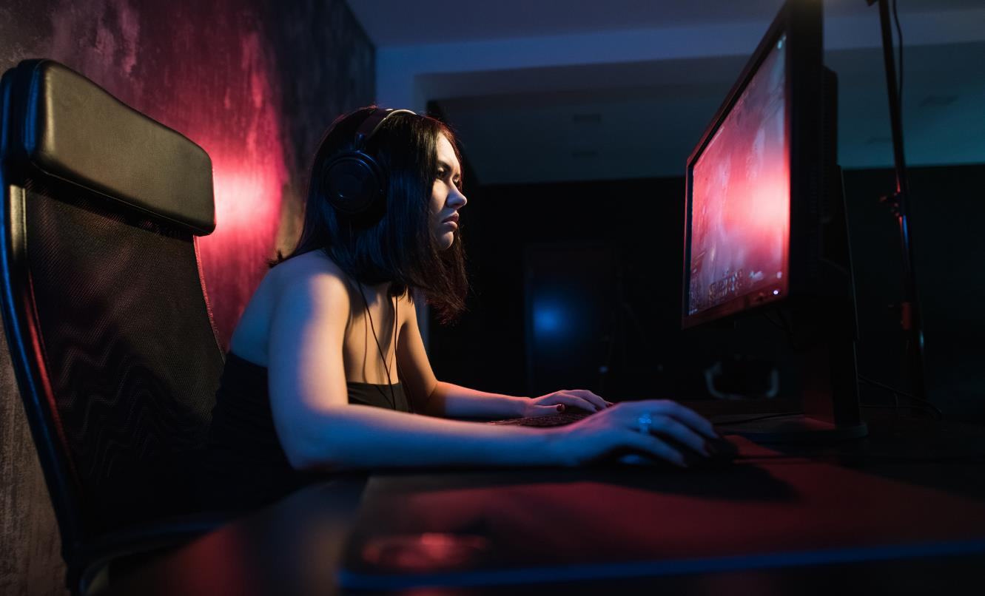
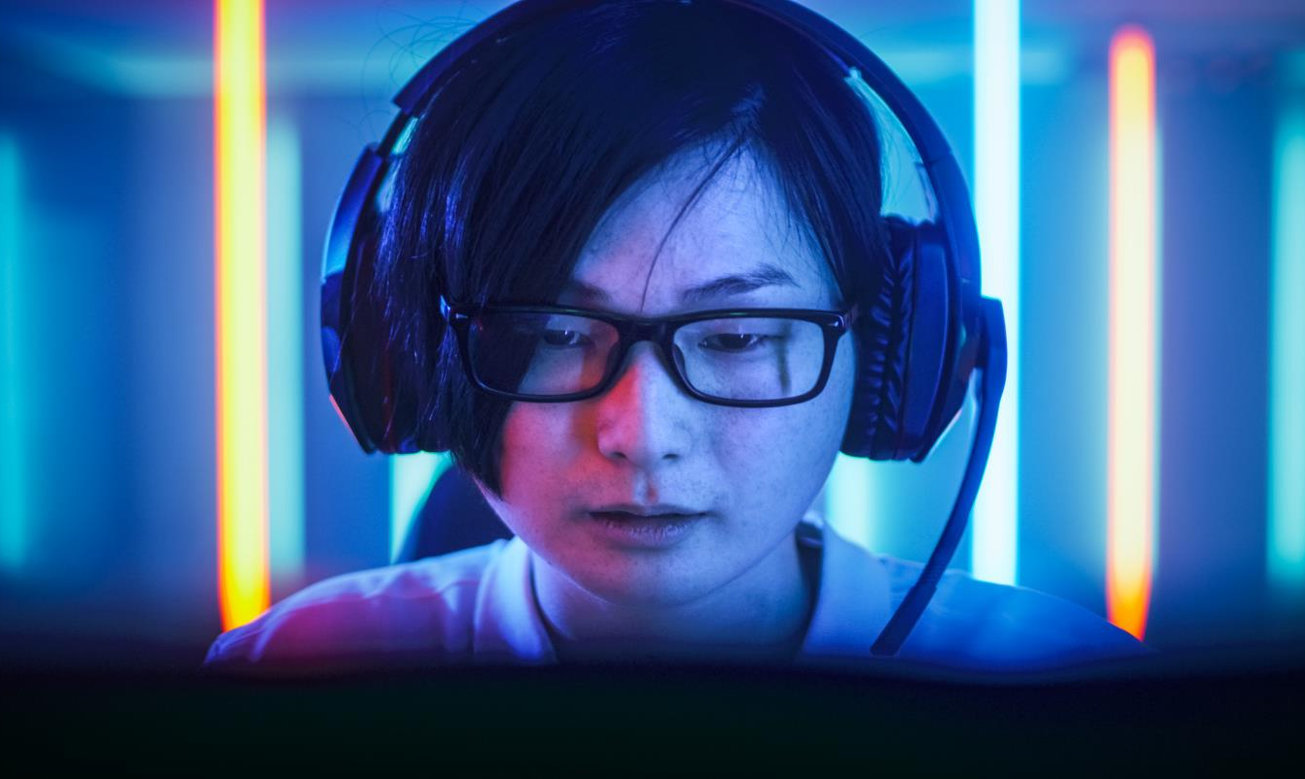
Three Levels of Esports Fandom
Engaged Viewer
Gaming Enthusiast
Esports Fanatic
The engaged viewer is the largest segment comprising 56% of esports fans. These multi-dimensional viewers are passionate about esports, but have a variety of outside interests as well. They were exposed to esports through
TV or online streams and they follow their favorite teams/players.
Gaming and watching esports are a hobby of the enthusiast and they directly engage with professional content more than once a month. They are up to date with the latest happenings in the industry and support their favorite teams/players.
Esports and gaming are their biggest hobbies and passion pillars. They watch and support their favorite teams when they play in leagues or tournaments, online or in person.
Source: “engaged viewer” reflects % of casual /occasional viewer based on NewZoo 2019 Global Esports Market Report
18

Slide 19





Esports Delivers Hard-To-Reach Demographics:
Millennials, Males, HHs with Kids, Affluent & Multicultural
65%
62%
58%
43%
30%
are millennials, with an average age of 26
are male, however 25% of female fans stream at least weekly
of esports fans aged 25+ live with kids in their household
Have an annual household income of $75K+.
(31% have HHI of $90K+)
More likely to be non-white among esports streamers
Source: Mindshare, Game On: What Marketers Should Know About Esports Fans; Nielsen Esports Playbook 2017; VAB Analysis of S&P Global Consumer Insights, Who is watching esports?
19

Slide 20



Esports Fans Are…
Community Oriented
Competitive
Invested in Fandom
Gamers At Heart
67% of esports fans have made new friends or acquaintances through games and esports
71% of esports fans say that “watching professionals play makes me a better player”
60% of esports fans are willing to travel to see their favorite games, tournaments and players
8.2 Hours spent playing video games weekly
Source: Mindshare, Game On: What Marketers Should Know About Esports Fans; Nielsen Esports Playbook
20

Slide 21




Fans Engage With Esports To Improve Their Own Gaming Skillsets Among Other Reasons
Reasons Fans Engage With Esports
53%
51%
51%
48%
45%
30%
To become a better gamer
Learn tips and tricks from the pros
Experience the entertainment aspects
Experience gamers/gaming in a new way
To see the best gamers
Experience the competition aspects
Source: Nielsen, The Esports Playbook 2017
21

Slide 22
Hours Spent Per Week
Among Esports Fans
Esports Fans Engage With A Lot More Video Content Beyond Esports
Source: Nielsen, The Esports Playbook 2017. Esports activity = related to pro competitive gaming, such as watching, attending, following, competing etc.
22

Slide 23








Interest In Leisure Activities & Content Types
(0-100 Rating Scale)
Fans Also Have A Variety Of Interests Beyond Esports
Source: Nielsen, The Esports Playbook 2017 (Television not included as a selection).
23

Slide 24




Interest In Traditional Sports Among Esports Fans
Football
Esports Fans
Are Also Fans
of Traditional Sports
Basketball
Baseball
Soccer
Boxing
Source: Nielsen, The Esports Playbook 2017
24

Slide 25
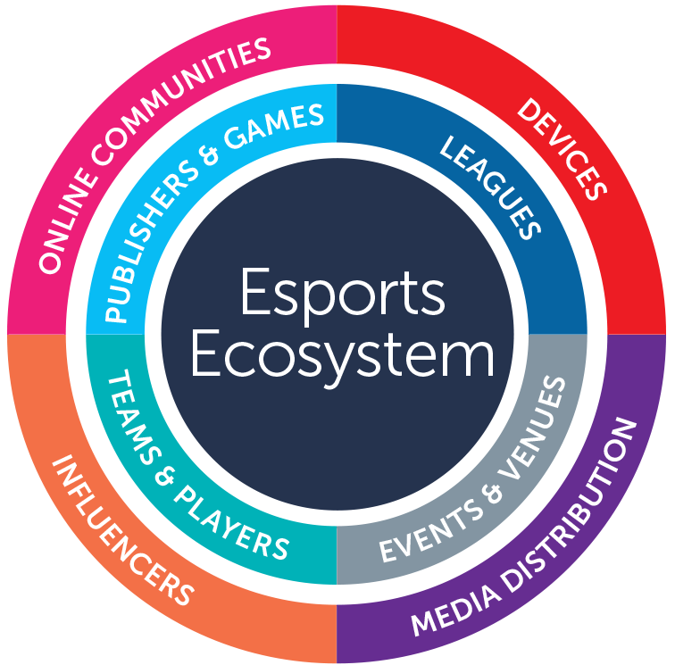
25

Slide 26
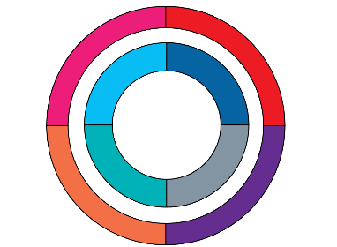












Simplified Esports Ecosystem
Examples
Teams & Players
Games
Leagues
Distributors
Devices
+
Play
In
+
Through
Viewed On
Events
26

Slide 27

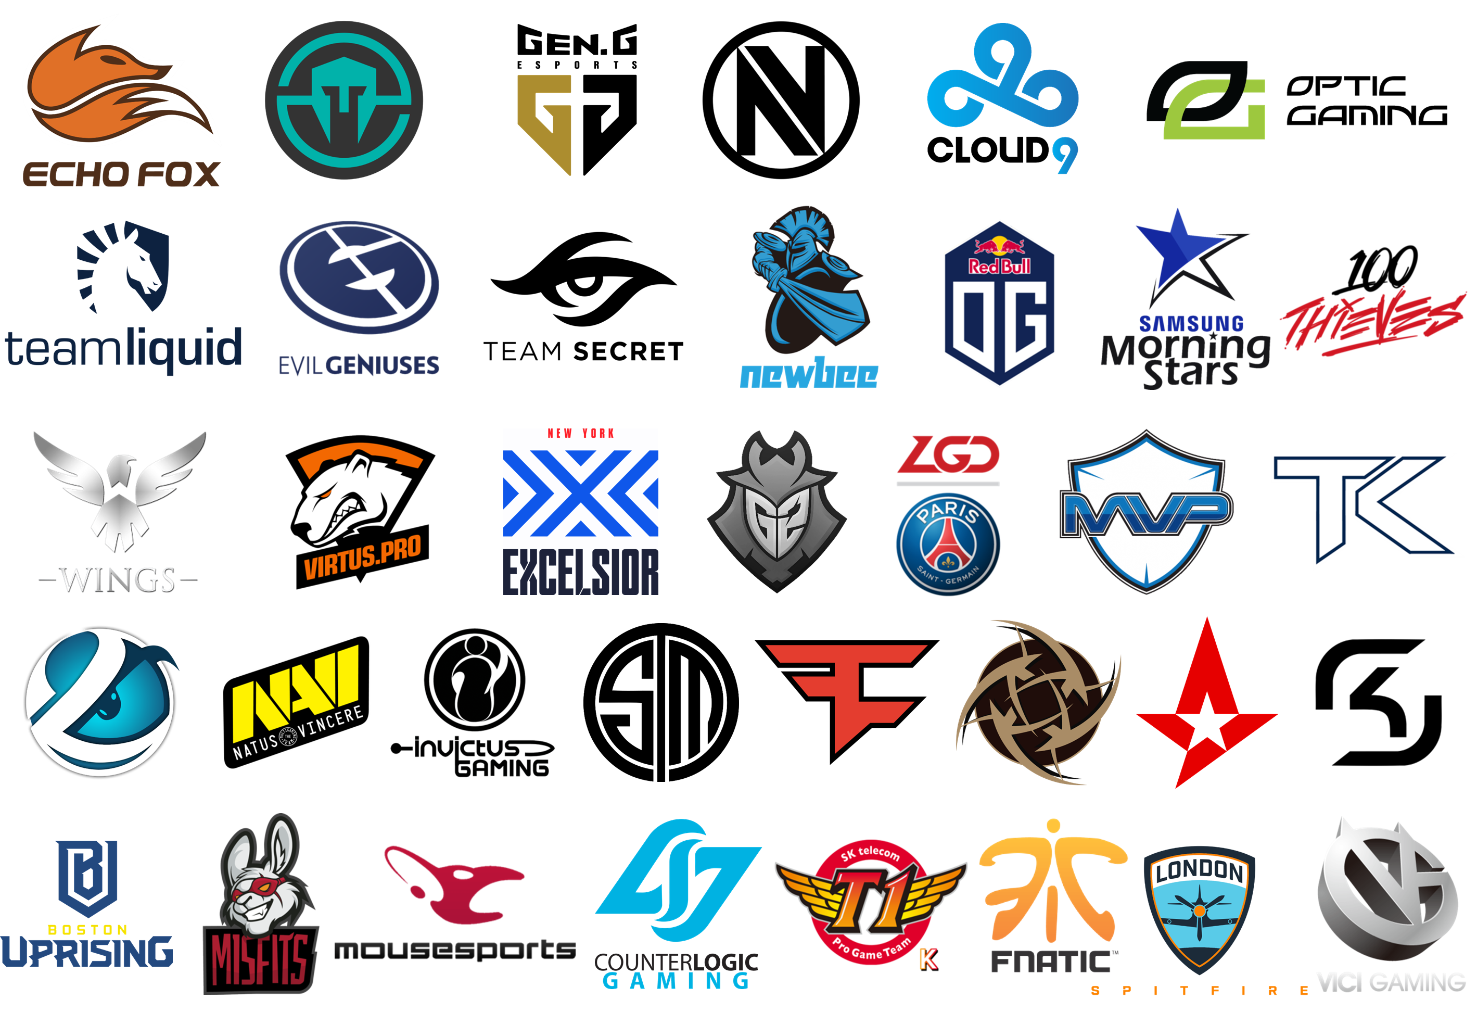
Teams
Teams compete in Esports leagues and tournaments.
Some global organizations, like Team Liquid & Evil Geniuses, field teams across multiple game titles.
Some teams are organized by geography (North America, Europe, Asia, etc.), while the emergence of the Overwatch League has popularized city-based teams which align with traditional sports locations (New York Excelsior, Boston Uprising, London Spitfire).
Note: Above reflects only a sampling of teams
27

Slide 28












Esports Teams Are Big Business
Twelve of the top Esports teams are collectively valued at over $1.7 Billion
$ in Millions
# of Teams
11
7
14
8
6
11
7
11
4
7
4
7
# of Players
92
39
65
23
52
45
50
53
22
69
33
45
Source: Forbes, ‘The World’s Most Valuable Esports Companies’
28

Slide 29
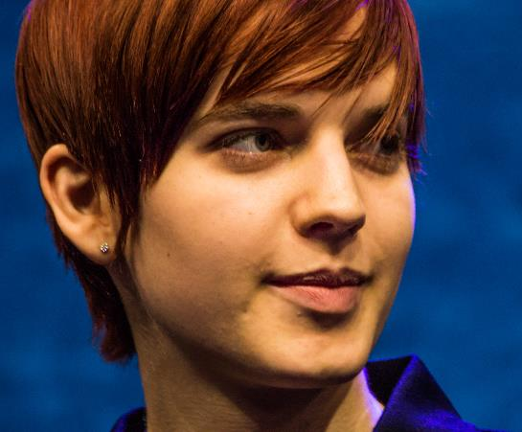
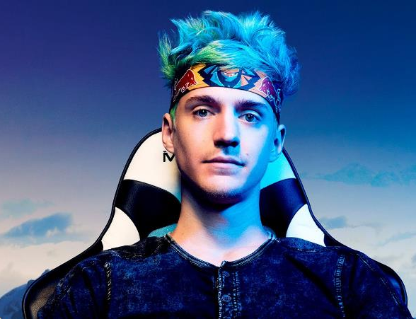

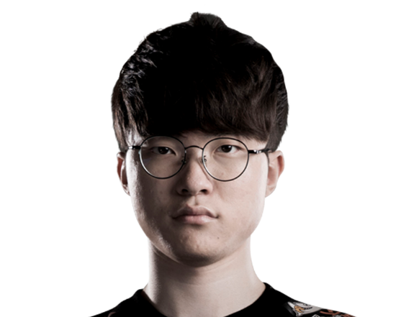

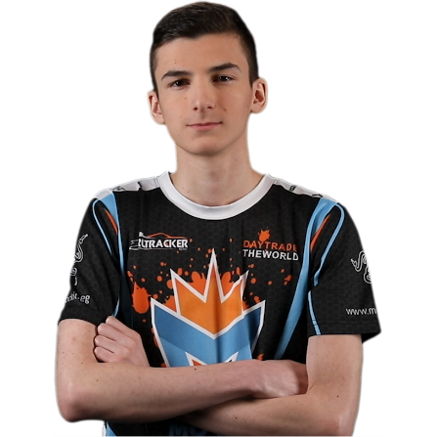






Players
Scarlett
Ninja
UNiVeRse
Just like traditional sports, some esports players stand out more than others and achieve a level of notoriety due to their talents.
Viewers can watch players in leagues and tournaments as well as through the players’ live-streams.
Popular players can be from single-player games (Scarlett, Ninja) or standouts from multiplayer teams (UNiVeRse, Faker, Vilga).
The top esports players earn millions of dollars annually.
Faker
Vilga
Kaydop
coldzera
$18.4 Million Earned Among Top 5 Esports Players
KuroKy
N0tail
Miracle-
MinD_ContRoL
Matumbaman
Source: EsportsEarnings.com, cume of top 5 earning players; Note: Above reflects only a sampling of players
29

Slide 30

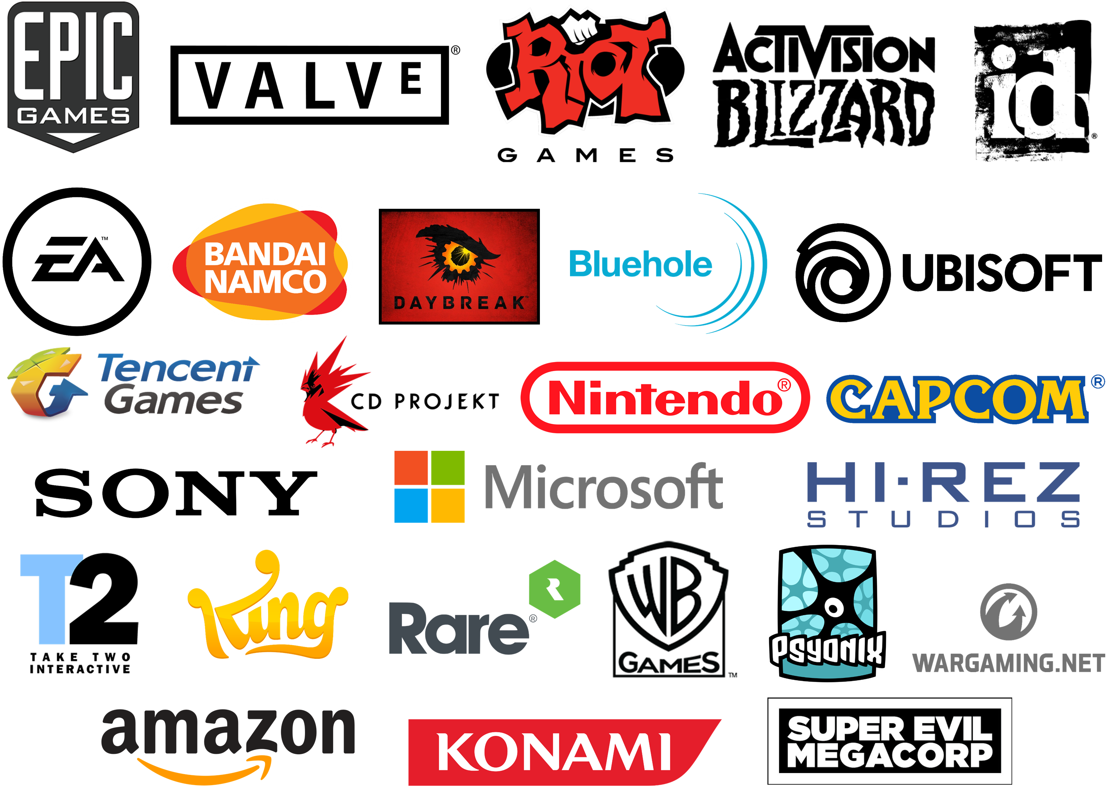
Publishers
Publishers have been developing games since the onset of computers and arcades several decades ago.
Many publishers have created multiple esports games and are tailoring the development of new games to the potential of creating a popular esports title.
Publishers are investing heavily into the community to grow esports, for instance, in 2018 Epic Games announced a $100 Million prize pool for the first competitive year of Fortnite.
Note: Above reflects only a sampling of publishers
30

Slide 31



























Games
There is a huge variety of titles that have competitive esports scenes.
Most major genres of games have multiple esports titles for players to compete in. Many of these titles appeal to casual fans but involve a deep skillset for professional players to hone their craft in competitions.
Some of the most popular game genres are MOBA (Multiplayer Online Battle Arena), Shooters & Battle Royale and Sports.
Note: Above reflects only a sampling of games
31

Slide 32
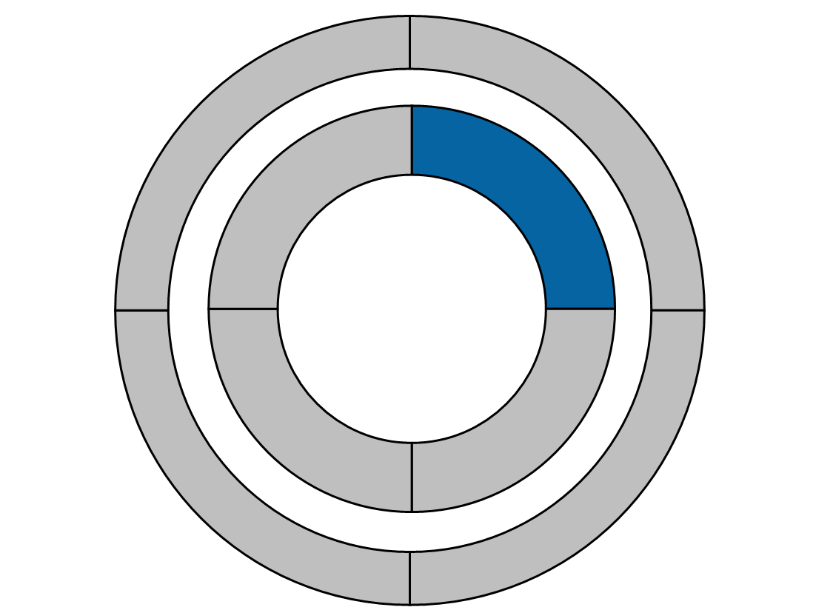

























Leagues
Leagues feature players and teams competing in different season-long formats (similar to traditional sports like MLB, NFL, etc.) to determine a winner.
These leagues hold match-ups throughout the season with many featuring a marquee tournament to crown a champion at seasons’ end.
Some leagues are single-game focused, others align with professional sports leagues while others are collegiate-based.
Note: Only a sampling of leagues
32

Slide 33























Events
As a major fan engagement opportunity, events feature the best players or teams competing against each other in tournaments to crown a champion.
Events are made for both in-venue spectators and viewers, with most offering video and streaming distribution through various media platforms.
Engagement is high with 60%
of esports fans saying they are willing to travel to see their favorite games, tournaments and players.
Source: Mindshare, Game On: What Marketers Should Know About Esports Fans; Nielsen Esports Playbook; Esports Marketing Blog, Intel Extreme Masters, 2017; Valve
33

Slide 34
Major Events Garner Millions Of Viewers
Esports event viewership has seen double-digit growth and the 2017 IEM Masters drew an unprecedented 46 million viewers across the event.
Increased viewership has also strengthen the Prize Pools available for tournaments. The International 2018 pool was over $25 Million with the top team (OG) sharing $11 Million between the five players. The majority of TI8’s prize pool was crowd-funded through in-game purchases.
Global Event Viewership
Millions
Esports Winnings
$ Millions
Source: Mindshare, Game On: What Marketers Should Know About Esports Fans; Nielsen Esports Playbook; Esports Marketing Blog, Intel Extreme Masters, 2017; Valve; Statista 2018. Annual Esports Prize Money
34

Slide 35



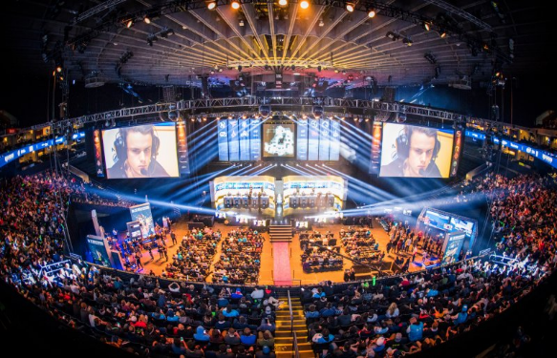
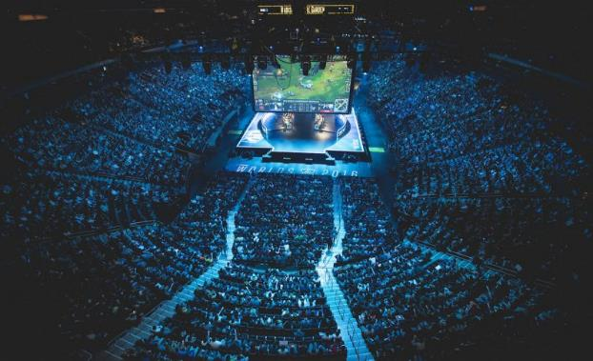
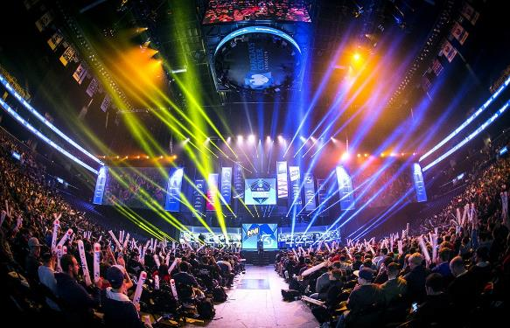
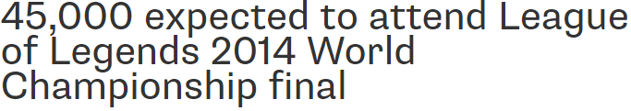
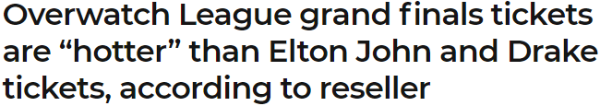




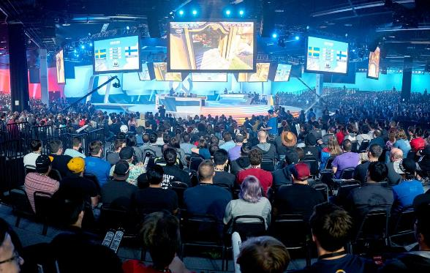
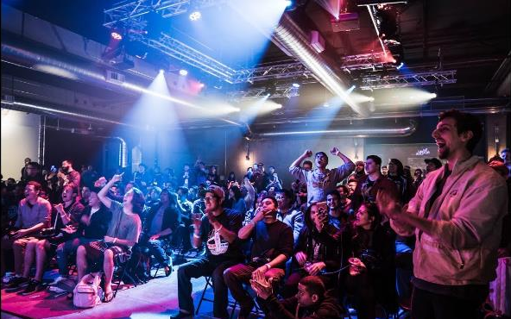
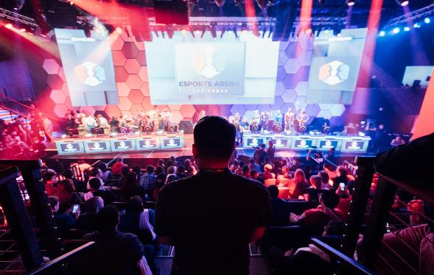



Venues
Adapted Venues
Adapted venues range from traditional sports venues like Madison Square Garden to convention centers around the world. These venues allow events to be held in any major city without long term infrastructure investment into esports.
Esports specific venues provide fans with a more intimate and engaging experience. The development of these venues have accelerated with numerous announcements in 2018 of multi-million dollar venues being built specifically for esports competitions.
Esports Specific Venues
35

Slide 36
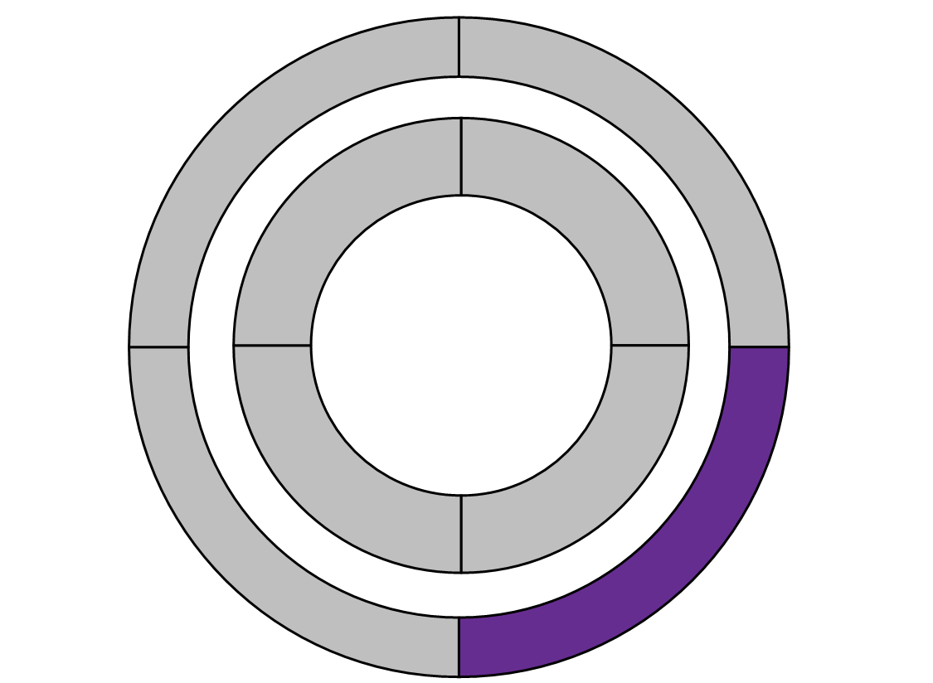




















Media Distributors
Online Platforms
Media Distributors produce and distribute the video streams of esports leagues and events to the public. There are a few ways to watch esports content: Online Platforms, Multiscreen TV and direct in-game spectating.
Traditionally, online platforms have been the main distributors of esports content but, over the last five years, television programmers have been distributing esports over multiscreen TV channels as well.
Some games also have direct in-game spectating options for leagues and tournaments.
Multiscreen TV
36

Slide 37

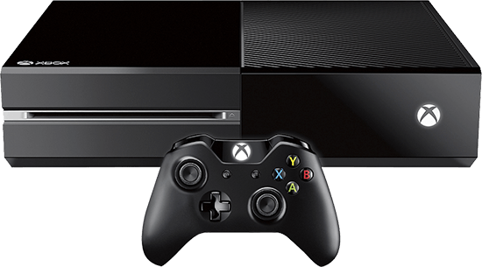
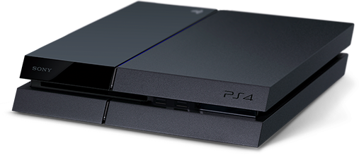
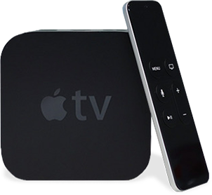

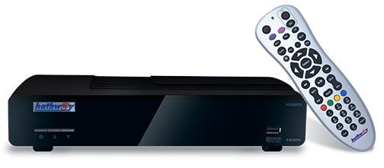
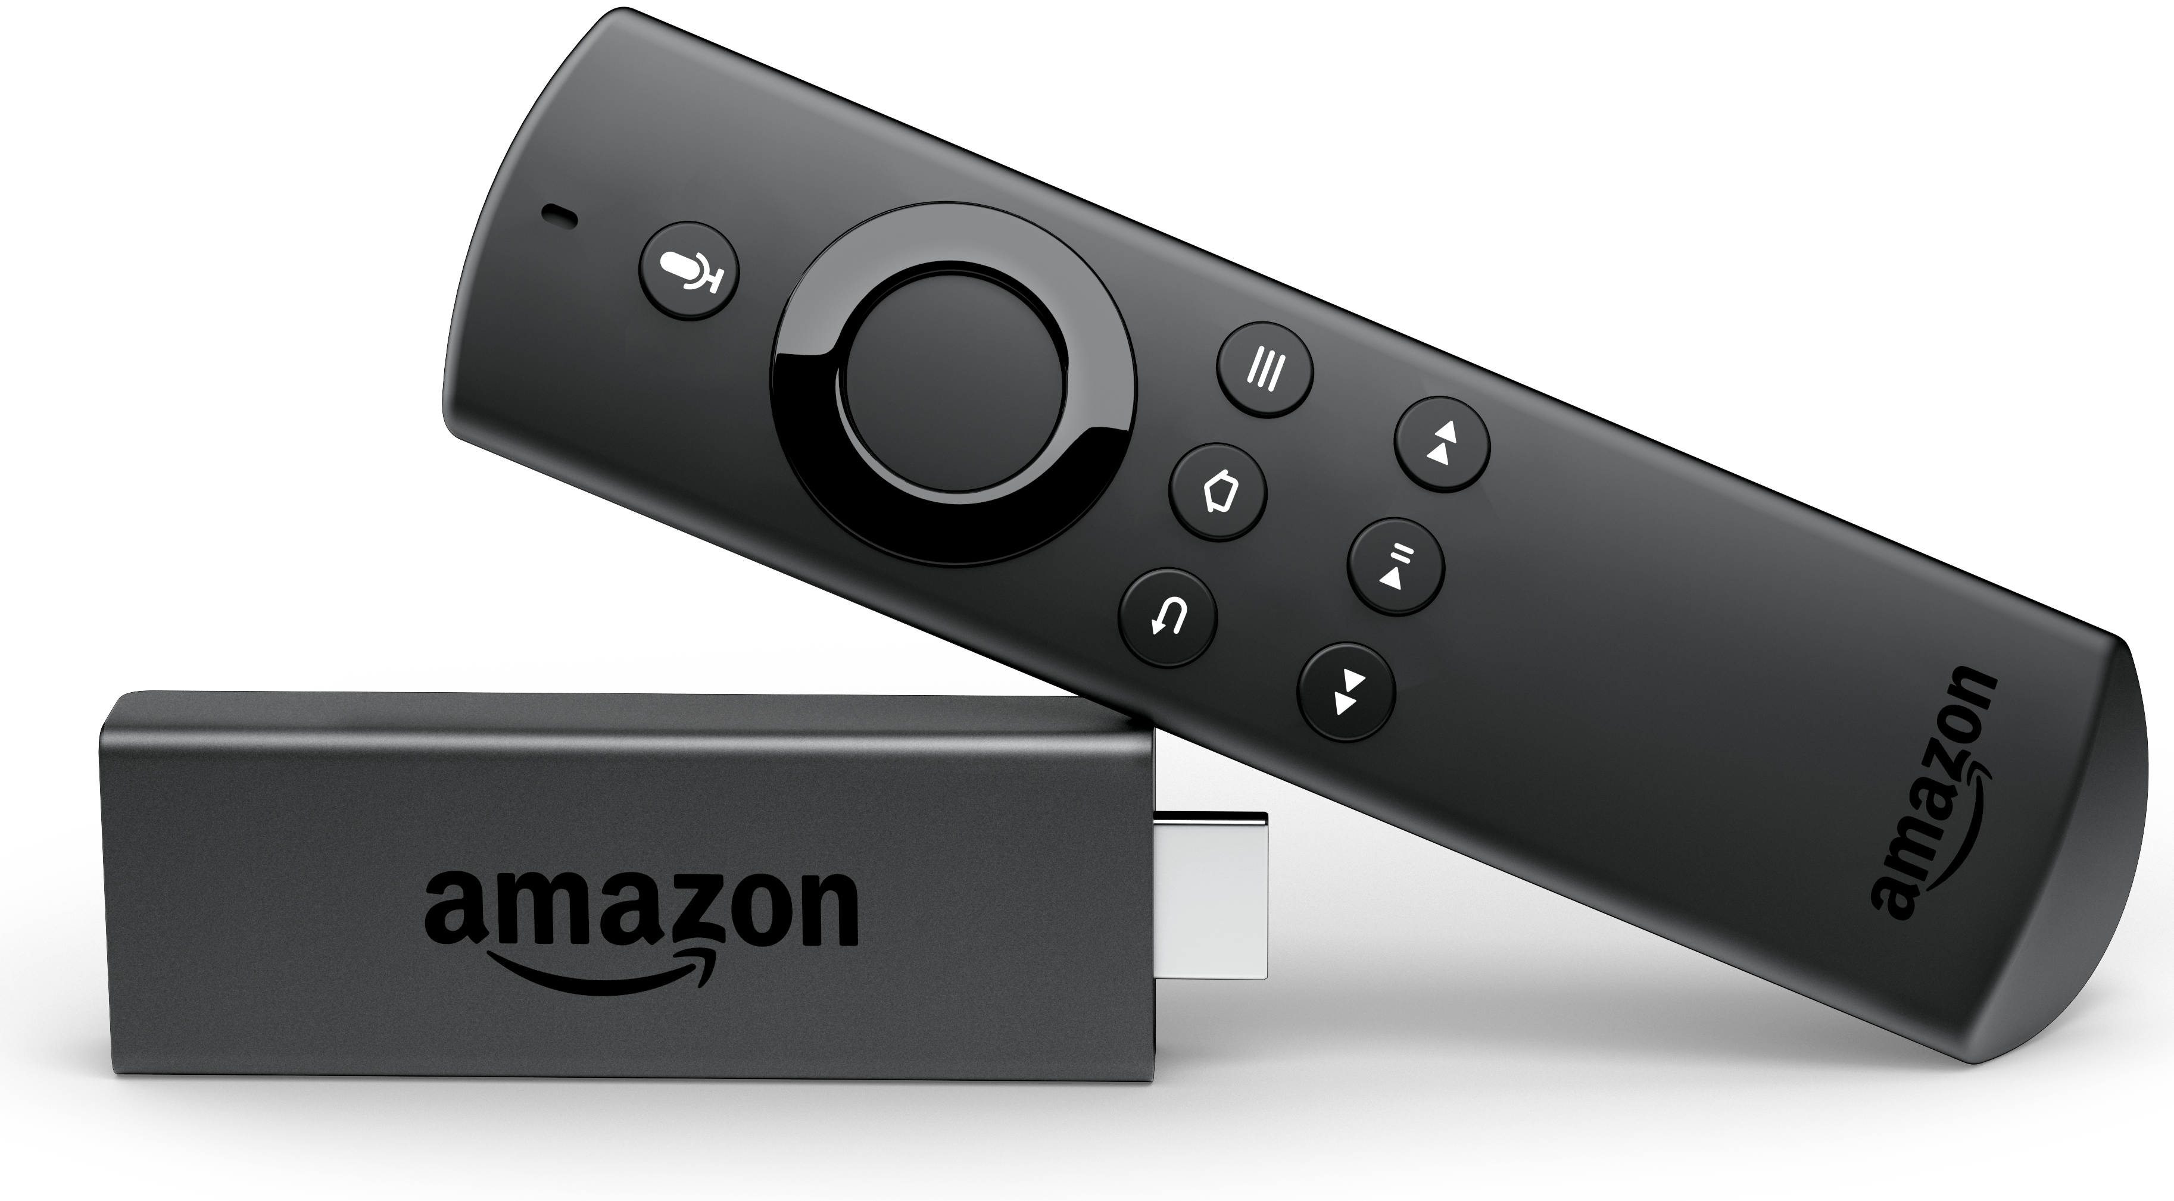





Devices
TVs & Connected Devices
-Streaming Devices (Fire TV Stick, Chromecast, Apple TV)
-Game Consoles
-Smart TVs
-Set Top Boxes
There are three main categories of devices for playing & watching esports:
TV & Connected Devices, Computers, and Mobile Devices.
Esports fans can watch from virtually anywhere and in any setting, from the TV in their living room to streaming through their smartphone.
Computers
-Laptops
-Desktops
-Virtual Reality Headsets
Mobile Devices
-Smartphones
-Tablets
37

Slide 38














Online
Communities
Online Communities
Online communities help to read the pulse of the esports community and allow discussion around individual games and the professional scene - including players, teams and influencers.
Reddit is the largest aggregator of gaming and esports communities, organized into game specific subreddits (/r/Overwatch, /r/Dota2, etc.).
Twitter hosts discussions based around players and personalities in each community.
1,977,060
Subscribers
1,546,508
Subscribers
827k
Followers
838k
Followers
/r/LeagueOfLegends
/r/Overwatch
@shroud
@FallenCS
Source: Reddit.com & Twitter.com as of 11/2/18
38

Slide 39
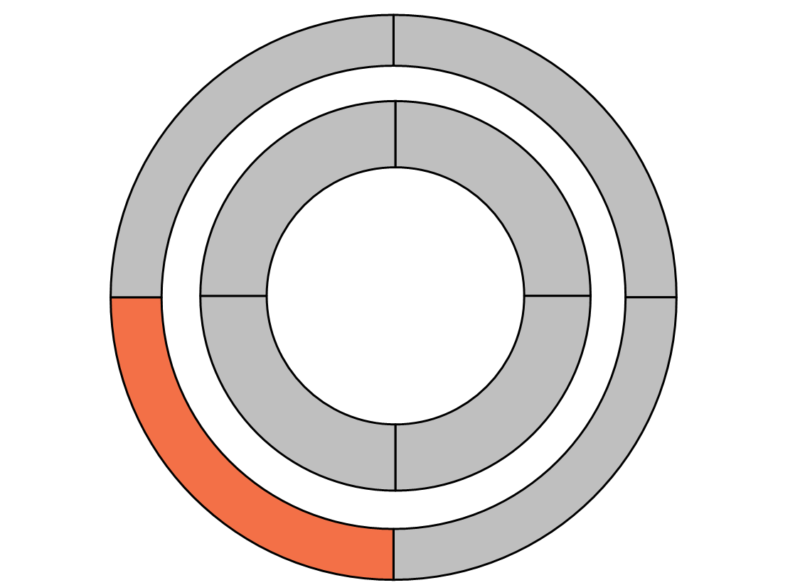


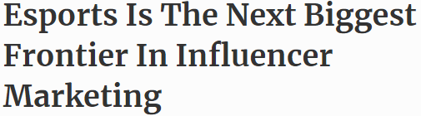
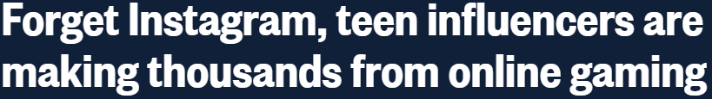


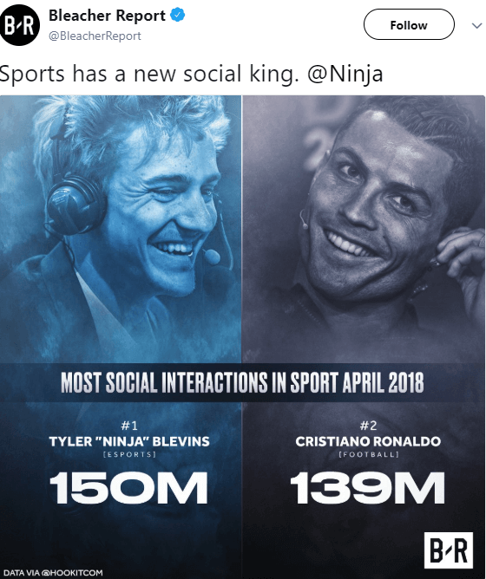
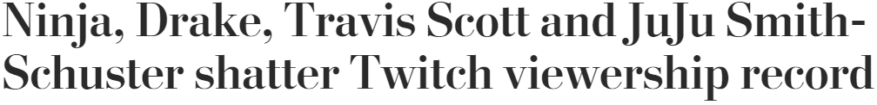
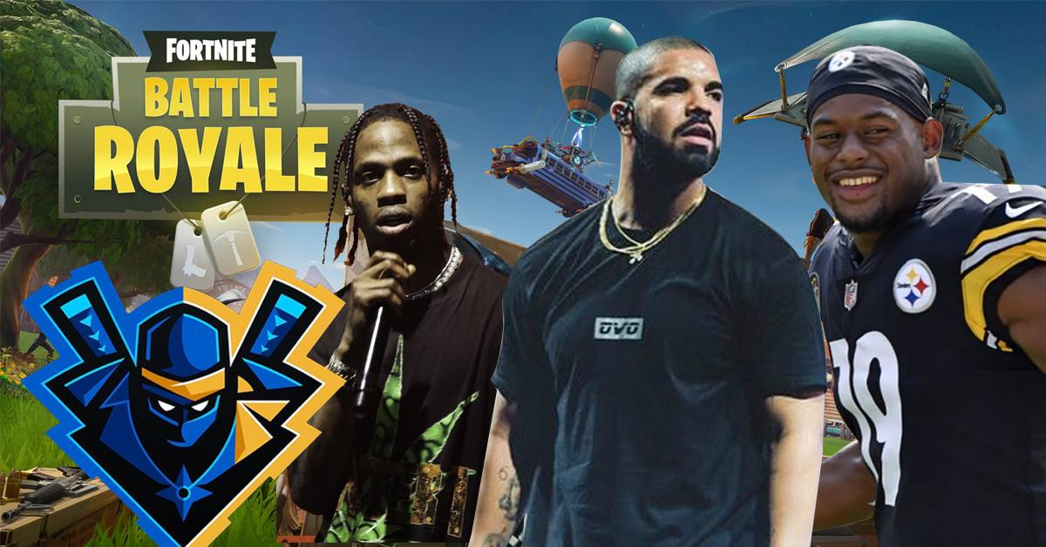
Influencers
Influencers are making a big splash in esports. Whether they are a professional gamer, esports caster or Twitch streamer, influencers are found in many aspects of esports communities and marketing.
The biggest esports influencer today is Ninja, a professional gamer who emerged as a household name after streaming with celebrities, making viral highlight videos and hosting game-specific events.
Ninja was the first esports athlete/influencer to be on the cover of ESPN the Magazine. Not only is he a household name, but he also outpaced Cristiano Ronaldo in social interactions.
One infamous stream featured rappers Drake and Travis Scott, along with Steelers WR JuJu Smith-Schuster, which broke Twitch viewership records for a non-tournament stream with 630,000 average concurrent viewers for the duration.
39

Slide 40

The ‘Mainstreaming’ Of Esports

Slide 41
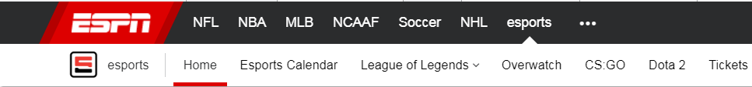

















Established Platforms
Emerging Publications
Esports are being covered by mainstream publications and established sports media, bringing esports to general audiences.
ESPN has a dedicated section just for esports
Esports has also led to the creation of a whole new segment with esports-specialized media platforms.
Esports News Is Covered On Established Platforms And Within Emerging Publications That Specifically Target Esports Fans
41

Slide 42







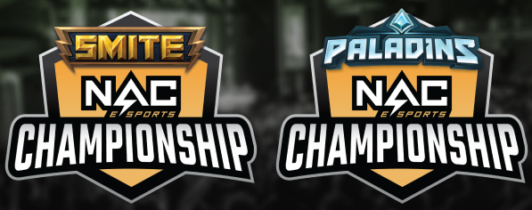













Not only is esports permeating media and culture, colleges are also leaning into the draw & allure of the sport.
Many colleges are creating varsity esports teams and providing scholarships.
Collegiate esports leagues & tournaments provide student athletes with prize pools and professional exposure.
Over 87 colleges in the U.S. have a varsity esports program
Source: ESPN, sample list of varsity esports programs, spans North America
42

Slide 43






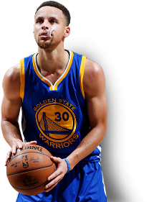























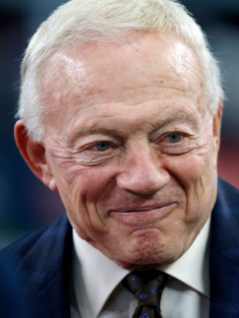


Sports Organizations
Celebrities
Traditional Sports Organizations And Owners Along With Celebrities And Corporate Entities Are Investing Heavily In Esports
DJ Steve Aoki
Drake
Steph Curry
Shaquille O’Neal
Alex Rodriguez
Jeremy Lin
Jennifer Lopez
Michael Strahan
Rodger Saffold
Marshawn Lynch
Rick Fox
Tony Robbins
Sports Team Owners
Corporate
Michael Jordan
Magic Johnson
Mark Cuban
Robert Kraft
Jerry Jones
43

Slide 44

Growth In Multiscreen Engagement

Slide 45
Reach & Engagement Within The Online Gaming Category Increased By Double-Digits YoY, Driven By Millennial Males
Monthly Reach
Total Audience
(000) - September
Average Minutes Per Visitor
Total Audience
September
Total Time Spent
Total Audience
Aggregated Minutes (MM) - September
+23%
+41%
+74%
Sept 2018 Stats:
Male Comp %: 59%
M18-34 Index: 204
Average Minutes / Male Visitor: 187
Average Minutes / M18-34 Visitor: 235
Male % of Total Time Spent: 71%
M18-34 Index: 248
M18-34 Index examples: Monthly Reach - M18-34 reach composition for the online gaming category is 104% higher than the online population; Total Time Spent – the % of total time spent with the online gaming category by M18-34 is 148% higher than the % of time spent vs. total internet
Source: comScore MediaMetrix Key Measures, Multiplatform, Total Audience (desktop P2+; mobile P18+), September 2017 & 2018, U.S. only. Category: Gaming Information (includes platforms like Twitch, IGN, Curse, Take Two Interactive, Microsoft Games, Blizzard Entertainment, etc).
45

Slide 46

















M18-34 Average Minutes Per Visitor
September 2018
Among Millennial Males, Gaming Has Some Of The Highest Engagement Across Targeted Digital Platforms
Gaming Website
Non-Gaming Website
Source: VAB analysis of comScore MediaMetrix Key Measures multiplatform (desktop + mobile) data, September 2018, U.S. only. Males 18-34, Average Minutes Per Visitor. comScore MediaMetrix data includes all visitor activity except for mobile video. Excludes streaming music websites.
46

Slide 47

4.3 Hours
spent watching TV weekly among the average esports fan
Esports Fans Consume More Linear TV Overall Than Multi-Screen Esports Content
2.4 Hours
spent with esports weekly among the average esports fan
Source: Nielsen, The Esports Playbook 2017. esports activity = related to pro competitive gaming, such as watching, attending, following, competing etc.
47

Slide 48





















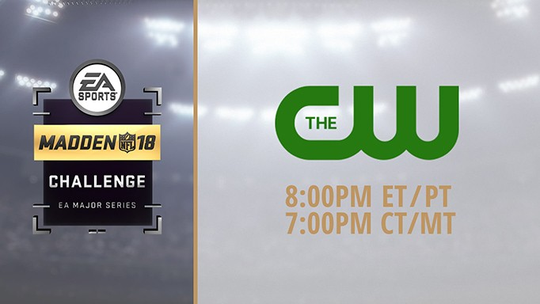

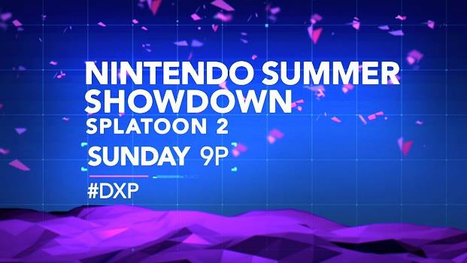
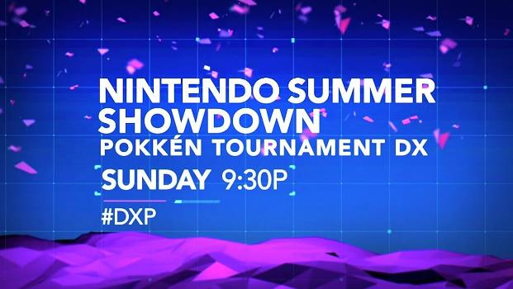
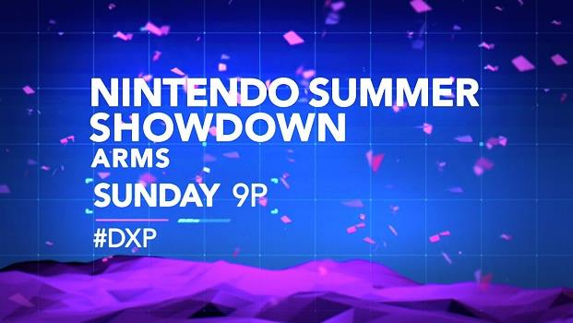
Because Of Fans’ Video Consumption Habits, Esports Leagues And Tournaments Now Air On A Diverse Set Of TV Networks
Networks
Leagues
Tournaments
Source: Nielsen NPower Reach & Frequency Report, Live+7, based on broadcast year ‘16-’17 & ‘17-’18; Nielsen NPower PowerPlay Report, based on broadcast year ‘16-’17 & ‘17-’18.
48

Slide 49


308
Hours of esports programming aired on linear TV in ‘17-‘18 season
+46%
vs. prior season
The # of Esports TV Programming Hours Grew By Almost 50% YoY In 2018
231
Telecasts of esports programming on linear TV in ‘17-‘18 season
23.8 Million
cume hours viewed of esports TV programming
in ‘17-‘18 season
Source: Nielsen NPower Reach & Frequency Report, Live+7, Broadcast Year ‘16-’17 vs. ‘17-’18; Nielsen NPower PowerPlay Report, Broadcast Year ‘16-’17 vs. ‘17-’18. Reflects U.S. data. Totals include originals + repeats.
49

Slide 50


Median Age of the Esports TV Viewer Is 32…
…With A 63% Male Skew
Source: Nielsen Ratings Analysis Program Report, Live+7, Broadcast Year ‘16-’17 & ‘17-’18. Median Age = average median age of esports TV programming. Composition based on average viewership of esports TV programming. Reflects U.S. data.
50

Slide 51

+33%
YoY Lift in Reach With P18-24
(+30% for M18-24)
Esports TV Programming Has Seen A Double-Digit Increase In Reach Against Young Millennials Over The Last Year
1.7 Million Hours
Cume viewership of esports TV programming by P18-24
+20%
Increase YoY
(+26% for M18-24)
Source: Nielsen NPower Reach & Frequency Report, Live+7, P18-24 & M18-24, Broadcast Year ‘16-’17 vs.’17- ‘18. Reflects U.S. data.
51

Slide 52
Demographic Reach On Esports TV Programming
In Fact, Nearly All Key Demos Have Seen A Double-Digit Increase In Reach Through Esports TV Programming
+19%
+17%
+33%
+16%
+8%
+16%
+14%
Source: Nielsen NPower Reach & Frequency Report, Live+7, Broadcast Year ‘16-’17 vs. ‘17-’18; Nielsen NPower PowerPlay Report, Broadcast Year ‘16-’17 vs. ‘17-’18. Reflects U.S. data.
52

Slide 53

Esports Advertising & Opportunities

Slide 54


A Majority Of Esports Fans
Have A Positive Attitude Towards Advertising And Product Sampling
58%
63%
of esports fans have positive attitudes towards brand involvement in esports
of esports fans definitely try products shown during esports games
Source: Research Now, Esports Gaming, Question: How strongly do you AGREE (strongly agree / agree somewhat) with each of these statements about Esports?; Nielsen, The Esports Playbook 2017
54

Slide 55





41%
Think that sponsors are critical to the success of esports
(134 index vs. traditional sports fan)
Furthermore, Team & Player Sponsorships Touch Esports Fans Throughout The Marketing Funnel, From Awareness To Advocacy
Awareness
Consideration
Intent
Purchase
Advocacy
43%
30%
35%
29%
31%
Notice brands that teams and athletes use/ wear during games/events
(172 index)
Believe that a product is better if their favorite team/athlete supports it
(253 index)
Are more willing to try a new brand if it sponsors the team they follow
(236 index)
Will try to buy the same brand if used by their favorite team/athlete
(288 index)
Say loyalty to their favorite teams means they support their sponsors, no matter what
(263 index)
Source: Simmons, Justifying Brand Investments in Esports, December 2018. Index is against traditional sports fans
55

Slide 56
42%
said they’d like them to give away free stuff
(ex: tournament tickets, computer hardware, t-shirts and hats)
said that they’d like them to demo new games and maps
said that they’d like them to provide customized in-game experiences/items
said that they’d like them to provide access to exclusive tips and tricks on gameplay from esports athletes
said that they’d like them to help meet their favorite teams and athletes
41%
What Do Esports Fans Want From Advertisers & Sponsors?
34%
32%
30%
Mindshare, Game On: What Marketers Should Know About Esports Fans
56

Slide 57

















From an advertising and sponsorship perspective, esports was originally built on endemic gamer brands, mainly in the computer hardware & software categories.
Most of the brands continue to have heavy exposure throughout the ecosystem.
57

Slide 58
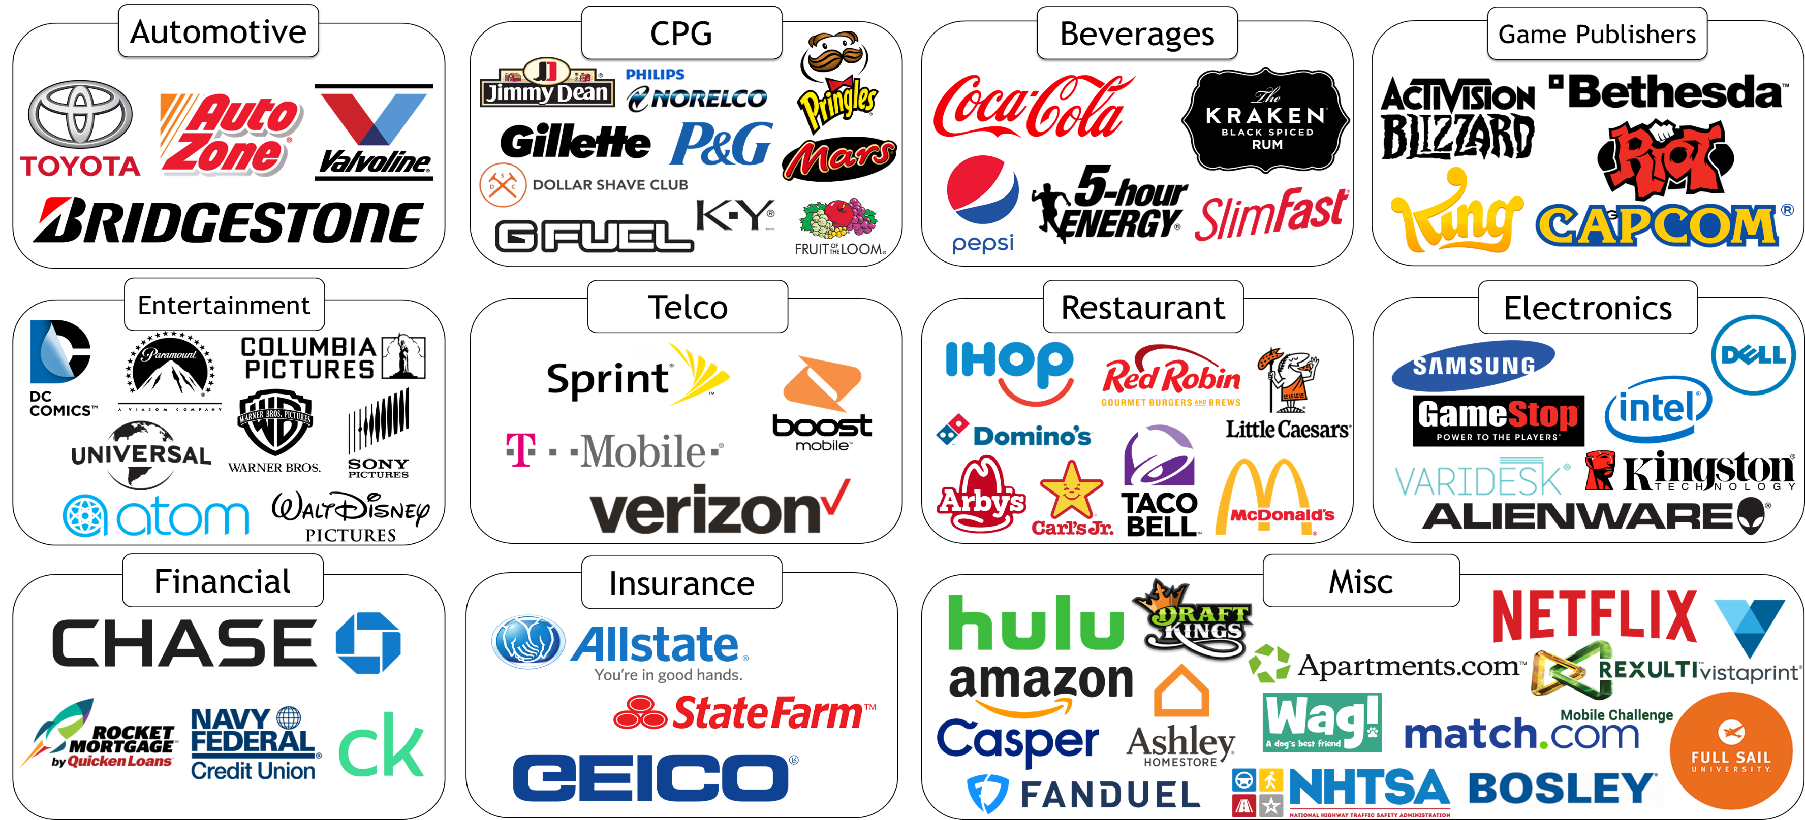
With Its Multiscreen TV Presence, Esports Advertising Has Now Grown Well Beyond Endemic Brands And Into Numerous Non-Endemic Categories
The # of TV advertisers within esports programming increased by 13% from 2017 vs. 2018
Source: Nielsen AdIntel, 2017-18, esports programming selection. # of TV advertiser % based on 1Q-3Q ‘17 vs. 1Q-3A ‘18
58

Slide 59












Teams & Players
Leagues & Events
There Are Several Main Types Of Sponsorships, Many Of Which Are Structured Like Traditional Sports Sponsorships With Media As A Part Of An Overall Package
Genres & Titles
Influencers
59

Slide 60
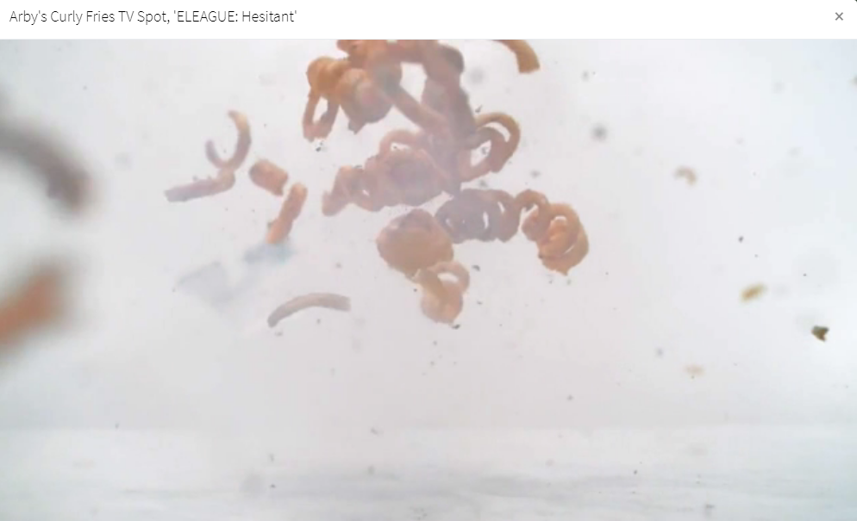













Advertising / Sponsorship Assets & Activation Ecosystem
Television
(:06, :15, :30, :60 Creatives, Custom Commercial Creatives, Customized Sponsored Content)
Digital
(Playable Video Ads, Clickable banners beneath video, brands participation in chats, etc)
Physical
(Jerseys, Analyst Desk, Scrimmage Rooms, and more)
Content
(Event Sponsorship, Interstitial Content, Highlights)
Social
(Banners, Social Brand Posts, Sponsored Social Content)
60

Slide 61

America’s ‘Most Elusive Demographic’ Is Found In Esports
Reach an passionate, desirable, elusive but receptive audience
Interact with engaged fans to lift your brand
Align with a fast-growing, dynamic new sport across platforms and programming
61

Slide 62




Contact Us
Jason Wiese
SVP, Director of Strategic Insights
jasonw@thevab.com
Join Our Email List
Reed Kiely
Senior Multi-Platform Video Analyst reedk@thevab.com
VAB (Video Advertising Bureau)
@VideoAdBureau

