Slide 1



Engaging Frequent Video Streamers Through Cinema

Slide 2
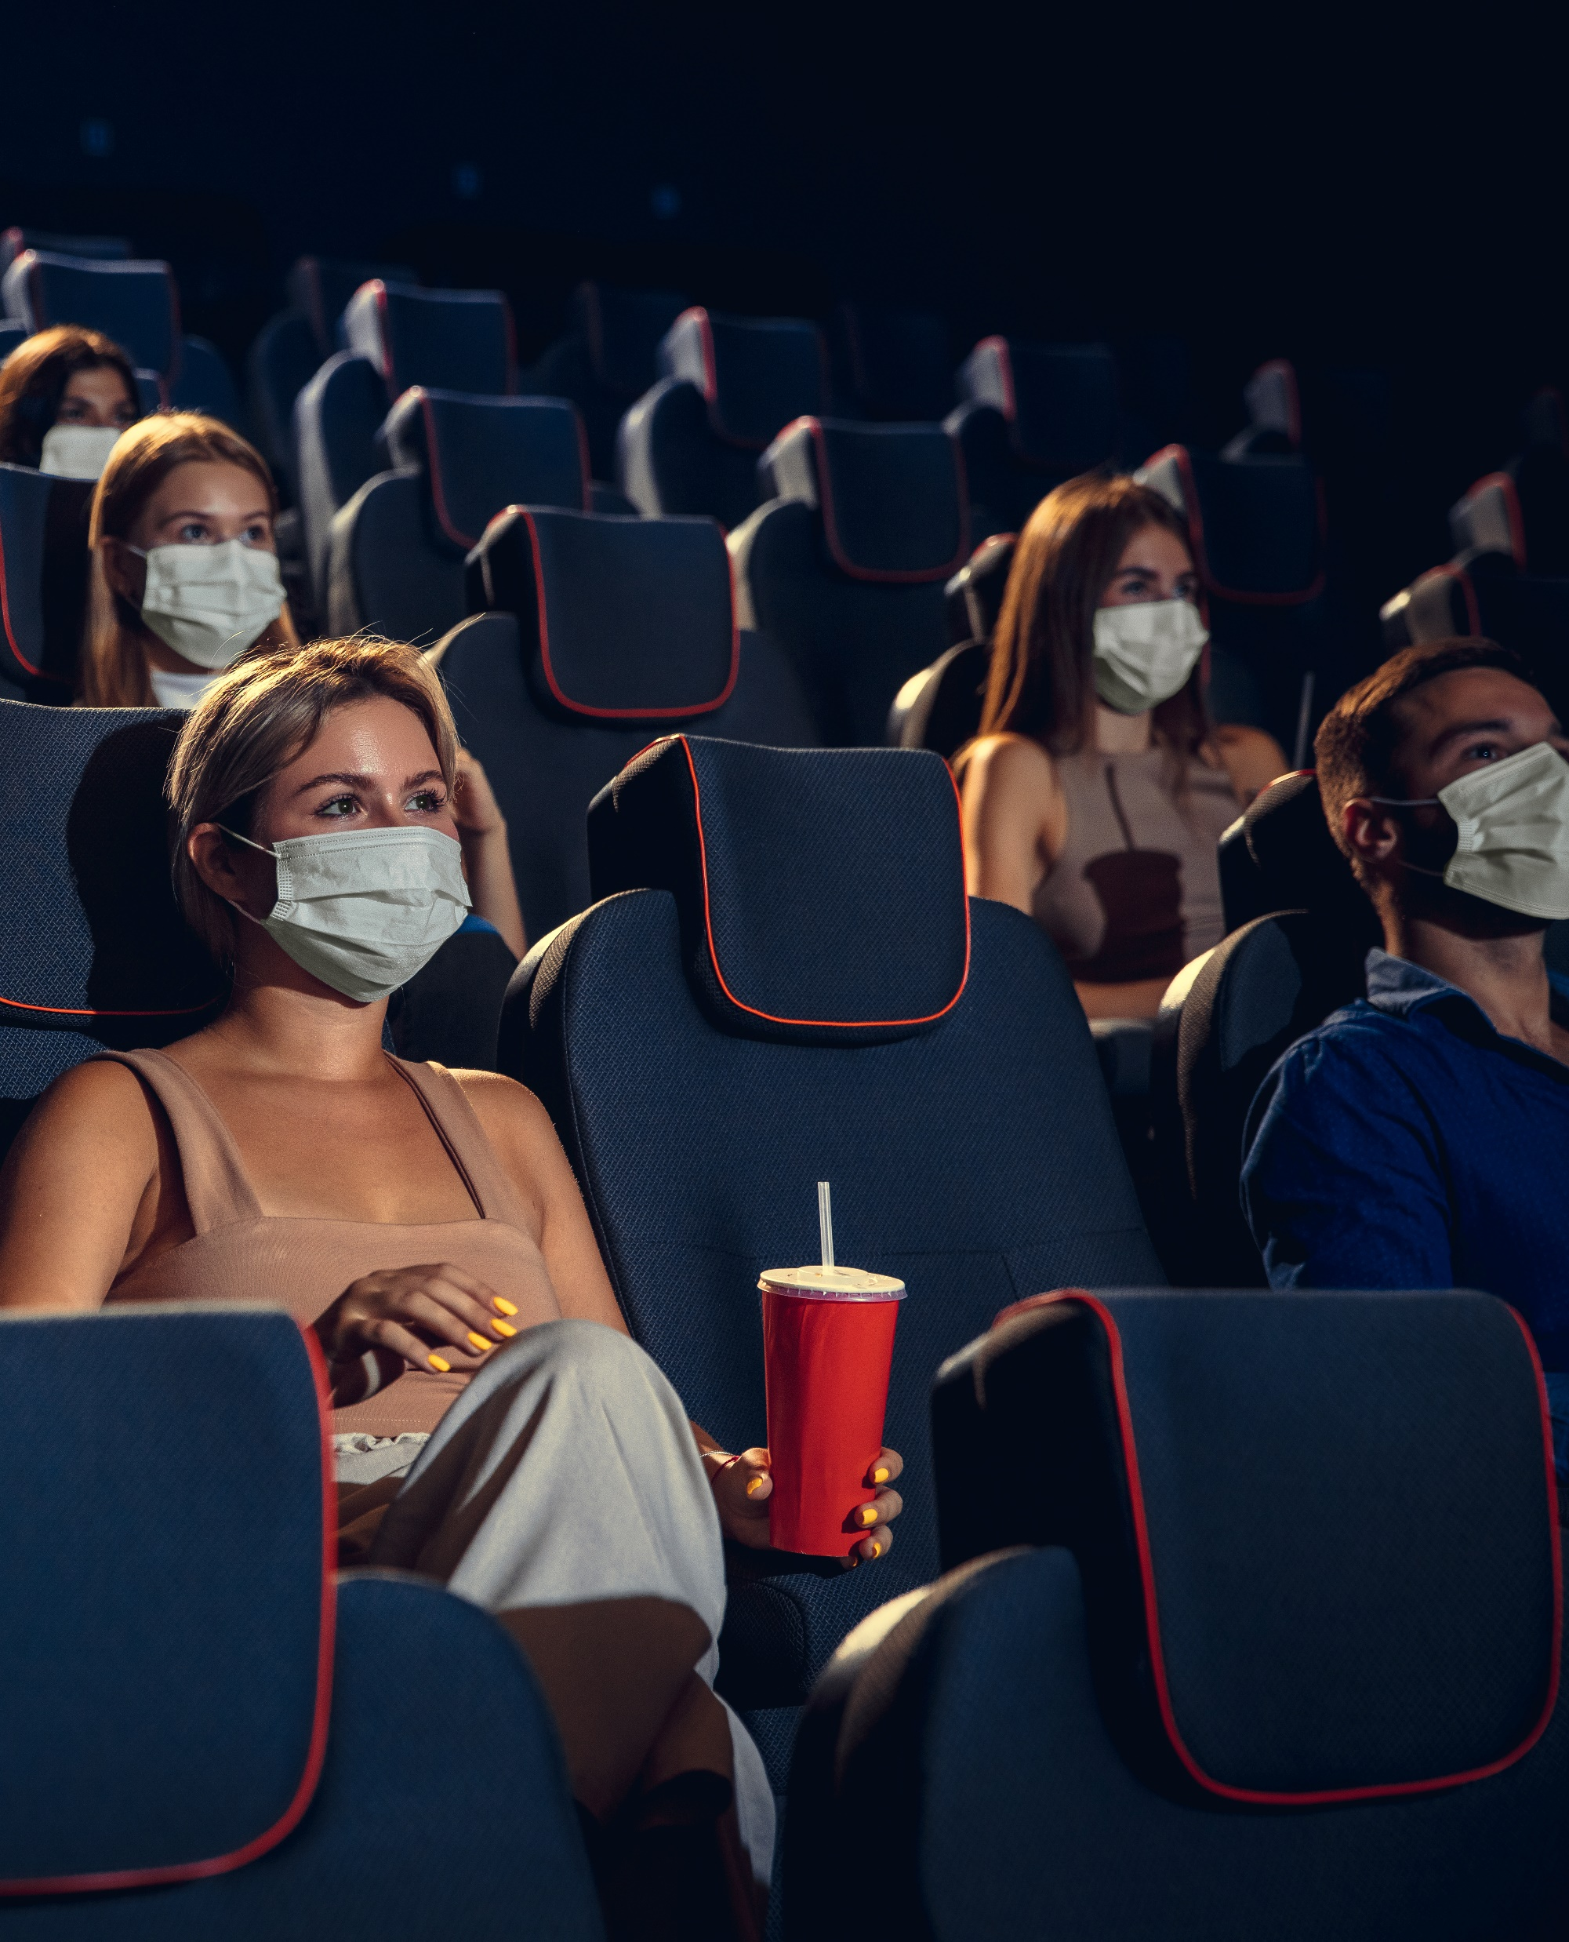

As COVID-19 restrictions loosen throughout the country, the pent-up desire to see movies on the
big screen has many people eager to go back to
the theater soon.*
One of the most eager groups to return are frequent video streamers. These inherently social beings enjoy spending time with friends and have always been habitual movie-goers who love the in-theater viewing experience.
Learn about video streamers’ psychographics and their specific movie-going behaviors so you can successfully engage these audiences as we
welcome them back to their local cineplex.
Source: Nielsen Total Audience Report, March 2021, based on a special COVID-related advertising survey fielded in February 2021, (Top 2 Box – very eager / somewhat eager) – ’63% of respondents are eager to go to a movie theater 0-3 months of covid restrictions being lifted.’
This information is exclusively provided to VAB members and qualified marketers. Further distribution is prohibited.
PAGE 2

Slide 3

  Frequent video streamers are social beings and more likely
  to be frequent movie goers

Slide 4



Frequent video streamers are inherently social beings and enjoy spending time with their close circle of friends
Pre-pandemic, over one-third of frequent streamers spent 3+ hours socializing and doing things with friends each week
58% of frequent streamers consider themselves to be
very sociable
Frequent streamers are 64% more likely than
the average adult to
be heavy users
of social media
Source: MRI-Simmons, GFK MRI Spring 2020, fielded March 2019 - May 2020. Base: P18+, ‘frequent’ video streamer (14% of streamers) - video streaming 10+ hours weekly. Streaming services include: AppleTV+, Amazon Prime Video, Disney+, Hulu or Netflix. Heavy user of social media – Quintile I of media consumption.
This information is exclusively provided to VAB members and qualified marketers. Further distribution is prohibited.
PAGE 4

Slide 5
While they enjoy doing many things out of the home, the shared experience of going to the movies was the most popular leisure activity among frequent video streamers pre-pandemic
Leisure Activities
(in the last 12 months – pre-pandemic)
Source: MRI-Simmons, GfK MRI Spring 2020, fielded March 2019 - May 2020; Base: P18+, ‘frequent’ video streamer (14% of streamers) – video streaming 10+ hours weekly. Streaming services include: AppleTV+, Amazon Prime Video, Disney+, Hulu or Netflix. Leisure activities – participated in last 12 months.
This information is exclusively provided to VAB members and qualified marketers. Further distribution is prohibited.
PAGE 5

Slide 6
Frequent video streamers are more likely than the average adult,
and even occasional streamers, to be habitual movie goers
In fact, according to a recent survey by Roku, 82% of users said that even though they can watch movies at home, they still love going to the movie theater
Pre-Pandemic Movie Attendance: Video Streamers vs. Adults 18+
‘Frequent’ / ‘Occasional’ Video Streamers
Once a Week or More
2+ Times a Month
At Least Once a Month
19%
of frequent video streamers went to the movies at least once a month pre-pandemic
‘Frequent’
Video Streamers:
vs. A18+
+17%
More likely
+23%
More likely
+23%
More likely
‘Occasional’
Video Streamers:
vs. A18+
-11%
less likely
-5%
less likely
+7%
more likely
16%
of occasional video streamers went to the movies at least once a month pre-pandemic
How to read: ‘Frequent’ video streamers are 17% more likely than the average adult to go to the movies at least once a week.
Source: MRI-Simmons, GfK MRI Spring 2020, fielded March 2019 - May 2020, Base: P18+, ‘frequent’ video streamer (14% of streamers) – video streaming 10+ hours weekly,‘ occasional’ video streamer (28% of streamers) – video streaming 5-9 hours weekly. Streaming services include: AppleTV+, Amazon Prime Video, Disney+, Hulu or Netflix. Frequency = # of times attended a movie in the last 90 days. Roku, ‘The Future of Movies: How Theaters & Studios Can Thrive in the Streaming Era,’ 2020
This information is exclusively provided to VAB members and qualified marketers. Further distribution is prohibited.
PAGE 6

Slide 7
Due to their excitement around films, frequent video streamers are also more likely than both the average adult and occasional streamer to see
a new movie on its opening weekend
When Do You Prefer To See A New Movie?: Video Streamers vs. Adults 18+
‘Frequent’ / ‘Occasional’ Video Streamers
Opening Weekend
Within First Two Weekends
33%
of frequent video streamers go to see a movie within the first two weekends
of release
‘Frequent’
Video Streamers:
vs. A18+
+26%
More likely
+16%
More likely
‘Occasional’
Video Streamers:
vs. A18+
+2%
more likely
+22%
more likely
35%
of occasional video streamers go to see a movie within the first two weekends
of release
How to read: ‘Frequent’ video streamers are 26% more likely than the average adult to see a new movie on its opening weekend.
Source: MRI-Simmons, GfK MRI Spring 2020, fielded March 2019 - May 2020, Base: P18+, ‘frequent’ video streamer (14% of streamers) – video streaming 10+ hours weekly,‘ occasional’ video streamer (28% of streamers) – video streaming 5-9 hours weekly. Streaming services include: AppleTV+, Amazon Prime Video, Disney+, Hulu or Netflix.
This information is exclusively provided to VAB members and qualified marketers. Further distribution is prohibited.
PAGE 7

Slide 8
As cinephiles, frequent video streamers are also more likely to experience movies in premium, more expensive, non-traditional formats at theaters
Non-Traditional Movie Formats: Video Streamers vs. Adults 18+
‘Frequent’ / ‘Occasional’ Video Streamers
Watched a 3D Movie in a Theater
Watched in an IMAX Theater
18%
of frequent video streamers watched a 3D or an IMAX movie ‘in the last 12 months’ pre-pandemic
‘Frequent’
Video Streamers:
vs. A18+
+35%
More likely
+25%
More likely
‘Occasional’
Video Streamers:
vs. A18+
+30%
more likely
+26%
more likely
18%
of occasional video streamers watched a 3D
or an IMAX movie ‘in the last 12 months’ pre-pandemic
How to read: ‘Frequent’ video streamers are 35% more likely than the average adult to have seen a 3D movie in the theaters within the last 12 months.
Source: MRI-Simmons, GfK MRI Spring 2020, fielded March 2019 - May 2020, Base: P18+, ‘frequent’ video streamer (14% of streamers) – video streaming 10+ hours weekly,‘ occasional’ video streamer (28% of streamers) – video streaming 5-9 hours weekly. Streaming services include: AppleTV+, Amazon Prime Video, Disney+, Hulu or Netflix. Based on ‘in the last 12 months.’
This information is exclusively provided to VAB members and qualified marketers. Further distribution is prohibited.
PAGE 8

Slide 9
  Affluent frequent video streamers are also social beings and more likely to be frequent movie goers

Slide 10
Much like the overall streamer, affluent frequent video streamers are social beings who enjoy spending time with their close circle of friends
Pre-pandemic, nearly
four in ten affluent frequent streamers spent 3+ hours socializing and doing things with friends each week
62% of affluent frequent streamers consider themselves
to be very sociable
Affluent frequent streamers are 51% more likely than the average affluent adult to be heavy users
of social media
Source: MRI-Simmons, GfK MRI Spring 2020, fielded March 2019 - May 2020, Base: Adults 18+ HHI $100K+, affluent ‘frequent’ video streamer (33% of affluent streamers) – video streaming 10+ hours weekly. Streaming services include: AppleTV+, Amazon Prime Video, Disney+, Hulu or Netflix. Heavy user of social media – Quintile I of media consumption.
This information is exclusively provided to VAB members and qualified marketers. Further distribution is prohibited.
PAGE 10

Slide 11
Just as we saw with overall frequent streamers, going to the movies was the most popular leisure activity among affluent frequent video streamers pre-pandemic
Leisure Activities
(in the last 12 months – pre-pandemic)
Source: MRI-Simmons, GfK MRI Spring 2020, fielded March 2019 - May 2020, Base: Adults 18+ HHI $100K+, affluent ‘frequent’ video streamer (12% of affluent streamers) – video streaming 10+ hours weekly. Streaming services include: AppleTV+, Amazon Prime Video, Disney+, Hulu or Netflix. Leisure activities – participated in last 12 months.
This information is exclusively provided to VAB members and qualified marketers. Further distribution is prohibited.
PAGE 11

Slide 12
Affluent frequent video streamers are much more likely than the average affluent adult and occasional streamer to also be frequent movie goers
Pre-Pandemic Movie Attendance: Affluent Video Streamers vs. Affluent Adults 18+
Affluent ‘Frequent’ / ‘Occasional’ Video Streamers
2+ Times a Month
At Least Once a Month
25%
of affluent frequent video streamers went to the movies at least once a month pre-pandemic
Affluent ‘Frequent’
Video Streamers:
vs. Affluent A18+
+72%
More likely
+40%
More likely
Affluent ‘Occasional’
Video Streamers:
vs. Affluent A18+
-17%
less likely
-2%
more likely
18%
of affluent occasional video streamers went to the movies at least once a month pre-pandemic
How to read: Affluent ‘frequent’ video streamers are 72% more likely than the average affluent adult to go to the movies at least twice a months.
Source: MRI-Simmons, GfK MRI Spring 2020, fielded March 2019 - May 2020, Base: Adults 18+ HHI $100K+, affluent ‘frequent’ video streamer (12% of affluent streamers) – video streaming 10+ hours weekly, affluent ‘occasional’ video streamer (33% of affluent streamers) – video streaming 5-9 hours weekly. Streaming services include: AppleTV+, Amazon Prime Video, Disney+, Hulu or Netflix. ‘Once a week or more’ frequency (174 index) is not reflected separately due to data instability.
This information is exclusively provided to VAB members and qualified marketers. Further distribution is prohibited.
PAGE 12

Slide 13
Due to their excitement around films, affluent frequent video streamers are also more likely than both the average adult and occasional streamer to see a new movie on its opening weekend
When Do You Prefer To See A New Movie?: Affluent Video Streamers vs. Affluent Adults 18+
Affluent ‘Frequent’ / ‘Occasional’ Video Streamers
Opening Weekend
Within First Two Weekends
38%
of affluent frequent video streamers go to see a movie within the first two weekends of release
Affluent ‘Frequent’
Video Streamers:
vs. Affluent A18+
+22%
More likely
+11%
More likely
Affluent ‘Occasional’
Video Streamers:
vs. Affluent A18+
+6%
more likely
+14%
more likely
39%
of affluent occasional video streamers go to see a movie within the first two weekends of release
How to read: Affluent ‘frequent’ video streamers are 22% more likely than the average affluent adult to see a new movie on its opening weekend.
Source: MRI-Simmons, GfK MRI Spring 2020, fielded March 2019 - May 2020, Base: Adults 18+ HHI $100K+, affluent ‘frequent’ video streamer (12% of affluent streamers) – video streaming 10+ hours weekly, affluent ‘occasional’ video streamer (33% of affluent streamers) – video streaming 5-9 hours weekly. Streaming services include: AppleTV+, Amazon Prime Video, Disney+, Hulu or Netflix.
This information is exclusively provided to VAB members and qualified marketers. Further distribution is prohibited.
PAGE 13

Slide 14
As cinephiles, affluent frequent video streamers are also more likely to experience movies in premium, more expensive, non-traditional formats
at theaters
Non-Traditional Movie Formats: Affluent Video Streamers vs. Affluent Adults 18+
Affluent ‘Frequent’ / ‘Occasional’ Video Streamers
Watched a 3D Movie in a Theater
Watched in an IMAX Theater
19%
of frequent video streamers watched a 3D or an IMAX movie ‘in the last 12 months’ pre-pandemic
Affluent ‘Frequent’
Video Streamers:
vs. Affluent A18+
+39%
More likely
+11%
More likely
Affluent ‘Occasional’
Video Streamers:
vs. Affluent A18+
+31%
more likely
+17%
more likely
20%
of occasional video streamers watched a 3D
or an IMAX movie ‘in the last 12 months’ pre-pandemic
How to read: Affluent ‘frequent’ video streamers are 35% more likely than the average affluent adult to have seen a 3D movie in the theaters within the last 12 months.
Source: MRI-Simmons, GfK MRI Spring 2020, fielded March 2019 - May 2020, Base: Adults 18+ HHI $100K+, affluent ‘frequent’ video streamer (12% of affluent streamers) – video streaming 10+ hours weekly, affluent ‘occasional’ video streamer (33% of affluent streamers) – video streaming 5-9 hours weekly. Streaming services include: AppleTV+, Amazon Prime Video, Disney+, Hulu or Netflix.
This information is exclusively provided to VAB members and qualified marketers. Further distribution is prohibited.
PAGE 14

Slide 15









Upcoming Releases
As vaccinations spread across the population and local restrictions are further loosened, marketers can expect the long-awaited releases of blockbuster movies in theaters soon, and with that, the return
of engaged audiences, particularly video streamers
May 28
May 28
June 4
June 18
June 25
July 2
July 9
July 26
Source: Box Office Mojo as of 4/18/21, release dates are subject to change.
This information is exclusively provided to VAB members and qualified marketers. Further distribution is prohibited.
PAGE 15

Slide 16



Key Takeaways For Marketers
Due to their inherent social nature and love of movies, streaming and cinema has never been an ‘either / or’ choice among frequent video streamers
Frequent video streamers love
the cinema experience
to reach these video-thirsty consumers, many of whom are streaming ad-free content, consider a cinema component as part of a holistic video plan
Frequent video streamers are also
‘first in line’ frequent moviegoers
align cinema activations with new movie releases throughout the year and not just concentrated on holiday weekends or during the summer
Engaging with ‘streaming cinephiles’
consider aligning your brand and brand messaging with premium experiences (3D screens, in-theater activations)
to engage frequent streamers in
a cinema environment
Similar findings among all frequent streamers & affluent frequent streamers
This information is exclusively provided to VAB members and qualified marketers. Further distribution is prohibited.
PAGE 16

Slide 17

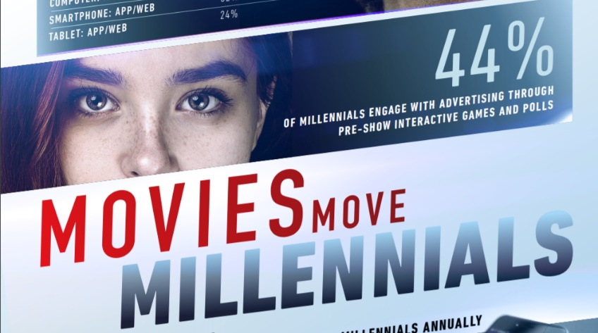
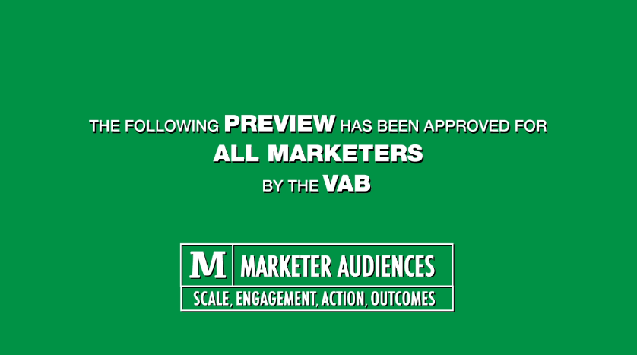
Creators
Jason Wiese
Reed Kiely
SVP, Director of Strategic Insights
jasonw@thevab.com
Insights Manager
reedk@thevab.com
The Power of Super Cinema Goers
Super Spenders, Social and Active Consumers
Discover more
Looking for more data, insights and takeaways? Check out this related VAB content
Movies Move Millennials
Cinema Ads Inspire Millennial Action
Cinema Highlights Trailer
Driving Action By Millennials, Delivering Outcomes For Brands
VAB Members, brand marketers and agencies get free and immediate access to VAB’s content library. Get access at theVAB.com
This information is exclusively provided to VAB members and qualified marketers. Further distribution is prohibited.
PAGE 17

Slide 18

About VAB
VAB is an insights-driven organization that inspires marketers to reimagine their media strategies resulting in fully informed decisions.
Drawing on our marketing expertise, we simplify the complexities in our industry and discover new insights that transform the way marketers look at their media strategy.
Discover
We keep you one step ahead with the latest thinking so you can create innovative, forward-looking strategies.
Simplify
We save you time by bringing you the latest data & actionable takeaways you can use to inform your marketing plans.
Transform
We help you build your brand by focusing on core marketing principles that will help drive tangible business outcomes.
We are committed to your business growth and proud to offer VAB members, brand marketers and agencies complimentary access to our continuously-growing Insights library. Get immediate access at theVAB.com.
This information is exclusively provided to VAB members and qualified marketers. Further distribution is prohibited.
PAGE 18

