Slide 1

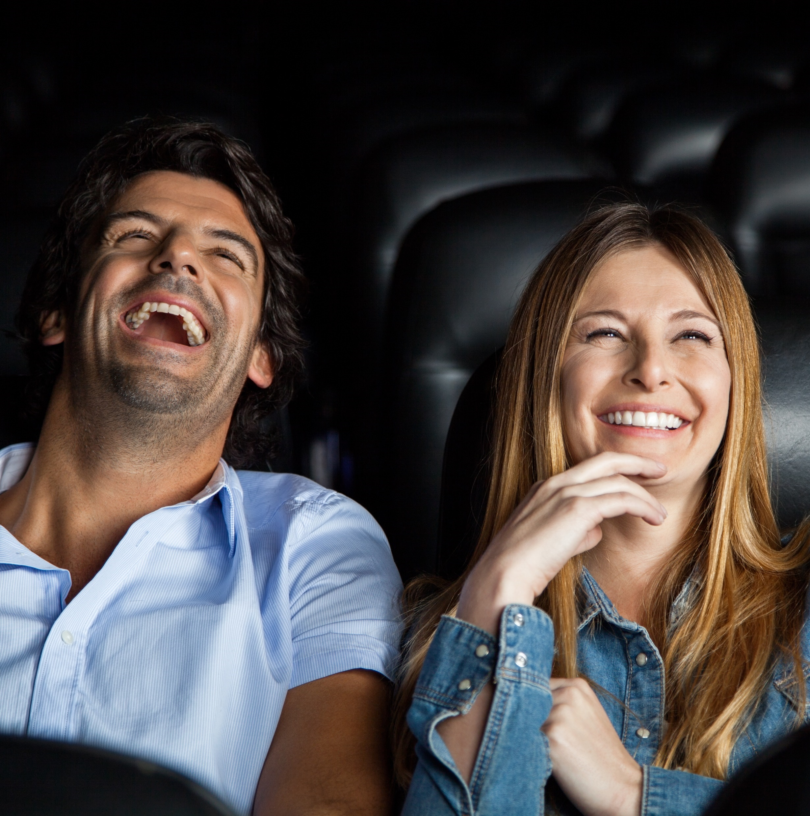



Engaging the ‘Sophisticates’ at the Cinema
How brands can reach adults 25-44 that value premium experiences

Slide 2
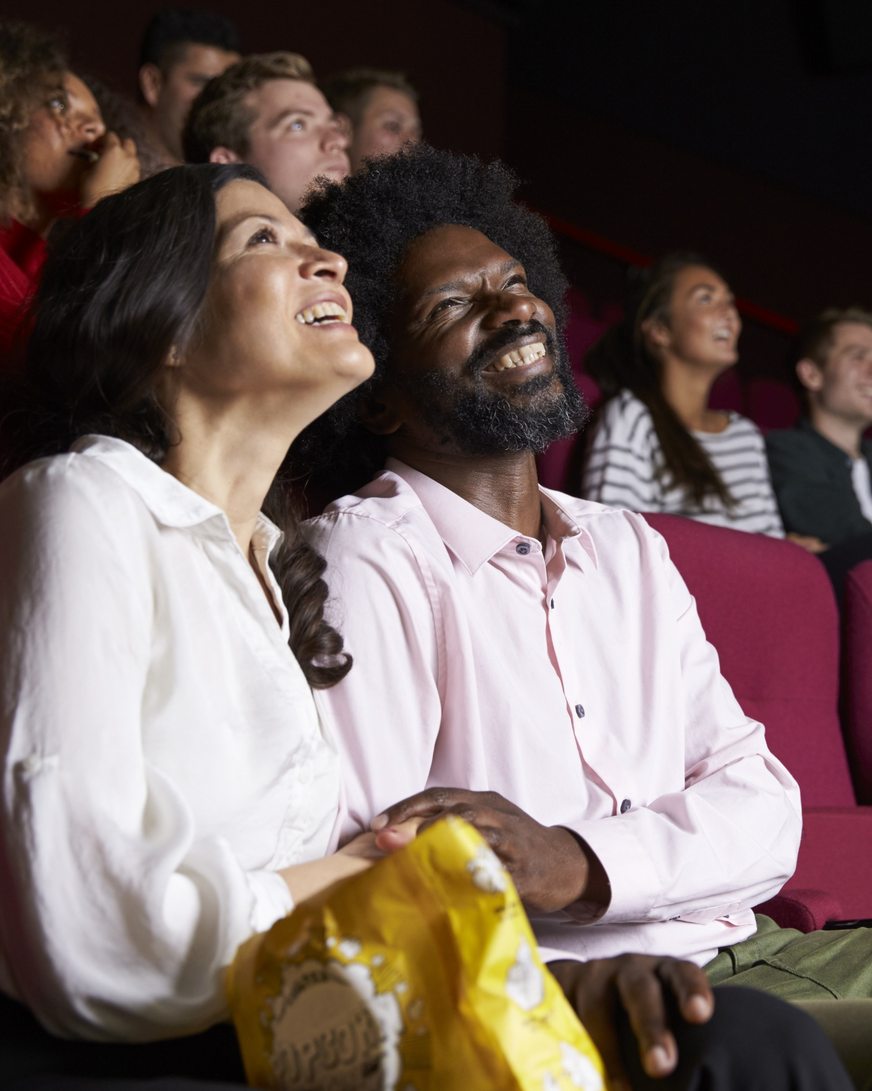

Adults 25-44 enjoy going to their local cineplex for a night out and the frequent movie goer within this demographic is particularly attractive to marketers as they are an influential, cultured, mature audience that values premium experiences throughout all facets of their very active and social lifestyles.
While this cultured and influential audience is harder to reach for marketers than other segments, cinema is the platform where these ‘Sophisticates’ can be consistently engaged.
We’ll explore the characteristics of this group and why they are such an attractive audience for marketers across a wide range of categories.
This information is exclusively provided to VAB members and qualified marketers. Further distribution is prohibited.
PAGE 2

Slide 3
Adults 25-44 are more likely to be frequent movie goers who are excited to see the latest releases immediately on the biggest screen possible
Adults 25-44 are…
+23%
+32%
+19%
more likely to go to the movie theater monthly
(123 index vs. adults 18+)
more likely to
see a movie during its opening weekend
(132 index vs. adults 18+)
more likely to be enrolled in a movie theater loyalty or rewards program
(119 index vs. adults 18+)
Source: VAB analysis of MRI-Simmons 2021 Fall Doublebase Study, Base: P18+.
This information is exclusively provided to VAB members and qualified marketers. Further distribution is prohibited.
PAGE 3

Slide 4
Their engagement extends to advertising as well, which provides marketers with opportunities to build brand awareness, interest and consideration
Adults 25-44 are…
+30%
+15%
Awareness
more likely to have seen a video ad in a movie theater lobby in last 30 days
(130 index vs. adults 18+)
more likely to have seen ads shown
on-screen before the start of a movie
in last 30 days
(115 index vs. adults 18+)
+30%
+18%
Interest
more likely to have had interest in
video ad in movie theater lobbies
(130 index vs. adults 18+)
more likely to have had interest in
ads shown on-screen before
the start of a movie
(118 index vs. adults 18+)
Source: VAB analysis of MRI-Simmons 2021 Fall Doublebase Study, Base: P18+. ‘Interest’ includes ‘considerable interest’ or ‘some interest.’
This information is exclusively provided to VAB members and qualified marketers. Further distribution is prohibited.
PAGE 4

Slide 5

Adult 25-44 frequent movie goers are ‘Sophisticates’ who enjoy premium experiences

Slide 6
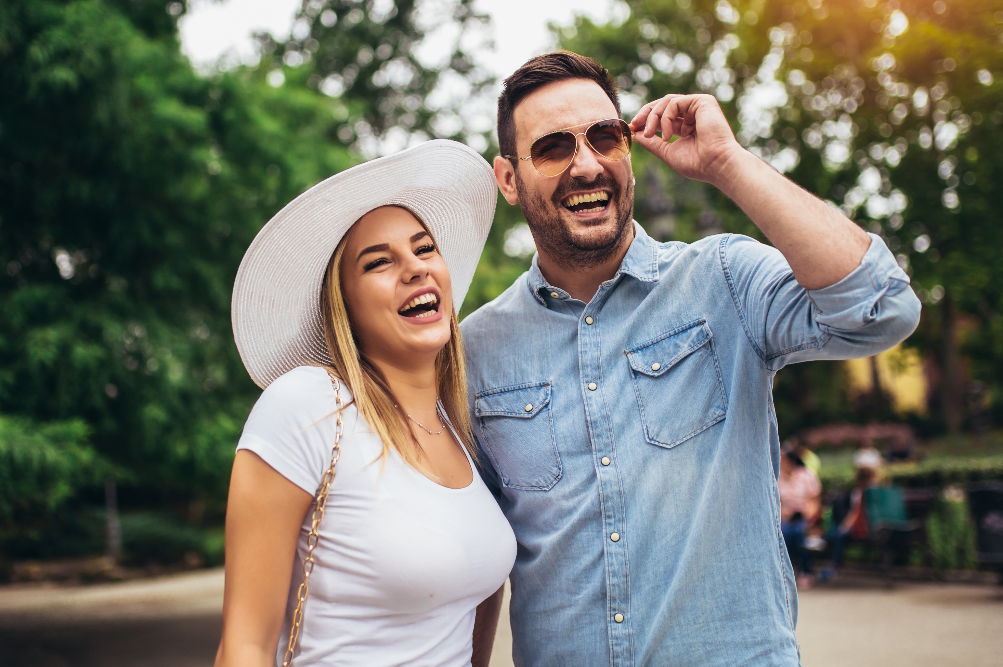




Who are the ‘Sophisticates’?
The ‘Sophisticates’
Premium
Influential
Social
Cultured
This information is exclusively provided to VAB members and qualified marketers. Further distribution is prohibited.
PAGE 6

Slide 7
Influential: Adult 25-44 frequent movie goers are early adopters and highly persuasive amongst their family and circle of friends
Adult 25-44 Frequent Movie Goers are…
+30%
+23%
+22%
more likely to say ‘they are one of the first of their friends to try new products or services’
(130 index vs. adults 25-44)
more likely to say ‘they have great knowledge on movies’
(123 index vs. adults 25-44)
more likely to say ‘their family / friends trust their advice on movies’
(119 index vs. adults 18+)
Source: VAB analysis of MRI-Simmons 2021 Fall Doublebase Study, Base: P25-44. ‘Frequent movie goer’ reflects people who have gone to the movies at least once in the last month.
This information is exclusively provided to VAB members and qualified marketers. Further distribution is prohibited.
PAGE 7

Slide 8









Cultured: Adult 25-44 frequent movie goers have many interests and passions that they enjoy to explore in their free time
Adult 25-44 Frequent Movie Goers are…
(vs. total adults 25-44)
+117%
+110%
+73%
+52%
more likely to attend
art galleries / shows
more likely to go to
live theater
more likely to go to museums
more likely to attend a food / beverage festival
+39%
+37%
+31%
+10%
more likely to play a musical instrument
more likely to take
adult education courses
more likely to attend a dance performance
more likely to attend
a wine tasting
Source: VAB analysis of MRI-Simmons 2021 Fall Doublebase Study, Base: P25-44. ‘Frequent movie goer’ reflects people who have gone to the movies at least once in the last month. Activities based on ‘participation in last 12 months.’ ‘Food / beverage festival attendance’ and ‘wine tasting’ based on MRI-Simmons 2022 Winter Study.
This information is exclusively provided to VAB members and qualified marketers. Further distribution is prohibited.
PAGE 8

Slide 9









Social: Adult 25-44 frequent movie goers are inherently active and like spending their money across a wide variety of categories and activities
Adult 25-44 Frequent Movie Goers are…
(vs. total adults 25-44)
+139%
+115%
+110%
+106%
+95%
more likely to attend a music festival
more likely to spend $1K+ on vacations annually
more likely to attend a musical concert
more likely to go to a comedy club
more likely to attend a food / beverage festival
+39%
+37%
+31%
+36%
+30%
more likely to
frequently dine out
(5+ times in last 30 days)
more likely to attend a sporting event
more likely to go dancing
more likely to heavily socialize with friends
(6+ hours weekly)
more likely to go to
bars / nightclubs
Source: VAB analysis of MRI-Simmons 2021 Fall Doublebase Study, Base: P25-44. ‘Frequent movie goer’ reflects people who have gone to the movies at least once in the last month. Activities based on ‘participation in last 12 months.’ ‘Music festival attendance’ based on MRI-Simmons 2022 Winter Study. Vacations include both domestic and foreign travel. Musical concerts include rock, country, classical music/opera, other.
This information is exclusively provided to VAB members and qualified marketers. Further distribution is prohibited.
PAGE 9

Slide 10



Premium: Adult 25-44 frequent movie goers highly value exceptional experiences and are willing to pay extra for them
% of Adult 25-44 Frequent Movie Goers who say…
73%
64%
53%
‘for me, going out to eat is all about the ‘experience’’
(109 index vs. total adults 25-44)
‘it’s worth it to me to pay more for
high quality hotel accommodations’
(108 index vs. total adults 25-44)
‘I would pay extra for a product that is consistent with the image I want to convey’
(123 index vs. total adults 25-44)
52%
42%
38%
‘I’m willing to spend more for a quality bottle of wine’
(111 index vs. total adults 25-44)
‘I’m willing to pay more for a flight in order to travel on my favorite airline’
(118 index vs. total adults 25-44)
‘I take vacation experiences that help differentiate me from my friends’
(129 index vs. total adults 25-44)
Source: VAB analysis of MRI-Simmons 2021 Fall Doublebase Study, Base: P25-44.
This information is exclusively provided to VAB members and qualified marketers. Further distribution is prohibited.
PAGE 10

Slide 11
Engaging with ‘Sophisticates’ – a collection of the influential and cultured that value premium experiences in their active social lives – through cinema provides marketers an opportunity to connect with this highly desirable, ‘hard to reach elsewhere with advertising’ audience with relevant messaging on a big screen alongside super premium video content in a captive environment
Watching movies on the big screen is a major interest of these ‘Sophisticates’ but they actively participate in
a variety of other activities which enables cinema campaigns to drive engagement for relevant audiences across a wide range of categories during moments when they are highly attentive
Key Marketer Takeaways
This information is exclusively provided to VAB members and qualified marketers. Further distribution is prohibited.
PAGE 11

Slide 12
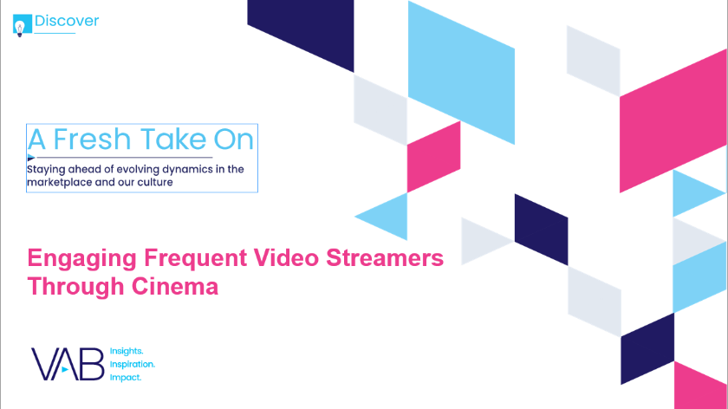

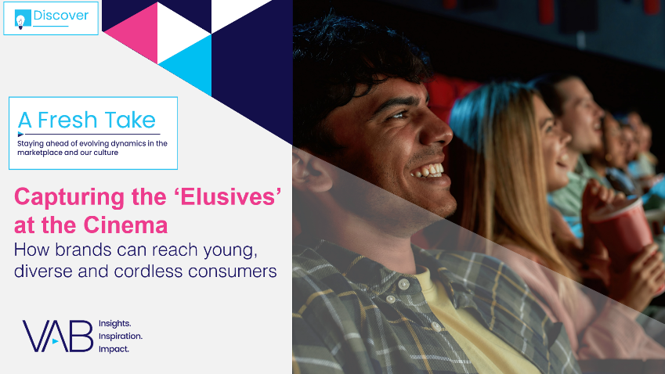
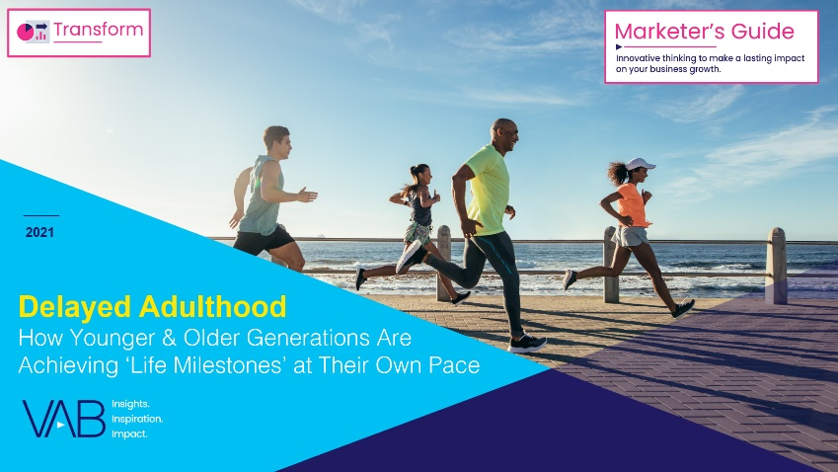
Creators
Jason Wiese
Reed Kiely
SVP, Director of Strategic Insights
jasonw@thevab.com
Associate Insights Director
reedk@thevab.com
Karolina Guillen
Insights Manager
karolinag@thevab.com
Discover more
Looking for more data, insights and takeaways? Check out this related VAB content
A Fresh Take On Engaging Frequent Video Streamers Through Cinema
The Power of Super Cinema Goers
Super Spenders, Social and Active Consumers
Capturing the ‘Elusives’ at the Cinema
How Brands Can Reach Young, Diverse and Cordless Consumers
Delayed Adulthood
How Younger & Older Generations Are Achieving ‘Life Milestones’ at Their Own Pace
VAB Members, brand marketers and agencies get free and immediate access to VAB’s content library. Get access at theVAB.com
This information is exclusively provided to VAB members and qualified marketers. Further distribution is prohibited.
PAGE 12

Slide 13


About VAB
VAB is an insights-driven organization that inspires marketers to reimagine their media strategies resulting in fully informed decisions.
Drawing on our marketing expertise, we simplify the complexities in our industry and discover new insights that transform the way marketers look at their media strategy.
We are committed to your business growth and proud to offer VAB members, brand marketers and agencies complimentary access to our continuously-growing Insights library. Get immediate access at theVAB.com.
Curious to learn more about VAB? Check out this quick video to see what we do and how we can help you develop business-driving marketing strategies.
This information is exclusively provided to VAB members and qualified marketers. Further distribution is prohibited.
PAGE 13

